Slide 1
ASP.NET Core,
PEEk into the future
By Expert Network
@FII Practic

Slide 2
Guest(S)
Placeholder

Slide 3
Short recap

Slide 4
Cascade delete

Slide 5
If delete X then delete everything that references X

Slide 6
Types Of Delete
Cascade (Default on non nullable FKs)
  Dependent entities are deleted
ClientSetNull (Default on non nullable FKs)
  Dependent entities have the FK set to null in the context
SetNull
  Dependent entities have the FK set to null in the context and the DB
Restrict
  Nothing happens to the dependent FKs

Slide 7
Diamond Cascade erorrs
Video
Video
Playlist
User
Playlist

Slide 8
How to fix it?
Best thing to do here is to use nullable FKs
public int? Video { set; get; }

Slide 9
Why this never Happens?
Because we use soft delete
This means we have a field IsDeleted
Because we want to keep the users data even if he leaves ☹

Slide 10
REpositories

Slide 11
What is a CRUD
C – Create (insert into a table)
R – Read (select data from a table)
U – Update (update rows in a table)
D – Delete (delete data from a table)

Slide 12
Generic Repository

Slide 13
Just add an interface for the future
public interface IRepository<T> where T : class
{
void Add(T entity);
void Update(T entity);
List<T> GetAll();
void Delete(T entity);
void Delete(IEnumerable<T> entities);
IQueryable<T> Query(Expression<Func<T, bool>> expression);
IQueryable<T> Query();
T GetById(int id);
}

Slide 14
Generic repository
public class Repository<T> : IRepository<T> where T : class
{
private readonly DbSet<T> dbSet;
private readonly TestContext dbContext;
public Repository(TestContext dbContext)
{
this.dbContext = dbContext;
this.dbContext.Database.EnsureCreated();
dbSet = dbContext.Set<T>();
}
...
}

Slide 15
Implementation
public void Add(T entity)
{
dbSet.Add(entity);
}
public void Update(T entity)
{
dbSet.Attach(entity);
dbContext.Entry(entity).State = EntityState.Modified;
}
public List<T> GetAll()
{
return dbSet.ToList();
}
public void Delete(T entity)
{
dbSet.Remove(entity);
}
public void Delete(IEnumerable<T> entities)
{
dbSet.RemoveRange(entities);
}
public IQueryable<T> Query(Expression<Func<T, bool>> expression)
{
return dbSet.Where(expression);
}
public IQueryable<T> Query()
{
return dbSet.AsQueryable();
}
public T GetById(int id)
{
return dbSet.Find(id);
}

Slide 16
Services

Slide 17
BookService
Return all books from a author
Return all rented books after a particular data (use a DatetimeService)

Slide 18
IOC & DI

Slide 19
What those letters mean?
IOC – Inversion of control
  Design principle in which custom-written portions of a computer program receive the flow of control from a generic framework
DI – Dependency Injection
  Technique whereby one object (or static method) supplies the dependencies of another object

Slide 20
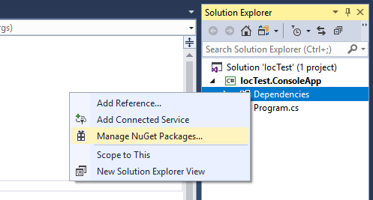
Open nuget packages manager

Slide 21
Add the package
Microsoft.Extensions.DependencyInjection

Slide 22
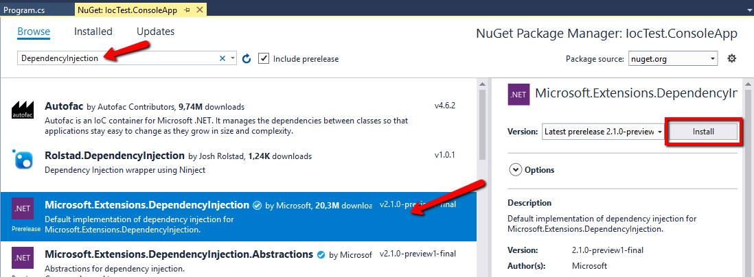
Something like this

Slide 23
How to use it
var serviceProvider = new ServiceCollection()
.AddTransient<IBookService, BookService>()
  .AddSingleton<IDateTimeService, DateTimeService>()
  .BuildServiceProvider();
//somewhere else
var bookService = serviceProvider.GetService<IBookService>();

Slide 24
DI Lifestyles
Transient
Singleton
Instance (not really a lifestyle)
Scoped (we will talk more about this when we use a web app)

Slide 25
Will we need to add a entry for all Generic Repository values?

Slide 26
Nope
var serviceProvider = new ServiceCollection()
.AddTransient<IBookService, BookService>()
.AddSingleton<IDateTimeService, DateTimeService>()
.AddTransient(typeof(IRepository<>), typeof(Repository<>))
.BuildServiceProvider();

Slide 27
How about the dbContext?

Slide 28
Make sure you have this package in the project
Microsoft.EntityFrameworkCore

Slide 29
It should look like this
var serviceProvider = new ServiceCollection()
.AddTransient<IDatetimeService, DatetimeService>()
.AddTransient(typeof(IRepository<>), typeof(Repository<>))
.AddDbContext<DbContext>()
.BuildServiceProvider();

Slide 30
Let’s put everything together

Slide 31
And if we have some time we will web

