Slide 1
ASP.NET Core,
PEEk into the future
By Expert Network
@FII Practic

Slide 2
Guest(S)
Placeholder

Slide 3
How was that homework?

Slide 4
Short recap

Slide 5
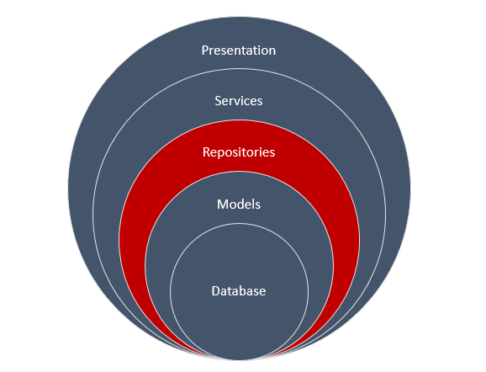
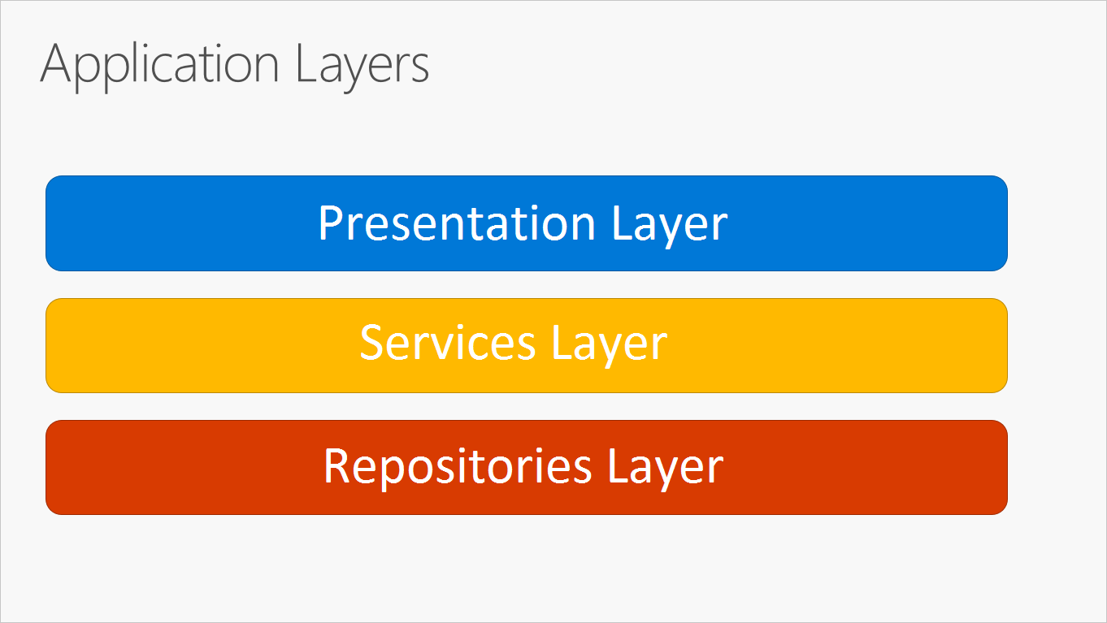
N-Layer Architecture

Slide 6
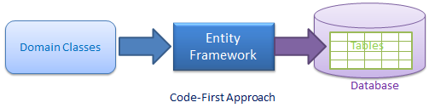
Create a Database using existing classes

Slide 7
A repository does CRUD operations
C – Create (insert into a table)
R – Read (select data from a table)
U – Update (update rows in a table)
D – Delete (delete data from a table)

Slide 8
What those letters mean?
IOC – Inversion of control
  Design principle in which custom-written portions of a computer program receive the flow of control from a generic framework
DI – Dependency Injection
  Technique whereby one object (or static method) supplies the dependencies of another object

Slide 9
DI Lifestyles
Transient
Singleton
Instance (not really a lifestyle)
Scoped (we will talk more about this when we use a web app)

Slide 10
Dependency injection talk and example

Slide 11
Service Layer

Slide 12
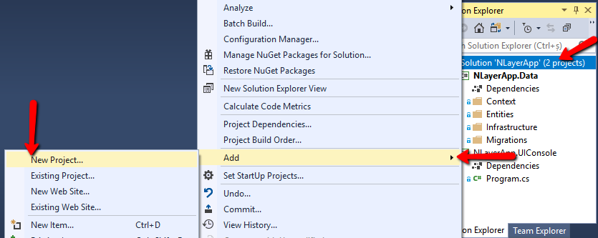
Let’s create a Service LAyer

Slide 13
BookService
Create a BookService with the following method:
  GetBooksByReviewScore
Extract an interface
Register the service and interface to the injector
Try to display it in the UIConsole

Slide 14
ASP.NET Core,
FINALLY PEEking into the future

Slide 15
What is asp.net core
Cross-platform, high performance, open-source framework for building modern, cloud-based, Interned-connected {insert cool word here} applications.

Slide 16
WHY?
Redesign of ASP.NET 4.x, with architectural changes that result in a leaner, more modular framework
Can build web UIs and web APIs
Integrates modern, client-side frameworks and development flows
Built-in dependency injection.
A lightweight, high-performance, and modular HTTP request pipeline.
Ability to build and run on Windows, macOS, and Linux
Open-source and community focused

Slide 17
WHAT IS HTTP?
Hypertext Transfer Protocol (HTTP) is a protocol designed to enable communications between clients and servers.
A web browser may be the client, and an application on a computer that hosts a web site may be the server.

Slide 18
More on HTTP
HTTP can be used for transmitting hypermedia documents, such as HTML, JSON, XML, etc.
Designed for communication between web browsers and web servers.
HTTP follows a classical client-server model, with a client opening a connection to make a request, then waiting until it receives a response.
Stateless protocol, meaning that the server does not keep any data (state) between two requests.

Slide 19
Most used http requests
Two commonly used methods for a request-response between a client and a server are:
GET – Requests data from a specified resource
POST – Submits data to be processed to a specified resource

Slide 20
Query string
Let's skip the theory
http://localhost/MyApp/Authors/GetAuthors?name=Popescu&age=33

Slide 21
The get method
Essentially, used to retrieve remote data.
GET should not be used to cause side-effects, such as updating data inside a database.
http://localhost/MyApp/Authors/GetAuthors?name=Popescu&age=33 <-- GET Request that retrieves Authors.

Slide 22
The post method
POST submits data to be processed (e.g., from an HTML form).
The data is included in the body of the request.
This may result in the creation of a new resource or updates of existing resources or both.
http://localhost/MyApp/Authors/CreateAuthor

Slide 23
GET VS. POST
GET /foo?par1=val1&par2=val2 HTTP/1.1
User-Agent: Mozilla/5.0
Host: Host
Accept: */*
POST /foo HTTP/1.1
User-Agent: Mozilla/5.0
Host: Host
Accept: */*
par1=val1&par2=val2

Slide 24
What is ASP.net core mvc?
ASP.NET Core MVC (Model View Controller) provides a patterns-based way to build dynamic websites that enables a clean separation of concerns.
It gives you full control over markup, supports TDD-friendly development and uses the latest web standards.

Slide 25
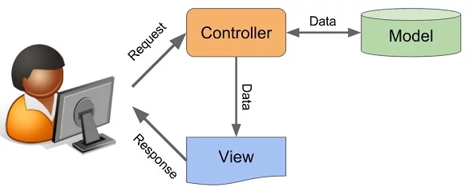
MVC representATION

Slide 26
How does an mVC Work?
The user sends a request to the controller(will explain later)
The controller creates the model (if needed)
The controller prepares the view using the model (if needed)
The controller returns the view
The user sees the view
Repeat

Slide 27
ASP.net core mvc features
Routing
Model binding
Model validation
Dependency injection
Filters
Areas
Web APIs
Razor view engine
Strongly typed views

Slide 28
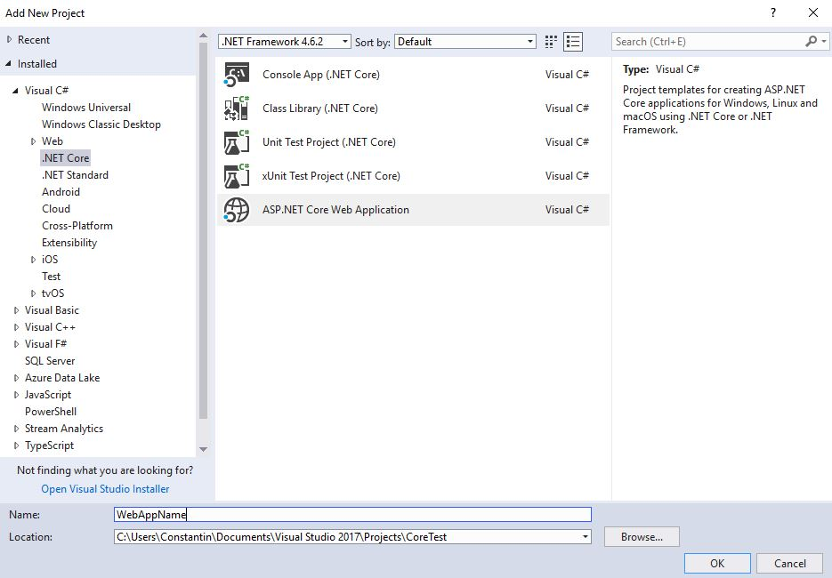
Create new project

Slide 29
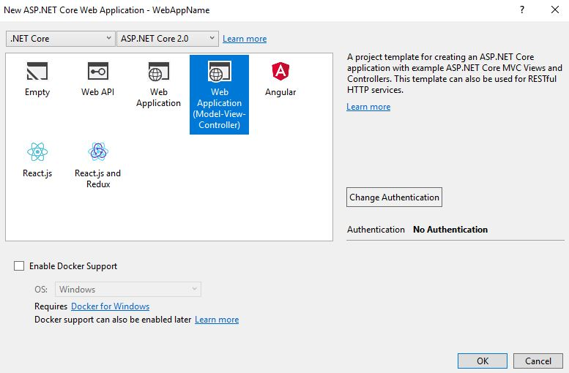
Create new project

Slide 30
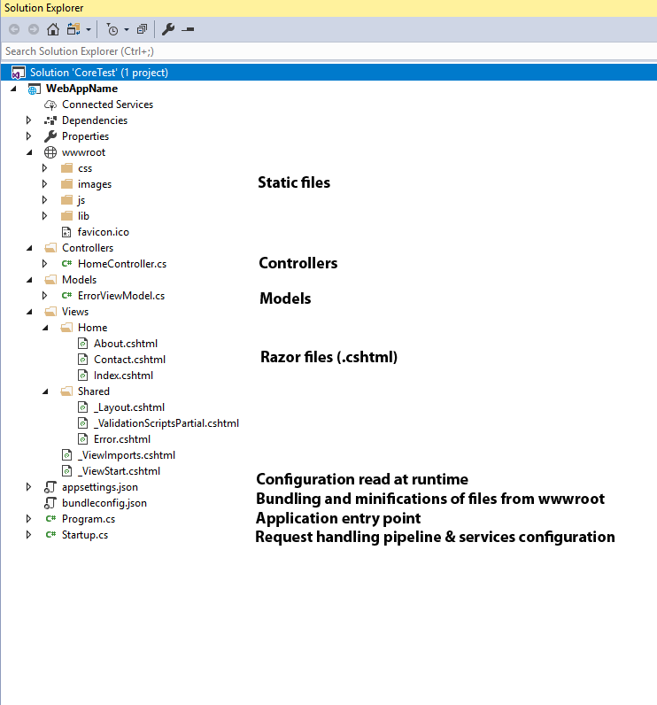
structure

Slide 31
Application entry point
public class Program
{
public static void Main(string[] args)
{
BuildWebHost(args).Run();
}
public static IWebHost BuildWebHost(string[] args) =>
WebHost.CreateDefaultBuilder(args)
.UseStartup<Startup>()
.Build();
}

Slide 32
Startup class
Define request handling pipeline
Define services needed by the app

Slide 33
Just run it

Slide 34
What runs inside that console?

Slide 35

kestrel

Slide 36
kestrel
Kestrel is an open source, cross platform, light weight and a default webserver used by ASP.NET Core applications.
Based on libuv (which was primarily developed for Node.JS)
Does not have advanced features of webservers like IIS, nginx, Apache, etc.
Due to its lightweight nature, Kestrel provides better request processing performance to ASP.NET Core applications.
Most times, used with a reverse proxy (e.g. IIS, nginx, etc.).

Slide 37
Some stories about kestrel
It uses that "useless" thing that we have never used in a real-life scenario: Binary Search.
Uses a lot of bitwise operations with masks (remember C?)
HTTP method names can be allocated on a long (8 bytes)
Uses Span
And more stuffs that I don't remember anymore.

Slide 38
Controllers
Controllers, actions and action results are a fundamental part of how developers build apps using ASP.NET Core MVC
A controller is used to define and group a set of actions.
An action (or action method) is a method on a controller which handles requests.
Controllers logically group similar actions together.
Within the Model-View-Controller pattern, a controller is responsible for the initial
processing of the request and instantiation of the model. Generally, business
decisions should be performed within the model.

Slide 39
Routing

Slide 40
Why we are seeing this?
ASP.NET Core MVC uses the Routing to match the URLs of incoming requests to map them to actions.
Routes are defined in startup or by using attributes
Routes describe how URL paths should be matched to actions.

Slide 41
Routes examples
/Products/Details/5 URL path will attempt to locate a controller named ProductsController and run the action Details
public class ProductsController : Controller
{
public IActionResult Details(int id) {... }
}

Slide 42
Routing details
/Books URL path will attempt to locate a controller named BooksController and run the action Index.
/Books/GetBooksByAuthor?authorName=Oliver will attempt to run an action named GetBooksByAuthor containing a parameter named authorName.
public ActionResult GetBooksByAuthor(string authorName) {...}

Slide 43
Crud - demo

Slide 44
Razor
Razor is a markup syntax for embedding service-based code into webpages.
Consists of Razor markup, C#, and HTML.
Files containing Razor generally have a .cshtml file extension.

Slide 45
Razor code blocks
@{
var quote = "The future depends on what you do today";
}
<p>@quote</p>
@{
var quote = "Hate cannot drive out hate, only love can do that.";
}
<p>@quote</p>
--> Renders:
<p>The future depends on what you do today.</p>
<p>Hate cannot drive out hate, only love can do that. </p>

Slide 46
Razor can do more
Looping @for, @foreach, @while, and @do while
Conditionals @if, else if, else, and @switch
@try, catch, finally
@using directive
@model LoginViewModel (model passed to a view)

Slide 47
When should i rebuild?
Rebuild the project if you modify .cs files.
Rebuilding is NOT necessary when modifying Razor files (.cshtml), CSS, HTML, JS.

Slide 48
It is not that simple

Slide 49
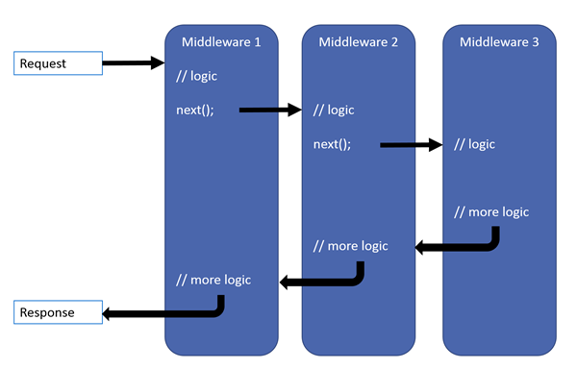
middleware

Slide 50
Simple middleware
app.Use(async (context, next) =>
{
Console.WriteLine("Someone wants something from: " + context.Request.Path);
if (context.Request.Path.ToString().ToLower().Contains("admin"))
{
await context.Response.WriteAsync("Nope.");
return;
}
await next.Invoke();
});

