Slide 1
ASP.NET Core,
PEEk into the future
By Expert Network
@FII Practic

Slide 2
Guest(S)
Placeholder

Slide 3
Razor
Razor is a markup syntax for embedding service-based code into webpages.
Consists of Razor markup, C#, and HTML.
Files containing Razor generally have a .cshtml file extension.

Slide 4
Razor code blocks
@{
var quote = "The future depends on what you do today";
}
<p>@quote</p>
@{
var quote = "Hate cannot drive out hate, only love can do that.";
}
<p>@quote</p>
--> Renders:
<p>The future depends on what you do today.</p>
<p>Hate cannot drive out hate, only love can do that. </p>

Slide 5
Razor can do more
Looping @for, @foreach, @while, and @do while
Conditionals @if, else if, else, and @switch
@try, catch, finally
@using directive
@model LoginViewModel (model passed to a view)

Slide 6
When should i rebuild?
Rebuild the project if you modify .cs files.
Rebuilding is NOT necessary when modifying Razor files (.cshtml), CSS, HTML, JS.

Slide 7
It is not that simple

Slide 8
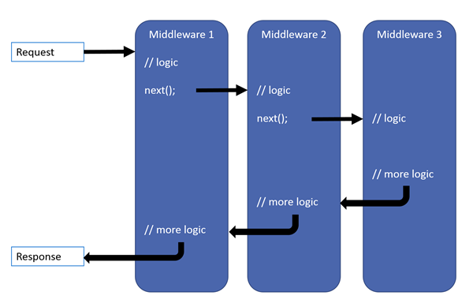
middleware

Slide 9
Simple middleware
app.Use(async (context, next) =>
{
Console.WriteLine("Someone wants something from: " + context.Request.Path);
if (context.Request.Path.ToString().ToLower().Contains("admin"))
{
await context.Response.WriteAsync("Nope.");
return;
}
await next.Invoke();
});

Slide 10
View compilation
Razor views are compiled at runtime when the view is invoked.
Optionally, we can compile Razor views with the app (precompilation). Precompiling views results in smaller published bundle and faster startup time but you can't edit Razor files after you precompile them.

Slide 11
layout
Most web apps have a common layout that provides the user with a consistent experience as they navigate from page to page.
The layout typically includes common user interface elements such as the app header, navigation or menu elements, and footer.

Slide 12
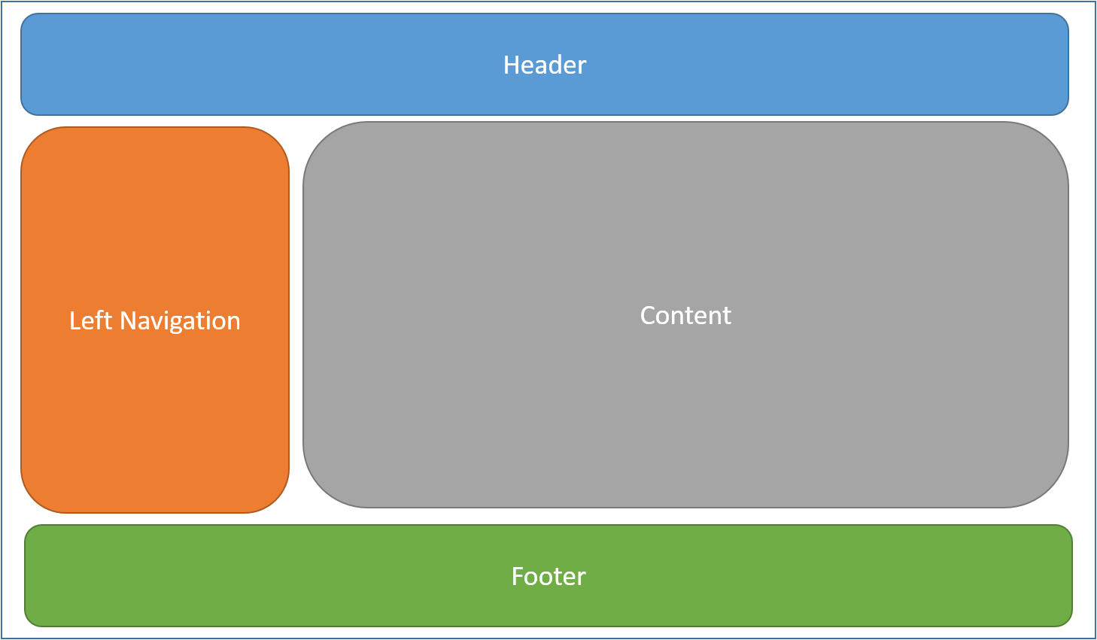
layout

Slide 13
good place for JS and CSS
Common HTML structures such as scripts and stylesheets are also frequently used by many pages within an app.
All of these shared elements may be defined in a layout file, which can then be referenced by any view used within the app.
Layout reduce duplicate code in views.

Slide 14
Layout convention
By convention, the default layout for an ASP.NET Core app is named _Layout.cshtml and is situated in Views/Shared folder.

Slide 15
Layout example

Slide 16
Specify layout in views
At the top of the razor file:
@{
Layout = "_Layout";
}

Slide 17
Specify layout in views
Not needed if we specify the layout inside _ViewStart.cshtml.

Slide 18
No layout in view
@{
Layout = null;
}
When do we need this?

Slide 19
Tag helpers

Slide 20
Just like Razor but newer
They are .NET Core’s substitute for Razor (but they do basically the same things)
They make sharing views more easy by not having views that work only in .NET framework

Slide 21
Comparison
Razor
Tag Helper
@using (Html.BeginForm())
{
<div>
@Html.LabelFor(m => p.Name, "Name:")
@Html.TextBoxFor(m => p.Name)
</div>
<input type="submit" value="Create" />
}
<form asp-controller="Products" asp-action="Create" method="post">
<div>
<label asp-for="Name">Name:</label>
<input asp-for="Name" />
</div>
<input type="submit" value="Save" />
</form>

Slide 22
Jquery

Slide 23
The most used js library
Inhances javascript
Makes using javascript easier

Slide 24
Comparison
Javascript
JQuery
var elements = document.getElementsByClassName(“link”);
var i;
for(I = 0; i< elements.length; i++){
elements[i].className = elements[i].className + “ selected”;
}
$(‘.link’).addClass(“selected”)

Slide 25
equivalents
Javascript
JQuery
document.getElementsByClassName(“class”);
document.getElementsById(“id”);
$(‘.link’);
$(‘#id’)

Slide 26
ajax

Slide 27
ajax
Client-side script that communicates to and from a server without the need for a postback or a complete page refresh.
(The method of exchanging data with a server, and updating parts of a web page – without reloading the entire page.)

Slide 28
ajax
Asynchronous – Allows you to make asynchronous calls to a web server. This allows the client browser to avoid waiting for all data to arrive before allowing the user to act once more.
User-Friendly – Because a page postback is being eliminated, AJAX enabled applications will always be more responsive, faster and more user-friendly.
Increased Speed – Send and receive only the needed data (XML/JSON w/out HTML for example).

Slide 29
Ajax structure
$.ajax({
url: url, //String -> A string containing the URL to which the request is sent.
data: data, //PlainObject || String -> Data that is sent to the servier with the request.
success: success, //Function -> A callback function that is executed if the request succeeds.
dataType: dataType //String -> type of data expected from server. Default: Intelligent Guess.
});

Slide 30
Basic Ajax example
<script>
$("footer").on('click',
function() {
$.ajax({
url: '@Url.Action("Index", "Home")',
success: function(data) {
console.log(data);
}
});
});
</script>

Slide 31
Let's hear more examples

Slide 32
A day at the spa

Slide 33
SPA
A single-page application is a web application or web site that interacts with the user by dynamically rewriting the current page rather than loading entire new pages from a server.
Either all necessary code – HTML, JavaScript and CSS are retrieved with a single page load, or the appropriate resources are dynamically loaded and added to the page as necessary, usually in response to user actions.
Page does not reload at any point in the process, nor does transfer to another page.
SPA often involves dynamic communication with the webserver behind the scenes.

Slide 34
SPA
Web browser JavaScript frameworks have adopted SPA principles.
Some example of JavaScript frameworks:
AngularJS
Ember.js
Meteor.js
Aurelia
React

Slide 35
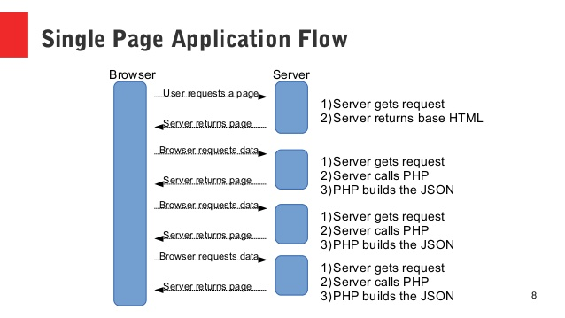
SPA

Slide 36
File uploads

