Slide 1
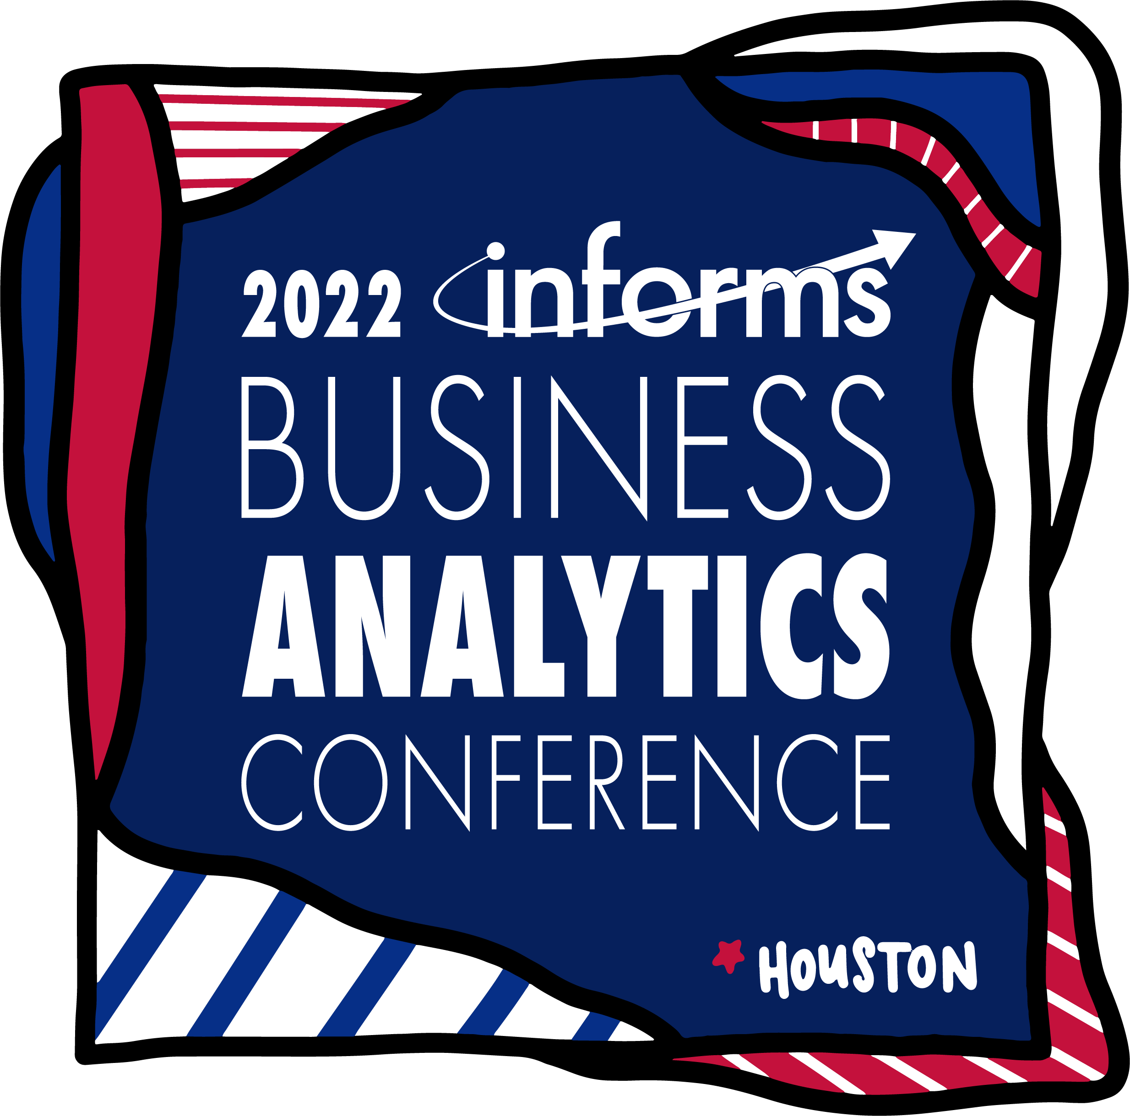

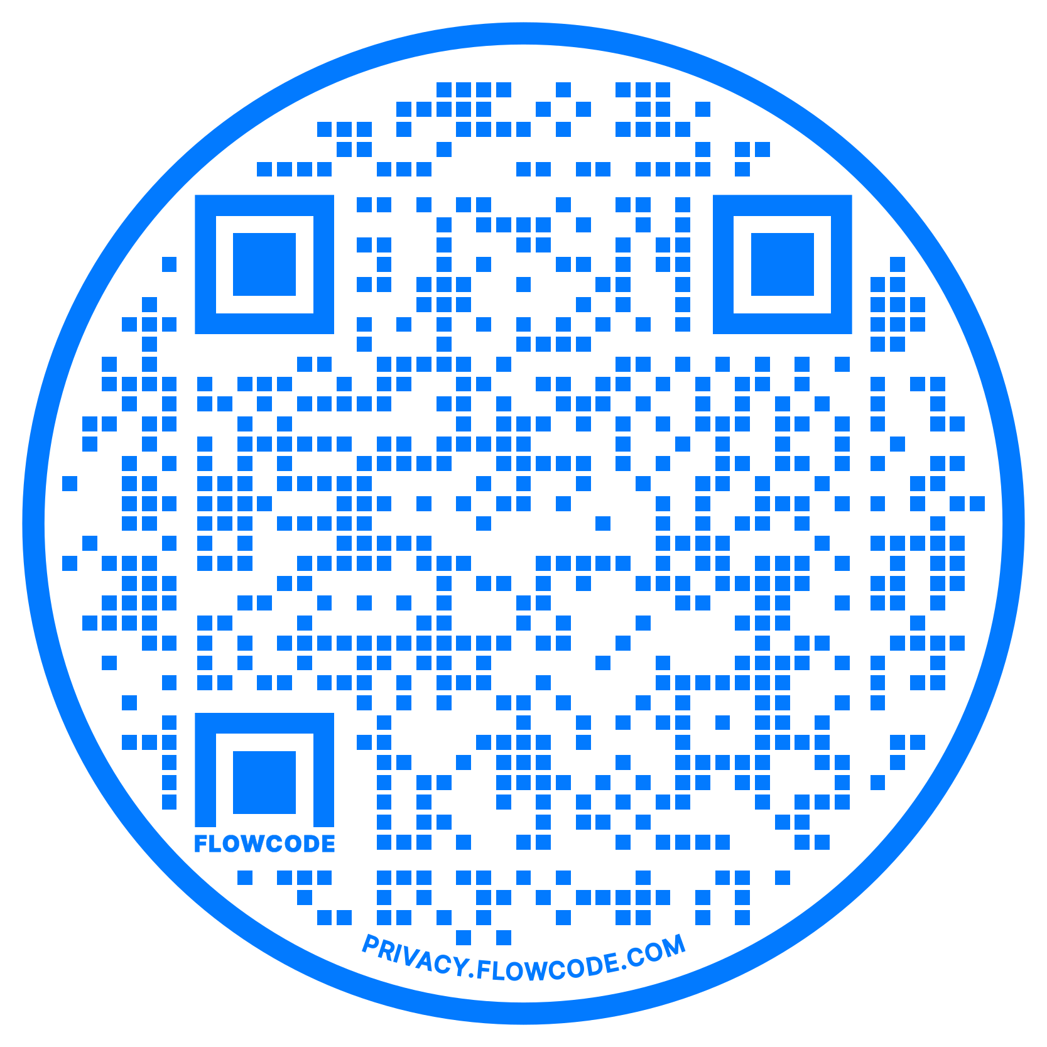





Intelligently Ordering Machine Translation Seed Data
to Improve Local Language Translation
Amaan Ansari, Devansh Batra, Jai Woo Lee, Paul Chen, Gagan Pahuja, Manideep Sharma, Daniel Whitenack, Matthew A. Lanham
Purdue University, Krannert School of Management
ansari4@purdue.edu; batra17@purdue.edu; lee3999@purdue.edu; chen3876@purdue.edu; gpahuja@purdue.edu; sharm536@purdue.edu; lanhamm@purdue.edu
ABSTRACT
LITERATURE REVIEW
STATISTICAL RESULTS
BUSINESS IMPACT
There is a critical need for optimizing the seed data needed for creating a widely acceptable machine translation model for low-level local languages. This research addresses the seed data concern by determining an optimized order of seed data which results in both more accurate and quicker translations as compared to a random order. This is achieved by dividing data from large translation project into various combination of test and train sets and achieve a BLEU score on the test data in the least amount of time and with the least number of iterations.
While all relevant studies focus on only machine translation or optimization (e.g. dynamic selection of seed data), none of them focused on optimizing seed data through ordering them differently based on semantic aspects.
1
BLEU scores at 20,414
Diversity
SIL is currently engaged in 1600+ language projects around the world
SIL will expand the translation projects to up to 2000 by 2022
Depth
11.2
Study | Ordering based on semantic meaning | Machine Translation | Optimization
Our methodology (2022) | YES | YES | YES
Liwei Wu, Shanbo Cheng, Mingxuan Wang, Lei Li (2021) |  | YES
Xinyi Wang and Graham Neubig (2019) |  | YES | YES
Laura Martinus and Jade Abbott (2019) |  | YES | YES
Marlies van der Wees, Arianna Bisazza, and Christof Monz (2017) |  | YES
Ranathunga, S., Lee, E. S. A., Skenduli, M. P., Shekhar, R., Alam, M., & Kaur, R. (2021) |  | YES | YES
Div+Dep
10.44
CURRENT
STATE
FUTURE
STATE
Our MT models in loop with human translators will lead to potential savings of $600k per project for SIL Or $6M for 10-15 large projects
Sequential
10.36
Have direct costs to SIL of $1.3M per project
5.3
2
Sent. used to get 6 BLEU
Lasts up to 15 years
Reduce time to completion by 7-8 years.
INTRODUCTION
Diversity
8,000
A set algorithm for translations engines, which will allow the client to optimize the translation seed data
Depth
8,000
Div+Dep
8,000
Sequential
13,500
Based on our methodology and NMT model, we expect that our client can save as much as ~46% of human capital cost per project ($1.3M -> $0.6M)
We also expect that the time to complete 10-15 large language projects can be reduced by as much as ~53% (15 years -> 7-8 years)
METHODOLOGY
3
Increase rate in BLEU
Create and clean parallel corpora
STEP 1
Diversity
12.7%
 | Book | Chapter | Verse | Sequence | English | Javanese
0 | GEN | 1 | 1 | 1 | In the beginning God created the heavens and t... | Ing jaman kawitan Gusti Allah nitahake langit ...
1 | GEN | 1 | 2 | 1 | Now the earth was formless and empty, darkness... | Anadene bumi mau campur-bawur lan suwung, sega...
… | … | … | … | … | … | …
29952 | REV | 22 | 20 | 1144 | He who testifies to these things says, “Yes, I... | Kang nglairake paseksen bab iki mau kabeh ngan...
29953 | REV | 22 | 21 | 1144 | The grace of the Lord Jesus be with Godʼs peop... | Sih-rahmate Gusti kita Yesus Kristus nunggila ...
Sequential
9.3%
CONCLUSION
Translation
Cost
Human
Error
Amount of Train
Data Needed
4
Percentage difference
Statistical result of our MT model shows that diversity of the semantic domain is the most significant parameter to achieving higher BLEU score for smaller as well as a larger training dataset
Based on the diversity parameter, our model used about 40% fewer seed data (8,000 sent.) to accomplish the same BLEU score to the sequential parameter.
We’ve found that using the most diverse sentences as early as possible in the early stage boosts not only the initial BLEU scores but also an increasing rate of BLEU scores in subsequent sets of sentences
In the first subset of 4,000 sent, having more diverse sentences by 16%p+ improved the initial BLEU score by 60% and the overall increasing rate by 3.4%p+
We believe that adding the external supplemental data will boost the accuracy rate even more. However, that data should have sufficiently high or comparable diversity and depth scores with Bible text.
HIGH
HIGH
LARGE
Diversity
1.8% ~ 33.8%
Translation cost is a significant limiting factor on the pace and availability of translated important content.
There are only handful of available methods to achieve the accuracy with minimum seed data usage.
This project will demonstrate the ‘high-accuracy low-data dependent’ algorithm that can be generalized and scaled across different languages to create effective translation for low-level local languages.
Get diversity & depth score for each chapter and split into train & test dataset
Sequential
-11.8% ~ 34.1%
STEP 2
Diversity & depth
Split
20k Verses
Ch1
Diversity
0.67
Depth
0.08
Train set:
Ch2
Diversity
0.70
Depth
0.03
Test set:
8k Verses
Less diversity
& depth
5
Increase rate in avg. div.
Order train dataset based on diversity and depth scores
Diversity
STEP 3
Sequential
-1.91%
RESEARCH OBJECTIVES
Train 1
(diversity)
Chapter 185
Chapter 181
Chapter 910
Chapter 555
Chapter 776
…
0.32%
Our research focuses on answering the following questions:
What are the most important factors that play a role in optimizing the seed data for language translation?
What kind of role does supplemental data pertaining to similar semantic domain play in optimization?
How can business across world utilize this research to reduce translation cost?
Train 2
(depth)
Chapter 555
Chapter 124
Chapter 299
Chapter 940
Chapter 24
…
6
Effect of avg. div. on BLEU
Avg. div.
BLEU
ACKNOWLEDGEMENTS
Run each subset of train set into JoeyNMT model and get test BLEU scores
Diversity
86%
3.81
STEP 4
Sequential
70%
2.38
We thank our industry partner Daniel Whitenack for his trust, support and encouragement while approaching this problem. We also thank Professor Matthew Lanham for constant guidance on this project.
Train 1
(diversity)
0-200 verses
JoeyNMT
Model
BLEU score 1
16%p+
60%+
0-400 verses
BLEU score 2
Avg. div. in
4,000 sent.
BLEU
0-600 verses
BLEU score 3
…
…

