Slide 1
Cloud Computing Service Models (IaaS, PaaS, SaaS)
Somnath Paul (CSE-AIML/23/71)
Supratim Nag (CSE-AIML/22/57)
Sangita Kumar (CSE-AIML/22/25)
Sumay Paul (CSE-AIML/22/05)
Cloud Computing Active Learning
CA-1
PPT Presentation

Slide 2
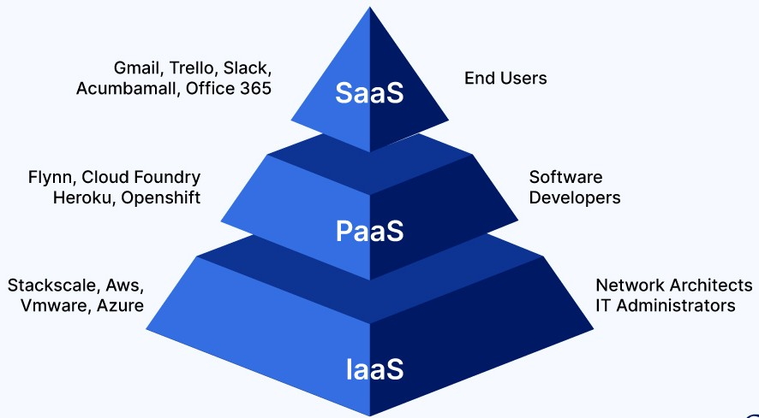
Introduction to Cloud Service Models
What Are Cloud Computing Service Models?
Three primary models: IaaS, PaaS, SaaS
IaaS (Infrastructure as a Service): Provides virtualized infrastructure like servers, storage, and networking, allowing users to manage and scale resources as needed.
PaaS (Platform as a Service): Offers a development platform with tools and frameworks to build, deploy, and manage applications without worrying about infrastructure.
SaaS (Software as a Service): Delivers ready-to-use software applications over the internet, accessible through web browsers without installation or maintenance.
Widely used by businesses for scalability and cost-efficiency.

Slide 3
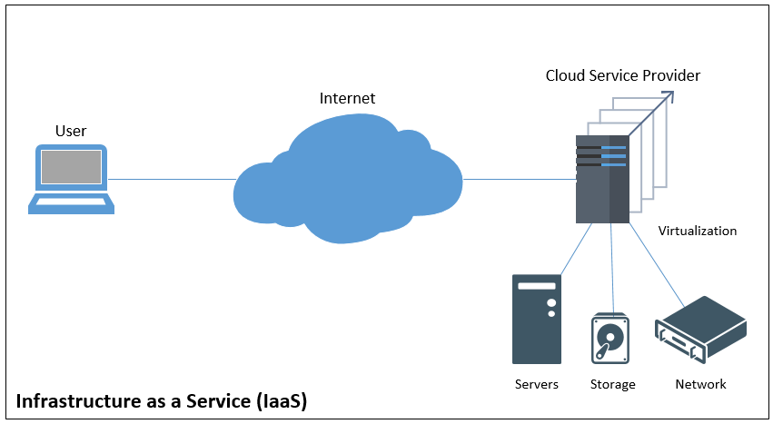
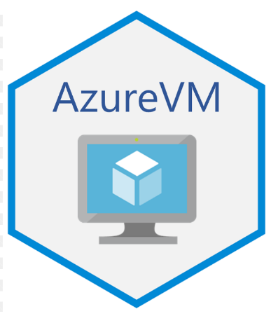


Infrastructure as a Service (IaaS)
Definition:
IaaS provides virtualized computing infrastructure over the internet. It allows businesses to rent resources such as servers, storage, networking, and operating systems on a pay-as-you-go basis.
Key Features:
Scalability: Easily scale resources up or down based on demand.
Customization: Users have control over operating systems, storage, and networking configs.
Virtualization: Offers virtual machines or containers to run applications.
Cost-Efficiency: Eliminates the need to invest in physical hardware and reduces maintenance costs.
Examples:

Slide 4
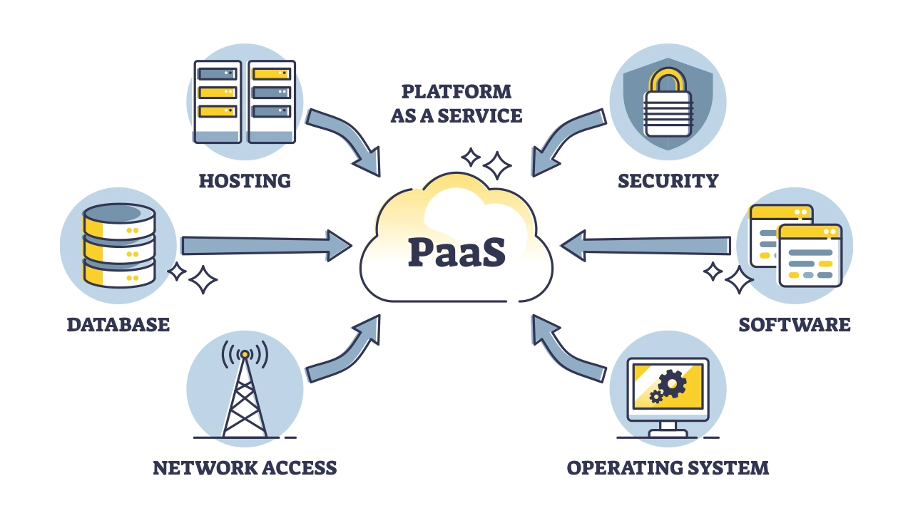



Platform as a Service(PaaS)
Definition:
PaaS offers a platform that allows developers to build, deploy, and manage applications without worrying about underlying infrastructure. It provides a set of tools, libraries, and services to streamline application development and deployment.
Key Features:
Managed Infrastructure: The cloud provider manages hardware, networking, storage, and OS, so developers can focus solely on application development.
Development Tools: Provides tools for coding, testing, and deploying applications, frameworks, databases, and middleware.
Built-in Scalability: Automatically scales applications as needed without manual intervention.
Cost-Effective: Developers can reduce overhead by using a shared platform rather than maintaining their own infrastructure.
Examples:

Slide 5

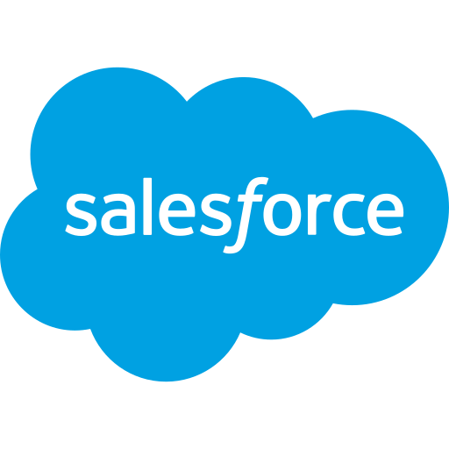
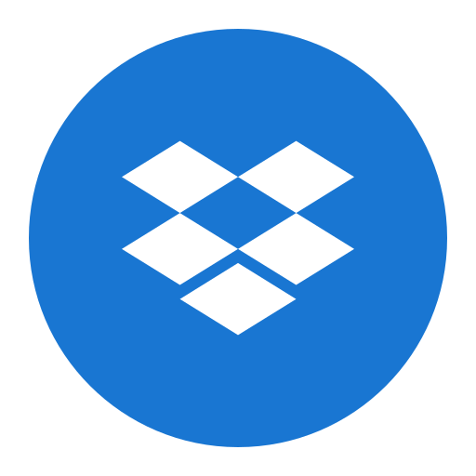

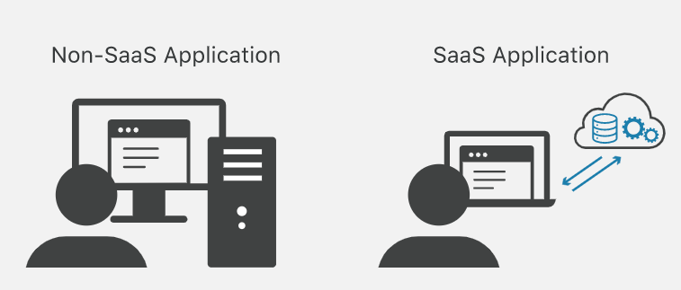
Software as a Service (SaaS)
Definition: SaaS delivers fully functional software applications over the internet, on a subscription basis, without the need for users to install or maintain the software themselves. The software is hosted and managed by a service provider, and users can access it through web browsers or apps.
Key Features:
Accessibility: Users can access the software from any device with internet connectivity.
No Installation or Maintenance: The service provider handles software updates, security patches, and maintenance, allowing users to focus on using the software rather than managing it.
Subscription-Based: Typically offered on a pay-as-you-go or subscription basis, providing flexible pricing options.
Multi-Tenant Architecture: Multiple users (or organizations) share the same software instance, but their data is kept separate and secure.
Scalability and Updates: Users automatically benefit from new features, enhancements, and scalability without requiring manual updates.
Examples:

Slide 6
IaaS vs. PaaS vs. SaaS: Cloud Service Models
 |  |  | ️
SaaS ☁ | Customers are provided with applications that are accessible anytime and from anywhere. | Web applications and services (Web 2.0) | SalesForce.com (CRM); Clarizen.com (Project Management); Google Apps…
PaaS 🏭 | Customers are provided with a platform for developing applications hosted in the Cloud. | Programming APIs and frameworks; Deployment Systems. | Google AppEngine; Microsoft Azure; Manjrasoft Aneka; Data Synapse…
IaaS 🏗 | Customers are provided with virtualized hardware and storage on top of which they can build their infrastructure. | Virtual machines management infrastructure; Storage management; Network management. | Amazon EC2 and S3; GoGrid; Nirvanix…
Feature
Characteristic
Product Type
Examples

Slide 7
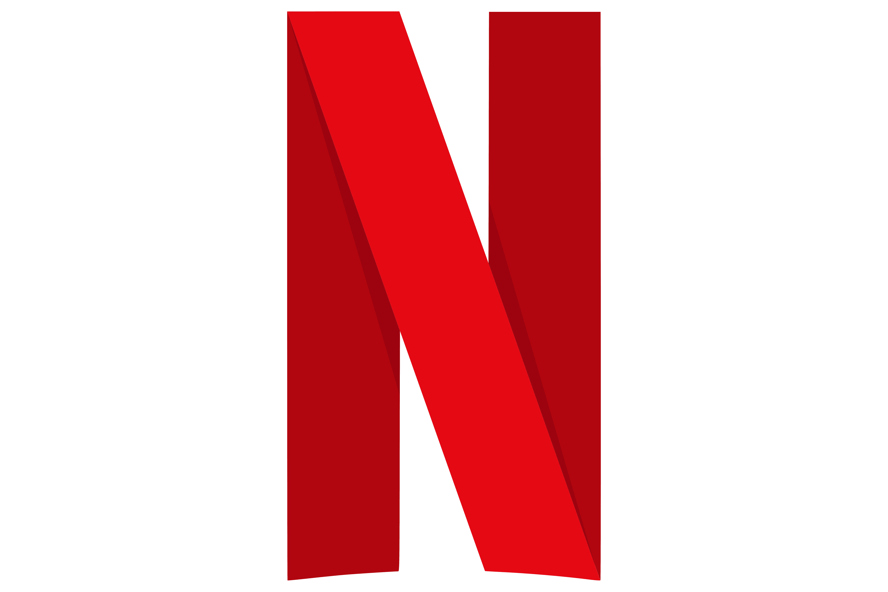

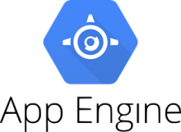

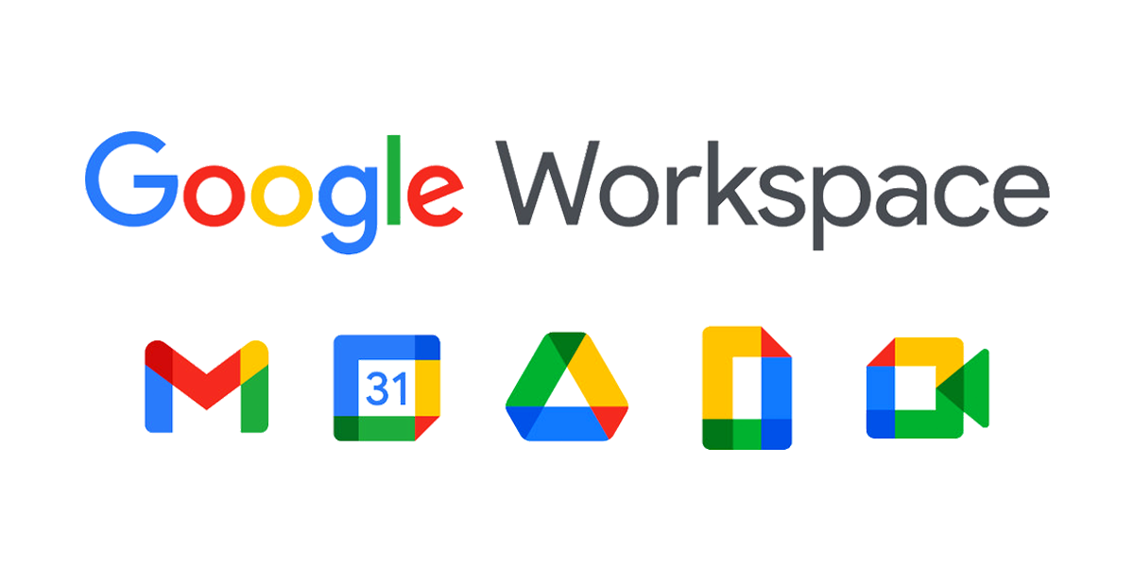
Real-World Use Cases
🛠 Service Models & Use Cases :
📌 IaaS (Infrastructure as a Service)
Use Case: Large-scale data storage and processing
Example: Netflix uses AWS to manage its streaming infrastructure
📌 PaaS (Platform as a Service)
Use Case: Application development and scaling
Example: Spotify uses Google App Engine for backend services
📌 SaaS (Software as a Service)
Use Case: Productivity and collaboration tools
Example: Google Workspace enables cloud-based collaboration

Slide 8
Benefits of Cloud Service Models
Cost Efficiency & Scalability
Pay-as-you-go model reduces upfront infrastructure costs
Easily scale up/down based on demand
Focus on Core Business Operations
No need to manage hardware or infrastructure
Allows businesses to concentrate on innovation and services
High Availability & Reliability
Cloud providers ensure uptime with robust failover mechanisms
Data redundancy and disaster recovery options
Improved Collaboration & Innovation
Cloud tools enable real-time collaboration across teams
Continuous software updates and feature improvements
Scalability 📈
Cost Efficiency 💰
Cloud Benefits
Collaboration 🤝
Reliability ⚡

Slide 9
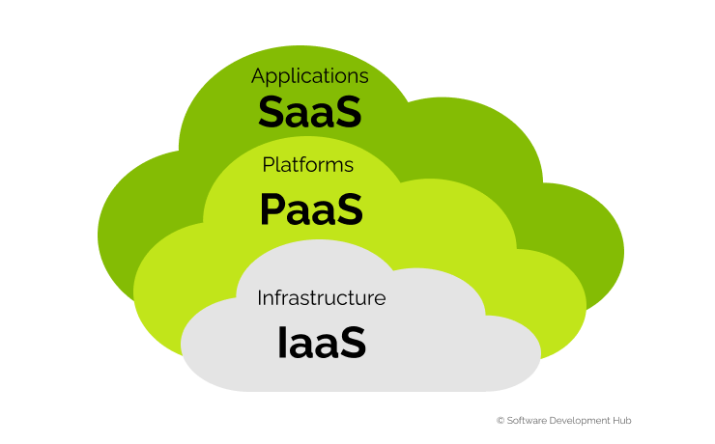
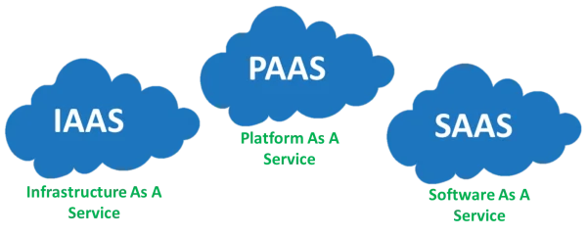
Conclusion - Key Takeaways :
🌟 Key Takeaways:
✅ IaaS, PaaS, and SaaS provide flexibility and cater to different needs.
✅ Choose the right cloud model based on your business requirements.
✅ Cloud service models drive innovation, efficiency, and cost savings.

Slide 10
THANK YOU

