Slide 1


1
Replicating the paper: Temporal Relational Ranking for Stock Prediction
112700019 Paul
Department of Information Management and Finance, National Yang Ming Chao Tung University

Slide 2
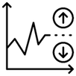
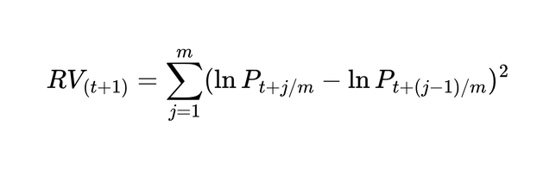
R1
2
Motivation and Why this topic interests you
      Stock-return models often treat stocks as independent time series, ignoring industry and other relations
      Feng et al. (2019) propose RSR: Temporal Graph Convolution encodes relations between stocks
      This project replicates RSR vs. a no-relation baseline: does relation information improve next-day return ranking?
      Why me: my multi-agent trading system lacks any cross-stock relation signal
AAPL
NVDA
BAC
MSFT
JPM
Stocks linked by industry relations (RSR relation graph)
RSR
Notes:
真正的波動度其實是一個不可觀測的潛在變數，為了更精確地衡量實際市場波動，Andersen & Bollerslev提出了 Realized Volatility 的概念
一段期間內的「真實波動度」可以表示為瞬時波動度的積分，稱之為Integrated Volatility
利用quadratic variation 理論來估計實際波動度。根據 quadratic variation 的性質，如果價格資料的取樣頻率足夠高，則高頻報酬率平方的加總會收斂到真實的 integrated volatility，用於近似真實波動度。

