Slide 1
ElearningAcadamy
Online Traing Solution
Supervised by:
Nadira Islam Ruku
Lecturer (Senior Scale)
Daffodil Internation University
Presented by:
Debanjan Paul
ID: 171-35-2044

Slide 2
Introduction
This system will provide learning and teaching facalities for Students and teachers.
1
Title
Title
Title
Title
It will solve tradition training system providing a good training enviroment.
2
Elearning
Acadamy
Learning process will be more faster and reliable from the past.
3
This system will also help to solve unimployment problem.
4
1

Slide 3
Why I Choose The System
Classroom Alternative
01
This system will be provide pysical classroom alternative erviroment.
Material Eificiency
02
Wtudent can be receive world class Material.
Connect with Education
03
Student can be connected with education without techonology side effect.
One Stop Educatoin
04
Organization can manage all kind of teaching solution at one point.
2

Slide 4
Difference From The Existing System
More Functionlity
Live Class, live message and like this other system integreded with this system.
Easy To Control
All Users accessible control settings will very understandable who will increase user experience.
Low Cost
All course price will very low swatable what will benefit both kind of users.
Good Support
A admin support team will help to solve all kind of technical problem 24/7 hours in a week.
3

Slide 5
Key Features Of This System
1
2
3
4
5
Live Class
Discussion Form
Storage Data
Quiz
Certificate
Teacher will teach the students into a featurestic rich live class.
student can send message for course topic discussion with teacher and classmate.
All kind of course related data will strored for all time.
Teacher can be attached quiz in module for jastify and increase student ablility.
After Finishing Course Student will able to get course Certificate.
4

Slide 6
Tools And Technologies
Server
Frontend
Backend
Tools
01
02
03
04
Linux
Redis Channel Layer
HTML 5
CSS 4
JavaScript
BootStrap
Python V3.10.4
Django V4.0
PostgreSQL
WebRTC
Django Channel
Visual Sudio Code
Github
5

Slide 7

UML Design
6

Slide 8
USE CASE DESIGN
7

Slide 9
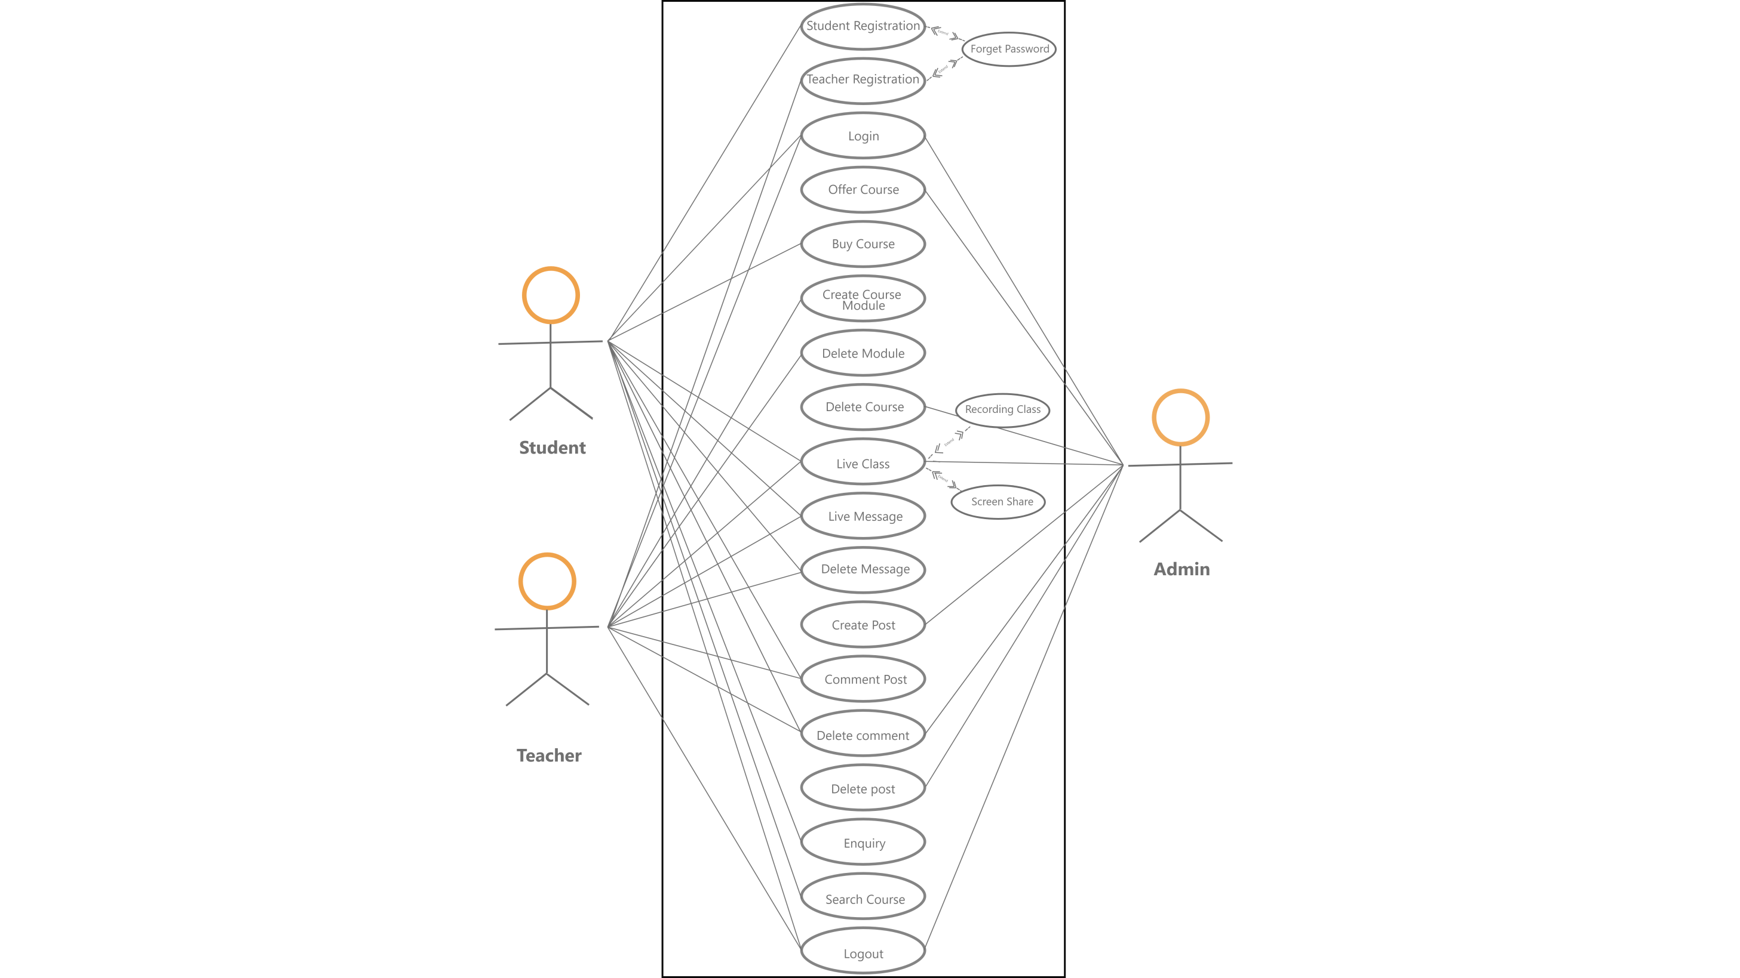
8

Slide 10
ACTIVITY DIAGRAM
9

Slide 11
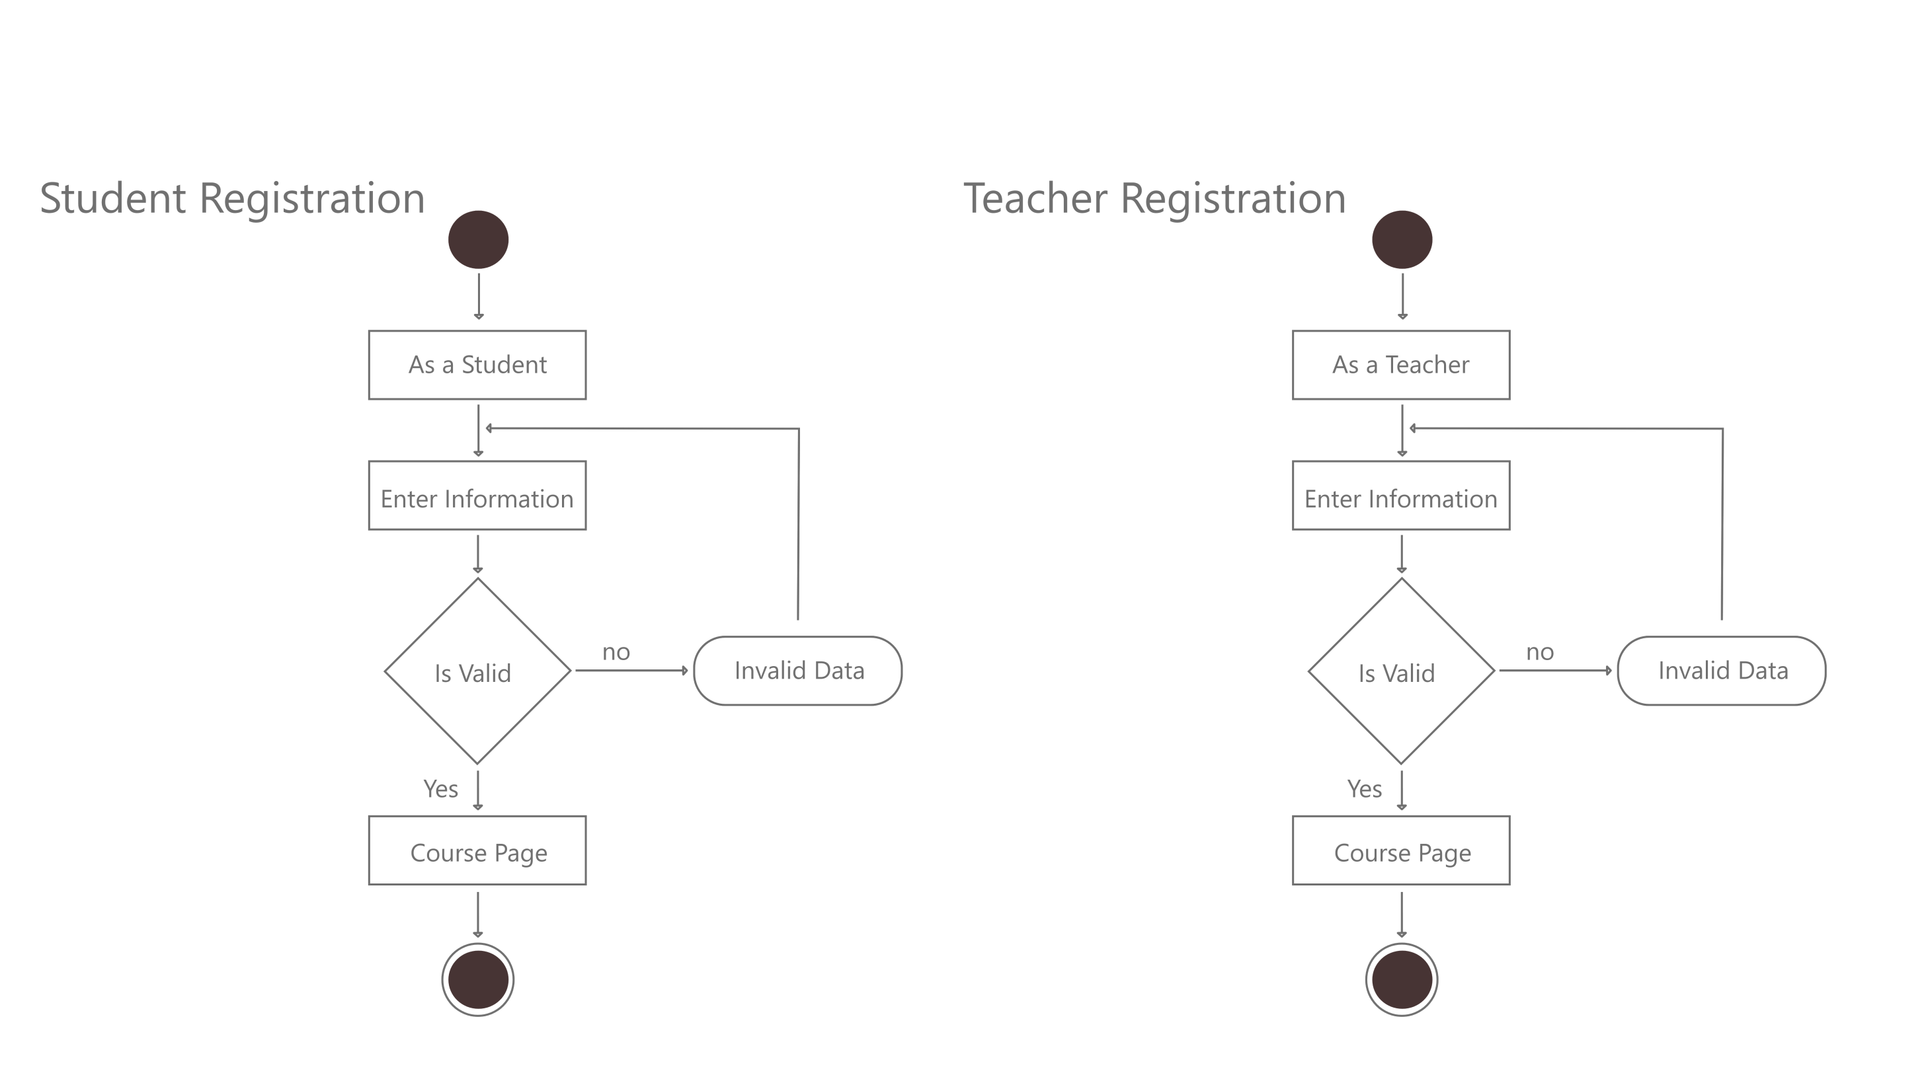
10

Slide 12
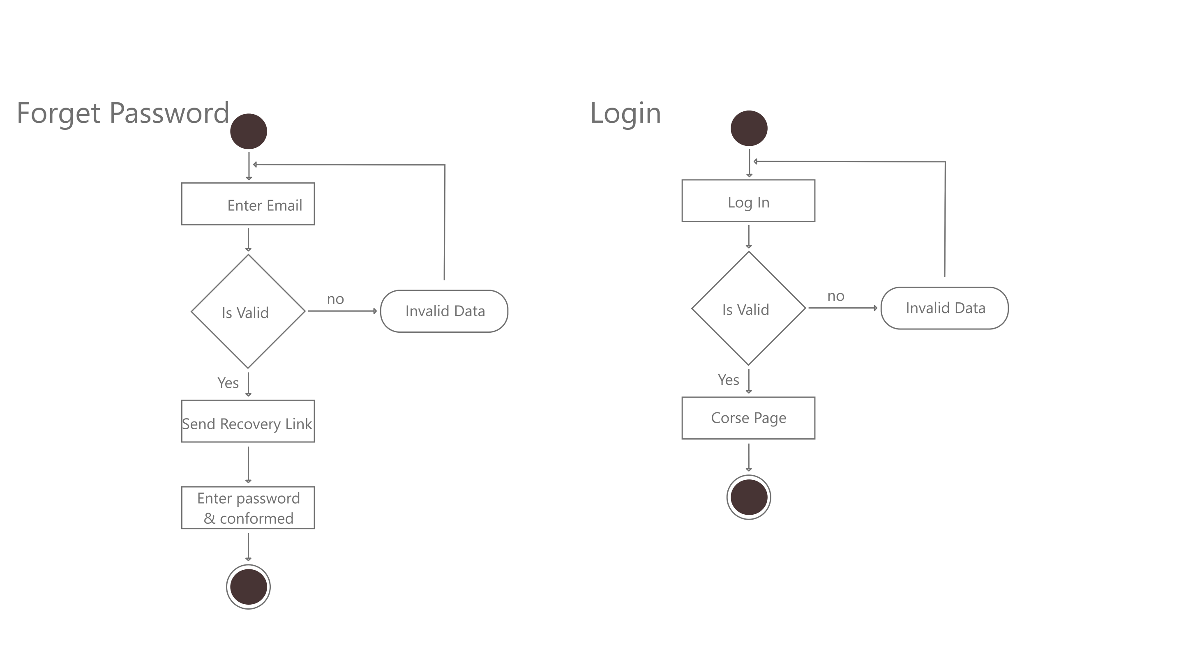
11

Slide 13
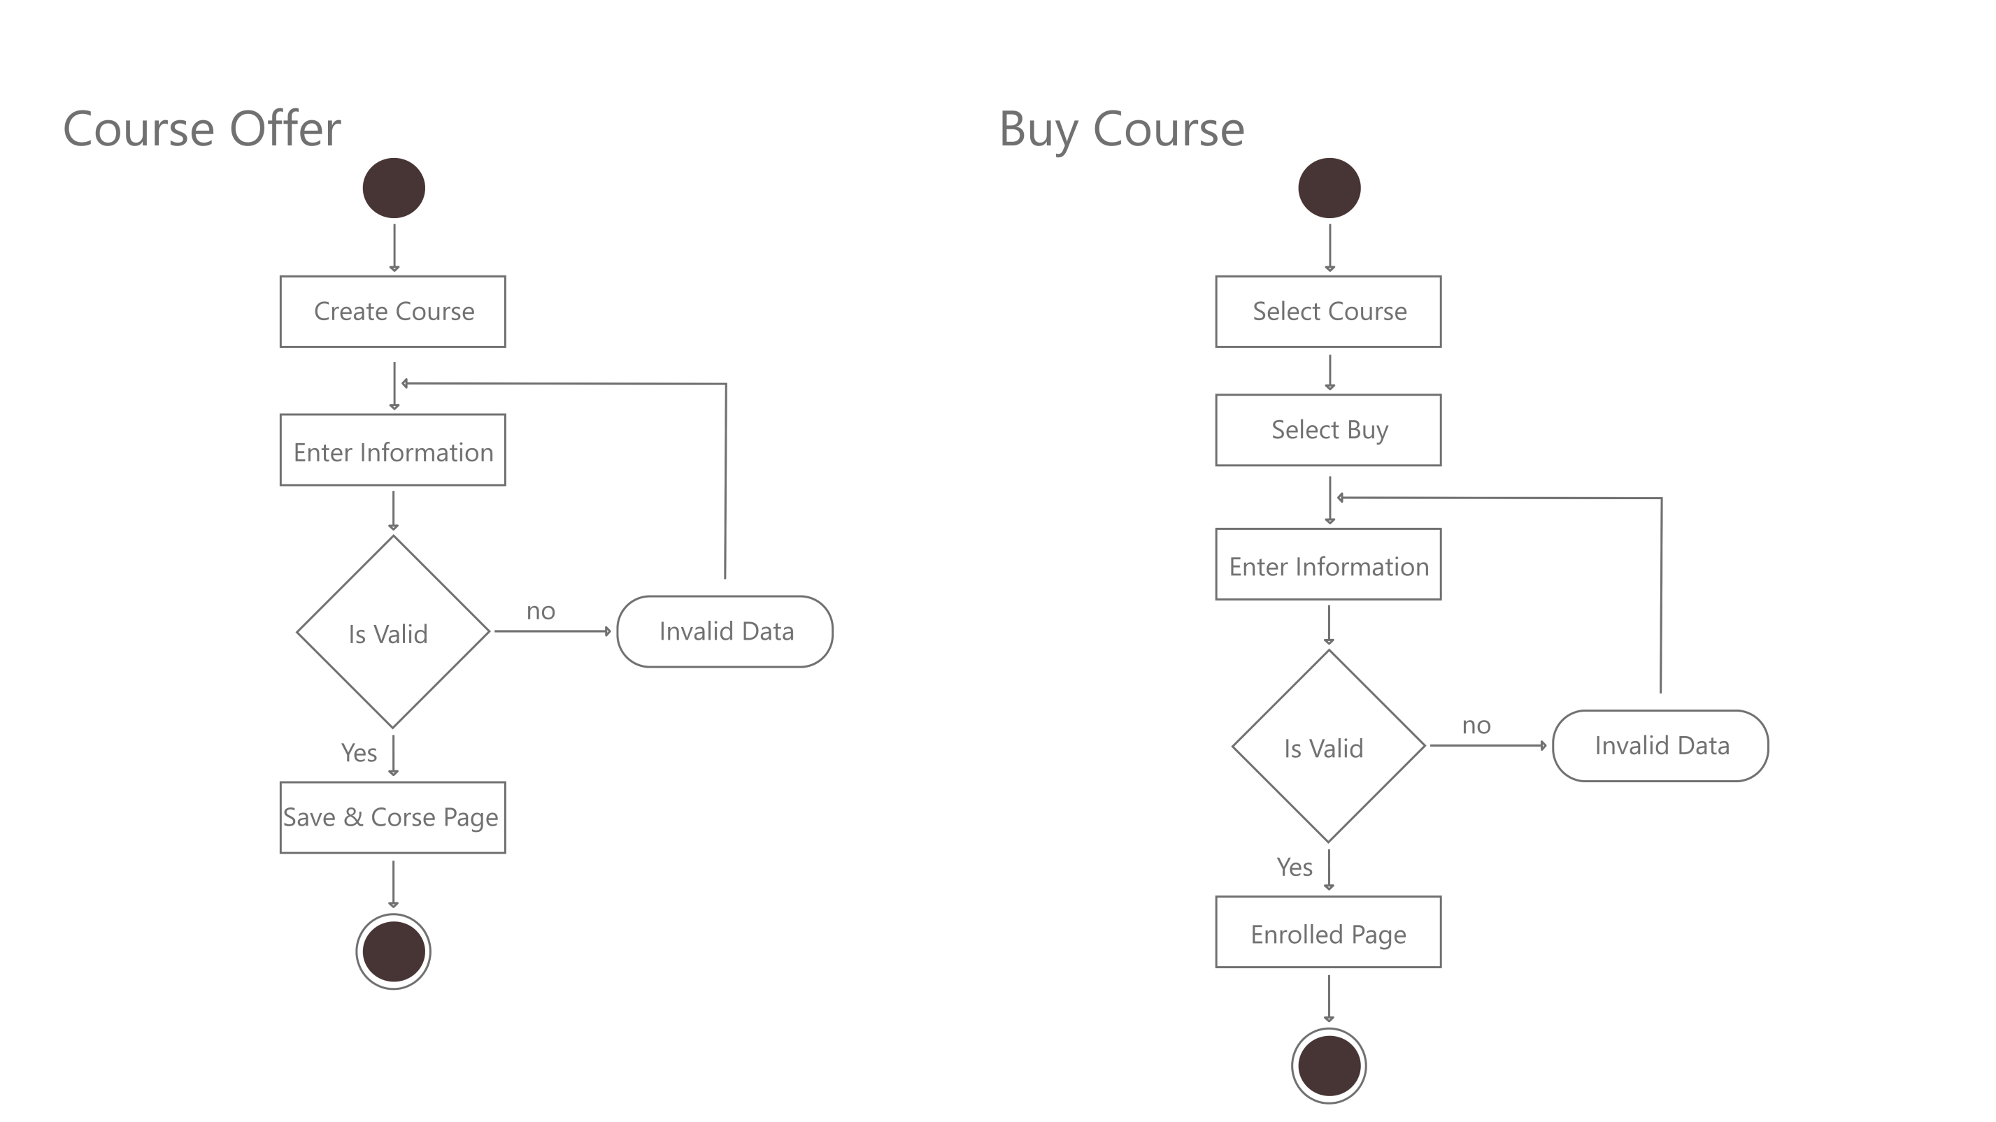
12

Slide 14
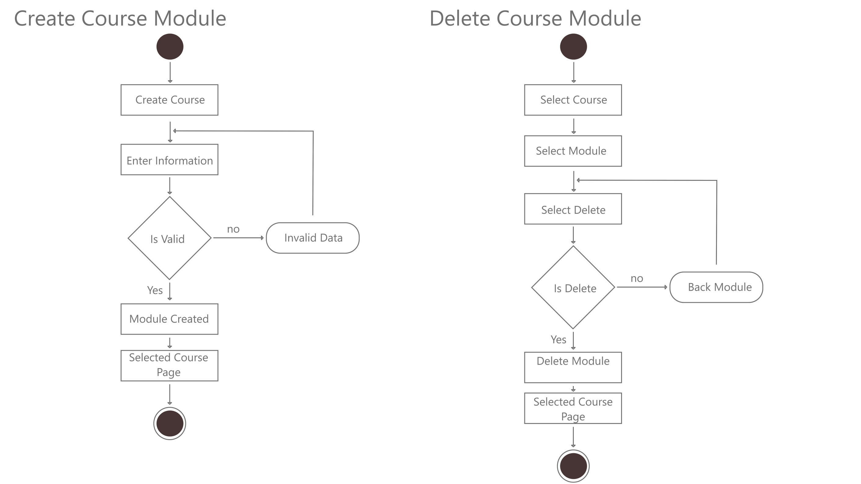
13

Slide 15
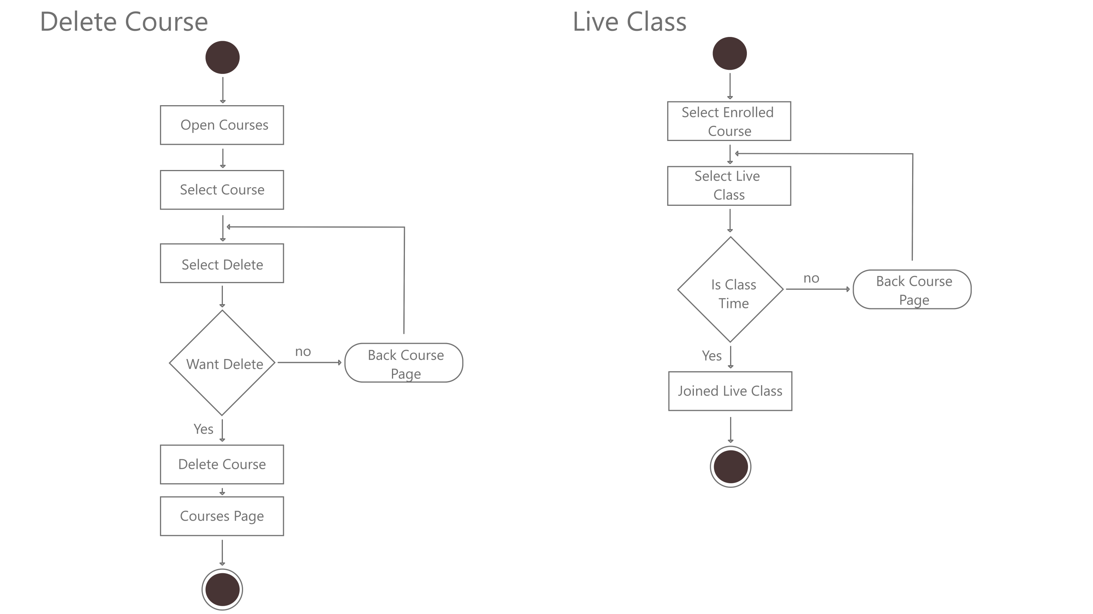
14

Slide 16
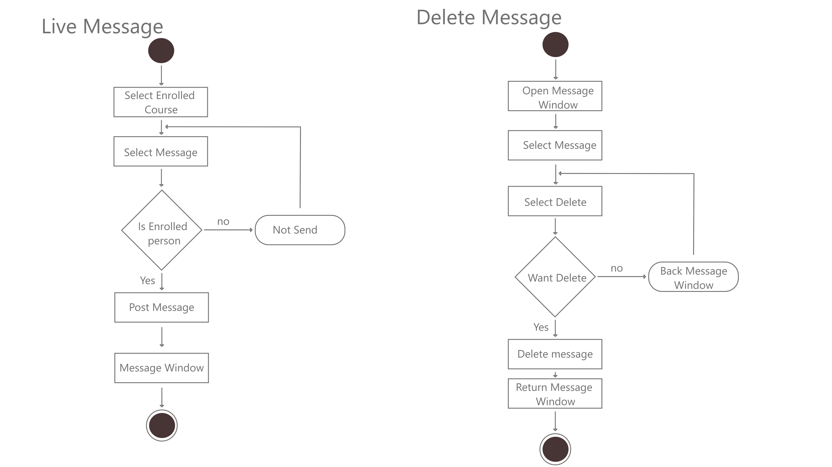
15

Slide 17
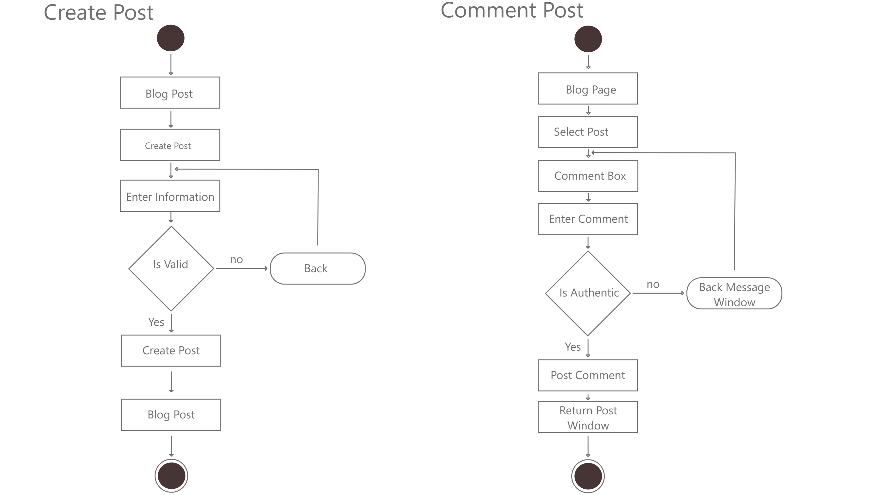
16

Slide 18
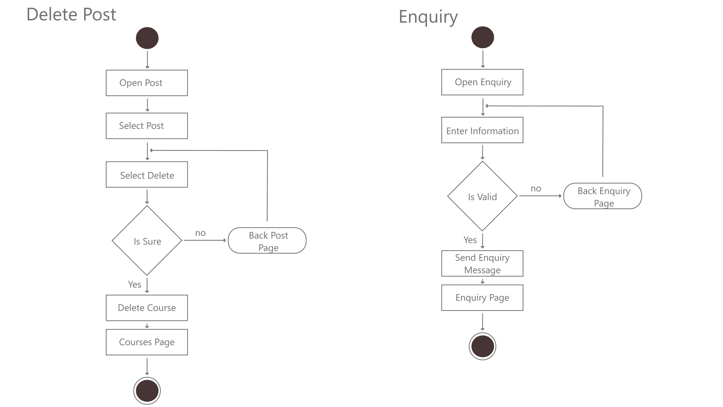
17

Slide 19
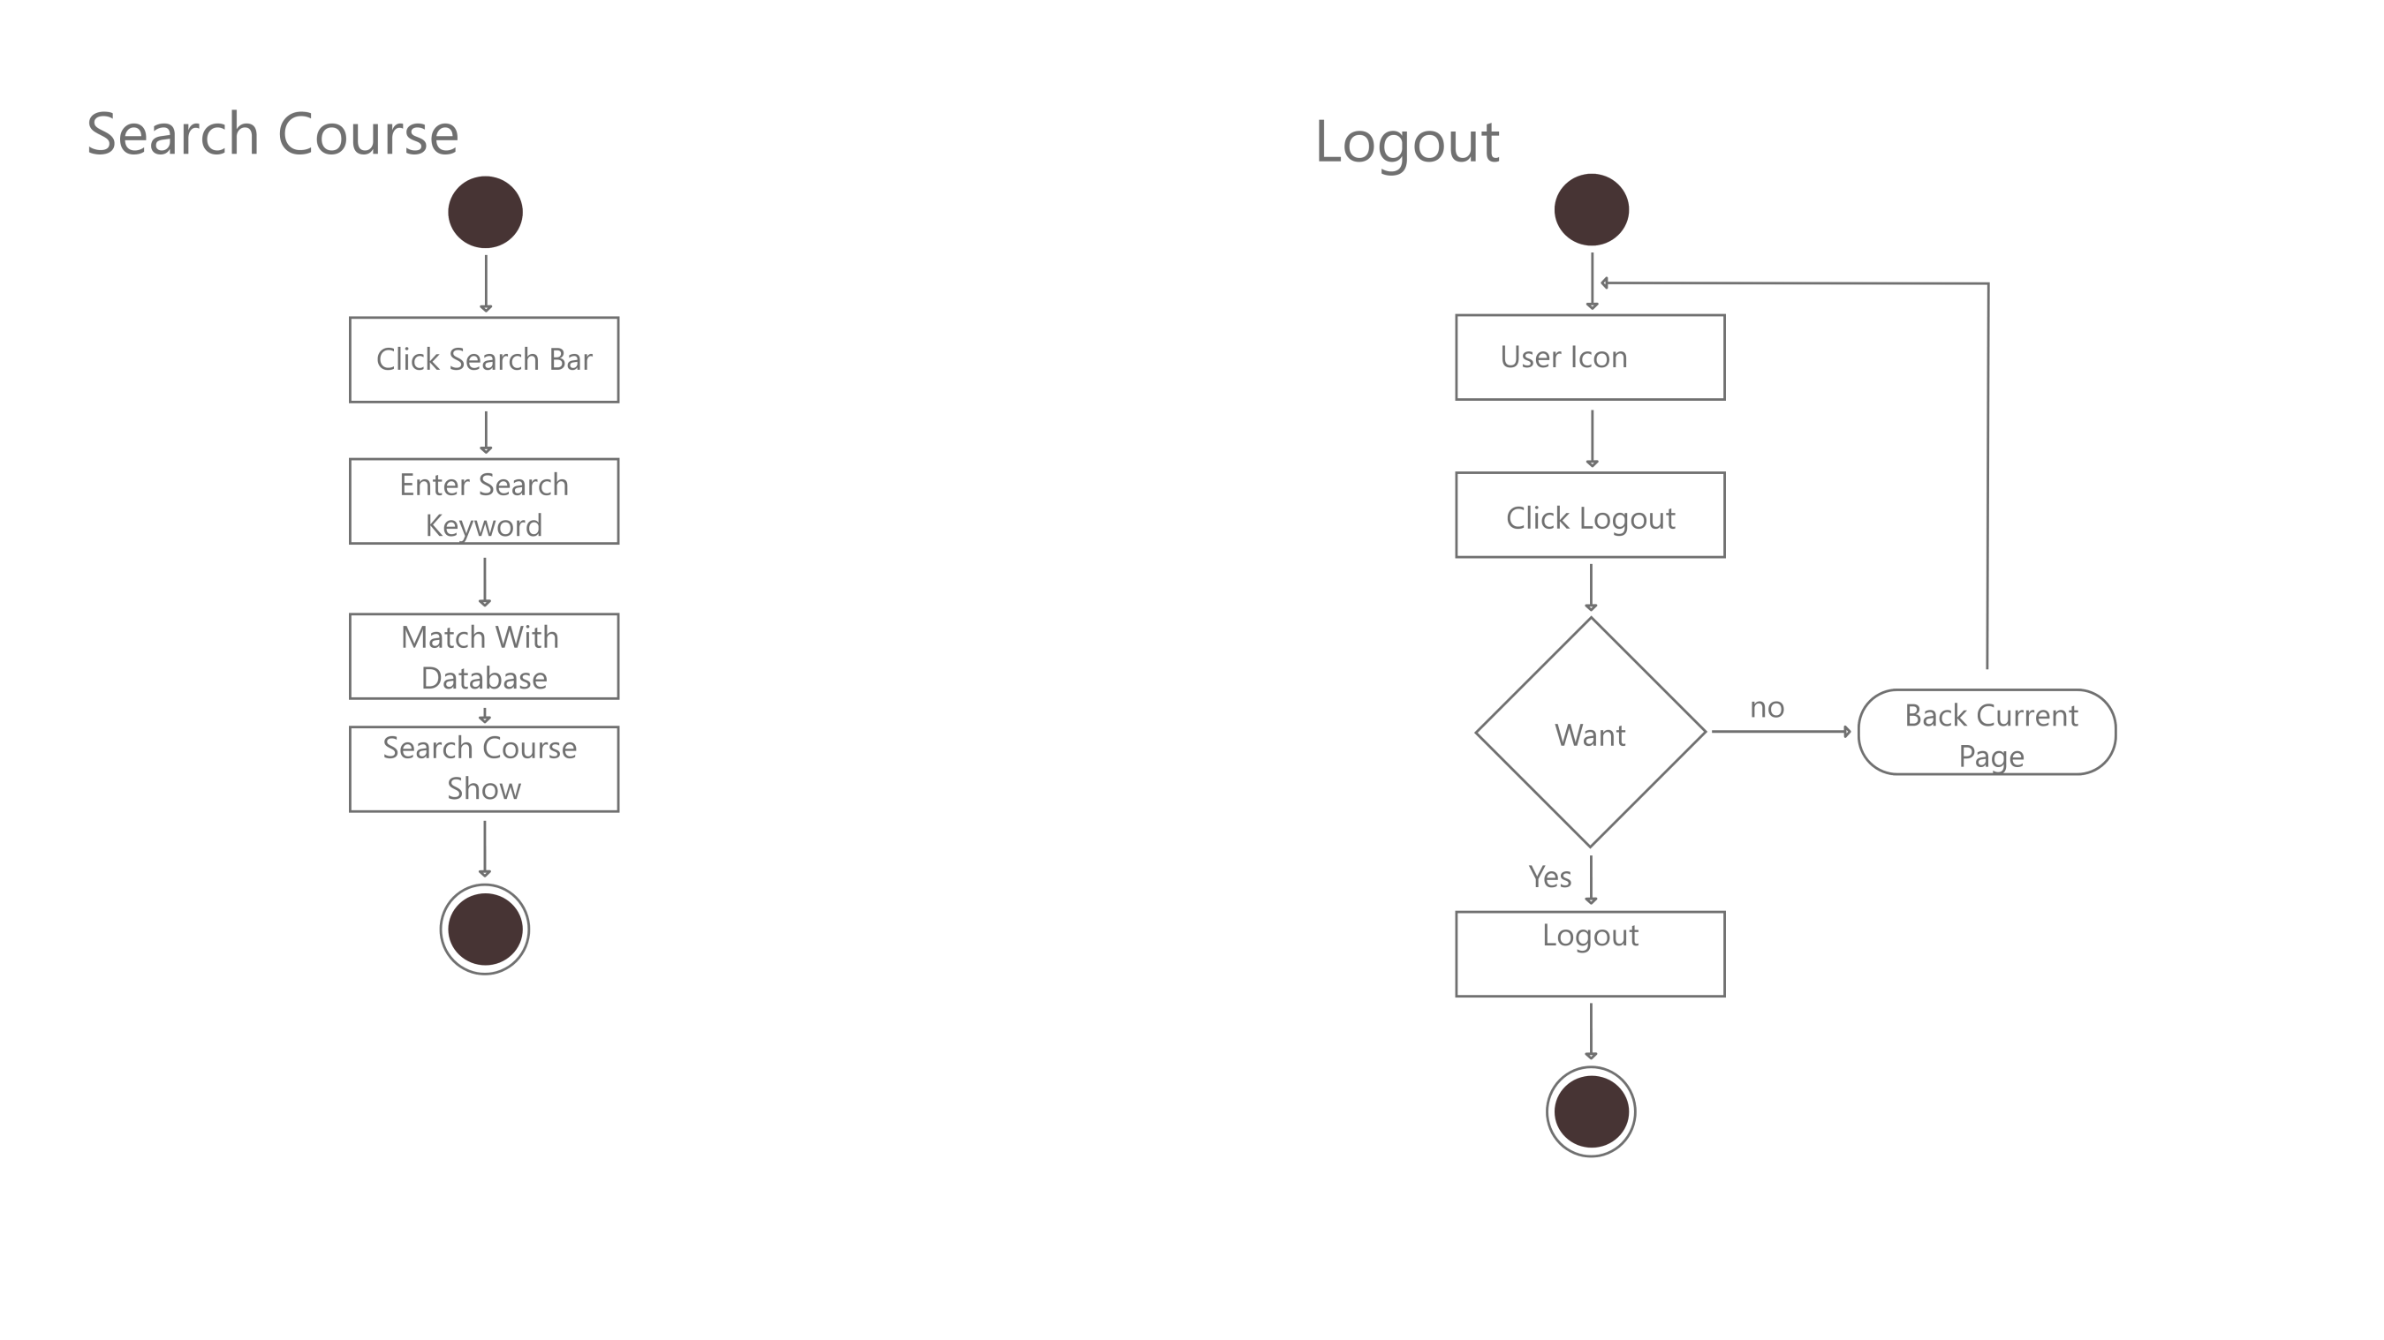
18

Slide 20
SEQUENCE DIAGRAM
19

Slide 21
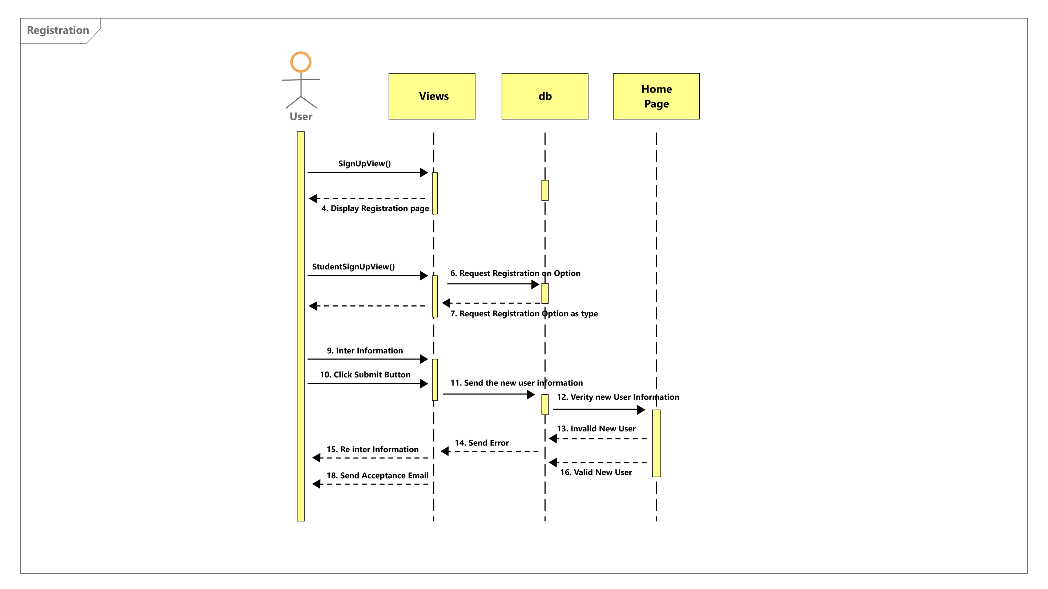
20
20
20

Slide 22
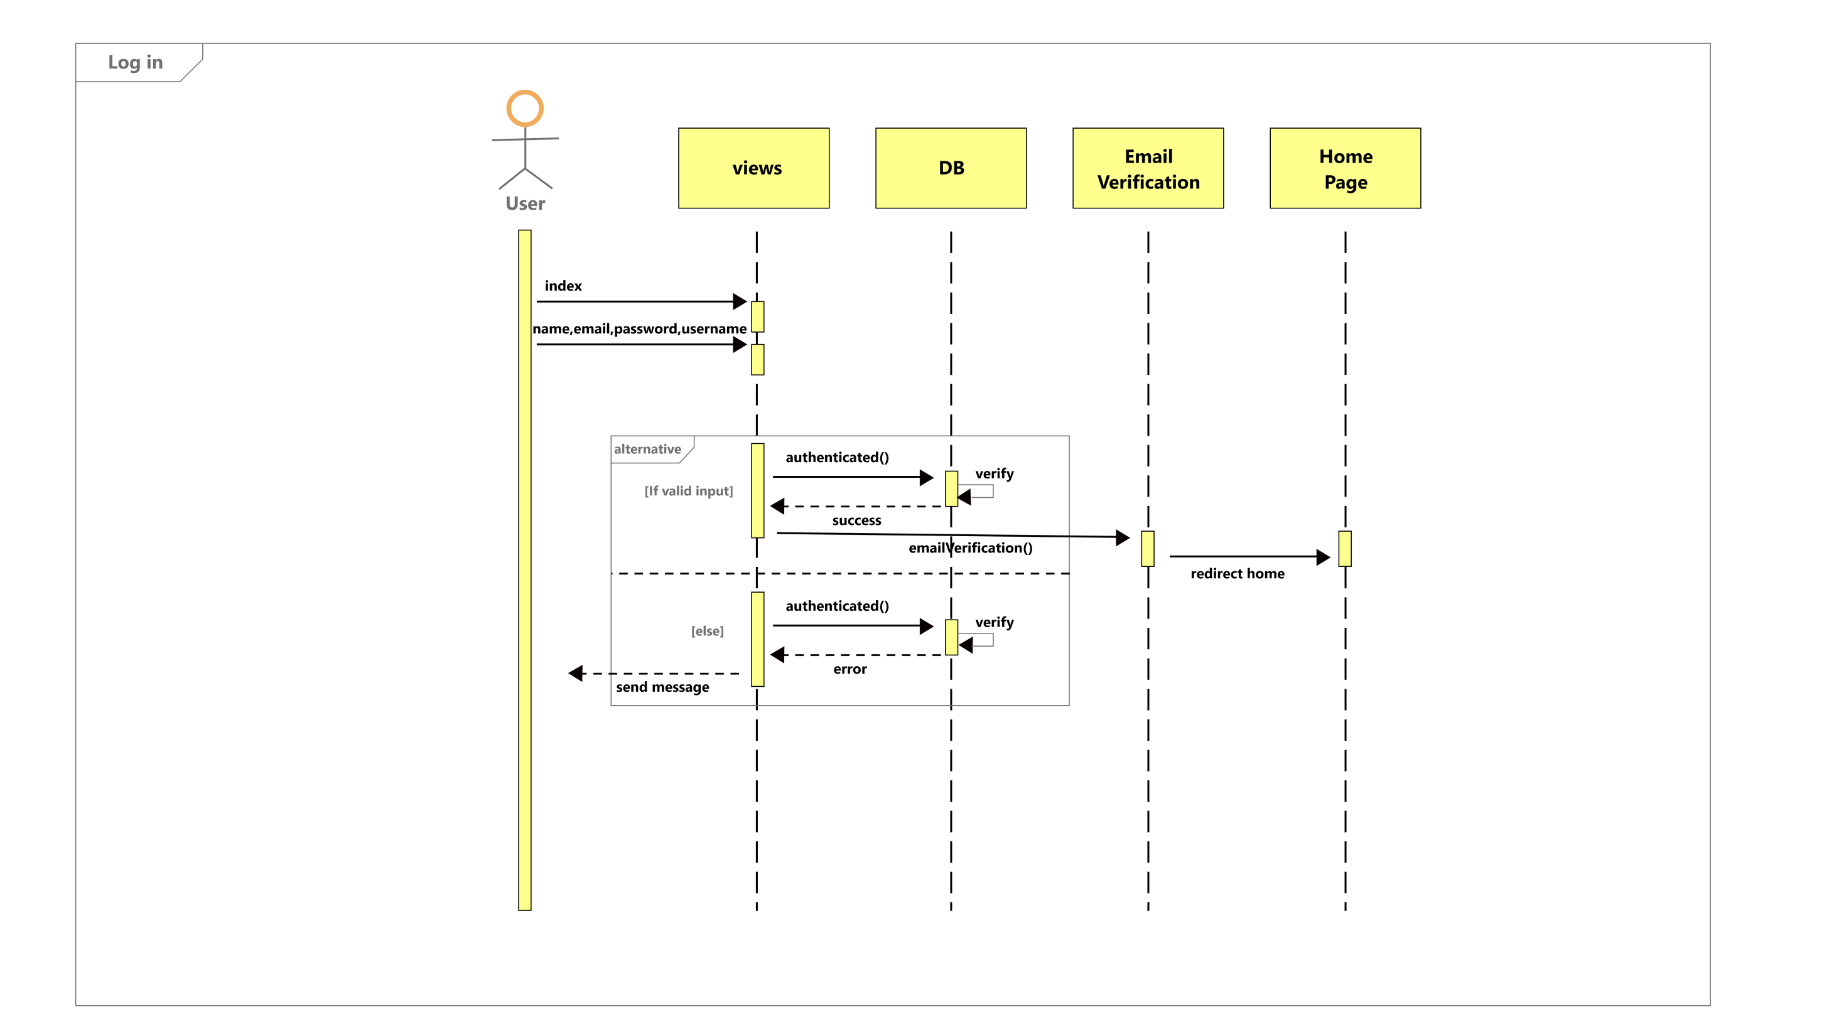
21
21
21

Slide 23
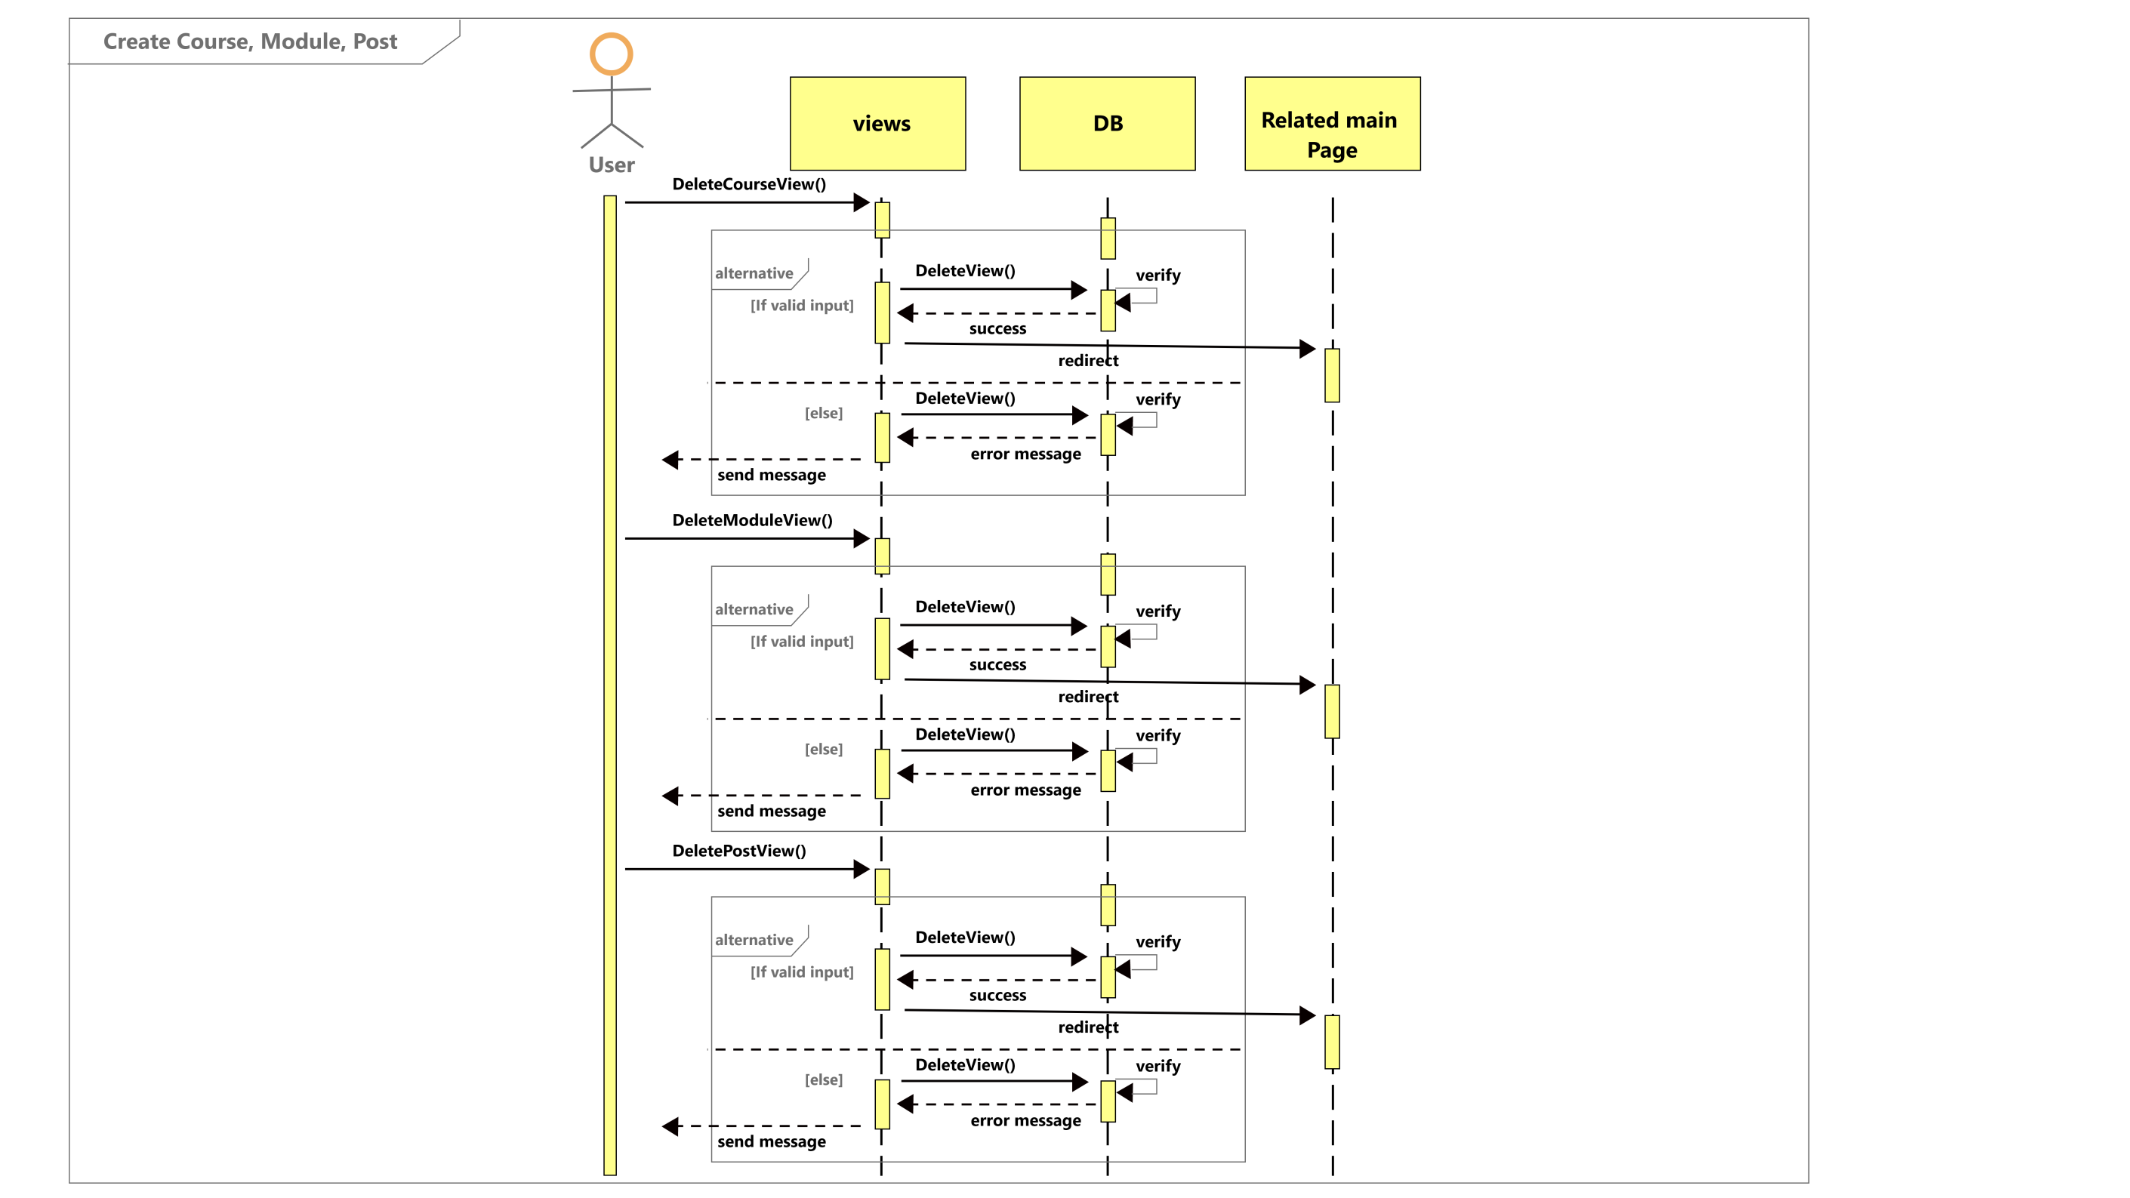
22
22

Slide 24

22
23

Slide 25
SEQUENCE DIAGRAM
24

Slide 26
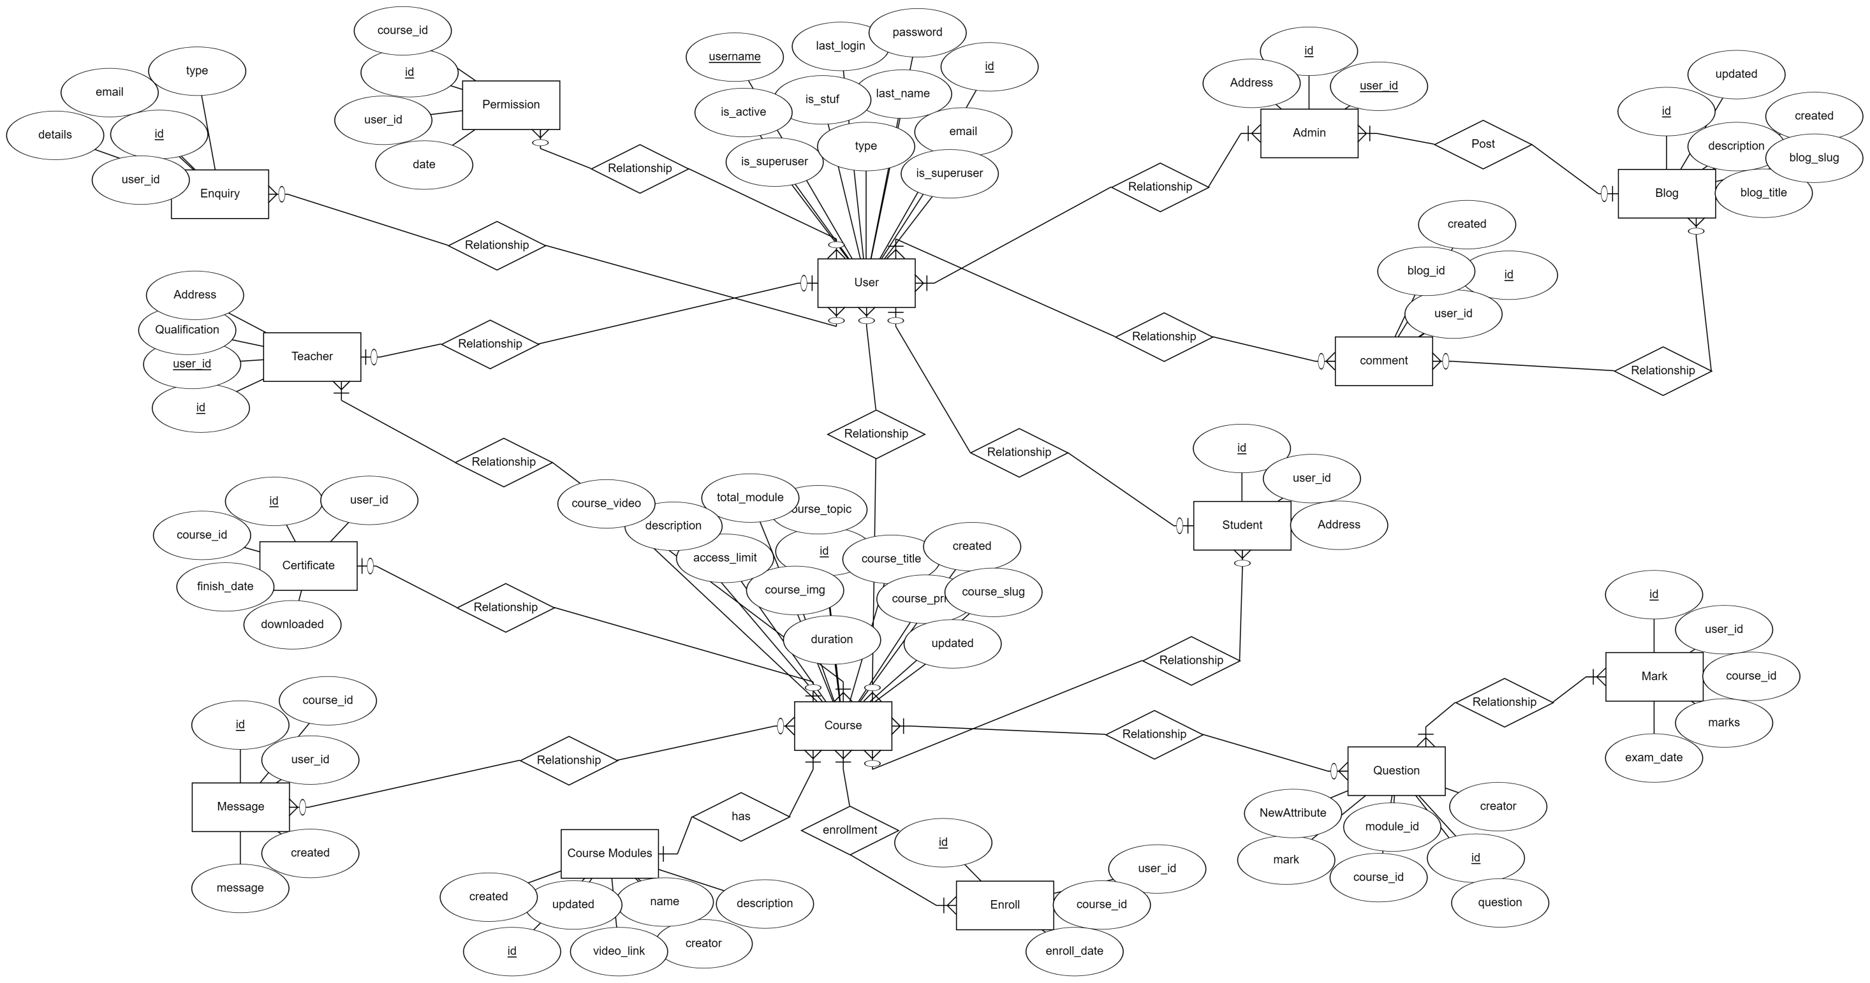
25

