Slide 1


SWE211
Lecture 7
Instructor:
Nusrat jahan
Lecturer, SWE, DIU.

Slide 2
Unnormalised Normal Form (UNF)
orderno | odate | cusno | cusname | custadd | prodno | proddes | price | quan | Line total | ordertotal
12345 | 14th feb | 001964 | Mark | E11 | T5060 | hook | 3 | 1 | 2 | 15
12345 | 14th feb | 001964 | Mark | E11 | PT42 | bolt | 4 | 2 | 8 | 15
12345 | 14th feb | 001964 | Mark | E11 | QZE48 | salt | 5 | 1 | 5 | 15
ORDER (order-no, order-date, cust-no, cust-name, cust-add,
(prod-no, prod-desc, unit-price, ord-qty, line-total)*, order-total

Slide 3
First Normal Form (1NF)
Definition: A relation is in 1NF if, and only if, all its underlying attributes contain atomic values only.
Remove repeating groups into a new relation
A repeating group is shown by a pair of brackets within the relational schema.
ORDER (order-no, order-date, cust-no, cust-name, cust-add,
(prod-no, prod-desc, unit-price, ord-qty, line-total)*, order-total
Steps from UNF to 1NF:
Remove the outermost repeating group (and any nested repeated groups it may contain) and create a new relation to contain it.
Add to this relation a copy of the PK of the relation immediately enclosing it.
Name the new entity (appending the number 1 to indicate 1NF)
Determine the PK of the new entity
Repeat steps until no more repeating groups.

Slide 4
Example - UNF to 1NF
ORDER (order-no, order-date, cust-no, cust-name, cust-add,
(prod-no, prod-desc, unit-price, ord-qty, line-total)*, order-total
orderno | odate | cusno | cusname | custadd | prodno | proddes | price | Quan | Line total | ordertotal
12345 | 14th feb | 001964 | Mark | E11 | T5060 | hook | 3 | 1 | 2 | 15
12345 | 14th feb | 001964 | Mark | E11 | PT42 | bolt | 4 | 2 | 8 | 15
12345 | 14th feb | 001964 | Mark | E11 | QZE48 | salt | 5 | 1 | 5 | 15
1. Remove the outermost repeating group (and any nested repeated groups it may contain) and create a new relation to contain it. (rename original to indicate 1NF)
ORDER-1 (order-no, order-date, cust-no, cust-name, cust-add, order-total
(prod-no, prod-desc, unit-price, ord-qty, line-total)
2. Add to this relation a copy of the PK of the relation immediately enclosing it.
ORDER-1 (order-no, order-date, cust-no, cust-name, cust-add, order-total
(order-no, prod-no, prod-desc, unit-price, ord-qty, line-total)
3. Name the new entity (appending the number 1 to indicate 1NF)
ORDER-LINE-1 (order-no, prod-no, prod-desc, unit-price, ord-qty, line-total)
4. Determine the PK of the new entity
ORDER-LINE-1 (order-no, prod-no, prod-desc, unit-price, ord-qty, line-total)

Slide 5
Second Normal Form (2NF)
Definition: A relation is in 2NF if, and only if, it is in 1NF and every non-key attribute is fully dependent on the primary key.
Remove partial functional dependencies into a new relation
Steps from 1NF to 2NF:
Remove the offending attributes that are only partially functionally dependent on the composite key, and place them in a new relation.
Add to this relation a copy of the attribute(s) which are the determinants of these offending attributes. These will automatically become the primary key of this new relation.
Name the new entity (appending the number 2 to indicate 2NF)
Rename the original entity (ending with a 2 to indicate 2NF)

Slide 6
Example - 1NF to 2NF
ORDER-LINE-1 (order-no, prod-no, prod-desc, unit-price, ord-qty, line-total)
1. Remove the offending attributes that are only partially functionally dependent on the composite key, and place them in a new relation.
ORDER-LINE-1 (order-no, prod-no, ord-qty, line-total)
(prod-desc, unit-price)
2. Add to this relation a copy of the attribute(s) which determines these offending attributes. These will automatically become the primary key of this new relation..
ORDER-LINE-1 (order-no, prod-no, ord-qty, line-total)
(prod-no, prod-desc, unit-price)
3. Name the new entity (appending the number 2 to indicate 2NF)
PRODUCT-2 (prod-no, prod-desc, unit-price)
4. Rename the original entity (ending with a 2 to indicate 2NF)
ORDER-LINE-2 (order-no, prod-no, ord-qty, line-total)

Slide 7
Third Normal Form (3NF)
Definition: A relation is in 3NF if, and only if, it is in 2NF and every non-key attribute is non-transitively dependent on the primary key.
Remove transitive dependencies into a new relation
Steps from 2NF to 3NF:
Remove the offending attributes that are transitively dependent on non-key attribute(s), and place them in a new relation.
Add to this relation a copy of the attribute(s) which are the determinants of these offending attributes. These will automatically become the primary key of this new relation.
Name the new entity (appending the number 3 to indicate 3NF)
Rename the original entity (ending with a 3 to indicate 3NF)

Slide 8
Example - 2NF to 3NF
ORDER-2 (order-no, order-date, cust-no, cust-name, cust-add, order-total
1. Remove the offending attributes that are transitively dependent on non-key attributes, and place them in a new relation.
ORDER-2 (order-no, order-date, cust-no, order-total
(cust-name, cust-add )
2. Add to this relation a copy of the attribute(s) which determines these offending attributes. These will automatically become the primary key of this new relation..
ORDER-2 (order-no, order-date, cust-no, order-total
(cust-no, cust-name, cust-add )
3. Name the new entity (appending the number 3 to indicate 3NF)
CUSTOMER-3 (cust-no, cust-name, cust-add )
4. Rename the original entity (ending with a 3 to indicate 3NF)
ORDER-3 (order-no, order-date, cust-no, order-total

Slide 9
Example - Relations in 3NF
ORDER-3 (order-no, order-date, cust-no, order-total
CUSTOMER-3 (cust-no, cust-name, cust-add )
PRODUCT-2 (prod-no, prod-desc, unit-price)
ORDER-LINE-2 (order-no, prod-no, ord-qty, line-total)
prod-no
order-no
PRODUCT
ORDER
places
contains
shows
placed by
belongs to
cust-no
order-no, prod-no
CUSTOMER
part of
ORDER-LINE

Slide 10
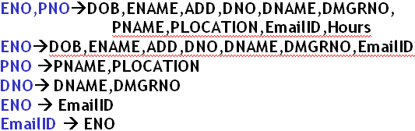
Case Study on Normalization
Consider the table
EMP_DEPT_PROJ
And the following dependencies which exist in the above table:

Slide 11
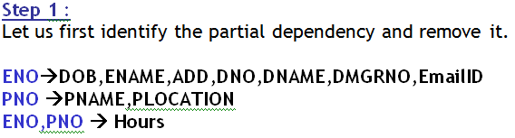
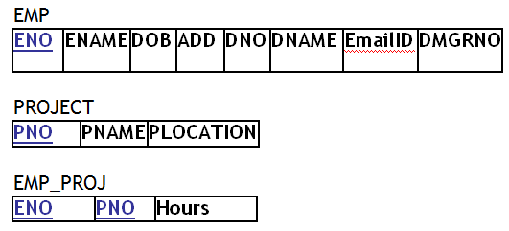
Steps to Normalize the database
D
Thus we will have 3 tables

Slide 12
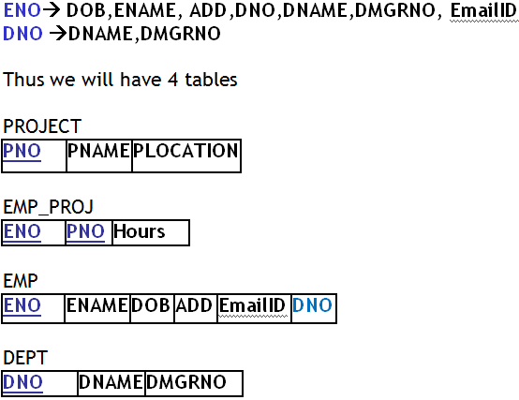
Steps to Normalize the database
Step 2
Let us now identify the transitive dependency and remove it.

Slide 13

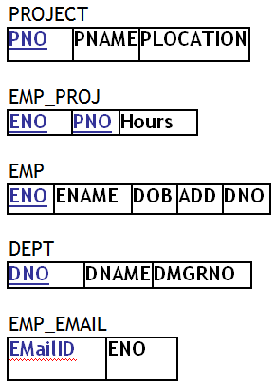
Steps to Normalize the database
Step 3:
Let us now identify the non key determinants and remove them.
Thus we will have 5 tables

Slide 14
Thanks

