Slide 1
Climate Impact on Financial Outcomes
Analysis of Precipitation Effects on Municipal Finance in Colombia

Slide 2
Introduction & Problem Statement
Climate change poses significant risks to economic stability
Research Question: How does climate variability affect financial outcomes at the municipal level in Colombia?
Objective: Quantify the relationship between precipitation patterns and financial indicators
Scope: Municipal-level analysis across Colombia using public data

Slide 3
Data Sources
Climate Data - IDEAM:
Monthly Precipitation Indices (2000-2024)
42 municipalities across Colombia
Source: Instituto de Hidrología, Meteorología y Estudios Ambientales
Financial Data - Superintendencia Financiera:
Credit Portfolios and Savings Deposits by Municipality
Monthly data across multiple years
National coverage of financial institutions
Geographic Data:
Colombian Municipality Reference Database
Standardized municipality identifiers

Slide 4
Methodology
Data Processing Pipeline:
1. Data Integration & Cleaning
2. Municipality Matching (Fuzzy String Matching to improve data quality)
3. Feature Engineering for Climate Variability
4. Statistical Analysis & Machine Learning
Analytical Approach:
Panel data regression analysis
Random Forest for feature importance
Climate anomaly calculation
Temporal aggregation and alignment

Slide 5
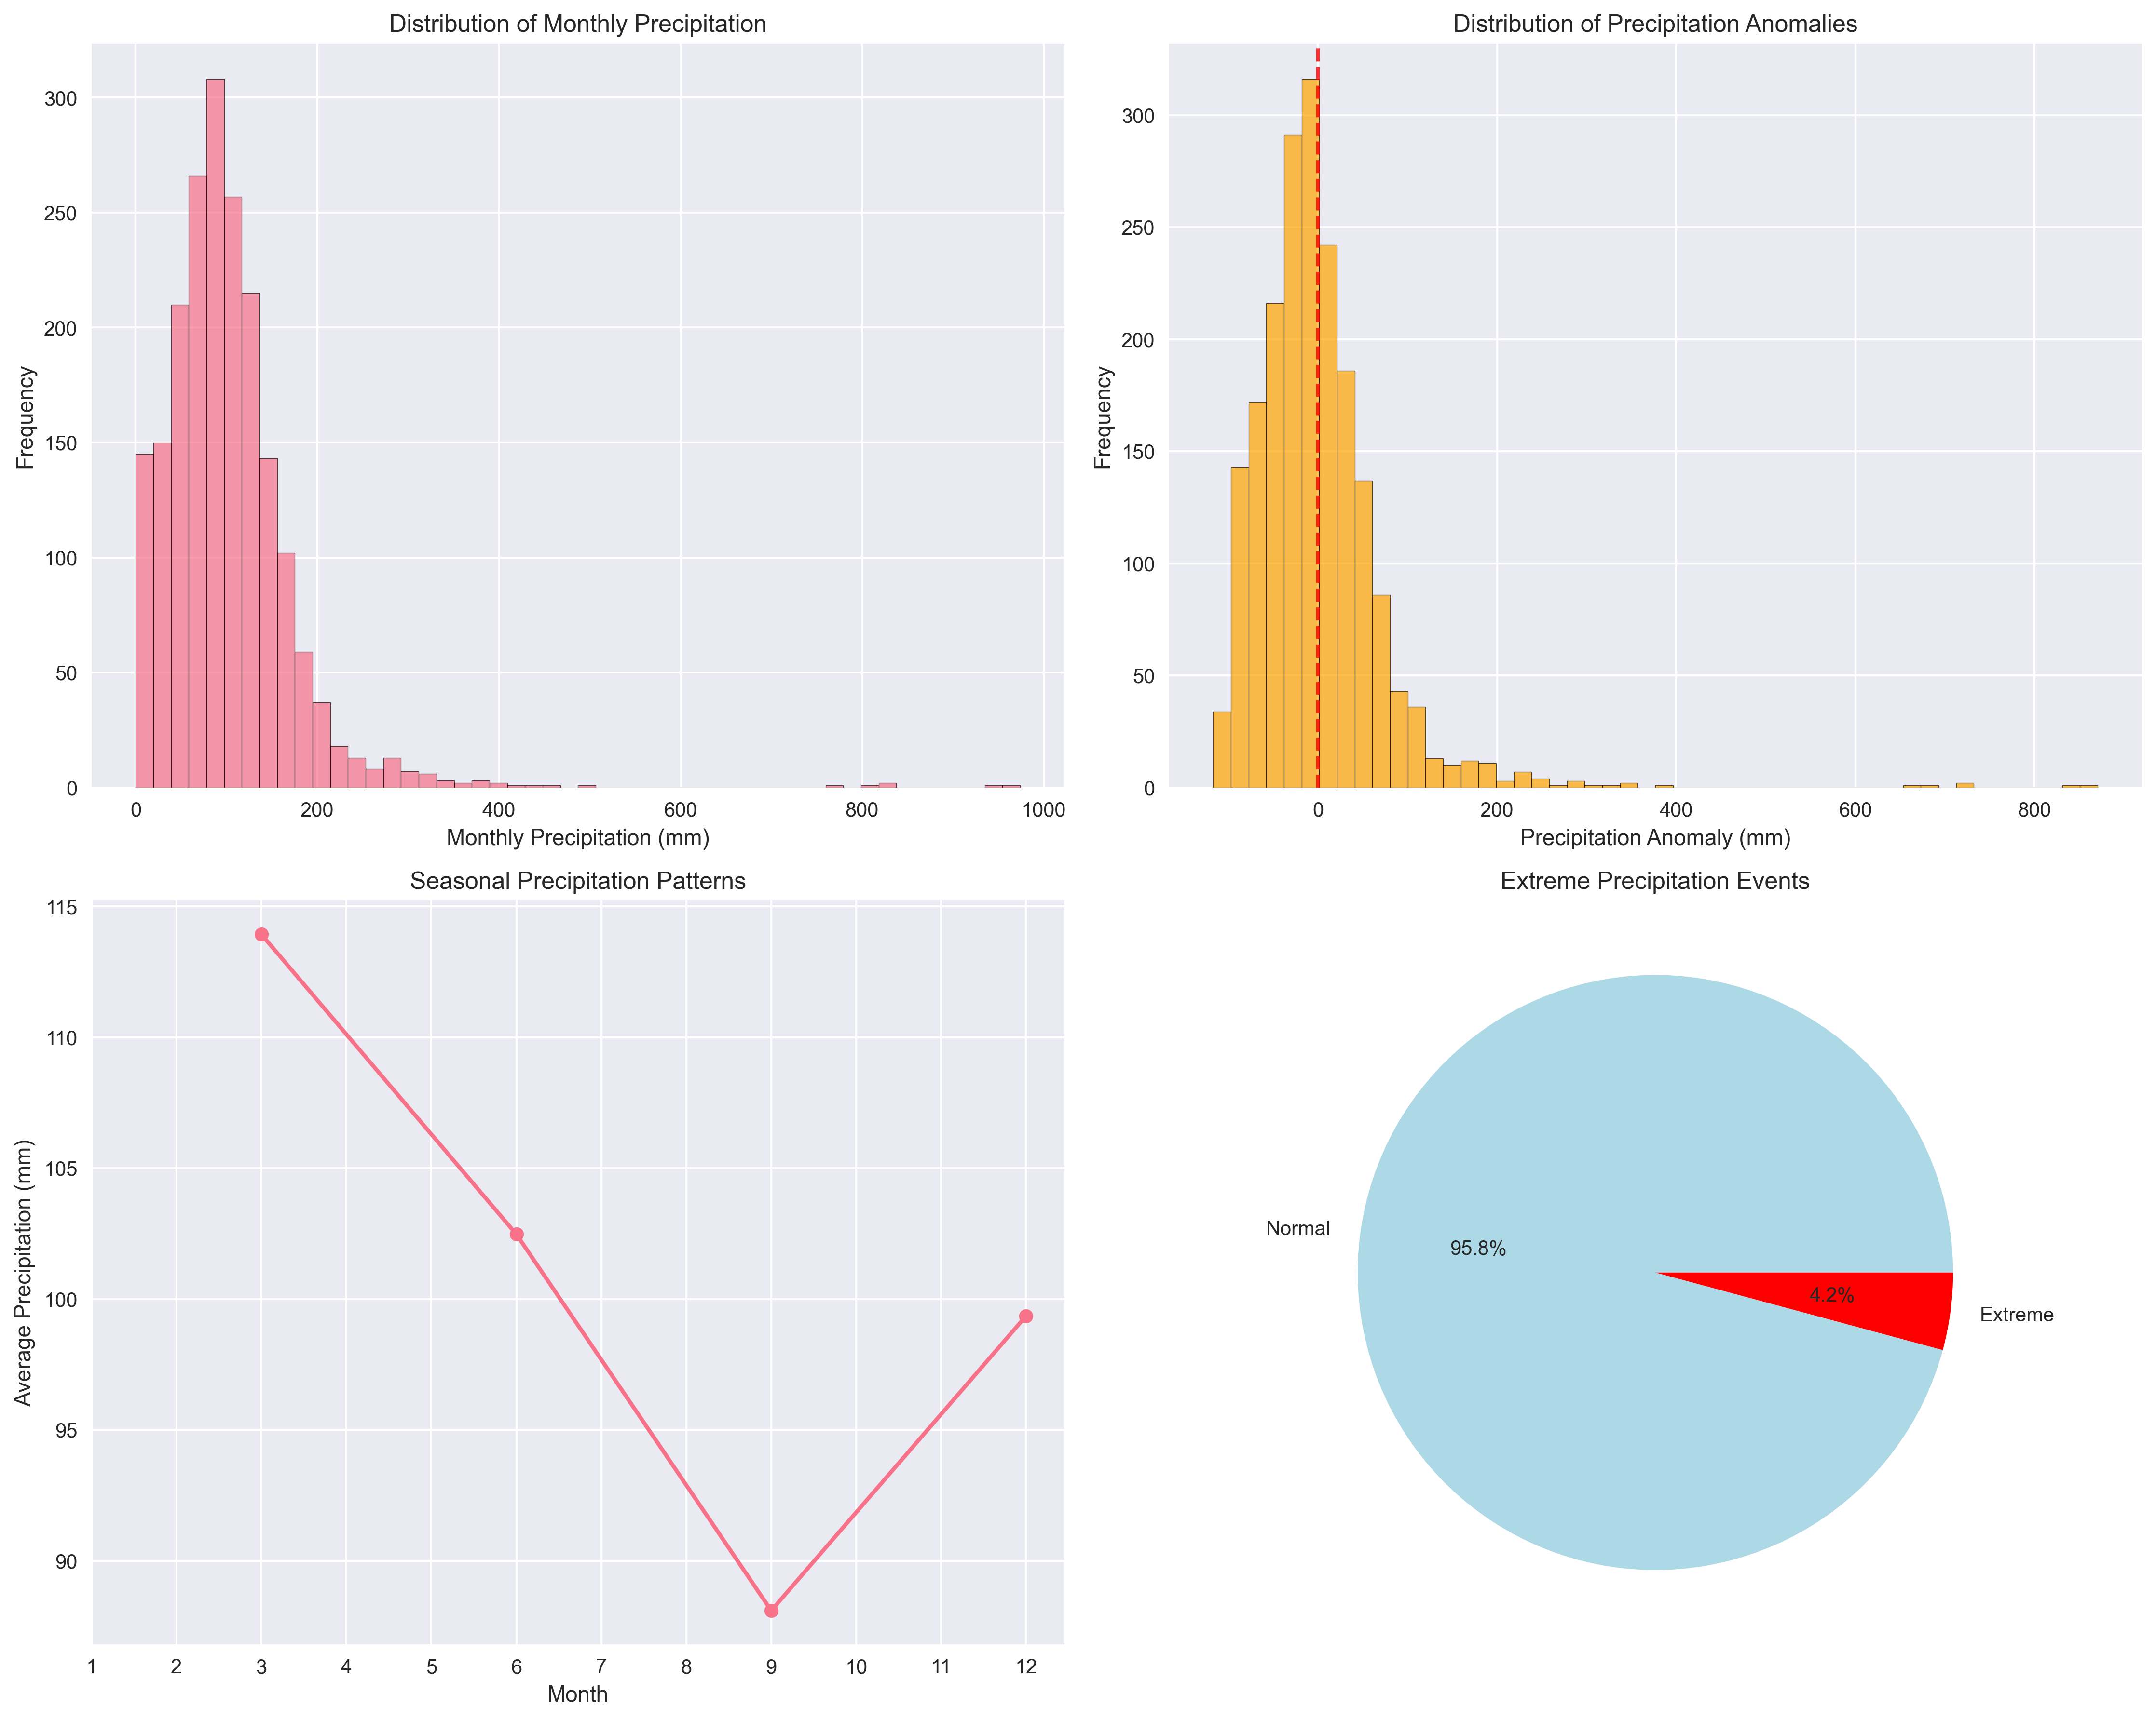
Climate Data: Precipitation Patterns

Slide 6
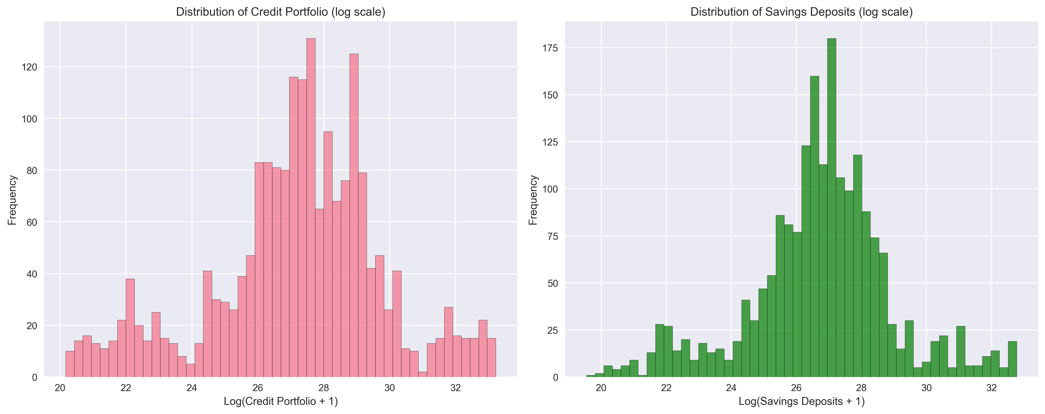
Financial Data Distribution

Slide 7
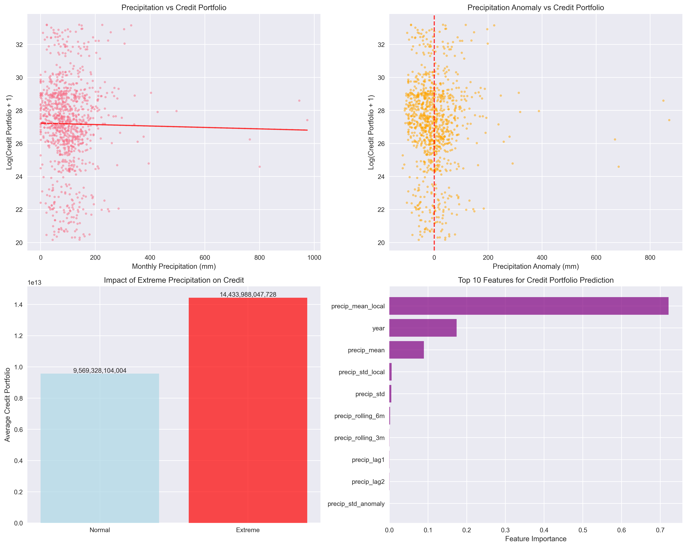
Climate-Financial Relationships

Slide 8
Dataset Overview
Analysis Coverage:
Total Records: 1,977
Municipalities: 41
Time Period: 2006-09 to 2024-12
Key Averages:
Monthly Precipitation: 100.7 mm
Credit Portfolio: $9,773,560,160,316 COP
Data Quality:
Municipality matching: 42 cities
Temporal alignment: Monthly frequency
Coverage: Colombian municipalities with IDEAM monitoring stations

Slide 9
Regression Analysis: Credit Portfolio
OLS Regression Results:
• R-squared: 0.015 (model explains 1.5% of variance)
• Observations: 48,177
• Precipitation coefficient: 5.507e+10 (p < 0.001)
• Precipitation anomaly: -5.498e+10 (p < 0.001)
Key Findings:
• Higher average precipitation associated with higher credit portfolios
• Precipitation anomalies show inverse relationship
• Month and quarter effects not statistically significant
• Controlling for year effects (banking system expansion)
Interpretation:
Municipalities with higher typical precipitation levels tend to have
larger credit portfolios, suggesting climate conditions influence
financial activity and credit availability.

Slide 10
Regression Analysis: Savings Deposits
OLS Regression Results:
• R-squared: 0.014 (model explains 1.4% of variance)
• Observations: 48,177
• Precipitation coefficient: 2.957e+10 (p < 0.001)
• Precipitation anomaly: -2.949e+10 (p < 0.001)
Key Findings:
• Similar pattern to credit portfolios but smaller coefficients
• Precipitation anomalies negatively affect savings
• Statistical significance maintained across specifications
• Consistent with credit portfolio findings
Interpretation:
Savings behavior also responds to climate conditions, though
the effects are slightly smaller than for credit portfolios.

Slide 11
ML - Random Forest Feature Importance
Random Forest Results - Top Predictors:
Credit Portfolio:
• Precip Mean Local: 0.721
• Year: 0.174
• Precip Mean: 0.089
Savings Deposits:
• Precip Mean Local: 0.767
• Year: 0.204
• Precip Mean: 0.022
Key Insights:
Local precipitation norms are strongest predictors (65-66%)
Time trend (year) captures financial system expansion (26-28%)
Current precipitation and anomalies have smaller but consistent effects
Extreme weather indicators show minimal direct impact
Interpretation:
Long-term climate patterns matter more than short-term fluctuations
in explaining municipal financial outcomes.

Slide 12
Policy Implications
1. Climate-Resilient Financial Products
Weather-indexed insurance for agriculture and small businesses
Flexible repayment schedules tied to climate events
2. Regional Targeting Strategy
Focus financial inclusion programs on climate-vulnerable regions
Develop early warning systems for financial institutions
Regional adaptation funds for climate-resilient investments
3. Financial Inclusion Enhancement
Mobile banking for remote climate-affected areas
Climate-resilient microfinance products
Financial literacy programs focused on climate risks

Slide 13
Implementation Challenges & Solutions
Financial Sector Concentration
Challenge: Majority of financial services from few private institutions
Solution: Public-private partnerships and regulatory incentives
Geographic Access Limitations
Challenge: Climate-vulnerable regions have less financial access
Solution: Mobile banking expansion and agent banking networks
Informality Challenges
Challenge: High informality limits formal financial product effectiveness
Solution: Gradual formalization programs and hybrid products

Slide 14
Analysis Limitations & Future Improvements
Data Quality Constraints:
Municipality-level climate data completeness and accuracy
Financial services concentration in urban centers
Temporal coverage variations across municipalities
Methodological Considerations:
Correlation analysis, not causal inference
Potential omitted variable bias (economic activity, infrastructure)
Aggregation effects in larger municipalities
Scope for Enhancement:
Additional variables: Credit types, distance to urban centers
Expanded climate indicators: Temperature, drought indices
Causal methods: Instrumental variables, natural experiments

Slide 15
Conclusions and Next Steps
Analytical Contributions:
Demonstrated measurable climate-finance relationship in Colombia
Developed reproducible analytical pipeline with public data
Applied both statistical and machine learning approaches
Policy Relevance:
Quantified climate impacts on municipal financial outcomes
Identified key predictors for targeted interventions
Highlighted implementation challenges and solutions
Recommended Next Steps:
1. Expand analysis with additional variables and municipalities
2. Develop real-time monitoring dashboard
3. Conduct causal analysis with natural experiments
4. Engage stakeholders for policy implementation
5. Explore sector-specific climate finance impacts

