Slide 1
Demystifying Education
Castro Sanchez, Paula & Gwak Seungmin

Slide 2
Why?
Understand what drives student success
Create a model for student performance prediction
Separate students into classes
More personalized learning leads to better outcomes

Slide 3
Add here first analysis

Slide 4
Diving deeper into data
Understand the importance of other personal, social, and school-related features for student success.
We predict the last period´s grade (‘G3’)
- Low level (0-69%) [ 0 , 13]
- Medium level (70-89%) [14 , 17]
- High level (90-100%) [18 , 20]

Slide 5
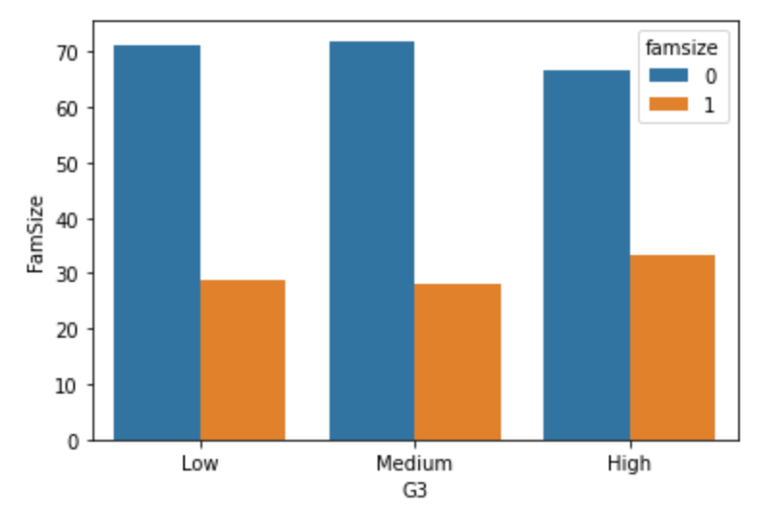
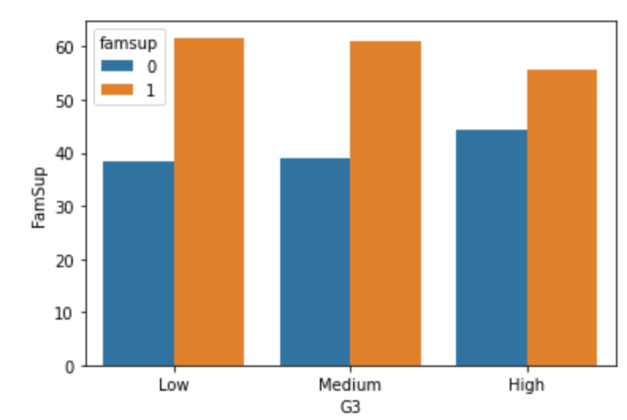
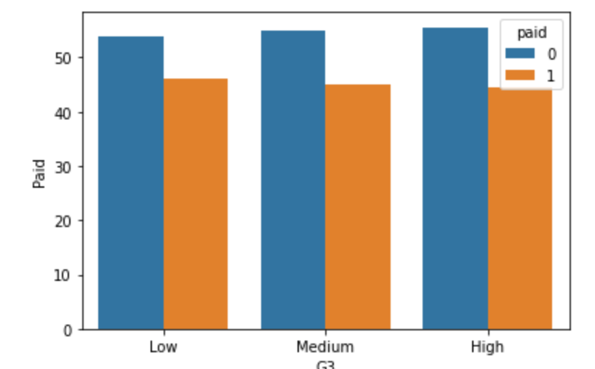
Exploratory Data Analysis (1)
Understand our data and raise some interesting questions
Numerical Features:
Higher age is related to lower performance
Categorical Features:
Some variables seemed to have no discriminative power
We removed these

Slide 6
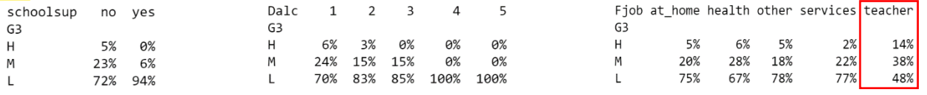
Exploratory Data Analysis (2)
Categorical Features:
Other variables looked valuable to distinguish between the different student groups

Slide 7
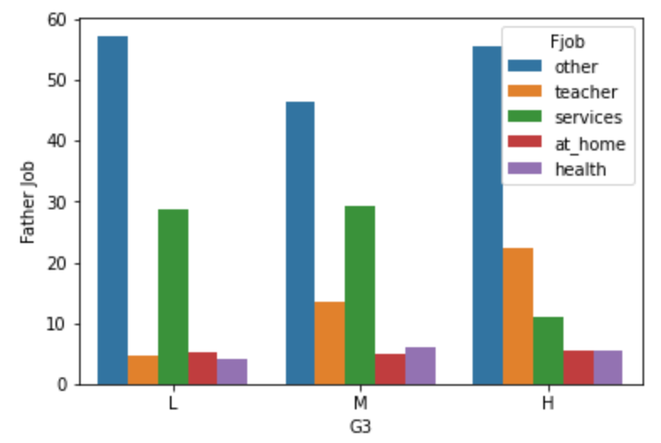
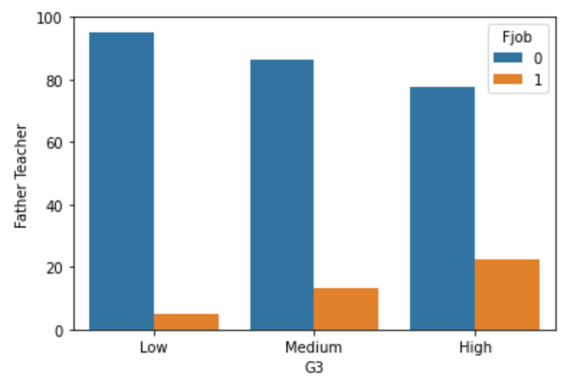
Feature Engineering (1)
Reshape existing categorical variables to be more informative

Slide 8
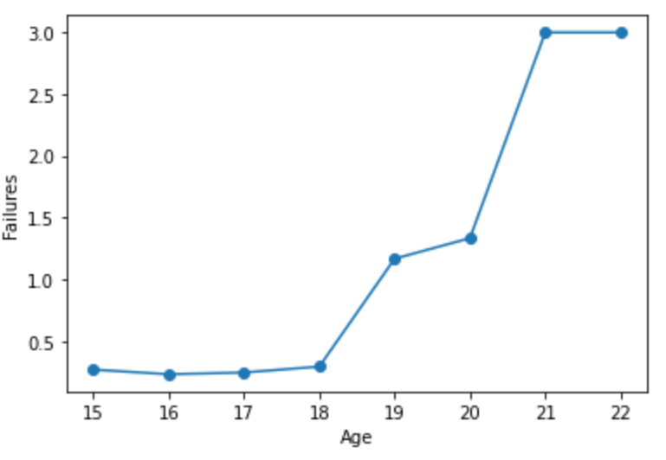
Feature Engineering (2)
Merging variables to create more informative ones
Average Alcohol consumption
Repeaters (>16 and +1 failures)

Slide 9
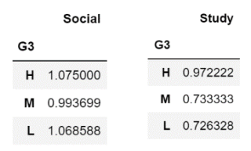
Feature Engineering (3)
Time itself is not informative
We want to study the proportion of the free time spent on each activity

Slide 10
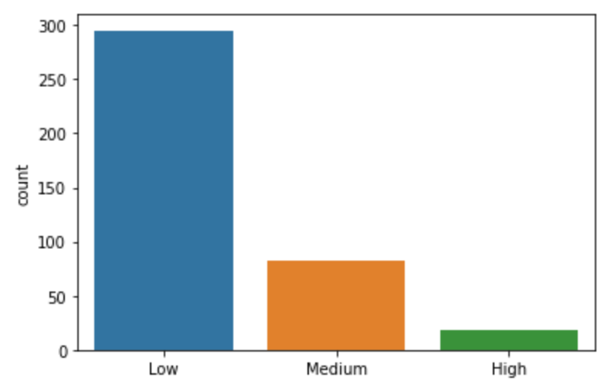
Modeling
Multi-class Classification Problem
Accuracy, F1 Score, Confusion Matrix
Imbalanced Classes
Accuracy, F1 Score, Confusion Matrix
Feature Selection and Feature normalization

Slide 11
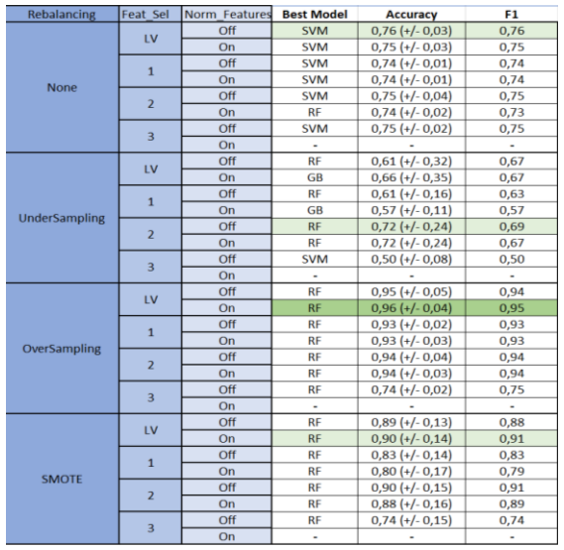
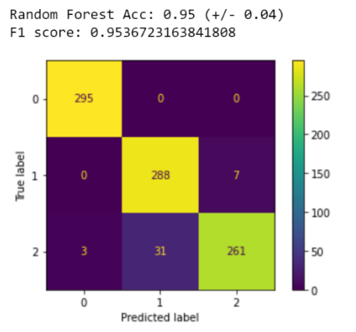

Slide 12
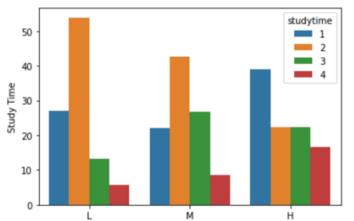
Key Take-Away
It is not the total amount of study time that matters
It looks like H students are busier, but the free time they have they do spend efficiently
Students with a better work-life balance seem to achieve higher

Slide 13
THANK YOU

