Slide 1
Target Flipping on the RNA ND GP map
How does non-determinism get selected for ?
Paula Garcia-Galindo

Slide 2
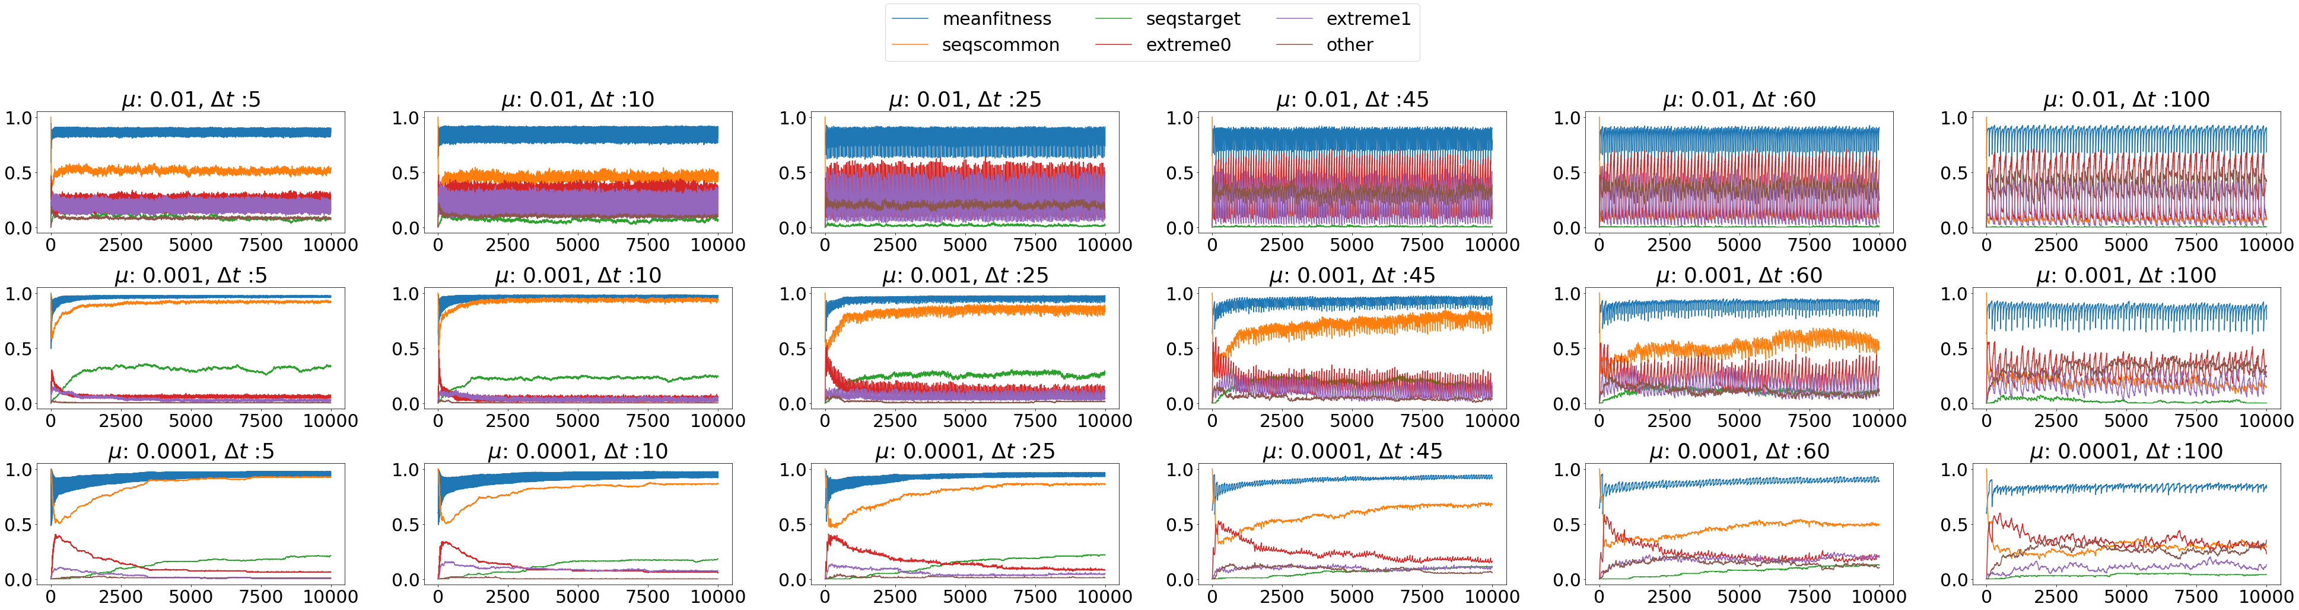
Initial conditions: target T0 and seqs at seqscommon with max prob in T1
Each point is averaged over 100 simulations with the same parameters
( seqstarget increase present)
Simulation params:
N sample for fitness max = 10
N pop = 100
Fitness landscape = hamming

Slide 3
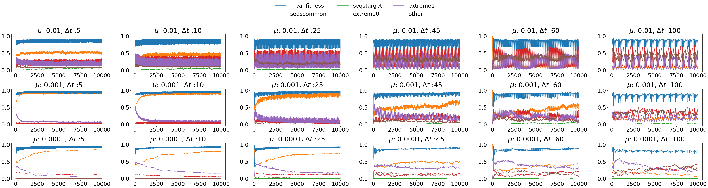
Initial conditions: target T1 and seqs at seqscommon with max prob in T0
Each point is averaged over 100 simulations with the same parameters
( no seqstarget increase in this case)
Simulation params:
N sample for fitness max = 10
N pop = 100
Fitness landscape = hamming

Slide 4
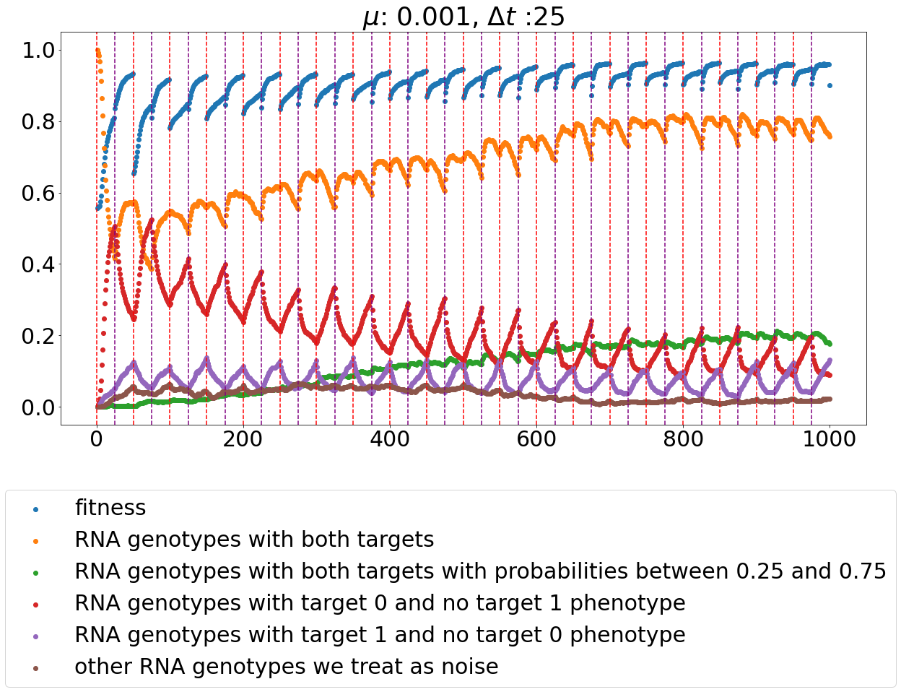
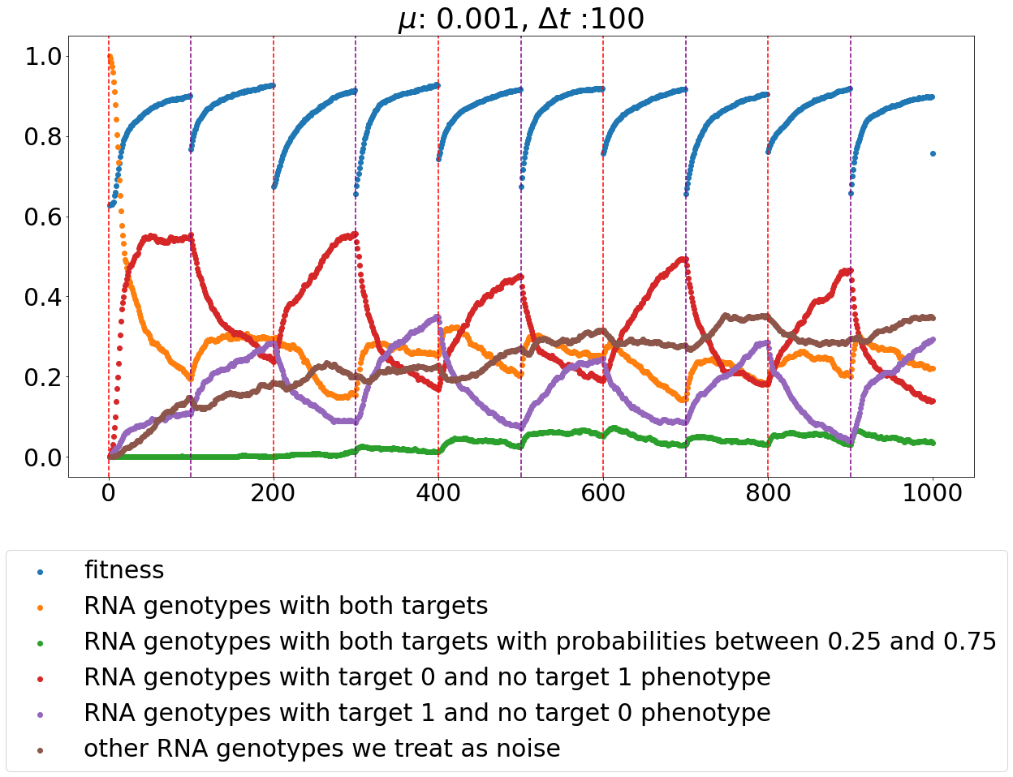
Special close-up examples
(Vertical lines are target flips)
T0
T0
T0 -> T1
T1 -> T0
…
T1 -> T0
T0 -> T1
…
generations
generations

Slide 5
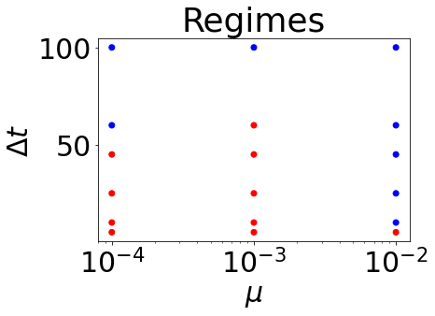
Dominating seqs are the represented as diff regimes blue: area extremes + area noise > area seqscommon + seqstarget red: area seqscommon + area seqstarget > area extremes + area noise
Initial conditions: target T0 and seqs at seqscommon with max prob in T1
Integral over the curve for each type of seq and compare the areas to see which one dominates over the tot evolutionary sim
In progress… collecting more points now.

