Slide 1
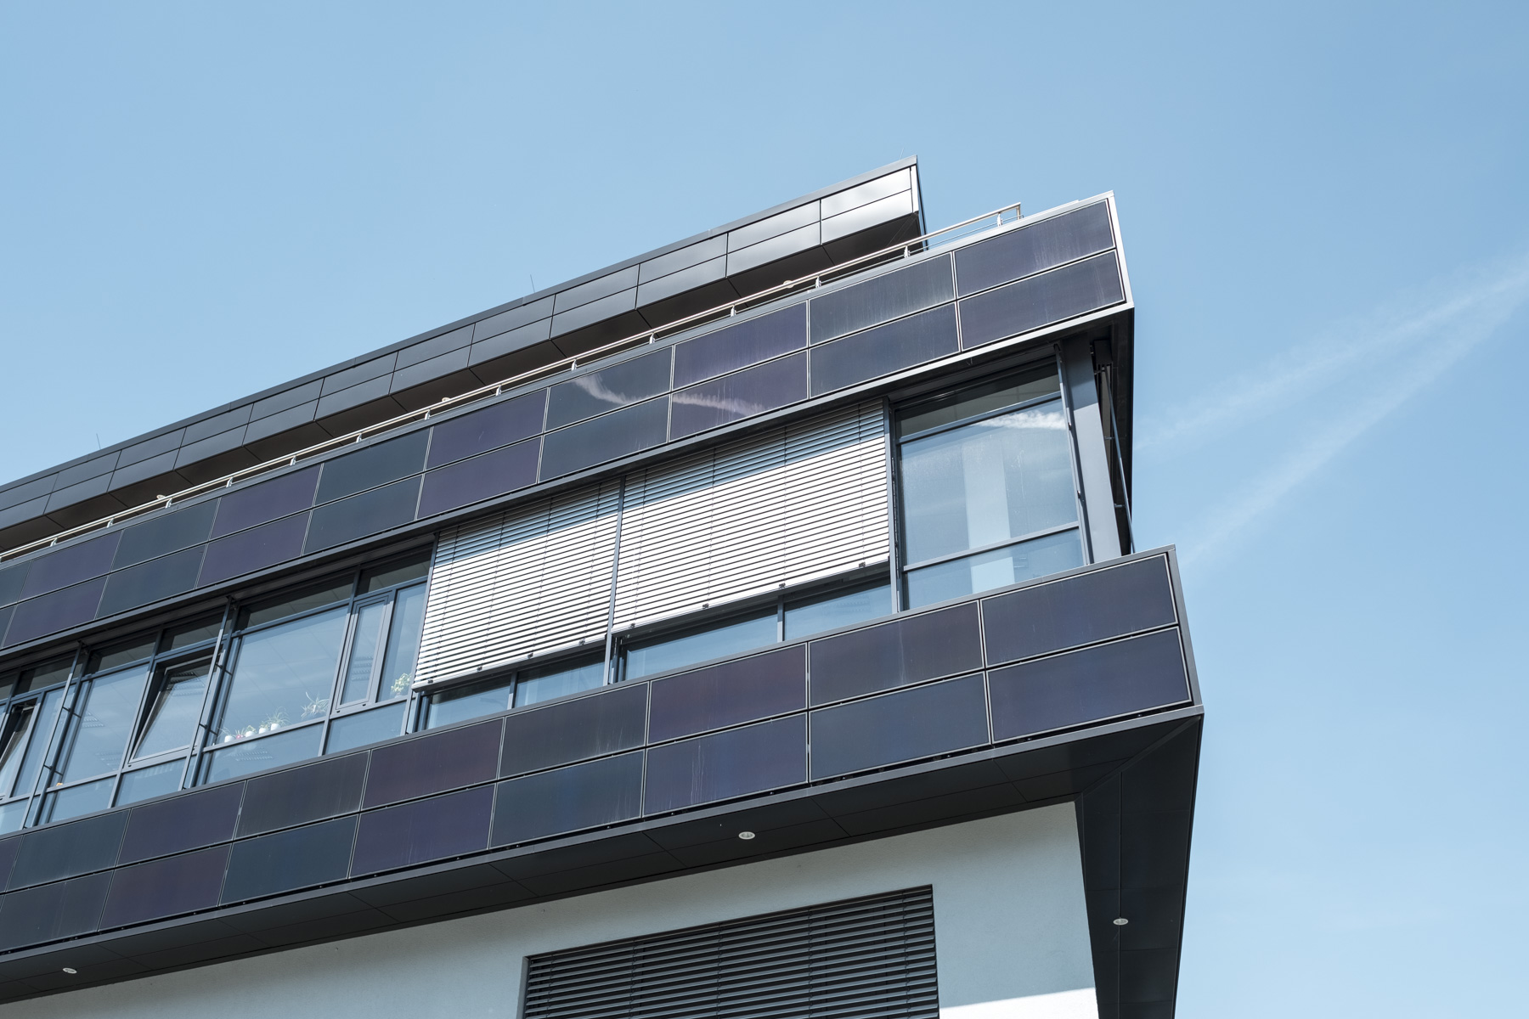
Introduction to Python
— Moritz Schiel
Notes:
<Foliennummer>

Slide 2
Workshop Agenda
Begrüßung
Tagesordnungspunkt 3
Diskussion
Tagesordnungspunkt 2
Tagesordnungspunkt 1
18.05.2022
Reiner Lemoine Institut
1

Slide 3




1. Programming at RLI
Version-control software
Integrated Development Environment
Python distribution
18.05.2022
Reiner Lemoine Institut
<Foliennummer>

Slide 4





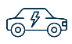
1. Programming at RLI
SMOOTH
€
SpiceEV
SMOOTH
SimBEV, ebus toolbox, Schienentool, etc.
18.05.2022
Reiner Lemoine Institut
<Foliennummer>

Slide 5
2. Python Use Cases
Running a python tool
Data analysis and visualization
Developing a python tool
Adding functions you need
Fitting the tool to your use case
18.05.2022
Reiner Lemoine Institut
<Foliennummer>
Notes:
Why is python good for these things?
<Foliennummer>

Slide 6
3. What do I have to learn?
Setup the software and environments
Read code
Repurpose existing code
Plan before writing
Trial and error
Debugging!
Use documentations
18.05.2022
Reiner Lemoine Institut
5

