Slide 1
Mission Tracker
Raciel Uzcanga
Paula Ricarte
Patricia Caamaño

Slide 2
Technologies Used
✔ Java & JSP
✔ MariaDB
✔ Apache Tomcat
✔ Maven
✔ Bootstrap
✔ Git & GitHub
Deploy in AWS (work in progess)

Slide 3
Key Features
some functionalities
Add, edit, delete and view astronauts
Manage space missions with full details
Filter and search by role or nationality
Responsive interface for all devices

Slide 4
GitHub Repository
🔗 https://github.com/paularicarte28/MissionTracker.git
tags
readme
releases
git ignore
git flow

Slide 5
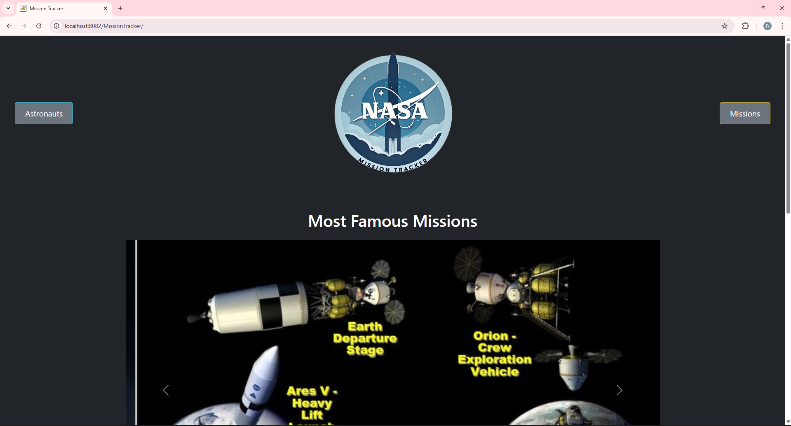
Home Page

Slide 6
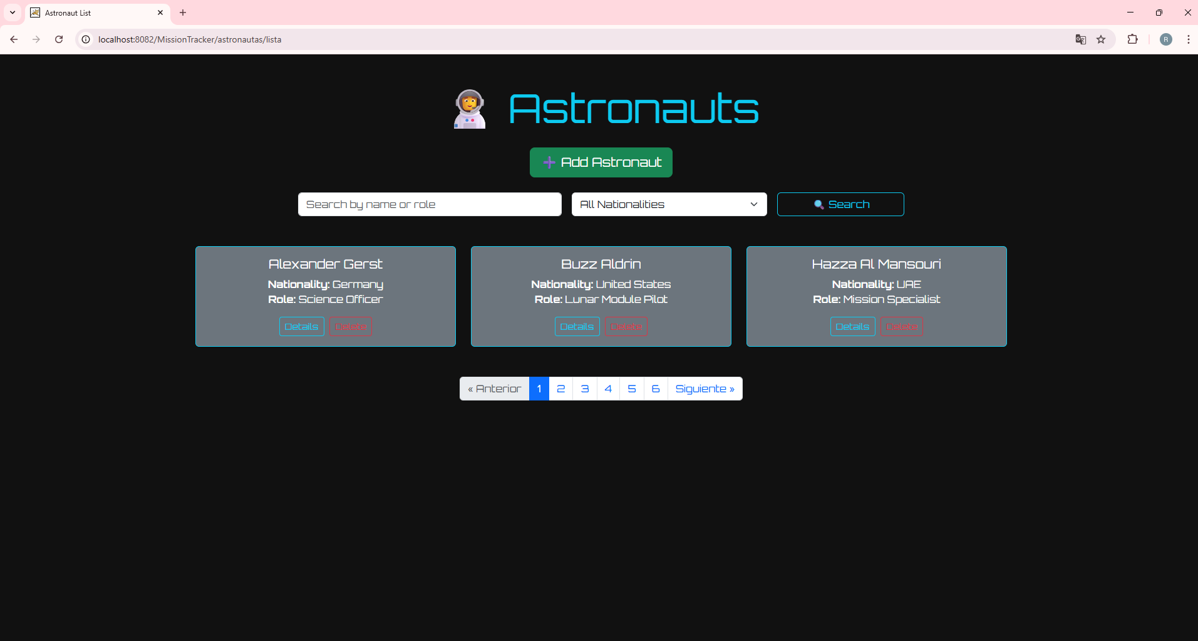
Astronaut List

Slide 7
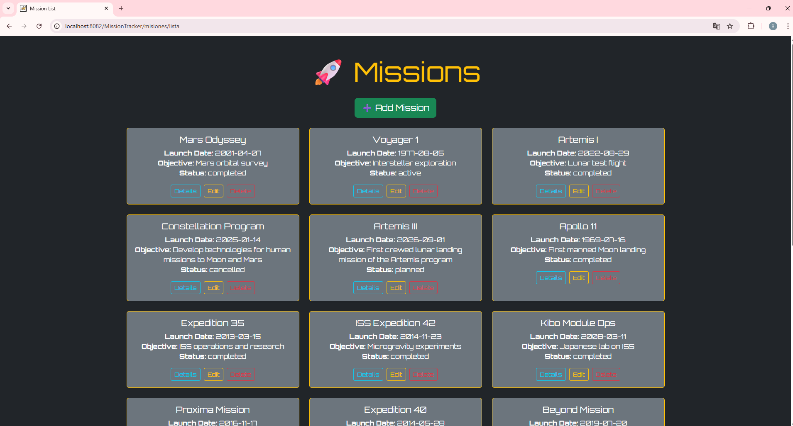
Mission List

Slide 8
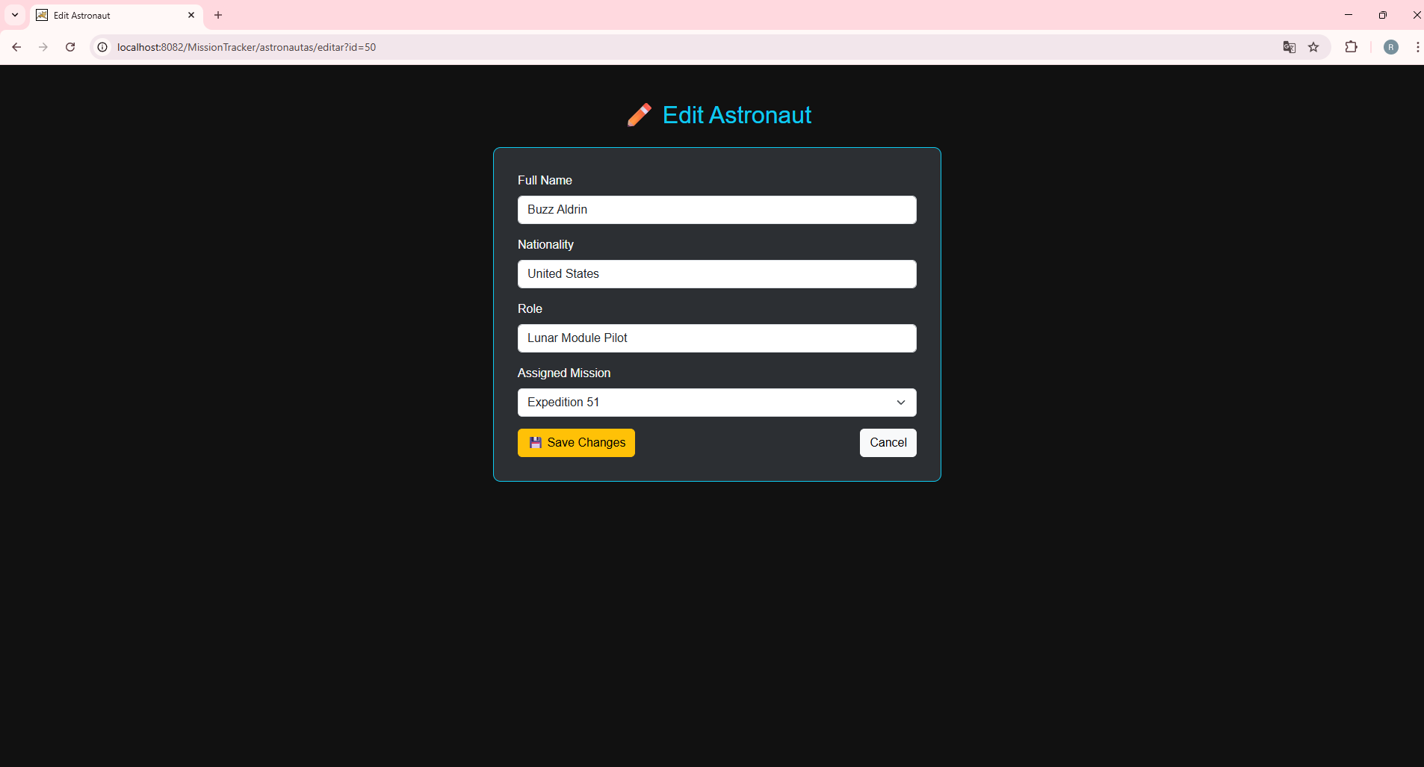
Astronaut Detail

Slide 9
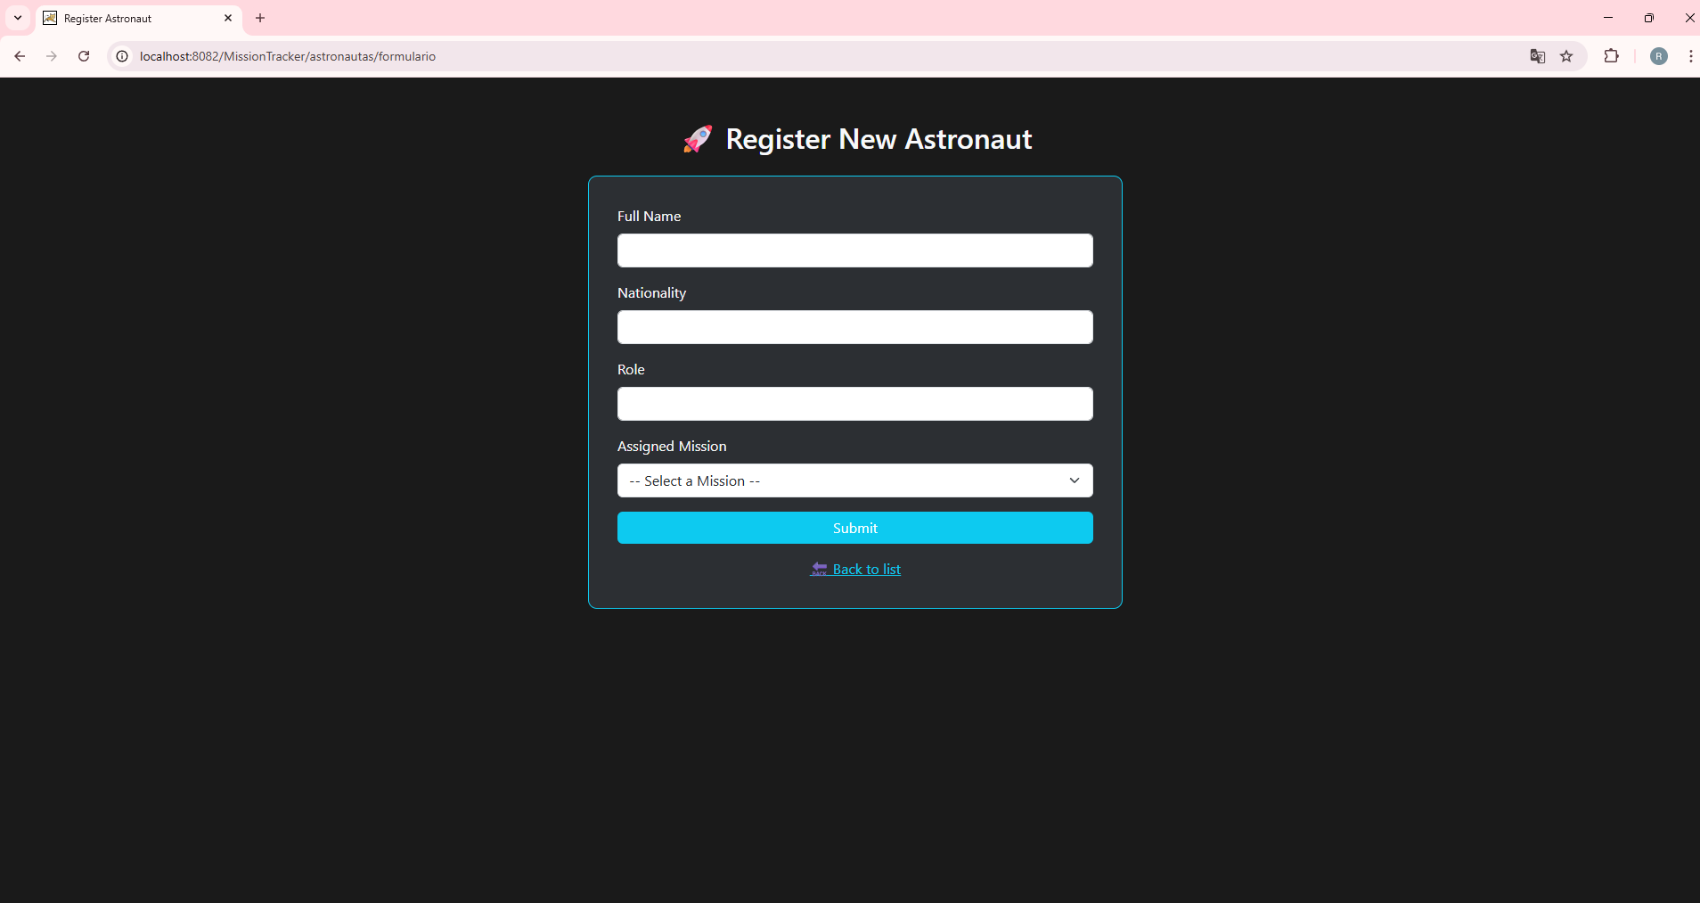
Edit Astronaut

Slide 10
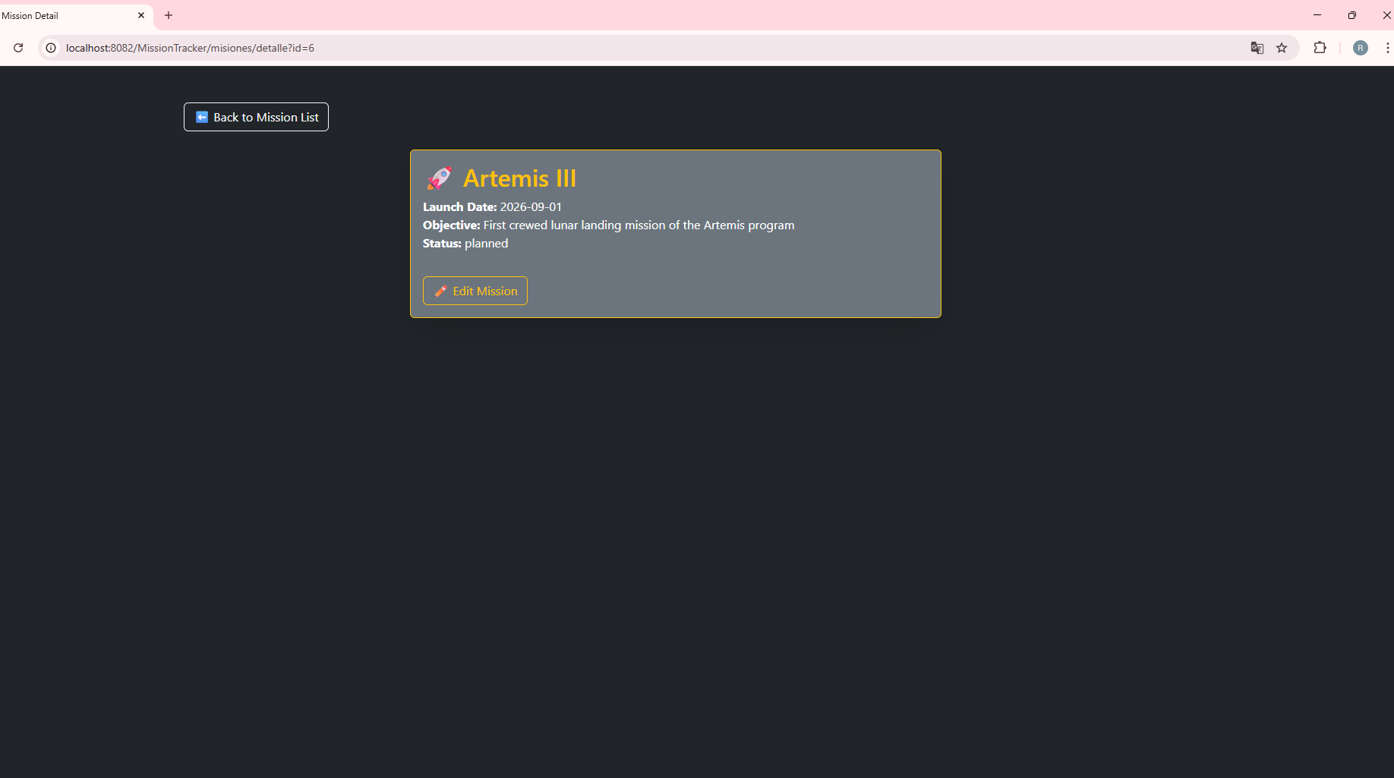
Register Astronaut

Slide 11
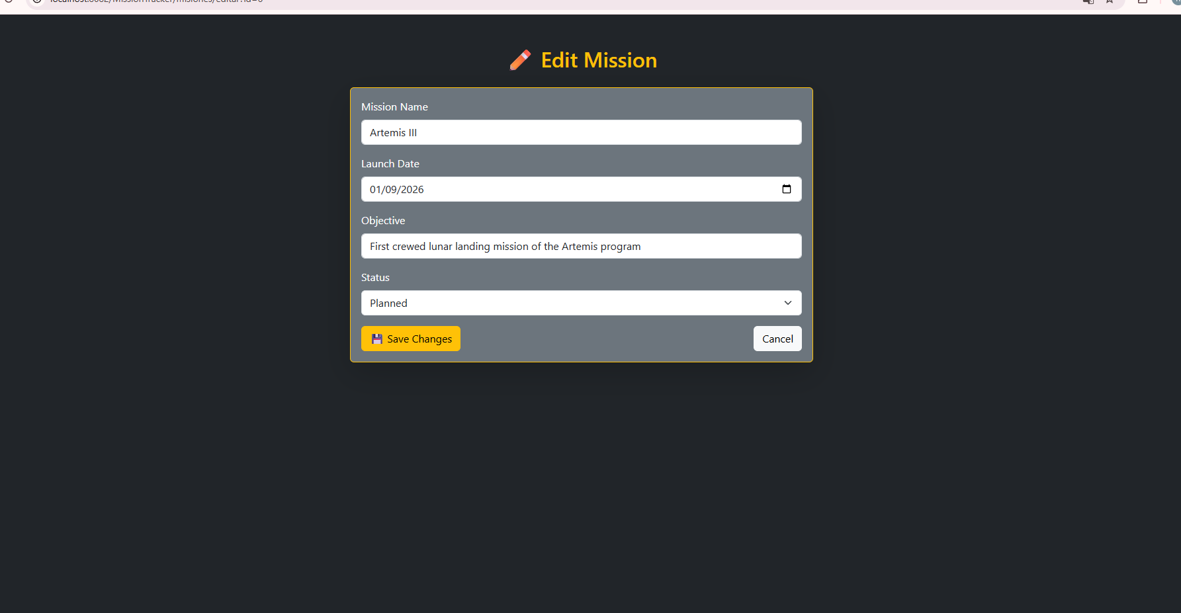
Mission Detail

Slide 12
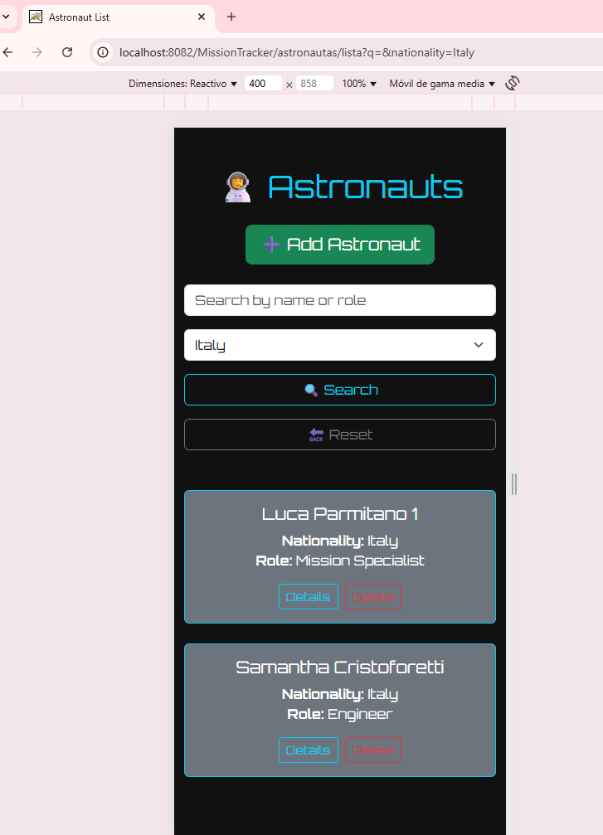
Edit Mission

Slide 13
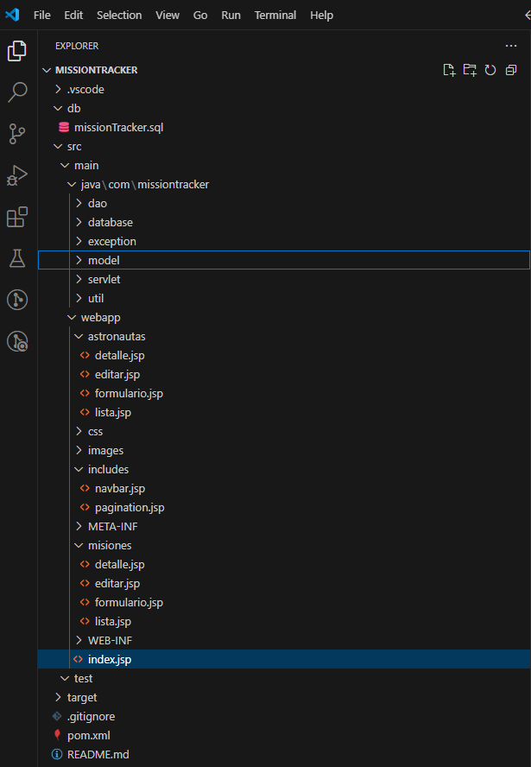
Project Structure

Slide 14
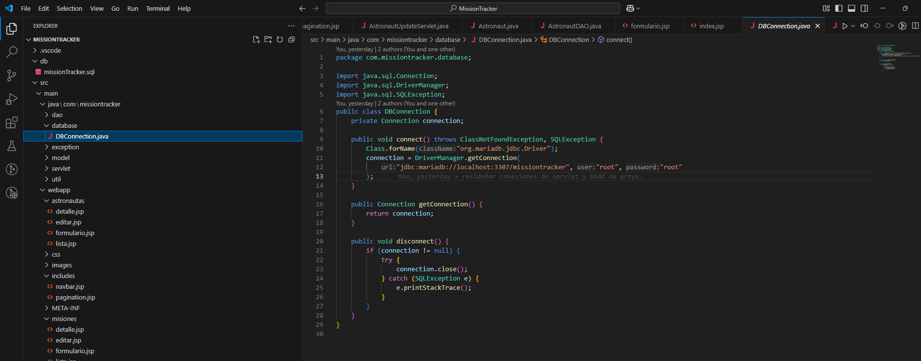
DB Connection Example

Slide 15
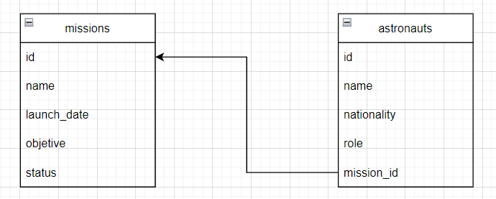
DIAGRAMA ENTIDAD RELACION

Slide 16
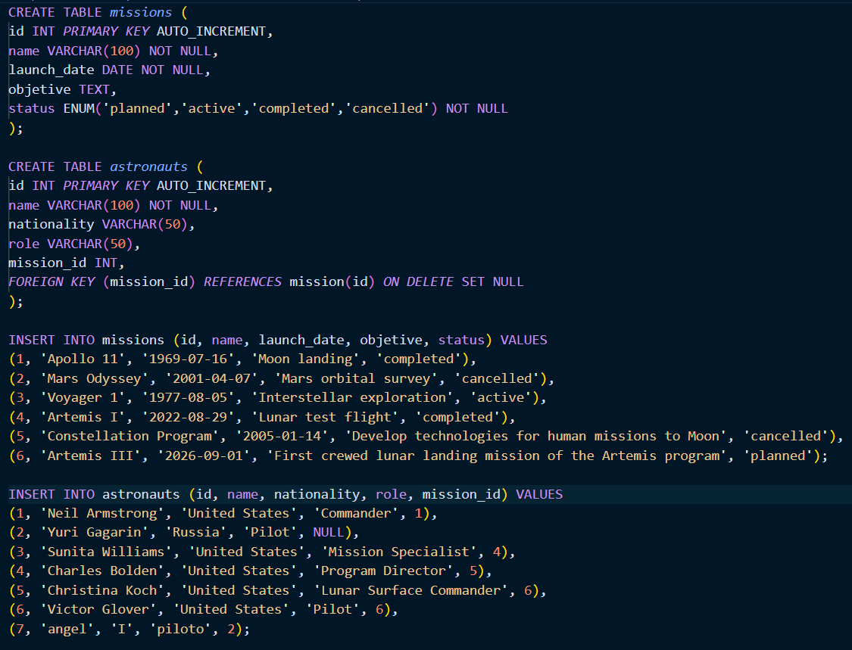
SCRIPTS

