Slide 1
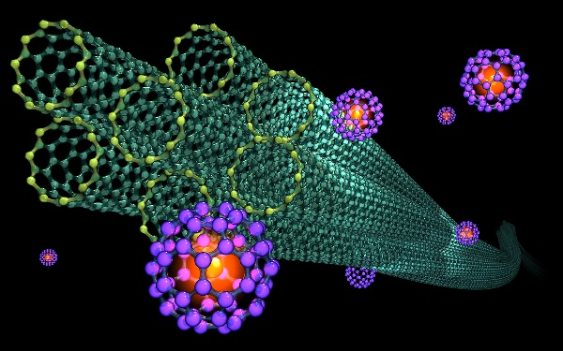
INTELLIGENT MATERIALS DISCOVERY
Arindam Paul

Slide 2

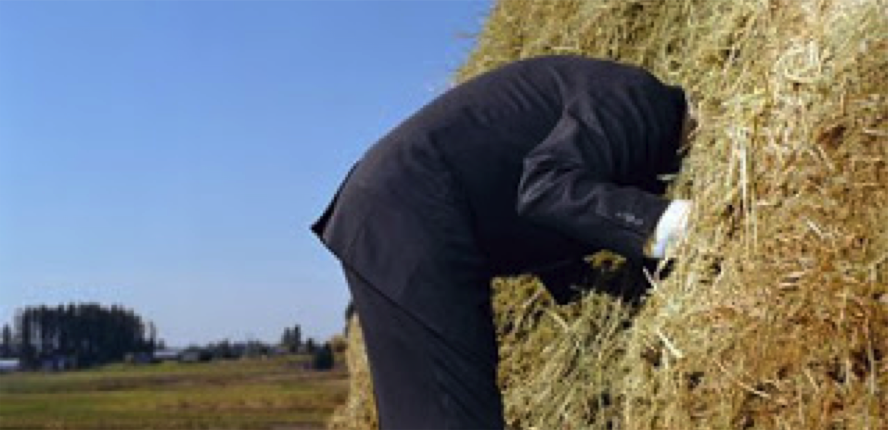

Slide 3
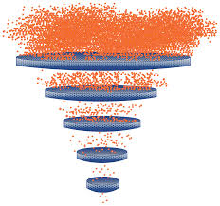

Slide 4



Slide 5


Slide 6


Slide 7


Slide 8
Does your anti-depressant always make you feel tired ? Its time to ask your doctor for ….

Slide 9
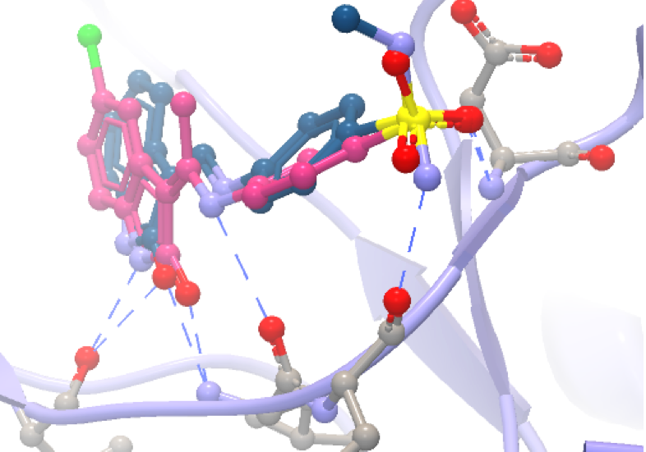

Slide 11
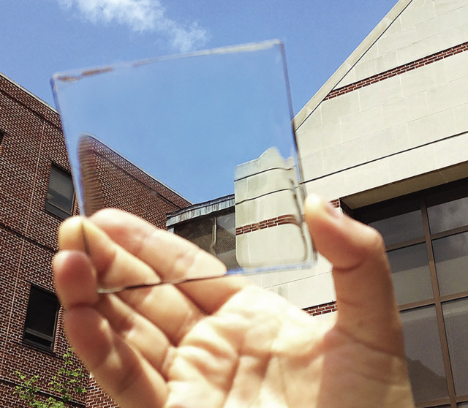

Slide 12
