Slide 1
The Viruses that Took Over the World
Paula Urteaga
Stacy Rodriguez
Anthony McNichols

Slide 2
Data Sources
Ebola
SARS
Coronavirus
Ebola 2014-2016 Outbreak Complete Dataset
SARS 2003 Outbreak Complete Dataset
Novel Coronavirus 2019 Dataset

Slide 3
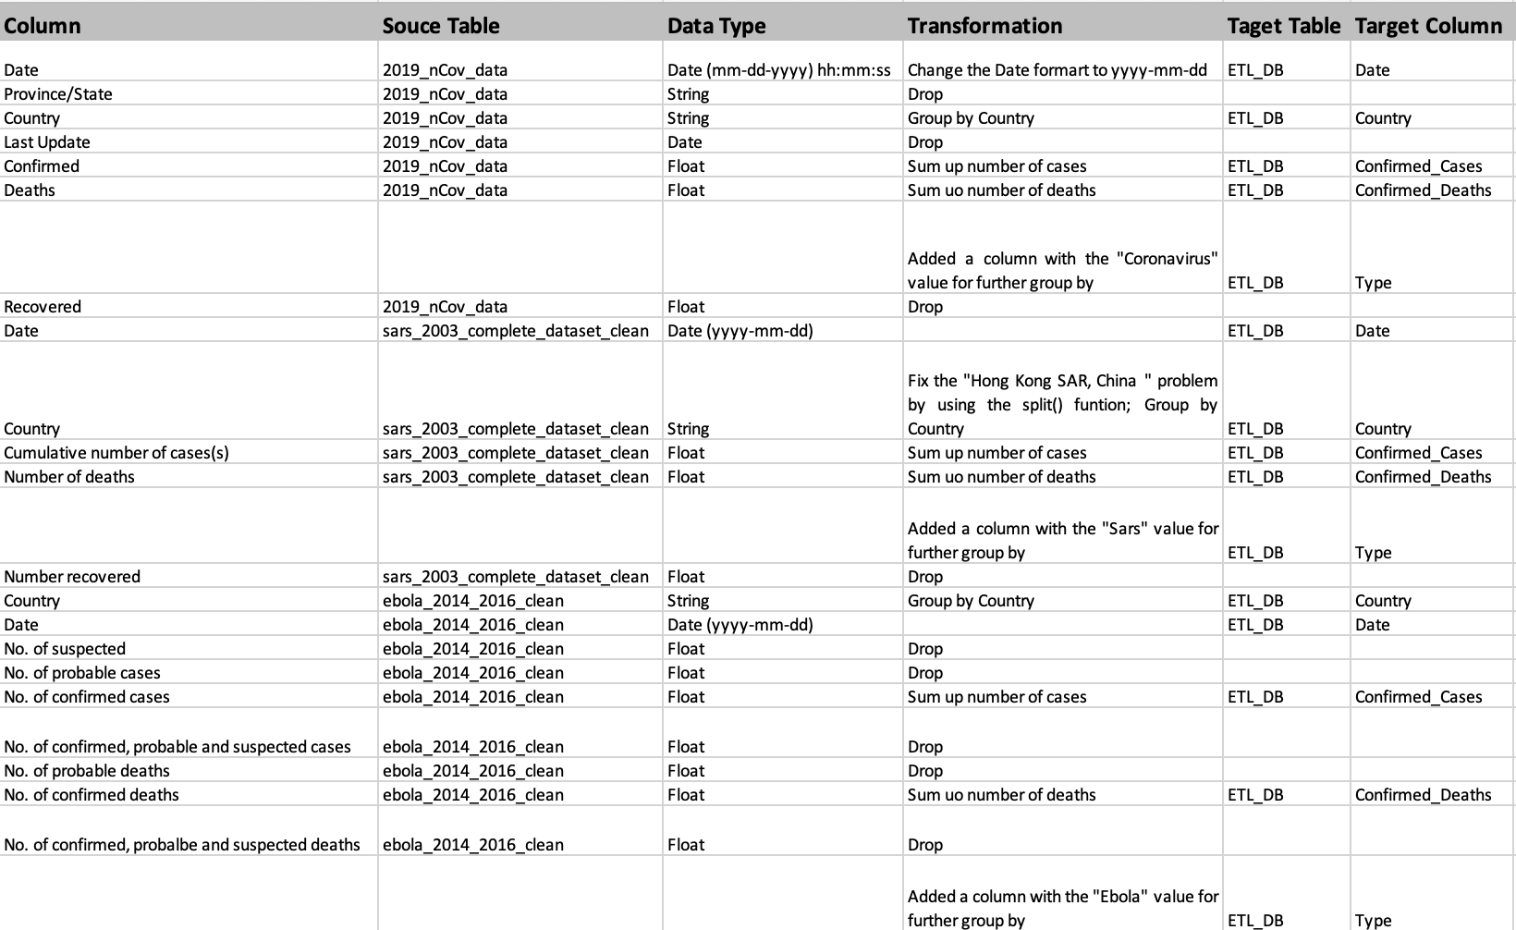
Transformations

Slide 4
Load
grouped.to_sql(name='Virus_data',con=engine, if_exists='append', index=True)

Slide 5
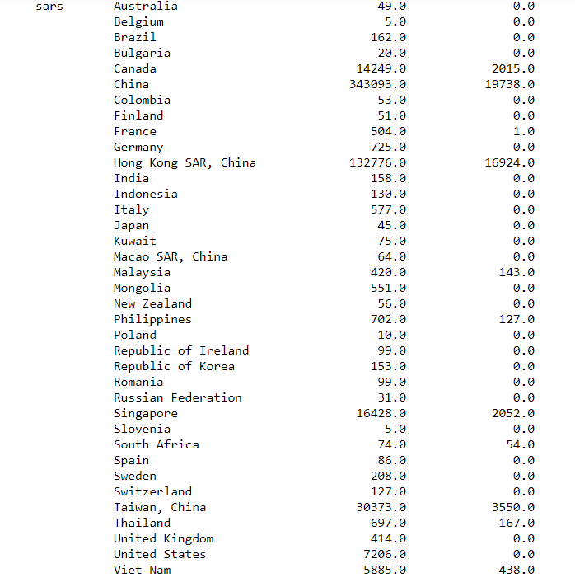
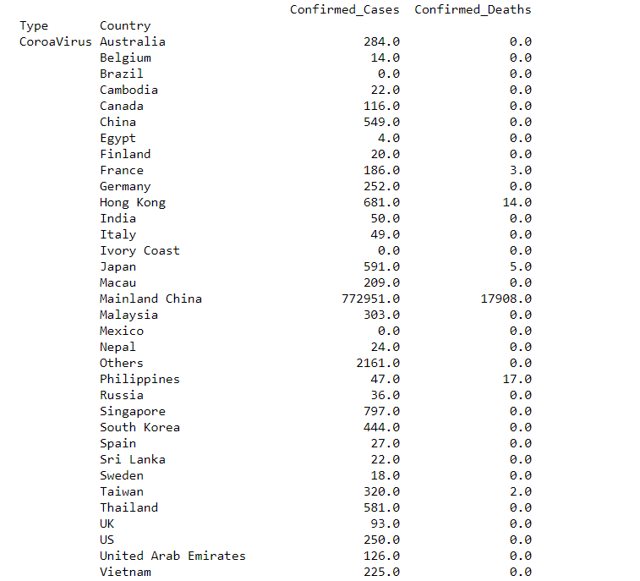
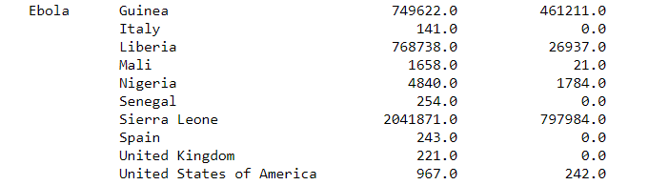

Slide 6
The End

