Slide 1


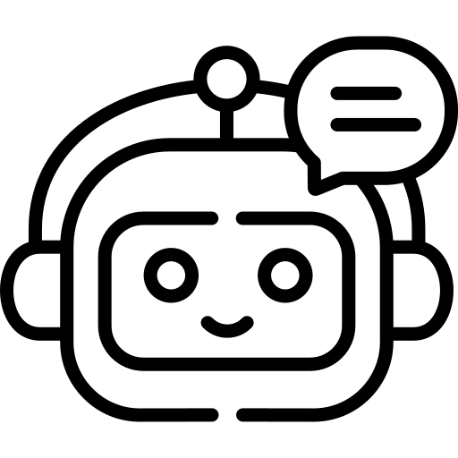


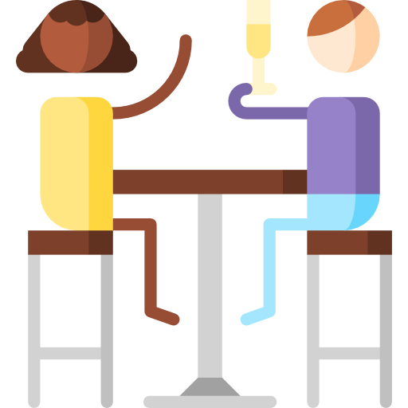
Spoken Dialogue Systems
SoSe 2023
Karan Bhanushali
Christine Oellbrunner
Paula Villavecchia Skrebba
Institut für maschinelle Sprachverarbeitung
Motivation and description
Calling all bar enthusiasts! Get ready to explore the vibrant bar scene in Stuttgart with our cutting-edge dialog system! Whether you're looking for a cozy spot to relax, a place with live music, or a budget-friendly option that matches your price range, BarGPT is at your service.
Our aim is to provide you with relevant information and personalized recommendations from about 123 amazing bars in Stuttgart, ensuring you have all the details you need to make an informed choice. Additionally, our system also offers a convenient reservation service, allowing you to secure a table effortlessly for you and your friends. Cheers!
Problems:
Domains are not constricted, leading to
limited textbased interactions
Add synonyms for all slots without overlap
Implementing new system act in all needed files
System cannot answer everything
Future work:
Real reservations
Expanding to multiple domains (restaurants, nightlife clubs, tourist highlights)
Adaption to different cities
Ngoc Thang Vu,
Dirk Väth,
Lindsey Vanderlyn
These are some of the bars which match your interests...
Phoenix Shisha Lounge
Havana Cafe & Cocktail Stuttgart
reBOOTS
…
Example:
Can you suggest me a bar with live music?
Implementation details
System acts: welcome, inform_byname, inform_alternatives, request, confirm, select, reqmore, bad, closingmsg, confreq, declinereq, returnSuggestion, makereservation
User acts: inform, negativeinform, request, hello, bye, thanks, affirm, deny, reqalts, ack, bad, confirm, selectdomain, suggest, makereservation
Example:
There is a bar called Biddy Earlys Irish Pub. What do you want to know about it?
Can I make a reservation?
I can reserve a table for you! On which day and time would you like to book a table?
Monday 7pm
Booking confimed for Biddy Earlys Irish Pub at monday 7pm
Biddy Earlys Irish Pub
Conclusion:
NLU
Beliefstate
Policy
NLG

