Slide 1

MSc EMERGING DIGITAL TECHNOLOGIES · UCL × KNIGHT FRANK
Estimating UK Retail Car-Park Occupancy from High-Resolution Aerial Imagery
A domain-adapted object-detection approach
Paula Xho Vilajeti · Academic supervisor: Dr David Vidal Tomas · Industrial supervisor: Toby Merritt, Knight Frank
Notes:
TITLE LAYOUT. Replace the dashed box with the official Knight Frank logo (top-left). Swap the placeholder green/gold accent for the official KF colours. Serif headline = Cambria stand-in for KF Domaine/New Baskerville.

Slide 2
AGENDA
What we'll cover
01
The problem & background — occupancy as a retail-activity signal
02
The approach & data — learn broadly, then adapt to the UK
03
Training the model — the pipeline, step by step
04
Testing on UK data — three experiments, scored fairly
05
Results — detection, counting & occupancy
06
Counting & occupancy — turning boxes into a trusted number
07
Where demand sits — the within-lot geography, and next steps
UK CAR-PARK OCCUPANCY
01
Notes:
Roadmap. Problem, approach, the build steps, testing, results, and where it goes.

Slide 3
SECTION 01
The Problem & Background
Why car-park occupancy is worth measuring — and why it is hard.
Notes:
Set up the commercial question and the technical obstacle.

Slide 4
THE OPPORTUNITY
How busy is a store — and could we tell from above?
How busy a store is — its footfall — is valuable information for retail and real-estate, but it is hard and expensive to measure.
In-store sensors must be fitted store by store; mobile-location data is patchy and hard to compare fairly across a whole portfolio.
For most out-of-town and edge-of-centre stores, the car park is the front door: it fills when trade is brisk and empties when it is slow.
SO WHAT
Car-park occupancy is a practical stand-in for how busy a store is — if we can measure it reliably, and at scale.
Notes:
The commercial hook. Footfall drives value but is awkward to measure and to compare across a portfolio. The car park is the customer gateway, so watching it fill and empty is an indirect but informative signal of trade. The whole project rests on this: occupancy as a proxy for how busy a store is — provided we can measure it reliably and at scale, which is the technical challenge.

Slide 5
THE IDEA
Measure it from the sky — hundreds of sites, one system
Rather than fitting equipment at every store, a single system can observe hundreds of car parks from above — and turn each image into one simple, comparable number.
→
→
01
02
03
Aerial image
Count the cars
Occupancy
of the car park, from above
find every vehicle in the image
cars ÷ capacity = how full
Do it consistently and any two stores can be compared on equal terms — the whole point for a portfolio.
Notes:
The concept in one line: photo in, occupancy out. Three plain steps — find the cars, count them, divide by capacity. The prize is scale and consistency: one system across hundreds of sites, comparable on equal terms. The next few slides are about the one hard part — reliably finding the cars.

Slide 6
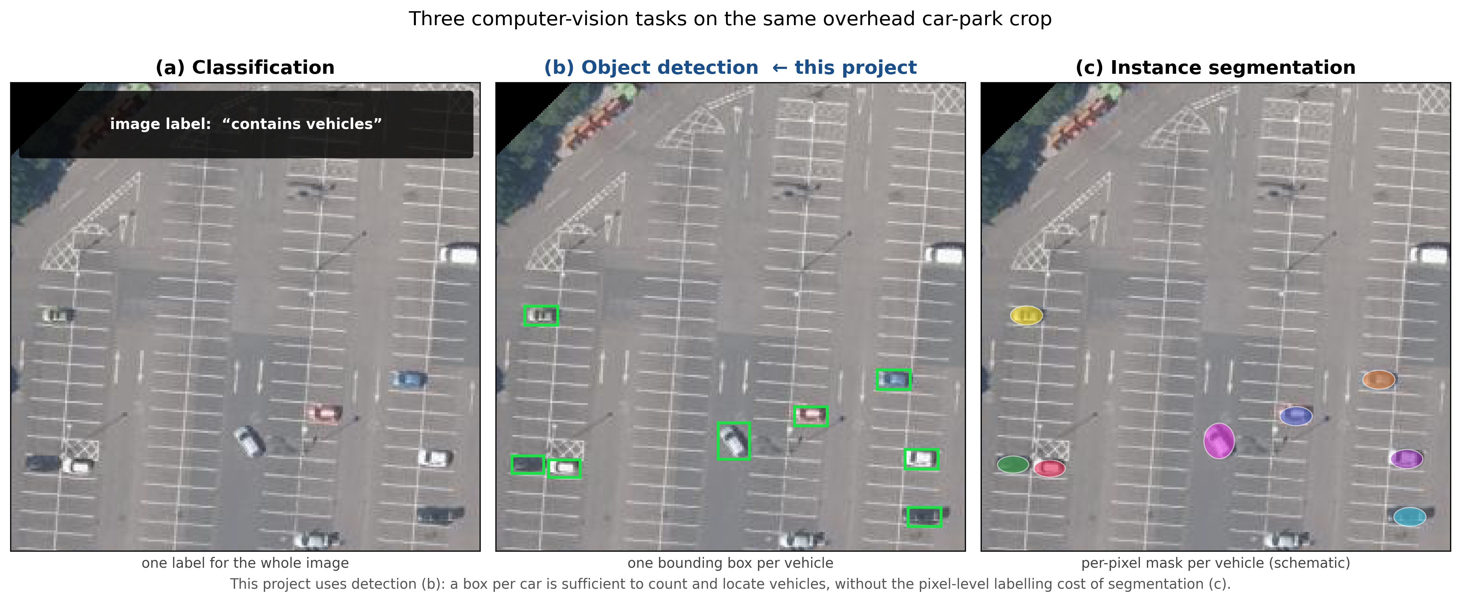
BACKGROUND · THE TECHNOLOGY
What is “object detection”?
Object detection is the computer-vision task of finding each object in an image and drawing a box around it — here, every car.
Two families dominate. Fast “one-look” detectors (the YOLO family) scan the whole image in a single pass; slower two-step detectors (the R-CNN family) are a little more accurate but much heavier.
For scanning many large aerial images at reasonable cost, speed and simplicity win — so this project builds on YOLO (specifically YOLOv8).
Detection = one box drawn around each car.
Notes:
Keep this plain. Detection finds and boxes each object. Name the two model families without going deep: YOLO is fast and single-pass (what we use); R-CNN is accurate but heavier. For lots of big aerial images, YOLO's speed is the right trade-off.

Slide 7
THE CHALLENGE
Why reading the photo is genuinely hard
01
02
03
Cars are tiny
Resolution decides
No UK data
From directly above, a car is only a handful of pixels — easily missed, or merged with its neighbour.
How sharp the image is largely decides whether a car can be seen at all. Coarse satellite imagery is not enough.
No ready-made dataset covers UK car parks, so a detector trained on foreign imagery cannot be assumed to work here.
These three are exactly why earlier attempts struggled — and what the approach is designed to overcome.
Notes:
Three obstacles, plainly. Small size, image sharpness, and the missing UK data. The prior UK attempt used coarse satellite imagery and detected only ~11% of cars — the resolution point in action.

Slide 8
SECTION 02
The Approach & Data
Learn what a car looks like from above — then teach it UK car parks.
Notes:
The strategy and the datasets behind it.

Slide 9
THE APPROACH
Learn broadly, then adapt to the UK
→
1 · Learn broadly
2 · Adapt locally
Train the detector on large public collections of overhead car images from the US and Europe, all matched to our image sharpness (~25 cm per pixel).
Fine-tune it on a small, purpose-built set of 30 hand-labelled UK retail car parks — the target it will actually be used on.
A little local data does most of the work — the central practical finding of the project.
Notes:
Two moves: learn what a car looks like from above using existing data, then teach it UK car parks with a small hand-labelled set. Emphasise that the local step is small but decisive.

Slide 10
THE DATA · SOURCES
Two very different training sources
COWC — United States
VEDAI — Europe
Dense, crowded car parks: the tightly packed, overlapping condition that most resembles UK retail. Our main teacher for the hard case.
Sparse, rural scenes with few vehicles per image. Broadens what the model has seen, but deliberately avoids the dense case.
Using both — matched to the same image sharpness — gives the detector the widest, most relevant experience before it ever sees UK data.
Notes:
[INSERT under §02 The Approach] Why two datasets: COWC teaches the dense/occluded case that looks like UK retail; VEDAI adds breadth. Both are resolution-matched.

Slide 11
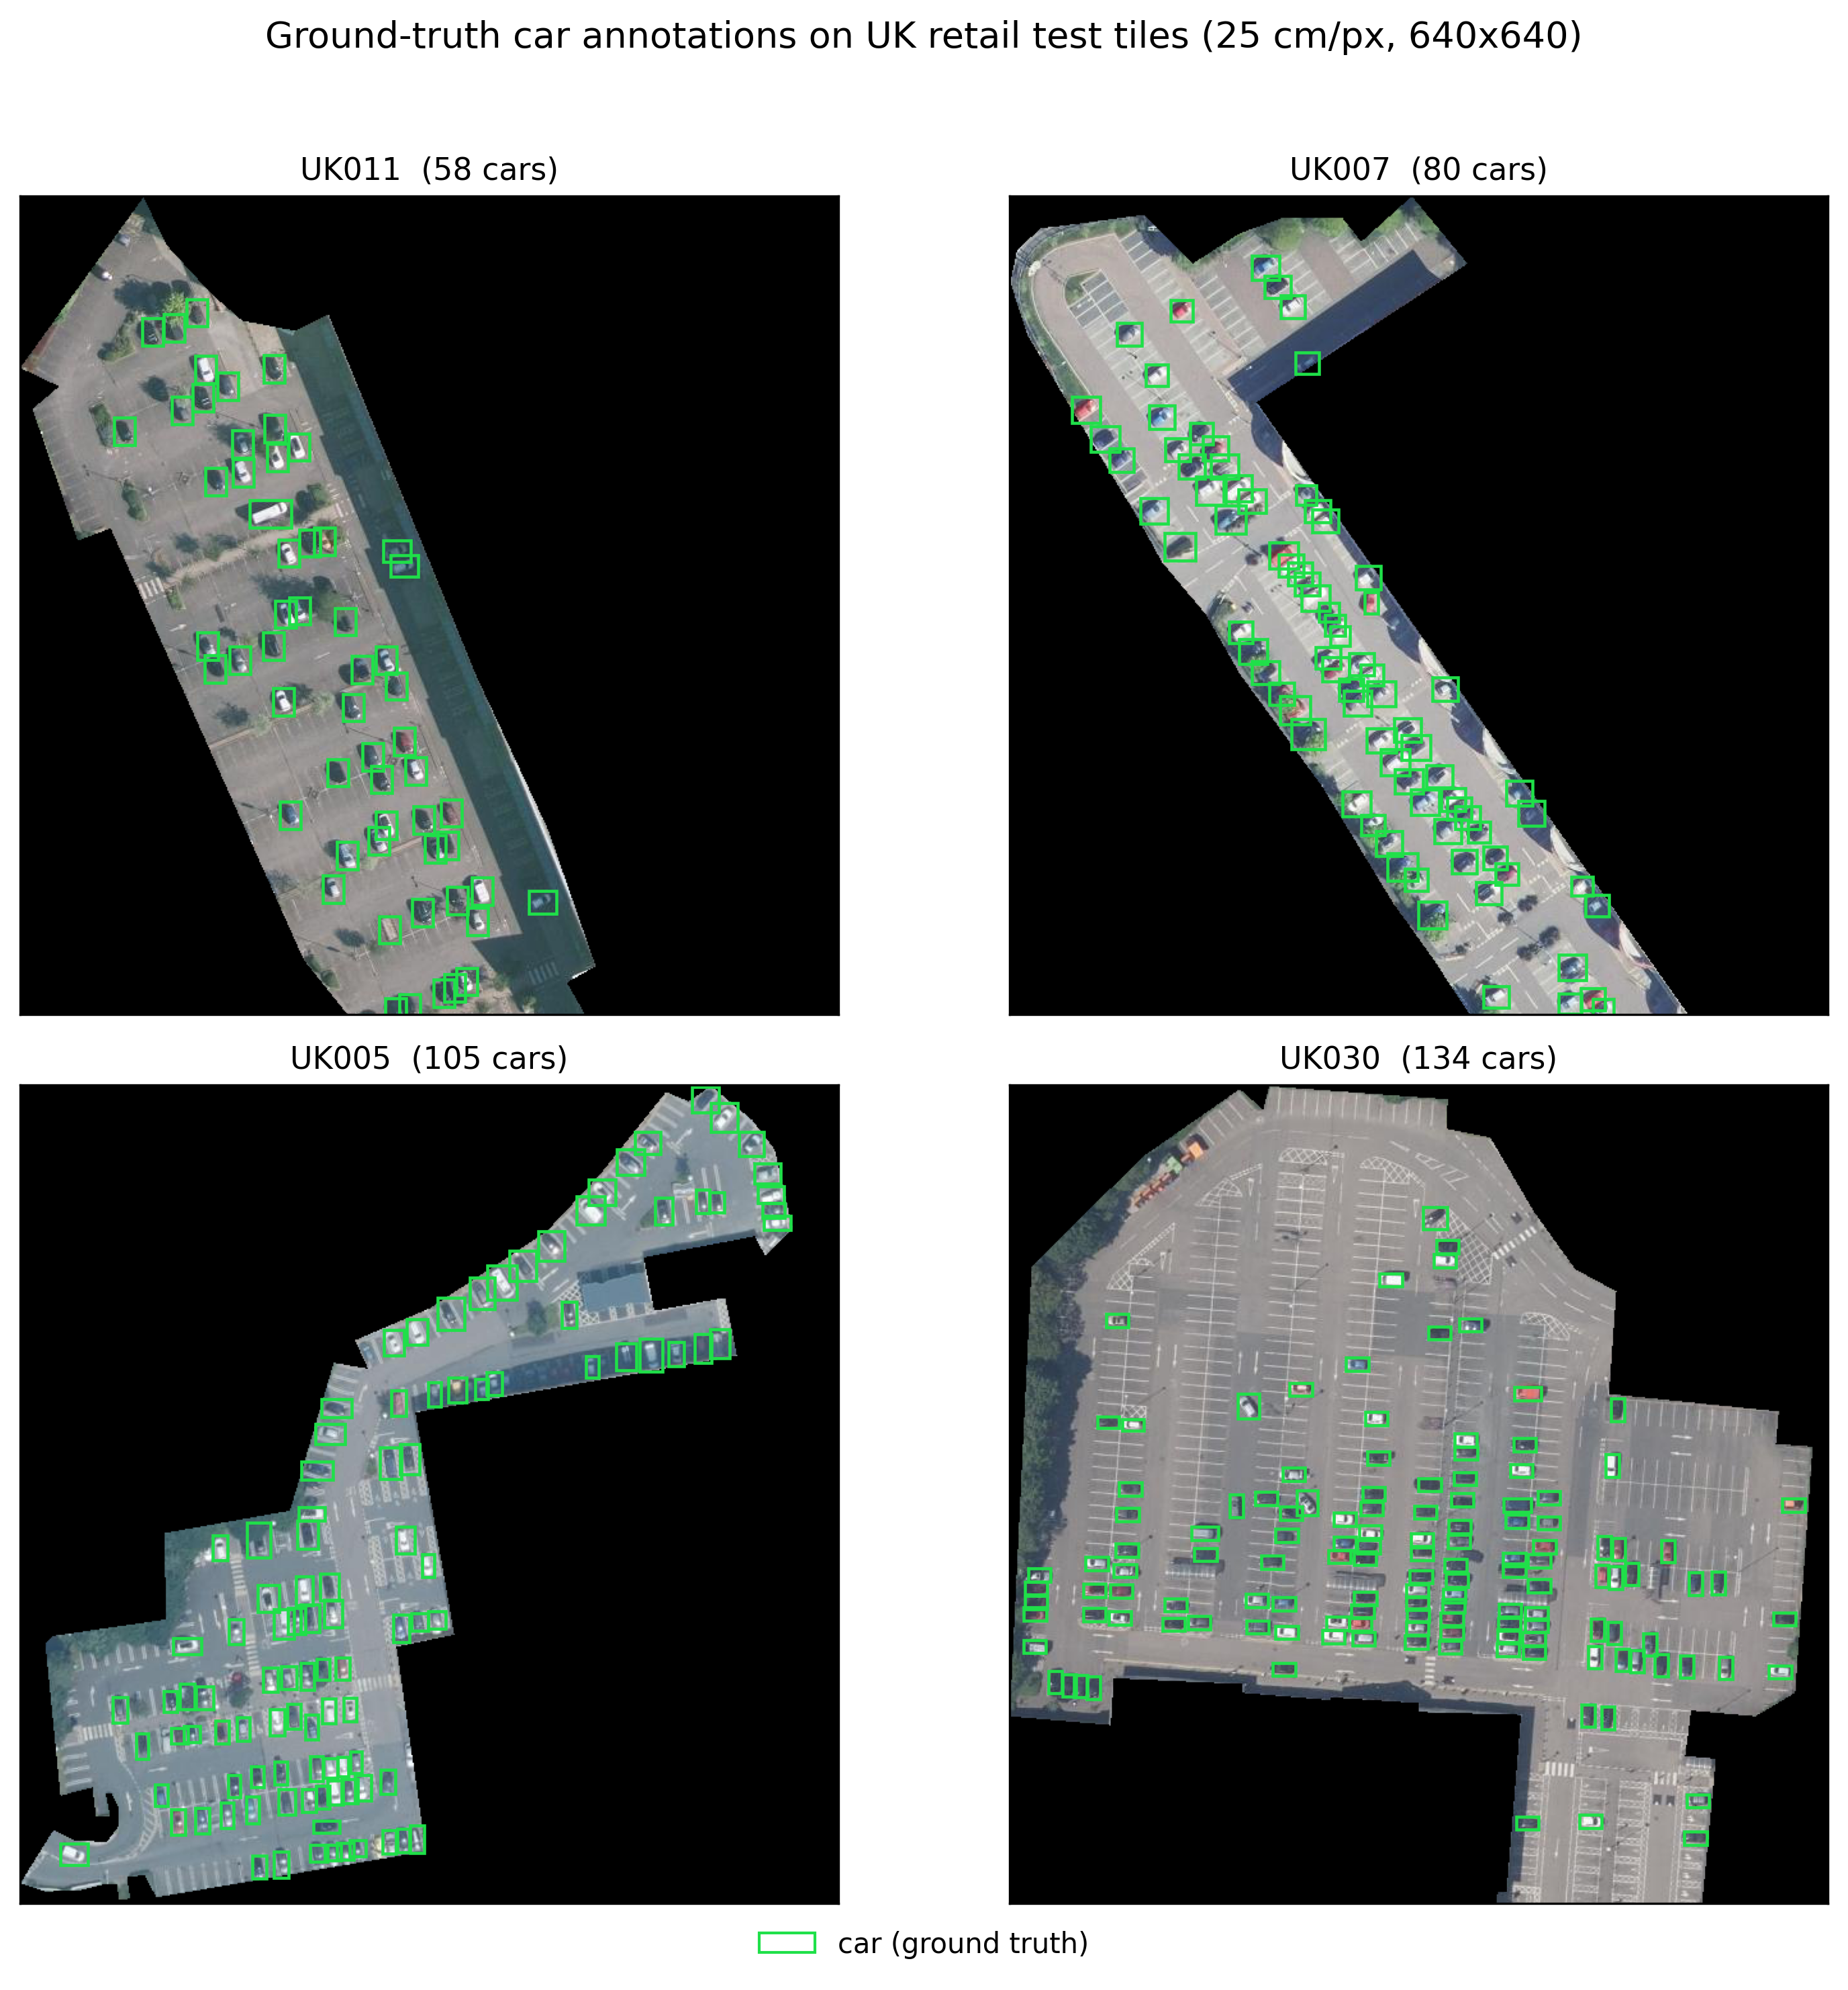
THE DATA · UK GROUND TRUTH
A purpose-built UK dataset — labelled by hand
Thirty UK supermarket car parks — Aldi, Asda, Tesco, Sainsbury's, Lidl, Morrisons and more — chosen to span retailers and lot sizes.
Each car-park boundary was clipped from aerial imagery, then every visible car was boxed by hand in a labelling tool.
This hand-checked set is both what we teach the model on and the honest benchmark it is judged against.
Every car hand-verified, across sparse to full lots.
Notes:
[INSERT under the 'Manually Annotated UK retail dataset' section] The manual labelling stage you showed last time — 30 sites, every car boxed by hand.

Slide 12
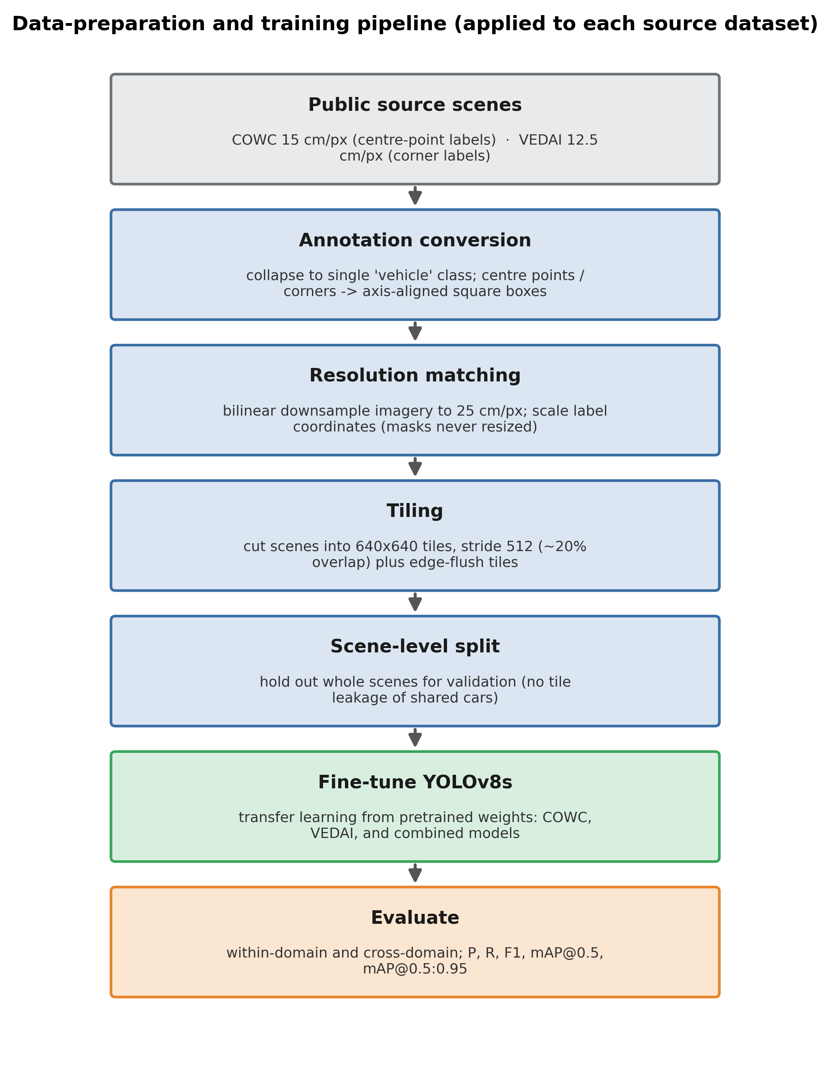
THE APPROACH · PIPELINE
The pipeline at a glance
Every image — public or UK — flows through the same seven steps.
Prepare the labels, match the sharpness, tile the scene, split it fairly, fine-tune, then evaluate.
The next few slides walk through each step in plain terms.
UK CAR-PARK OCCUPANCY
09
Notes:
Orientation slide. Show the whole pipeline once, then unpack each box. Same recipe applied to every data source.

Slide 13
SECTION 03
Training the Model
How raw aerial images become a detector that works on UK car parks.
Notes:
The build, step by step. Non-technical but complete.

Slide 14
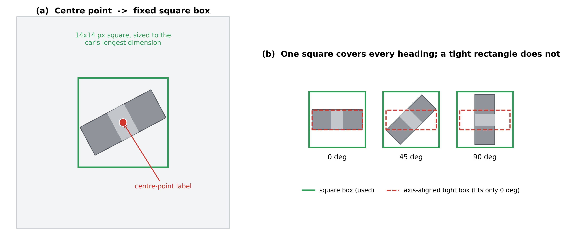
TRAINING · STEP 1
Turning marks into boxes the model can learn from
The public data marks each car with a single dot, not a box — but the detector needs boxes to learn from.
So we centre a fixed-size square on each dot. A square, not a rectangle, because cars sit at every angle and a square fits any heading equally.
We sized it on densely parked rows: large enough to cover a car, small enough not to swallow its neighbour.
A fixed square, centred on each car.
Notes:
[INSERT under §03 Training] Box conversion — the first prep step. Dots -> squares; square is rotation-agnostic.

Slide 15
TRAINING · STEP 2
Matching the image sharpness
The public images are sharper than ours, so we down-sample them to the same ~25 cm per pixel as the UK imagery.
The model should learn cars at the exact sharpness it will meet in use — and 25 cm sits in the range where cars stay clearly detectable.
Coarser satellite imagery falls off an accuracy cliff — which is precisely where earlier UK work failed.
WHY IT MATTERS
Same sharpness in training and in use means no nasty surprises at deployment.
Notes:
[INSERT under §03 Training] Resolution matching. Train at the sharpness you deploy at; 25 cm is the sweet spot.

Slide 16
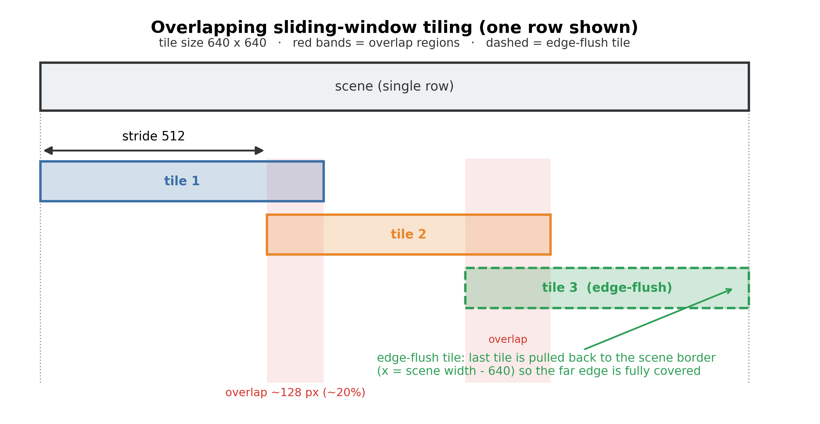
TRAINING · STEP 3
Cutting big scenes into bite-sized tiles
Aerial scenes are far too large for the detector to read in one go, so each is cut into small, overlapping tiles.
The overlap — plus an extra tile flush to each edge — guarantees every car appears whole in at least one tile, so nothing is lost at a seam.
Overlapping tiles, with full edge coverage.
Notes:
[INSERT under §03 Training] Tiling with overlap so no vehicle is cut in half at a boundary.

Slide 17
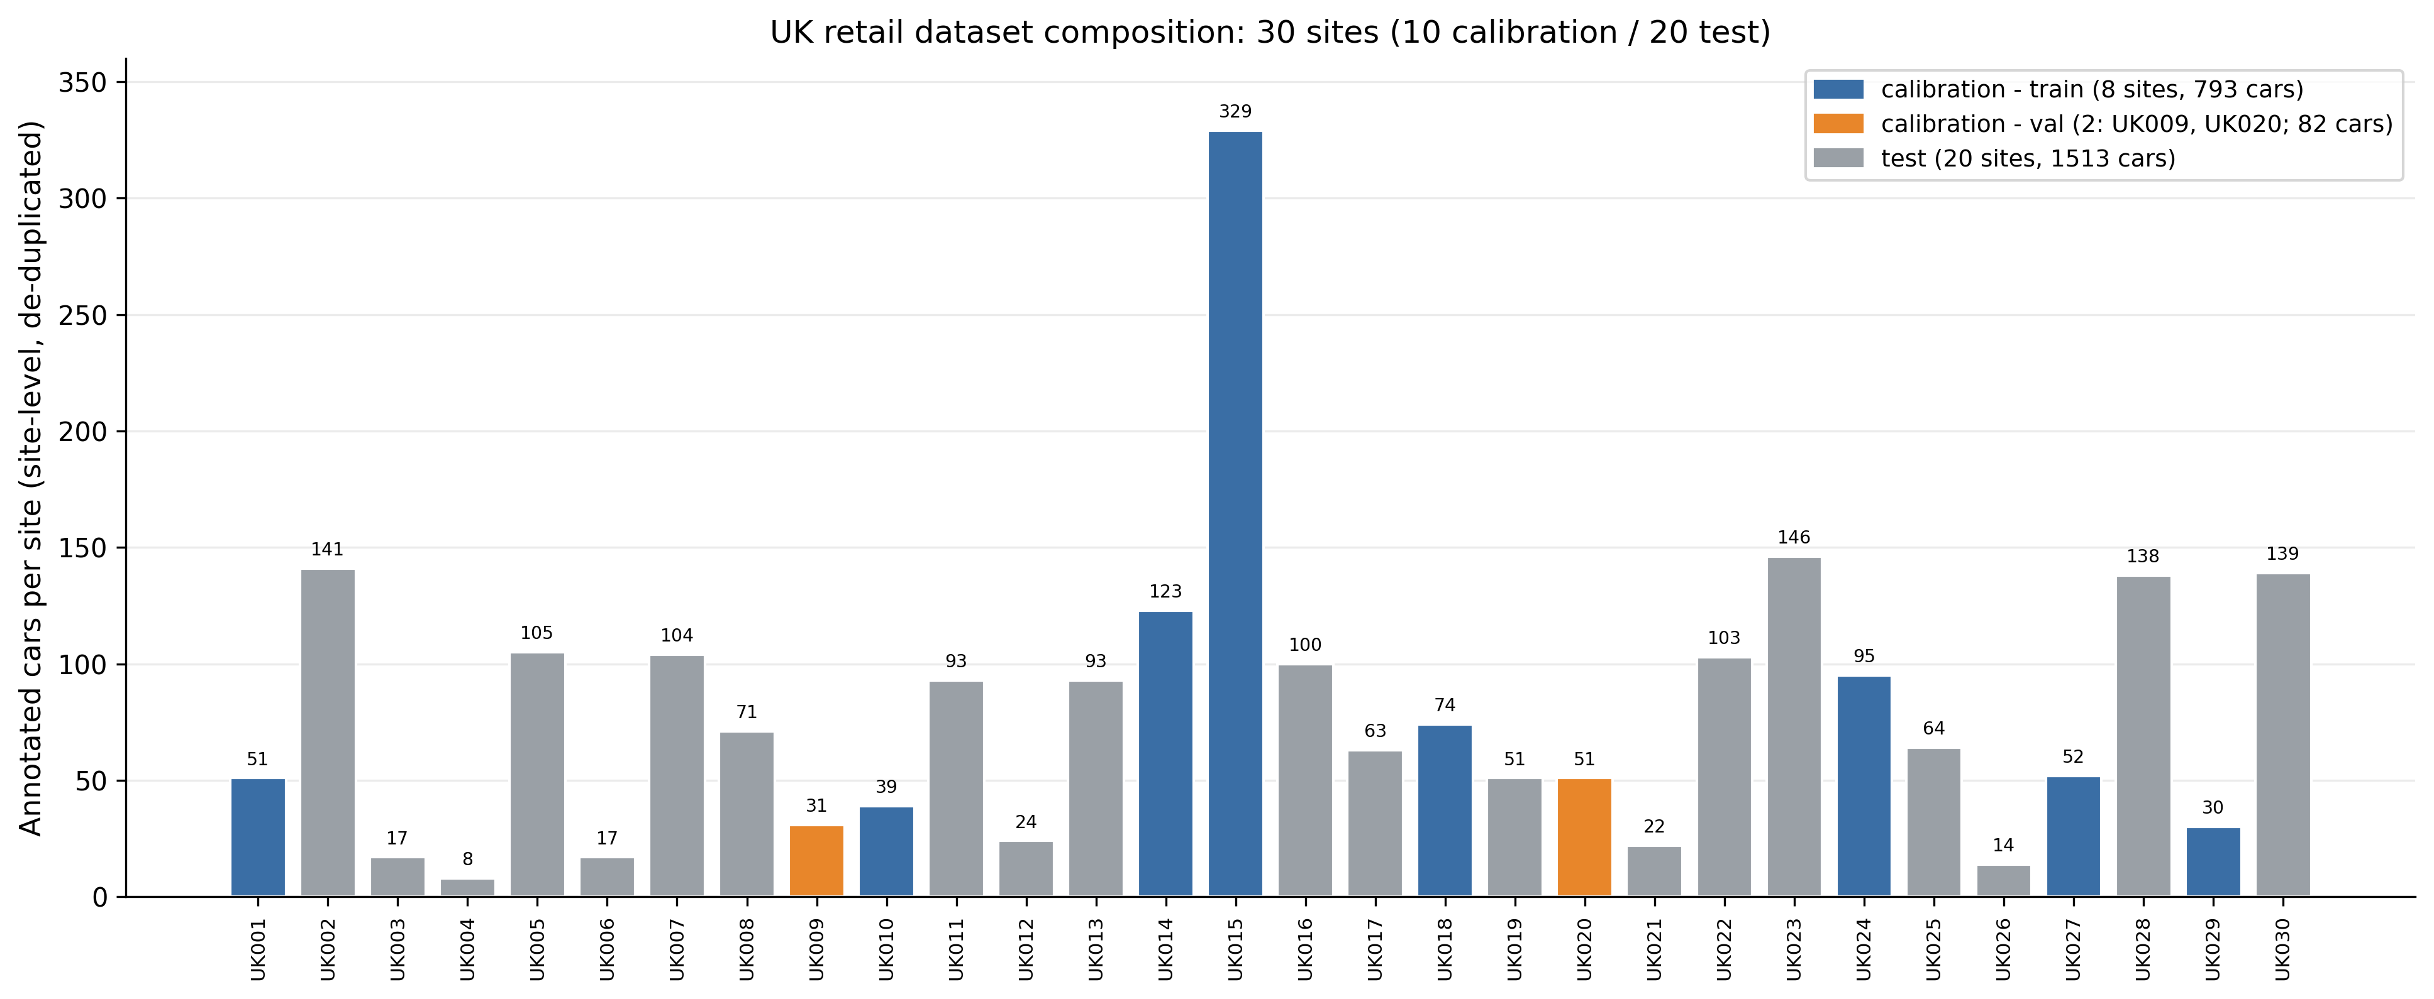
TRAINING · STEP 4
Keeping the test honest
Training and testing data are separated by whole site — never by tile — so the model is never quietly tested on a car park it also trained on.
Just eight sites are used to fine-tune, two to calibrate, and twenty are held back purely for testing — frozen before we saw any accuracy.
UK dataset composition: 30 sites — 8 fine-tune, 2 calibration, 20 held-out test.
13
Notes:
Site-level, frozen split — no tile leakage, no cherry-picking. The composition chart shows how few labelled sites the training actually needs.

Slide 18
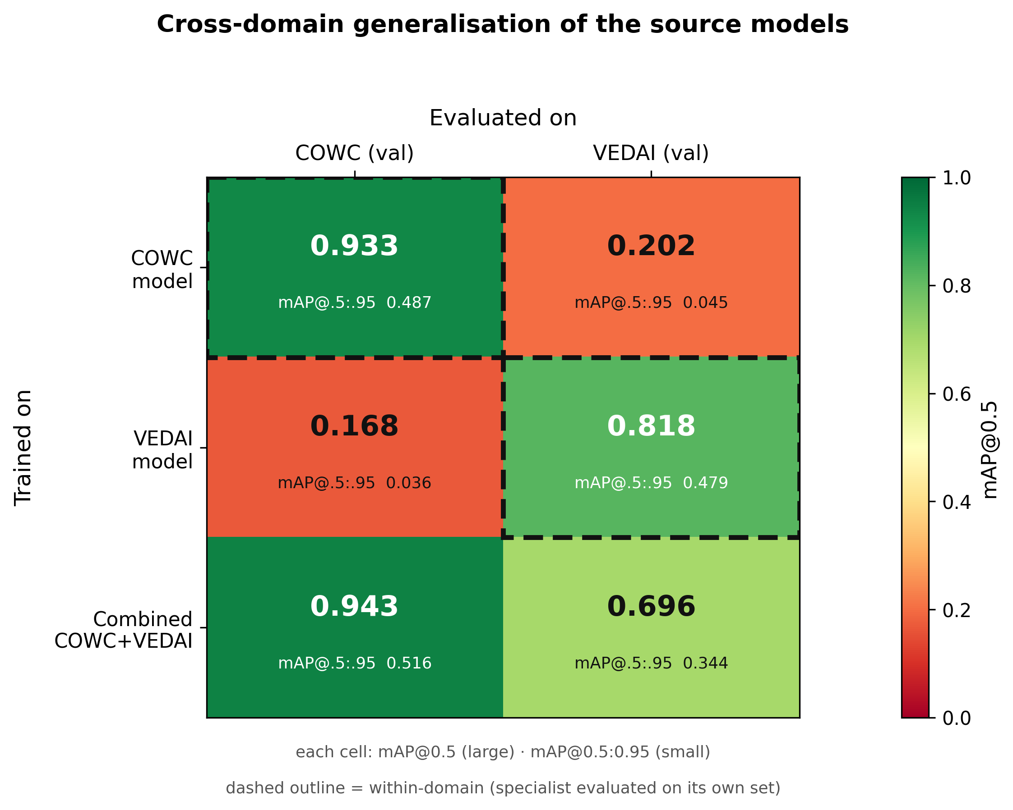
TRAINING · STEP 5
Train each source — then combine them
A detector is trained on each source, and on both together.
On its own, each is strong on its own data but collapses on the other; combined, it keeps the dense-scene skill and regains the rest.
The combined detector is the one carried into the UK.
Read the diagonal: specialists shine only on their own data; combined stays strong on both.
UK CAR-PARK OCCUPANCY
14
Notes:
Combining COWC+VEDAI recovers cross-domain coverage. Bright diagonal = specialists; bright everywhere = combined.

Slide 19
SECTION 04
Testing the Model on UK Data
A clean, fair contest on twenty car parks the model never trained on.
Notes:
Experimental design and fairness.

Slide 20
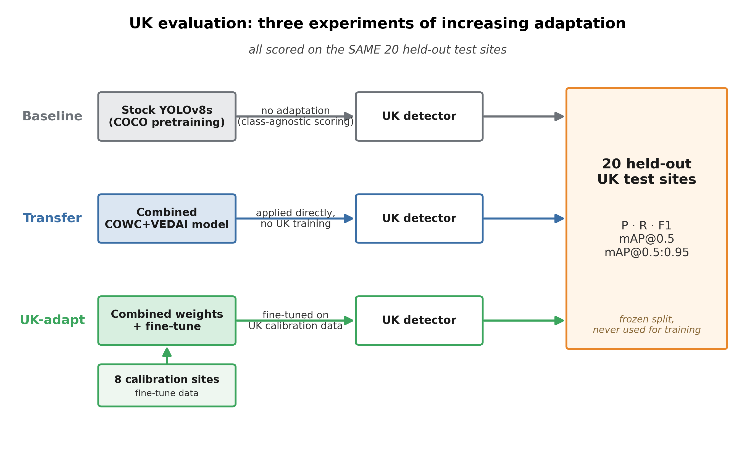
TESTING · THE DESIGN
Three experiments to isolate what each step adds
We test three versions on the same twenty UK car parks — off-the-shelf, trained-elsewhere, and UK-adapted — so any difference is down to the adaptation alone.
Same held-out test set for all three versions.
UK CAR-PARK OCCUPANCY
15
Notes:
Clean design: one benchmark, three levels of adaptation.

Slide 21
TESTING · FAIRNESS
Scoring it fairly
Same benchmark
Generous baseline
No tuning on the test
All three versions are judged on the identical twenty held-out car parks.
The off-the-shelf model is scored as leniently as possible, so it is not unfairly penalised.
The operating point is set on separate calibration sites — never on the data it is judged against.
The result is an apples-to-apples comparison a reviewer can trust.
UK CAR-PARK OCCUPANCY
16
Notes:
Three fairness safeguards — pre-empts 'did you make it look good?'.

Slide 22
SECTION 05
Results
Does it work — accurately enough to compare stores?
Notes:
The headline outcomes.

Slide 23
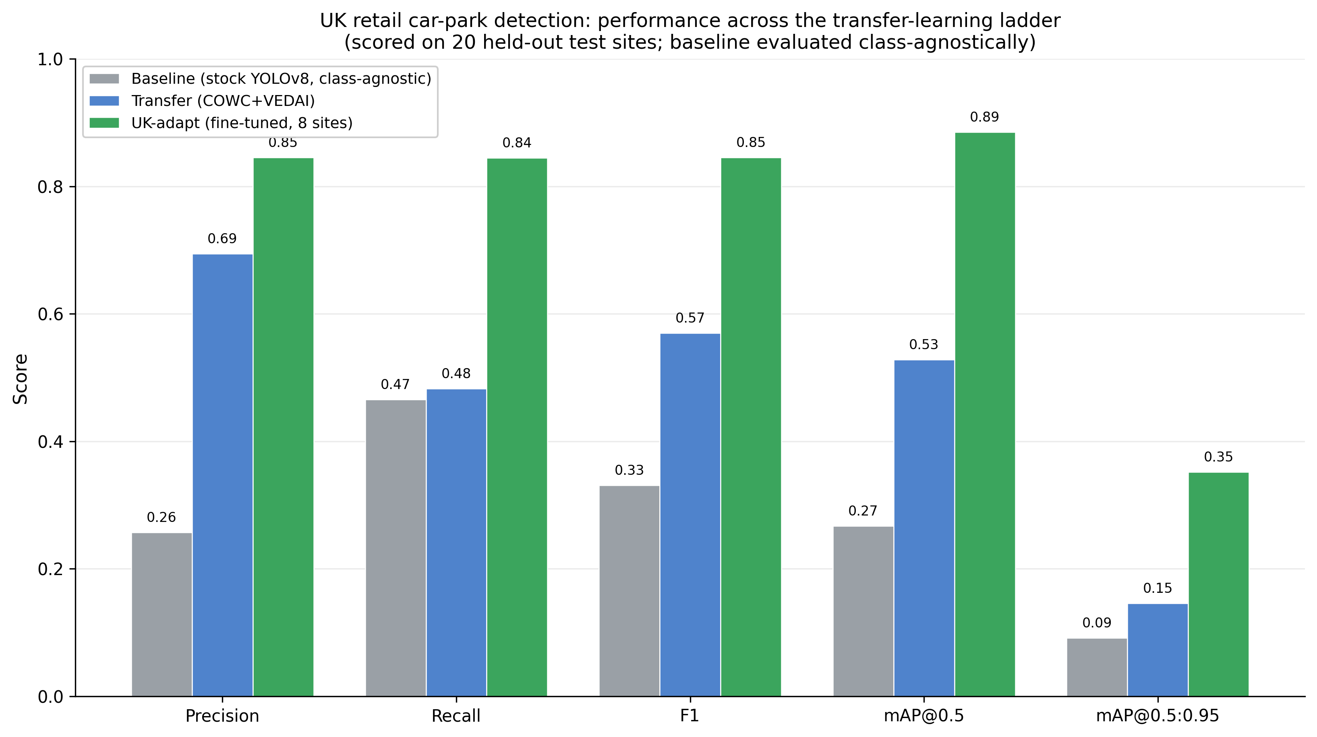
RESULTS · 1
It works — and it's cheap to reach
Accuracy climbed at each stage: off-the-shelf → trained elsewhere → adapted to the UK.
Fine-tuning on just eight UK car parks added more accuracy than the entire broad-training stage.
A commercial user does not need a large bespoke UK dataset — a small, carefully chosen set does most of the work.
8 sites
of local data outweighed all the broad training
UK CAR-PARK OCCUPANCY
Detection accuracy rises with each stage of adaptation.
18
Notes:
The adaptation ladder. A little local data beats a lot of generic data — affordable to stand up.

Slide 24
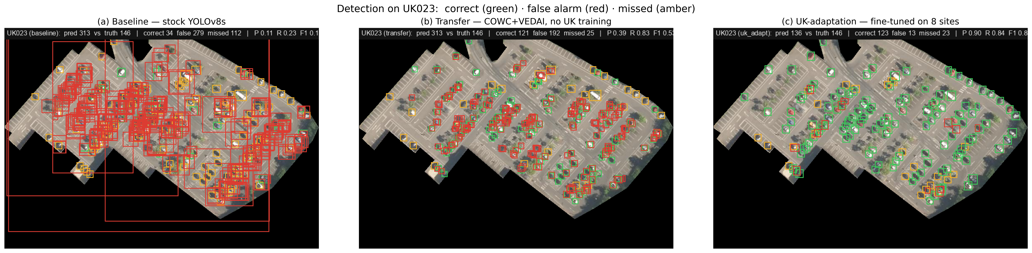
RESULTS · 1 · SEEN ON ONE SITE
You can see the improvement
The same car park, read by each version — green is a correct car, red a false alarm, amber a miss. Errors fall away as the model is adapted.
UK023 — (a) stock YOLOv8 → (b) trained elsewhere → (c) adapted on 8 UK sites.
UK CAR-PARK OCCUPANCY
19
Notes:
Qualitative proof on one site: red and amber clear up left-to-right as adaptation is added. Makes the metric ladder tangible.

Slide 25
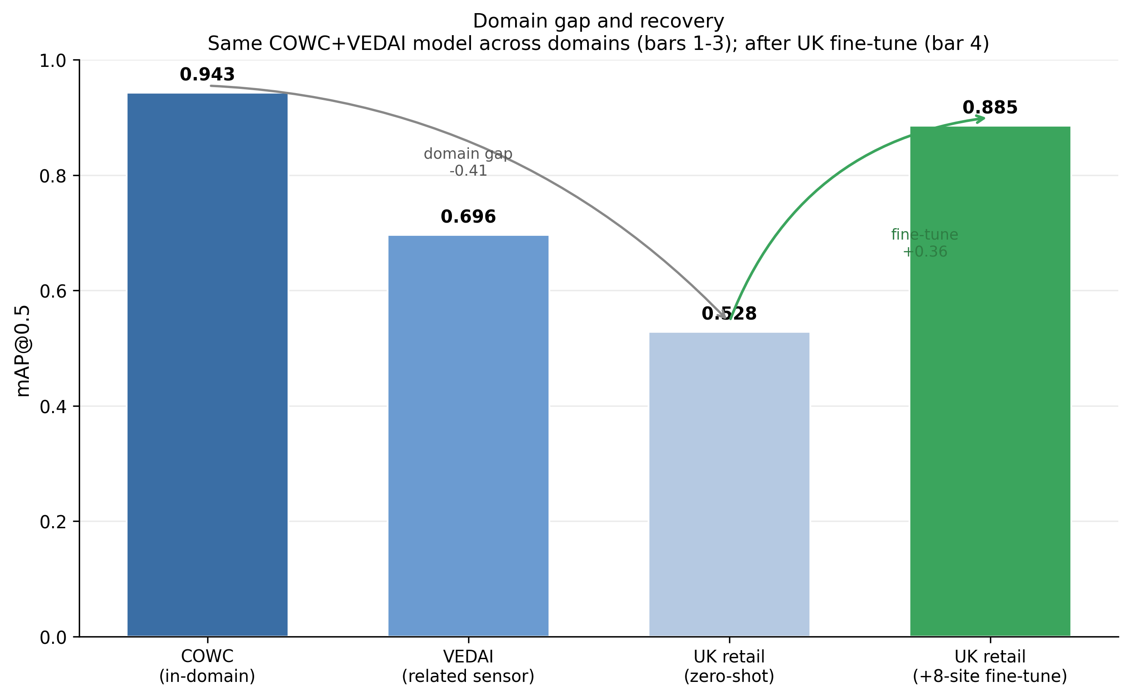
TESTING · THE DOMAIN GAP
The gap to the UK — and how far we close it
The same detector loses about two-fifths of its accuracy as the target moves from its own data to UK car parks.
Adapting on just eight UK sites recovers most of that gap — back to near its 'home' performance.
UK CAR-PARK OCCUPANCY
Accuracy falls across domains, then fine-tuning recovers it.
17
Notes:
Big drop, then recovery from a little local data.

Slide 26
SECTION 06
Counting & Occupancy
Turning boxes on a picture into one number we can stand behind.
Notes:
From detections to a defensible occupancy figure.

Slide 27
A DISCIPLINE THAT BUILDS TRUST
Spotting cars is not the same as counting them
A system can look impressive at “spotting cars” yet still miscount — false alarms and missed cars can hide a wrong total.
So we checked counting accuracy separately from detection accuracy — something the closest prior UK study did not do.
Only a system that counts accurately can be trusted to estimate occupancy at all.
WHY IT MATTERS
A good detection score is not the same as a usable count. We report both — so the occupancy figure is defensible, not optimistic.
UK CAR-PARK OCCUPANCY
21
Notes:
The rigour that separates this from the prior UK study, which conflated the two.

Slide 28
COUNTING · THE STEP
Counting each car once — even across tile seams
Because the tiles overlap, a car sitting near a seam can be detected twice.
We merge detections that overlap across neighbouring tiles, so every physical car is counted exactly once.
Only then do we divide by the car park's capacity to get occupancy — the % full.
THE OUTPUT
One honest count per site → occupancy = cars ÷ capacity. This is the number the whole project set out to produce.
UK CAR-PARK OCCUPANCY
22
Notes:
De-duplication across tile seams, then occupancy. Plain: don't count the same car twice.

Slide 29
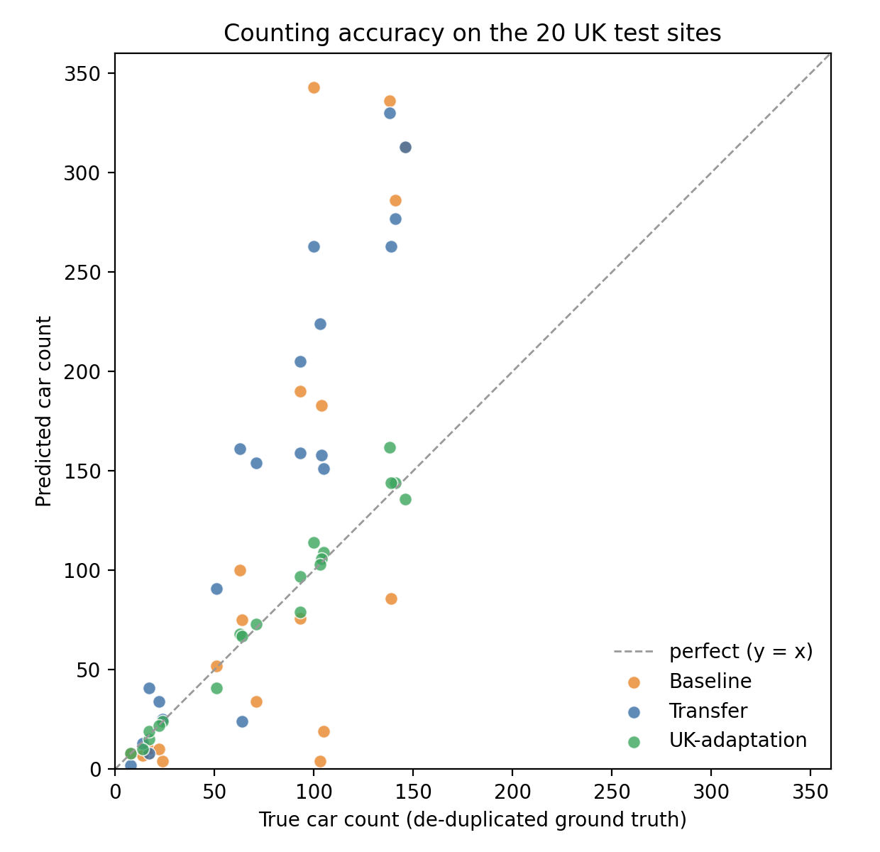
COUNTING · RESULTS
Accurate enough to compare stores
The adapted system recovered how full each car park was to within about three percentage points of capacity.
Predicted and true counts line up almost perfectly along the diagonal.
That is accurate enough to rank and compare stores by how busy they are.
2.6 pp
R² 0.97
occupancy error
predicted vs true count
Green = the adapted model; it sits on the line.
UK CAR-PARK OCCUPANCY
20
Notes:
Occupancy to within ~2.6 pp, R² 0.97. Unadapted models can't count — only the adapted one is trustworthy.

Slide 30
SECTION 07
From Counting to Geography
Not just how full — where inside the lot the demand sits.
Notes:
The spatial differentiator.

Slide 31
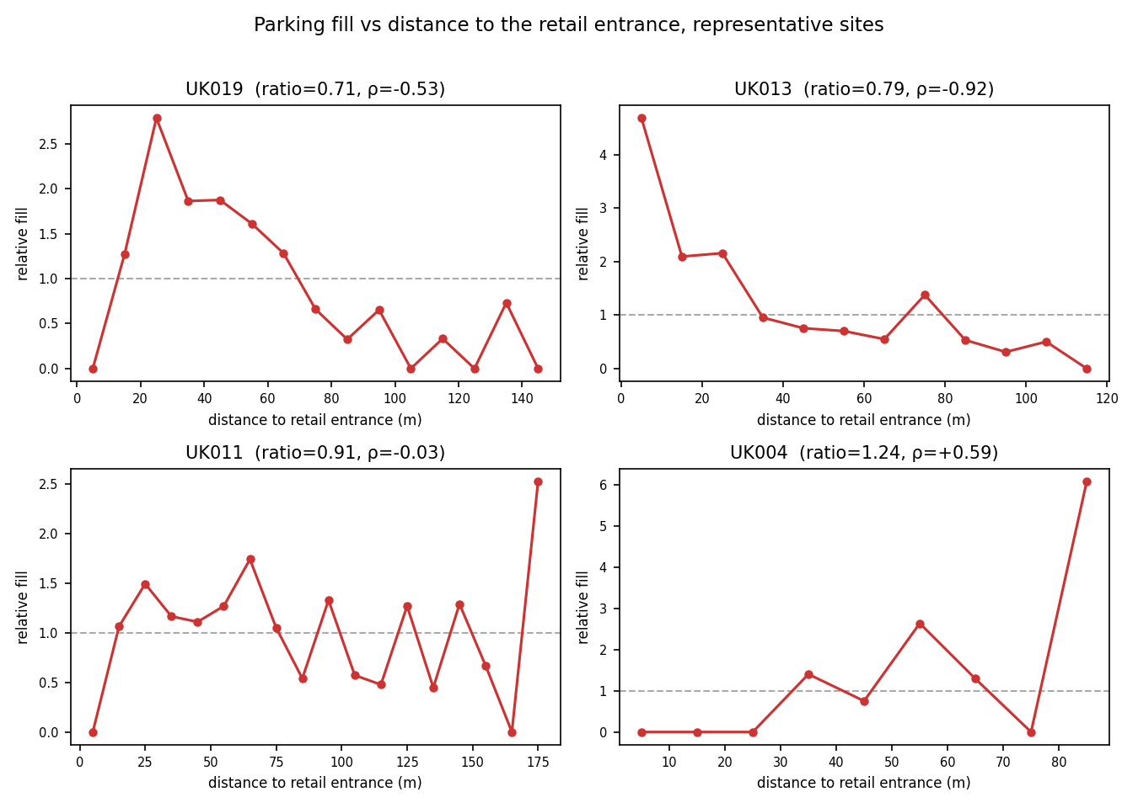
GEOGRAPHY · METHOD
How we measured “where demand sits”
For each car we measure its distance to the store entrance — but we compare it against how far the car park's own space is from that entrance.
That comparison strips out lot shape, so a long thin car park can't fool the result.
If cars sit closer to the door than the average space does, demand is genuinely drawn to the entrance.
Fill is highest near the door, falling with distance.
UK CAR-PARK OCCUPANCY
23
Notes:
Method behind the entrance finding: compare where cars are vs where space is, relative to the door.

Slide 32
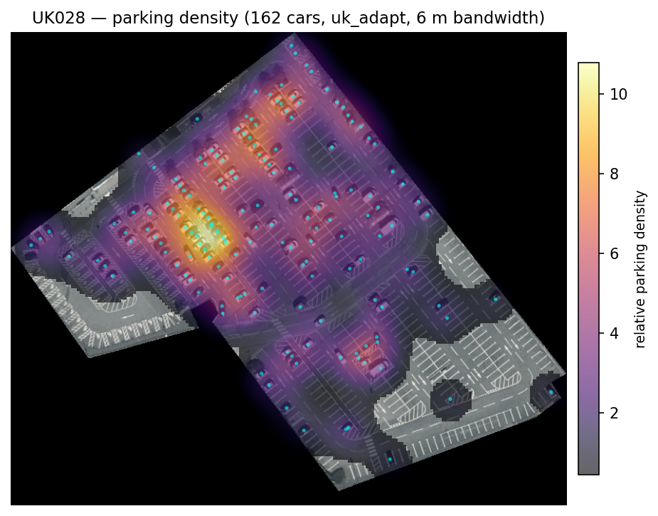
RESULTS · 3
Not just how full — where demand sits
Because every car is located, we can map where cars concentrate within a lot.
Across the sites, parking clusters around the store's pedestrian entrance — not where cars drive in.
The area near the door is the most informative place to watch demand.
18 / 20
sites cluster at the store entrance
Heatmap of parking demand — warmer = denser.
Notes:
The differentiator. We don't just get a number, we get a map: demand organises around the shop door. Commercially, that tells you where footfall concentrates within a site.

Slide 33
WHAT IT MEANS
What this means for the business
Scalable
Affordable
Richer than a number
One system compares many stores from above, on equal terms — no equipment at each site.
Eight labelled sites, not a large bespoke dataset, are enough to reach a deployable standard.
A within-lot picture of where demand falls — information a single occupancy figure hides.
A scalable, defensible way to compare how busy stores are from above — and to see where their demand concentrates.
UK CAR-PARK OCCUPANCY
25
Notes:
Value proposition: scalable, affordable, richer-than-a-number.

Slide 34
WHERE THIS GOES NEXT
Today a snapshot — next, a trend
→
NOW
NEXT
One image per site gives how full a car park is — a single moment in time.
Repeat the imagery over time and the same system turns snapshots into activity — the rise and fall of trade across hours, days and seasons.
This is a data-collection step, not a new method — the pipeline is already built to consume it.
Notes:
Honest close on limitations and roadmap. Today it is a snapshot; the real product is the trend over time. Crucially that is a data step, not a research problem — the system is ready for it.

Slide 35
THANK YOU
Questions & Discussion
Paula Xho Vilajeti · ucabpxv@ucl.ac.uk · UCL Department of Computer Science · in partnership with Knight Frank
Notes:
Close, invite questions. Be ready for: how capacity is defined; is eight sites enough; comparison to prior UK work; what the temporal product looks like.

