Slide 1
hi
hi

Slide 2

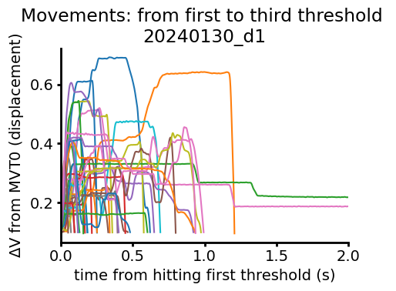
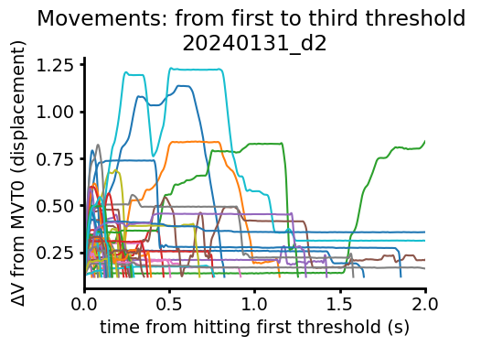

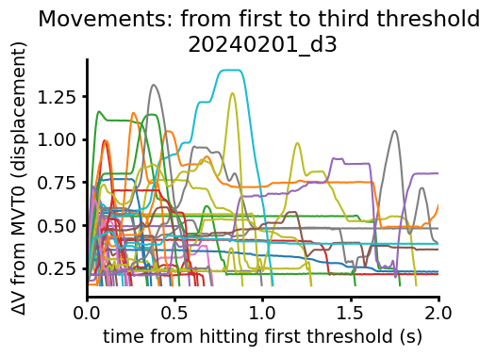


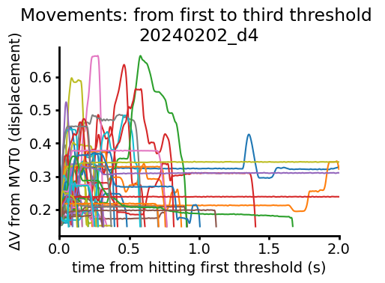
ANM7 Second Threshold Aligned Movements
10s decision, 10s ITI started day 3

Slide 3

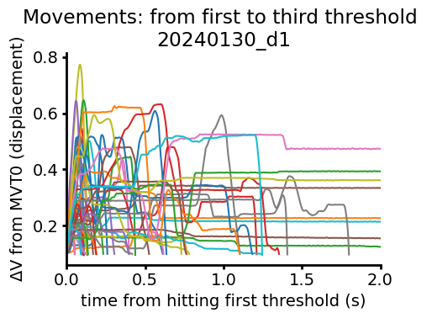

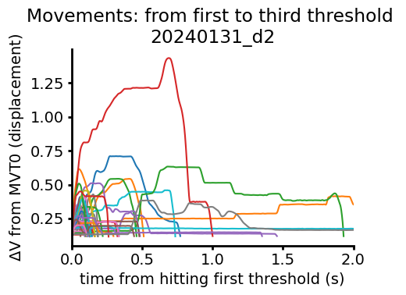

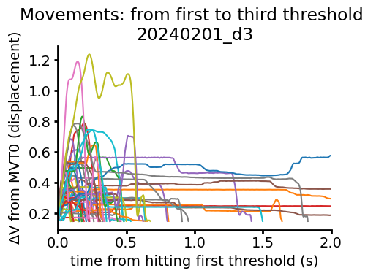

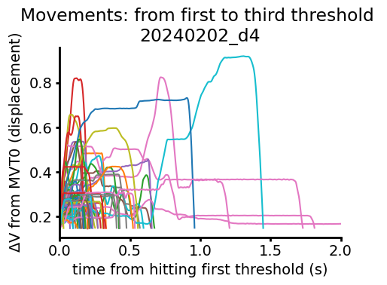

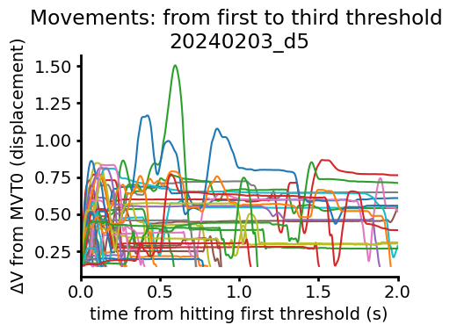
ANM8 Second Threshold Aligned Movements
10s decision, 10s ITI started day 3
Headpost fell off this session; only 44 hits

Slide 4
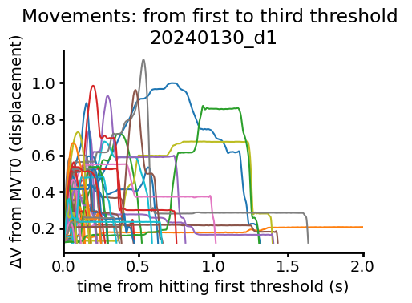

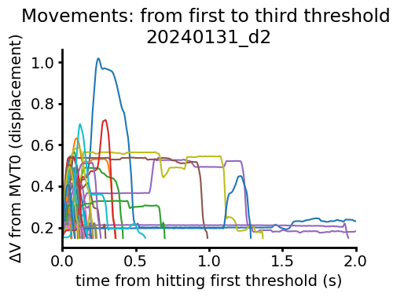

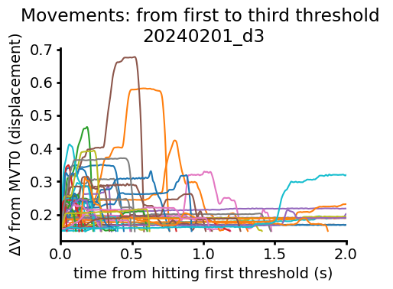

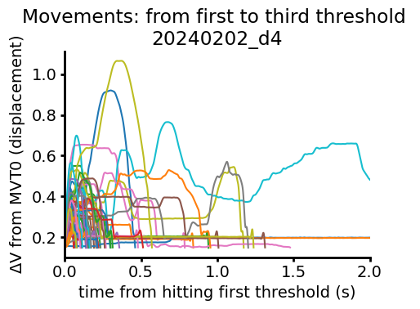

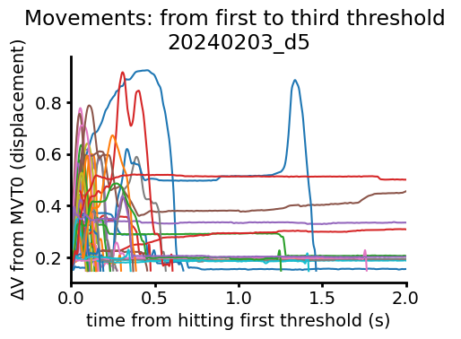

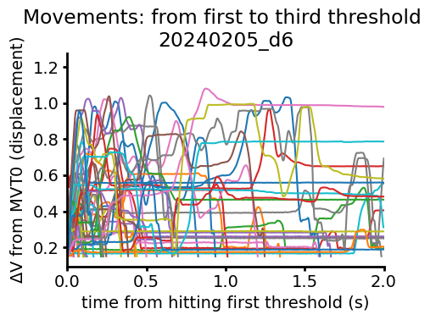

ANM1 Second Threshold Aligned Movements
10s decision, 10s ITI started day 3
Took a break between day 5 and day 6

Slide 5
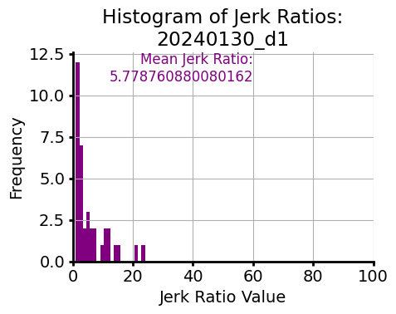
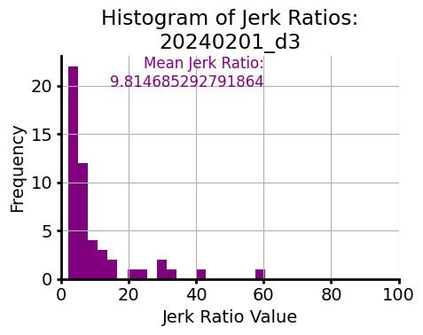
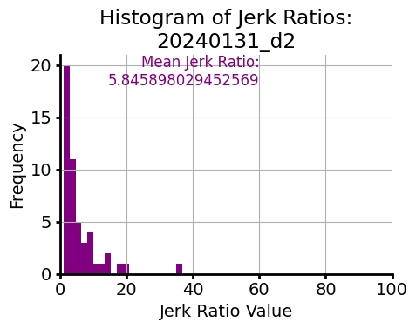
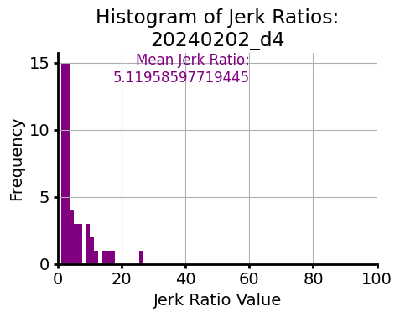
Normalized total jerk (jerk ratio) from first to third threshold
10s decision, 10s ITI started day 3
ANM7

Slide 6

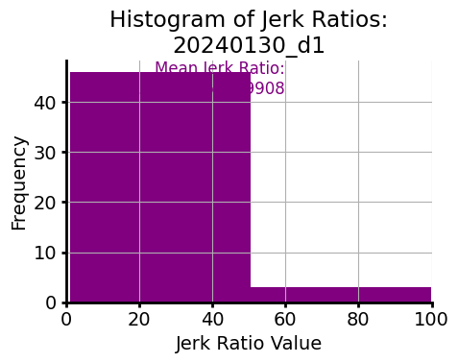
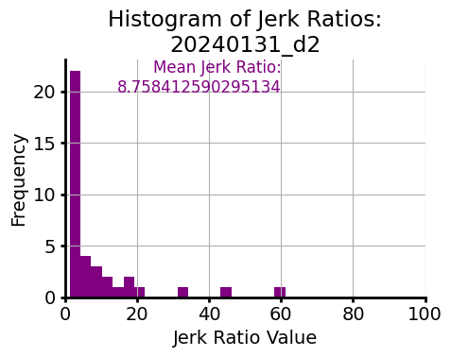
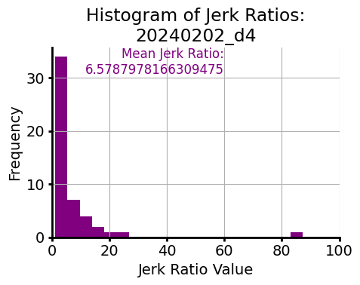
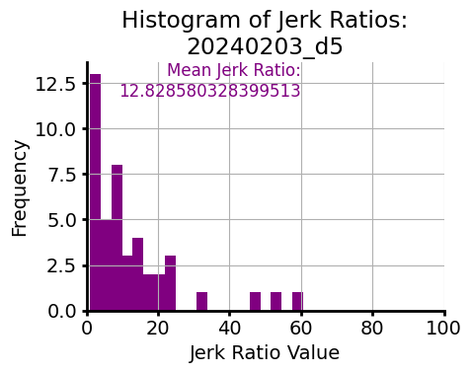
Normalized total jerk (jerk ratio) from first to third threshold
10s decision, 10s ITI started day 3
ANM8
Headpost fell off this session; only 44 hits

Slide 7
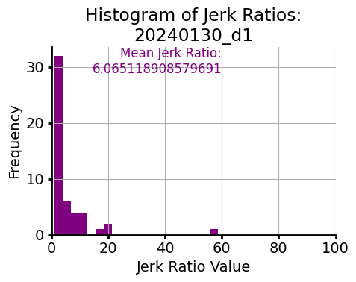
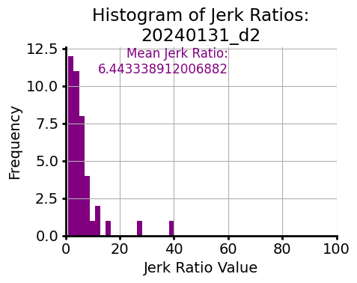
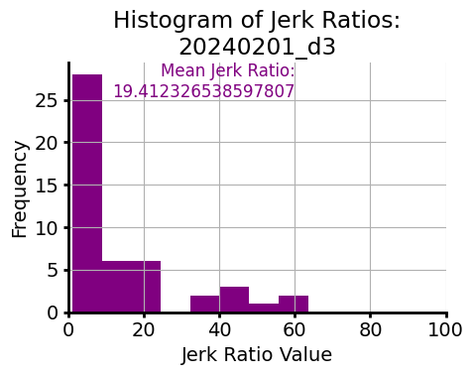
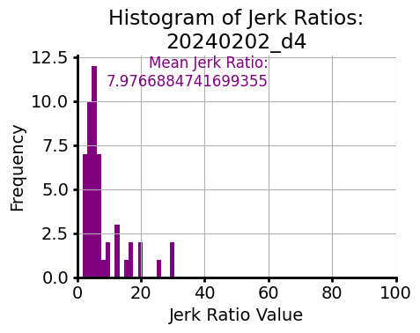
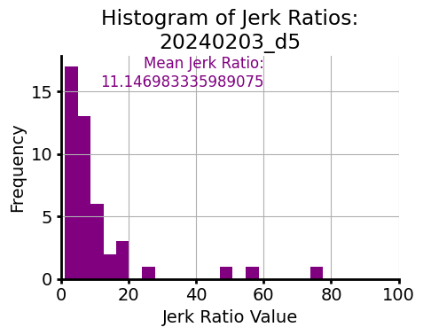
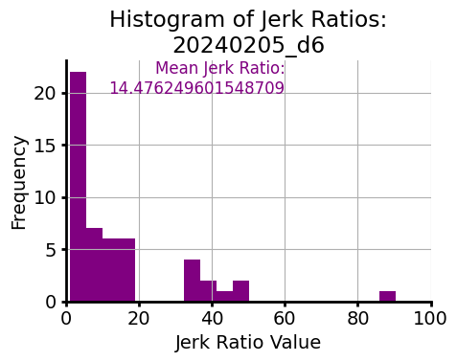
Normalized total jerk (jerk ratio) from first to third threshold
10s decision, 10s ITI started day 3
ANM1
Took a break between day 5 and day 6

Slide 8
Normalized total jerk (jerk ratio) from first to third threshold
Because data not ~N, plotting median +/- 95 cdf for now, but might go back to mean not sure
Yes, upper outliers are therefore cut off

Slide 9
Temporal compression of the movement?

Slide 10
Reaction times

