Slide 1
hi
hi

Slide 2
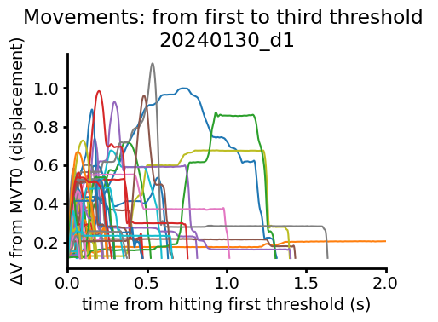

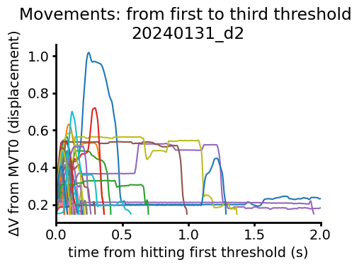

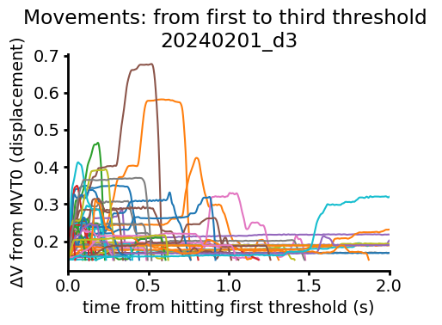

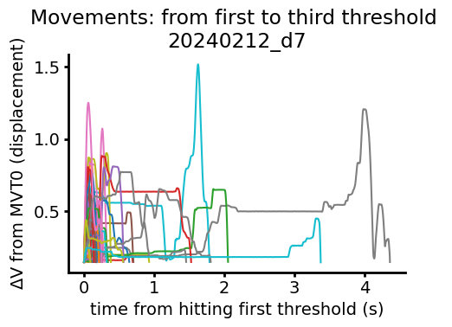
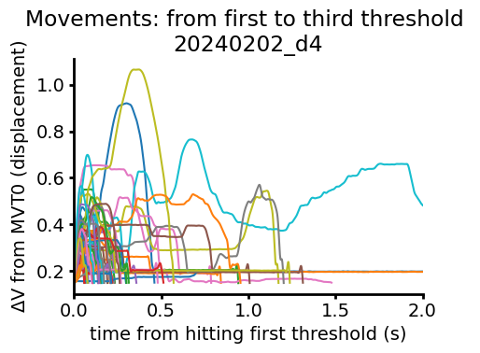

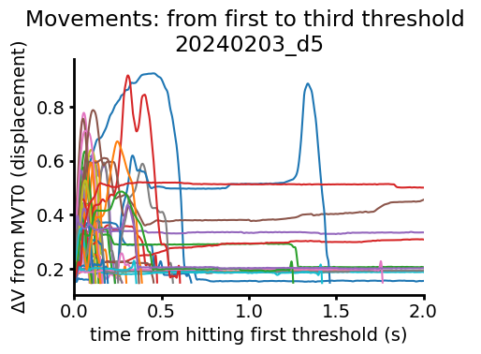

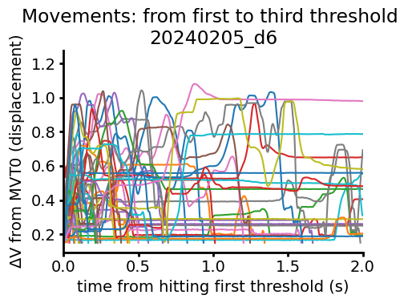

ANM1 Second Threshold Aligned Movements
10s decision, 10s ITI started day 3
Took a break between day 5 and day 6

Slide 3

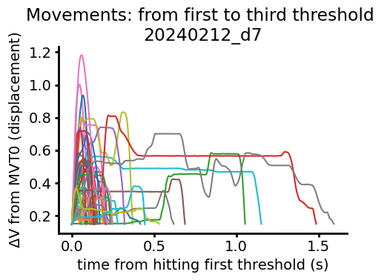
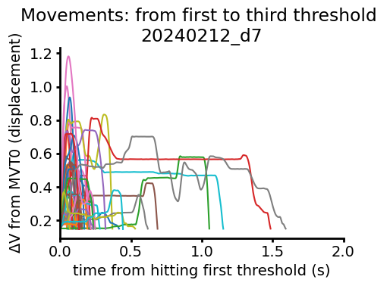

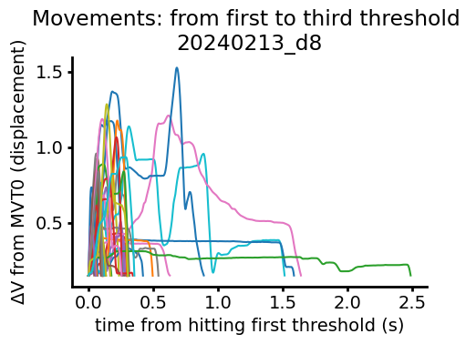
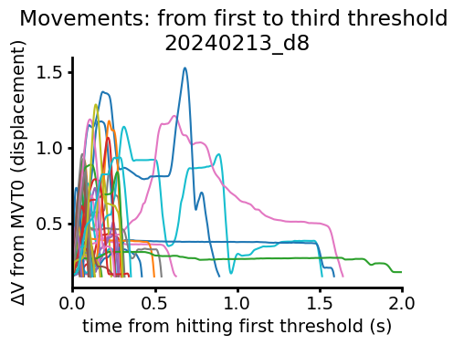
ANM1 Second Threshold Aligned Movements (continued)

Slide 4

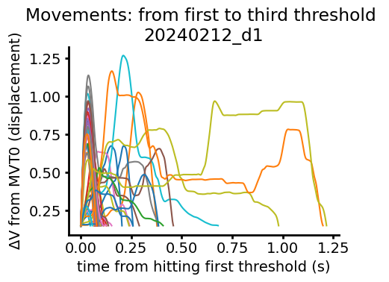
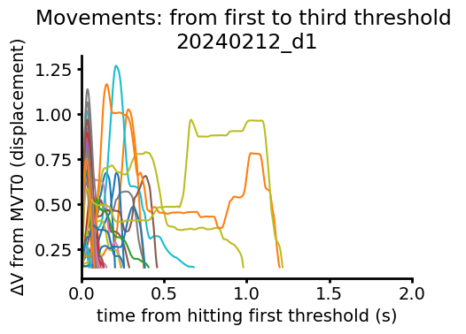

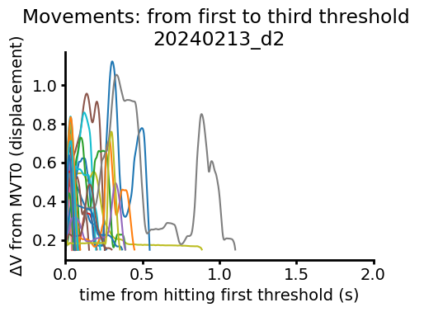
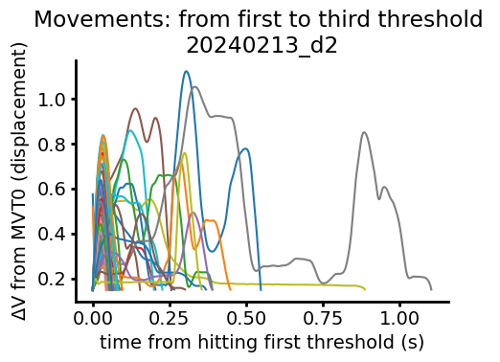
ANM5 Second Threshold Aligned Movements

Slide 5

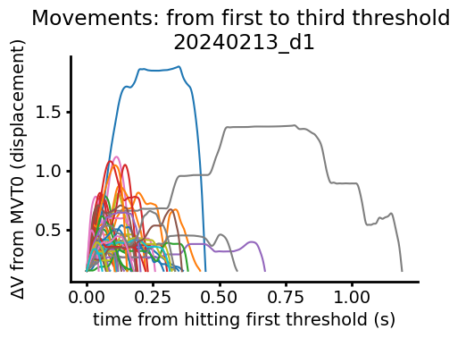
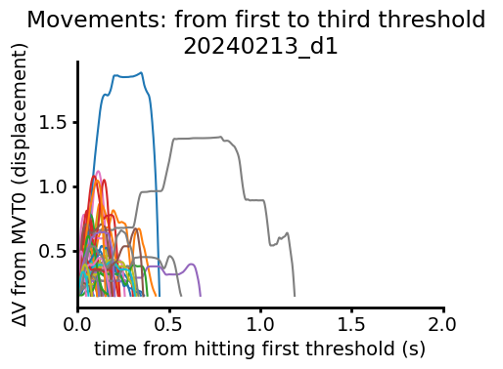
ANM3 Second Threshold Aligned Movements

Slide 6

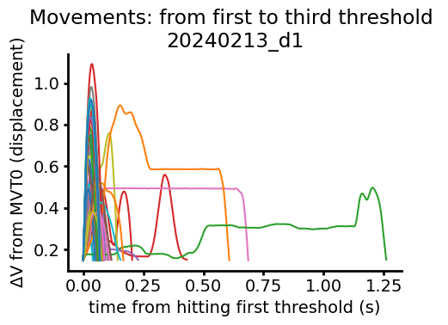
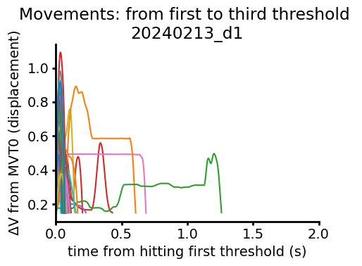
ANM4 Second Threshold Aligned Movements

Slide 7
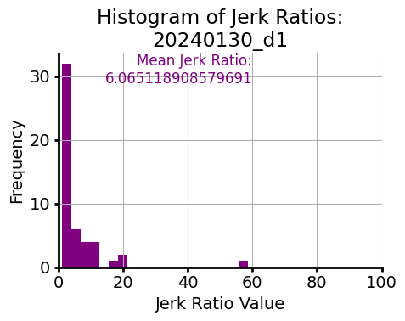
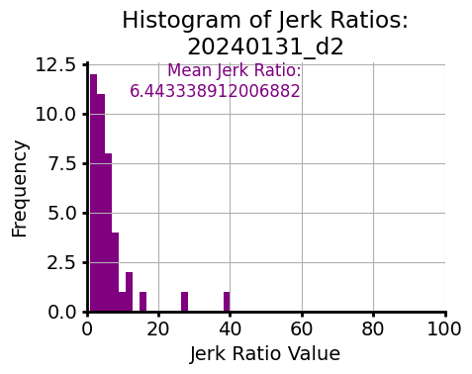
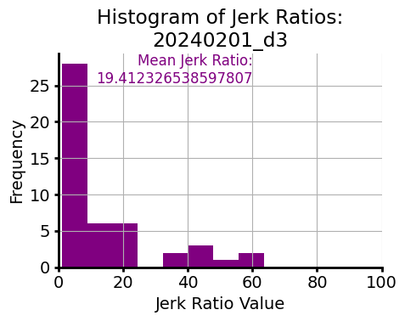
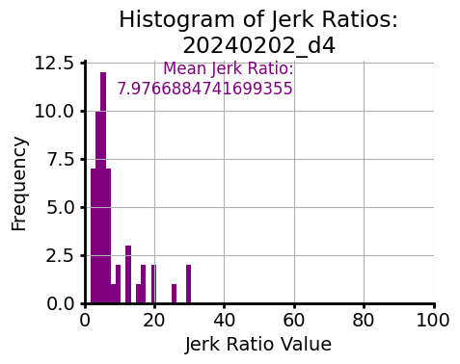
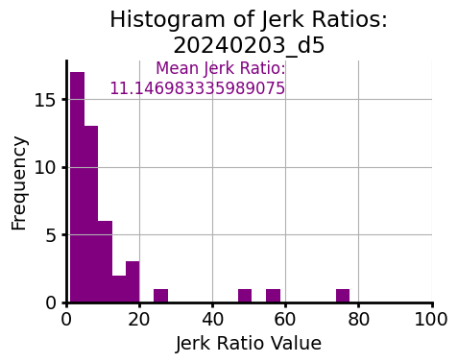
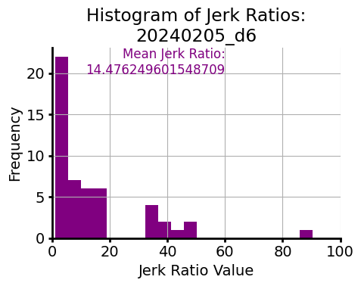
Normalized total jerk (jerk ratio) from first to third threshold
10s decision, 10s ITI started day 3
ANM1
Took a break between day 5 and day 6

Slide 8
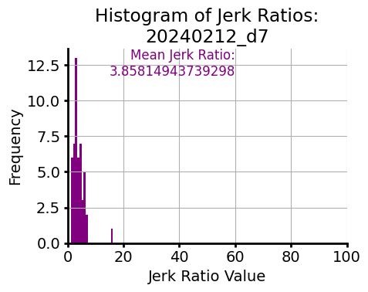
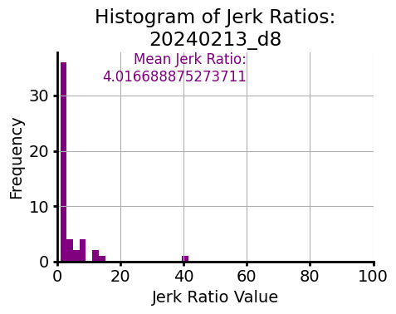
Normalized total jerk (jerk ratio) from first to third threshold (continued)
ANM1

Slide 9
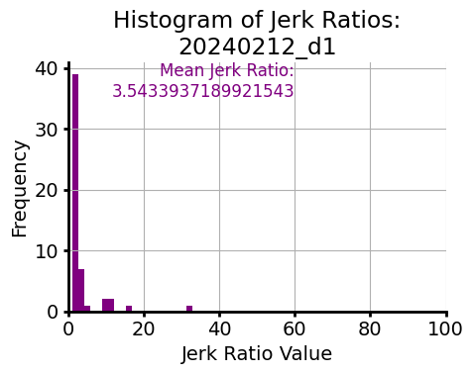
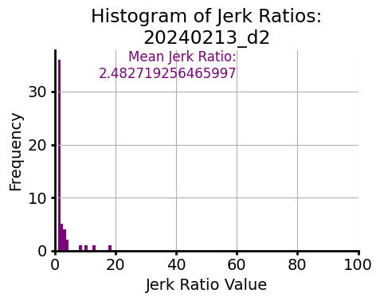
Normalized total jerk (jerk ratio) from first to third threshold
ANM5

Slide 10
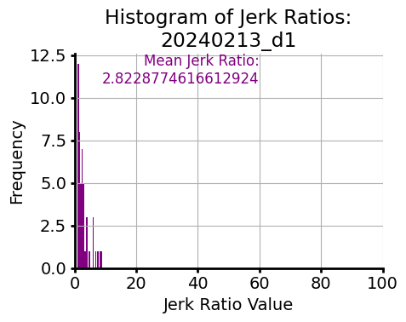
Normalized total jerk (jerk ratio) from first to third threshold
ANM3

Slide 11
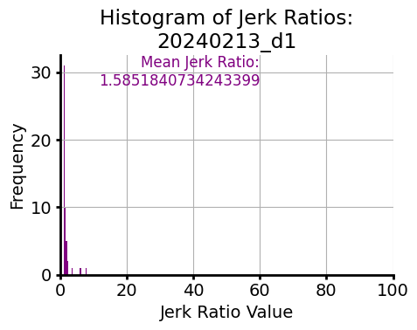
Normalized total jerk (jerk ratio) from first to third threshold
ANM4

Slide 12
Normalized total jerk (jerk ratio) from first to third threshold
Because data not ~N, plotting median +/- 95 cdf for now, but might go back to mean not sure
Yes, upper outliers are therefore cut off

Slide 13
Temporal compression of the movement?

Slide 14


temp

