Slide 1
hi
hi

Slide 2
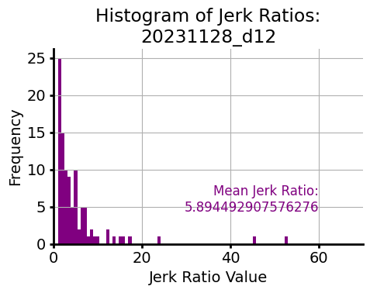

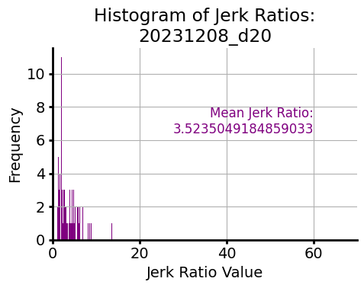


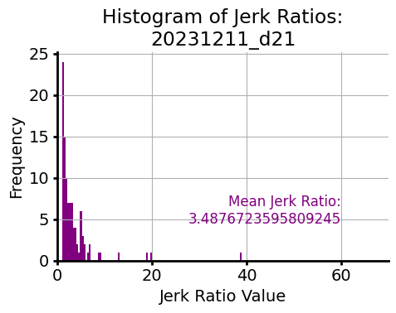
ANA1 Second Threshold Aligned Movements

Slide 3
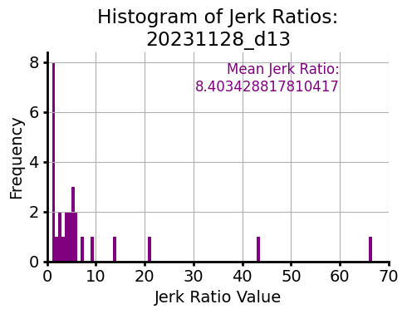

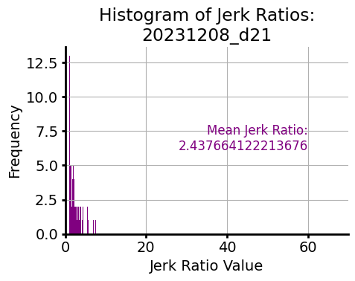


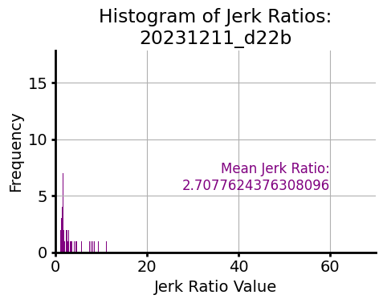
ANA2 Second Threshold Aligned Movements

Slide 4
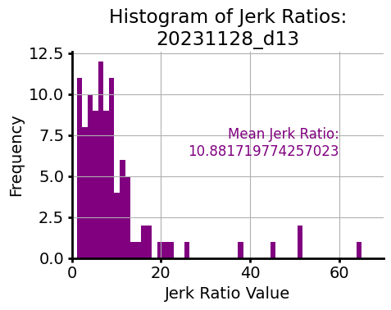


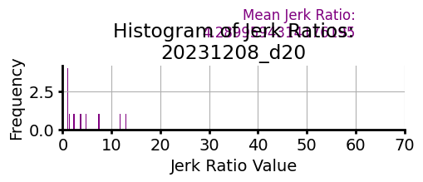

ANB1 Second Threshold Aligned Movements
(Mean jerk ratio says 4.2899)

Slide 5



ANB2 Second Threshold Aligned Movements

