Slide 1
hi
hi

Slide 2
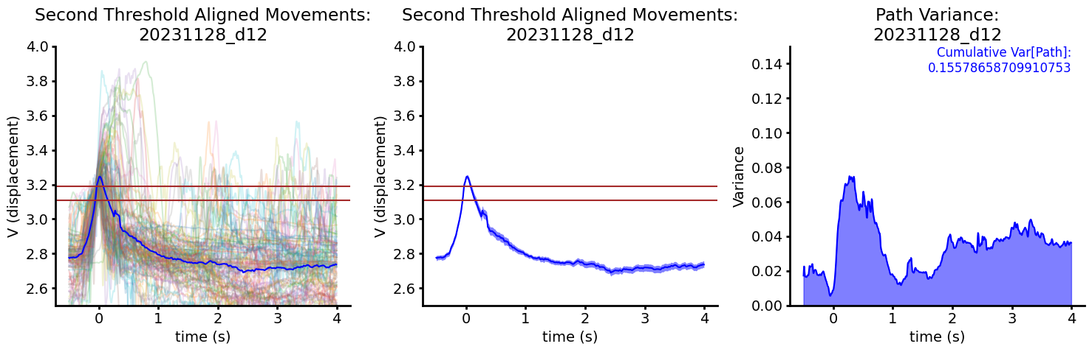
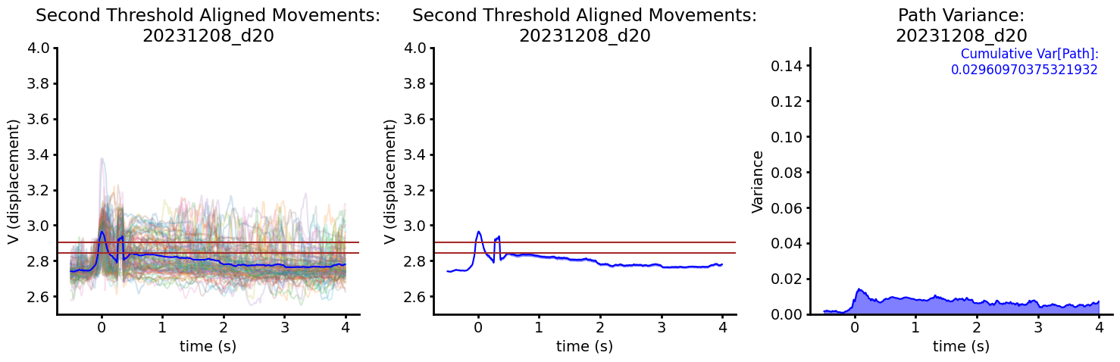
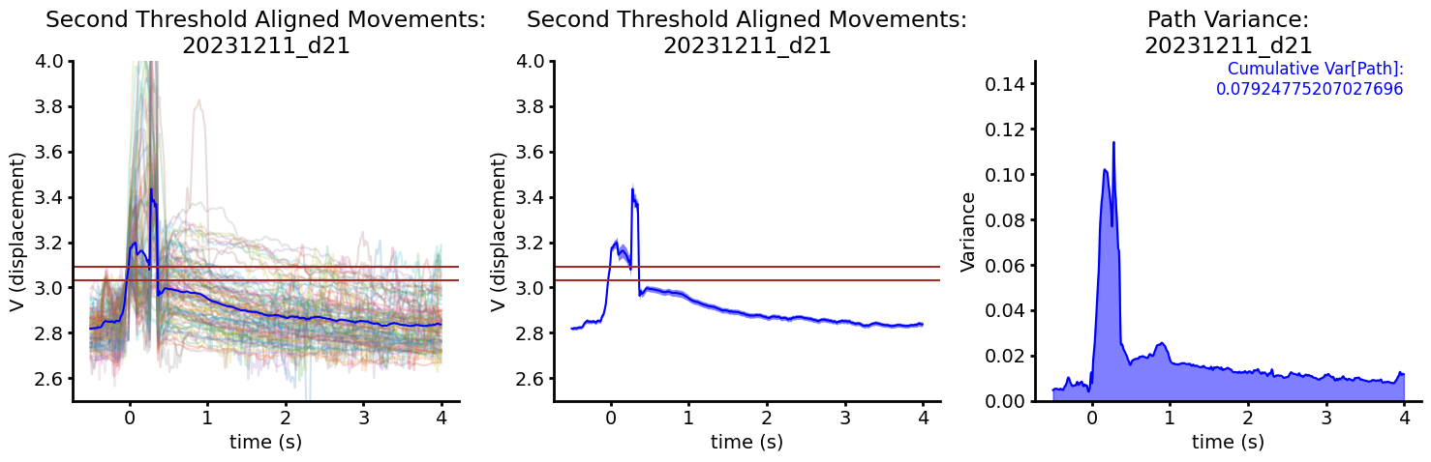
ANA1 Second Threshold Aligned Movements

Slide 3
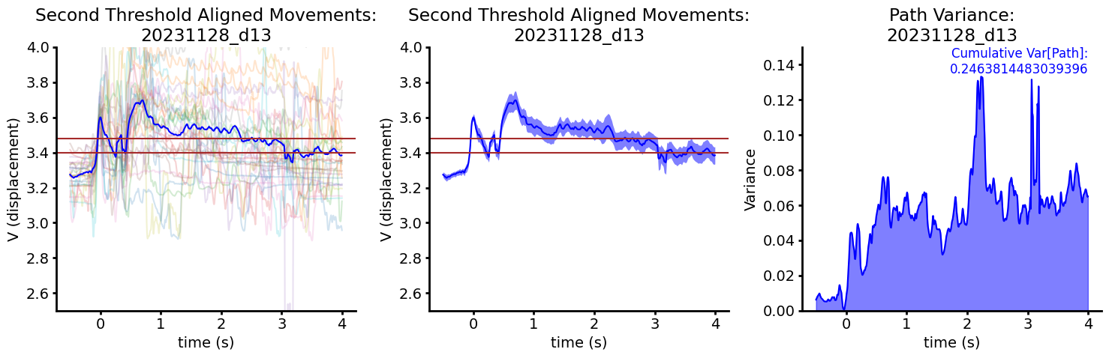
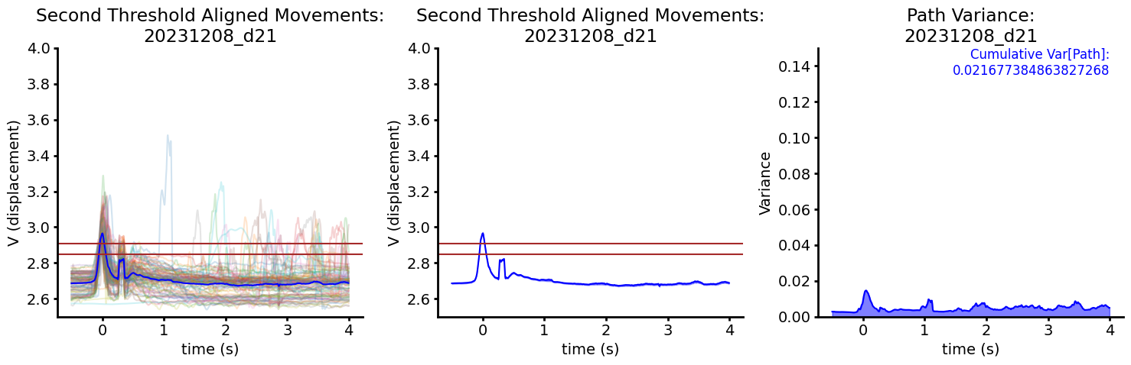
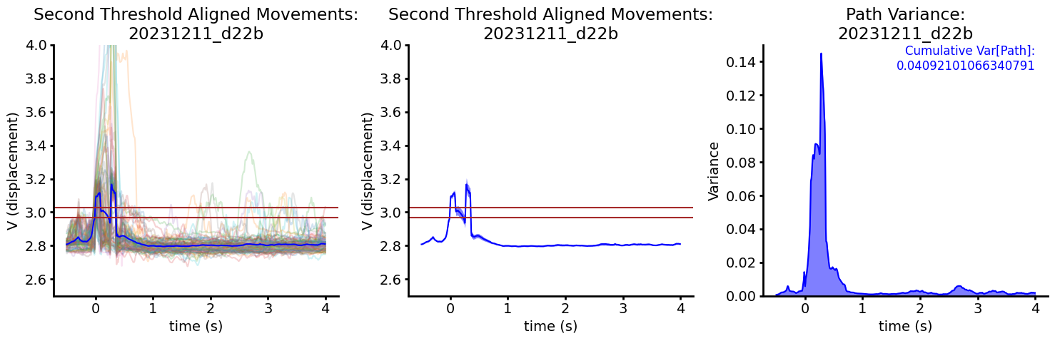
ANA2 Second Threshold Aligned Movements
From only 3 days, it problematically looks like mice are learning to keep the lever closer during the threshold calculation—I want to plot the voltage baseline across days at some point to make sure this isn’t the case (and avoid all of our analysis trends being due to higher baseline/thresholds)

Slide 4
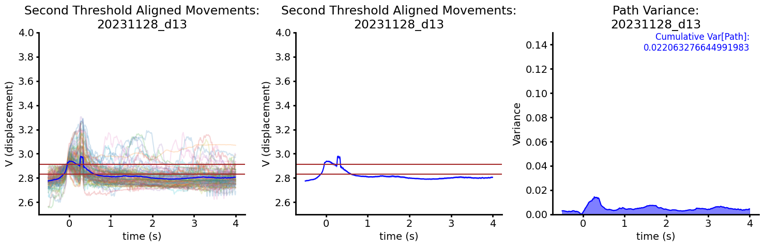
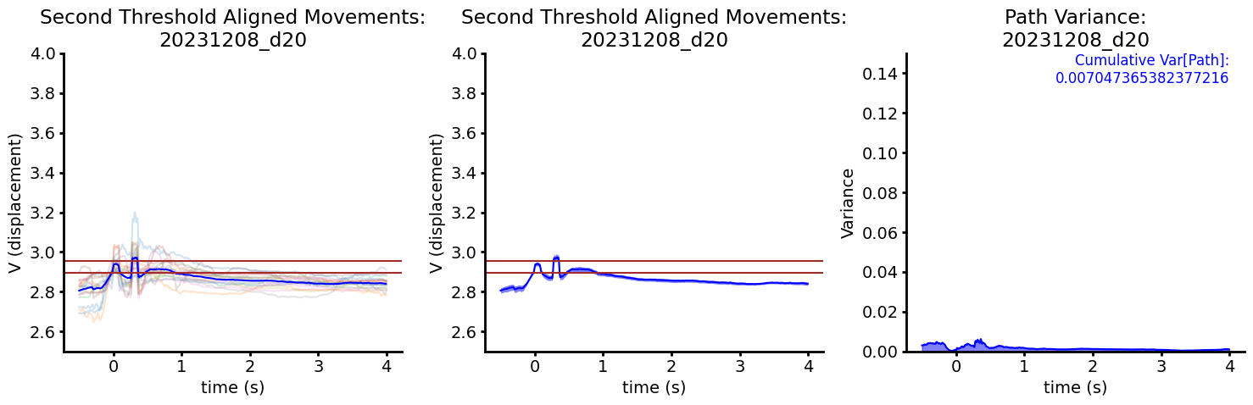
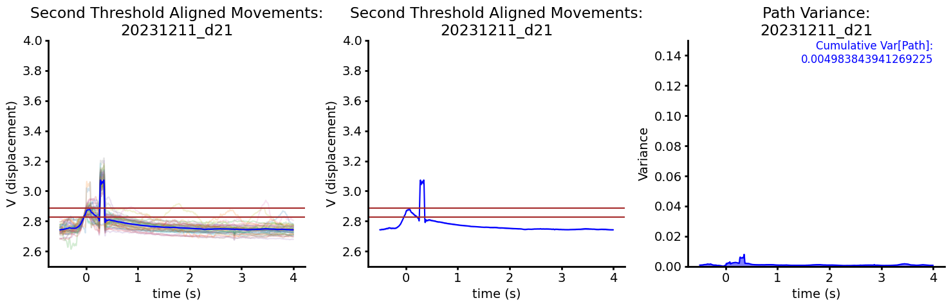
ANB1 Second Threshold Aligned Movements

Slide 5
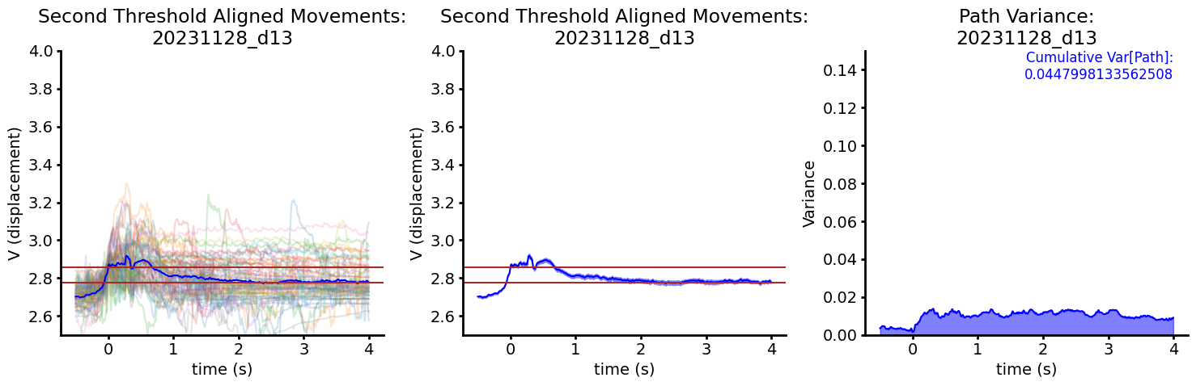
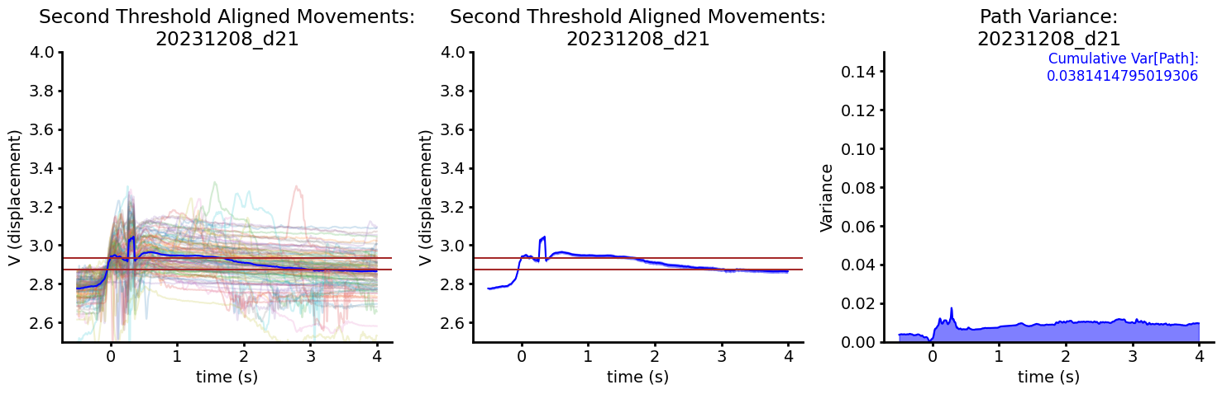
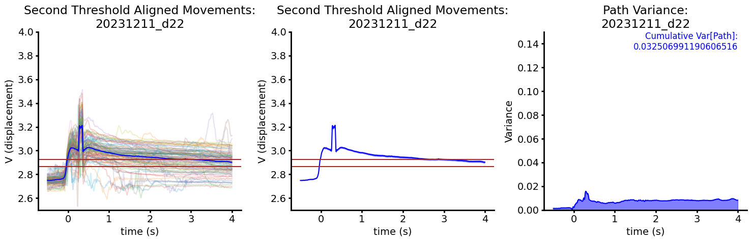
ANB2 Second Threshold Aligned Movements

Slide 6
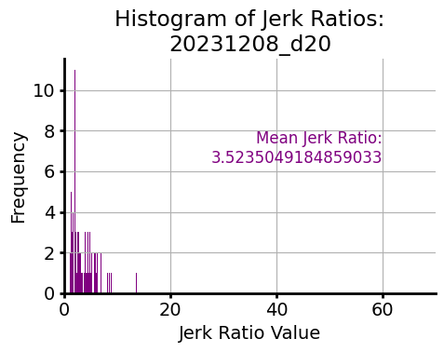
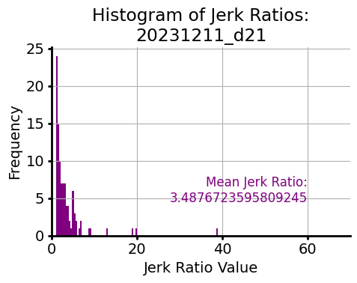
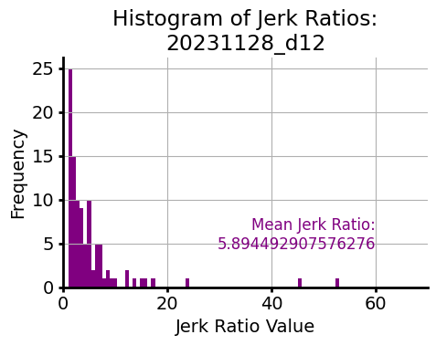
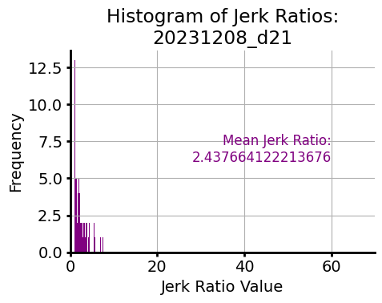
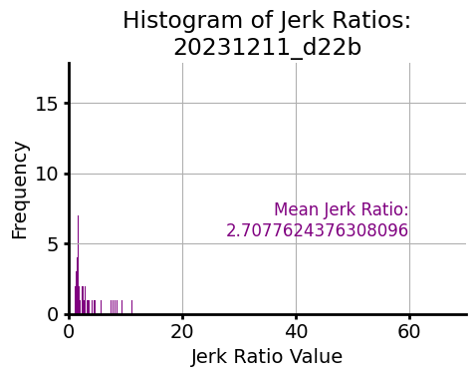
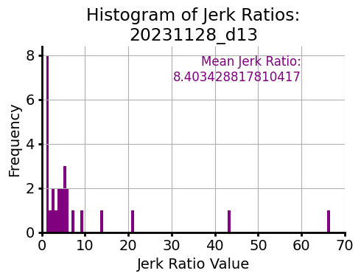
Normalized total jerk (jerk ratio) from first threshold to peak of leverpress (not full lever press right now because of weird electrical thing)
ANA1
ANA2

Slide 7
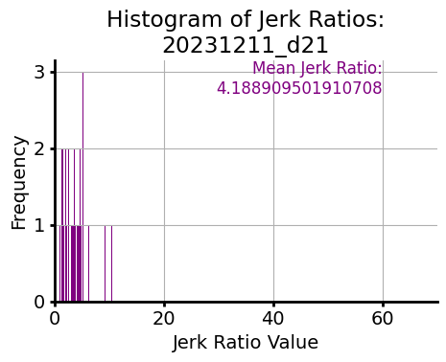
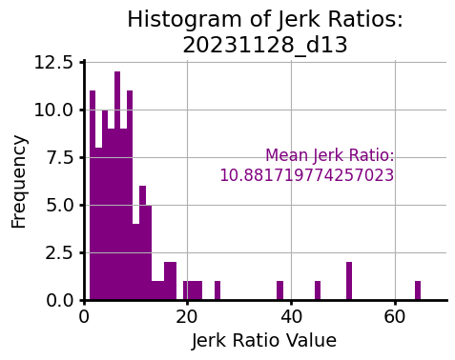
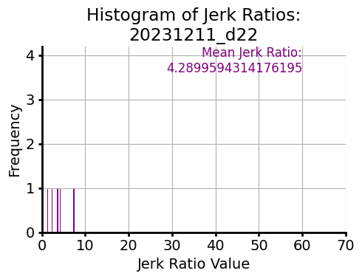
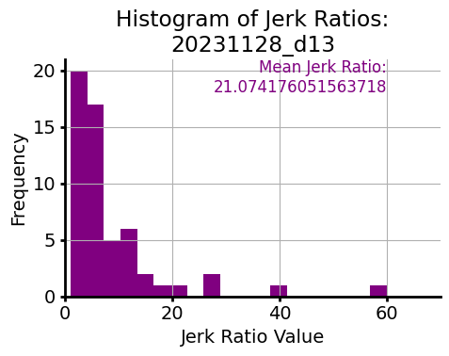
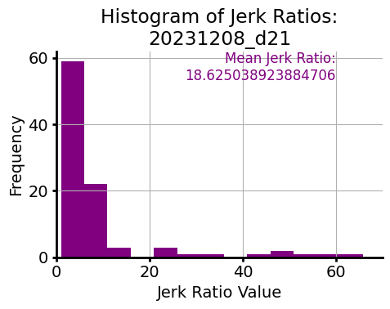
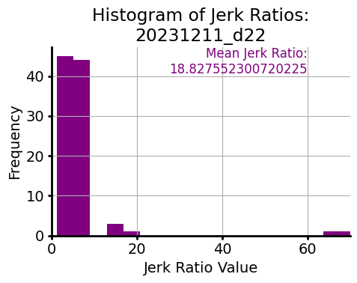
Normalized total jerk (jerk ratio) from first threshold to peak of leverpress (not full lever press right now because of weird electrical thing)
ANB1
Only doing first matfiles for now (haven’t gone through combining them in Matlab), so some have less than 100 trials
ANB2

Slide 8
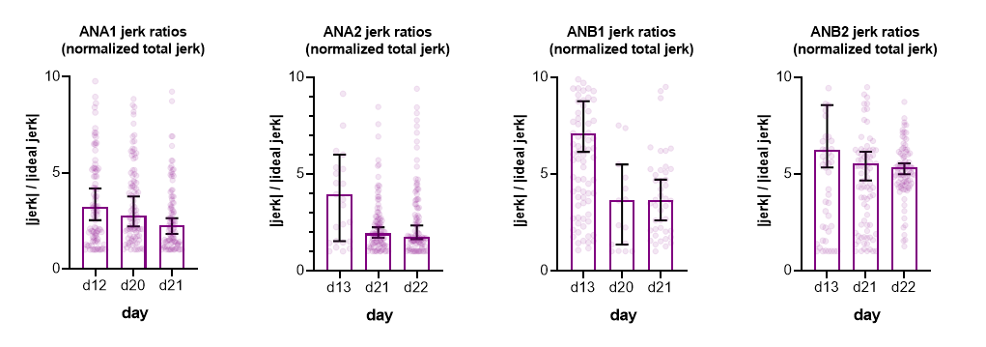
Normalized total jerk (jerk ratio) from first threshold to peak of leverpress (not full lever press right now because of weird electrical thing)
Because data not ~N, plotting median +/- 95 cdf for now, but might go back to mean not sure
Yes, upper outliers are therefore cut off

Slide 9
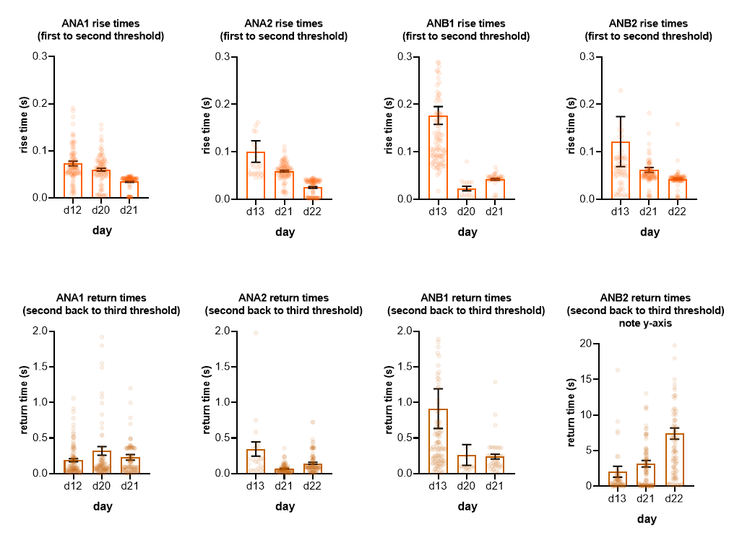
Temporal compression of the movement?

Slide 10
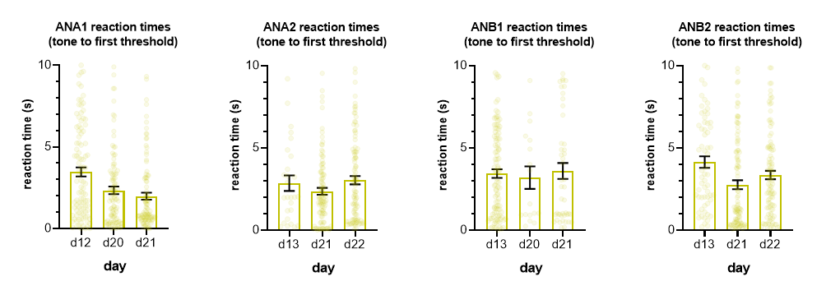
Reaction times

