Slide 1
hi
hi

Slide 2
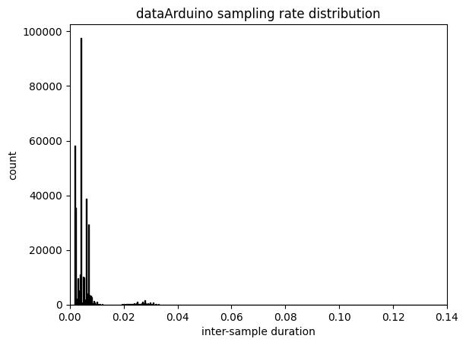
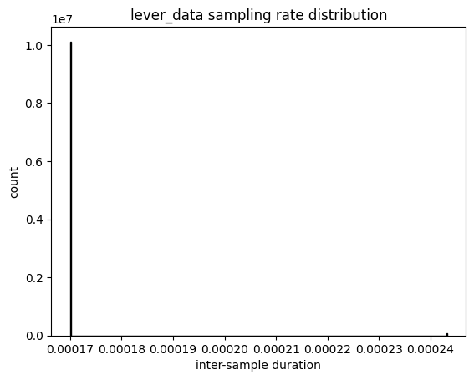
Differences in sampling rate between sampling in between running sections of code (dataArduino) and asynchronous sampling (lever_data)
First trial is very slightly slower, the rest are pretty consistent though

Slide 3
Differences in sampling rate between sampling in between running sections of code (dataArduino) and asynchronous sampling (lever_data)
Sampling in between running sections of code (dataArduino):
mean: 198.38423234066542 Hz
std of inter-sample duration: 0.004876950084407895 s
min: 7.0670529046647905 Hz
max: inf Hz (for some reason some samples have the same MATLAB time)
90th slowest percentile 142.91635106016963
99th slowest percentile 35.11407580020113
99.9th slowest percentile 30.399102428821255
Sampling asynchronously (lever_data):
mean: 5863.553632027255 Hz
std of inter-sample duration: 6.284963455219297e-06 s
min: 4111.914414672553 Hz
max: 5882.776329143213 Hz
90th slowest percentile 5882.195786268558
99th slowest percentile 5881.783760278223
99.9th slowest percentile 4111.914414672553

