Slide 1
hi
hi

Slide 2
Differences in sampling rate between sampling in between running sections of code (dataArduino) and asynchronous sampling (lever_data)

Slide 3
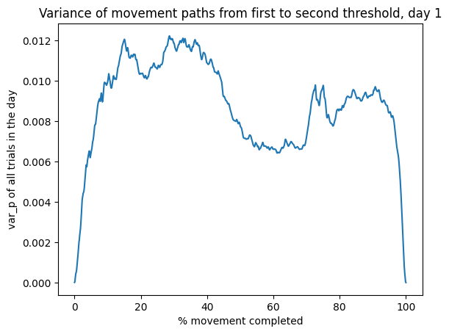
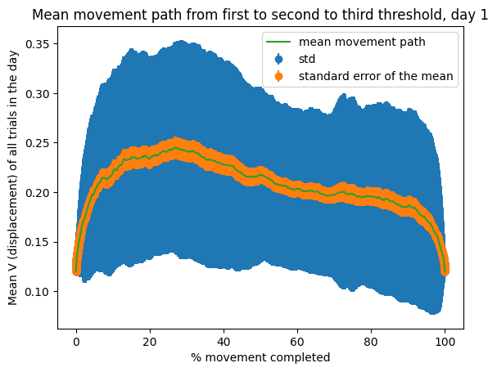
B1

