Slide 1
hi
hi

Slide 2

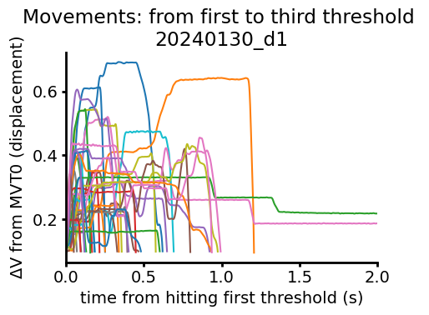
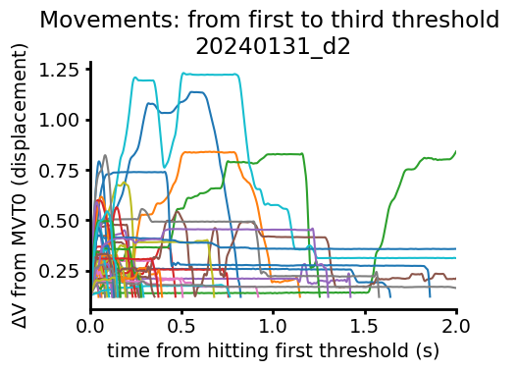

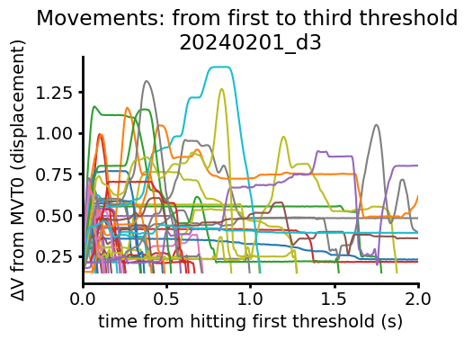


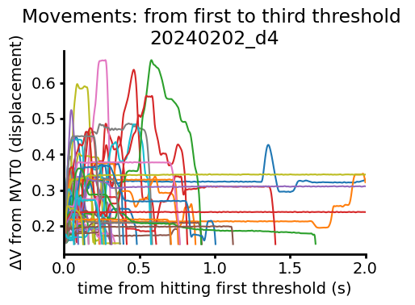
ANM7 Second Threshold Aligned Movements

Slide 3

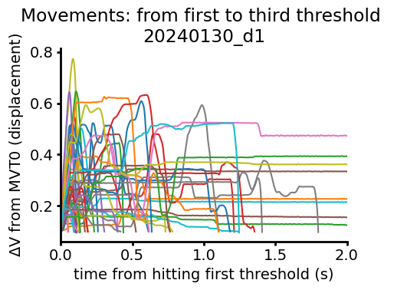

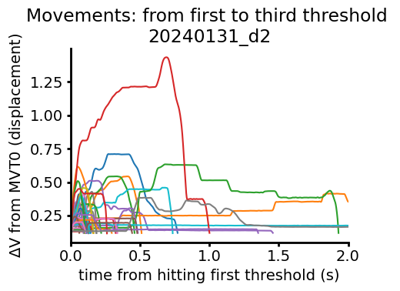

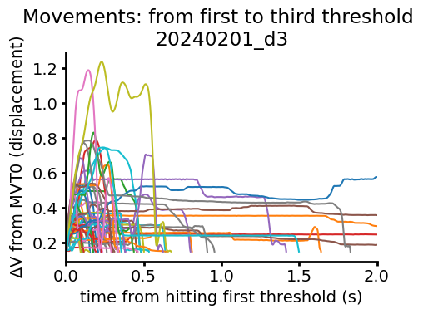

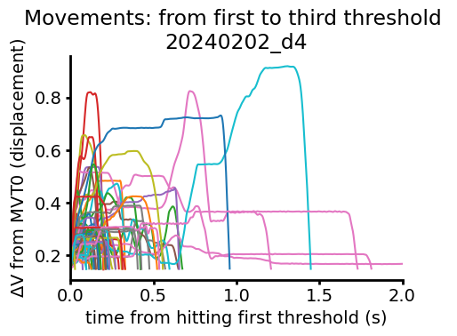

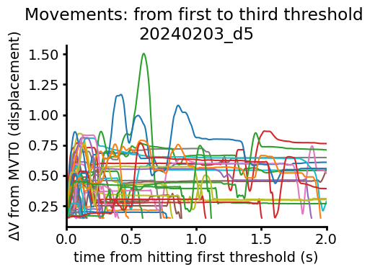
ANM8 Second Threshold Aligned Movements

Slide 4
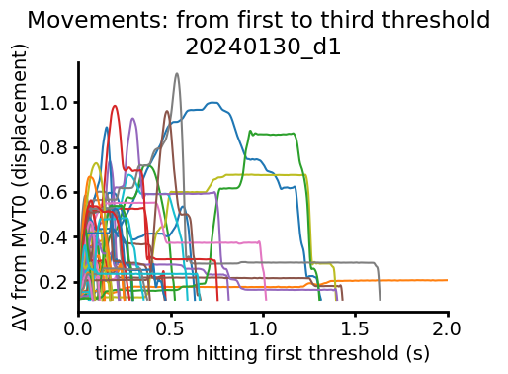

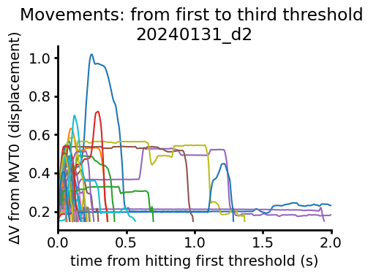

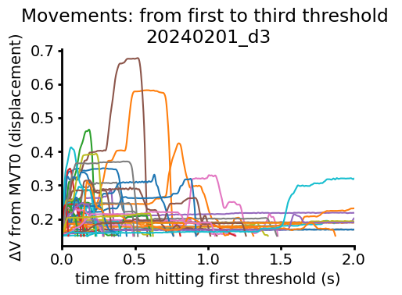

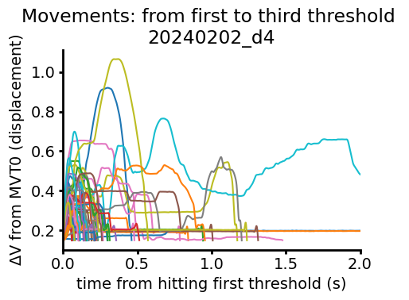

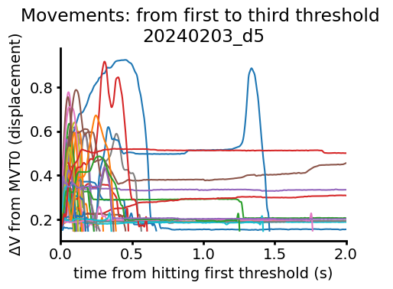

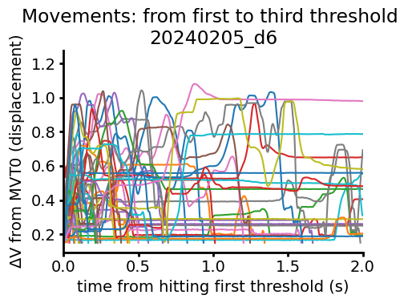

ANM1 Second Threshold Aligned Movements

Slide 5
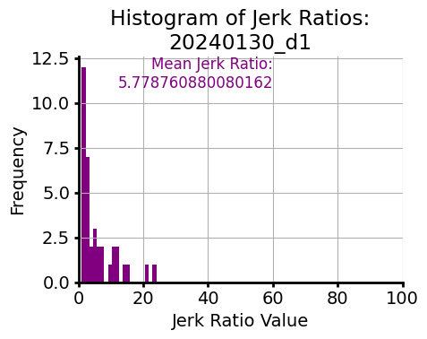
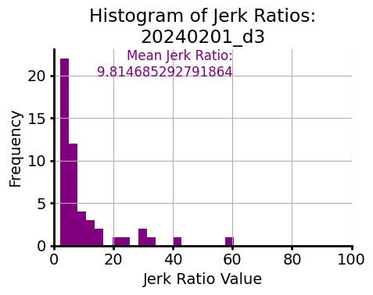
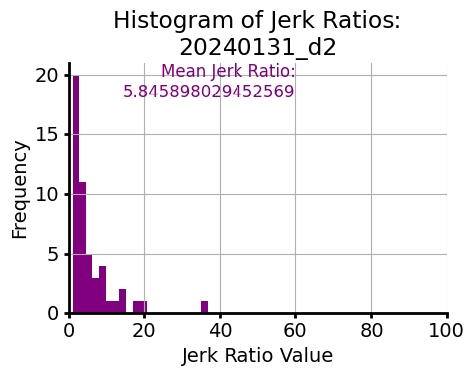
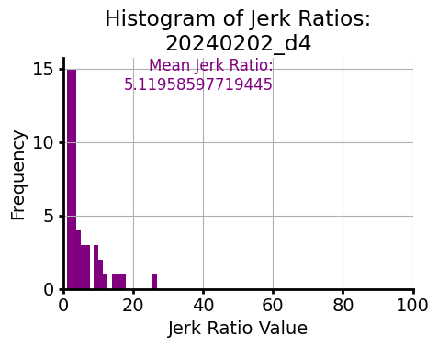
Normalized total jerk (jerk ratio) from first to third threshold
ANM7

Slide 6
Normalized total jerk (jerk ratio) from first to third threshold
ANM8

Slide 7
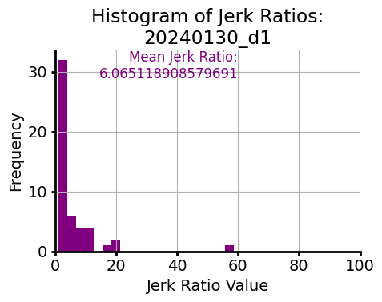
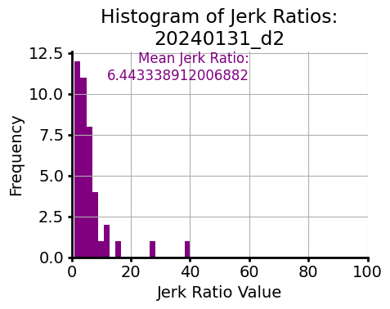
Normalized total jerk (jerk ratio) from first to third threshold
ANM1

Slide 8
Normalized total jerk (jerk ratio) from first threshold to peak of leverpress (not full lever press right now because of weird electrical thing)
Because data not ~N, plotting median +/- 95 cdf for now, but might go back to mean not sure
Yes, upper outliers are therefore cut off

Slide 9
Temporal compression of the movement?

Slide 10
Reaction times

