Slide 1

Quick sheet reference Last updated 26/08/2019
# Import
The import statements load functionality into Python. They should be the first lines of your program.
from microbit import *
from neopixel import NeoPixel
import random
import music
import radio
# Buttons & pins
The two buttons and 3 pins detect user input
if button_a.was_pressed():
if button_b.was_pressed():
if pin0.is_touched():
if pin1.is_touched():
if pin2.is_touched():
# Pause
Pause the program so the user has time to see what is happening or to respond.
sleep(2000)
# Control structures
Decide which code to run.
if condition_is_met:
do_this
do_this
do_this
elif other_condition_is_met:
do_this_other_thing
do_this_other_thing
do_this_other_thing
else:
last_resort_thing_to_do
last_resort_thing_to_do
last_resort_thing_to_do
always_do_this
always_do_this
always_do_this
while condition_is_met:
do_this_thing_repeatedly
do_this_thing_repeatedly
loop_is_over_with
# Display
Control the 5x5 LED display.
display.scroll(“text”)
display.scroll(“text”, delay=75) # double the speed
display.show(Image.HAPPY)
display.show(Image(“00000:00000:00000:00000:00000”))
display.clear()
# Gestures
Detect basic types of movement. Valid gestures are
"up", "down", "left", "right", "face up", "face down", "freefall", "3g", "6g", "8g", "shake".
if accelerometer.current_gesture() == "shake":
display.scroll(“Shake your booty”)
elif accelerometer.was_gesture() == "up":
display.scroll(“You lift me up”)
# Variables & calculations
Create a variable
q = 10 # create q with value 10
Operations (change the value of a variable)
q = r + s # r add s, save to q
q = r - s # r subtract s, save to q
q = r * s # r times s, save to q
q = r / s # r divided by s, save to q
Conditions (does a variable match a certain value?)
if r == q: # is r equal to q?
if r > q: # is r bigger than q?
if r < q: # is r less than q?
if r != q: # is r not equal to q?
Boolean variables (“True” or “False” variables)
keepgoing = True
while keepgoing:
do_something
# Bluetooth radio
Communicate with another Microbit
Must be on the same channel (from 0 to 83)
from microbit import *
import radio
radio.config(channel=10)
radio.on()
while True:
display.clear()
if button_a.was_pressed():
radio.send("iheart")
if button_b.was_pressed():
radio.send("upset")
incoming = radio.receive()
if incoming == "iheart":
display.show(Image.HEART)
sleep(2000)
elif incoming == "upset":
display.show(Image.SAD)
sleep(2000)
else:
display.show(“.”)
sleep(100)
display.show(“”)
sleep(100)
For more Python & Microbit resources visit
https://youtube.com/pbaumgarten
https://pbaumgarten.com/python
# Random
Generate a random number between 0 and 99
import random
r = random.randint(0,100)
Notes:
# Simple variables and calculations
# Simple arrays

Slide 2
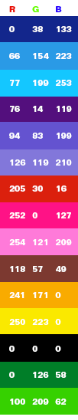
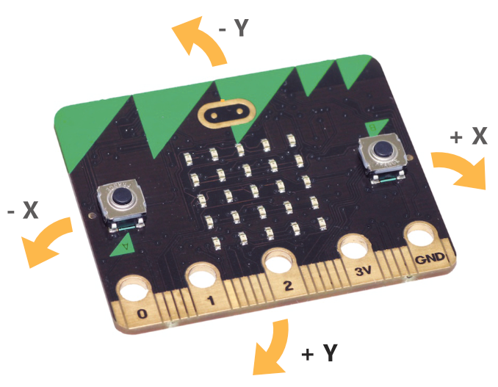
Quick sheet reference Last updated 26/08/2019
# Neopixels
Programmable multi colour LEDs that attach to the microbit.
White wire to pin 0 (or change code)
Red wire to 3V pin
Black wire to GND pin
Create the Neopixel object Replace the 8 with the number of LEDs you have
from neopixel import NeoPixel
leds = NeoPixel(pin0, 8)
Create your colours (refer to common colours table)
Colour values are red, green, blue values with range from 0 (fully off) to 255 (fully on).
white = [255, 255, 255]
blue = [ 0, 0, 255]
red = [255, 0, 0]
green = [ 0, 255, 0]
magenta = [255, 0, 255]
black = [ 0, 0, 0]
Set individual LEDs to a colour.
Remember: The first LED is 0, the second LED is 1, the third LED is 2 etc.
leds[0] = white
leds[1] = blue
leds[2] = red
leds.show() # don’t forget this
Full example
from microbit import *
from neopixel import NeoPixel
leds = NeoPixel(pin0, 8)
white = [255,255,255]
black = [0,0,0]
n = 0
while True:
for q in range(8):
leds[q] = black
leds[n] = white
leds.show()
n = n + 1
sleep(200)
if n >= 8:
n = 0
# Accelerometer
Detect movement.
X axis - tilting from left to right.
Y axis - tilting forwards and backwards.
Z axis - moving up and down
x,y,z = accelerometer.get_values()
if x < -50:
display.scroll(“tilting left”)
elif x > 50:
display.scroll(“tilting right”)
# Music
Play music. Assumes speaker connected to pin0 and GND.
Each note has three parts as follows:
noteoctave:duration
Note is one of a,b,c,d,e,f,g. F-sharp would be f# and A-flat would be Ab. The note “r” indicates rest (silence).
Octave starts at 4. Remembers each time you change it and applies until next change.
Duration starts at 4. Remembers each time you change it and applies until next change.
import music
tune = ["f#:2", "f#:4", "d", "b3", "r:2", "b3:4", "r:2", "e4:2", "r:2", "e:2", "r:2","e:2", "r:2", "g#:2", "g#:4", "a", "b", "a:2", "a:2", "a:2","e:4","d", "f#:2", "r:2", "f#:2", "r:2", "f#:2", "e:4", "e", "f#", "e" ]
music.set_tempo(bpm=168, ticks=4)
music.play(tune, wait=False)
# Speech
Your Microbit will talk back to you if you let it
import speech
speech.say("Hello, I am your microbit", speed=92, pitch=60, throat=110, mouth=190)

