Slide 1
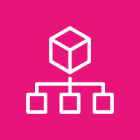
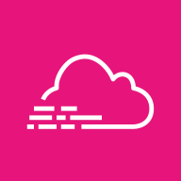
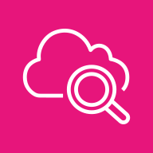


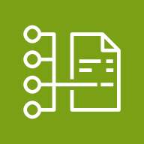

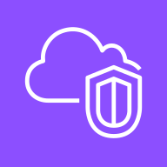

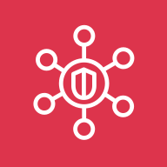
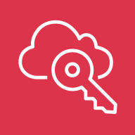
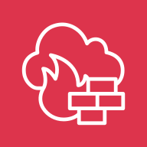
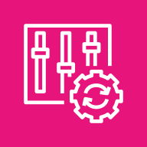


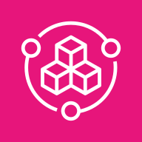
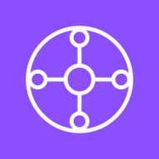

Titanium Landing Zone — Overview
1
AWS Organizations in the Management Account manages the OU structure and applies Service Control Policies.
Multi-account architecture providing security, networking, monitoring, and cost management foundations. Implements organizational units with delegated administration, centralized logging, and Transit Gateway connectivity.
2
AWS Budgets, AWS Compute Optimizer, and AWS Cost Optimization Hub provide centralized cost visibility and optimization recommendations across all accounts.
Management Account
Cost Management
1
2
3
Security services (Amazon GuardDuty, AWS Security Hub) are delegated from the Management Account to the Audit Account.
AWS Organizations
AWS CloudTrail
Amazon CloudWatch
AWS Budgets
AWS Compute Optimizer
AWS Cost Optimization Hub
4
AWS CloudTrail and AWS Config deliver logs from all accounts to the centralized Log Archive Account S3 buckets.
Security OU
Infrastructure OU
5
AWS IAM Identity Center in Shared Services Account provides SSO access across all accounts via delegated admin.
Log Archive Account
Audit Account
Shared Services Account
Network Account
Monitoring Account
6
AWS Transit Gateway in the Network Account provides centralized connectivity between workload VPCs.
3
5
7
Amazon GuardDuty
7
Inspection VPC with AWS Network Firewall (optional) inspects traffic flowing between VPCs and to the internet.
Amazon Simple Storage Service (Amazon S3)
VPC Flow Logs
AWS Security Hub
AWS CloudTrail
AWS IAM Identity
Center
Inspection VPC
Endpoint
VPC
AWS Network
Firewall
8
Amazon CloudWatch
4
6
8
Amazon CloudWatch and Amazon Simple Notification Service (Amazon SNS) in the Monitoring Account aggregate metrics and deliver alerts across accounts.
AWS Config
AWS CloudTrail
Amazon Detective
Amazon Macie
AWS Service
Catalog
AWS Transit Gateway
Amazon VPC IP Address Manager (IPAM)
Amazon Simple Notification Service (Amazon SNS)
9
Production and Development workload accounts with dedicated VPCs connected to the AWS Transit Gateway for centralized network routing.
Workloads OU
9
Sandbox OU
Exceptions OU
10
Sandbox accounts are isolated with no AWS Transit Gateway connectivity for safe experimentation.
Production Workloads
Development Workloads
10
11
Isolated sandbox accounts
(no TGW connectivity)
Accounts requiring
policy exceptions
11
Accounts requiring policy exceptions operate outside standard SCPs with compensating controls and enhanced monitoring.
Workload VPC
Workload VPC

