Slide 1



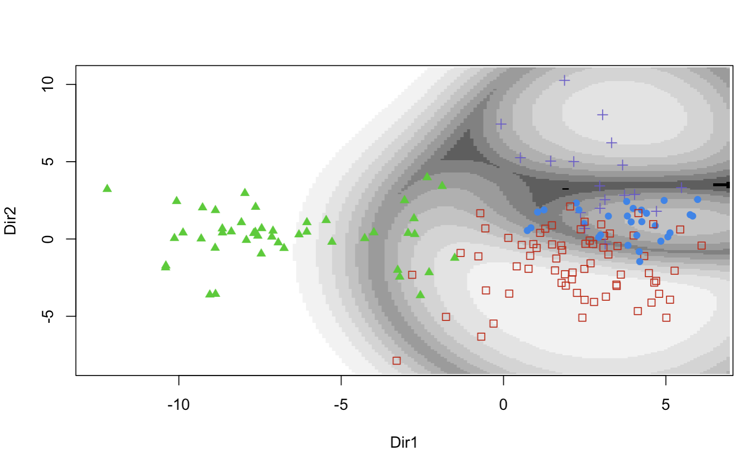
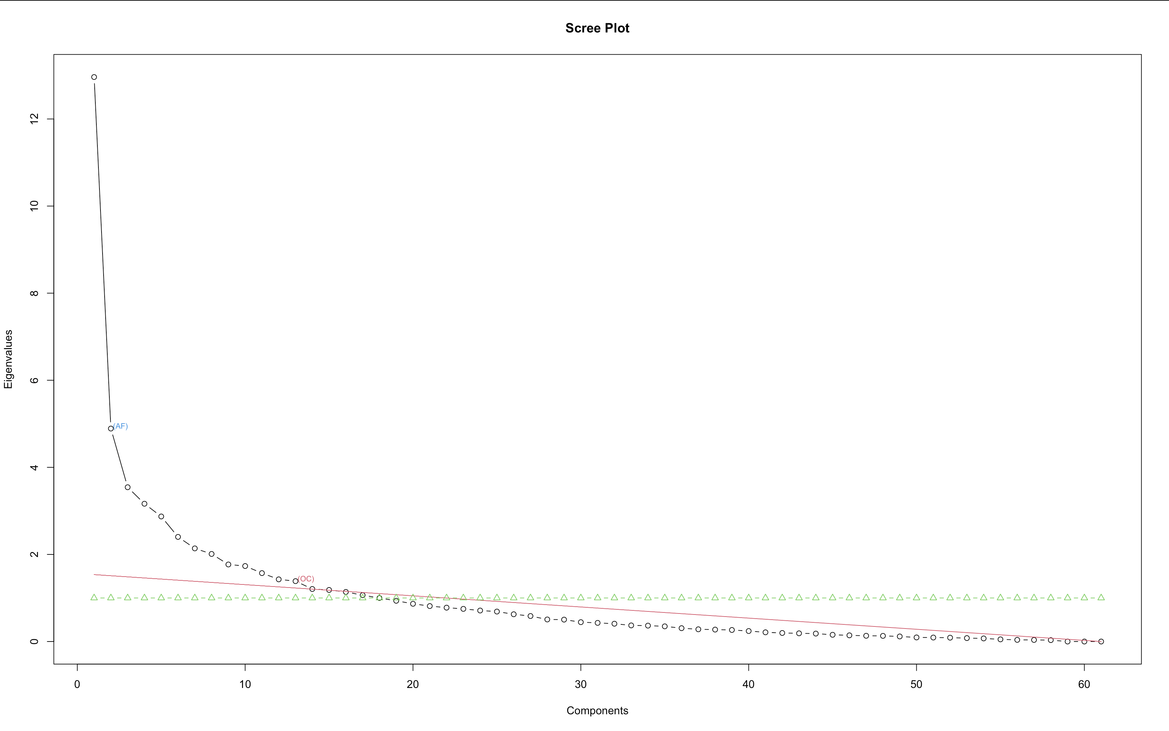
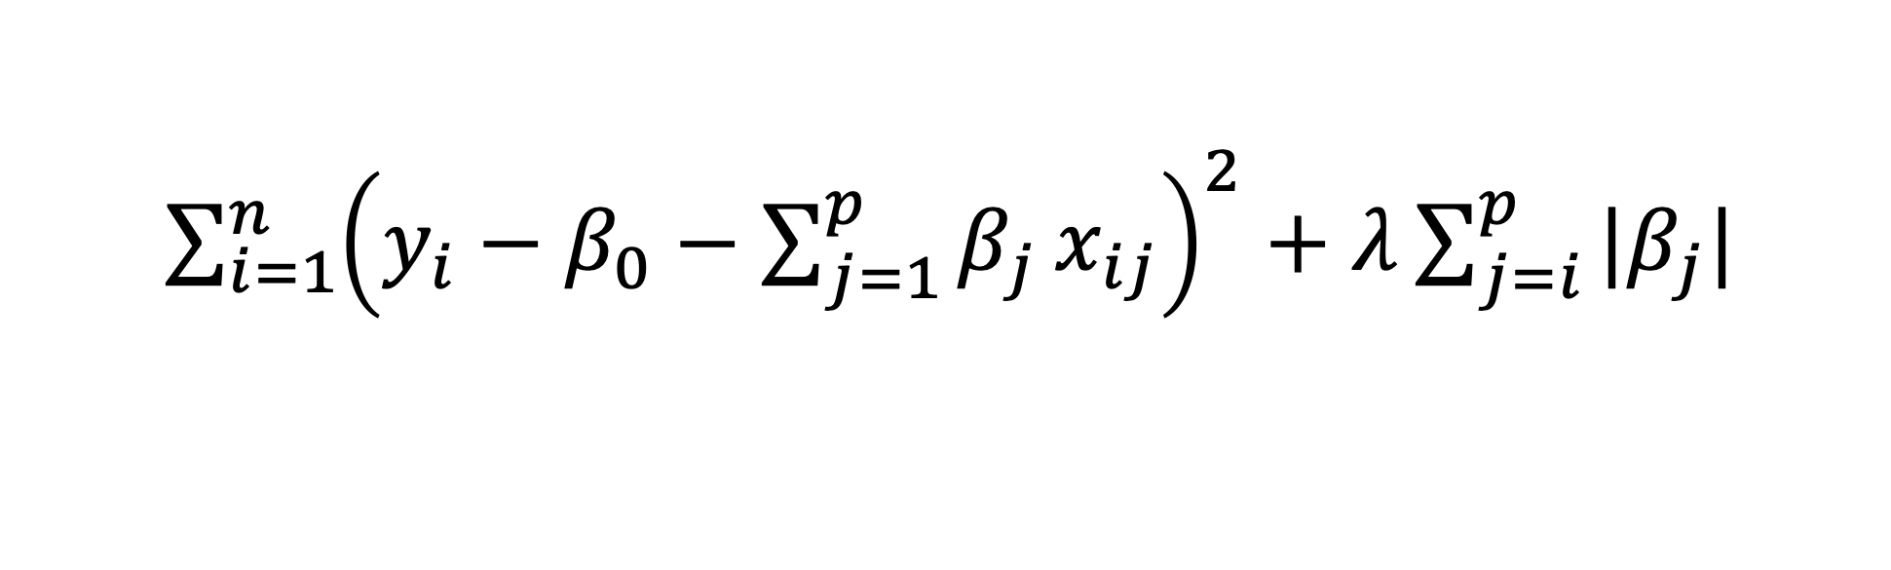

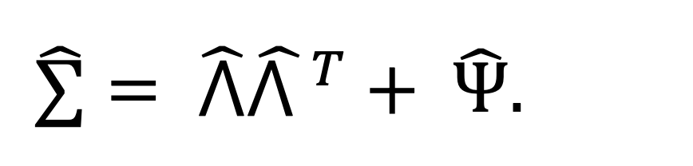
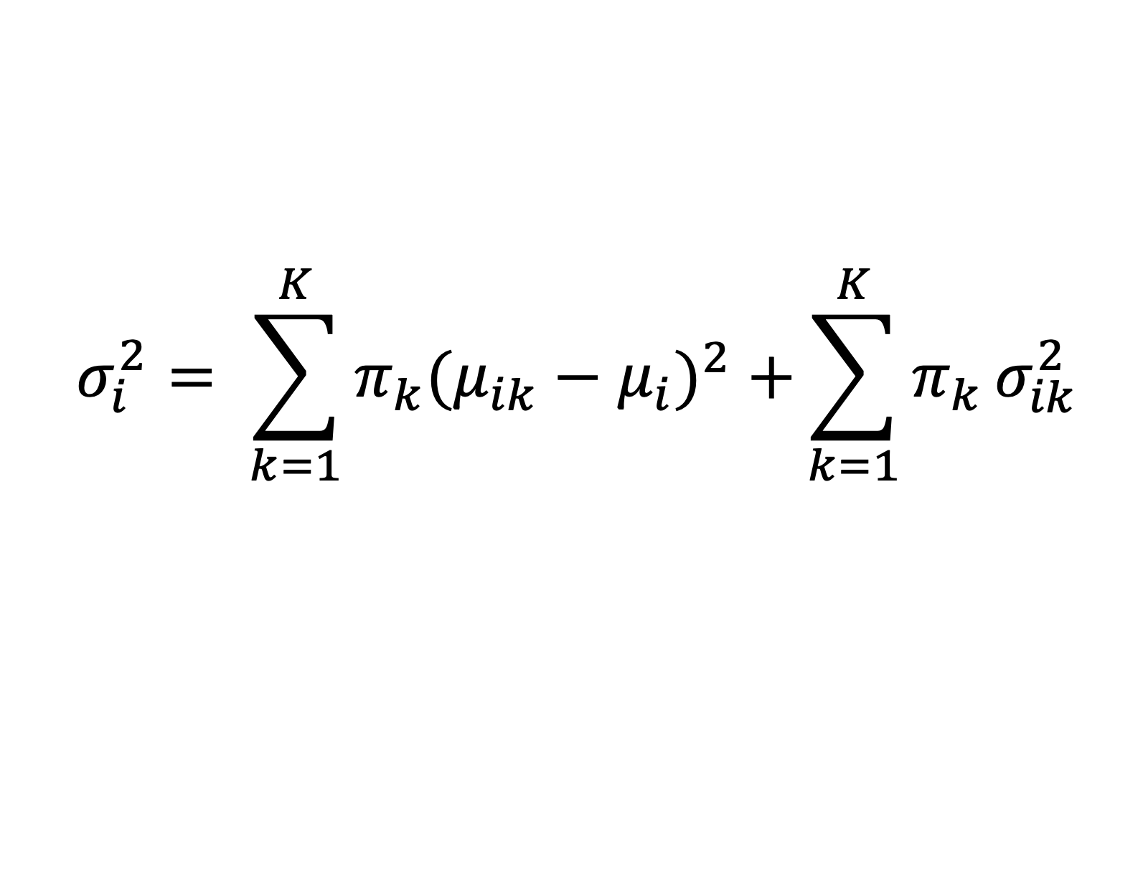



Motivation Question
Latent Profile Analysis on Gestational Age
Paul Bedu-Osei Jr. pbeduose@syr.edu; Department of Mathematics, Syracuse University.
Data Overview
161 observations.
4 types of Exposures (p=38): phthalates, phenols & parabens, polycyclic aromatic hydrocarbons, trace metals.
6 types of Endogenous biomarkers (p=61): Cyclooxygenase, Cytochrome p450, Lipoxygenase, Parent Compound, Oxidative Stress, Protein Damage, Inflammatory.
Covariates: age, insurance, specific gravity, initial BMI, education.
Response variable: gestation age at final visit.
Factor Analysis on Biomarkers
18 latent profiles, explaining 80% variance.
Rotation Method: Promax (correlates factors)
Challenges encountered during factor analysis:
  Complex data hindered relationship interpretation.
Predictor | Coefficient | Std. Error | T-value | P-value
t1bmi | 1.092 | 0.046 | 23.515 | 0.000
education | 3.786 | 0.558 | 6.789 | 0.000
Factor10 | 0.861 | 0.354 | 2.435 | 0.016
When t1bmi increases by 1 unit, gestation age at final visit would be 1.092 weeks longer, highly significant (p < 0.000).
When education increases by 1 unit, gestation age at final visit would be 3.786 weeks longer, highly significant (p = 0.000).
When Factor10 increases by 1 unit, gestation age at final visit would be 0.861 weeks longer, significant (p = 0.016).
Contour Plot: Shows clustering data density.
Projection: Onto first two principal components.
Visualization: Simplifies interpretation.
Identification: Visually identifies the 4 distinct clusters.
Research question
Are there unique profiles based on toxicant exposures and biomarkers among pregnant women?
How do these latent profiles relate to gestation age at the final visit?
Latent clusters on 38 exposures
Latent Cluster 1: Low exposure to phthalates, phenols and parabens, and PAHs.
Latent Cluster 2: Average exposure to phthalates, phenols and parabens, PAHs, and trace metals.
Latent Cluster 3: High exposure to phthalates, phenols and parabens, PAHs, and trace metals.
Latent Cluster 4: Very low exposure to trace metals.
  Determines number of factors.
  Maximizes coverage.
  AF: Actual elbow denotes minimum required factors.
  OC: Maximum feasible factors, last eigenvalue ≥ 1.
  Values > 1 preferred; < 1, especially, less desirable.
Conclusion
Initial BMI, Factor 10, and education are significant at the 5% significance level.
$R^{2}$= 0.957 indicates that 95.7% of the variability in gestational age at the final visit is explained by the predictors included in the model.
.
Latent Profile Analysis (LPA)
Objective of LPA:
Uncover hidden subgroups within a population by examining patterns of responses to observed variables.
Approach:
Utilizes a probabilistic model to estimate membership probabilities in latent profiles.
Model:
Factor Analysis
Aim:
  Identifies latent factors.
  Reduces dimensionality.
  Model:
Variability in data X, is represented by $∑.$
It’s estimate $\hat{∑}$ is composed of :
$\hat{⋀}{\hat{⋀ }}^{T}$: Variability explained by factors (communality).
$\hat{ Ψ}$: Variability not explained by factors (uniqueness)
Methodology:
  Principal Component Analysis.
  Maximum Likelihood Method.
LASSO regression
A regularization technique for variable selection.
Aim: Minimize residual sum of squares (RSS).
Objective: Penalizes absolute size of coefficients (β).
Model:
n: Number of observations.
${ y}_{i}$ : $i^{th}$ Outcome response.
${ β}_{0}$ ​: Intercept term.
${ x}_{ij}$ ​: Value of the $j^{th}$ predictor for the $i^{th}$observation.
${ β}_{j}$ : Coefficient for the $j^{th}$ predictor.
λ: Regularization parameter, controlling penalty strength.
References
1. James, G., Witten, D., Hastie, T., & Tibshirani, R. (2023). An Introduction to Statistical Learning. Accessed April 28, 2024, from https://www.statlearning.com/.
2. Hartmann, K., Krois, J., & Rudolph, A. (2023). Statistics and Geodata Analysis using R (SOGA-R). Department of Earth Sciences, Freie Universitaet Berlin.
3. Spurk, D., Hirschi, A., Wang, M., Valero, D. C., & Kauffeld, S. (2020). Latent profile analysis: A review and 'how to' guide of its application within vocational behavior research. Journal of Vocational Behavior, 120, 103445.
$\hat{∑}= \hat{⋀}{\hat{⋀ }}^{T}+ \hat{Ψ}.$
$\sum_{i=1}^{n}{{\left(y_{i}−β_{0}−\sum_{j=1}^{p}{β_{j}}x_{ij}\right)}^{2}+λ\sum_{j=i}^{p}{|β_{j}|}}$
$$σ_{i}^{2}= \sum_{k=1}^{K}{{π_{k}(μ_{ik}−μ_{i})}^{2}+}\sum_{k=1}^{K}{π_{k}}σ_{ik}^{2}$$
${ μ}_{ik}$ and $σ_{ik}$ represent profile-specific means and variances for variable i.
$π_{k}$ indicates profile density.

