Slide 1
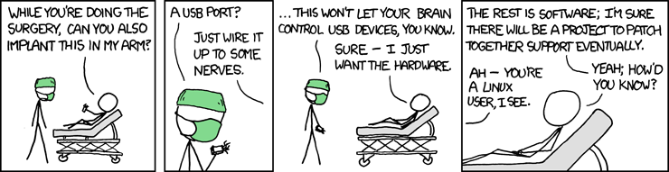
Cptr 497 – Seminar
Twitter-Sense
Paul Bellamy
June 2010

Slide 2
Statement
To explore the limits of brain plasticity and sensory addition, and to examine the possibility of a brain-computer interface.
Abstract
The ultimate question posed by this project is, can the brain learn to perceive radically different and completely abstract new senses.
Notes:
Not strictly a computer science project, but CS skills are required for project completion.

Slide 3
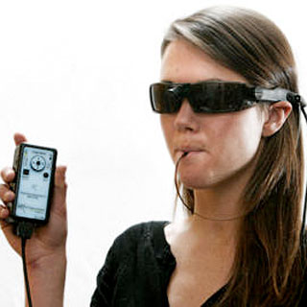
Project Background
  Bach-y-Rita
      Showed that the brain can adapt and integrate new senses through “sensory substitution”.
Notes:
Camera mounted on glasses
“Sensory Substitution” used to transform video into electrical impulses
Impulses sent to tongue
After ~15 mins average user can see basic shapes
After a few hours average user can read large print
Low-res video makes it hard to see fine detail
BrainPort for restoring balance after inner ear damage.
Initial training effort needed on part of user to integrate/interpret new sensory data.
Bach-y-Rita died in November 2006 leaving his research unfinished.

Slide 4
Project Background
  Projects Since Bach-y-Rita
    Showed that the brain can add new senses.
Notes:
Northpaw/Feelspace
Leads to qualitatively different experiences for the user.
No (or very little) effort needed on part of user to integrate new data.
Magnetic Implants
Allows the user to feel electro-magnetic impulses and fields like live wires, etc.
No (or very little) effort needed on part of user to integrate new data.

Slide 5
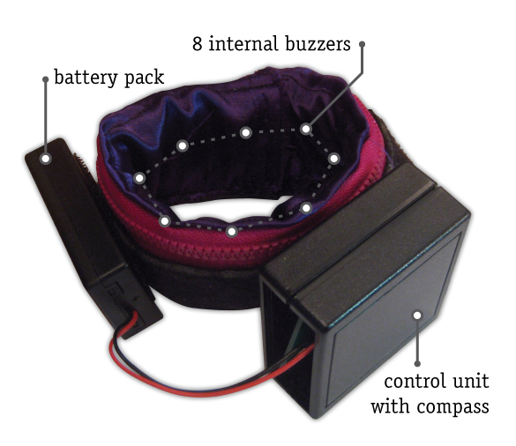
Project Background
  Projects Since Bach-y-Rita
    Showed that the brain can add new senses.
  Northpaw/Feelspace
    Uses compass and vibrators to add a sense of direction. The user always knows which direction is north.
Notes:
Northpaw/Feelspace
Leads to qualitatively different experiences for the user.
No (or very little) effort needed on part of user to integrate new data.
Magnetic Implants
Allows the user to feel electro-magnetic impulses and fields like live wires, etc.
No (or very little) effort needed on part of user to integrate new data.

Slide 6
Project Background
  Projects Since Bach-y-Rita
    Showed that the brain can add new senses.
  Northpaw/Feelspace
    Uses compass and vibrators to add a sense of direction. The user always knows which direction is north.
  Magnetic Implants
    Not for the squeamish.
Notes:
Northpaw/Feelspace
Leads to qualitatively different experiences for the user.
No (or very little) effort needed on part of user to integrate new data.
Magnetic Implants
Allows the user to feel electro-magnetic impulses and fields like live wires, etc.
No (or very little) effort needed on part of user to integrate new data.

Slide 7
Project Background
  Projects Since Bach-y-Rita
    Showed that the brain can add new senses.
  Northpaw/Feelspace
    Uses compass and vibrators to add a sense of direction. The user always knows which direction is north.
  Magnetic Implants
    Not for the squeamish.
  Nick Hasty's EM Brace
    Sensing EM Fields
Notes:
Northpaw/Feelspace
Leads to qualitatively different experiences for the user.
No (or very little) effort needed on part of user to integrate new data.
Magnetic Implants
Allows the user to feel electro-magnetic impulses and fields like live wires, etc.
No (or very little) effort needed on part of user to integrate new data.

Slide 8
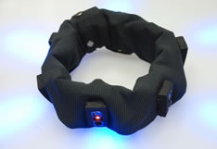
Project Background
  Projects Since Bach-y-Rita
    Showed that the brain can add new senses.
  Northpaw/Feelspace
    Uses compass and vibrators to add a sense of direction. The user always knows which direction is north.
  Magnetic Implants
    Not for the squeamish.
  Nick Hasty's EM Brace
    Sensing EM Fields
  Haptic Radar / Extended Skin Project
    Headband analogous to a cat's whiskers
Notes:
Northpaw/Feelspace
Leads to qualitatively different experiences for the user.
No (or very little) effort needed on part of user to integrate new data.
Magnetic Implants
Allows the user to feel electro-magnetic impulses and fields like live wires, etc.
No (or very little) effort needed on part of user to integrate new data.

Slide 9
Project Details
  All the previous projects have been used sensory substitution to add spatially-bound senses.
  The goal of this project is to determine if the human brain can integrate completely abstract spatially-independent data as a new sense.

Slide 10
Project Details
  All the previous projects have been used sensory substitution to add spatially-bound senses.
  The goal of this project is to determine if the human brain can integrate completely abstract spatially-independent data as a new sense.
In Other Words...

Slide 11
Twitter-Sense

Slide 12
Intended Outcomes
Notes:
4 potential outcomes

Slide 13
Intended Outcomes
  Weak Integration
    In principle, the new sensory information provided can be processed. Thereby, training can improve performance.

Slide 14
Intended Outcomes
  Weak Integration
    In principle, the new sensory information provided can be processed. Thereby, training can improve performance.
  Strong Integration
    New sensory data can be firmly integrated in human perception. Sensory input of the device produces measurable responses of the test persons.

Slide 15
Intended Outcomes
  Weak Integration
    In principle, the new sensory information provided can be processed. Thereby, training can improve performance.
  Strong Integration
    New sensory data can be firmly integrated in human perception. Sensory input of the device produces measurable responses of the test persons.
  Subcognitive Processing
    After training, attention is not needed to process sensory information.

Slide 16
Intended Outcomes
  Weak Integration
    In principle, the new sensory information provided can be processed. Thereby, training can improve performance.
  Strong Integration
    New sensory data can be firmly integrated in human perception. Sensory input of the device produces measurable responses of the test persons.
  Subcognitive Processing
    After training, attention is not needed to process sensory information.
  New Modality
    Complete integration and mastery of the new sensory information results in qualitatively new experiences.

Slide 17
Project Timeline
Three Phases

Slide 18
Project Timeline
Three Phases
  Developmental Phase: Dec 14 - Feb 12
Goals: Select appropriate data source.
Develop and build device.
Develop and build training method/interface.

Slide 19
Project Timeline
Three Phases
  Developmental Phase: Dec 14 - Feb 12
Goals: Select appropriate data source.
Develop and build device.
Develop and build training method/interface.
  Experimental Phase: Feb 16 – May 14
Goals: Test the hypothesis.
Maintain experimental validity, as much as possible.

Slide 20
Project Timeline
Three Phases
  Developmental Phase: Dec 14 - Feb 12
Goals: Select appropriate data source.
Develop and build device.
Develop and build training method/interface.
  Experimental Phase: Feb 16 – May 14
Goals: Test the hypothesis.
Maintain experimental validity, as much as possible.
  Analysis Phase: May 17 – May 28
Goals: Thoroughly examine the results.
Draw conclusions about the hypothesis.
Find/Examine areas for further study.

Slide 21
Project Timeline (revised)
Three Phases
  Developmental Phase: Dec 14 – Mar 12
Goals: Select appropriate data source.
Develop and build device.
Develop and build training method/interface.
  Experimental Phase: Mar 15 – Apr 30 (at least 1 month)
Goals: Test the hypothesis.
Maintain experimental validity, as much as possible.
  Analysis Phase: May 3 – May 14
Goals: Thoroughly examine the results.
Draw conclusions about the hypothesis.
Find/Examine areas for further study.
  Buffer Zone: May 14 – May 28

Slide 22
Sensory Substitution
  Need to transform:
    Text → Tactile Information
  Practical Limitations:
    Low Resolution
    Unknown Bandwidth
Notes:
Low-res(Minimal points of contact)
Unknown Bandwidth (How fast can a person process this?)
Limited Transmission Speed (can only transmit Morse code so fast before losing clarity)

Slide 23
Sensory Substitution
  Need to transform:
    Text → Tactile Information
  Practical Limitations:
    Low Resolution
    Unknown Bandwidth
  Where is this already done? Where could this be done easily?
Notes:
Low-res(Minimal points of contact)
Unknown Bandwidth (How fast can a person process this?)
Limited Transmission Speed (can only transmit Morse code so fast before losing clarity)

Slide 24
Sensory Substitution
  Need to transform:
    Text → Tactile Information
  Practical Limitations:
    Low Resolution
    Unknown Bandwidth
  Where is this already done? Where could this be done easily?
    Morse Code
      1-bit Time-based Transmission
      Limited Transmission Speed
Notes:
Low-res(Minimal points of contact)
Unknown Bandwidth (How fast can a person process this?)
Limited Transmission Speed (can only transmit Morse code so fast before losing clarity)

Slide 25
Sensory Substitution
  Need to transform:
    Text → Tactile Information
  Practical Limitations:
    Low Resolution
    Unknown Bandwidth
  Where is this already done? Where could this be done easily?
    Morse Code
      1-bit Time-based Transmission
      Limited Transmission Speed
    Braille
      6 or 8-bit Time-independent Transmission
      Not time based
      Transmission Speed only limited by recognition
Notes:
Low-res(Minimal points of contact)
Unknown Bandwidth (How fast can a person process this?)
Limited Transmission Speed (can only transmit Morse code so fast before losing clarity)

Slide 26
Sensory Substitution
  Need to transform:
    Text → Tactile Information
  Practical Limitations:
    Low Resolution
    Unknown Bandwidth
  Where is this already done? Where could this be done easily?
    Morse Code
      1-bit Time-based Transmission
      Limited Transmission Speed
    Braille
      6 or 8-bit Time-independent Transmission
      Not time based
      Transmission Speed only limited by recognition
    Vibratese
      No Documentation or Information on it!
Notes:
Low-res(Minimal points of contact)
Unknown Bandwidth (How fast can a person process this?)
Limited Transmission Speed (can only transmit Morse code so fast before losing clarity)

Slide 27
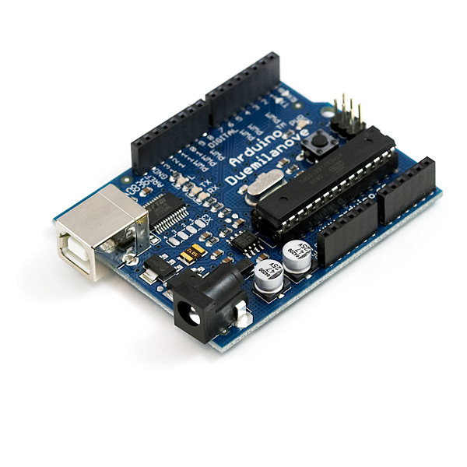
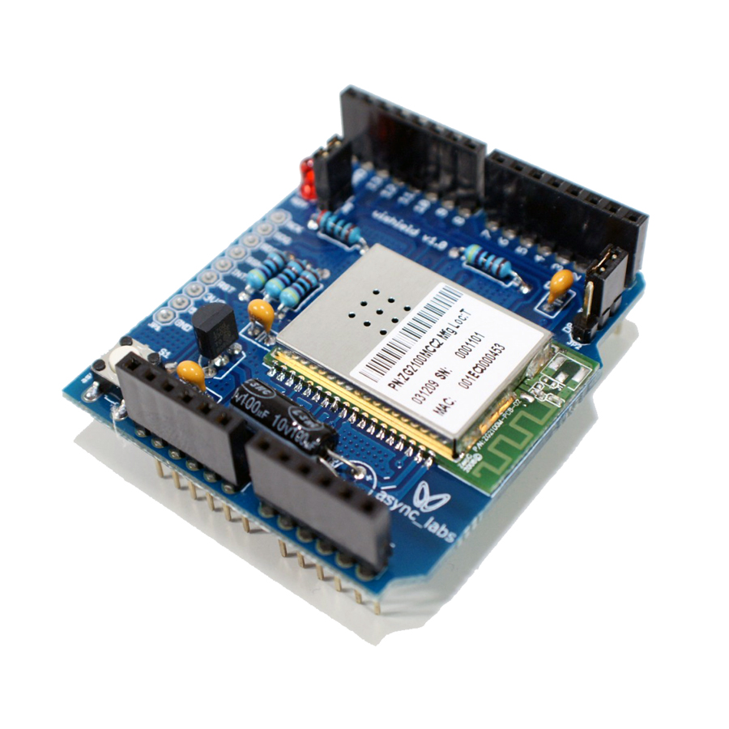
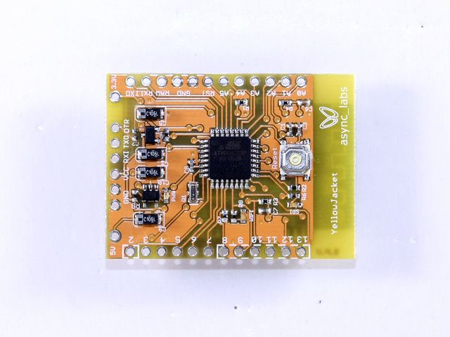
The Client – v1.0 → v2.0
  6-bit Braille Interface
  Arduino based
    Easy prototyping
    Compact form factor (ish)
    Little Memory!
  Vibration feedback
    Unobtrusive tactile feedback
  Wi-fi data transmission
      For mobility and comfort
      Queries the server for data
The Client – v3.0
  1-bit Morse Interface
  Smaller Yellowjacket form factor

Slide 28
The Server
  PHP
    Queries and Parses Twitter Feeds
    Sends formatted data to the client

Slide 29
Training
  Schedule
    1hr/day (most days)
    Similar schedule to learning a foreign language, would be nice, but too intensive
  Software
    Web interface to device
    Spaced Repetition System (SRS)
    Working towards full word recognition
  Method
    Combination of Koch Method and Farnsworth

Slide 30
Results
  Weak and Strong Integration shown
      Subject able to use and respond to device
      No subcognitive processing

Slide 31
Results
  Weak and Strong Integration shown
      Subject able to use and respond to device
      No subcognitive processing
  Training taking longer than expected

Slide 32
Results
  Weak and Strong Integration shown
      Subject able to use and respond to device
      No subcognitive processing
  Training taking longer than expected
  Continuing training into summer
    Hopefully achieve subcognitive processing

Slide 33
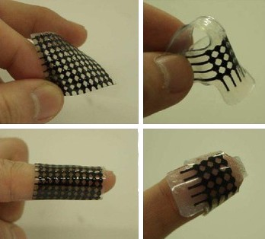
Areas for Future Study
  Return device to initial form-factor
  Better materials for the device may
  improve results.
  Ways to speed up training
  An effective brain → computer interface
  for output.
  Just how abstract is the data that the
  brain can learn to process?
    Is text the most abstract?
    Raw Binary? Raw Wifi?
  Augmented Reality Applications
  Vibratese as a transmission method
Notes:
Flexible tactile feedback material developed by a grad student in Korea

Slide 34
Bibliography
feelSpace Project - http://feelspace.cogsci.uni-osnabrueck.de/en/index.html
Hackaday.com - http://hackaday.com/2008/06/13/wearable-haptic-devices-bestow-sixth-senses/
More info on Dr. Paul Bach-y-Rita - http://en.wikipedia.org/wiki/Paul_Bach-y-Rita
Augmented Reality Applications - http://www.physorg.com/news189747401.html
Nick Hasty's EM Brace - http://jnhasty.com/embrace/
Haptic Radar Project - http://www.k2.t.u-tokyo.ac.jp/perception/HapticRadar/index-e.html

