Slide 1

Paul Benedict M. Rosin
BSChE - 2B
NAME IT, DRAW IT
Two-Way IUPAC Nomenclature of Alkanes, Cycloalkanes and Haloalkanes
CHEM 13 — Organic Chemistry (Lecture) | BS Chemical Engineering

Slide 2
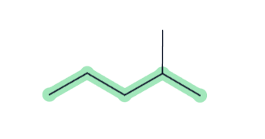
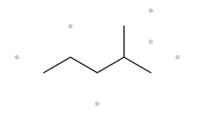

CARD A01 - STRUCTURE - NAME
FOUNDATION | MOLECULAR FORMULA: C6H14
1 - NUMBERED PARENT
2 - NAMING TRAIL
Parent: longest chain = 5C ￫ pentane
Numbering: right ￫ left gives 2; left ￫ right gives 4. 2<4, so start from the right.
Substituents: methyl group on C2 ￫ 2-methyl
4
2
5
3
1
3 - MY NAME (WRITTEN FIRST)
4 - THE ALKANE CHECK
2-methylpentane
Returned name: 2-methylpentane
✓ Match
longest chain confirmed
lowest locants
alphabetical order
punctuation
formula counted

Slide 3
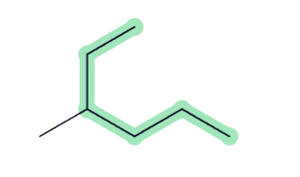
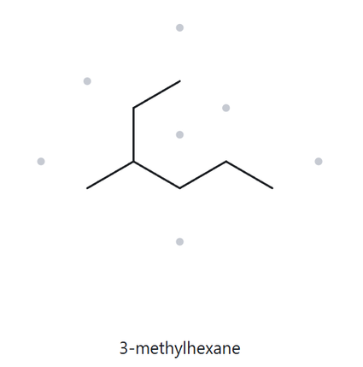
CARD A02 - STRUCTURE - NAME
FOUNDATION | MOLECULAR FORMULA: C7H16
1 - NUMBERED PARENT
2 - NAMING TRAIL
Parent: longest chain = 6C ￫ hexane
Numbering: right ￫ left gives 4; from the uppermost going down gives 3. 3<4, so start from the uppermost.
Substituents: methyl group on C3 ￫ 3-methyl
1
2
3
5
4
6
3 - MY NAME (WRITTEN FIRST)
4 - THE ALKANE CHECK
3-methylhexane
Returned name: 3-methylhexane
✓ Match
longest chain confirmed
lowest locants
alphabetical order
punctuation
formula counted

Slide 4
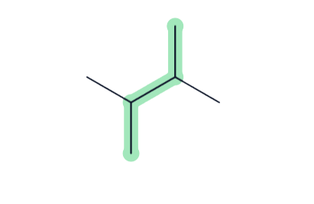
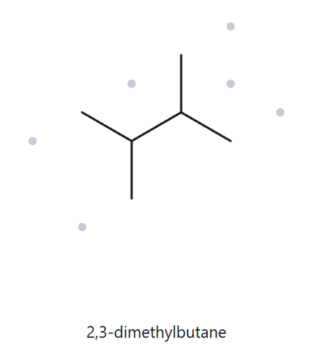
CARD A03 - STRUCTURE - NAME
FOUNDATION | MOLECULAR FORMULA: C6H14
1 - NUMBERED PARENT
2 - NAMING TRAIL
4
Parent: longest chain = 4C ￫ butane. The same chain can be achieved on 4 other ways.
Numbering: from bottommost to uppermost gives 2 as the lowest locant and the same result can be achieved by starting from the top.
Substituents: 2 methyl on C2 and C3 groups are found￫ 2, 3-dimethyl
3
2
1
3 - MY NAME (WRITTEN FIRST)
4 - THE ALKANE CHECK
2,3-dimethylbutane
Returned name: 2,3-dimethylbutane
✓ Match
longest chain confirmed
lowest locants
alphabetical order
punctuation
formula counted

Slide 5
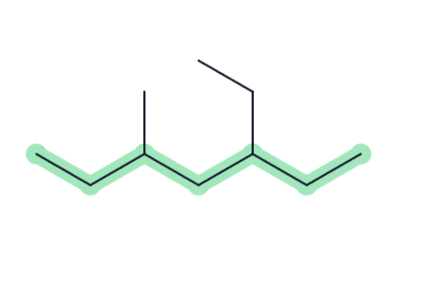
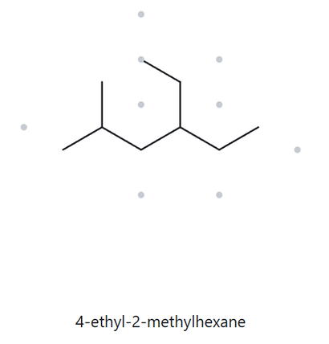
CARD A04 - STRUCTURE - NAME
DEVELOPING | MOLECULAR FORMULA: C10H22
1 - NUMBERED PARENT
2 - NAMING TRAIL
Parent: longest chain = 6C ￫ hexane
Numbering: starting from left to right gives 2 as the lowest locant; starting from right to left gives 3 as the lowest locant. So start from the left.
Substituents: methyl group on C2 and ethyl group on C4 ￫ 4-ethyl-2-methyl
2
4
6
1
3
5
3 - MY NAME (WRITTEN FIRST)
4 - THE ALKANE CHECK
4-ethyl-2-methylhexane
Returned name: 4-ethyl-2-methylhexane
✓ Match
longest chain confirmed
lowest locants
alphabetical order
punctuation
formula counted

Slide 6
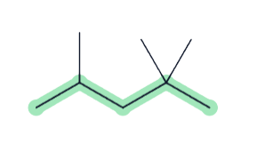
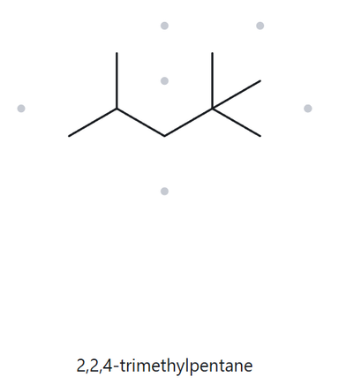
CARD A05 - STRUCTURE - NAME
DEVELOPING | MOLECULAR FORMULA: C8H18
1 - NUMBERED PARENT
2 - NAMING TRAIL
Parent: longest chain = 5C ￫ pentane
Numbering: starting from left to right gives 2 as the lowest locant, same as starting from the right, but starting from left gives 2,4,4 and from right 2,2,4; so start from right.
Substituents: 2 methyl groups on C2 and a methyl group on C4 ￫ 2,2,4-trimethyl
4
2
5
3
1
3 - MY NAME (WRITTEN FIRST)
4 - THE ALKANE CHECK
2,2,4-trimethylpentane
Returned name: 2,2,4-trimethylpentane
✓ Match
longest chain confirmed
lowest locants
alphabetical order
punctuation
formula counted

Slide 7
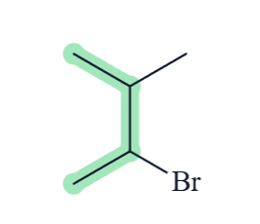
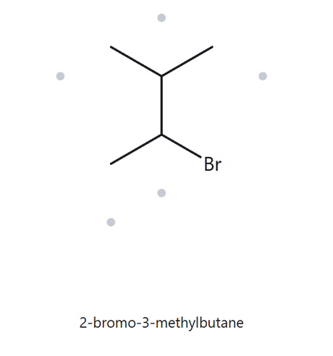
CARD A06 - STRUCTURE - NAME
DEVELOPING | MOLECULAR FORMULA: C5Br
1 - NUMBERED PARENT
2 - NAMING TRAIL
Parent: longest chain = 4C ￫ butane. The length can be achieved from CA to C1 but Br is a priority so C1 to C4.
Numbering: starting from the C4 gives 3 for Br while starting from bottom gives 2 as the locant number for Br. So from bottom first.
Substituents: Bromine atom at C2 and methyl group at C3 ￫ 2-bromo-3-methyl
4
A
3
2
1
3 - MY NAME (WRITTEN FIRST)
4 - THE ALKANE CHECK
2-bromo-3-methylbutane
Returned name: 2-bromo-3-methylbutane
✓ Match
longest chain confirmed
lowest locants
alphabetical order
punctuation
formula counted

Slide 8
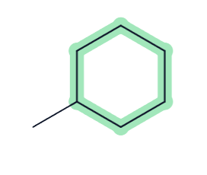
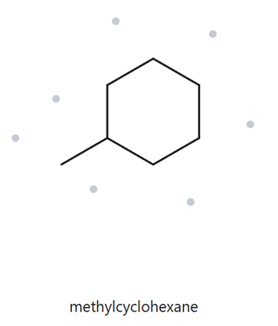
CARD A07 - STRUCTURE - NAME
DEVELOPING | MOLECULAR FORMULA: C7H14
1 - NUMBERED PARENT
2 - NAMING TRAIL
5
Parent: ring of 6C is the parent ￫ cyclohexane
Numbering: only one substituent present so not needed
Substituents: a methyl group ￫ methyl
6
4
1
3
2
3 - MY NAME (WRITTEN FIRST)
4 - THE ALKANE CHECK
methylcyclohexane
Returned name: methylcyclohexane
✓ Match
longest chain confirmed
lowest locants
alphabetical order
punctuation
formula counted

Slide 9
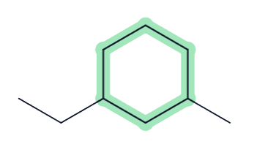
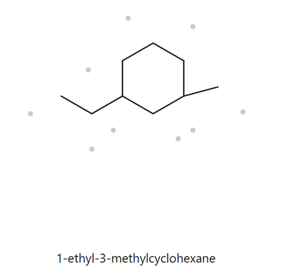
CARD A08 - STRUCTURE - NAME
CHALLENGE | MOLECULAR FORMULA: C9H18
1 - NUMBERED PARENT
2 - NAMING TRAIL
5
Parent: ring of 6C is the parent ￫ cyclohexane
Numbering: Ethyl group is a priority so this is the start of the chain. Going clockwise gives 5 for methyl while going counterclockwise gives 3. So go counterclockwise at counting.
Substituents: an ethyl group at C1 and a methyl group at C3 ￫ 1-ethyl-3-methyl
6
4
1
3
2
3 - MY NAME (WRITTEN FIRST)
4 - THE ALKANE CHECK
1-ethyl-3-methylcyclohexane
Returned name: 1-ethyl-3-methylcyclohexane
✓ Match
longest chain confirmed
lowest locants
alphabetical order
punctuation
formula counted

Slide 10
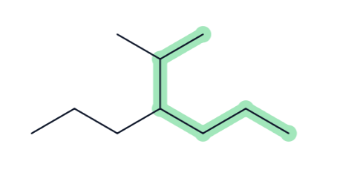
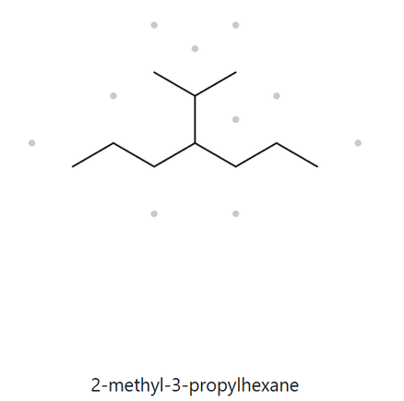
CARD A09 - STRUCTURE - NAME
CHALLENGE | MOLECULAR FORMULA: C10H22
1 - NUMBERED PARENT
2 - NAMING TRAIL
1
Parent: longest chain = 6C ￫ hexane. There are 4 ways to achieve this chain.
Numbering: from uppermost and going down gives 2 as the lowest locant; from bottom and going up gives 4 as the lowest locant. So start from the uppermost.
Substituents: C2 shows a methyl group and C3 gives propyl group ￫ 2-methyl-3-propyl
2
3
5
4
6
3 - MY NAME (WRITTEN FIRST)
4 - THE ALKANE CHECK
2-methyl-3-propylhexane
Returned name: 2-methyl-3-propylhexane
✓ Match
longest chain confirmed
lowest locants
alphabetical order
punctuation
formula counted

Slide 11
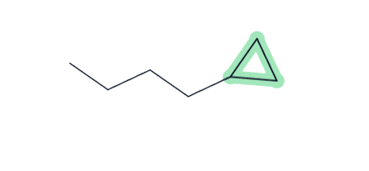
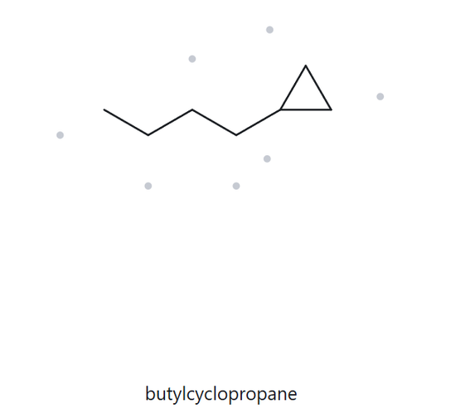
CARD A10 - STRUCTURE - NAME
CHALLENGE | MOLECULAR FORMULA: C7H12
1 - NUMBERED PARENT
2 - NAMING TRAIL
3
Parent: ring of 3C is the parent ￫ cyclopropane
Numbering: one locant only so not needed
Substituents: butyl group ￫ butyl
1
2
3 - MY NAME (WRITTEN FIRST)
4 - THE ALKANE CHECK
butylcyclopropane
Returned name: butylcyclopropane
✓ Match
longest chain confirmed
lowest locants
alphabetical order
punctuation
formula counted

Slide 12
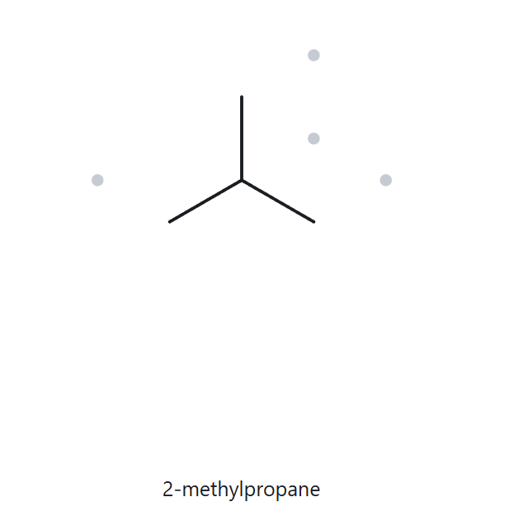
CARD B01 - NAME - STRUCTURE
FOUNDATION | GIVEN NAME: 2-methylpropane
1 - NAME DECODED
2 - BOND-LINE STRUCTURE (THE ALKANE)
Parent: propane ￫ a 3-carbon chain
Substituents: methyl on C2
Expected Formula: 3 + 1 = 4C; open chain ￫ C4H10
3 - FORMULA CHECK
4 - BACK-CHECK
Returned by the Alkane:
✓ Same as the given name
Counted from the drawing: C4H10
CnH2n+2 = C4H10 ✓
parent length matches
substituent positions match
formula agrees
back-check recorded

Slide 13
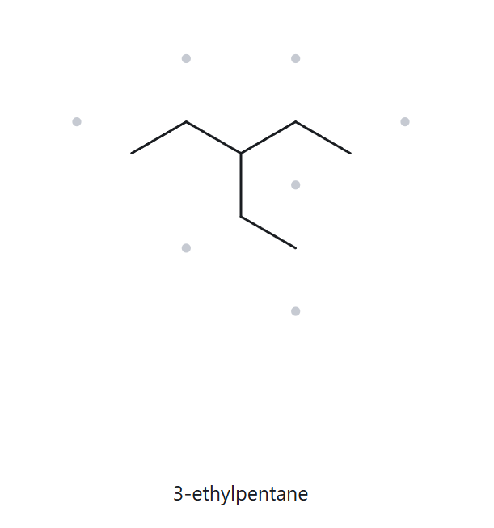
CARD B02 - NAME - STRUCTURE
FOUNDATION | GIVEN NAME: 3-ethylpentane
1 - NAME DECODED
2 - BOND-LINE STRUCTURE (THE ALKANE)
Parent: pentane ￫ a 5-carbon chain
Substituents: ethyl on C3
Expected Formula: 5 + 2 = 7C; open chain ￫ C7H16
3 - FORMULA CHECK
4 - BACK-CHECK
Returned by the Alkane:
✓ Same as the given name
Counted from the drawing: C7H16
CnH2n+2 = C7H16 ✓
parent length matches
substituent positions match
formula agrees
back-check recorded

Slide 14
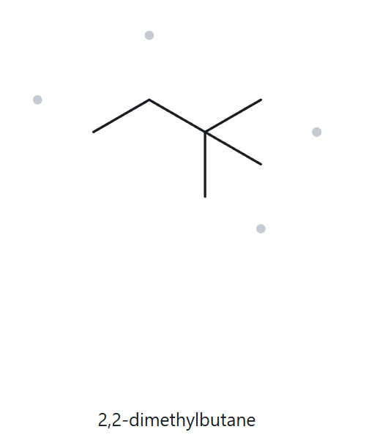
CARD B03 - NAME - STRUCTURE
FOUNDATION | GIVEN NAME: 2,2-dimethylbutane
1 - NAME DECODED
2 - BOND-LINE STRUCTURE (THE ALKANE)
Parent: butane ￫ a 4-carbon chain
Substituents: 2 methyl groups on C2
Expected Formula: 4 + 1(2) = 6C; open chain ￫ C6H14
3 - FORMULA CHECK
4 - BACK-CHECK
Returned by the Alkane:
✓ Same as the given name
Counted from the drawing: C6H14
CnH2n+2 = C6H14 ✓
parent length matches
substituent positions match
formula agrees
back-check recorded

Slide 15
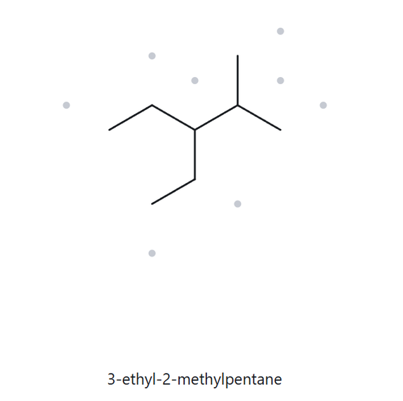
CARD B04 - NAME - STRUCTURE
DEVELOPING | GIVEN NAME: 3-ethyl-2-methylpentane
1 - NAME DECODED
2 - BOND-LINE STRUCTURE (THE ALKANE)
Parent: pentane ￫ a 5-carbon chain
Substituents: methyl on C2 and ethyl on C3
Expected Formula: 5 + 2 + 1 = 8C; open chain ￫ C8H18
3 - FORMULA CHECK
4 - BACK-CHECK
Returned by the Alkane:
✓ Same as the given name
Counted from the drawing: C8H18
CnH2n+2 = C8H18 ✓
parent length matches
substituent positions match
formula agrees
back-check recorded

Slide 16
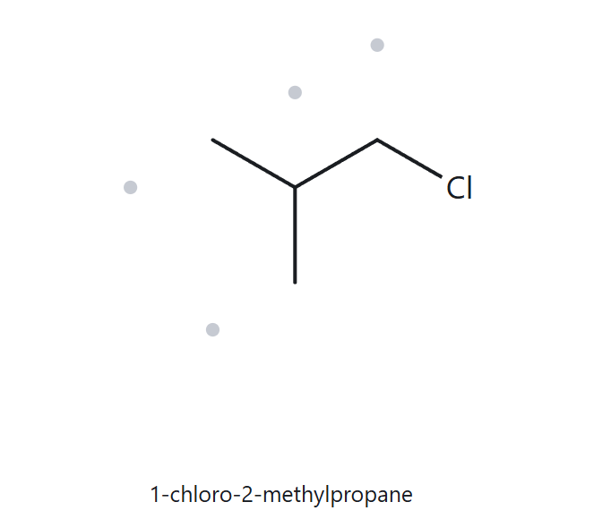
CARD B05 - NAME - STRUCTURE
DEVELOPING | GIVEN NAME: 1-chloro-2-methylpropane
1 - NAME DECODED
2 - BOND-LINE STRUCTURE (THE ALKANE)
Parent: propane ￫ a 3-carbon chain
Substituents: methyl on C2 and chloro on C1
Expected Formula: 3 + 1 = 4C; open chain ￫ C4H10; Cl replaces one H ￫ C4H9Cl
3 - FORMULA CHECK
4 - BACK-CHECK
Returned by the Alkane:
✓ Same as the given name
Counted from the drawing: C4H9Cl
CnH2n+1 Cl = C4H9Cl ✓
parent length matches
substituent positions match
formula agrees
back-check recorded

Slide 17
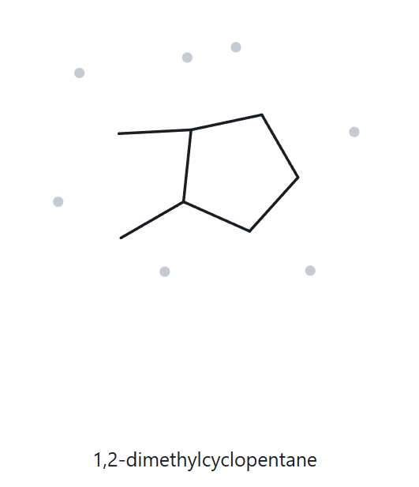
CARD B06 - NAME - STRUCTURE
DEVELOPING | GIVEN NAME: 1,2-dimethylcyclopentane
1 - NAME DECODED
2 - BOND-LINE STRUCTURE (THE ALKANE)
Parent: cyclopentane ￫ a 5-carbon ring
Substituents: 2 methyl groups on C1 and C2
Expected Formula: 5 + 1(2) = 7C; one ring ￫ C7H14
3 - FORMULA CHECK
4 - BACK-CHECK
Returned by the Alkane:
✓ Same as the given name
Counted from the drawing: C7H14
One Ring: CnH2n = C7H14 ✓
parent length matches
substituent positions match
formula agrees
back-check recorded

Slide 18
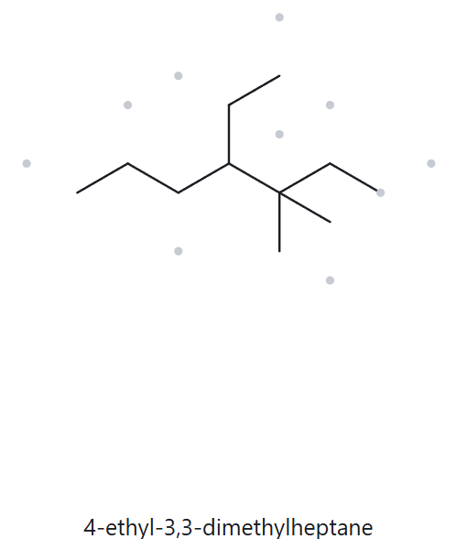
CARD B07 - NAME - STRUCTURE
DEVELOPING | GIVEN NAME: 4-ethyl-3,3-dimethylheptane
1 - NAME DECODED
2 - BOND-LINE STRUCTURE (THE ALKANE)
Parent: heptane ￫ a 7-carbon chain
Substituents: 2 methyls on C3 and ethyl on C4
Expected Formula: 7 + 1(2) + 2 = 11C; open chain ￫ C11H24
3 - FORMULA CHECK
4 - BACK-CHECK
Returned by the Alkane:
✓ Same as the given name
Counted from the drawing: C11H24
CnH2n+1 Cl = C11H24 ✓
parent length matches
substituent positions match
formula agrees
back-check recorded

Slide 19
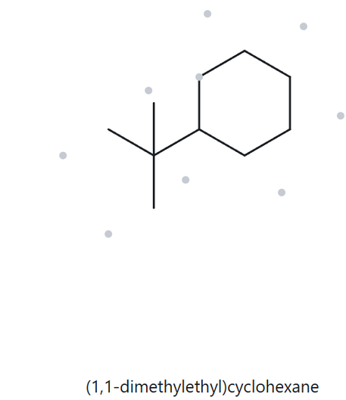
CARD B08 - NAME - STRUCTURE
CHALLENGE | GIVEN NAME: tert-butylcyclohexane
1 - NAME DECODED
2 - BOND-LINE STRUCTURE (THE ALKANE)
Parent: cyclohexane ￫ a 6-carbon ring
Substituents: tert-butyl group on C1
Expected Formula: 6 + 4 = 10C; one ring ￫ C10H20
3 - FORMULA CHECK
4 - BACK-CHECK
Returned by the Alkane:
☓ NOT the same as the given name
though tert-butyl and 1,1-dimethyl are equivalent forms
Counted from the drawing: C10H20
One Ring: CnH2n = C10H20 ✓
parent length matches
substituent positions match
formula agrees
back-check recorded

Slide 20
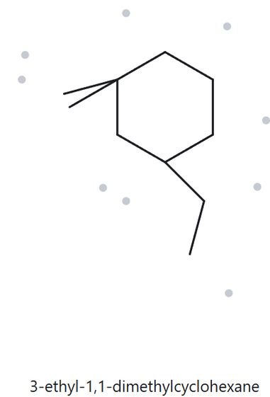
CARD B09 - NAME - STRUCTURE
CHALLENGE | GIVEN NAME: 3-ethyl-1,1-dimethylcyclohexane
1 - NAME DECODED
2 - BOND-LINE STRUCTURE (THE ALKANE)
Parent: cyclohexane ￫ a 6-carbon ring
Substituents: 2 methyl groups on C1 and an ethyl on C3
Expected Formula: 6 + 1(2) + 2 = 10C; one ring ￫ C10H20
3 - FORMULA CHECK
4 - BACK-CHECK
Returned by the Alkane:
✓ Same as the given name
Counted from the drawing: C10H20
One Ring: CnH2n = C10H20 ✓
parent length matches
substituent positions match
formula agrees
back-check recorded

Slide 21
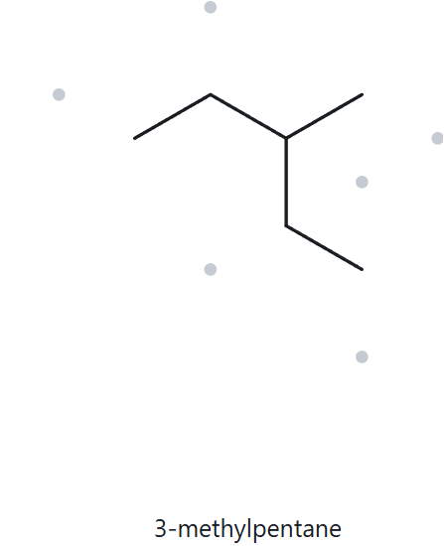
CARD B10 - NAME - STRUCTURE
CHALLENGE | GIVEN NAME: 2-ethylbutane
1 - NAME DECODED
2 - BOND-LINE STRUCTURE (THE ALKANE)
Parent: butane ￫ a 4-carbon chain
Substituents: ethyl on C2
Expected Formula: 4 + 2 = 6C; open chain ￫ C6H14
3 - FORMULA CHECK
4 - BACK-CHECK
Returned by the Alkane:
☓ NOT the same as the given name
It is incorrect because the longest continuous carbon chain actually has five carbons rather than four, making the correct name 3-methylpentane.
Counted from the drawing: C6H14
CnH2n+1 Cl = C6H14 ✓
parent length matches
substituent positions match
formula agrees
back-check recorded

