Slide 1
Python Quick Camp
TDWI Accelerate - October 2017
Paul Boal - @paulboal

Slide 2
Purpose

Slide 3
Agenda

Slide 4
Hello World!

Slide 5
Introduction
Business Scenario:
Healthcare costs vary dramatically from one facility to the next, even in the same community.
Are there any geographic features that might be tied to those cost patterns?
Steps:
Getting procedure costs
Get facility information
Get additional external data
Review correlations in data

Slide 6
1. Get Procedure Costs
1. Get Procedure Costs

Slide 7
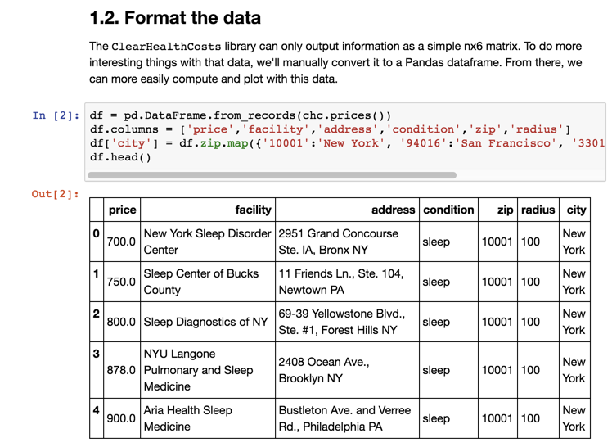
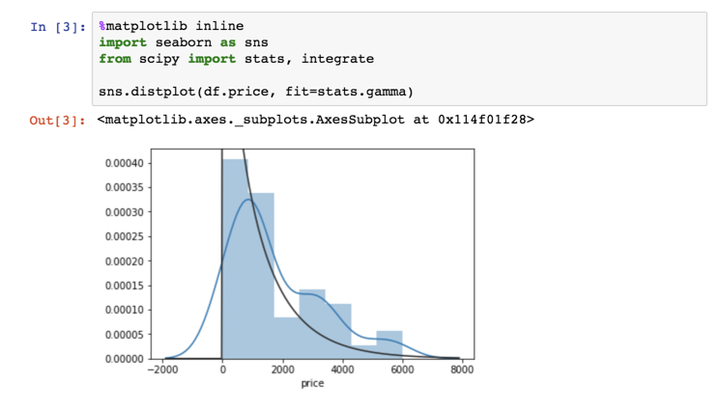
Introducing the Jupyter Notebook
1. Getting procedure costs
Jupyter tool bars
Cell types
Documentation
Code
Output
Print statements
Variable contents
Plots
NOTE: Jupyter saves files with a .ipynb extension. These are structured JSON and contain all of the notebook contents including documentation, code, and visible results. The notebook file does not contain a snapshot of the variable contents – that only exists in the current Python instance.

Slide 8
Using Modules
1. Getting procedure costs

Slide 9
GetPrices Module: Parse HTML with BeautifulSoup
1.1 Get the data

Slide 10
Getting Prices: Thinking in Objects
1.1 Get the data

Slide 11
Processing Data: Introducing the DataFrame
1.2 Format the data

Slide 12
Making Data Readable: Code to Descriptions Maps
1.2 Format the data

Slide 13
Visualizing Price Distribution: Histograms
1.3 Quick data profiling

Slide 14
Plotting Libraries
1.3 Quick data profiling
Package | Uses
matplotlib | Basic plotting capabilities following the paradigms from Matlab designed for scientific publications. Not built with web based notebooks in mind first, but interactive charts are available.
pandas | DataFrames have built-in plotting functions that use matplotlib under the hood.
seaborn | This library makes the default matplotlib plots prettier and adds many functions to make common plotting activities easier.
plotly | Plot.ly is much more than just a plotting library. It’s a comprehensive web service that gives analysts a way to manage and share data, code, and visualizations. Basic and public usage is free, but enterprise services are paid.
bokeh | An Open Source plotting library that makes interactive web graphics easier to create within environments like Jupyter.

Slide 15
Cleaning Bad Data: Filtering a DataFrame
1.4 Check for bad data

Slide 16
Drill Down: Histograms by Series
1.5 Break things down

Slide 17
2. Getting more information about these facilities
2. Get Facility Information

Slide 18
Type of Facility: Natural Language Processing
2.1 Classifying the facilities

Slide 19
Labeling Facility Types: Loops and Conditions
2.2 Label the clusters

Slide 20
Looking at Facility Types: Histograms and Bars
2.3 Compare the distributions by label

Slide 21
3. Get Additional External Data
3. Bring in external data

Slide 22
Clean Addresses: Google Maps Geocoding
3.1 Geocode addresses

Slide 23
Checkpoint Your Data: Saving and Loading Excel
3.1 Geocode addresses

Slide 24
Get Local Population: DataFrames as Lookups
3.2 Census data

Slide 25
Plotting Relationships: Scatterplot / LM Plot
3.2 Census data

Slide 26
4. Review Correlations in Data
4. Look at correlations

Slide 27
Be a Lazy Programmer: Lists, Loops, and Lambda
4.1 Pull in several variables from census

Slide 28
Scatterplot Matrix
4.2 Correlation plot with Plotly

Slide 29
Plotly Gallery

Slide 30
What Else Can I do with Python?

