Slide 1

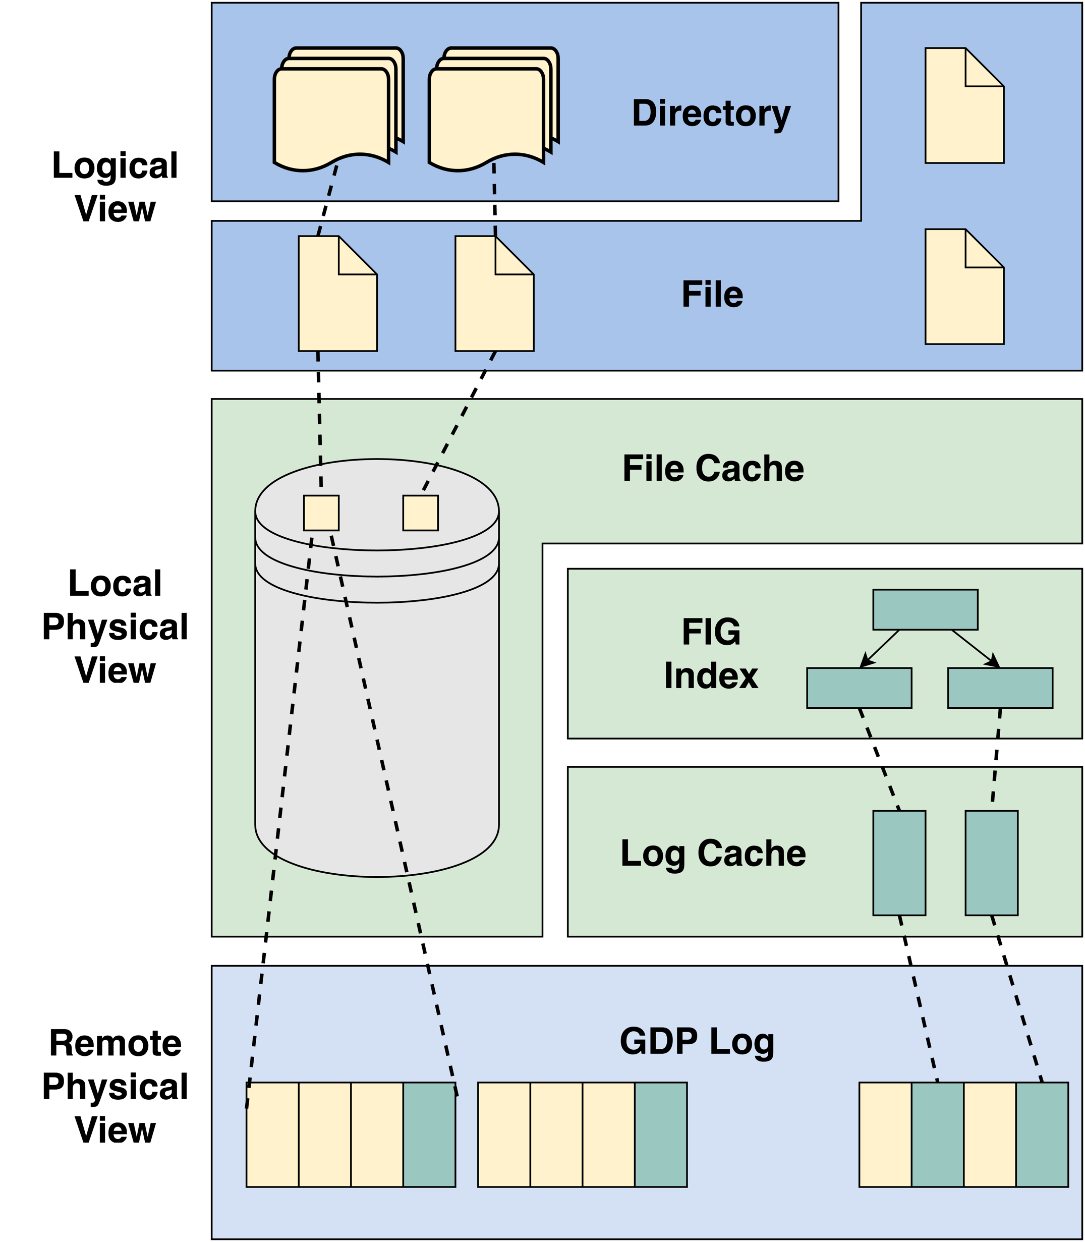
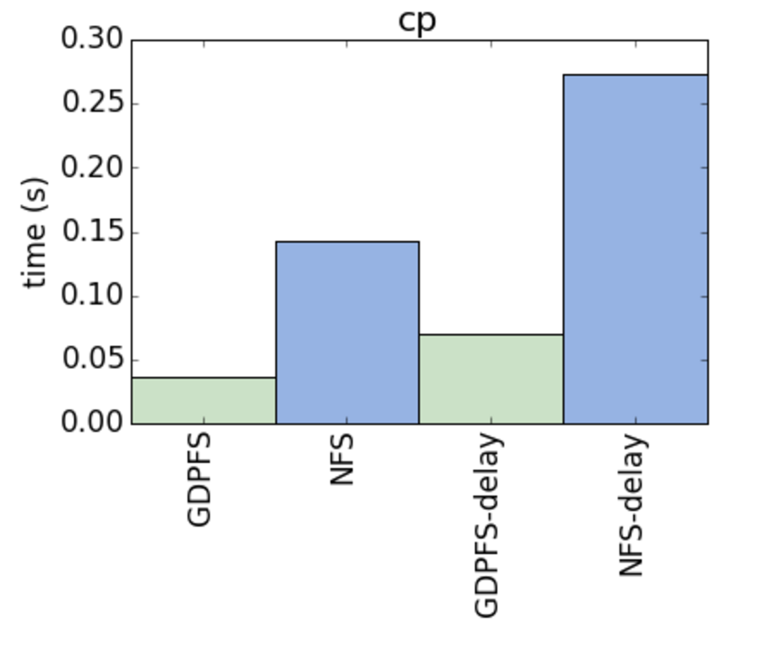
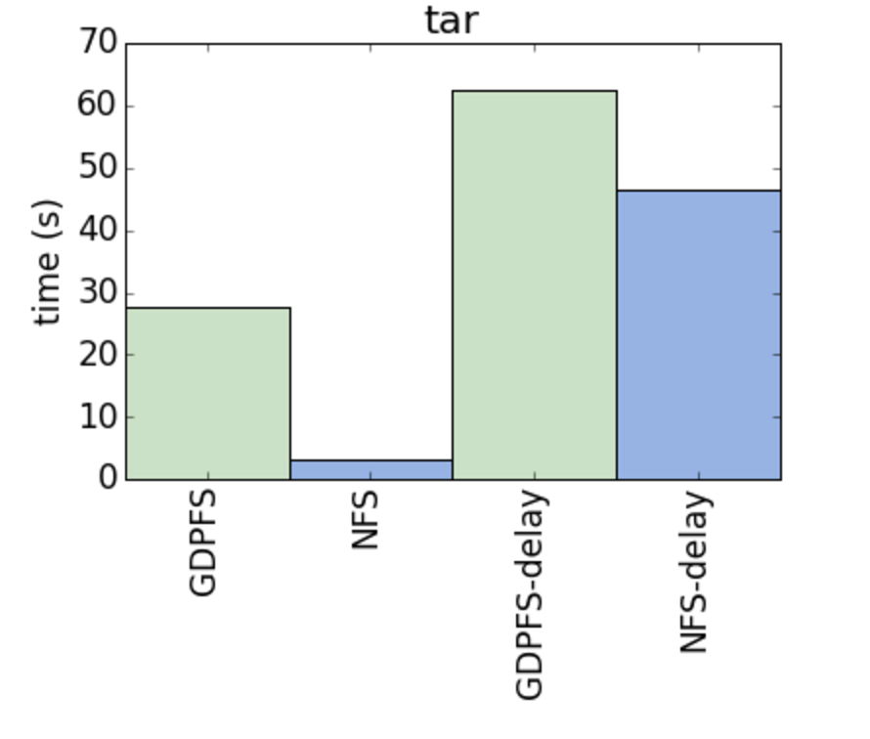
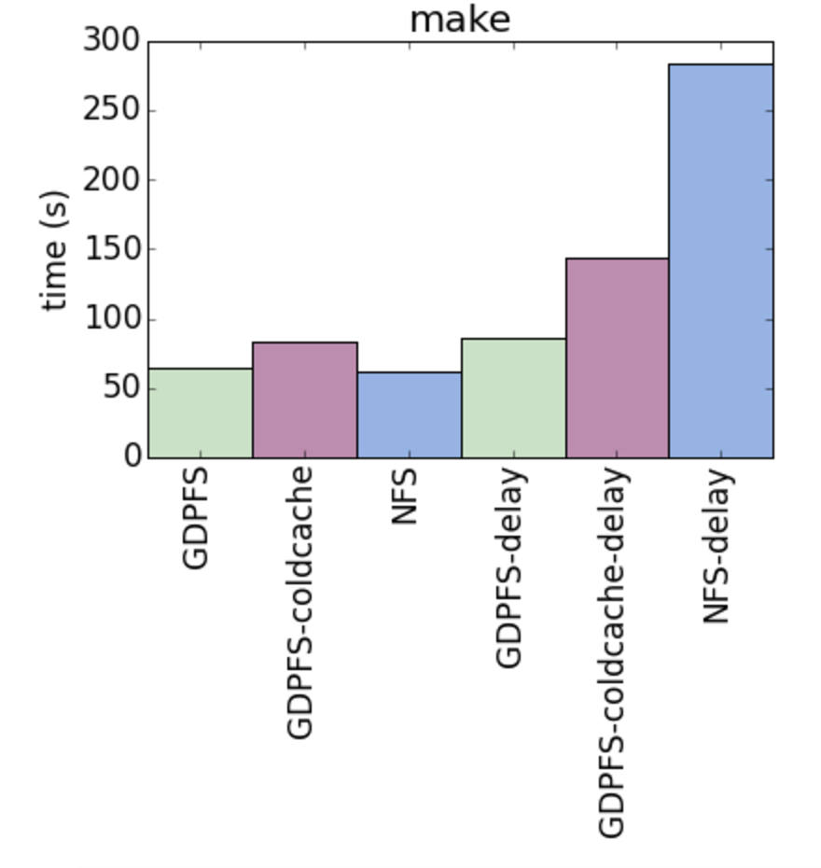

Efficient Data Retrieval from a Secure,
Durable, Append-Only Log
Paul Bramsen, Andrew Chen, Sam Kumar, and John D. Kubiatowicz
Motivation
The Global Data Plane File System (GDPFS)
The Global Data Plane (GDP) is a service that provides secure data storage and distribution over untrusted hardware
The basic primitive provided by the GDP is a secure, single-writer log
Allows replication with relatively little effort
Providing complex abstractions on top of the GDP is nontrivial
Tradeoff between strong guarantees and rich semantics
Is it feasible to build a system on top of the GDP that provides mutable data semantics and efficient data retrieval?
The GDPFS stores all data in GDP logs
Each file lives within its own GDP log
Each log entry stores some metadata such as the offset and size of that entry’s data
GDP log metadata includes signer’s public key and a log’s name is the hash of its metadata
The integrity of an entire filesystem can be verified given only the name of the root log
Figure 1: Basic file in the GDPFS
Caching Strategies and Optimizations
Performance Results
Cache files on the local filesystem to eliminate network overhead and file reconstruction costs
Periodically checkpoint files with a File Indexed Group (FIG) Tree to allow efficient fetching of relevant log entries on reads
Locally cache portions of FIG Trees so that the index can usually be accessed without hitting the network
Figure 2: GDPFS structure
Figure 3: Redis cp/tar/make
Benchmarked GDPFS against NFS on workload compiling Redis
Redis is a popular key-value store
Comprised of 3 steps: cp, tar, make
Tested with no added latency as well as 10±2ms simulated latency
Tested make after wiping cache to test effectiveness of indices
AFS benchmark also run (results omitted due to space constraints)
Related Work
Global Data Plane (Log-Based Data Substrate)
Kafka Messaging Service (Log-Based Messaging)
Ocean Store (Similarity in Index)
Log-Structured File System
B-Tree File System
Tahoe File System (Secure Distributed File System)

