Slide 1
ACME’s offices in EUrope
Determining identical neighborhoods to support a corporate extension in Europe
Paul Beauregard, 2020

Slide 2
Background
The conglomerate ACME, major player on the U.S. market wants to extend its presence in Europe, and open 3 brand new offices. The targeted markets are the Portuguese, Spanish and Dutch one.
I have been contacted to undertake an analysis of the different areas that would be the most suitable for the new ACME offices in Lisbon, Madrid and Amsterdam.

Slide 3
problem
ACME's head office is in the neighbourhood of SoHo in Manhattan and is composed of over a thousand employees. It has been voted the most enjoyable place to work in the U.S two years in a row, and location was a major player amongst others.
It has been internally approved to establish the new premises in the respective European capitals, but the HR department at ACME fears that the initial culture shock might affect negatively the employees' productivity. Reason is that the teams transitioning from the ACME head office in New-York, to Europe, are composed of U.S. citizens, unfamiliar to European culture.
The objective of this analysis, stated by ACME, is to find an adequate neighbourhood in each destination that will match the standards and atmosphere that SoHo provides.

Slide 4
Data acquisition & cleaning
The datasets I am using are a list of Lisbon, Madrid and Amsterdam neighbourhoods found on Wikipedia.
Once scraped with the BeautifulSoup package, the datasets were combined into one pandas data frame, to which I appended Soho Manhattan in order to have a future reference.
Madrid’s data set came with the city name, neighbourhood name, population index, as well as the area dimensions. Population index and neighbourhood surface were dropped as they are not essential to obtain the neighbourhoods’ postcodes. I then merged the city and neighbourhood names to prepare the next step.
After using the geopy package to retrieve the latitude and longitudes, I have been parsing each entry into a API call using the free tier Foursquare API, to retrieve the top 100 venues, in each neighbourhood, in a radius of 500 meters.
Next step was to calculate the frequency of each venue category for each neighbourhood and define a top 10, last step to prepare our dataset for our K-Means algorithm.

Slide 5
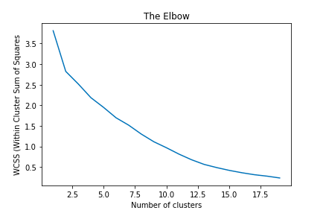
K-Means & clusters
In order to find the ideal number of clusters to pass into our K-Means clustering algorithm, I used the Elbow Method to plot the different values of K errors, for different number of clusters. As show in fig1, the elbow was not very easy to determine, and was finally identified at 13.

Slide 6
CONclusion
My recommendation to ACME is to focus their searches on these areas, in order to better fit the expectation of their moving employees:
MADRID
AMSTERDAM
LISBON
Centro
Centrum
Noord
Oost
West
Zuid
Alfama
Bairro Alto
Chiado
Baixa

