Slide 1

SWEN90014 2024 Workshop 1
SWEN90014 2025 Workshop 1
Digital Bricks for Science Gallery
Preparation for sprint 1

Slide 2
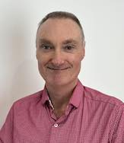
Your Mentor
My responsibilities
My Background
Project Manager, IT Business Analyst, Application Developer, Scrum Master and Agile Coach in industry for over 8 years
Applications Development (low code) and Full Stack Development expertise (JS)
Interest in Agentic AI and business automation
Supervising SWEN90009, 90014 and 90017/18 for 6 years
Support you – not do the work for you.
Advocate for you based on the evidence you provide in your assessments
Escalation for issues or problems that are outside your control
Guidance over best practices in industry
Prepare you for the full year Capstone project next year
Paul Calverley
He/him/his

Slide 3
Agenda
Introductions
Scope and objectives
Scrum Master and Product Owner roles
Admin – Github, Confluence, Slack, weekly mentor meetings
Requirements resolution process
Design concept (time permitting)

Slide 4

Team Member Introductions
Acknowledgement: ChatGPT-4o
Notes:
A few minutes within your own team. Introduce yourself to each other. 1 thing you would most like to takeaway from this experience in 12 weeks time

Slide 5
Primary objectives in the project
Document the Architecture of your solution (before you start coding)
To code and test a solution based on the set of requirements that were documented last semester in SWEN90009
Test and demonstrate the solution to the client
Notes:
You will be building new software in this project. It implies that you be very hands-on.
Architecture is an abstracted view of the system, as a whole, how different building blocks connect to others. It’s important that we design the architecture, before we start coding. If we don’t have a good architecture, then you might be building a product that cannot be scaled, or is a real pain to be maintained.

Slide 6
Project expectations
This is a self-driven project supported by lectures and workshops.
It is continuously assessed. You cannot ‘cram’ at the end.
Be respectful and considerate to each team member. Everyone must have equal opportunity to contribute and learn.
Be respectful and considerate to the client(s).
Balance your effort between documentation and product.
Everyone must have an engineering contribution. You cannot just be a scribe, or be a passive by-stander

Slide 7

Workshop Schedule
Every Tuesday 11am -12pm in PAR-166-L1-138-FEIT
Tue 12 Aug – Online Zoom
Tue 26 Aug – Online Zoom
There will be 2 workshops where I will be online instead of in class. You must turn up in person. Please bring your laptop, camera and headphones.
https://unimelb.zoom.us/j/3863515138?pwd=cllVUElpWHFyS3AzSGUzSlQ3OUZFUT09
Password: 074644

Slide 8
Workshop expectations
This is a workshop, not a lecture. You will be expected to participate.
Please prepare for the workshop. During the semester, expect to give a 15 min stand-up in front of others.
Please close your laptops (unless the activity requires it)
Please mute your mobile devices
If you are going to be away, please let your team know
None of us are perfect. None of us (including the teaching team) know all the answers. This is a safe place to learn. Ask lots of questions!

Slide 9

Access to systems
Canvas LMS – have you managed to access the 90009 Zip files
Slack – communication between team members (and Mentor)
Confluence – your team documentation resource
https://feit-teaching.atlassian.net/wiki/home
GitHub – for project tracking and source code repository

Slide 10

Scrum Master vs Product Owner
Scrum Master
Product Owner
Organise meetings
Maintain the team’s kanban
Reports progress
Manage any issues or problems within the team
Monitors the workload of team members
Looks out for risks to team delivery and seeks to mitigate them
Understands and can explain the client’s intentions
Knows the product better than anyone!
Keeps the client informed at all stages
Starts the Sprint Review/Showcase meeting
Set the team goals and objectives for each sprint
Communicates clearly with confidence
Super organized!
Super communicator!

Slide 11
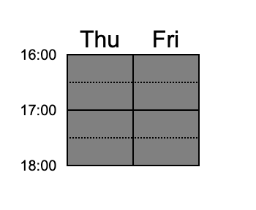
Mentor team meeting availability
https://www.when2meet.com/?31518544-EwSxH
The Scrum Master of each Team should nominate ONE 30 min meeting time slot for their team.
This meeting is online over Zoom.

Slide 12
Team Exercise
5 minutes.
Discuss within your team your availability for the weekly meeting with your Mentor
Decide who wants to take the role of Scrum Master and Product Owner

Slide 13
Week 2 Requirements Resolution
The objective is to produce a single, agreed-upon set of requirements that both teams will use as the basis for their project work.
Both teams work together through this process.
Notes:
We currently have 3 sets of requirements. But we only want 1 set to work from.

Slide 14





Collaborative Process
Review from client/user perspective
Team1
Team2
Questions for clients
consolidate
What was your
Process?
3 x 90009 repos
Baseline repo
Who
How
Result
Review from technical perspective
SWEN90014-2025-VI-Baselined-Requirement
SWEN90014-2025-DB-Baselined-Requirement
Questions for clients

Slide 15
Collaborative Process
Consolidation (3 repos → 1 repo)
Review
Document your process
The Product Owners, of each team, are responsible for coordinating others to complete the task.

Slide 16
1. Consolidation
Review each artefact by comparing all three versions side by side
Which version is of better quality? Avoid versions with vague, ambiguous or incomplete requirements.
Are there any notable differences such as omissions, or duplications?
You may need to edit the artefact to correct any defects
Transfer the refined/updated artefact to the baseline Github repo

Slide 17
2. Review
Proof-check each artefact in the baseline repo.
Does the scope and background make sense to you?
Have the user stories and acceptance criteria captured all functionality?
Make a list of key technical requirements (e.g security, accessibility, points of integration, identified external components)
Compose a list of questions you want to clarify with the client

Slide 18
3. Document the process
Who was responsible for what in the team?
How did the teams work together to consolidate and review?
e.g did you hold meetings, shared notes etc?
What artefacts were updated during the process?
What are the questions you need to clarify with the client?
Create a file ‘Requirements Resolution.md’ in the baseline repo to document the requirement resolution process.

Slide 19
Workshop Deliverable today
Do these steps within your own team;
The Product owner will lead the consolidation. Choose 2 other team members to participate with this work
Choose 2 team members to participate in technical review of the baseline
Choose 2 team members to participate in review of the user/client related artefacts
Create a Requirements-resolution.md file, in your baseline GitHub repository.
On it, list all team members’ contact details, and clearly state the role each person will play in requirements resolution process.

Slide 20
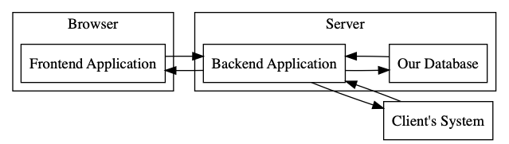
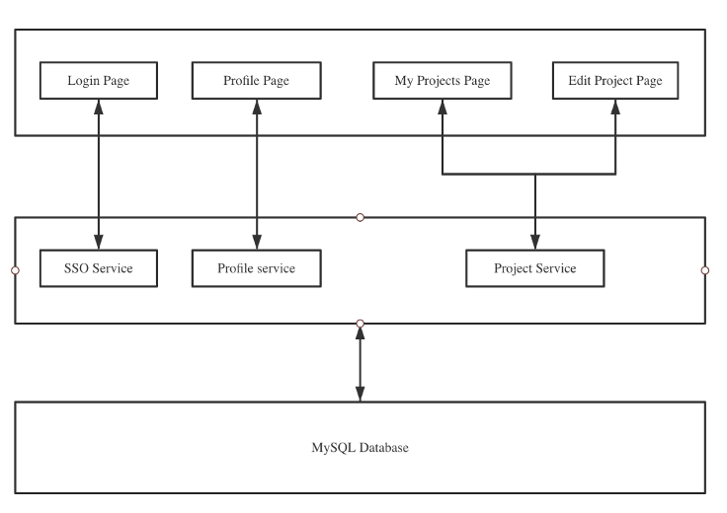
The Design Concept
It’s a block diagram + a description of the diagram
Example:
Example:
Our product would be a web-based application, with a frontend client run in a browser, and a backend server as well. The system is standalone. Data would be transferred to the server and stored in our database. Only curated data would be pushed to the client's existing system.

Slide 21
The Design Concept
It’s high level, first draft of the system block diagram.
It should focus on functional building blocks, where each block in the diagram is titled by what it does (e.g. Authentication service, API gateway, User service, Data Adapter, Messaging Service, etc)
Try to avoid describing the technology (e.g. React, python, mySQL) at this stage
You can produce more than one concept design, if you wish, and select the one that best meets the needs of security, scalability and maintainability

Slide 22
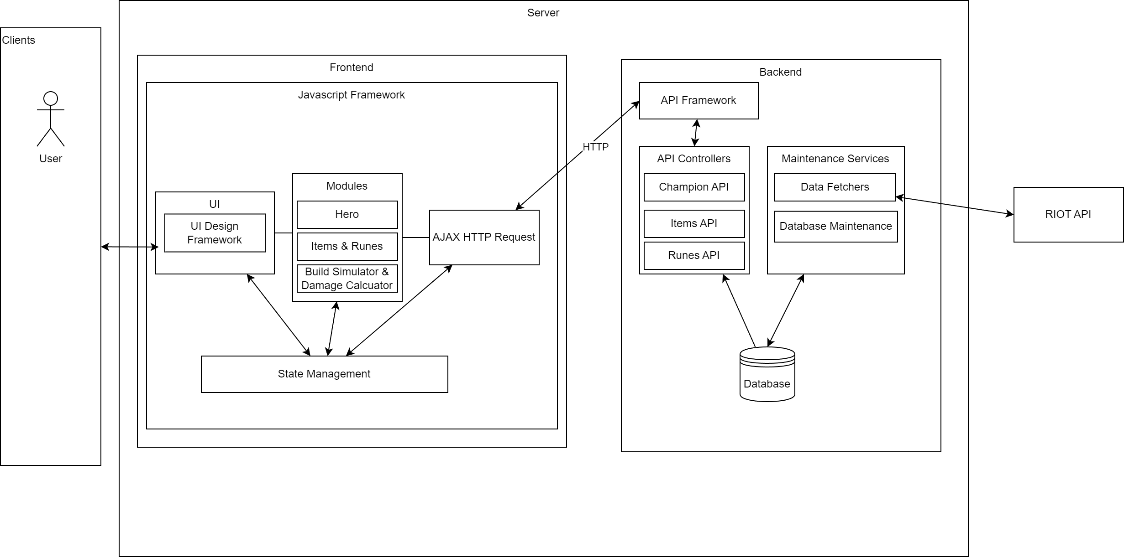
Example 2

Slide 23
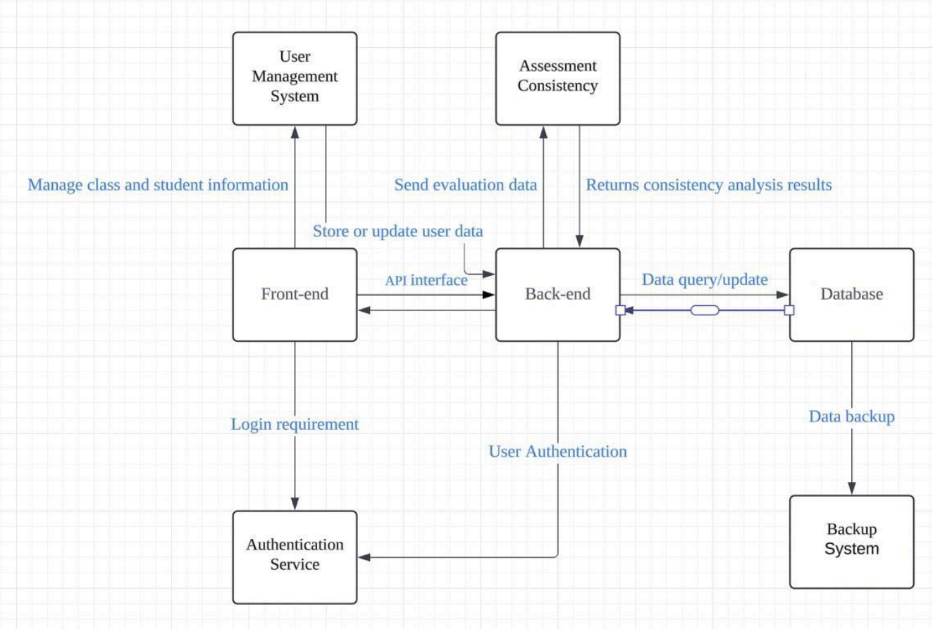
Example 3
Notes:
https://github.com/feit-swen90014/SC-Platypus/blob/3dece07a99c2ea7c32e86a6d16be278acbd7299f/docs/Sprint3%20Documents/Design%20Concept/High%20Level%20Design%20Concept%20Diagram.pdf

Slide 24
Considerations
What sort of Application are you building? Web? Native mobile? Desktop? Server? Embedded?
Is the solution modular (separated frontend and backend) and if so, what is the purpose of those modules?
Are there external software/hardware components required? How will these be integrated into your solution?
Is data required to be stored? What sort of data and where will it be stored?
What physical resources (Cloud, Servers, Devices etc) will be required?
What components do you think you can re-use, out of the box or with some modification? Libraries? Frameworks?
How will you create a secure solution?

