Slide 2

Oft speculated rarely tested
Cognitive neuroscience has increasingly focused on how cognitive functions are distributed across multiple regions
  Functional modules
Different types of information are processed in a distributed fashion
  fMRI research demonstrates how brain areas specialize in representing specific features (Deniz, … Gallant, 2019)
  PFC in particular is thought to…
Yet there is little reach on how these different regions work together to represent stimuli
  Analyses typically target “micro” levels
(Deniz, … Gallant, 2019)
Notes:
Mouse research shows how reciprocal loops among cortical regions are necessary for working memory maintenance (Voitov & Mrsic-Flogel, 2022)

Slide 3
Traditional methodology
Usually, representations are studied in terms of voxel-level (BOLD) activation
Such data are submitted to RSA
This is thought to tap into information processing of neural populations
Can this framework be adapted to research possible distributed representations?

Slide 4



Traditional RSA
To perform traditional RSA, you need a vector of measurements for each trial
Typically, the vector represents BOLD activation
  Each element is the beta for a given voxel in an ROI
  The vector length is equal to the number of voxels in the ROI
Input:
Neural vectors
Build neural RSM
Neural RSM x
Model RSM
Trial 1
$r_{ij}=corr$ ($x_{i},x_{j})$
Trial 2
Trial 3
Trial 4
ROI $m$
Trial 5
Trial 6
×
Trial $n$
Neural RSM
Model RSM

Slide 5

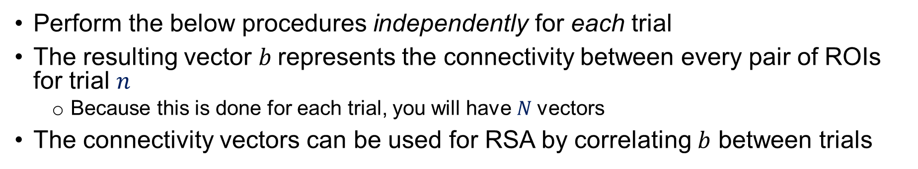








Measuring single-trial connectivity
Perform the below procedures independently for each trial
The resulting vector $b$represents the connectivity between every pair of ROIs for trial $n$
  Because this is done for each trial, you will have $N$vectors
The connectivity vectors can be used for RSA by correlating $b$ between trials
Input:
Voxel betas
Average
across voxels
ROI-ROI coherence
Vectorize
triangle
$a_{ij}=|$ $\overline{x_{i}}$ - $\overline{x_{j}}|$
ROI 1
$$(x_{1})$$
$$(\overline{x_{1}})$$
ROI 2
2
3
ROI 3
1
4
Further analysis (e.g., RSA, IPS)
Trial $n$
ROI 4
5
6
$$b_{1}$$
$$b_{(m−1)(m−2)/2}$$
ROI 5
ROI 6
ROI $m$
$$(x_{m})$$
$$(\overline{x_{m}})$$
Notes:
Look at specific edges or sub-regions and maybe look at specific tasks. Plot specific edges

Slide 6
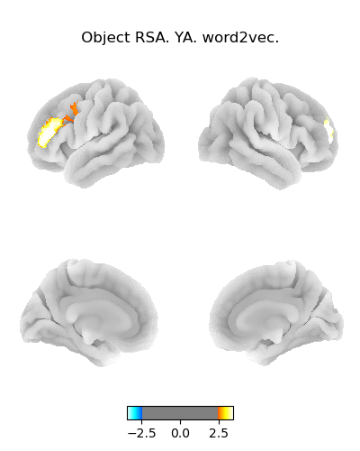
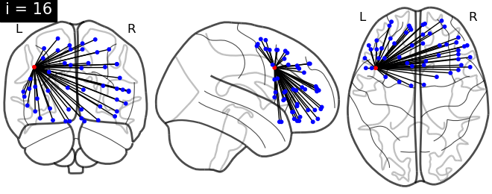
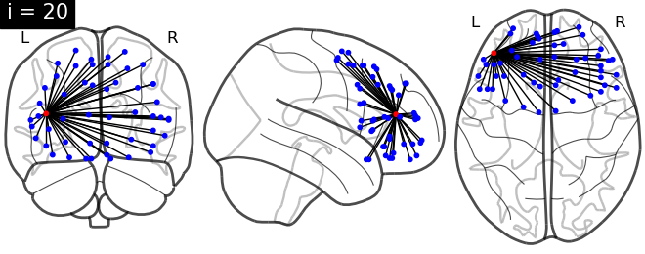
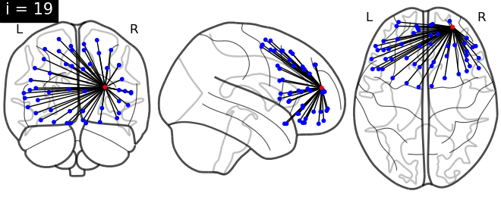
ROI-based visualization (RSA)
Here, I plotted
p < .01 uncorrected
The symmetry is nice
Of these ROIs, one survives following Bonferroni correction for 52 tests (t = 3.4)
  FDR correction does not yield more results
Notes:
BNA atlas
Left side figure is p < .01 (one-tailed) threshold
FDR correction still leads to only one surviving
Yet, of the 52 ROIs, 48 show a numerically positive effect

Slide 7
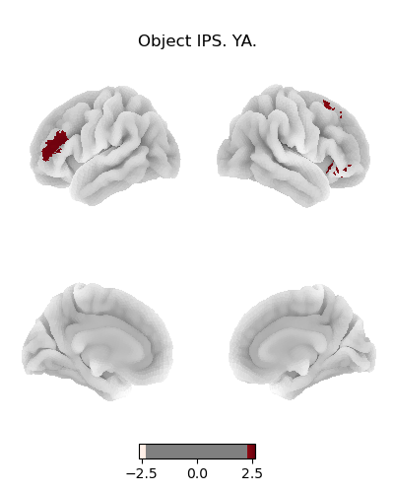
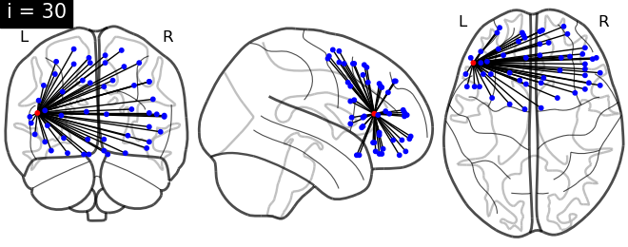
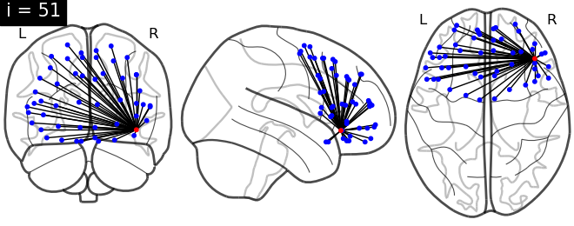
ROI-based visualization (IPS)
Consistency with the L MFG result for RSA
However, this one is t = 2.6 and would not survive Bonferroni correction for 52 tests
Notes:
BNA atlas
Left side figure is p < .01 (one-tailed) threshold

Slide 8
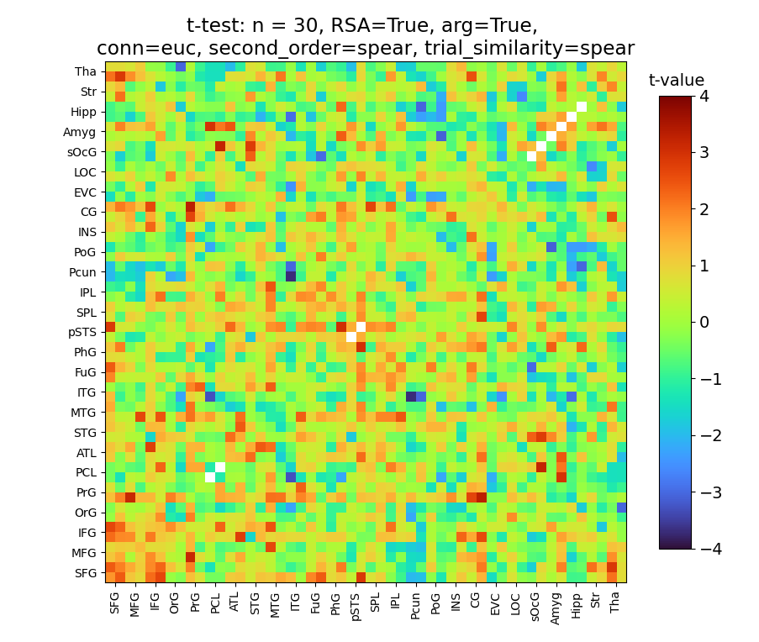
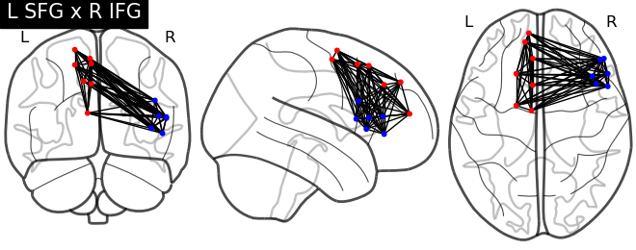
Sub-region pair visualization
RSA effects seen based on the connectivity between pairs of PFC gyri
PFC

Slide 9
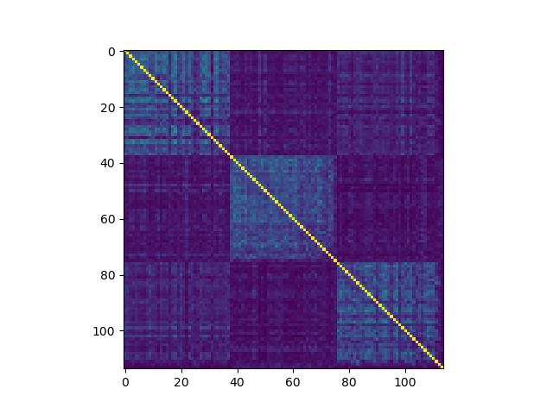
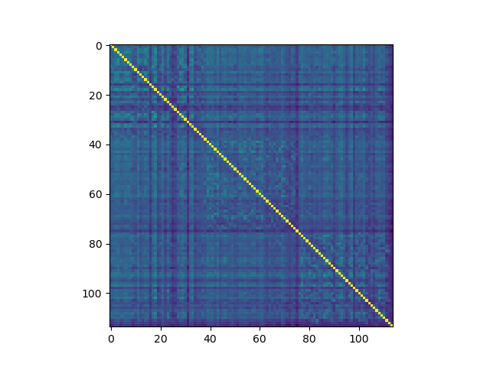
Differences like this aren’t accounted for by dropping within-run

Slide 10
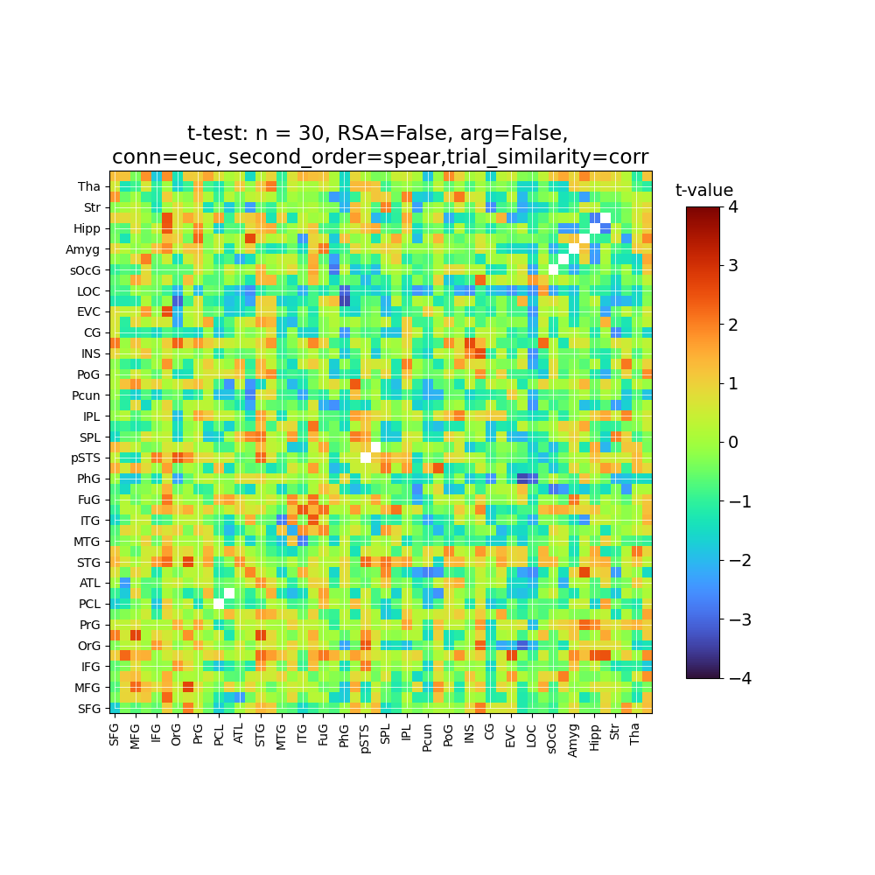
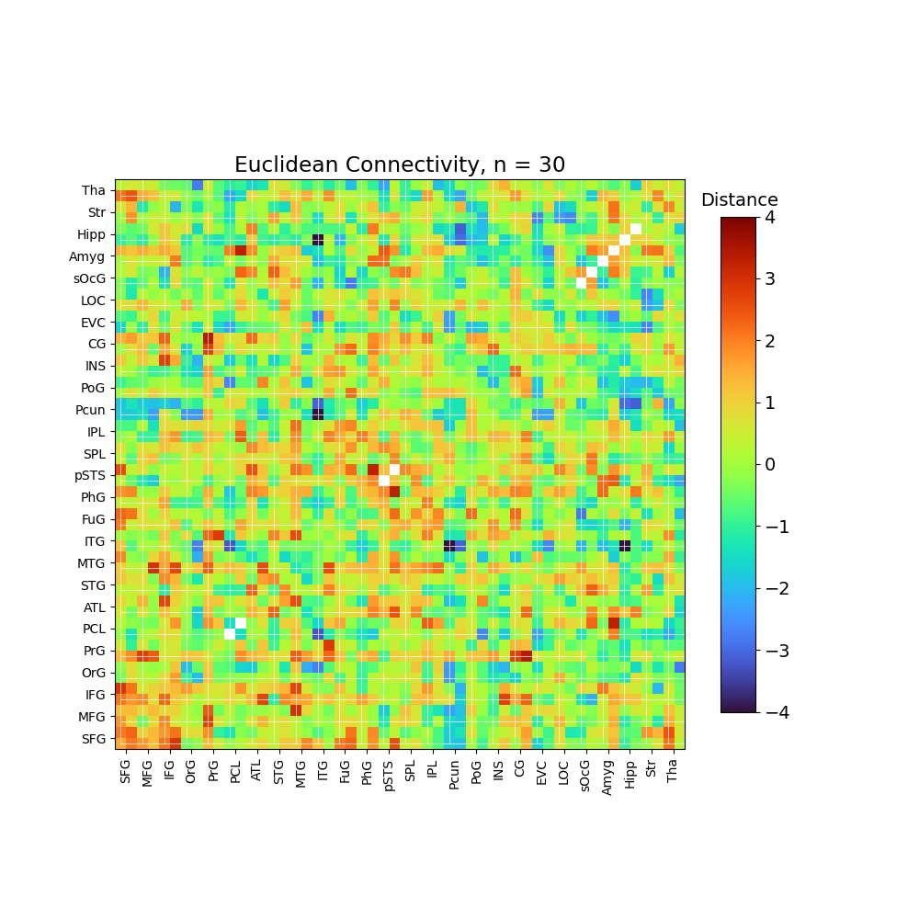
Spearman

Slide 11
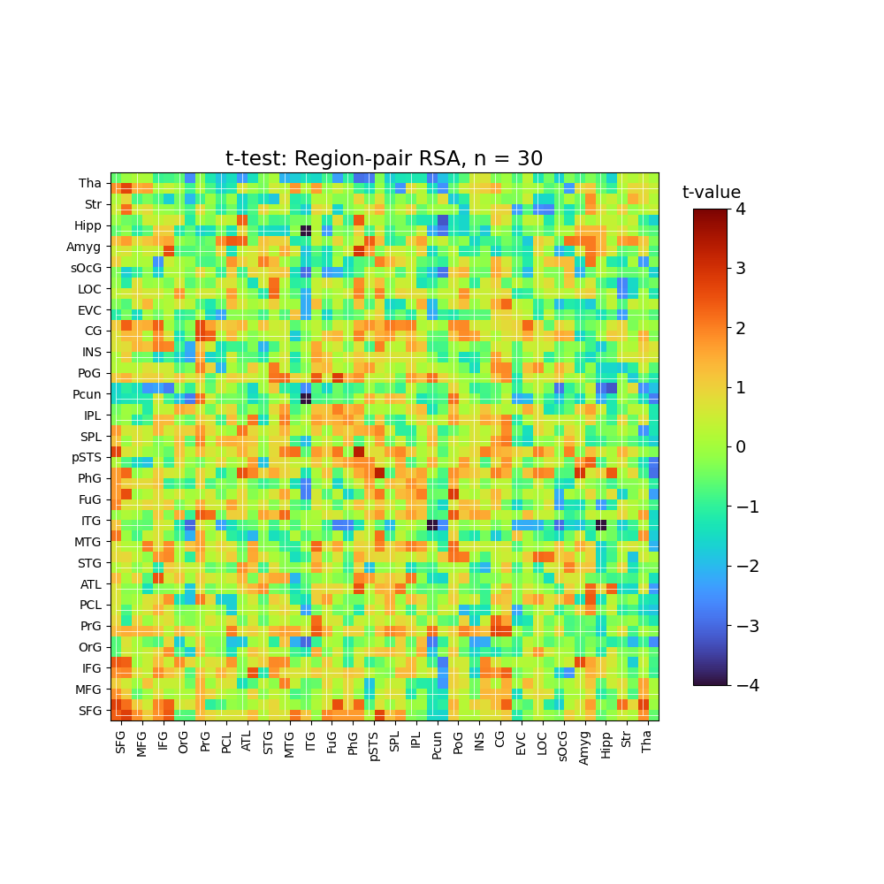

Slide 12
Only one edge: PCL_L, PCL_L
Only one edge: PCL_R, PCL_R
Only one edge: pSTS_L, pSTS_L
Only one edge: pSTS_R, pSTS_R
Only one edge: sOcG_L, sOcG_L
Only one edge: sOcG_R, sOcG_R
Only one edge: Amyg_L, Amyg_L
Only one edge: Amyg_R, Amyg_R
Only one edge: Hipp_L, Hipp_L
Only one edge: Hipp_R, Hipp_R

Slide 14
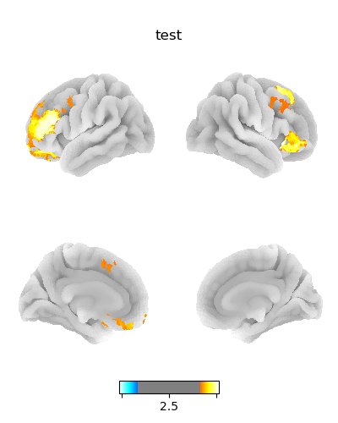
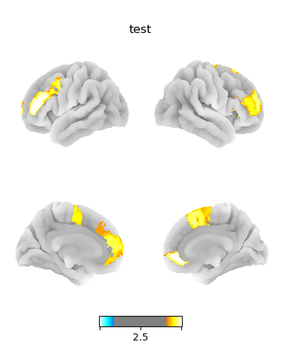
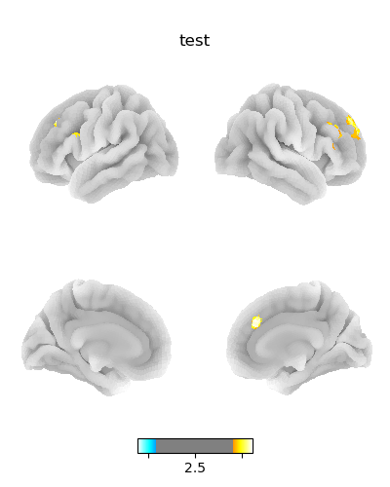

Slide 15
