Slide 1
SchemeRep
January 11, 2024

Slide 2

3-session fMRI study
Baseline: rated image-label typicality for objects
Encoding: Presentation of scene and object. Rated how likely one is to find the object in the scene
Retrieval: conceptual old/new followed by visual old/similar/new

Slide 3
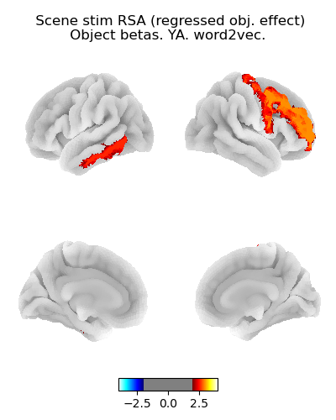
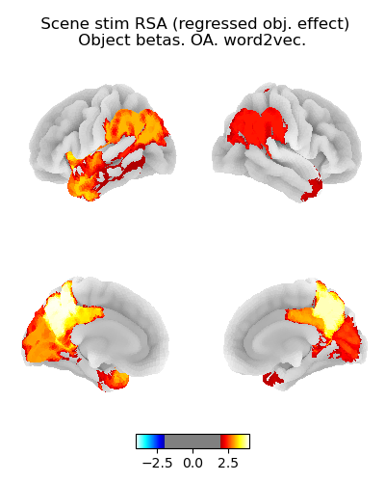
Scene RSA: Object presentation betas
Younger adults
Older adults
t-value
t-value

Slide 4
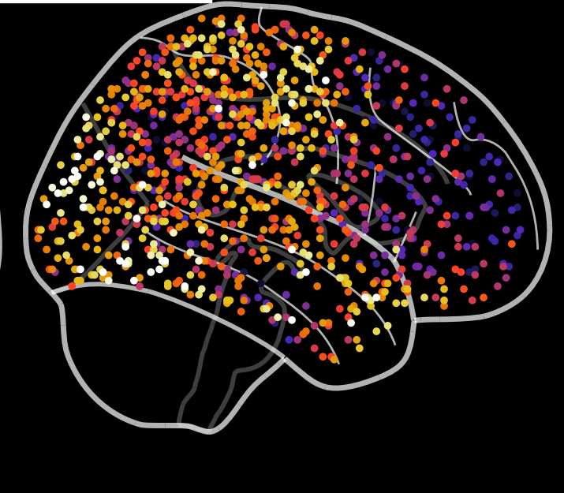
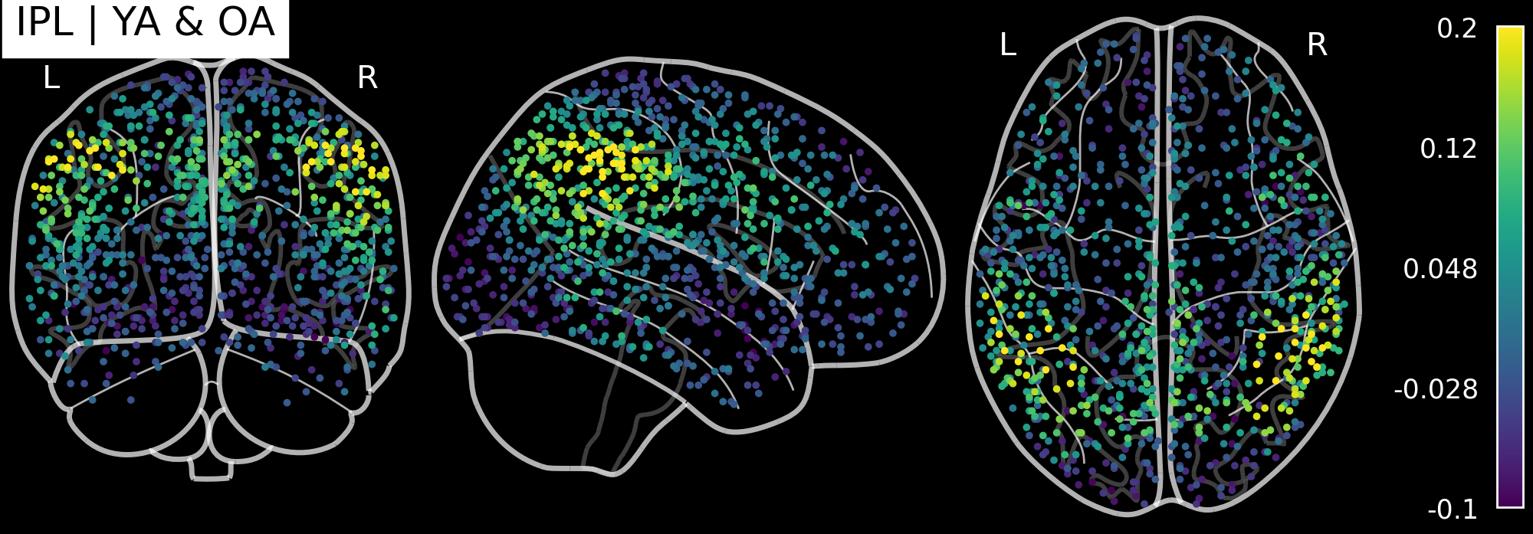
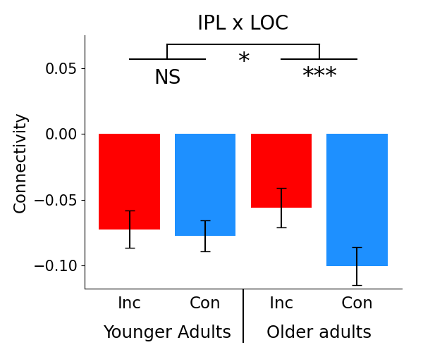
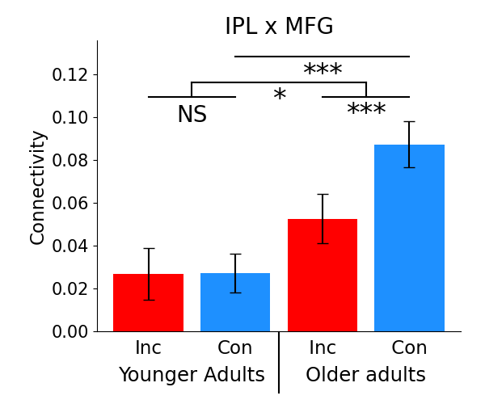

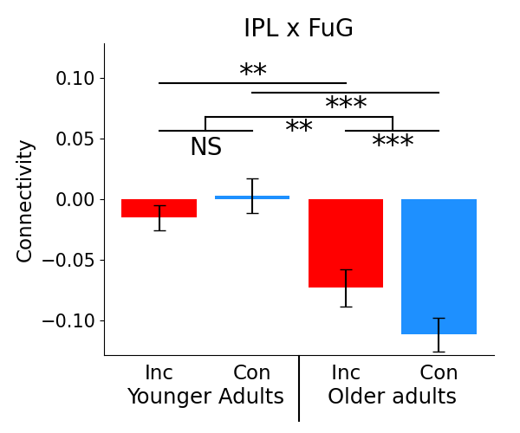
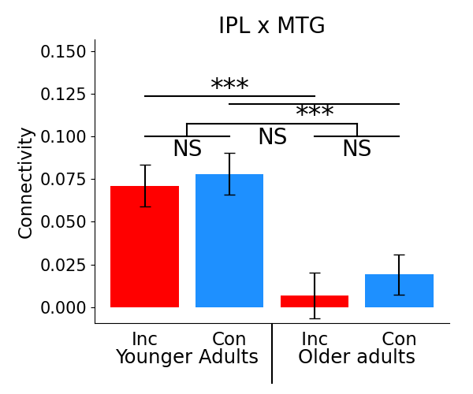
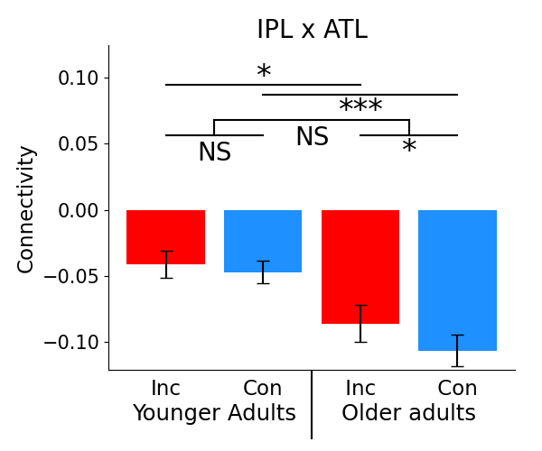
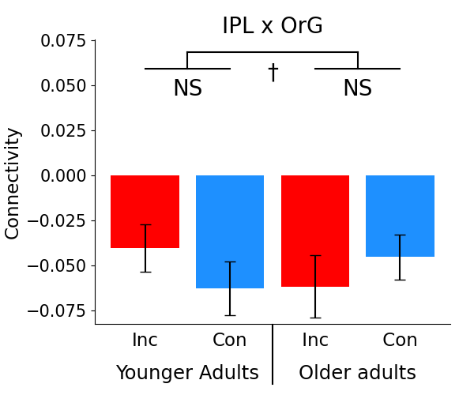
Inferior parietal lobule (IPL)
Mean
FC
Effects in OA
OA t-tests
Congruency
IPL
MFG
LOC
FuG
Incongruency
ATL

Slide 5
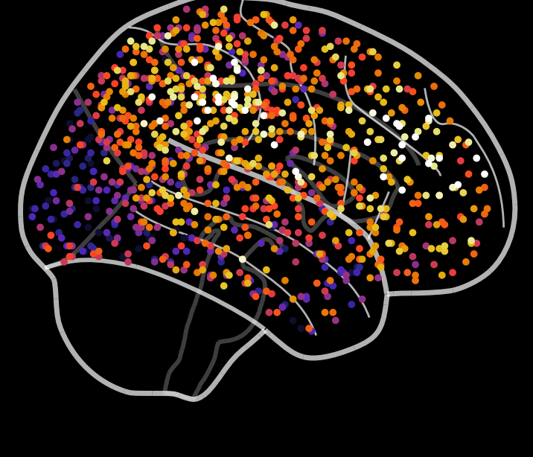
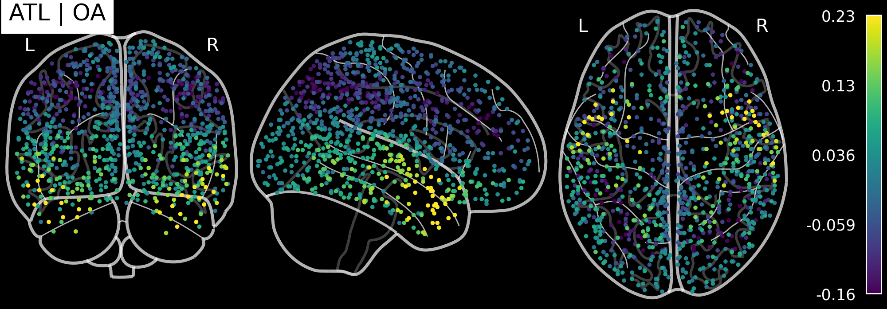
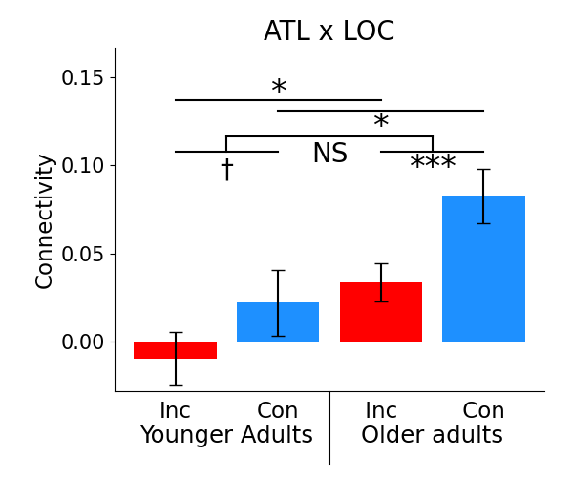
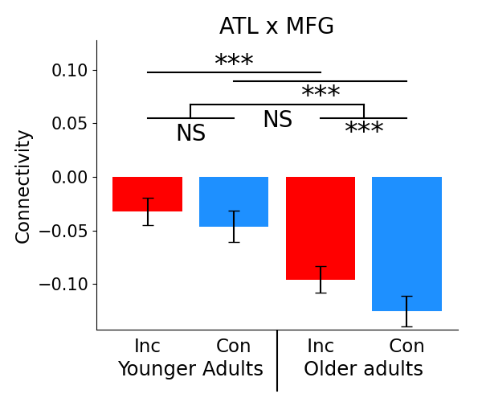
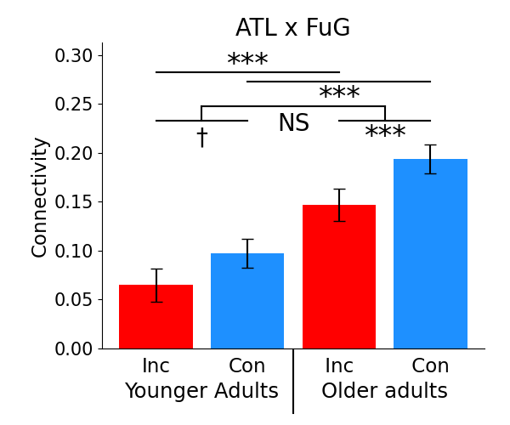
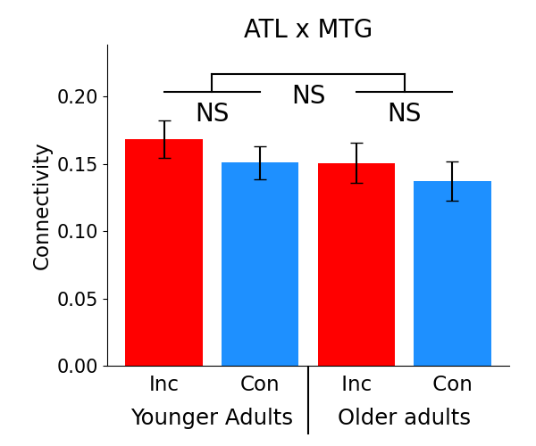
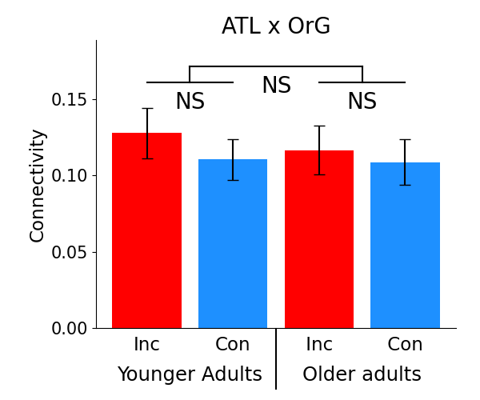
Anterior temporal lobe (ATL)
Mean
FC
Effects in OA
OA t-tests
Incongruency
IPL
MFG
LOC
FuG
Congruency
ATL

