Slide 1
Ven-Dor
2/2/2024

Slide 2
Introduction
The human mind is continuously applying existing knowledge to incoming information
  At the most basic level, pattern-detection is an example of this, as it is the process of evaluating whether stimuli are congruent with schemas
  Evaluating matches
This topic is seeing ever-growing interest
  Consider the rising popularity of neural and cognitive theories based on prediction errors
Yet there are limitations with existing research
  Studies typically focus on small subsets of the brain (e.g., single regions), even though congruency-assessment is a whole-brain phenomena
  Relatedly, most studies focus on “basic” forms of congruency (i.e., prediction error in decision-making) rather than the type of semantic-congruency assessment, which makes us human

Slide 3
Introduction
This topic is of particular interest to aging research
Older adults show greater use of prior knowledge when processing incoming stimuli
  This is a defining characteristic of aging
  Behavioral studies have demonstrated several downstream effects (e.g., on memory)
However, the neural correlates of how older adults evaluate apply their prior semantic knowledge (schemas) to incoming information remains mostly unclear

Slide 4
Questions / Aims
How do individuals (YA & OA) process congruency?
How do OAs process congruency differently?
  Do OA brains reflect a continuous search for congruency?
  i.e., by default, are OAs always in a “processing congruency” state?
How are the neural correlates of congruency processing linked to other aspects of cognition
  Stimulus representation
  Memory

Slide 5
Result 1: Identifying the Ven-Dor modules

Slide 6

Incongruency-congruency conn matrix
t-test compare congruent vs. incongruent
Combine YA and OA
Notes:
fin_plot_conn_matrix.py

Slide 7



Modularity
Submitted the thresholded connectivity matrix to a modularity-detection algorithm
  I used a version of Louvain’s algorithm
These modules reflect t-tests done on both YA and OA data
  If only OA were used, then later analyses of the modules comparing YA vs. OA would be circular
Dorsal
Congruency
Par.
Ventral
PFC
Occ.
Congruency
ATL

Slide 8

Dort?
Rather than a “dorsal” module, it’s actually more of a frontoparietal control network (FPCN) module
  I know the FPCN is a construct based on resting-state fMRI
  But it’s popped up in task studies
  It’s striking to me that the MTG spot lands closely to where the temporal component of the FPCN typically appears
Instead of Ven-Dor, it may be more correct to say “Ventral-FPCN”
  Nonetheless, I proceed with the Ven-Dor idea and the MTG component for now
FPCN
Congruency
Par.
PFC
MTG

Slide 9

Quadrants
The two modules can be split into quadrants
Outlier
Parietal
PFC
ATL
OccTemp

Slide 10

Quadrants (scrubbing)
The two modules can be split into quadrants
Outlier
Parietal
PFC
ATL
OccTemp

Slide 11

Anatomical Quadrant
The quadrants could be defined anatomically
  Here, I picked regions based on the atlas region labels
Parietal
PFC
ATL
OccTemp
I didn’t pursue this in the current slides’ results, but it’s an option

Slide 12






Traditional modularity results (for reference)
Modules based on average connectivity (quite localized)

Slide 13




Quadrant seeds
Parietal
PFC
Parietal
PFC
OccTemp
ATL
Each quadrant was tested as a seed
OccTemp
ATL

Slide 14

Ven vs. Dor
Par.
Within
Between
PFC
Occ.
Within
Many interactions attempted
General hypothesis
There exists Ven-Dor “brain state”, characterized by a dissociation of the two modules
  High within
  Low between
People, YA and OA, enter this Ven-Dor state when processing congruency
This state is heightened at all times for OA, reflecting a constant increased application of semantic knowledge in coming stimuli
  This occurs even when processing incongruency
  However, this state is particularly heightened when processing congruency
Current interactions don’t significantly show this
Need to still look into ipsilateral only
ATL

Slide 15
Bar graphs for the four sides

Slide 16

Anatomical-based results
Results are a bit more attractive if we select the ROIs based on anatomical labels
One upside to this approach, is that it avoids any circularity biases
However, there is a risk, with just plucking and choosing anatomical labels, that one is making arbitrary choices
  (and massaging the data)
  For what it’s worth, I didn’t tweak the labels after seeing these results
Surprising that YAs do not show anything
  I think the results on OA are more compelling if YA show weaker but still present Ven-Dor effect
Notes:
No matrix_mask

Slide 17
An interlude
What does high within-connectivity mean?
  High dorsal?
  High ventral?

Slide 18
Result 2: The temporal properties of Ven-Dor and congruency processing
(Dynamic Ven-Dor)

Slide 20

Ven x Dor
Method:
  These analyses do not look at congruency
  Measuring the correlation between average connectivity on a trial-by-trial-basis
  The figure here just shows correlations but everything is consistent with multilevel regressions
Results:
  In older adults, the Ven and Dor modules move in greater sync
  Interestingly, so do the anterior and posterior connections
Constantly fluctuating
  Fluctuation is evidenced by the negative correlation
  Although it’s hard to judge magnitude based on the figure, the negative slopes are quite strong (up to r = -.38)
Ven x Dor
Aging interaction
Ven x Dor
Aging interaction
Negative correlations indicating fluctuation

Slide 21
Interim summary
Considering the full set of results in light of this fluctuation…
Individuals (YA and OA) are continuously fluctuating between a Pos-Ant state & Ven-Dor state
  Processing congruency pushes individuals toward Ven-Dor
Aging influences the states
  OAs show a greater tendency to be in the Ven-Dor state, particularly when processing congruency
OA also influences fluctuation
  Ven & Dor move in sync more
  Pos & Ant move in sync more
  Interpretable as OA showing less global processing?
Ven-Dor
Pos-Ant
Fluctuation
Par.
Par.
PFC
PFC
Occ.
Occ.
ATL
ATL
Would it help to look at resting state data? See if we find that there too?

Slide 22
Result 3: Interpreting
Ven & Dor
(These analyses would be framed as exploratory)

Slide 23
VEN module linked to scene representation

Slide 24
DOR linked to memory

Slide 25

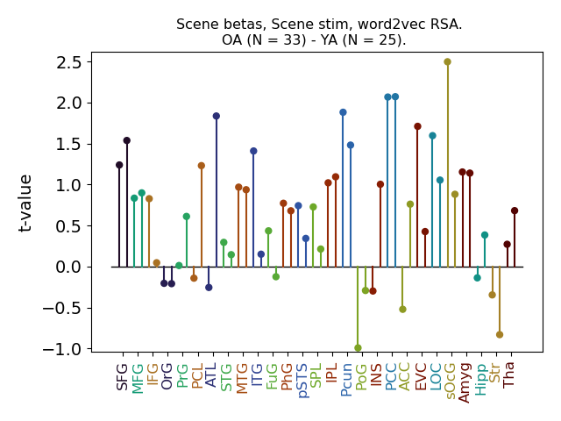

We also have this RSA finding…
Trial-by-trial analyses do not show links between representation and Ven-Dor
Maybe this result isn’t necessary?

Slide 26
End

Slide 28
Congruency
IPL
Congruency
MFG
Par.
LOC
PFC
FuG
Occ.
Congruency
ATL
ATL
Fluctuation
Par.
Par.
Par.
PFC
PFC
Incongruency
Occ.
Occ.
PFC
Incongruency
Occ.
ATL
ATL
ATL
Fluctuation
Par.
Par.
PFC
PFC
Occ.
Occ.
ATL
ATL

Slide 29

Vendor effect
Effects in OA
Plot VEN & plot DOR
Could plot a triangle matrix for each pair?

