Slide 1
SchemeRep
January 11, 2024

Slide 2

3-session fMRI study (SchemRep)
Baseline: rated image-label typicality for objects
Encoding: Presentation of scene and object. Rated how likely one is to find the object in the scene
Retrieval: conceptual old/new followed by visual old/similar/new

Slide 3
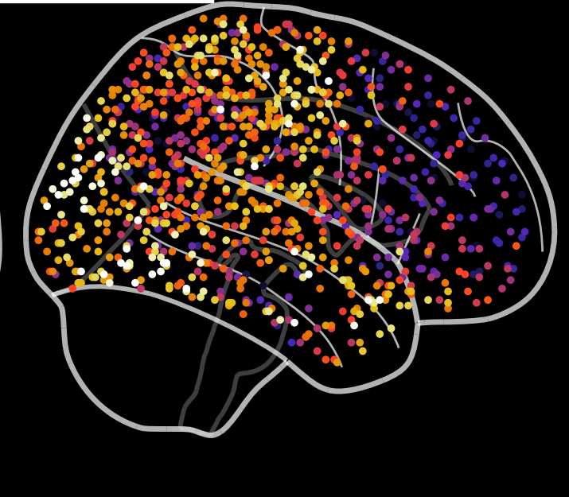
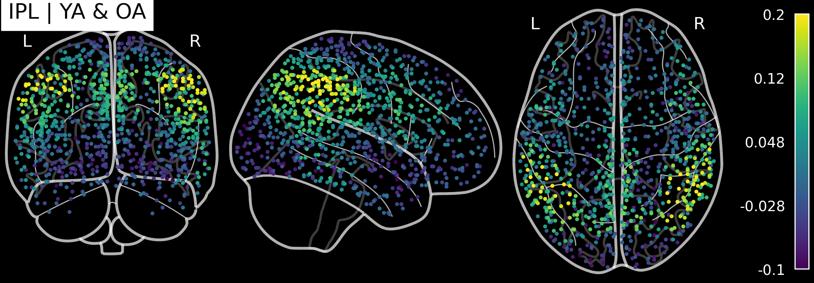
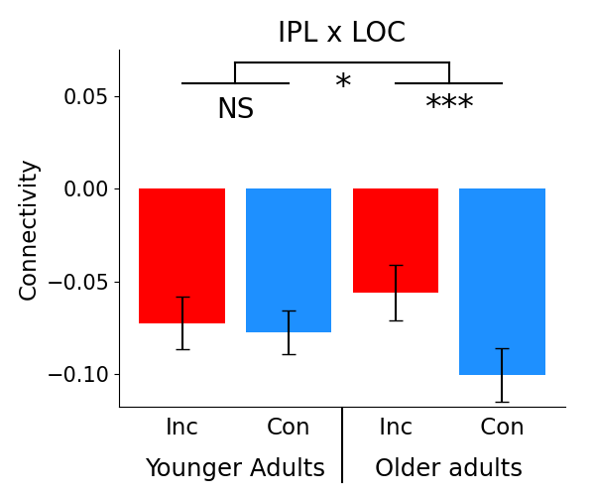
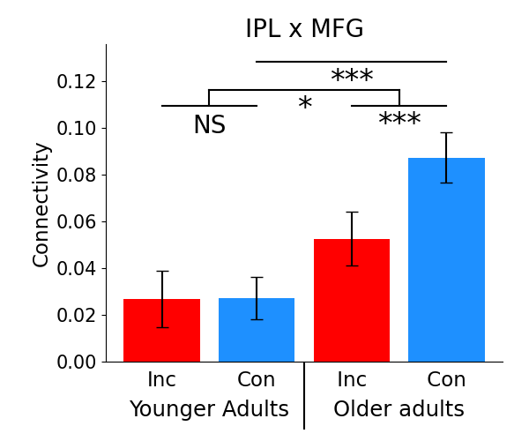

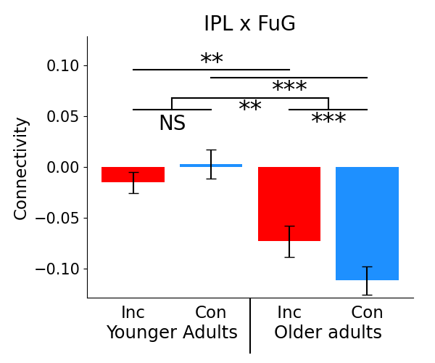
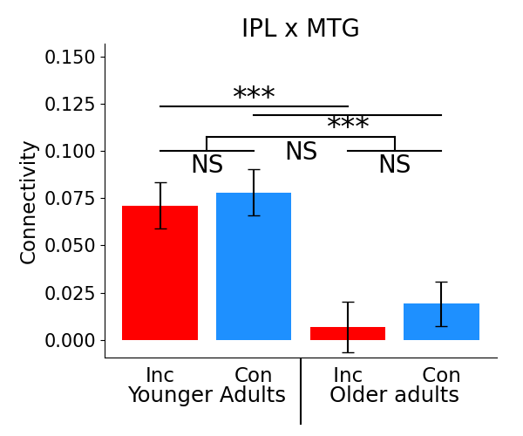
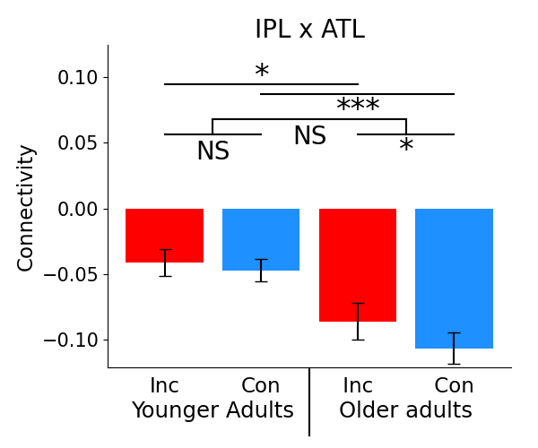
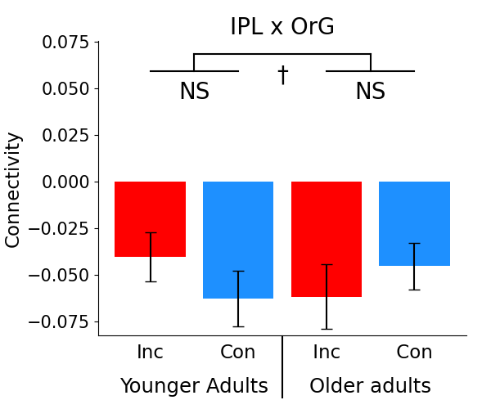
Inferior parietal lobule (IPL)
Focus on IPL is justified by classifier-based analyses showing that it’s connectivity is impacted by congruency
PCun showed a prominent RSA effect, but it doesn’t show connectivity effects linked to congruency
Mean
FC
Effects in OA
OA t-tests
Congruency
IPL
MFG
LOC
FuG
Incongruency
ATL

Slide 4
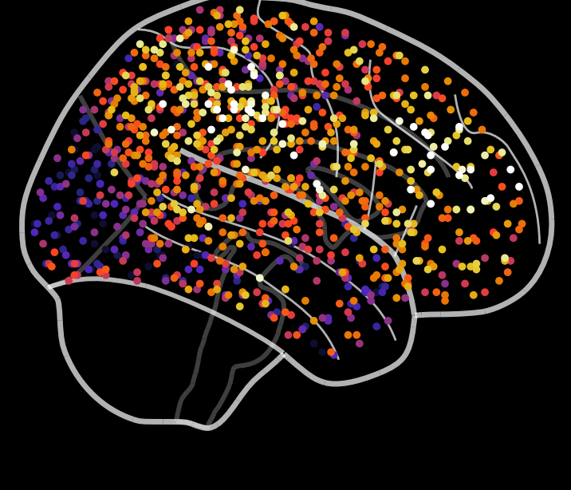
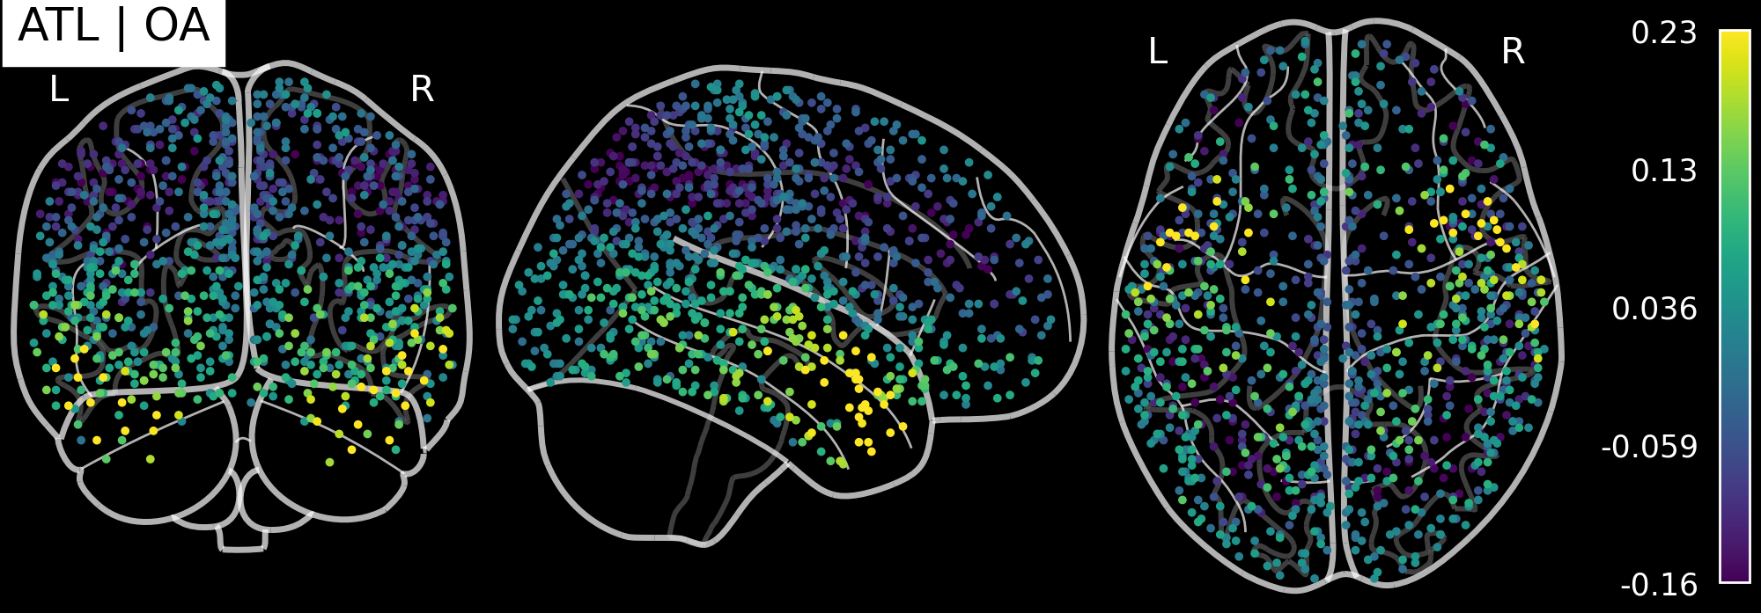
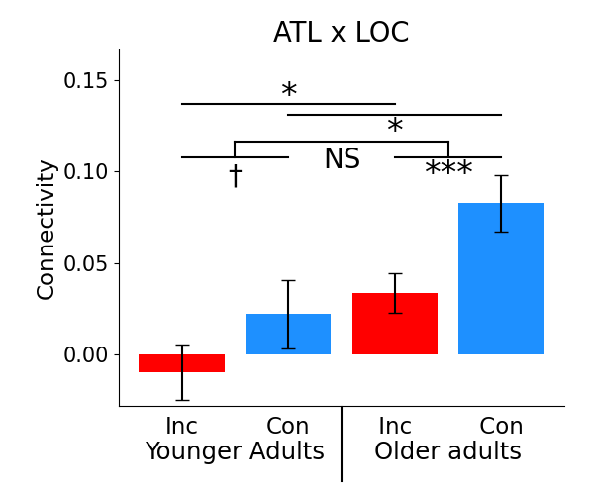
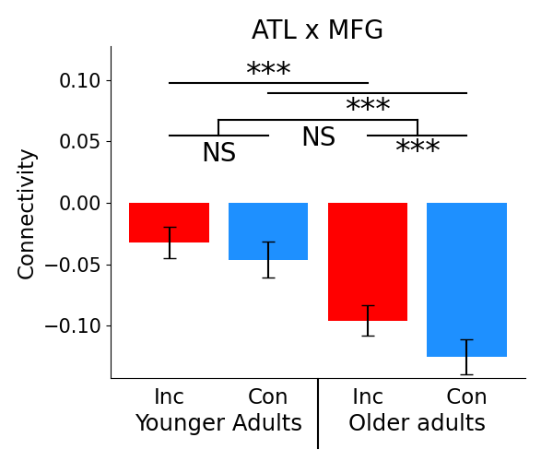
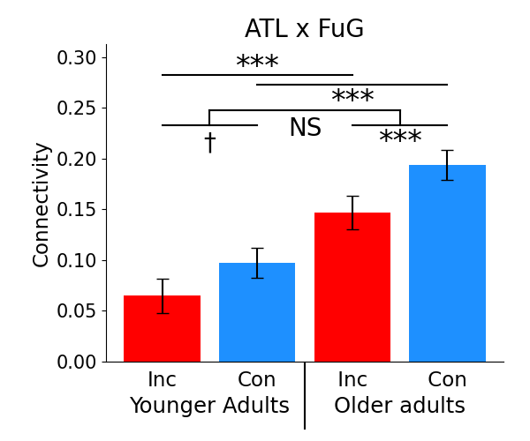
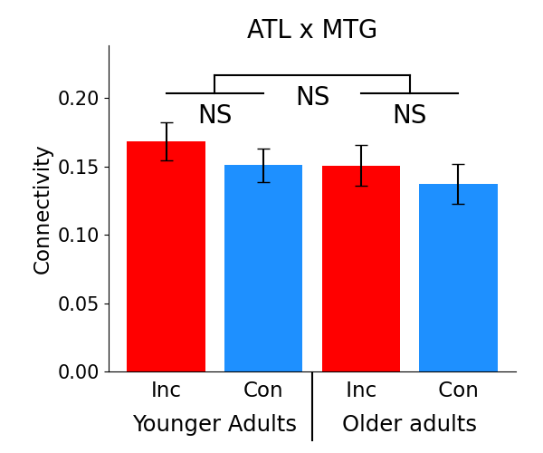
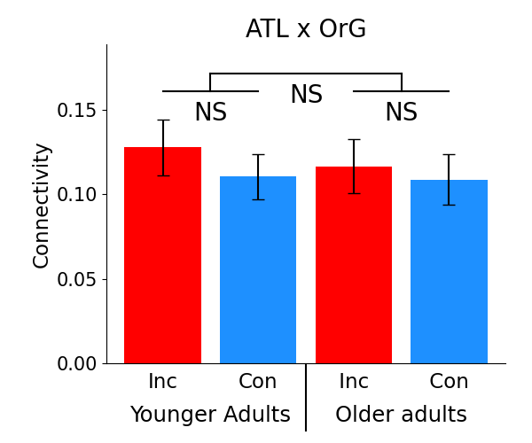
Anterior temporal lobe (ATL)
Mean
FC
Effects in OA
OA t-tests
Incongruency
IPL
MFG
LOC
FuG
Congruency
ATL

Slide 5
SchemeRep
January 15, 2024

Slide 6
Results
Older adults represent schemas more strongly
In OA, congruency is processed by separate ventral and dorsal modules
YA-OA differences in connectivity are more larger when processing congruent information
  The effect of aging is greatest when applying schemas

Slide 7
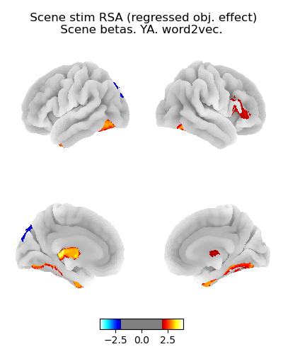
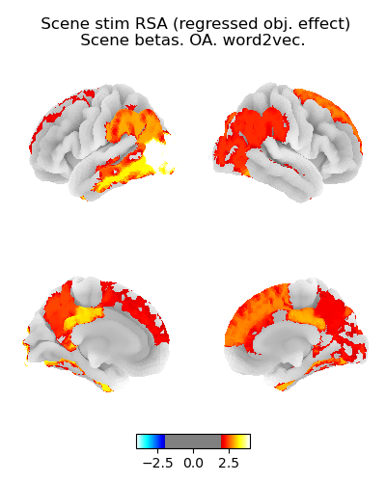
Scene RSA: Scene presentation betas
Younger adults
Older adults
Similar results when using the scene betas as when using the object betas
OA show significant representation

Slide 8
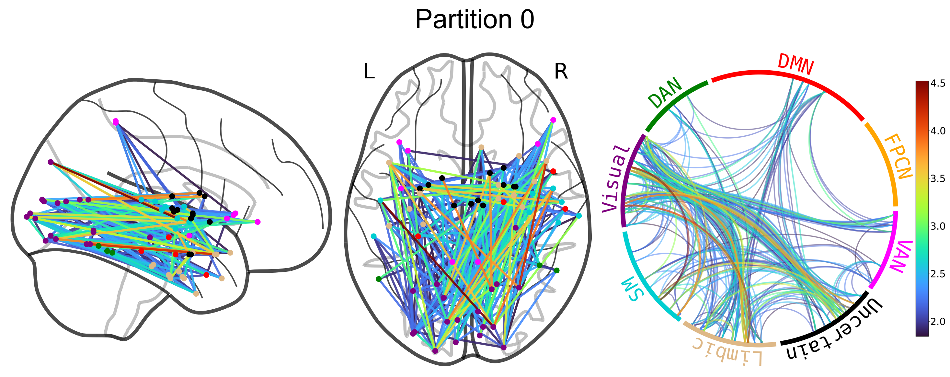
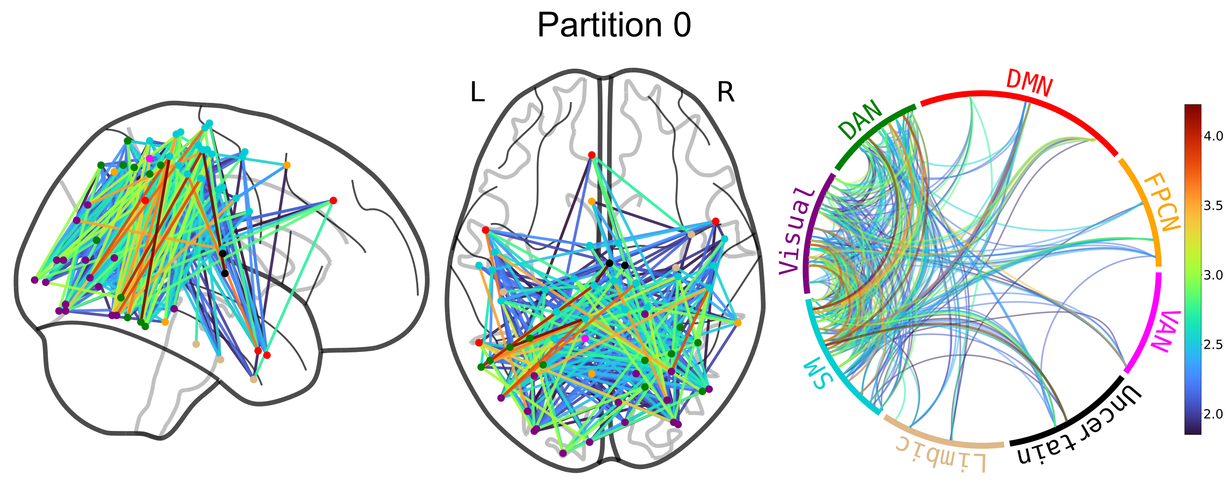
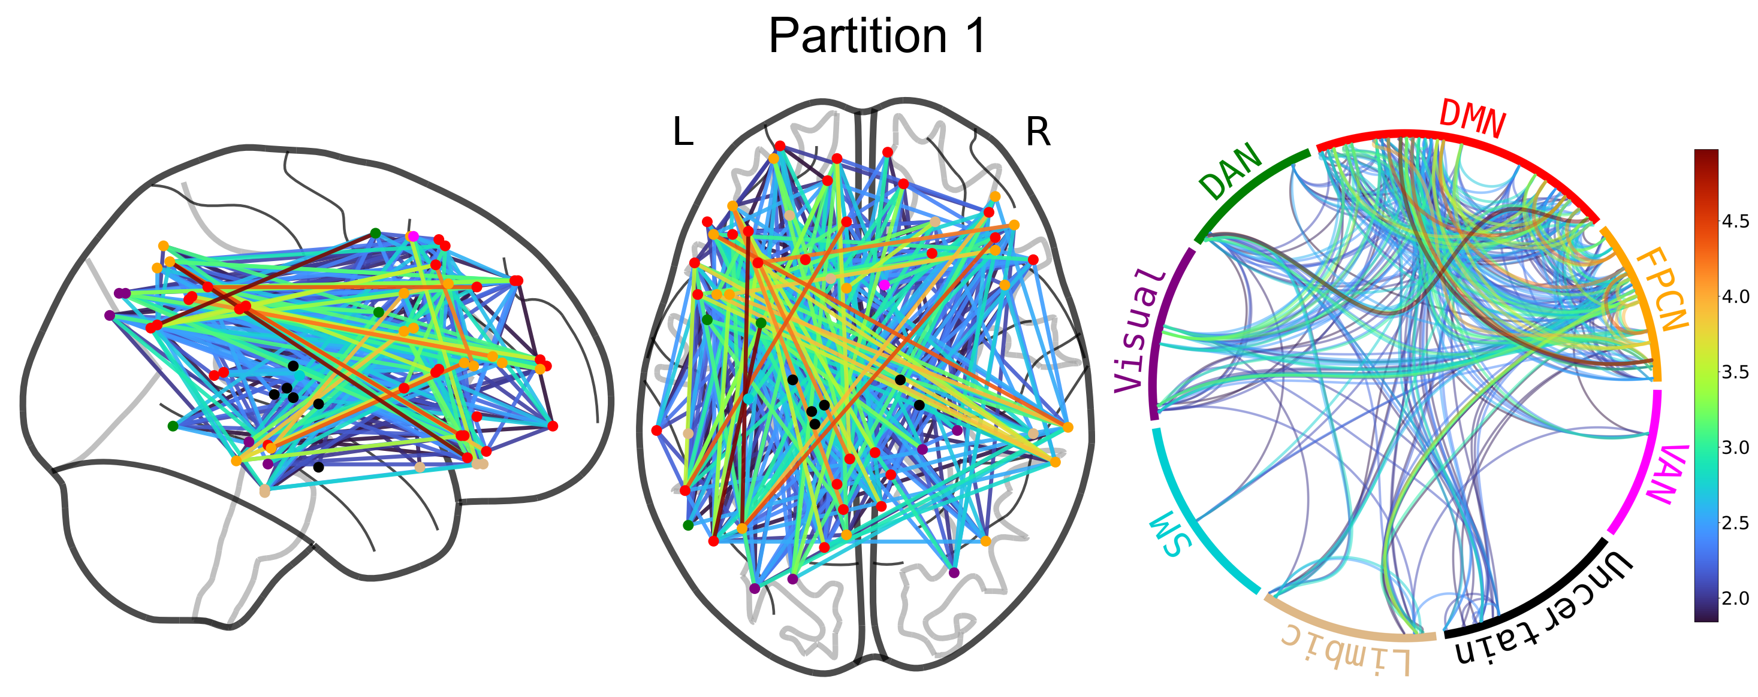
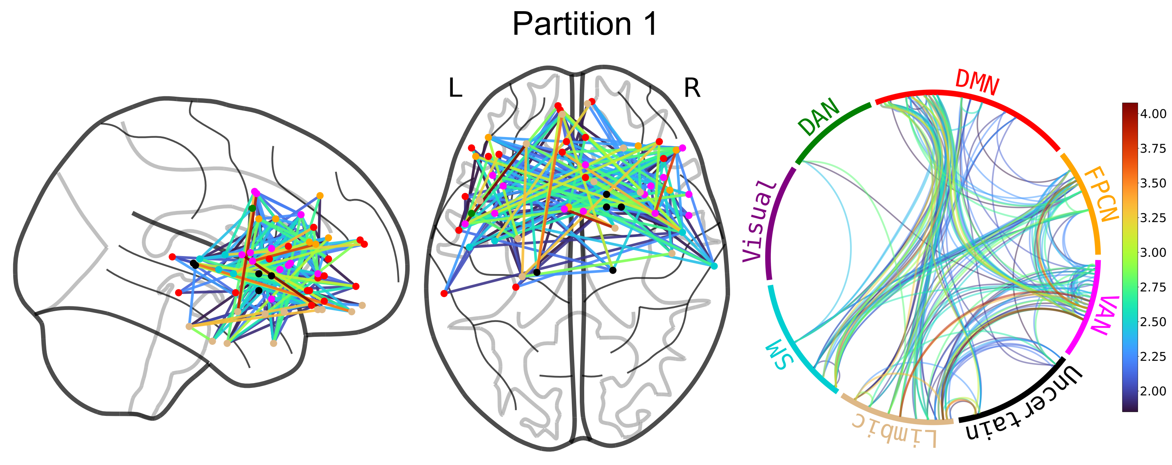
Modularity analysis of the congruency t-graph
Aging leads to a dorsal-ventral division of congruency processing
Congruency
Congruency
Incongruency
Incongruency
Average connectivity within one of these “modules” does not predict subsequent memory
Notes:
Could do the models to formally test YA vs. OA. Look at between/within
Correlate item accuracy with between/within average

Slide 9
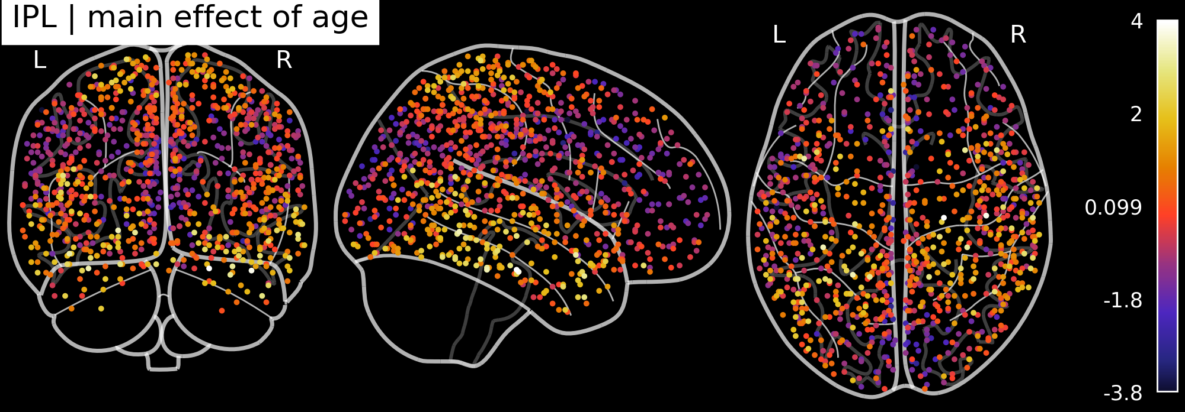
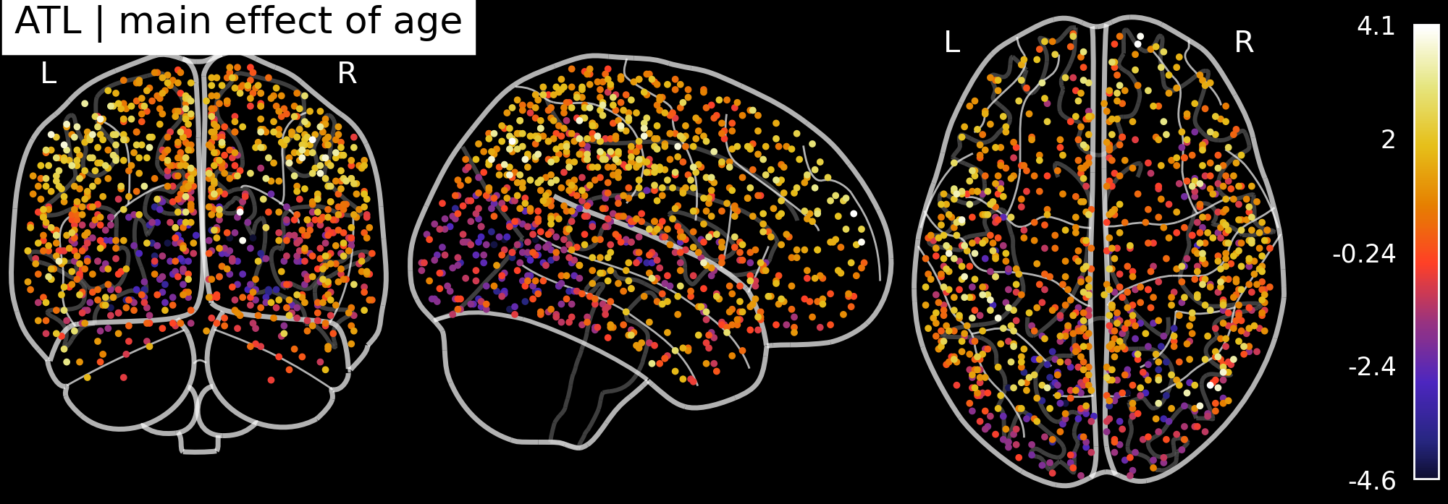
Main effect of age
Positive (bright color) = higher in YA
Negative (dark) = higher in OA
Incongruency leads to YA becoming more like OA
Maybe could look at a contrast with rs-fMRI to establish that these are task-related differences

Slide 10
Tried regressing memory accuracy on scene RSA
Hit ~ IPL * MFG + LOC * ATL + (1 | subject)
Does not yield reliably significant results
  I tried switching around the dependent variable (visual vs. conceptual hit) and the terms

Slide 11
OA data collection isn’t done?

Slide 12
Ruth K. Broad fellowship

Slide 13
Draft
The proposal’s theme:
  Studying stimulus representation helps bridge the gap from low-level neurobiology to cognitive impairment in AD
  Argues that we are studying aspects of AD that are distinctly human
    Processing abstract information + integrating information into semantic networks
  Tries to sell the idea that fMRI research is useful, even for people primarily focused on animal or cellular neurobiology
Three specific aims:
  Analyze data from SchemeRep
    MCI participants are called “pre-AD”
  Conduct new study
    On relational memory using some type of analogy-design to study the “representation of relations”
  Advance methodology
    fMRI research aging and AD is often difficult because individual differences are often subtle (less statistical power than dissociations between task conditions)
    In pursuing the first two aims, we expect new methodological innovations
Notes:
This last aim isn’t necessary, but I think the foundation funded a methodological project before, so I think this could help?

Slide 14
SchemeRep
January 26, 2024

Slide 15
3-session fMRI study (SchemRep)
Baseline: rated image-label typicality for objects
Encoding: Presentation of scene and object. Rated how likely one is to find the object in the scene
Retrieval: conceptual old/new followed by visual old/similar/new

Slide 16
Behavioral results

Slide 17
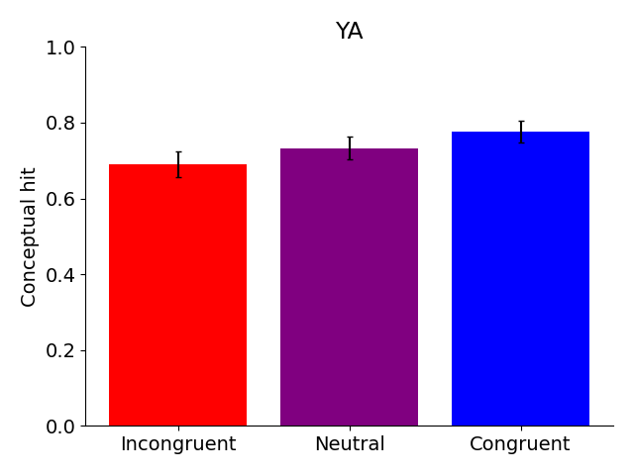
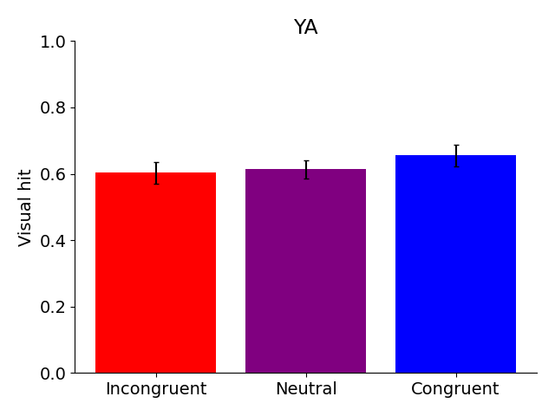
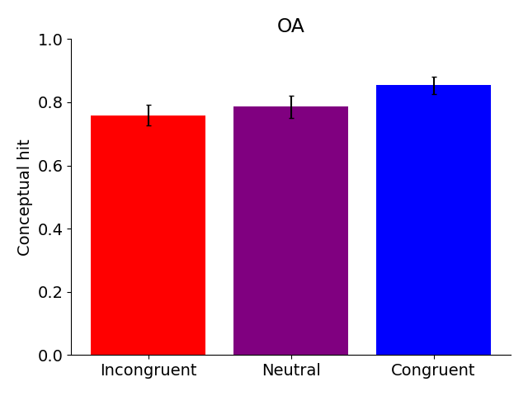
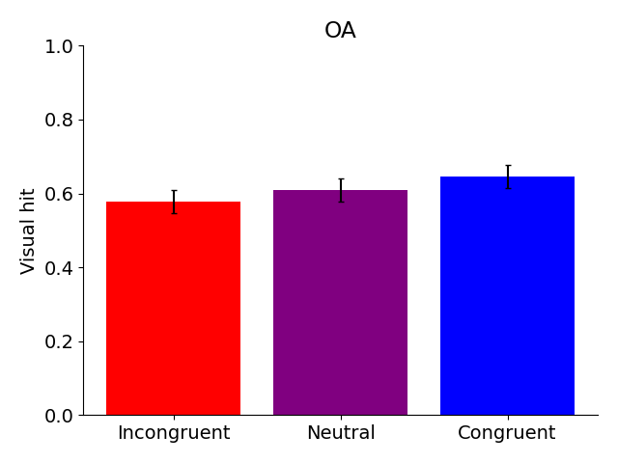
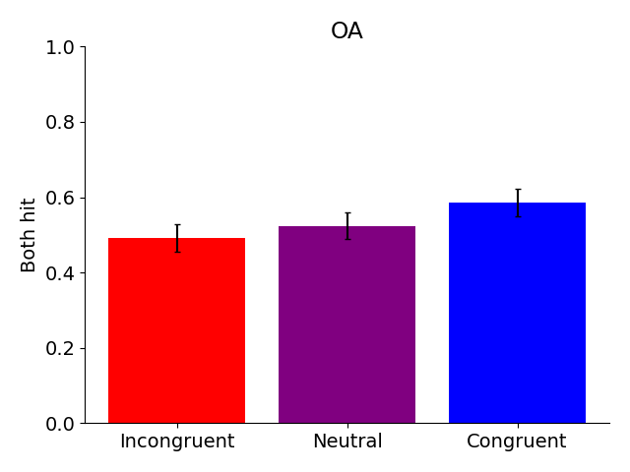
Behavioral: Memory accuracy

Slide 18
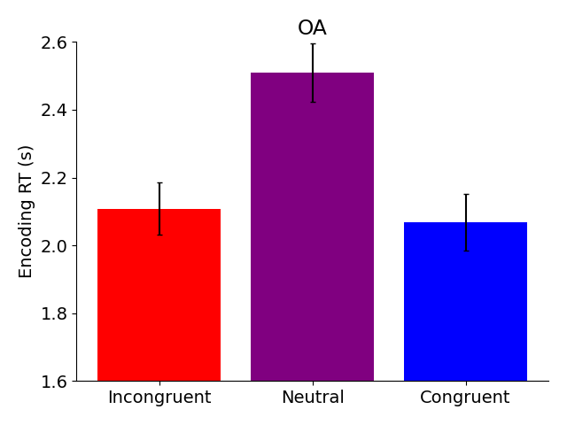
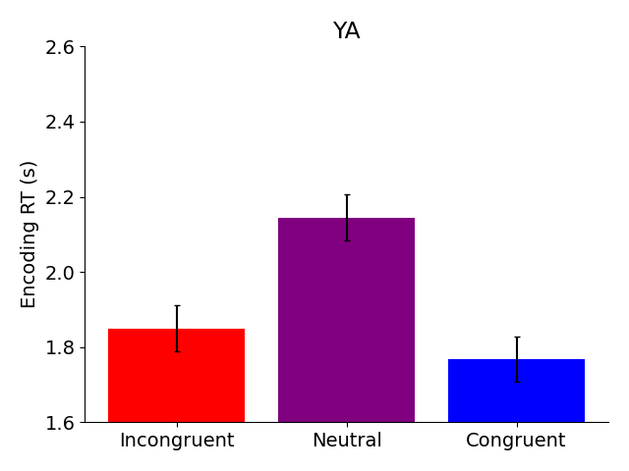
Behavioral: Congruency judgment RT
OA are uniformly slower

Slide 19
Connectivity

Slide 20
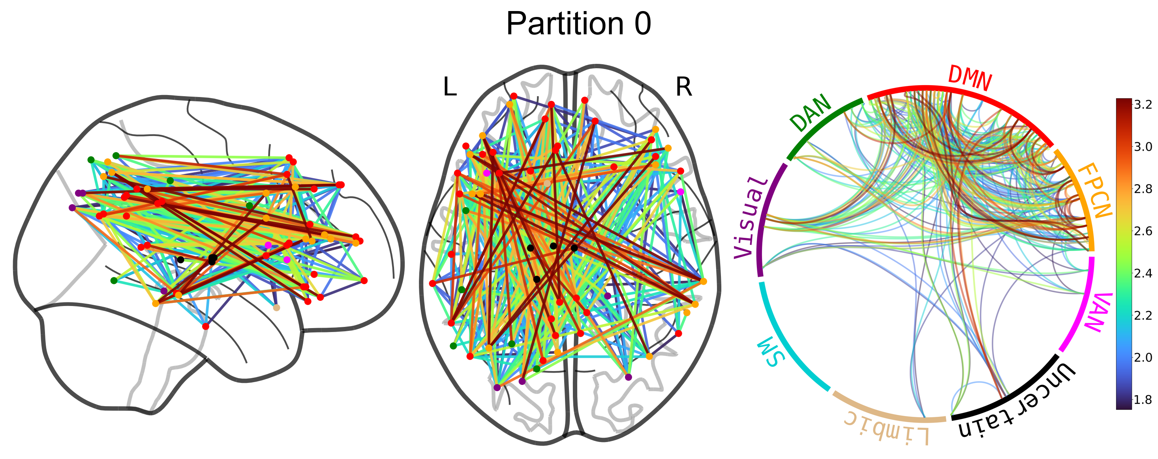
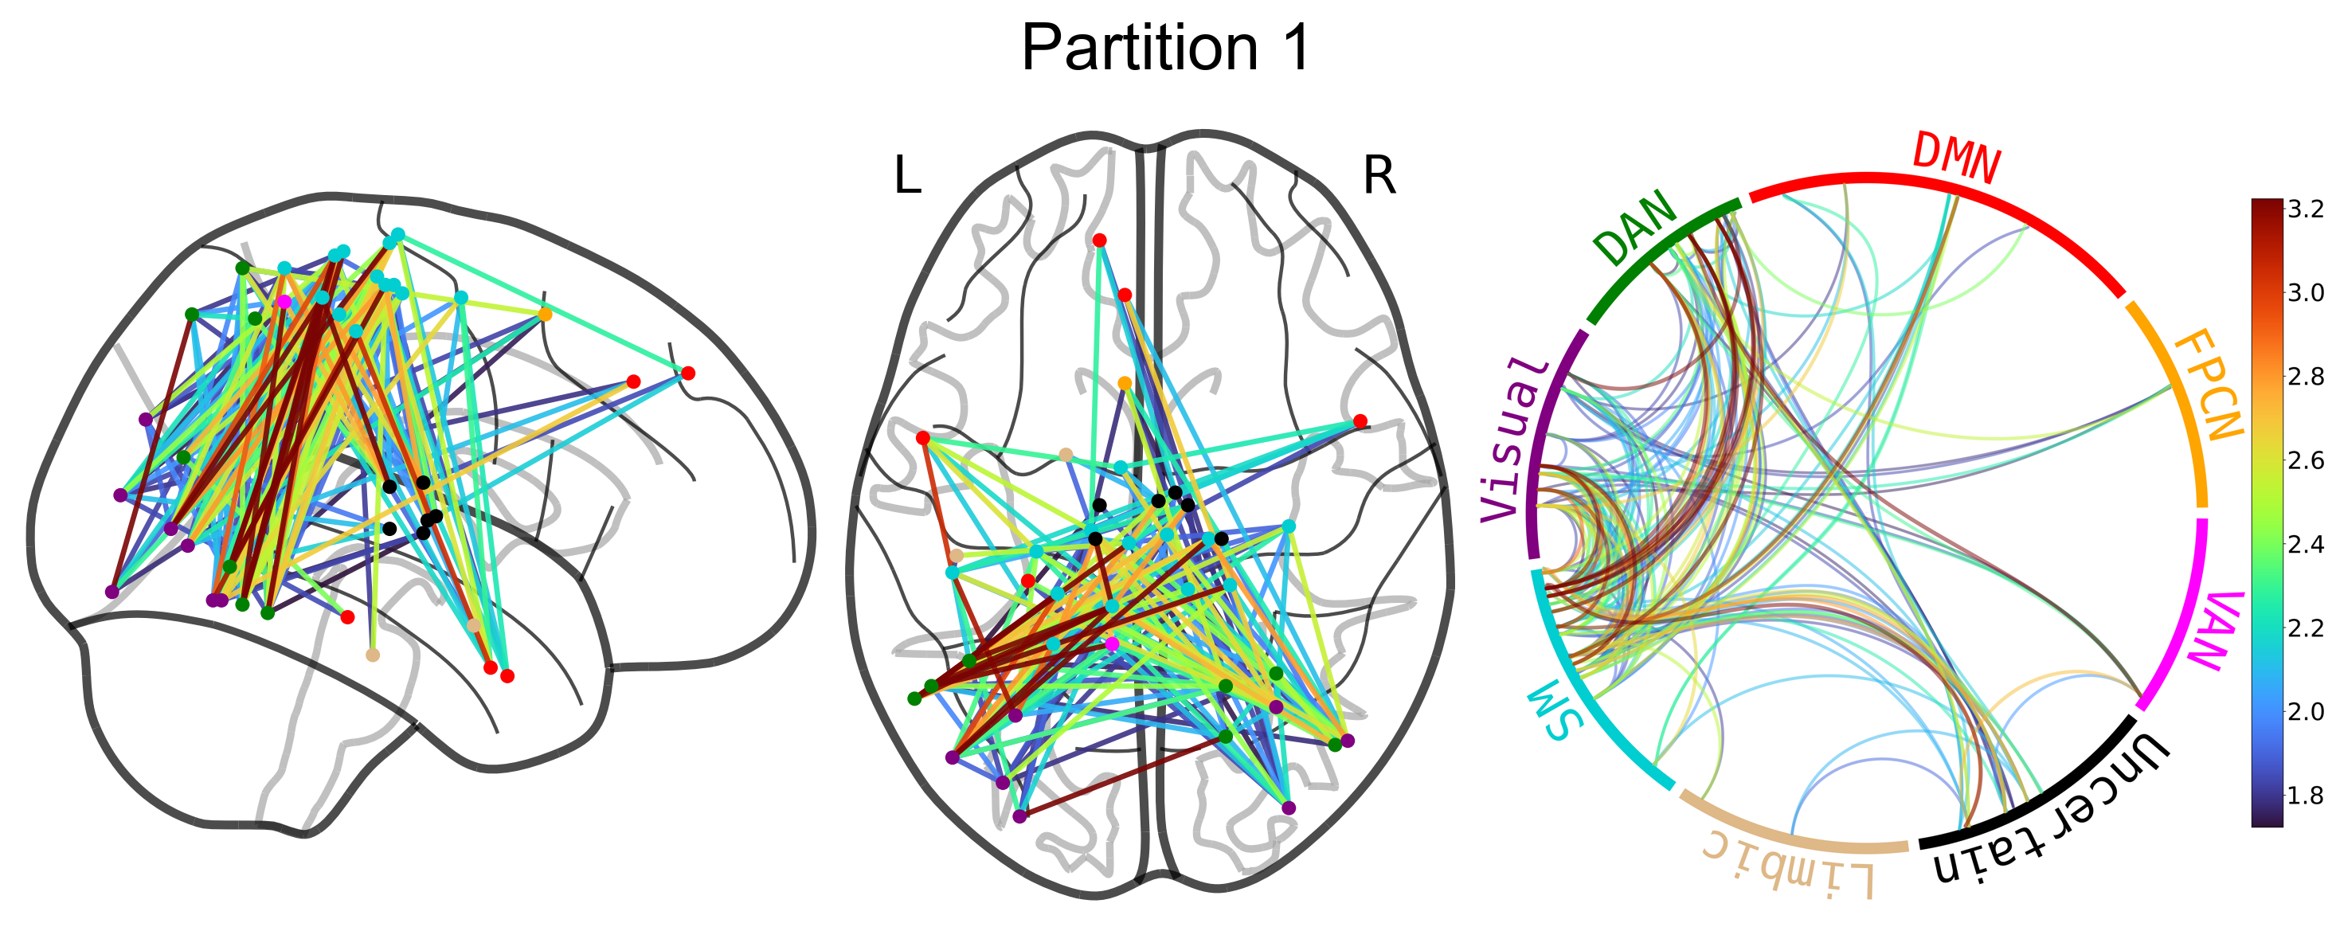
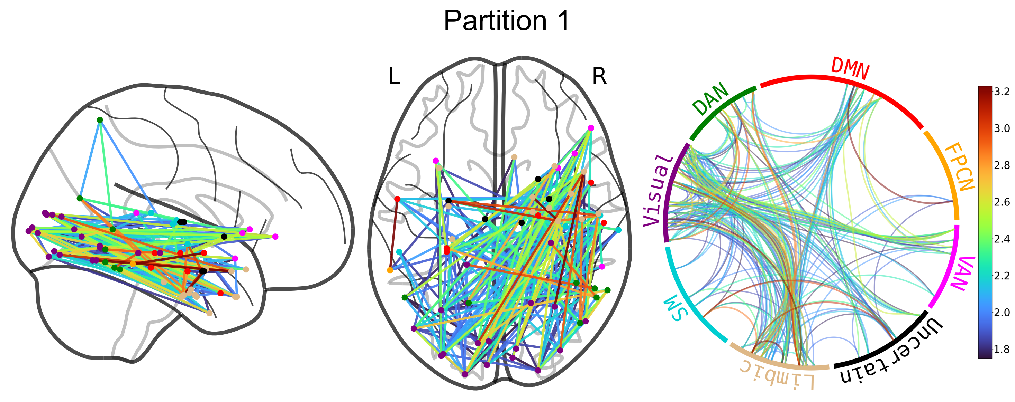
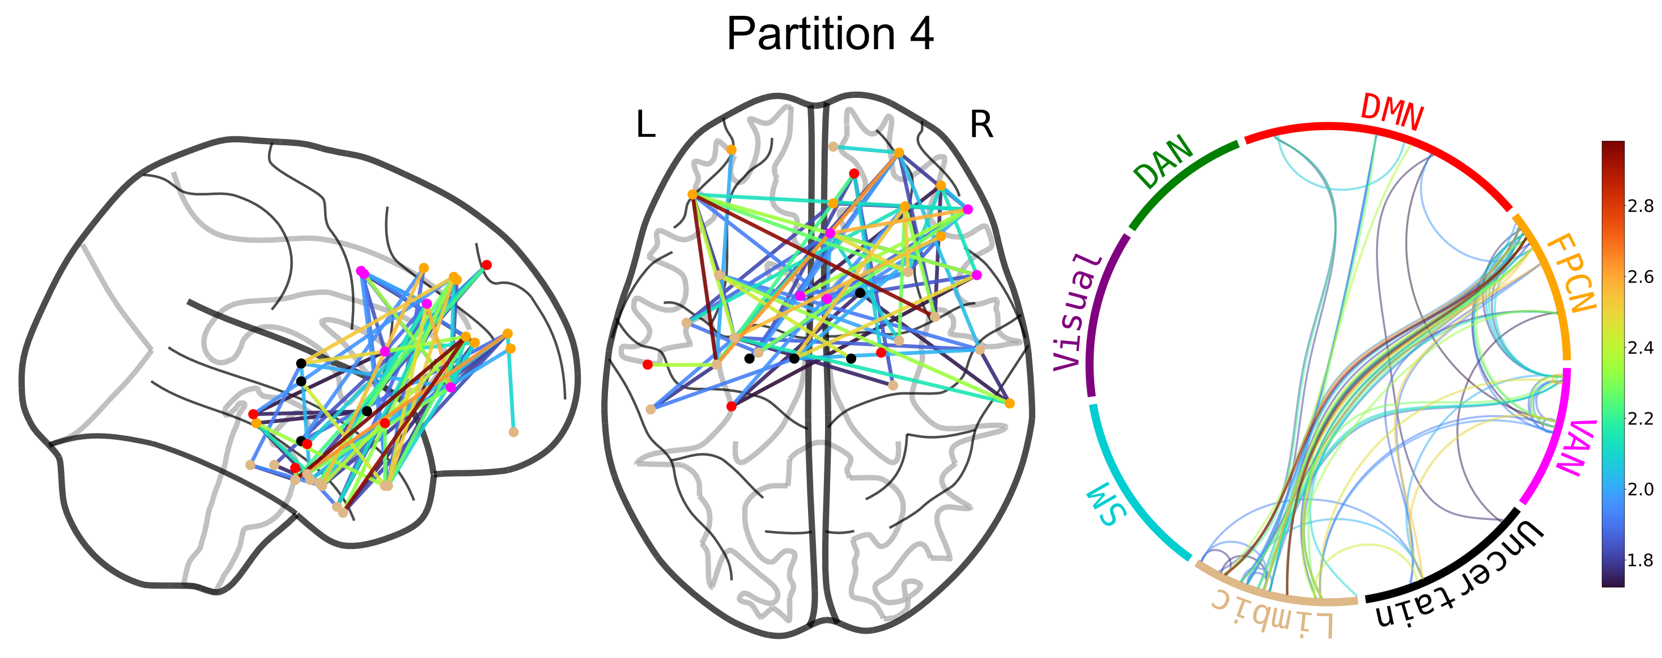
Congruent (OA)
Incongruent (OA)

Slide 21
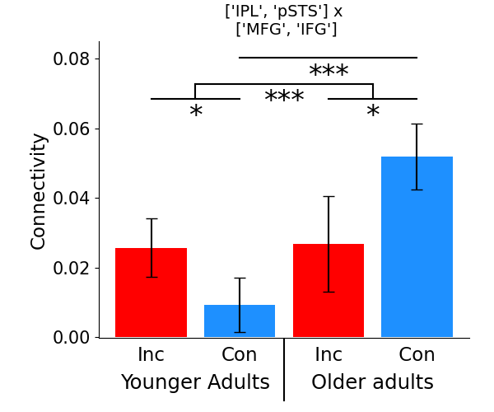
Dorsal posterior-anterior
The bars reflect the average connectivity between the top list of regions x bottom list of regions

Slide 22
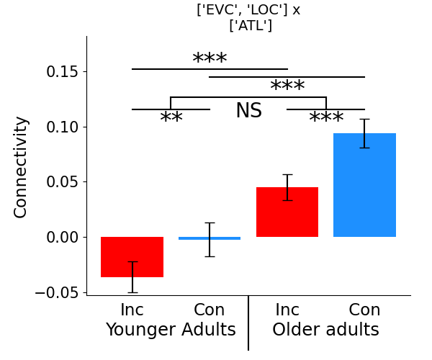
Ventral posterior-anterior

Slide 23
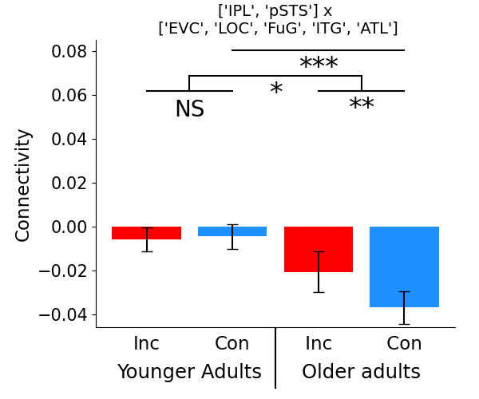
Posterior dorsal-ventral

Slide 24
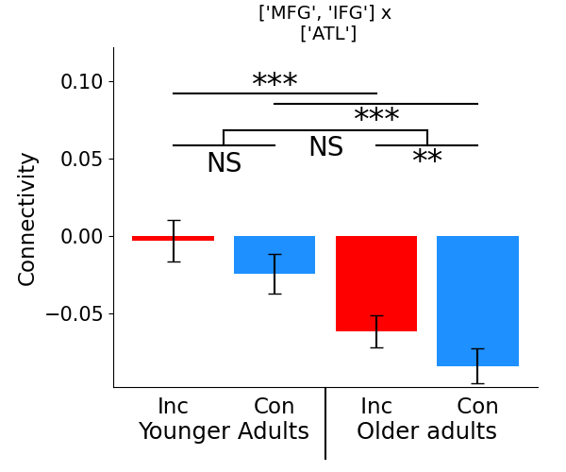
Anterior dorsal-ventral

Slide 25
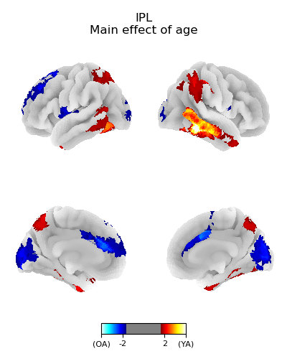
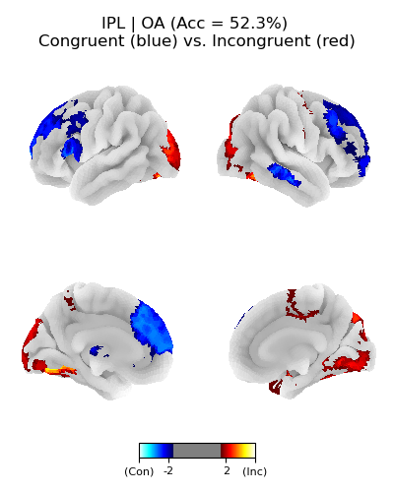
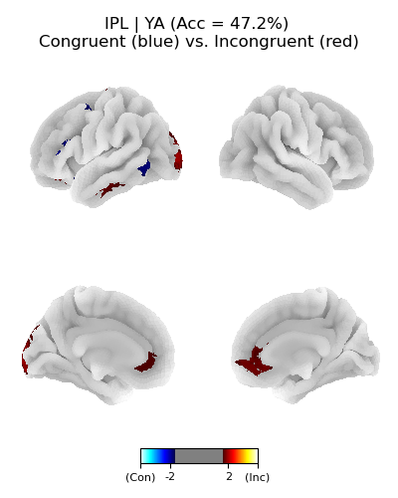
IPL

Slide 26
RSA

Slide 27

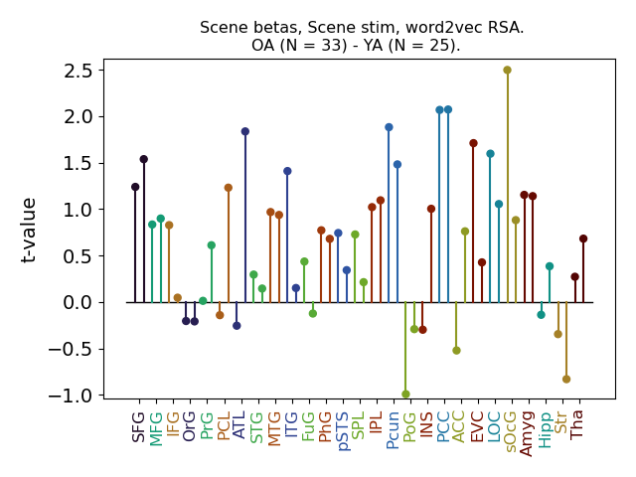

RSA: scene fMRI x scene (semantic) stim

Slide 28
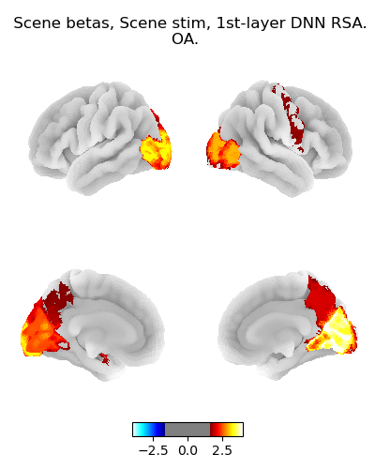
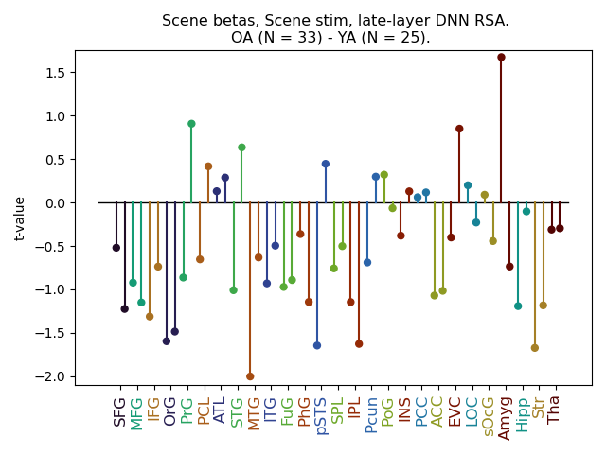
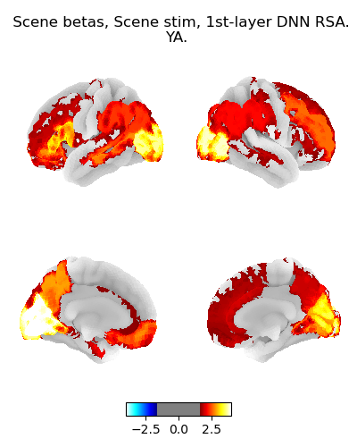
RSA: scene fMRI x scene (perceptual) stim

Slide 29
More RSA…

Slide 30
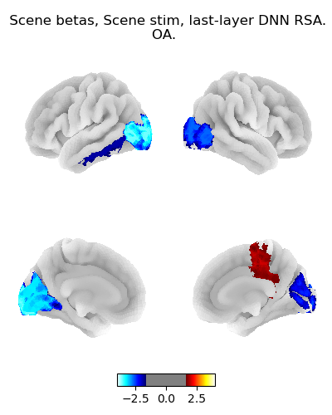
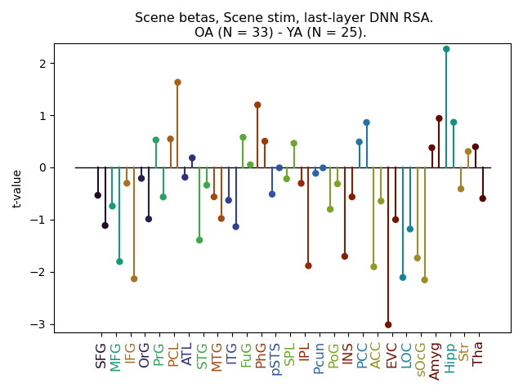
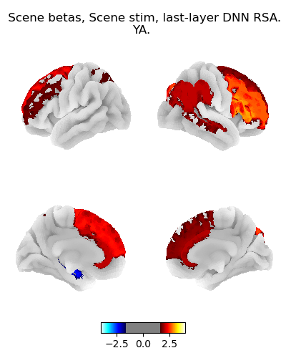
RSA: scene fMRI x scene (last-layer DNN) stim
Not sure what’s going on here…

Slide 31
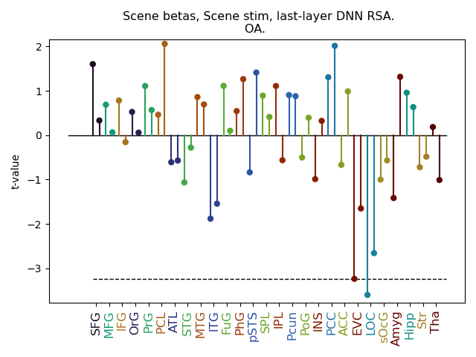
RSA: scene fMRI x scene (last-layer DNN) stim
fMRI responses are more dissimilar when stimuli are more similar
  I have trouble believing that there can exist “anti-RSA” effects like this
It’s also hard to dismiss this as pure noise, given that it appears is fairly strong (t < -3) and also in occipital areas
  However, once in a blue moon, we will see freakishly strong patterns that are purely noise, so maybe that is just what we’re dealing with here

Slide 32
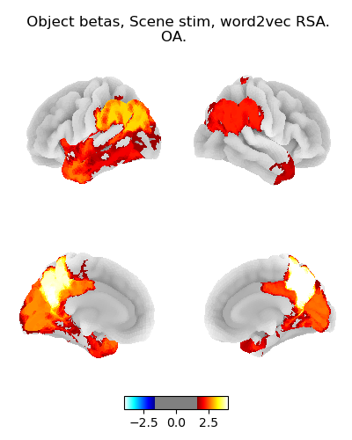


RSA: object fMRI x scene (semantic) stim

Slide 33



RSA: object fMRI x scene (perceptual) stim
I think these null results make sense, as participants are presumably using semantic rather than perceptual features to evaluate congruency

Slide 34



Sanity: scene fMRI x object (semantic) stim
TODO: check if specific to congruent because congruent vectors are correlated between scene x object (RDM x RDM)

Slide 35



Sanity: scene fMRI x object (perceptual) stim

Slide 36



RSA: object fMRI x object (semantic) stim
This is fairly orthogonal to the focus on scenes

Slide 37



RSA: object fMRI x object (last-layer DNN) stim

Slide 38



RSA: object fMRI x object (perceptual) stim

Slide 39
Meeting follow-up

Slide 40
IRAF x IRAF predicting memory
Hit ~ IPL * MFG + LOC * ATL + (1 | subject)
No coefficient is significant results
Tried a likelihood-ratio test to see whether all of the coefficients together are predictive
  Analogous to an F-test in ANOVA;
  It did not yield anything

Slide 41

Object betas vs. scene betas

Slide 42
BL x encoding item pattern similarity
Not impacted by congruency

Slide 43


Univariate activation effects:
Congruent vs Incongruent
Older adults
Younger adults

Slide 44


Activation MVPA effects:
Congruent vs Incongruent
OA MVPA
YA MVPA
What did you mean by “MVPA”?

Slide 45
Distinguishing congruent vs. incongruent in retrieval
No univariate effects
No MVPA effects

Slide 46


RSA of scene information from retrieval betas
Didn’t yield anything
  Threshold is quite low in this picture (t = 1.65)
In the meeting, I was actually fairly optimistic about this one…
  Something like this worked with Lifu’s data
Results are similar for YA

