Slide 1
Paul Update
10/3/2023

Slide 2
Lifu dissertation results

Slide 3

3-session fMRI study (SchemRep)
Baseline: rated image-label typicality for objects
Encoding: Presentation of scene and object. Rated how likely one is to find the object in the scene
Retrieval: conceptual old/new followed by visual old/similar/new

Slide 4

Lifu results 1.1

Slide 5

Lifu Results 1.2

Slide 6

Lifu Results 2.1

Slide 7

Lifu Results 2.2

Slide 8

Lifu Results 2.3

Slide 9
Warning: Results may shift

Slide 10



Preprocessing
As Cortney said, the data will be preprocessed again
Also, as we discussed in the lab meeting, we will need to discuss exactly what will be done about the within-run point
There are also questions about what exactly it means to “regress out” (e.g., should it be done run by run?)

Slide 11
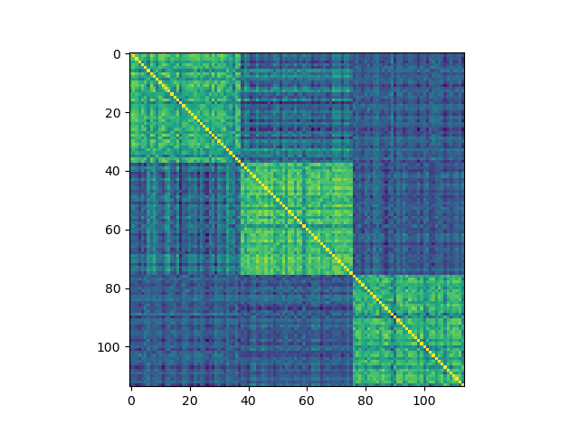
L_ATL for 102

Slide 12



Emerging property
If including within-run analysis, then we see similar IRAF across all ROIs for a given trial

Slide 13
Proposed direction

Slide 14
Background
Predictive coding theory argues that all information is processed in terms of prediction errors
  Prediction error is a computational mechanism used across the brain
    Goes well beyond early theories that reward prediction error underlies behavioral learning and ventral striatum processing
  Perceptual prediction error
    Perception depends on the perceived likelihood of encountering a stimulus
  Cognitive prediction error
    Information is processed in terms of prior beliefs and updating
Predictive coding has been studied with univariate analyses
  Perceptual prediction error correlated with activity in both cortical and subcortical regions
Notes:
Prediction error is not just an “outcome” of processing information but rather is a computational mechanism that influences
Example of perceptional prediction error: car honking feels louder in a classroom than on a busy street
Meta analysis: Corlett, P. R., Mollick, J. A., & Kober, H. (2022). Meta-analysis of human prediction error for incentives, perception, cognition, and action. Neuropsychopharmacology, 47(7), 1339-1349.
Perception results: Iglesias, S., Mathys, C., Brodersen, K. H., Kasper, L., Piccirelli, M., den Ouden, H. E., & Stephan, K. E. (2013). Hierarchical prediction errors in midbrain and basal forebrain during sensory learning. Neuron, 80(2), 519-530.
* dlPFC result (IFG and MFG)

Slide 15
Primary Question
Are stimuli represented as prediction errors?
  No study has genuinely investigated this question
    “Genuinely” = beyond univariate tests
  Yet, this idea is a central element of predictive coding theory
  This question gets at a critical point of contention
    Opponents of the theory accept that prediction error plays some role in the brain (e.g., in the striatum) but push back against these bolder higher-order claims
Multivariate analyses of representations are strong tests of predictive coding theory
  Other neural theories, supported by univariate results, broke down when tested via multivariate methods

Slide 16
Present Study and Hypotheses
Identify areas that make predictions
  Based on schema (scene) presentation, which regions represent the schema?
Among the regions representing the scene, does any area represent the object as a prediction error relative to the scene?
Is prediction error used as a computational mechanism?
  Specifically, is object information encoded as a prediction error?
    Does stronger prediction-error representation predict subsequent memory?
    Are there signatures of prediction error during retrieval, even when the original scheme is no longer shown?

Slide 17
Methods

Slide 18

Data
I looked at the encoding data for SchemeRep
  Object presentation screen
  Scene presentation screen
3 s
3 s
jitter
4 s
Notes:
I learned about how to run Word2Vec + DNNs because Lifu didn’t yet try applying these to the scene images
However, I didn’t do the word2vec properly, so I don’t provide results on that

Slide 19
3-session fMRI study (SchemRep)
Baseline: rated image-label typicality for objects
Encoding: Presentation of scene and object. Rated how likely one is to find the object in the scene
Retrieval: conceptual old/new followed by visual old/similar/new

Slide 20






Behavioral results

Slide 21

Brainnetome atlas
Used by Lifu and Shenyang
246 ROIs
  Cortical and subcortical
Notes:
Notably organized into:
EVC
LOC
FuG
ATL
Hippocampus
IFG
MFG
SFG

Slide 22

Stimulus representations
Single trial
Presentation of the scheme serves to inform the prediction
  RSA: scene vector x scene presentation fMRI
  Unsigned prediction error
Presentation of the object may elicit a prediction error
  RSA with the absolute-difference vector x object presentation fMRI
  Confound risk:
    Driven by solely the object
    Driven by solely the scene
  Hence:
    Regress out object RSA z-score and scene RSA z-score
-
=
absolute
difference
1
2
3
4
5
1
2
3
4
5
1
2
3
4
5
Trial 1
Trial 1
Trial 1
Trial 2
Trial 2
Trial 2
Trial 3
Trial 3
Trial 3
Trial 4
Trial 4
Trial 4
Trial 5
Trial 5
Trial 5
Object RDM
Scene RDM
Abs-Dif RDM

Slide 23
Many ways to interpret the abs-difference vector
Psychological meaning of the difference vector:
  Prediction error:
    Scenes establish a “prediction” that may be violated
    Predictive coding theory argues that all information is processed as prediction errors
  Priming:
    Scenes prime some representations, which will show weaker/stronger responses if activated again by the object
    Link to repetition suppression
  Relational memory:
    Broadly: The informational content of items influences how an association is encoded
    Specifically: Associative memories do not just blindly connect item representations. Rather, associations should be seen as representations that encode the relationship between the items
Speculative:
  Unclear meaning yet informative
    There is no clear psychological meaning of a “difference vector”
    Nonetheless, because this measure combines object and scene information, the findings must reflect some type of interaction between representations
  Analogical reasoning
    In the analysis, representational similarity entails parallels between trial 1’s scene-object relationship and trial 2’s scene-object relationship (i.e., an analogy)
    Because the analysis is looking for analogies, this implies that this is related to how humans process analogies?
Framed as possible competing hypotheses?

Slide 24
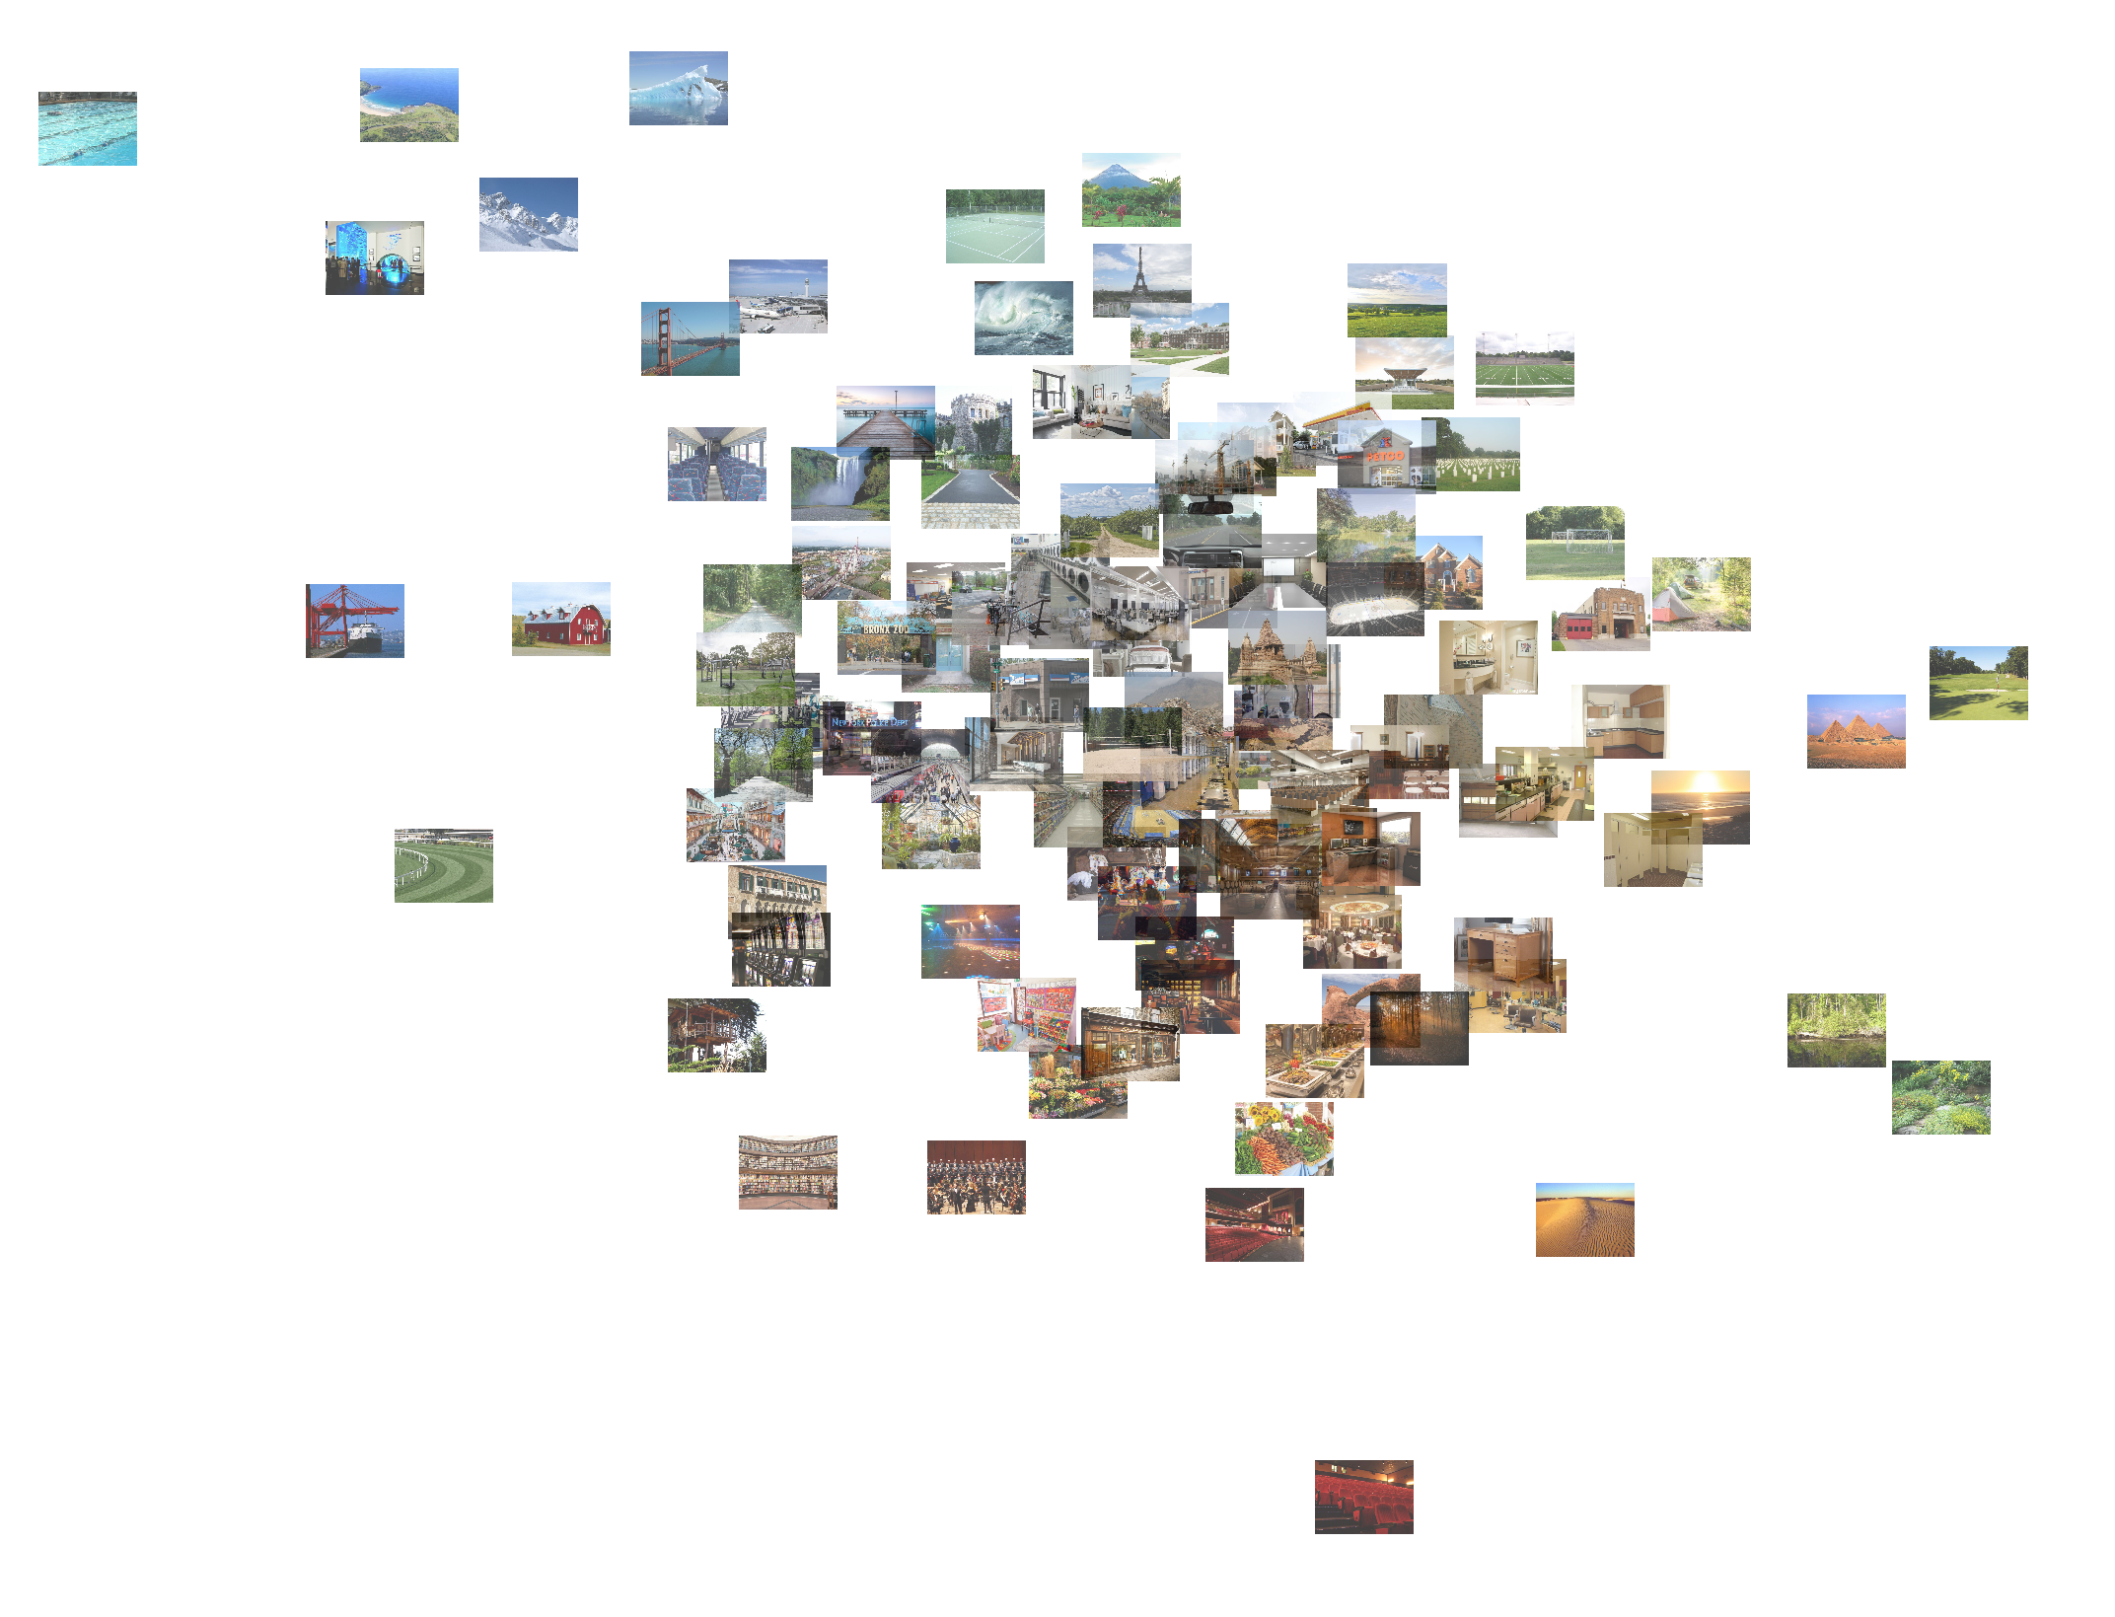

Perceptual vectors
Scene
Object

Slide 25

Abs-dif vector
Pink object
Object Scene
Brown scene
Green scene

Slide 26
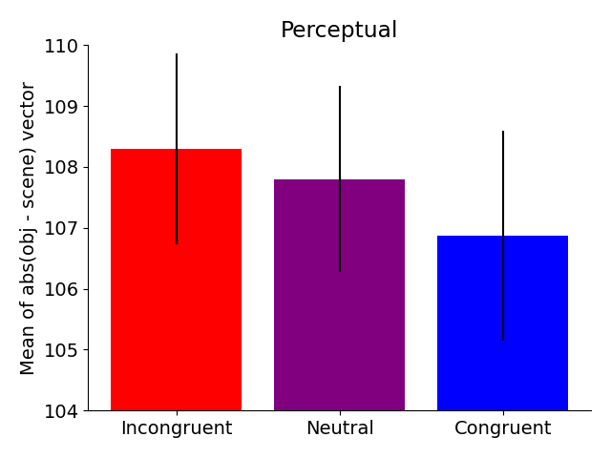
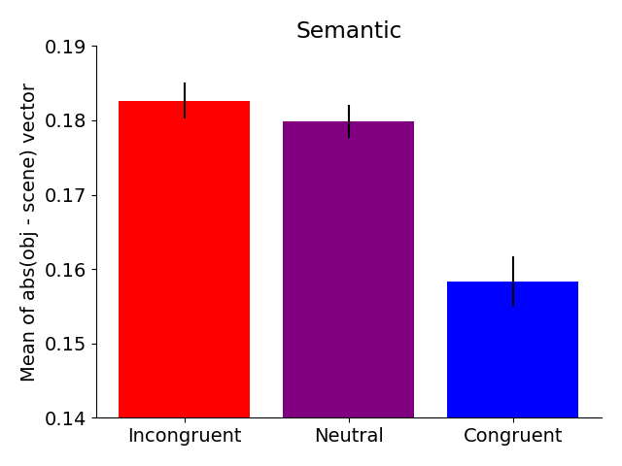
Difference vector by condition
t = 1.4

Slide 27
RSA overview
Stimulus RDM based on:
  Object stimulus vector
  Scene stimulus vector
  Object/scene abs-difference vector
fMRI RDM based on:
  Scene-presentation single-trial betas
  Object-presentation single-trial betas
Scene
fMRI
Object
fMRI
Scene
RDM
Object
RDM

Slide 28

Further temporal trend testing

Slide 29



Stimulus RSM/RDMs
Perceptual representations (1st layer of DNN)
The difference vector RSM doesn’t look particularly weird
Although not visualized here, the congruent/incongruent/neutral conditions don’t have much bearing on the vectors or RSMs

Slide 30
Results

Slide 31
Univariate findings to pad things out?

Slide 32


Result 1A: Schema representation
Perceptual scene decoding
Semantic scene decoding
PFC
Establishes the prediction
Notes:
Post hoc tests on bilateral SFG, for the eight dmPFC ROIs, t = 4.14. For the six dlPFC ROIs, t = 2.94. SFG bilateral altogether is 4.17.
mPFC overall (including some orbital and CG, yields 3.85. Excluding CG, we get 3.6.

Slide 33


Result 1C/1D: Object representation
Perceptual object decoding
Semantic object decoding
Weak/Null PFC
Reproducing patterns from Lifu’s thesis

Slide 34


Result 2A/2B: Schema-object prediction error
LPFC
Notes:
Downside: Doesn’t pan out for word2vec analysis. lPFC doesn’t pan out for connectivity. Also, doesn’t work if only looking at a single congruent/incongruent/neutral condition
HC result a bit less robust

Slide 35
Result 2A/2B: Schema-object prediction error
Confirmed by an additional “macro-level” analysis focusing on the LPFC overall
  Activation averaged by ROI
    26 ROIs = 26-length vector
    Submitted to RDM
  Significant RSA effect
  (t = 2.1, p = .02)
“Micro”
(standard)
“Macro”
LPFC
Notes:
Downside: Doesn’t pan out for word2vec analysis. lPFC doesn’t pan out for connectivity. Also, doesn’t work if only looking at a single congruent/incongruent/neutral condition
HC result a bit less robust

Slide 36
Result 2C: Connectivity: Activity x IRAF
Related to the linking and boosting points made in the grant/papers
Correlate:
  Region A: Mean connectivity across all voxels for a given trial
  Region B: IRAF
  Note: A x B ≠ B x A
  Test if significantly above zero

Slide 37
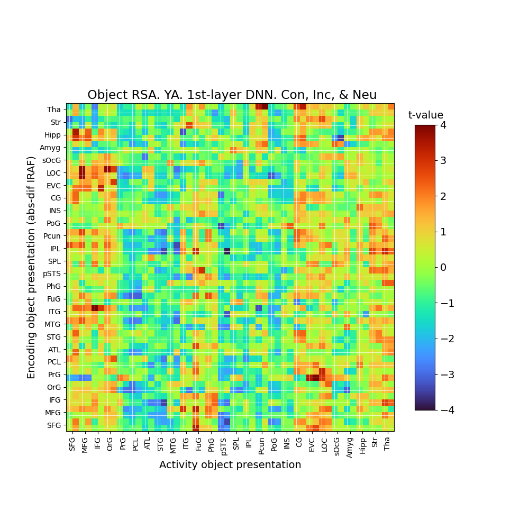
Result 2C: Difference RSA x connectivity
Occipital lobe and fusiform gyrus shows abs-dif effect, if LPFC activity is high
Top-down modulation?
Notes:
The amygdala also shows an interesting pattern
Stronger representation in the amgydala is linked to decreased connectivity with everything else
Beyond the present focus?

Slide 39
Result 3A: Prediction error IRAF predicts subsequent memory
LPFC abs-dif IRAF predicts subsequent memory

Slide 40


Result 3B: Retrieval retrieves scene representation
Conceptual task: Scene RSA
Visual task: Scene RSA

Slide 41
Other things

Slide 42
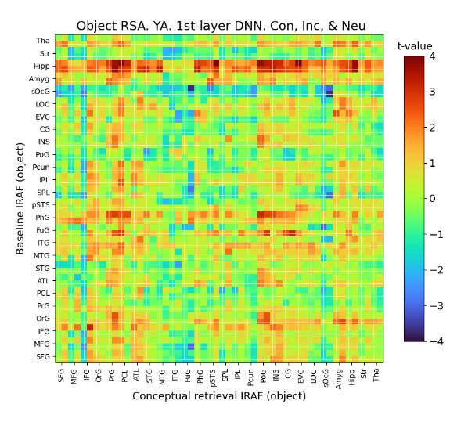
Something cool
Strong hippocampal representation during baseline -> stronger representation during conceptual retrieval

Slide 43


Significance testing and permutation testing
Notes:
This may be of general interest: You know how the RSA values (z-scores and IRAFs) between regions seem to be spatially correlated (neighboring regions are similar). This violates assumptions of independence. This violation may mean that multiple hypothesis correction methods may not be appropriate, and FWER corrections will be too strict. I explored this question in the SchemeRep data. The data can be split into either 45 large or 222 smaller ROIs meaning 45 or 222 comparisons*. I did a permutation-testing analysis, where I shuffled every trial, meaning that every trial’s fMRI data is matched with random stimulus data. I only shuffled within-run (e.g., moving Run 2 trial 1’s fMRI data to the Run 2 trial 5 position), to avoid issues related to within/between run RSA. The RSA analysis, for each ROI, entailed doing the fMRI_RDM x stim_RDM correlation, and submitting each participant’s score to a one-sample t-test, examining whether it is significantly above zero. I did this 2000 times for the analysis of 50 ROIs and 760 times for the analysis of 250 ROIs.
I plot here, in red, the maximum t-value seen across any ROI, for a given simulation. For reference, I also plot in green what would be expected if each ROI’s analysis independent from each other ROI’s analysis (this parallels the t-value threshold required after Bonferroni correction). We can see that the red line is slightly lower than the green line but not by very much (e.g., Bonferroni correction would require t = ~3.3, but the simulation suggests that t = ~3.15 is sufficient for FWER correction). In blue, I also tried modeling the red line to gain some intuition for its shape. It basically models the t-values by sampling from a multilevel model using variance settings measured from the simulated data.
In sum, standard multiple hypothesis correction techniques are basically fine. However, if your results are just barely falling under a standard FWER threshold, they may end up significant if permutation-testing is used. It’s not clear to mean what implications this would have for FDR correction.
*Note, I’m using the brainnetome atlas and 222 is slightly less than the number of ROIs in the brainnetome atlas. This is lower because I simply discarding ROIs where one or more participants have too many nan values.

Slide 44


Modularity
Replicate modules identified by Lifu

Slide 45
Encoding retrieval similarity
We see correlations:
  Baseline x encoding
  Baseline x visual (ERS)
  Encoding x visual (ERS)
Possibly interesting further work:
  Similarity is, in part, due to the same representation being activated
  Hence, we would expect to see an IRAF x ERS correlation
    Further, we would expect the correlation to be stronger based on what type of stimulus properties are used to calculate IRAF
    (e.g., if using DNN vectors, we would expect stronger IRAF x ERS in occipital, but if using word2vec vectors, we would expect stronger IRAF x ERS in ATL)
  Not sure how this could be useful. Maybe this can prove to be a more sensitive measure than RDM x RDM correlations?

Slide 46
Whiffs

Slide 47
Other analyses
Can you do RSA with respect to the fMRI difference vector?
  E.g., examine whether presenting a scene shifts the neural representation of the object between baseline ➜ retrieval
    [Scene stimulus vector] x [baseline-fMRI minus visual-fMRI]
    Overlapping ideas with that journal club paper we read on semantic shifts after learning
  No significant results
    This route may have potential, but it may just be too much of a stretch given the present design
Does congruency lead to connectivity patterns during scene presentation being more correlated with connectivity during object presentation?
  No, it doesn’t
If you calculate single-trial connectivity based on the scene x object betas (binary connectivity), and submit the data to RSA, will you find significant results?
  No, not really
  Found one significant RSA result:
    Within-occipital-lobe-connectivity x last-layer-activation-DNN
    My guess is that this is spurious

Slide 48
Study ideas
How are episodic memories and relational memories represented?
What is their structure?

Slide 49
Generalize the past, pinpoint the future
Hypothesis: When people think about an event, they have a broad imagination about what could have led to it, but narrowly consider what will follow the event.
Encoding task (roughly):
  Participants view a series of images, linked together sequentially (e.g., by telling participants that they’re traveling between locations)
  Same images are shown repeatedly
Retrieval (roughly):
  Cue participants with an image, and ask them to freely recall “all the images that may have preceded/followed” the cue
  Different further design elements can be included to test hypothesis

Slide 50
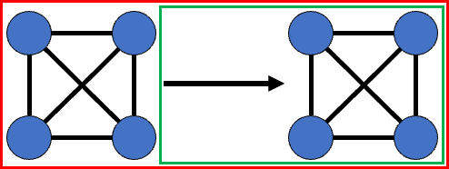
Episodic memory is intertwined with relational memory
What does “memory for an experience” mean?
Episodic memory:
  Familiarity + relations
Familiarity:
  Activation of an item representation
  Some pattern completion (i.e., retrieve the item upon only being shown some features of the item)
Recollection:
  Retrieval of (1) yourself performing an action and (2) the scene following the action
  Recollection is a video clip, not an image
Scene:
  Collection of items encountered together
Notes:
Consolidation
Via episodic memory retrieval, a semantic network is built

Slide 51
Broad design theme
If we present the same stimulus multiple times during encoding, this opens the door to many interesting analyses related to relational memory

Slide 52
Research goal
Investigate how individuals represent episodic memories and encode relations between items
Understand episodic memory by investigating relational memory at multiple levels:
  Relations (e.g., spatial) exist among items within a scene
  Temporal relations exist between scenes. Recalling a story involves repeated retrieval of episodic memories
Distinguish between the retrieval of relations involving episodic memory retrieval vs. semantic memory retrieval

Slide 53
Research goal
We do not want to only study how multiple items representations may be active at the same time
  Nor just study how activating one item representation leads to the activation of another item representation
  Not novel enough
Rather, we want to investigate the relations themselves
  Thinking of memory as a graph: We want to study the edges not the nodes
  Empirically:
    During encoding: Identify the correlates of the brain connecting two item representations
    During retrieval: Identify the neural correlates that reflect the activation of a relation and the correlates of neural communication via relations
  e.g., if two items are represented in the perirhinal cortex, and their association is implemented as connections from each representation to the hippocampus.
    Can we model the hippocampal signatures of the relation being encoded and, later, the relation being activated used during retrieval?
    More complex: Can we model network of relations that form among multiple stimuli?

Slide 54
What is an episodic memory?
Memory for an experience
Episodic memory:
  Familiarity + relation
Familiarity:
  Activation of an item representation
  Some pattern completion (i.e., retrieve the item upon only being shown some features of the item)
Scene:
  Collection of related items
Recollection:
  Retrieval of (1) yourself performing an action and (2) the scene following the action
  Recollection is a video clip, not an image

Slide 55




Task idea 1
“Target” image
Encoding:
  Participants perform task loosely related to a 1-back task
  In each trial:
    Presentation of image
    Prompted to indicate some relationship with the previous image (e.g., was it larger/same color/etc.)
  Each trial is 6 s, with 3 s presentation + response and ~3 s jitter
  This is a longer presentation than a standard 1-back.
    Encourage formation of episodic memories rather than just semantic memories
Retrieval:
  In a single trial:
    Participants shown image X and perform R/K task for it
    Participants shown image B, asked whether it was (1) previously shown just before X, (2) is similar to the image shown just before X, or (3) neither
    Participants shown image A, asked whether it was (1) previously shown just after X, (2) is similar to the image shown just after X, or (3) neither
Note:
  Must be in a single session or else memory will degrade too much
  Could vary the encoding question to be about different stimulus properties (e.g., Corish/k-crops perceptual vs. conceptual question)
  Using the cue in an R/K test means it shouldn’t be repeated?
  Could investigate memory for directionality accuracy, but I’m not sure how interesting that is
Respond
“Cue”
image
Target image
Respond
Target images are repeated
Before?
R/K/N
Old/
Similar/
Neither
Cue
After?
Old/
Similar/
Neither
Target
Target

Slide 56
Forward/backward dissociation behavioral results
For the forward/backward memory question:
  “Generalized hit” = “Old” or “similar” response to old or similar trials
  “Exact hit” = “Old” response to old, “similar” response to similar
Backward:
  Enhanced generalized hit rate
Forward:
  Enhanced exact hit rate
Potentially:
  Forward/backward distinction only after Remember responses in R/K
  Show that these results are linked to episodic memory retrieval

Slide 57
fMRI analysis
How do we investigate the neural correlates of relational memories?
One possible way is with RSA using combination vectors
  This analysis is premised on the idea that (1) how relations are encoded depends on the information being encoded and (2) this contingency is captured by the stimulus features we can model, e.g., with a DNN or word2vec
  However, what if relational memory encoding isn’t tracked by our stimulus features
Alternatively, we can measure pattern similarity between trials involving similar stimuli
  Participants encode relations X-A and Y-A
  Later, during retrieval, we may see similarity between retrieval of X and Y
    Need to rule out the possibility that the similarity is due to simply retrieval of the A item representation
  Regions showing X and Y similarity indicate areas involved in encoding the relation to stimuli A
    IRAF x activity correlations can be used to investigate connectivity and how other regions support encoding
Notes:
Maybe include a baseline task where participants just see all the targets. This will also help with encoding

Slide 58
Building on this analytic direction
Suppose participants encode eight relations:
  X-A, X-B
  Y-A, Y-B
  Z-A, Z-C
  W-C, W-D
In terms of the relations encoded, X is very similar to Y (both connected to A & B), X is somewhat similar to Z (both connected to A), and X shows no similarity with W
  Can be represented as the RSM on the right side
  Performing RSA using this RSM expands the analysis on the previous slide to work with many stimuli and relations
X
Y
Z
W
X
Y
Z
W
Notes:
(in task design 2, participants may encode X-A, X-B, and B-A simultaneously as an episodic memory)

Slide 59
Ways to interpret and extent these analyses
Participants encode a relational network
  Opens the door for graph theory analysis
  e.g., effects of retrieving stimuli with high centrality
  Parallels that journal club study which involved video clips
Participants encode a map
  Potential links to research on the PPA and spatial memory
  Can incorporate directionality (before/after) into the analysis
Episodic memories are a collection of relations
  Hence, these analyses can be thought of as investigating how episodic memories are represented
  Next study idea gets at this more directly
X
Y
Z
W
X
Y
Z
W
Z
X
A
C
W
Y
B
D

Slide 60
Episodic memories as state transitions
Do participants encode episodic memories as “state transitions”?
  Suppose participants view the sequence A-X-B and A-Y-B. Later, participants are asked to retrieve X and Y. In the retrieval test, will we see a positive correlation between X and Y activation patterns?
    By “correlation” I mean in the sense of encoding-retrieval similarity
  Confirmatory analysis: the X-Y similarity is greater than the “baseline” correlation between X and Y during encoding
Furthermore, if participants also view the sequence B-Z-A, is Z less correlated with X and Y?
  Z × X < X × Y
  Z × Y < X × Y
  Evidence that the directionality of A ➜ B is imbued in the representation of X and Y
  To rule out that participants are simply retrieving A, you’d also want to check:
    X × Y > X × A
    X × Y > Y × A
Could also look at difference vectors, like for SchemeRep
Notes:
This isn’t actually meaningful because participants may simply be retrieving image B upon cue with X and Y? No different from spatial retrieval

Slide 61




Task idea 2. Encoding task
Participants form temporal associations between sequential stimuli & spatial associations between stimuli presented nearby
“Target” stimuli are repeated and can be switched between spatial/temporal
Could have participants go through the stimuli more than once
Cue
Target
Spatial
Temporal
Cue
Targets
Judge relative to previous
(e.g., bigger smaller)
Judge between three
(e.g., biggest/smallest)
Return focus to center
Prepare for next trial

Slide 62
Task idea 2. Retrieval task
Retrieval same day as encoding
Downside: difficult to compare spatial vs. temporal memory behavioral results in a way that is interesting
  Spatial association accuracy may simply be higher because images are shown at the same time
Nonetheless, one possible interesting difference is finding that Remember responses enhance temporal accuracy but not spatial accuracy
  Would suggest that episodic memory is more linked to temporal associations than spatial associations
Before?
R/K/N
Old/
Similar/
Neither
Counterbalance question order
After?
Old/
Similar/
Neither
Left?
Old/
Similar/
Neither
Right?
Old/
Similar/
Neither

Slide 64
fMRI results
These effects are strongest following Remember responses in the R/K test
  Evidence against an “interference” interpretation (interference would suggest worse memory for the central item)
  Evidence for the role of episodic memory and not semantic memory

Slide 65
Analysis 1A: Relational network RSA
Suppose participants viewed two pairs of stimuli:
  X-A and Y-A
  “Induced relational network RDM”
    X-A distance of 1
    Y-A distance 1
    X-Y distance 2
  Can use this for RSA calculations like a typical RDM
  Can construct separate RDMs for, say, spatial maps vs. temporal maps
    For temporal associations, you could study directionality hypotheses, wherein the RDM is not symmetrical across the diagonal (e.g., X-A distance may be 1 but A-X distance could be something else).
RSA effects
  RSA analysis of retrieval fMRI data
  Hippocampus, PPA, mPFC
  Questions typically only investigated with rats
  Can investigate functional connectivity using IRAF x activity correlations.
    Functional connectivity is harder to study with rats (?), which makes this design poised for novel insights
    IRAF_{Map} x IRAF_{Item} analysis could speak to how information percolates through semantic networks. Activation of one representation will activate others

Slide 66
Analysis 1B. Other network RDM analysis
Some new stimuli shift the RDM more than others
  Encoding fMRI data
  The degree to which a new stimulus shifts the network may be proportional to activity in some regions (e.g., hippocampus)
Graph theory analyses
  Retrieval fMRI data
  Retrieval of stimuli with high centrality will induce more activation in some regions (e.g., hippocampus)

Slide 67
Analysis 1C. Consolidation

Slide 68
Analysis risk: We are not actually studying the relation itself. Rather, we are just studying the activation of other items.
  We must regress out the extent to which it is similar with target itself

Slide 69
Analysis 2A. flow through semantic network
During the presentation of cue:
  RSA between RDM_{fMRI-cue} x RDM_{Stim-cue} indicates activation of the cue’s representation
  RSA between RDM_{fMRI-cue} x RDM_{Stim-target} may indicate either:
    (1) information traveling through episodic retrieval or semantic network
    (2) the activation of the target’s representation
  May find divergence between the regions that activate to represent a cue vs. those involved in information traveling

Slide 70
Temporal flow analysis

Slide 71
Investigating hippocampal traces
Encoding an association between items X and Y requires:
  Representing X
  Representing Y
  Binding the two
Analysis:
  Investigate interplay between X-IRAF, Y-IRAF, BOLD activation, and memory accuracy
  Looking at encoding fMRI data:
    Accuracy ~ PFC_{X-IRAF} × PFC_{Y-IRAF} × HC_{BOLD}
  Looking at retrieval fMRI data, does cuing with X lead to activation of Y representations?
    PFC_{Y-IRAF} ~ PFC_{X-IRAF} × HC_{BOLD} (hit trials only)
    Linking X and Y without HC involvement may reflect consolidation
Maybe with some tweaks to the task, we can use it to compare different memory trace theories

Slide 72
Possible aging effects
Show less of a directionality effect
  The past-generalizing vs. future-pinpointing directionality effect
Retain representations of prior stimuli for longer/shorter intervals
  To what extent is the trial n stimulus maintained in working memory for trials n+1 or n+2?

Slide 73
(Beyond the task)
Older adults prototype rather than generalize
Prototyping = link stimuli to a previous similar “prototypical” stimulus
Generalization = identifying patterns common across multiple stimuli
May reflect past knowledge influencing encoding
Red = first stimulus presented
Testable behaviorally and via fMRI

Slide 74
Analyzing generalizing and prototyping
5-stimulus group (u, v, w, x, y)
During some experiment phase:
  Measure pairwise correlations among u, v, w, x, and y
  Examine whether the correlations are more consistent with the diagram on the left vs. right
Notes:
u, v, w, x, y

Slide 75
Other possible aging effect
Instead of more prototyping, maybe they show the opposite: more generalization due to only encoding gists and using crystalized knowledge
  Could get at this gist idea with an R/K test

Slide 76
Analyzing generalizing and prototyping with combination features (not done)
Identifying generalization:
  Integrating stimulus vectors
  One way to combine: Elementwise multiplication (u × v = g) will yield a product vector that represents features common across the two
    Other ways may work better for 3+ stimuli
    Definitions linked to computational memory theories?
  Examine whether participants retrieve g
    Perform RSA with the “generalization” vector g
Identifying prototyping
  Again, integrating stimulus vectors, but now to create a “prototype” vector (p)
  If u is the prototype…?

Slide 77
Extension into decision-making
Idea: Replace every other “location” with a “decision”
Participants are given a choice that influences the next image that will be shown (what location they will travel to)
  E.g., at location A, participants can choose between options X or Y, which will take them to locations B or C
  The options themselves are stimuli (e.g., “X and Y are magical objects that will teleport you to a new location”)
  “Selecting X/Y” is the episodic memory formed
Retrieval task:
  Could include a task where participants are asked “you are in A and you want to get to B, should you select X or Y?”
Downsides:
  Issue 1: different participants will see different stimuli, maybe some will not show diversity in their decision-making
  Issue 2: less statistical power for investigating state transitions (half as many state transitions)

Slide 78
Expanding to incorporate others’ interests
This is still on associative memory, so hopefully, Cortney would like it
I think Ricky’s interest in task sets and the instructions about focusing on perception/semantic information could be incorporated?

Slide 79
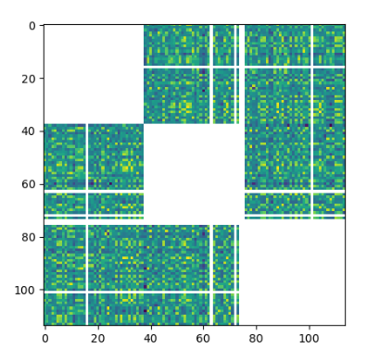
After removing outliers

