Slide 1
Effects of age and schema on Hippocampal encoding connectivity
“SchemRep_Network” project
Cabeza Lab Meeting
2023.07.10 + updates

Slide 2
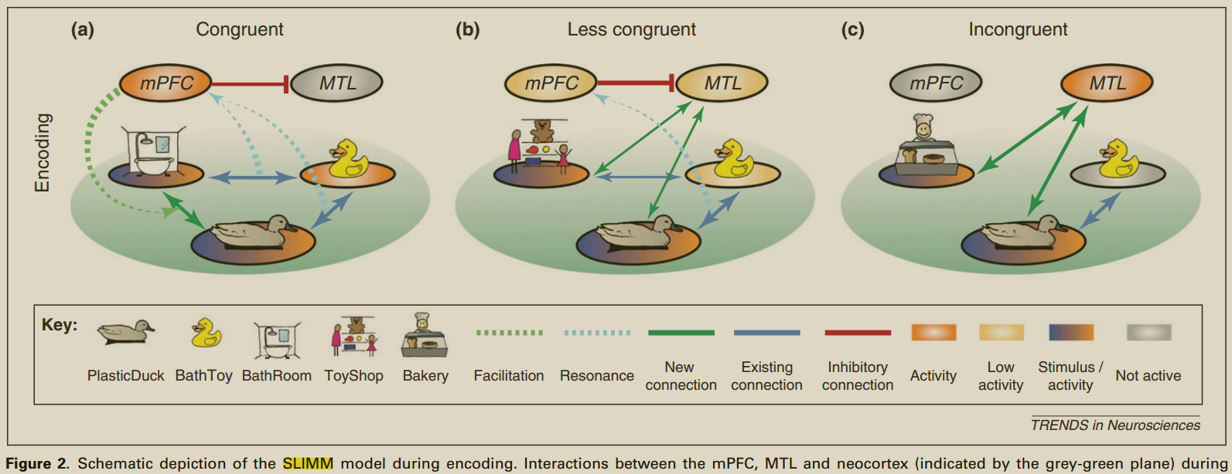
SLIMM
Schema-Linked Interactions between Medial prefrontal and Medial temporal regions (van Kesteren et al., 2012).

Slide 3
SLIMM predictions
“During encoding…,
(v)mPFC activity is predicted to increase with congruency,
MTL activity is predicted to decrease with congruency, and
mPFC–MTL coupling is predicted to be maximal for partially congruent conditions when mPFC and MTL are both partially activated”.
* No mentioning of aging-related effects though

Slide 4
Encoding results consistent with SLIMM
van Kesteren et al. (2013). Differential roles for medial prefrontal and medial temporal cortices in schema-dependent encoding: From congruent to incongruent
  Object-scene pair, tested item and associative memory. Greater congruency -> higher mPFC activity (guide integration of new info into schema), lower MTL activity (encoding arbitrary association), increased mPFC connectivity with right PPA (presumably related to binding visual representations).
van Kesteren et al. (2010). Persistent schema-dependent hippocampal–neocortical connectivity during memory encoding and postencoding rest in humans
  Movie. Stronger prior schema associated with less hippocampal-vmPFC connectivity, indicating the need for additional crosstalk to compensate for difficulty in integrating novel/schema-incongruent information.
Bein et al. (2014). Prior knowledge influences on hippocampus and medial prefrontal cortex interactions in subsequent memory
  Semantically related/unrelated word pairs. For schema-incongruent pairs only, positive HC-mPFC connectivity and positive connectivity of mPFC with visual and parietal regions; no diff in other memory or congruency conditions.
Bonasia et al. (2018). Prior knowledge modulates the neural substrates of encoding and retrieving naturalistic events at short and long delays
  Using narrative film clip. Greater congruence correlated with mPFC and parietal activation, but lower activation in, and functional connectivity between, MTL and posterior sensory cortices. Some other retrieval results.

Slide 5
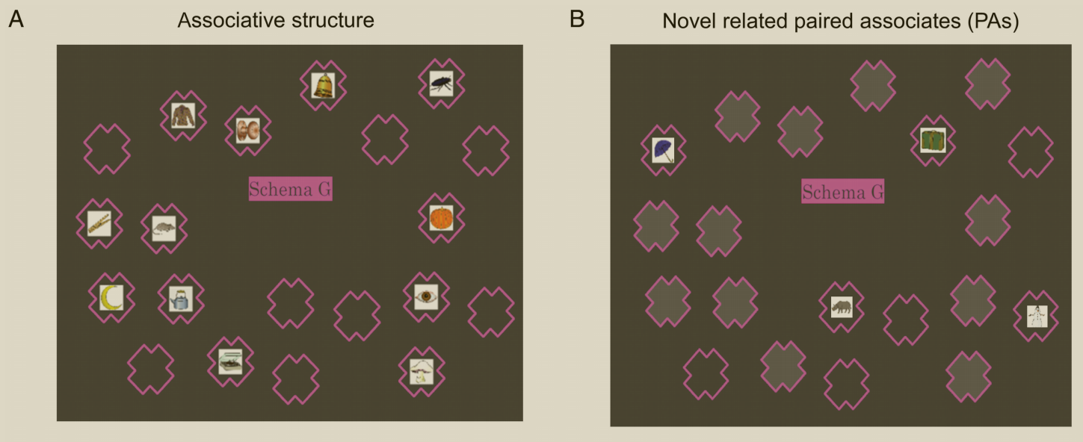
Encoding results inconsistent with SLIMM
Sommer (2016). The Emergence of Knowledge and How it Supports the Memory for Novel Related Information
  Object-location pairs. Greater coupling vmPFC with HPC and ventral precuneus/RSC during encoding of novel-related than control paired associates.
Liu et al. (2017). Effects of Prior-Knowledge on Brain Activation and Connectivity During Associative Memory Encoding
  Associate novel houses with famous/nonfamous faces. Famous faces -> stronger activation in vmPFC, HPC, PPA, FFA. vmPFC-HPC connectivity plays a greater role in the famous than nonfamous condition.

Slide 6
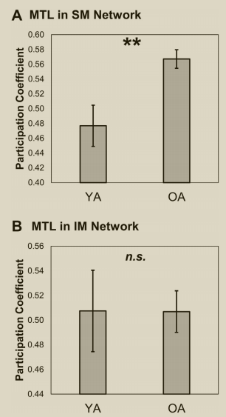
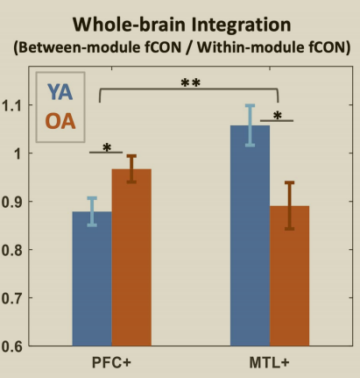
Past retrieval connectivity results
Geib et al. (2017). Hippocampal Contributions to the Large-Scale Episodic Memory Network Predict Vivid Visual Memories
  Scenes. Vivid vs dim memories: right hippocampus is more integrated with the brain. Whole-brain network was also more efficient.
Geib et al. (2017). From Hippocampus to Whole-Brain: The Role of Integrative Processing in Episodic Memory Retrieval
  Words. Remembering associated with stronger hippocampal connection with a retrieval assembly (precuneus, caudate, SMG, dlPFC).
Monge et al. (2018). Functional networks underlying item and source memory: shared and distinct network components and age-related differences
  Words and source (encoding task, size or pleasantness). For source retrieval, OAs had higher MTL integration than YAs’. No diff for item retrieval.
Deng et al. (2021). Age-Related Compensatory Reconfiguration of PFC Connections during Episodic Memory Retrieval
  Visual scenes. OAs show greater PFC integration with the rest of the brain, which is also associated with better retrieval performance within OAs. Consistently, OAs show stronger performance-related reconfiguration of PFC connectivity patterns, which tracked their reconfiguration reductions in MTL, suggesting functional compensation.

Slide 7
Aging-related encoding connectivity?
Capogna et al. (2023). Whole-brain connectivity during encoding: age-related differences and associations with cognitive and brain structural decline. https://academic.oup.com/cercor/article/33/1/68/6534389
D

Slide 8
Age-related effects / predictions
Compared to YAs, OAs show declined executive functions but preserved or enhanced crystalized knowledge—stronger schemas
Potentially different cognitive strategies at memory encoding:
  YAs may have more acute representations of things that are presented externally and individually (e.g., perceptual details of a tractor)
  OAs may rely more on schemas or gist, contextualizing and elaborating on their experiences (e.g., thinking of a tractor in a farm)
OAs showing a greater congruency benefit for hits than YAs
OA’s activation (anti)correlating more strongly with congruency
  Higher congruency -> higher mPFC, lower(?) hipp, lower occipital
Connectivity?

Slide 9

3-session fMRI study (SchemRep)
Baseline: rated image-label typicality for objects
Encoding: 3 pre-defined conditions for scene-object schema congruency, subjective ratings 1-4
Retrieval: conceptual old/new followed by visual old/similar/new

Slide 10
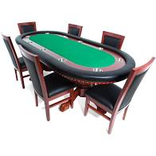
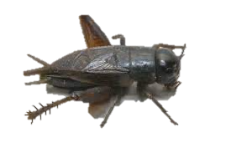
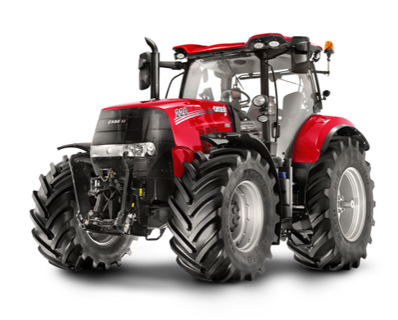
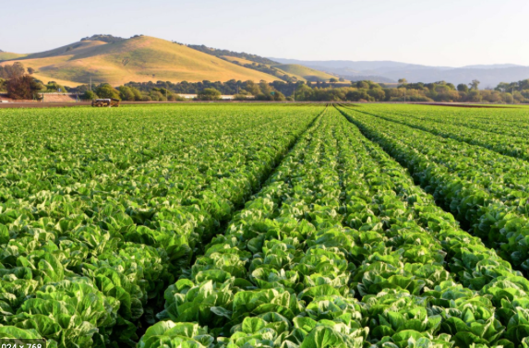
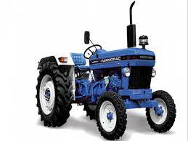
Day1. Baseline
Day 2. Encoding
(incongruent)
(neutral)
(congruent)
Day 3. Conceptual memory
Day 3. Visual memory
tractor
(old)
(old)
cricket
(old)
(similar)
ATM
(new)
(new)

Slide 11
Analysis plan (to do)
Behavioral analysis
  congruency ratings (1-4) ~ age group (Y/O)
  subsequent memory ~ age group * congruency ratings
Parametric modulation
  Univariate activation ~ congruency ratings (1-4) * age group
  Could also contrast baseline activation and encoding (schema-effect)
  Expected result: ↑ congruency ↑ mPFC ↓
Functional connectivity using hippocampal seed
  z ~ congruency (con vs inc) * age group (YA vs OA) * hipp (4 seeds)

Slide 12
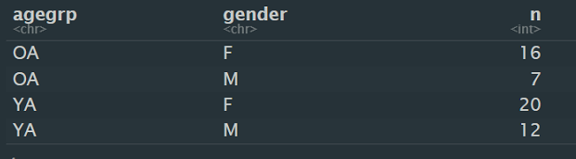
Participants
55 participants and counting
32 YA + 23 OA (more OAs to come, but also some to be excluded)
Need to find other details (age, education, race, etc.)

Slide 13
Participant exclusion criteria
fMRI: Dxxx bad scans (see participant info tracker excel)
Behavioral: Low performance on conceptual memory test (114 old + 30 new)
  Use 1-2=“new” and 3-4=“old”, compute d prime and exclude those with negative d’ [xxxxxx]
  Or comparing the trial-level response to old (all congruency levels) and new items, and exclude those not showing a significant old > new contrast. [109 119 227]
Statistical: Not enough number of trials in a certain bin (e.g., congruent)
  Only need to remove that cell, not the whole person
  [xxxxxxxxxxx]
Final sample =

Slide 14
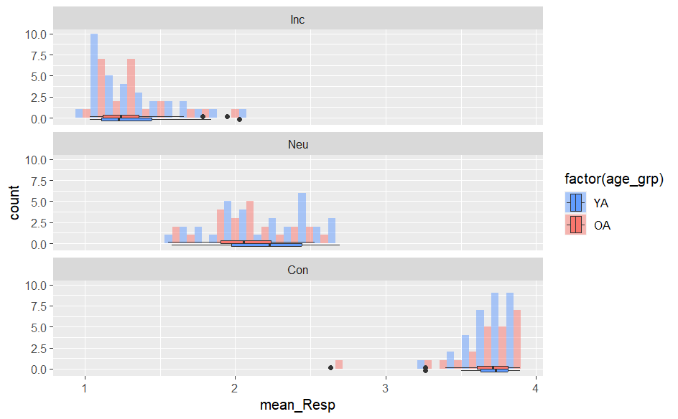
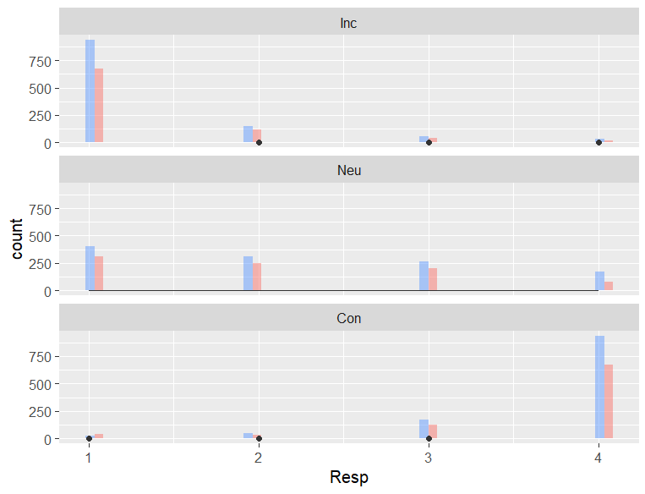
Subjective rating of congruency (1-4)
Participant-mean ratings clearly reflect the 3 conditions (inc, neu, con), yet trial-level data show that neural is somewhat weird. Thus, later analyses use each participant’s own response (1-2=inc, 3-4=con); alternatively, we can do 1=inc, 2-3=neu, 4=con.

Slide 15
Split trials (114) by subjective congruency (1-4)
Highlighting some low-count/imbalanced cases
Note that these are all trials, but subsequent analyses would focus on hits only
ID 12inc 34con 102 64 49 103 69 45 104 68 35 105 60 54 106 57 55 107 46 67 108 64 49 109 36 35 110 72 42 111 67 47 112 66 47 113 48 56 114 63 51 115 50 54 117 63 51 118 49 63 119 63 49 120 67 47 123 50 50 | 124 52 52 126 64 50 127 45 69 128 71 43 129 64 47 130 66 48 131 46 67 132 53 60 134 63 50 135 52 57 136 67 46 137 70 44 138 38 52 201 63 47 202 63 50 203 63 51 204 69 44 205 70 44 206 49 64 | 207 57 57 208 60 53 209 72 36 210 56 56 211 61 49 212 65 49 213 62 32 214 61 52 216 64 44 217 44 56 218 64 47 219 62 52 221 63 51 222 56 58 225 68 45 227 69 45 230 55 49 | ID 1inc 23neu 4con 102 49 22 42 103 49 29 36 104 50 26 27 105 39 36 39 106 47 26 39 107 30 46 37 108 37 47 29 109 17 37 17 110 54 28 32 111 47 39 28 112 43 36 34 113 31 39 34 114 49 40 25 115 37 28 39 117 48 29 37 118 36 29 47 119 52 26 34 120 49 28 37 123 24 44 32 | 124 44 25 35 126 44 27 43 127 31 22 61 128 58 33 23 129 51 25 35 130 55 20 39 131 26 47 40 132 50 6 57 134 46 44 23 135 34 33 42 136 52 29 32 137 56 26 32 138 33 20 37 201 52 25 33 202 44 42 27 203 47 23 44 204 67 3 43 205 49 35 30 206 14 71 28 | 207 19 68 27 208 38 34 41 209 56 27 25 210 34 40 38 211 49 21 40 212 45 37 32 213 52 18 24 214 32 54 27 216 51 31 26 217 29 36 35 218 43 33 35 219 48 32 34 221 51 25 38 222 44 34 36 225 59 20 34 227 57 22 35 230 43 24 37

Slide 16
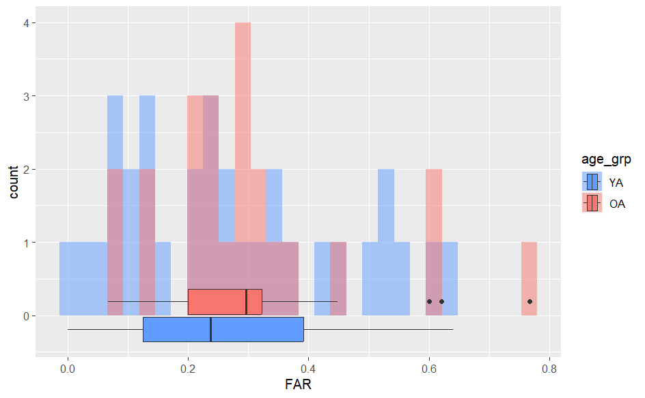
Conceptual false alarms (no congruency)
OAs show false alarm rates (FARs) than YAs.
Some high FAR outliers can be excluded, but since we’re focusing on encoding data now that matters a bit less. All 55 included for now.

Slide 17
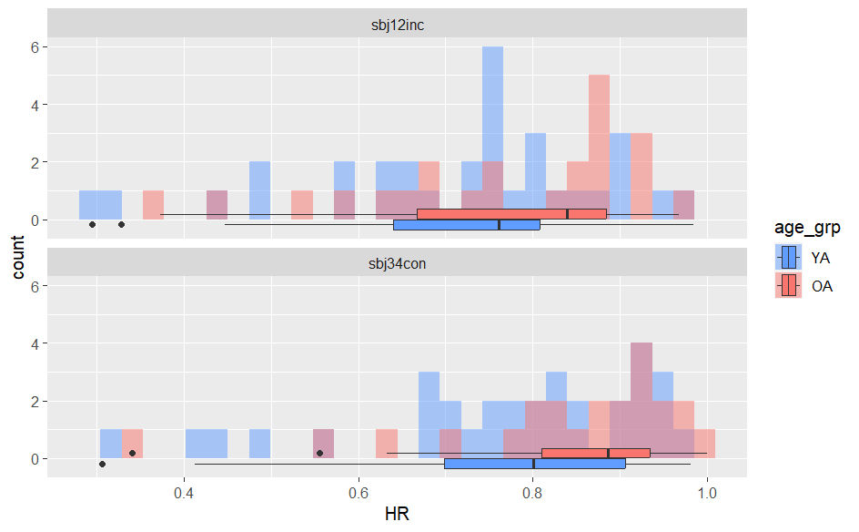
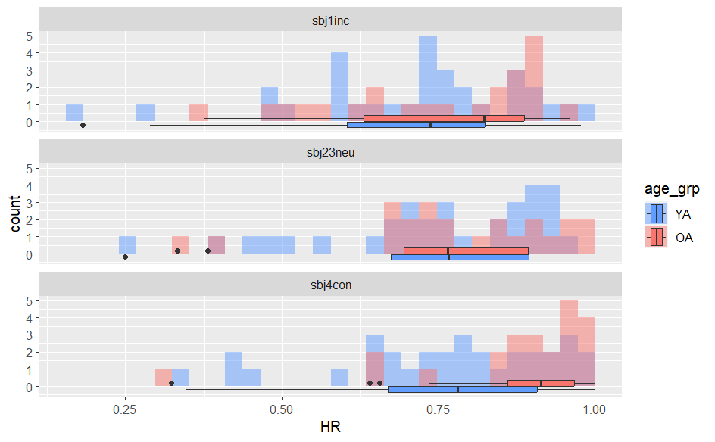
Conceptual hits by subjective congruency
OAs have higher HRs overall. Again, outliers with very low HRs may be excluded, but all 55 participants are included for now.
No corrections applied yet!

Slide 18
Univ parametric
Sbj con2

Slide 19

Beta series functional connectivity
ROI beta extraction based on the Brainnetome atlas -> 246 ROIs
  Focusing on hippocampal and cortical ROIs
Beta series correlation for pairs of ROIs, separately for these 3 conditions:
  Rem_sbj4con = later conceptually remembered & subject-rated as congruent
  Rem_sbj23neu = later conceptually remembered & subject-rated as incongruent
  Rem_sbj1inc = later conceptually remembered & subject-rated as incongruent
Notes:
- Can also examine baseline connectivity and retrieval connectivity

Slide 20
Age x Congruency interaction on connectivity
z ~ trial_type * age_grp * hipp + (1|ID)
z = connectivity, Fisher-transformed r, between hippocampal seeds and 160 cortical regions (except somatosensory and motor)
Trial type = rem_sbj1inc, rem_sbj23neu, rem_sbj4con
Age group = YA or OA
Hipp = 4 seeds (left/right x anterior/posterior)
ID = Random intercept for subjects
Type 3 ANOVA significance level set at uncorrected p < 0.001
Post hoc contrasts of marginal means corrected using the Tukey method for comparing 4 estimates

Slide 21
Results with 2-split of subjective congruency

Slide 22
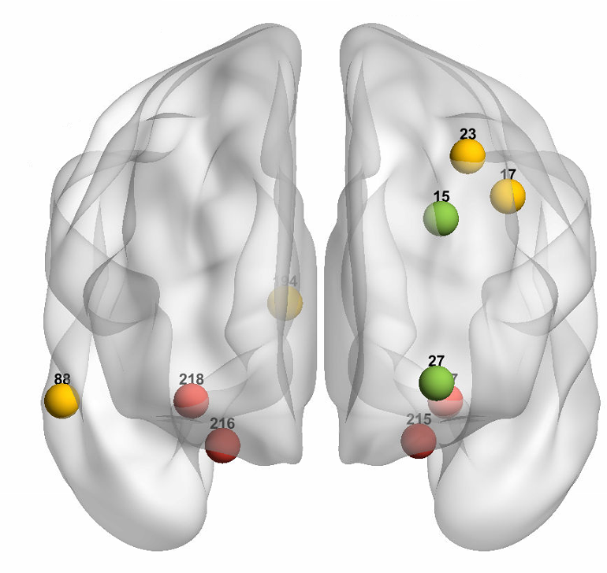
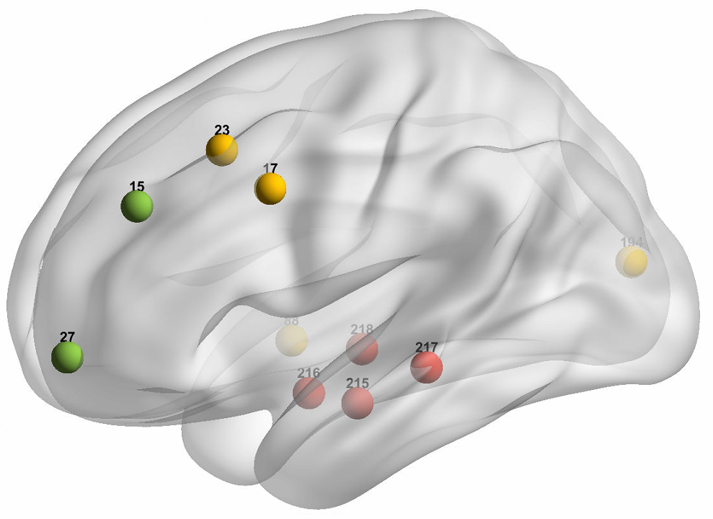
Results – hipp encoding connectivity
Will need to exclude bins with correlation computed with <20 trials
Lots of significant intercepts + main effect of Hipp seeds (not printed)
Green and Yellow ROIs showing trial type/congruency-related effects:
Notes:
Target 15 MFG_L_7_1
Effects trial_type:age_grp
--------------------------
NOTE: Results may be misleading due to involvement in interactions
contrast estimate SE df t.ratio p.value
OA rem_sbjcon - OA rem_sbjinc 0.0521 0.0138 371.0 3.771 0.0011
YA rem_sbjcon - YA rem_sbjinc -0.0192 0.0117 371.0 -1.640 0.3574
OA rem_sbjcon - YA rem_sbjcon 0.0256 0.0195 85.3 1.314 0.5567
OA rem_sbjinc - YA rem_sbjinc -0.0457 0.0195 85.3 -2.344 0.0961
Results are averaged over the levels of: hipp
Degrees-of-freedom method: kenward-roger
P value adjustment: tukey method for comparing a family of 4 estimates
-----------------------
Target 27 MFG_L_7_7
Effects trial_type:age_grp
--------------------------
NOTE: Results may be misleading due to involvement in interactions
contrast estimate SE df t.ratio p.value
OA rem_sbjcon - OA rem_sbjinc 0.0563 0.0152 371.0 3.716 0.0013
YA rem_sbjcon - YA rem_sbjinc -0.0222 0.0128 371.0 -1.731 0.3089
OA rem_sbjcon - YA rem_sbjcon 0.0442 0.0219 83.4 2.021 0.1886
OA rem_sbjinc - YA rem_sbjinc -0.0344 0.0219 83.4 -1.573 0.3997
Results are averaged over the levels of: hipp
Degrees-of-freedom method: kenward-roger
P value adjustment: tukey method for comparing a family of 4 estimates
-----------------------
Target 17 MFG_L_7_2
Effects trial_type
--------------------------
NOTE: Results may be misleading due to involvement in interactions
contrast estimate SE df t.ratio p.value
rem_sbjcon - rem_sbjinc 0.0358 0.0101 371 3.534 0.0005
Results are averaged over the levels of: age_grp, hipp
Degrees-of-freedom method: kenward-roger
-----------------------
Target 23 MFG_L_7_5
Effects trial_type
--------------------------
NOTE: Results may be misleading due to involvement in interactions
contrast estimate SE df t.ratio p.value
rem_sbjcon - rem_sbjinc 0.0609 0.013 371 4.704 <.0001
Results are averaged over the levels of: age_grp, hipp
Degrees-of-freedom method: kenward-roger
-----------------------
Target 88 MTG_R_4_4
Effects trial_type
--------------------------
NOTE: Results may be misleading due to involvement in interactions
contrast estimate SE df t.ratio p.value
rem_sbjcon - rem_sbjinc -0.0739 0.0197 371 -3.748 0.0002
Results are averaged over the levels of: age_grp, hipp
Degrees-of-freedom method: kenward-roger
-----------------------
Target 194 Cun_R_5_3
Effects trial_type
--------------------------
NOTE: Results may be misleading due to involvement in interactions
contrast estimate SE df t.ratio p.value
rem_sbjcon - rem_sbjinc -0.0471 0.0131 371 -3.587 0.0004
Results are averaged over the levels of: age_grp, hipp
Degrees-of-freedom method: kenward-roger
-----------------------

Slide 23
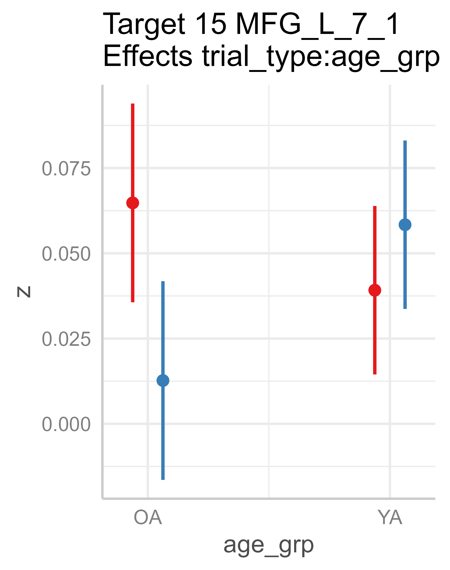
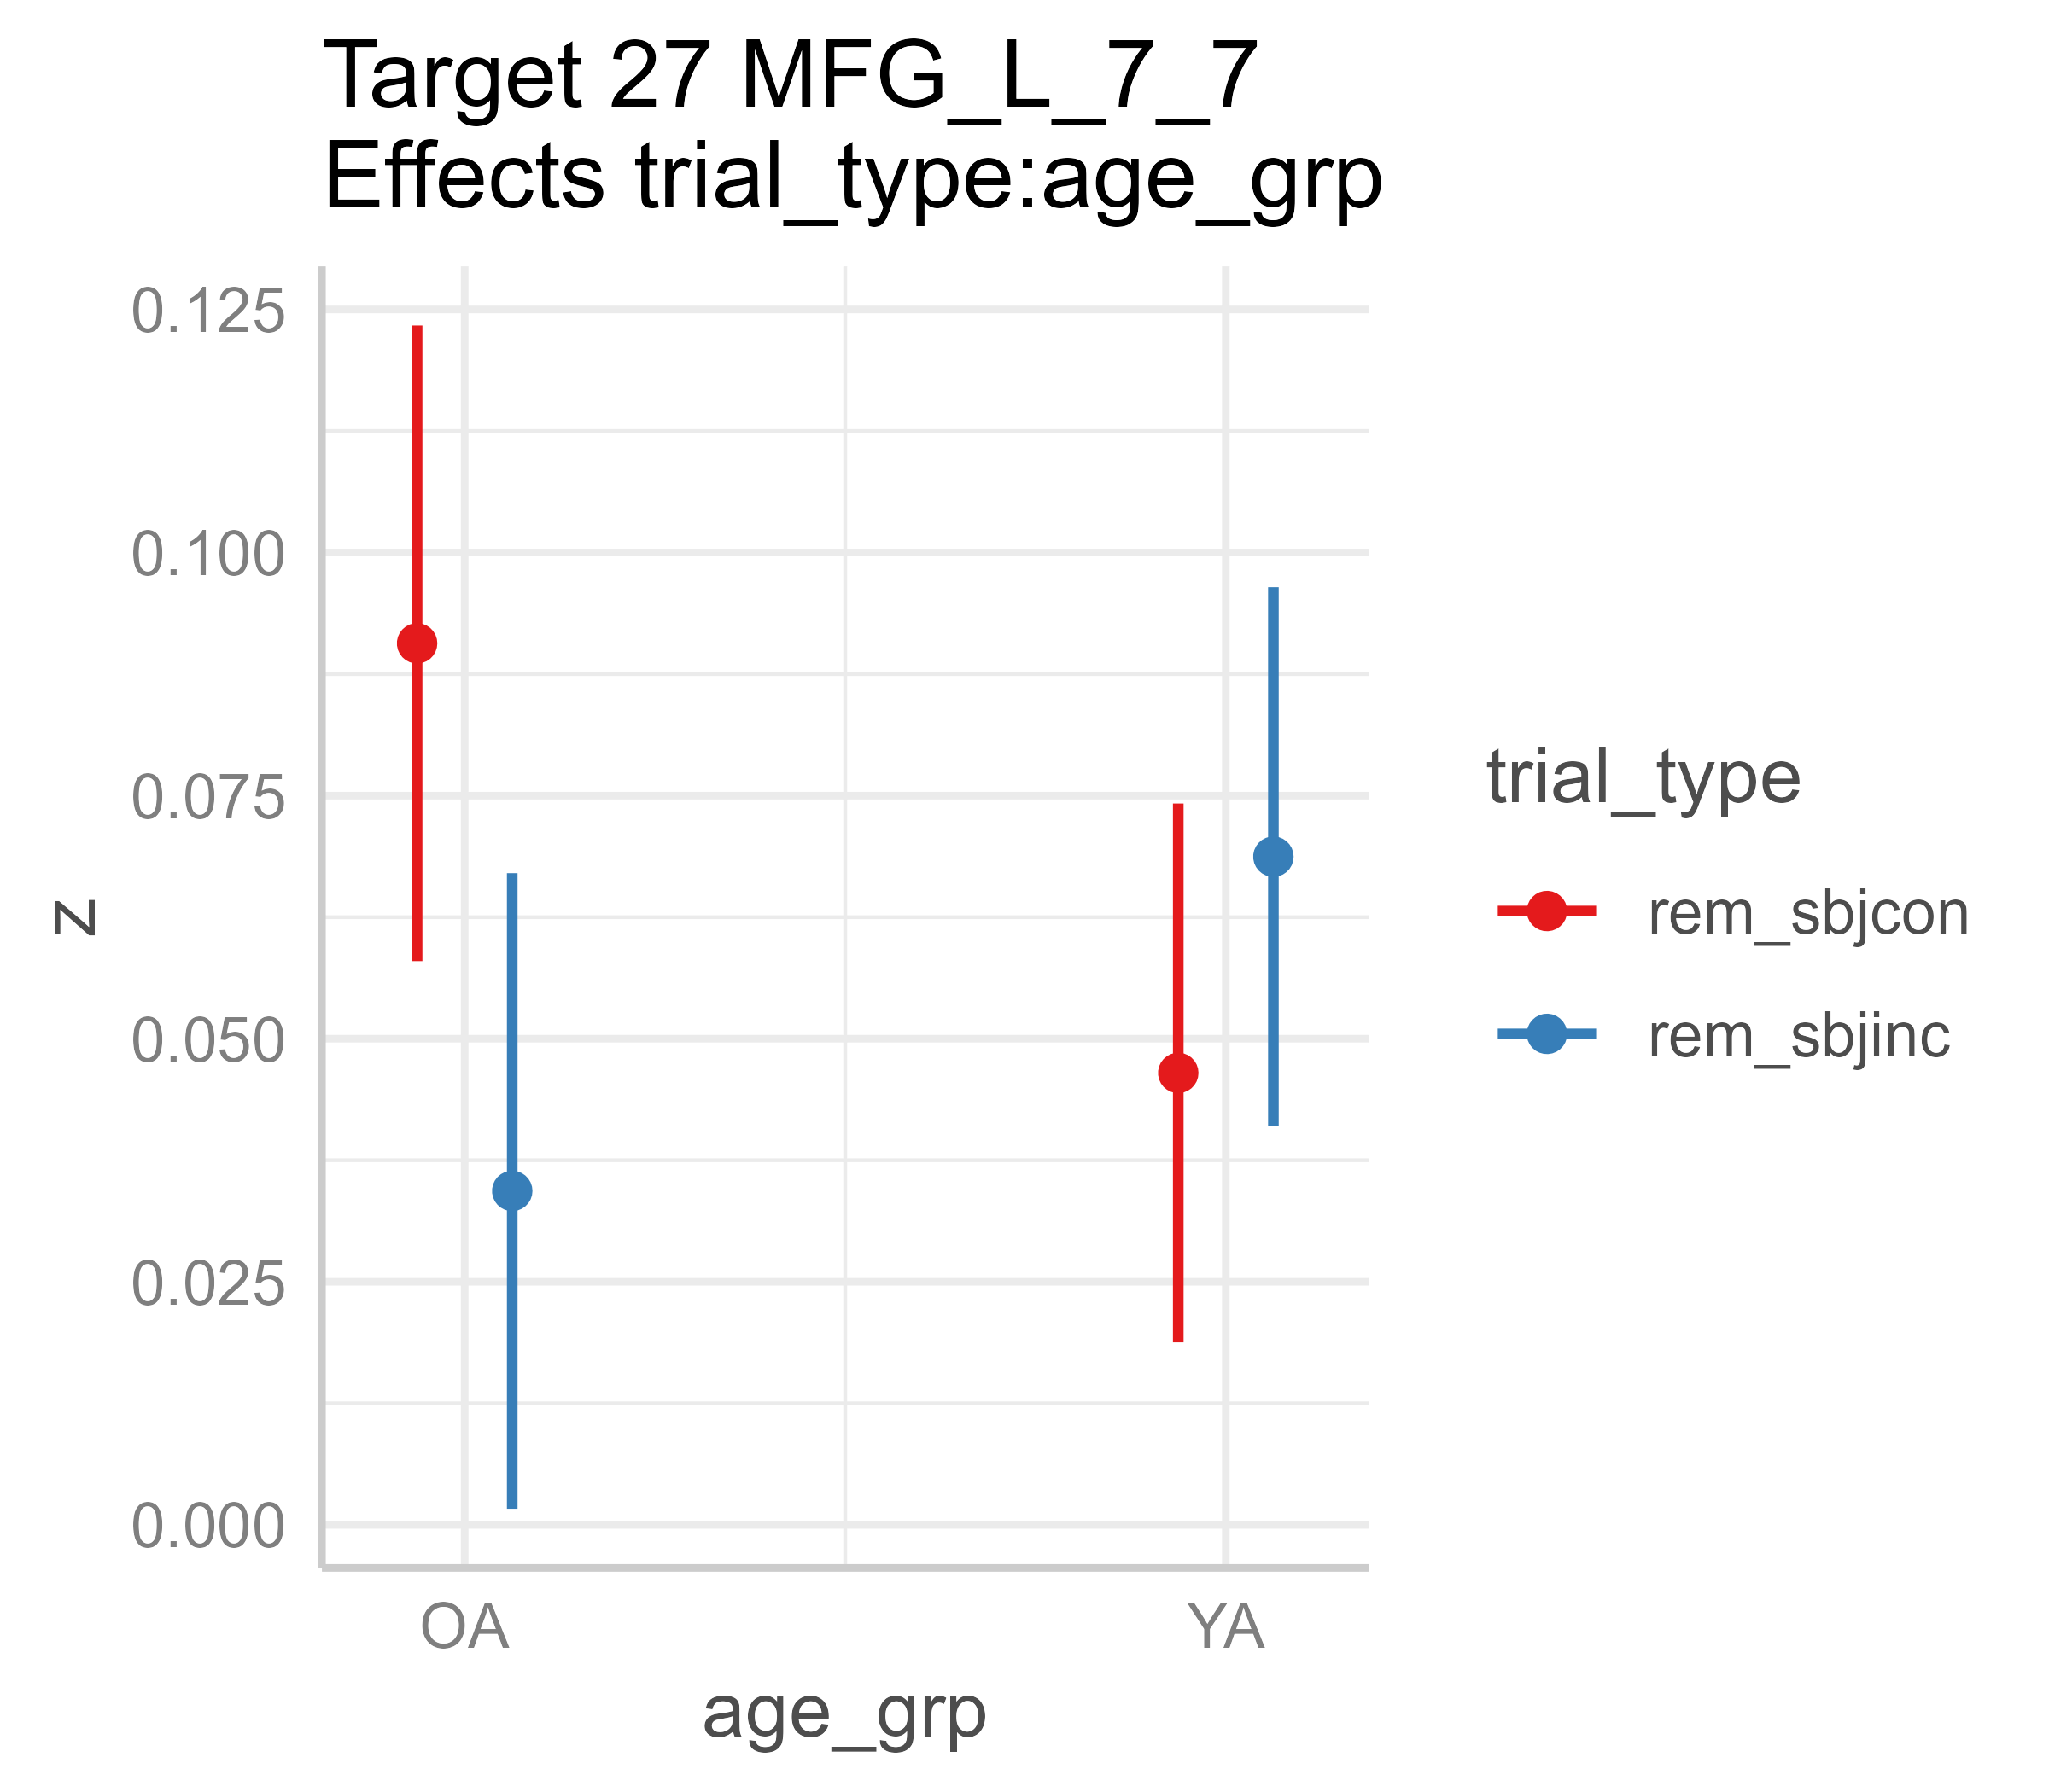
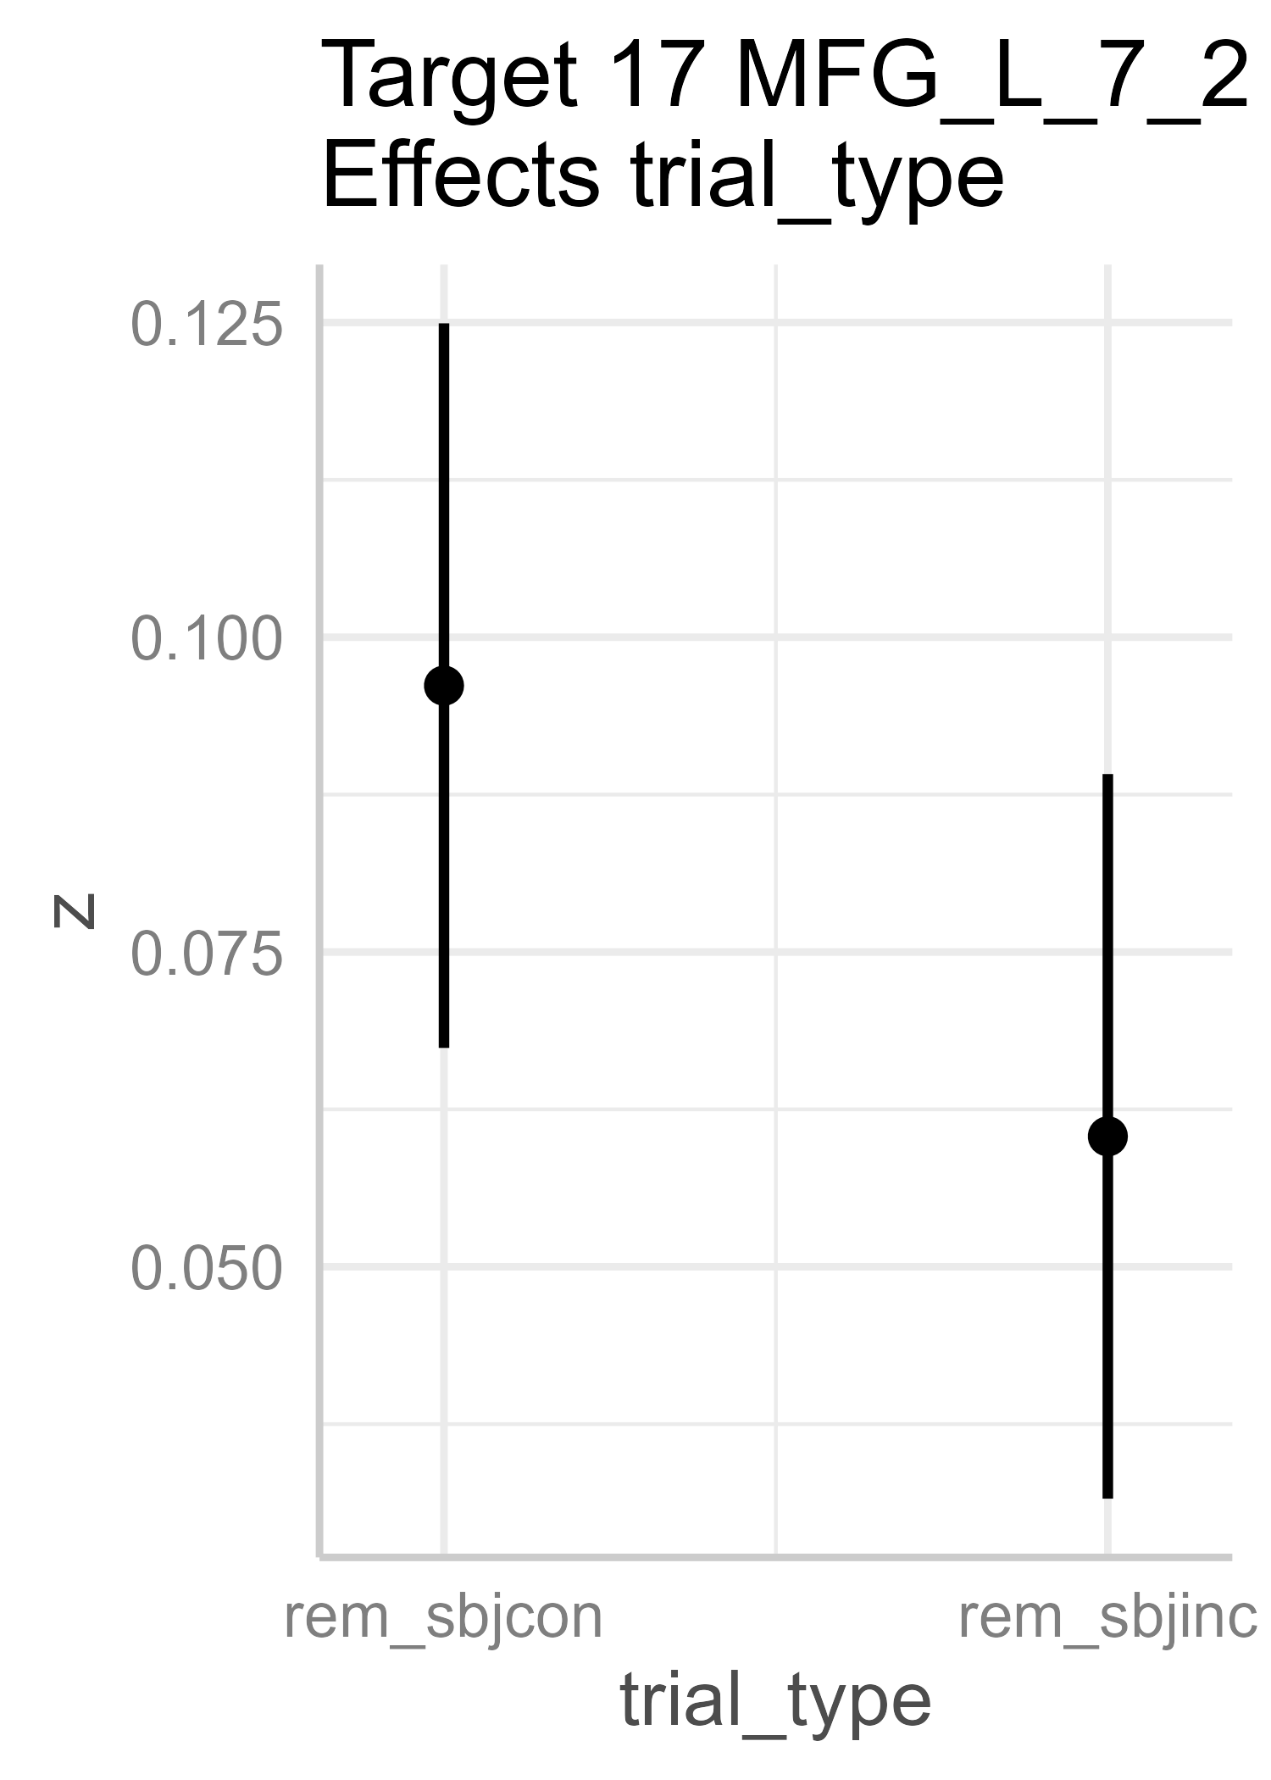
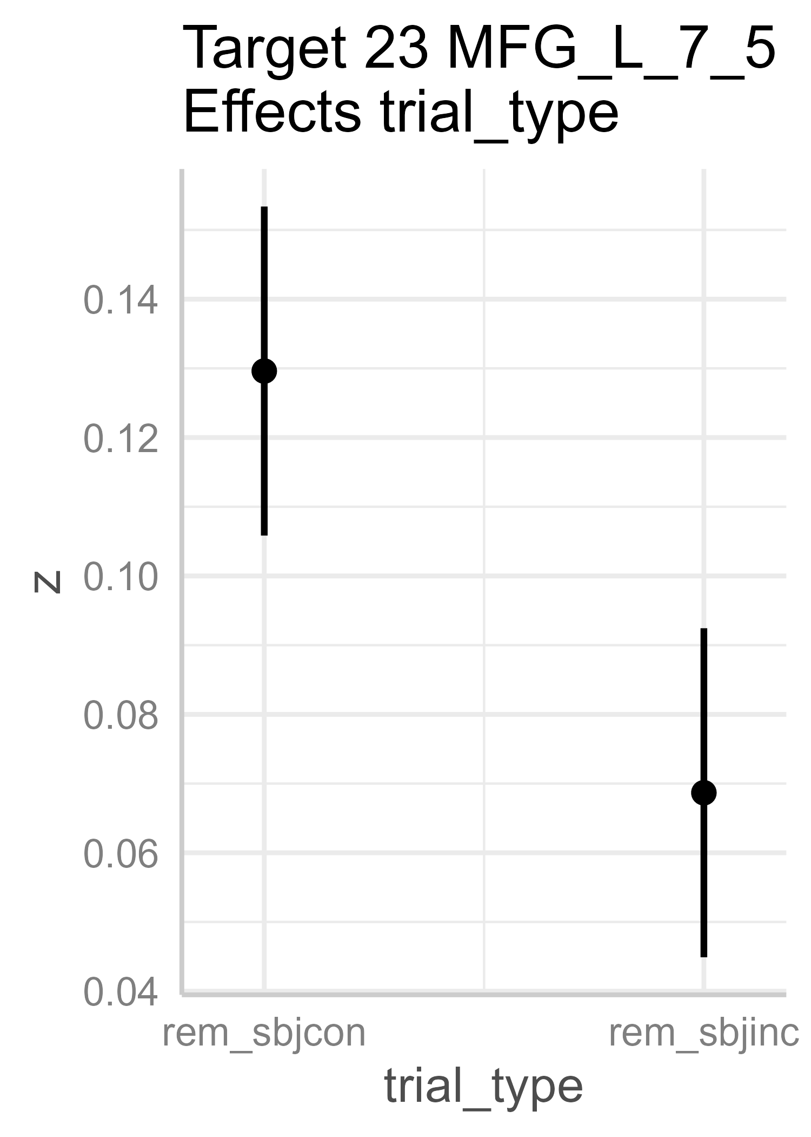
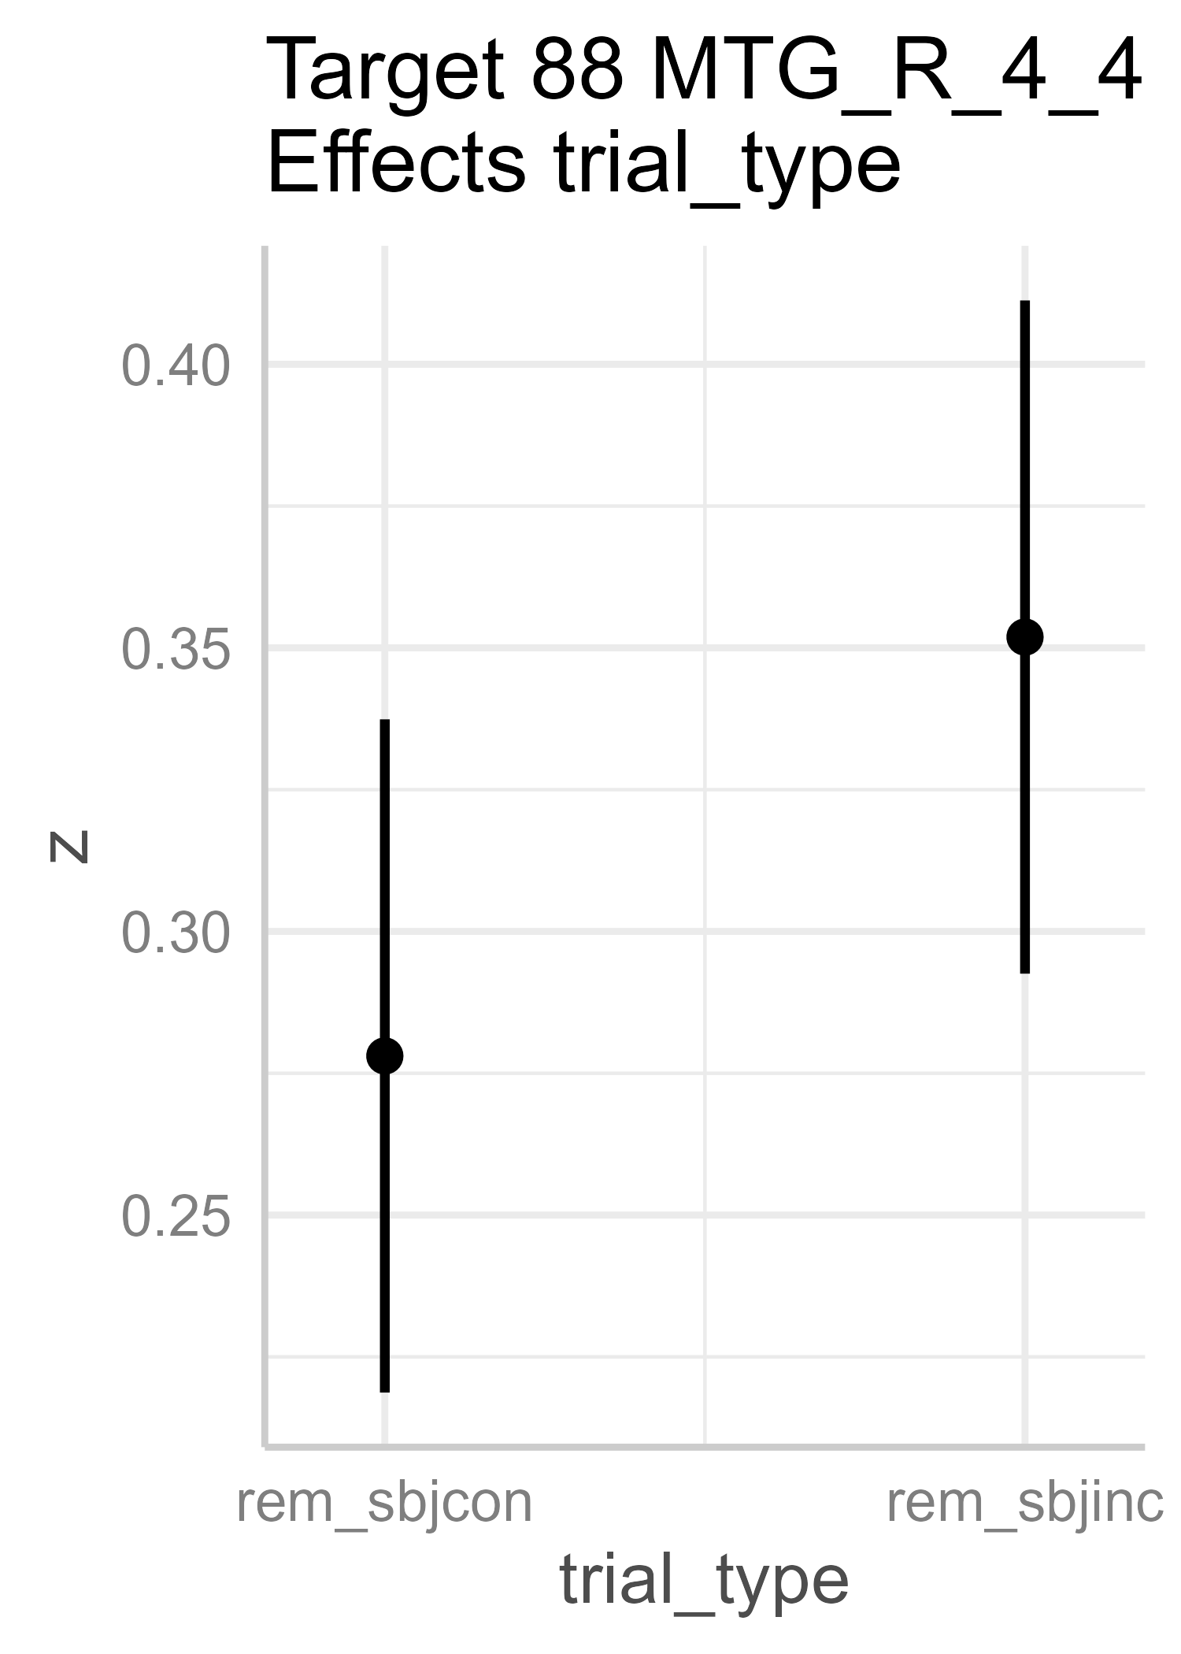
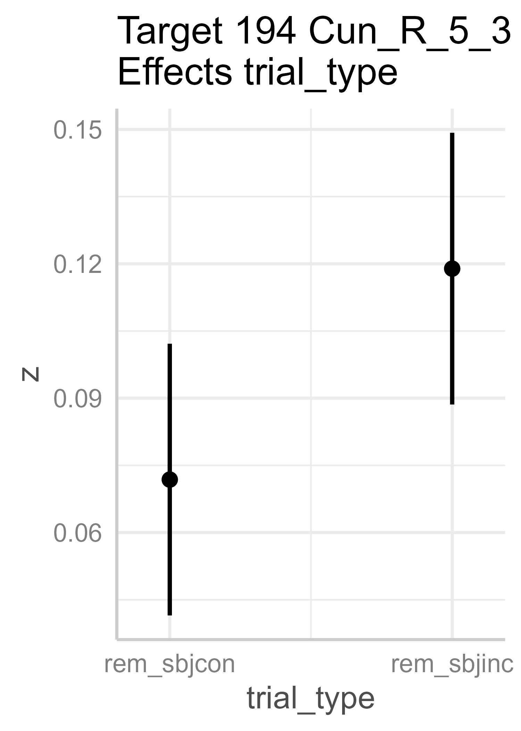
.0011
.0013
.0005
Main effect of trial-type: Hipp is more strongly connected with frontal regions for remembered, congruent items, but temporal and occipital regions for remembered, incongruent items.
OAs show stronger Hipp-mPFC connectivity for remembered, congruent than incongruent items, supposedly for compensation. No such difference in YAs.
No other significant contrasts (e.g., OA cong - YA cong)
.0002
<.0001
.0004
Notes:
Results with 2-split

Slide 24
Results with 3-split of subjective congruency

Slide 25
Results – hipp encoding connectivity
Will need to exclude even more bins with correlation computed with <20 trials
Lots of significant intercepts + main effect of Hipp seeds (not printed)
Green and Yellow ROIs showing trial type/congruency-related effects:
Notes:
Target 15 MFG_L_7_1
Effects trial_type:age_grp
--------------------------
NOTE: Results may be misleading due to involvement in interactions
contrast estimate SE df t.ratio p.value
OA rem_sbjcon - OA rem_sbjinc 0.0521 0.0138 371.0 3.771 0.0011
YA rem_sbjcon - YA rem_sbjinc -0.0192 0.0117 371.0 -1.640 0.3574
OA rem_sbjcon - YA rem_sbjcon 0.0256 0.0195 85.3 1.314 0.5567
OA rem_sbjinc - YA rem_sbjinc -0.0457 0.0195 85.3 -2.344 0.0961
Results are averaged over the levels of: hipp
Degrees-of-freedom method: kenward-roger
P value adjustment: tukey method for comparing a family of 4 estimates
-----------------------
Target 27 MFG_L_7_7
Effects trial_type:age_grp
--------------------------
NOTE: Results may be misleading due to involvement in interactions
contrast estimate SE df t.ratio p.value
OA rem_sbjcon - OA rem_sbjinc 0.0563 0.0152 371.0 3.716 0.0013
YA rem_sbjcon - YA rem_sbjinc -0.0222 0.0128 371.0 -1.731 0.3089
OA rem_sbjcon - YA rem_sbjcon 0.0442 0.0219 83.4 2.021 0.1886
OA rem_sbjinc - YA rem_sbjinc -0.0344 0.0219 83.4 -1.573 0.3997
Results are averaged over the levels of: hipp
Degrees-of-freedom method: kenward-roger
P value adjustment: tukey method for comparing a family of 4 estimates
-----------------------
Target 17 MFG_L_7_2
Effects trial_type
--------------------------
NOTE: Results may be misleading due to involvement in interactions
contrast estimate SE df t.ratio p.value
rem_sbjcon - rem_sbjinc 0.0358 0.0101 371 3.534 0.0005
Results are averaged over the levels of: age_grp, hipp
Degrees-of-freedom method: kenward-roger
-----------------------
Target 23 MFG_L_7_5
Effects trial_type
--------------------------
NOTE: Results may be misleading due to involvement in interactions
contrast estimate SE df t.ratio p.value
rem_sbjcon - rem_sbjinc 0.0609 0.013 371 4.704 <.0001
Results are averaged over the levels of: age_grp, hipp
Degrees-of-freedom method: kenward-roger
-----------------------
Target 88 MTG_R_4_4
Effects trial_type
--------------------------
NOTE: Results may be misleading due to involvement in interactions
contrast estimate SE df t.ratio p.value
rem_sbjcon - rem_sbjinc -0.0739 0.0197 371 -3.748 0.0002
Results are averaged over the levels of: age_grp, hipp
Degrees-of-freedom method: kenward-roger
-----------------------
Target 194 Cun_R_5_3
Effects trial_type
--------------------------
NOTE: Results may be misleading due to involvement in interactions
contrast estimate SE df t.ratio p.value
rem_sbjcon - rem_sbjinc -0.0471 0.0131 371 -3.587 0.0004
Results are averaged over the levels of: age_grp, hipp
Degrees-of-freedom method: kenward-roger
-----------------------

Slide 26
Questions?

Slide 27
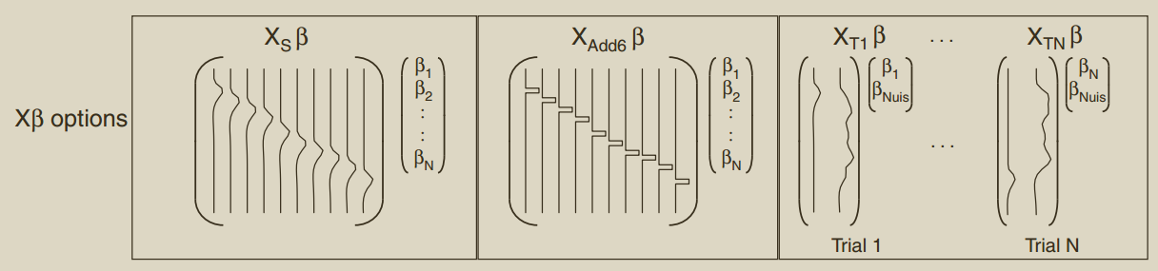
single-trial modeling approach for encoding
Current model: one regressor for the trial of interest, and one for all other trials (e.g., scene + object), but they should be separated.
Scene and object images were shown very closely in time, so the BOLD response for farm would overlap “bigly” with that for tractor.
An alternative model is a “double-trial” model where we have one regressor for farm, one for tractor, one for all other scenes, and one for all other objects.
Will give that a try later. Thoughts? :)

