Slide 1
DistRep
December 4, 2023

Slide 2
Traditional conceptual focus and methodology
Usually, representations are studied in terms of voxel-level (BOLD) activation
Such data are submitted to RSA
This is thought to tap into information processing of neural populations
Can this framework be adapted to research possible distributed representations?

Slide 3

Distributed processing:
Oft speculated rarely tested
Cognitive neuroscience has increasingly focused on how cognitive functions are distributed across multiple regions
There is an abundance of research showing that tasks yield clusters in main different regions
  Yet there is little research on how these different regions work together to represent stimuli
(Deniz, … Gallant, 2019)
Notes:
Mouse research shows how reciprocal loops among cortical regions are necessary for working memory maintenance (Voitov & Mrsic-Flogel, 2022)

Slide 4
PFC representation
PFC is typically thought to play a central role in maintaining information in one’s working memory and manipulating
  Yet relatively few studies have been able to identify representation in the PFC
The studies that managed to identify PFC representations required intricate experimental designs, generally probing abstract features of a stimulus
  Representation of the stimulus’ category
  Representation in terms of links to other stimuli
  Representation in terms of links to behavior
If neural populations specialize in representing abstract features like these, then the PFC may represent specific stimuli as the interaction between populations

Slide 5
Questions and goals
Questions:
  In some regions, are stimuli represented as the interaction between regions rather than as activity within neural populations?
  Can this perspective specifically explain how the PFC maintains information in one’s working memory?
Methodological goals
  Resolving the above two questions suggest that this focus on distributed representations would also be relevant to other questions and topics
  Hence, another goal is to show how other researchers can investigate similar questions in their own data

Slide 6



Traditional RSA
To perform traditional RSA, you need a vector of measurements for each trial
Typically, the vector represents BOLD activation
  Each element is the beta for a given voxel in an ROI
  The vector length is equal to the number of voxels in the ROI
Input:
Neural vectors
Build neural RSM
Neural RSM x
Model RSM
Trial 1
$r_{ij}=corr$ ($x_{i},x_{j})$
Trial 2
Trial 3
Trial 4
ROI $m$
Trial 5
Trial 6
×
Trial $n$
Neural RSM
Model RSM
Notes:
Color = units are beta value | Greyscale = units are z-transformed correlation coefficients

Slide 7
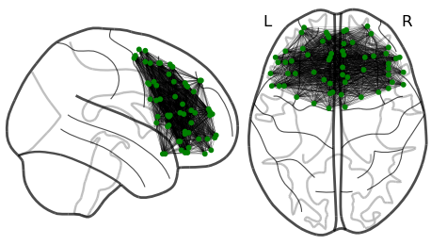

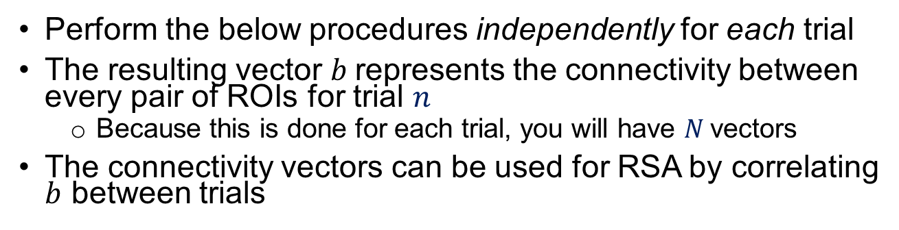








Measuring single-trial connectivity
Perform the below procedures independently for each trial
The resulting vector $b$represents the connectivity between every pair of ROIs for trial $n$
  Because this is done for each trial, you will have $N$vectors
The connectivity vectors can be used for RSA by correlating $b$ between trials
Input:
Voxel betas
Average
across voxels
ROI-ROI coherence
Vectorize
triangle
$a_{ij}=|$ $\overline{x_{i}}$ - $\overline{x_{j}}|$
ROI 1
$$(x_{1})$$
$$(\overline{x_{1}})$$
ROI 2
2
3
ROI 3
1
4
Further analysis (e.g., RSA, IPS)
Trial $n$
ROI 4
5
6
$$b_{1}$$
$$b_{(m−1)(m−2)/2}$$
ROI 5
ROI 6
ROI $m$
$$(x_{m})$$
$$(\overline{x_{m}})$$
Notes:
Look at specific edges or sub-regions and maybe look at specific tasks. Plot specific edges

Slide 8
Main results
Prelude:
  Traditional activation-based RSA and IPS yields solely results in perceptual areas
  No PFC effects
Main findings:
  Coherence-based RSA yields significant word2vec RSA effects in the PFC
  Distributed representations are particularly relevant when stimuli are not actively on the screen
    Consistent with the working memory focus
  Confirm that the effect is more than the sum of its parts
    Result remains significant even when controlling for activation-based effects
  Confirm that the effect is robust, and the general method is viable for other directions:
    Results yield significant effect when examining IPS rather than RSA
  Confirm that the effect is distributed
    Pursuing regional specificity identifies some PFC areas that may be more involved than others, but by and large, the distributed representation seems to be spread across nearly every PFC sub-region

Slide 9
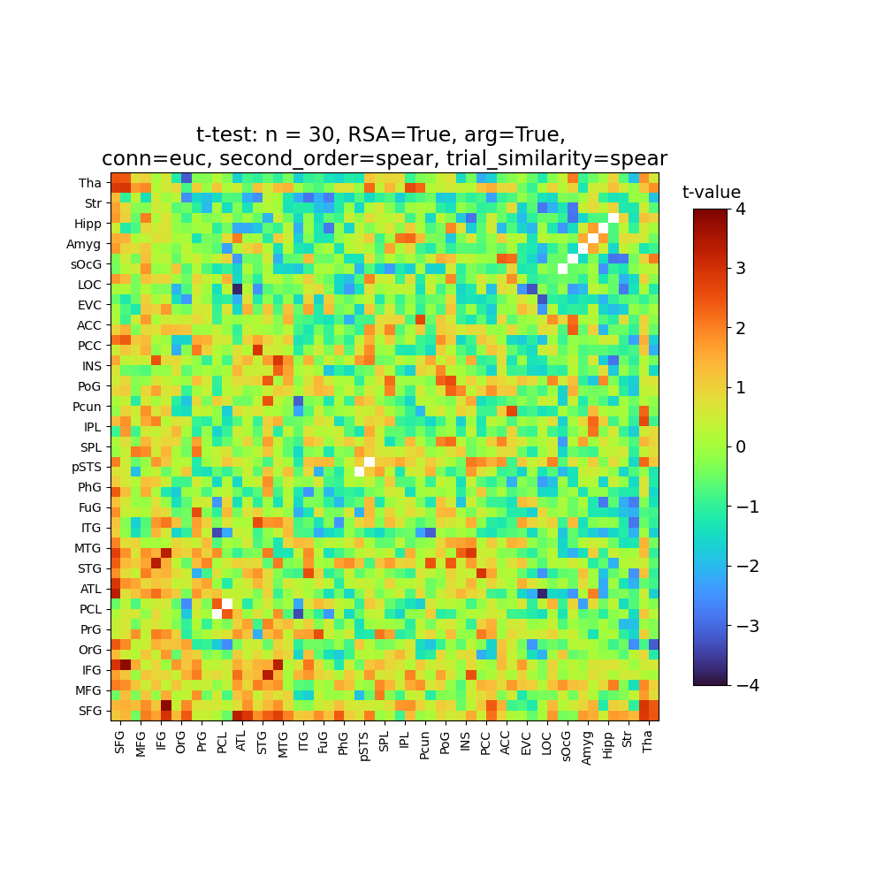
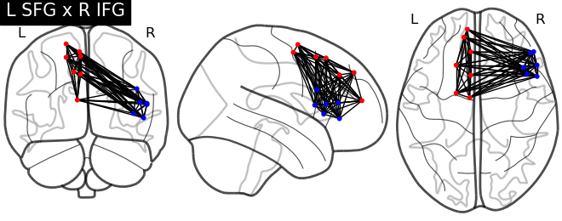
Region-pair visualization
Effect spread across the PFC
PFC
PFC (ACC)

Slide 10
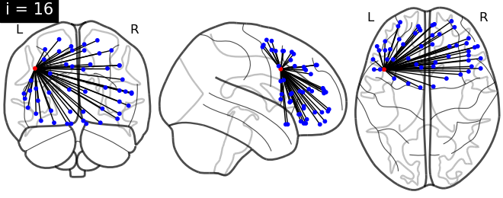
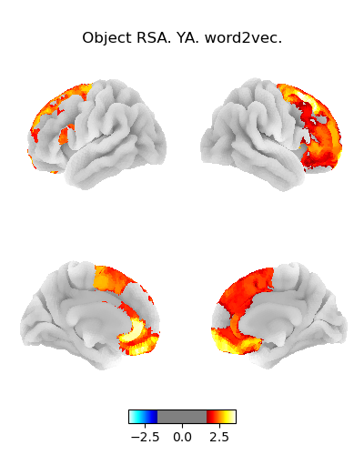
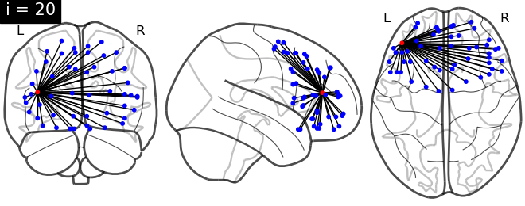
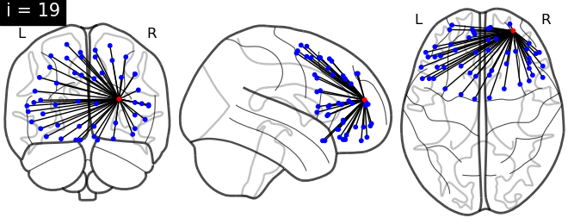
ROI-based visualization (RSA)
Effect spread across the PFC
60 ROIs
  Significant effect in 20 ROIs (p < .05)
  Numerical trend in 53 ROIs
Notes:
BNA atlas
Left side figure is p < .01 (one-tailed) threshold
FDR correction still leads to only one surviving
Yet, of the 52 ROIs, 48 show a numerically positive effect

Slide 11
Visuals
Figure 1: Diagram of RSA + diagram of single-trial coherence
  Could spread across two figures
Figure 2: Plot regions showing activation-based RSA/IPS effects
Figure 3: Bar graphs?
  Maybe something pointing to the conceptual retrieval task
Figure 4: Region-pair figure and/or ROI-based coherence figure
  Could spread across two figures

Slide 12
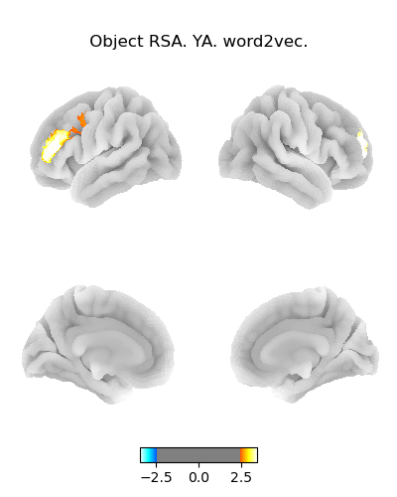
ROI-based visualization (RSA)
Here, I plotted
p < .01 uncorrected
The symmetry is nice
Of these ROIs, one survives following Bonferroni correction for 52 tests (t = 3.4)
  FDR correction does not yield more results
Notes:
BNA atlas
Left side figure is p < .01 (one-tailed) threshold
FDR correction still leads to only one surviving
Yet, of the 52 ROIs, 48 show a numerically positive effect

Slide 13
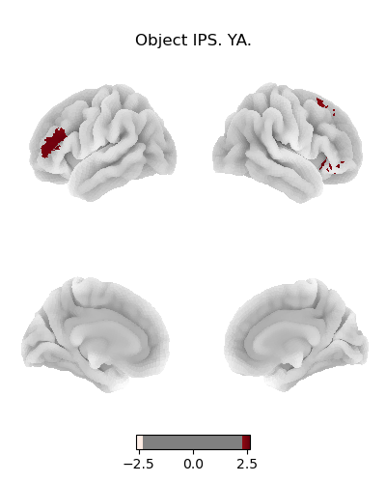
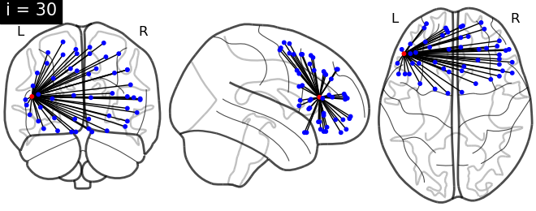
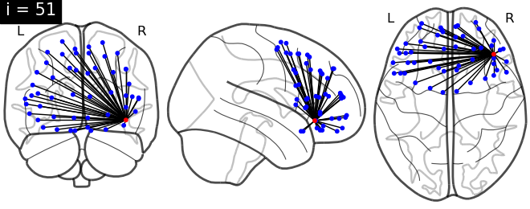
ROI-based visualization (IPS)
Consistency with the L MFG result for RSA
However, this one is t = 2.6 and would not survive Bonferroni correction for 52 tests
Notes:
BNA atlas
Left side figure is p < .01 (one-tailed) threshold

Slide 14
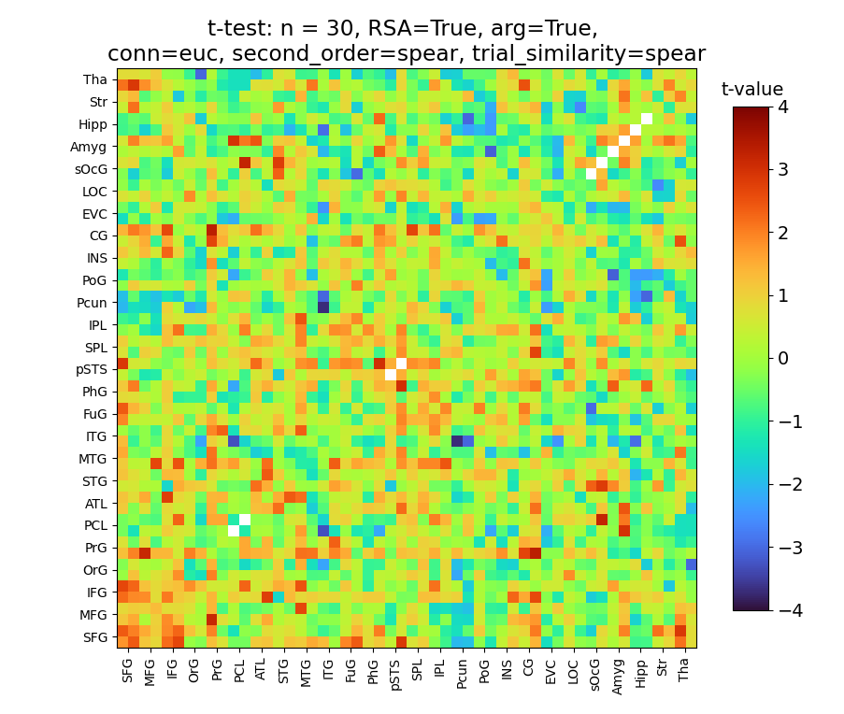
Sub-region pair visualization
RSA effects seen based on the connectivity between pairs of PFC gyri
PFC

Slide 15
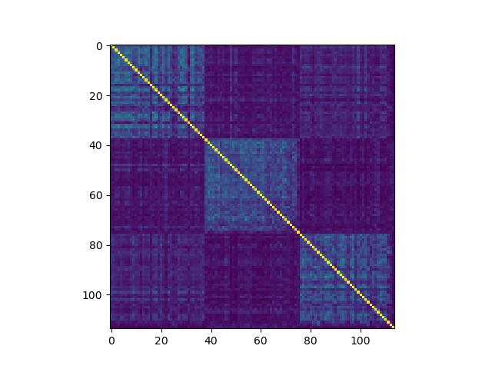
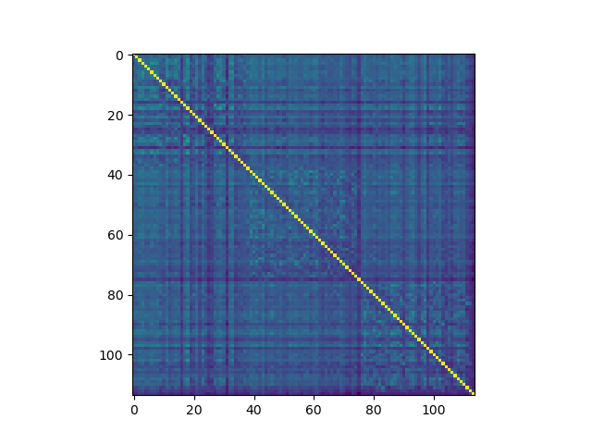
Differences like this aren’t accounted for by dropping within-run

Slide 16
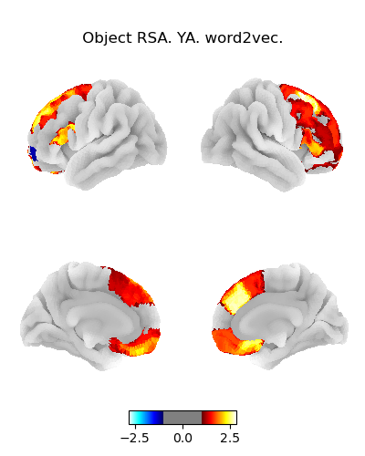
26 ROIs and PFC1

Slide 17
27 ROIs, PFC1 and PFC2

Slide 18
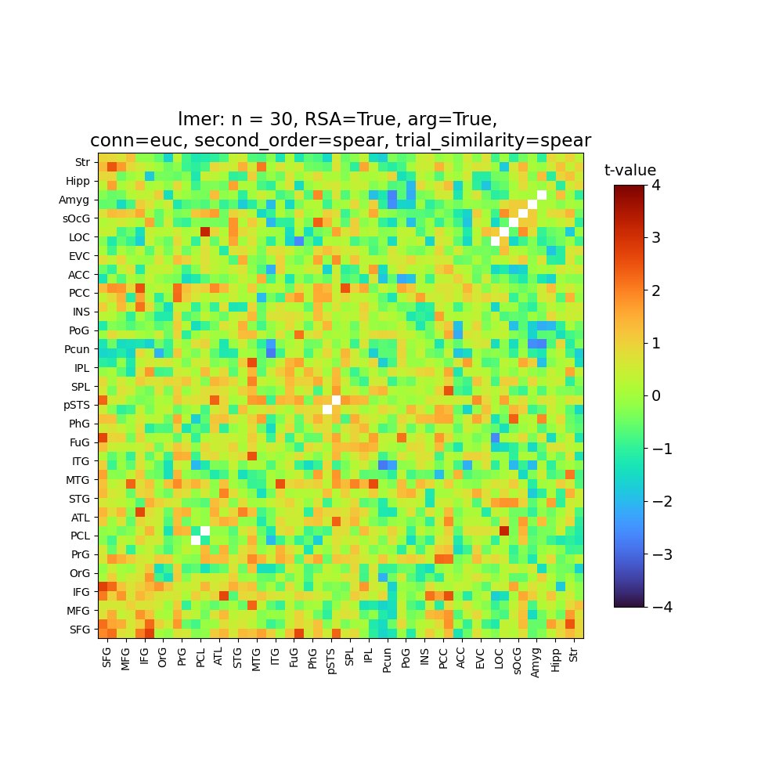

Slide 19


Slide 20
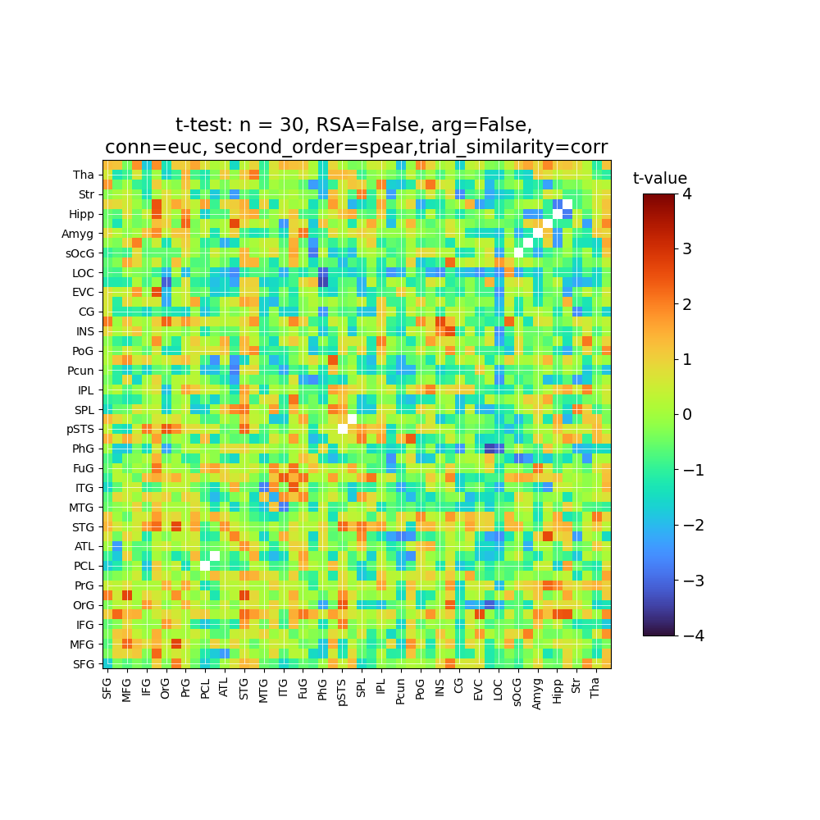
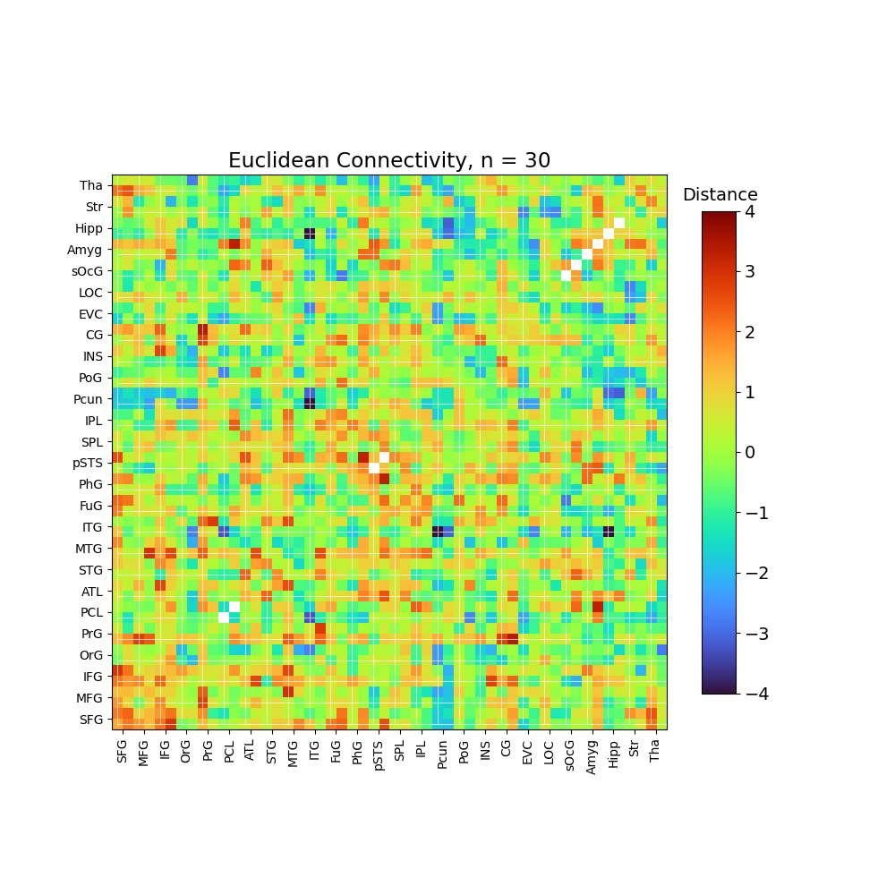
Spearman

Slide 21
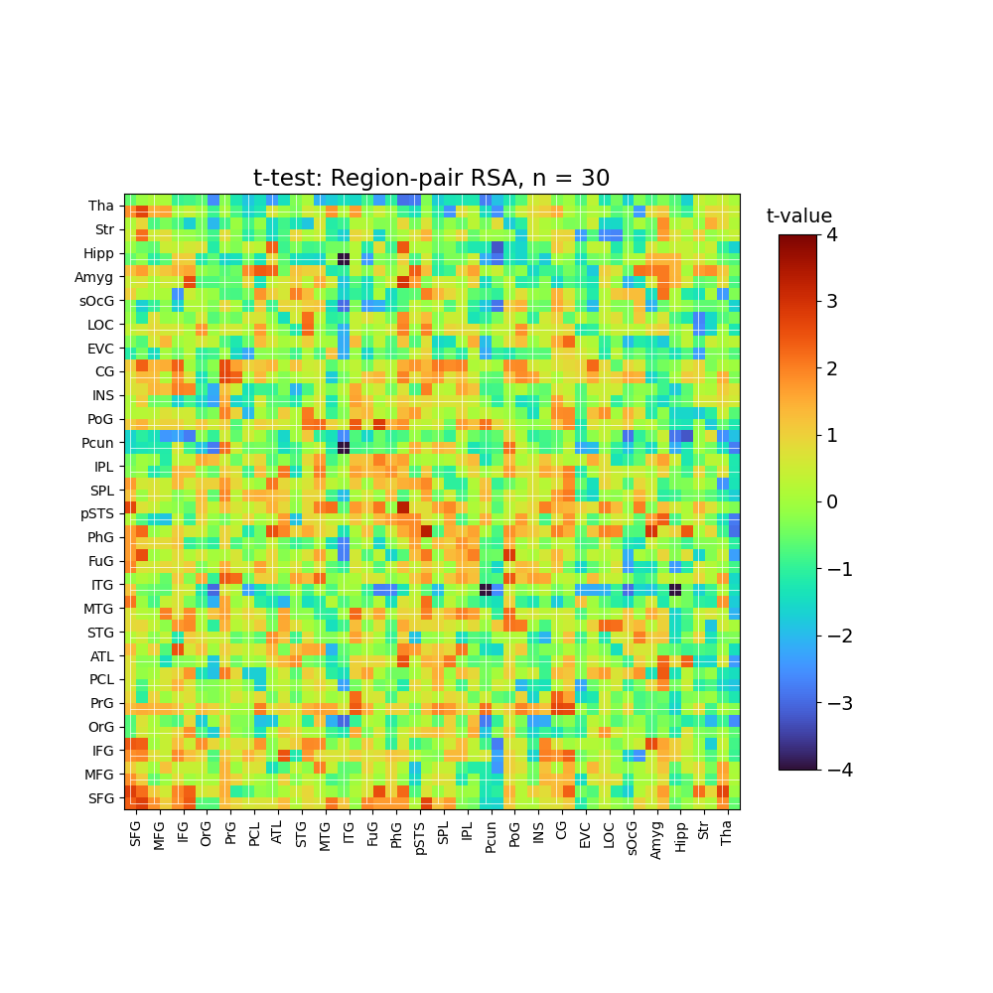

Slide 22
Only one edge: PCL_L, PCL_L
Only one edge: PCL_R, PCL_R
Only one edge: pSTS_L, pSTS_L
Only one edge: pSTS_R, pSTS_R
Only one edge: sOcG_L, sOcG_L
Only one edge: sOcG_R, sOcG_R
Only one edge: Amyg_L, Amyg_L
Only one edge: Amyg_R, Amyg_R
Only one edge: Hipp_L, Hipp_L
Only one edge: Hipp_R, Hipp_R

Slide 24
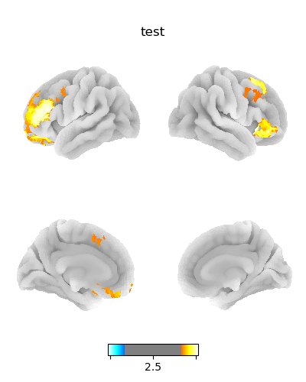
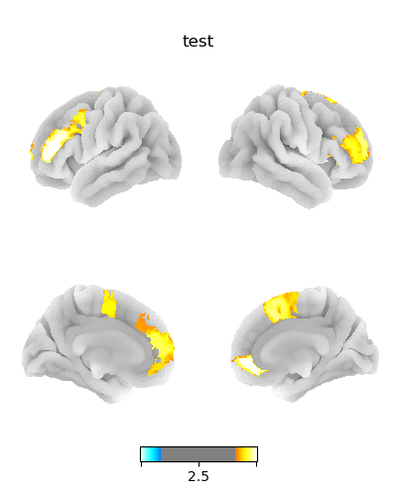
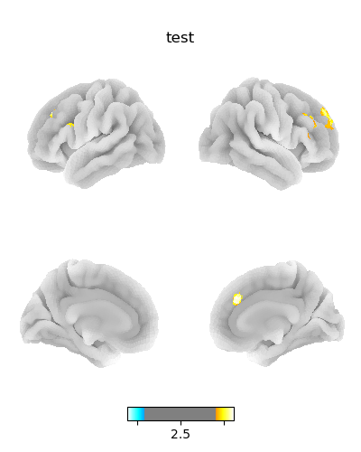

Slide 25
