Slide 2
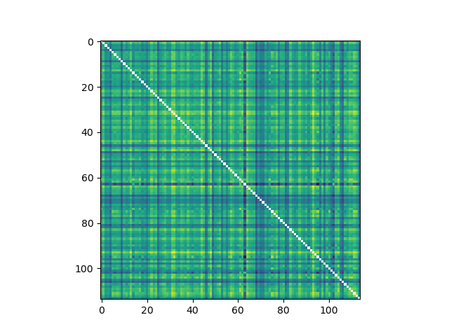
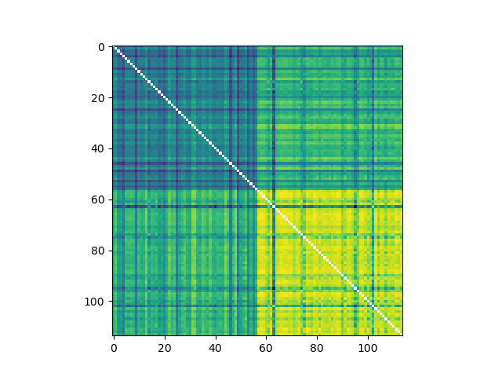
If your RSM looks like this, RSM x RSM comparison methods are better

Slide 3
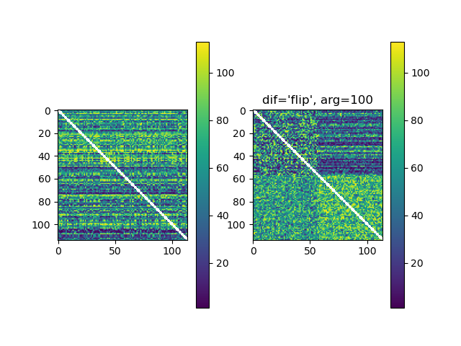
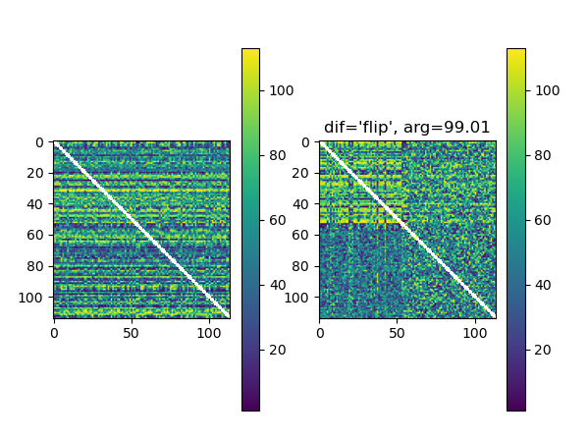
…
…
If the signal-to-noise is very high, traditional RSM seems to be better

Slide 4
Simulation results
I simulated a scenario where for condition 1 (50% of the stimuli), the brain strongly represents the stimuli.
  For the condition 2 (50% of the stimuli), the brain response is unrelated to the stimulus
If you do this then measure RSM x RSM for condition 1 you find a positive correlation. If you do that for condition 2, you find a negative correlation
However, if you calculate the average IRAF, you’ll find a positive correlation in condition 1 along with a positive correlation in condition 2
  Can elicit a strong condition 2 representational strength effect (one-sample t-test relative to zero)
  Sensitivity is slightly lower for comparisons (paired t-tests)
  Why is this?
Notes:
This result may be related to multicollinearity somehow?
The effect on condition 2 one sample t-tests can be assessed with real data

Slide 5
fMRI 0
fMRI 1
r(fMRI 0, fMRI 1)
∝
r(stim 0, stim 1)
Stim 0
Stim 1
Notes:
The fact that fMRI 0 and fMRI 1 strongly represent stim 0 and stim 0, creates upward pressure on Stim A IRAF
Flipping this scenario around, so that fMRI 0 and fMRI 1 are positively correlated does not cancel out this pressure (if you are using correlations to measure IRAF)

Slide 6
fMRI 0
fMRI 1
fMRI 0
r(fMRI 0, fMRI 1)
∝
r(stim 0, stim 1)
fMRI A
Mediation
r(A,1) ∝ r(A,0)*r(0,1)
fMRI 1
Stim 0
Stim 1
Notes:
The fact that fMRI 0 and fMRI 1 strongly represent stim 0 and stim 0, creates upward pressure on Stim A IRAF
Flipping this scenario around, so that fMRI 0 and fMRI 1 are positively correlated does not cancel out this pressure (if you are using correlations to measure IRAF)

Slide 7
fMRI 0
fMRI 1
fMRI 0
r(fMRI 0, fMRI 1)
∝
r(stim 0, stim 1)
fMRI A
Mediation
r(A,1) ∝ r(A,0)*r(0,1)
fMRI 1
Stim 0
Stim 1
If fMRI r(0, 1) is negative, then in the fMRI RSM, we will see fMRI r(A,1) ∝ -r(A,0).
Similarly, if stim r(0, 1) is negative, then in the stim RSM, we will see stim r(A,1) ∝ -r(A,0).
Because stim 0 and stim 1 are strongly represented, this means that stim r(0, 1) being negative goes hand-in-hand with fMRI r(0, 1) being negative
Hence, if we correlate the A row in the fMRI RSM and the A row in the stim RSM, we will tend to see a positive IRAF
Stim 0
Stim A
Stim 1
Mediation
r(A,1) ∝ r(A,0)*r(0,1)
Notes:
The fact that fMRI 0 and fMRI 1 strongly represent stim 0 and stim 0, creates upward pressure on Stim A IRAF
Flipping this scenario around, so that fMRI 0 and fMRI 1 are positively correlated does not cancel out this pressure (if you are using correlations to measure IRAF)

