Slide 2
Methodological note
Recursive

Slide 3
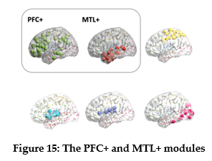
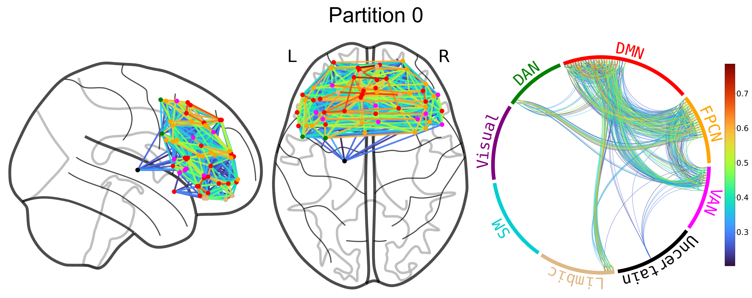
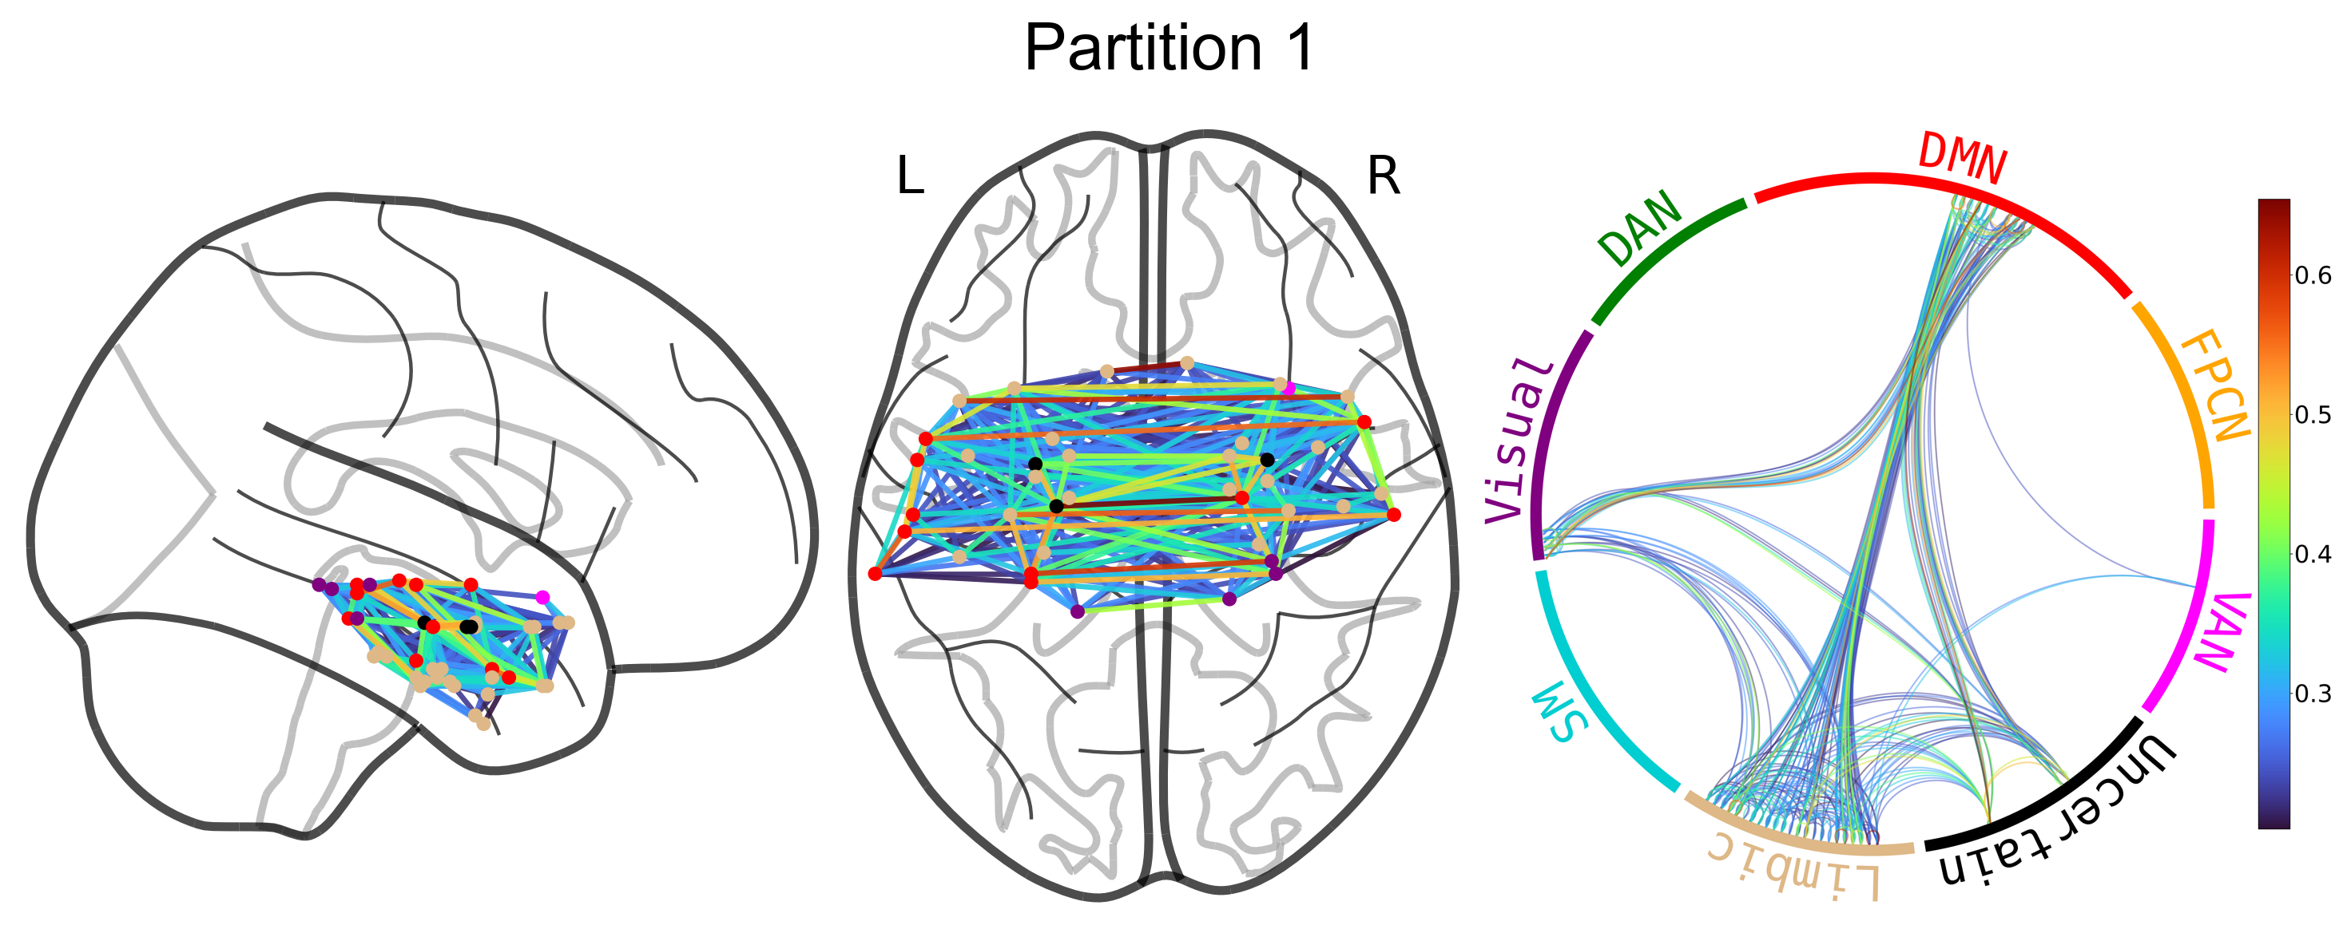
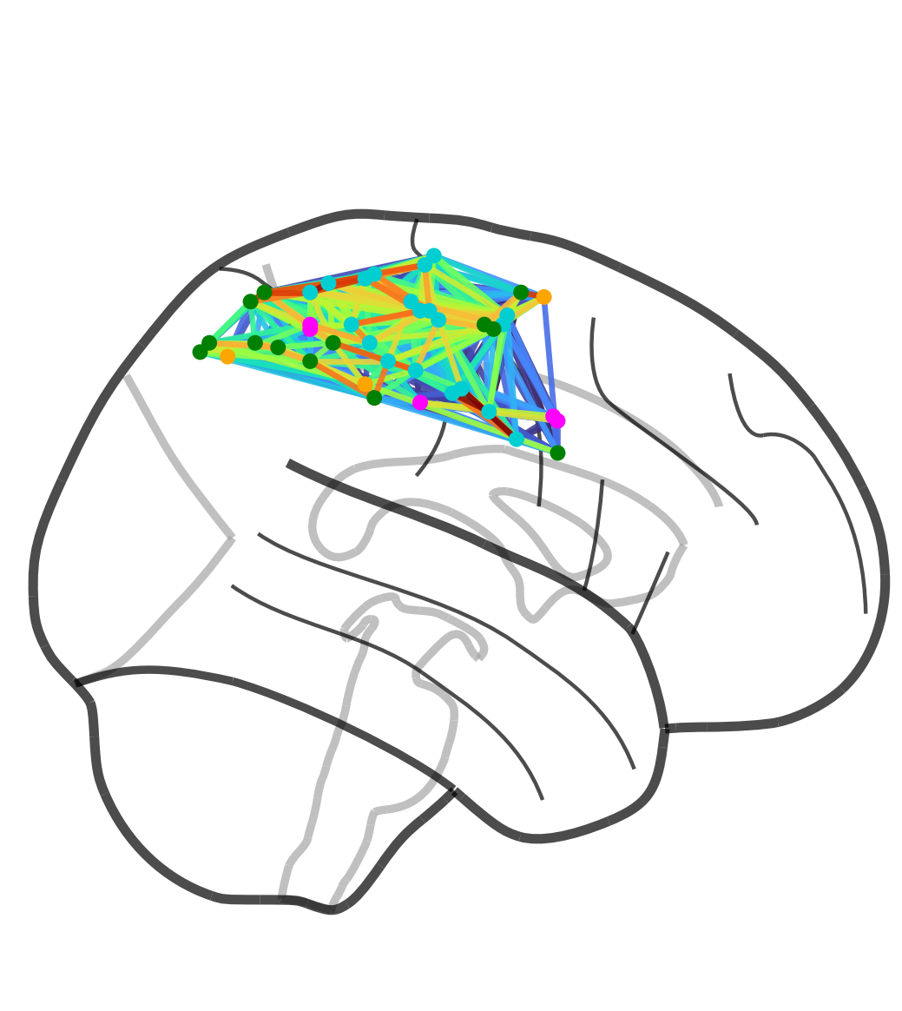
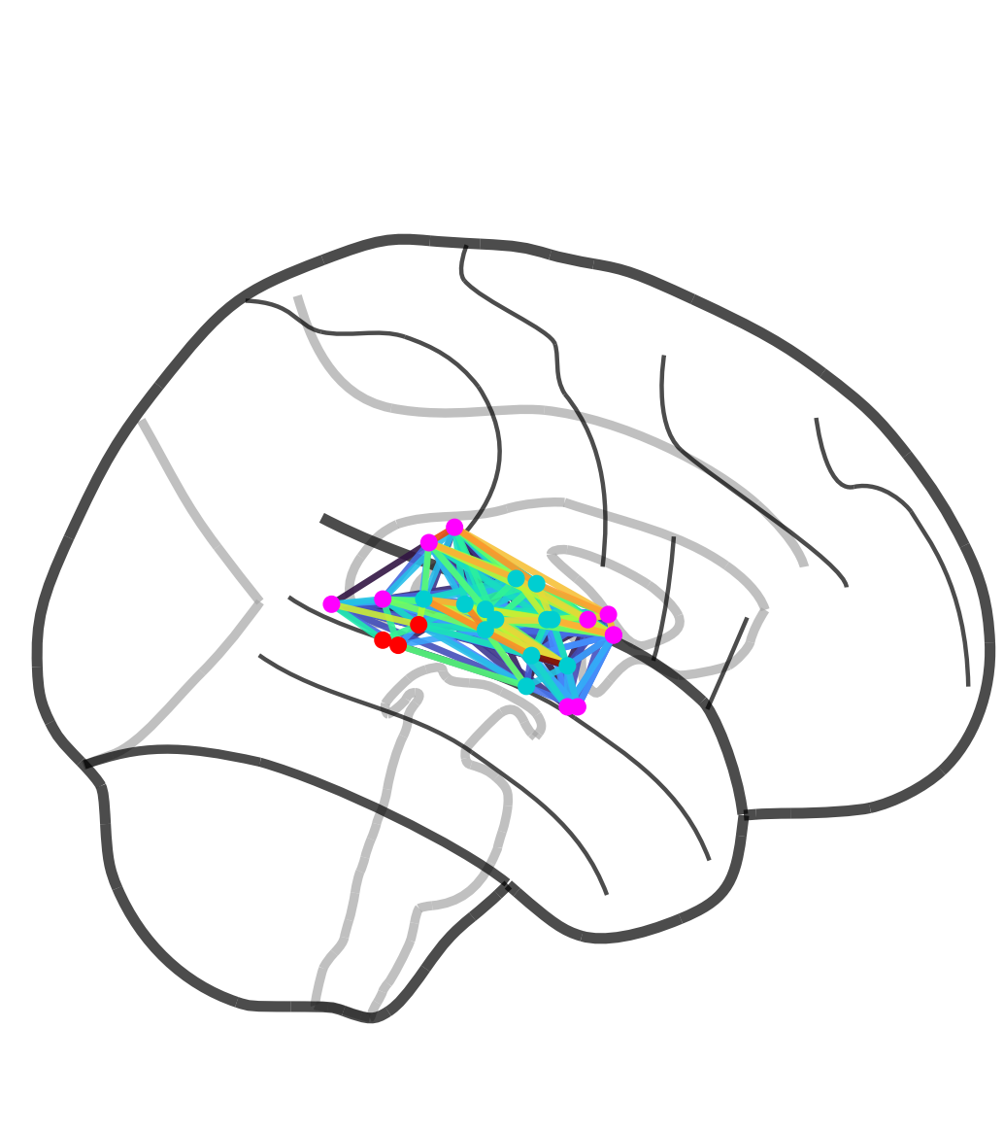
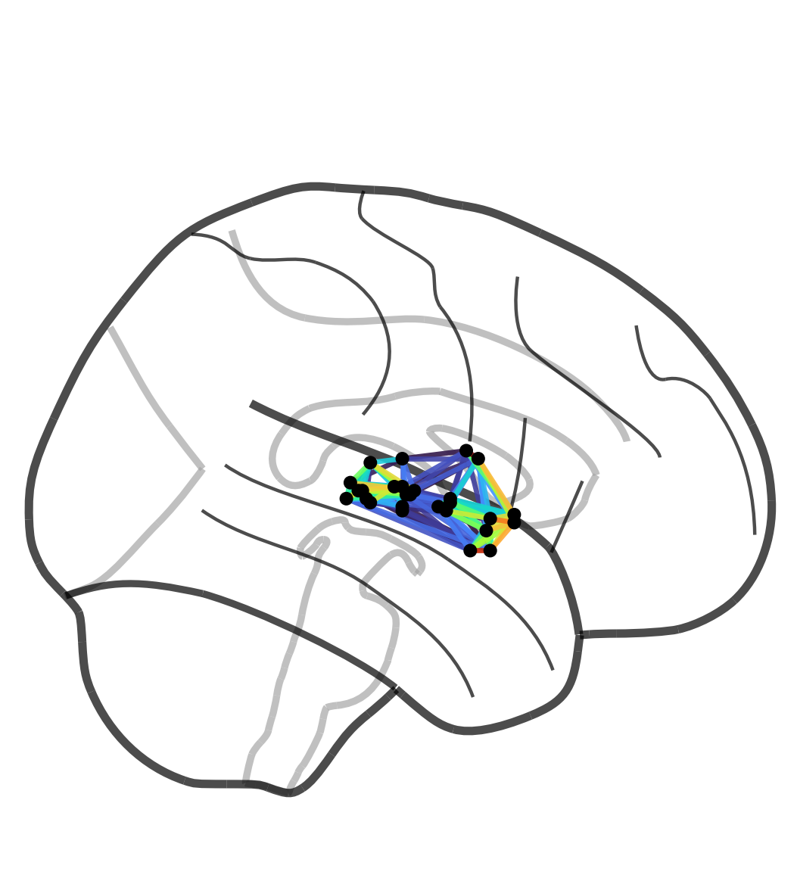
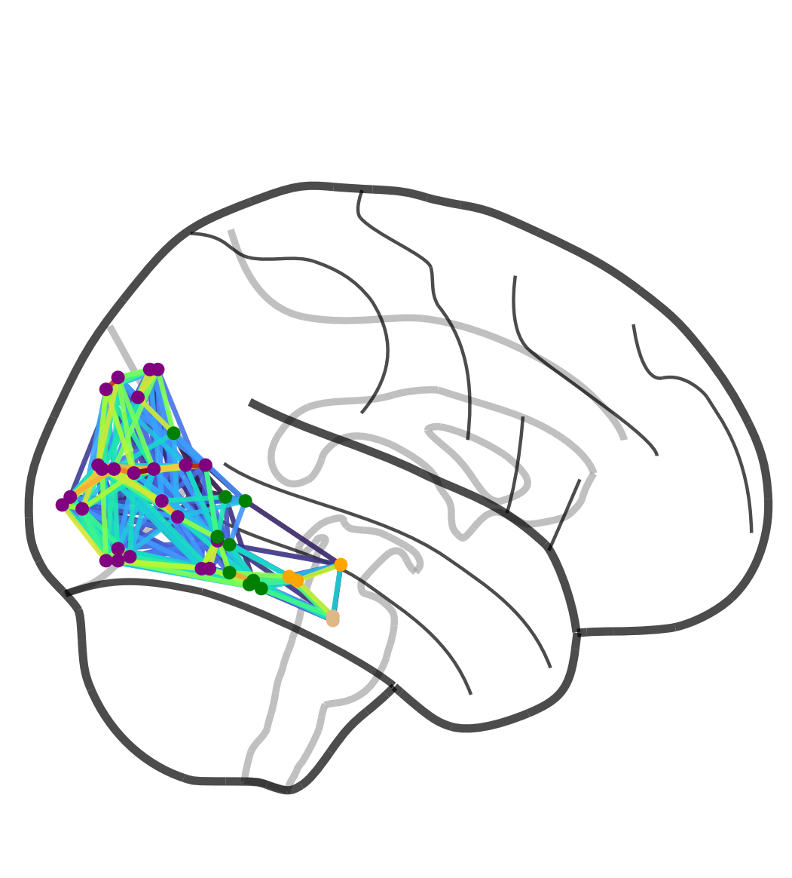
Figure 15A
Strikingly consistent
Slight differences
  My PFC module doesn’t include temporal + parietal ROIs
  My MTL+ is more exclusively anterior
Notes:
Alternative thresholding at 0.95%tile leads to a dissociation in the PFC (dorsal PFC & ventral PFC)

Slide 5
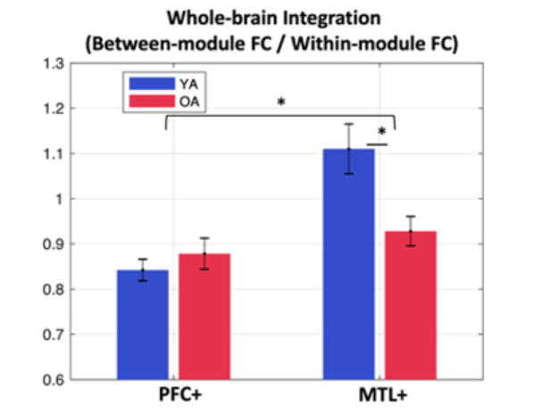
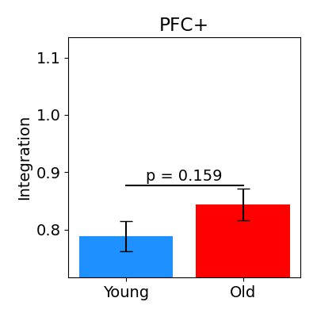
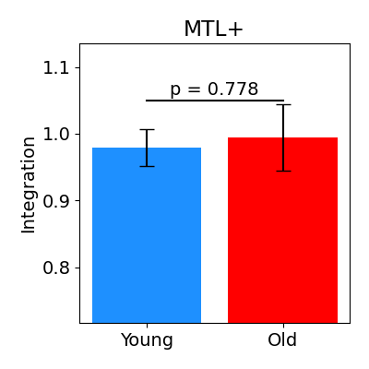
Figure 15B
Lifu
Paul
***

Slide 6
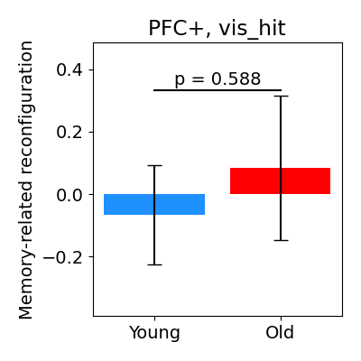
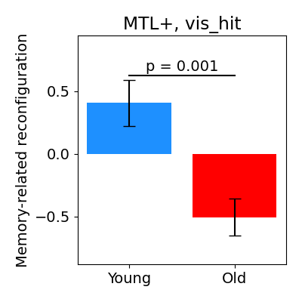

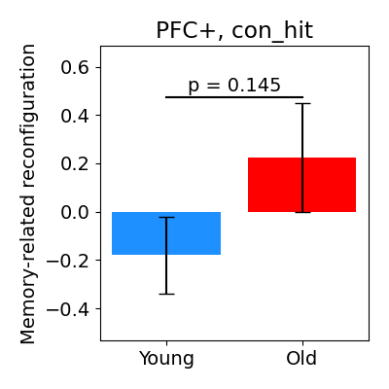
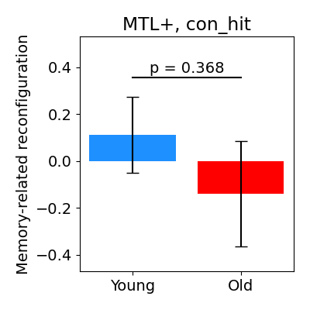
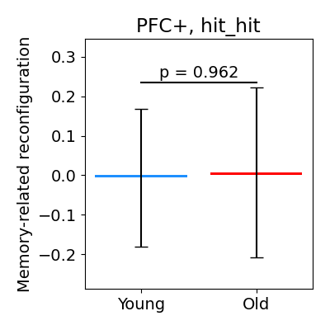
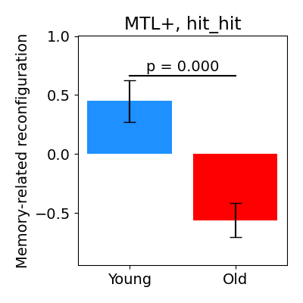
Figure 16A
Methods
Measure, for each subject, the correlation between their connectivity for hit trials x connectivity for miss trials
Lower correlation = more reconfiguration
Hence, a higher score here for YA relative to OA means that YA show greater effects of subsequent memory on connectivity
Using “z-score” as the unit is mysterious

Slide 7
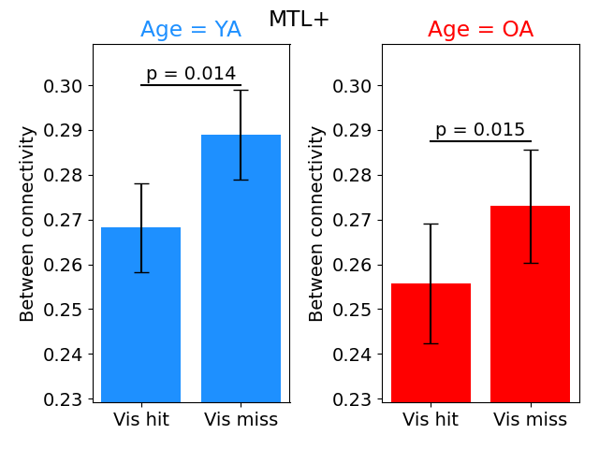
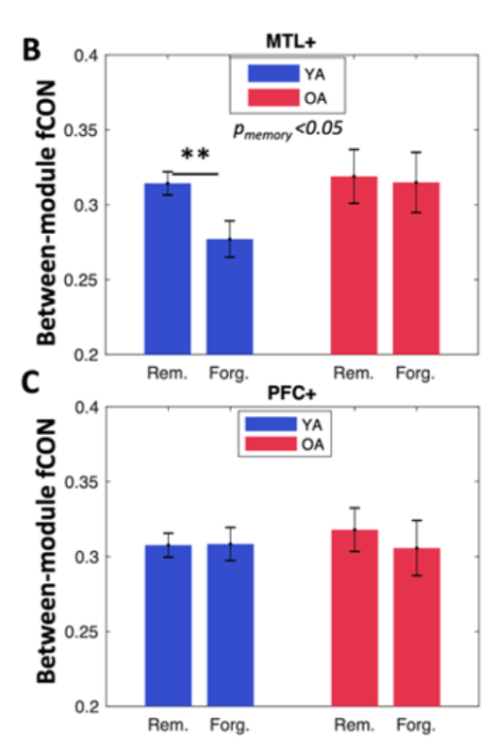
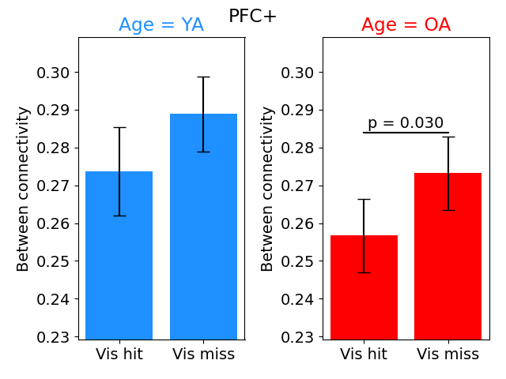
Figure 16B & 16C

Slide 8
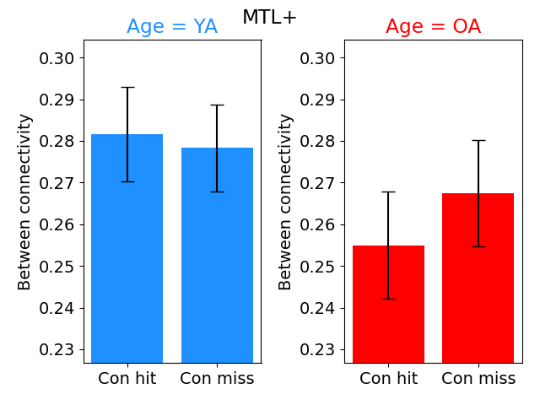
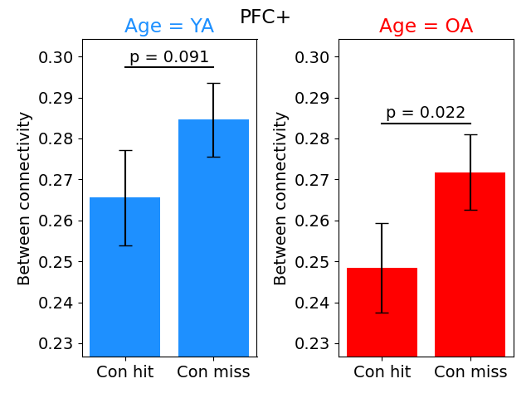
Figure 16B & 16C

Slide 9
Problem: YA show more variance in MTL connectivity
Analysis: Measure reconfiguration while randomly assigning trials to “hit” or “miss”
Consistently get a reasonably strong YA effect (d = .40)
This variability is interesting, but we can’t claim the previous result is a memory effect
☹

Slide 10
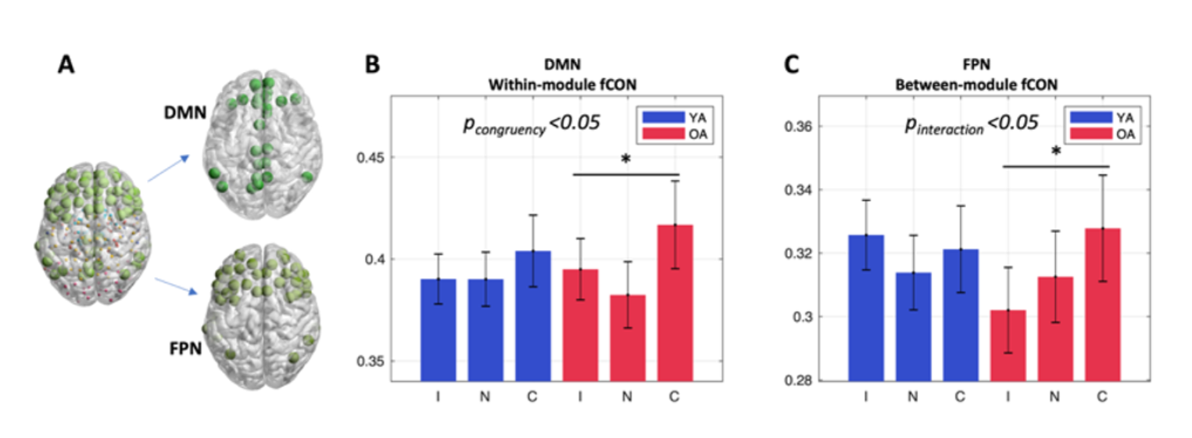
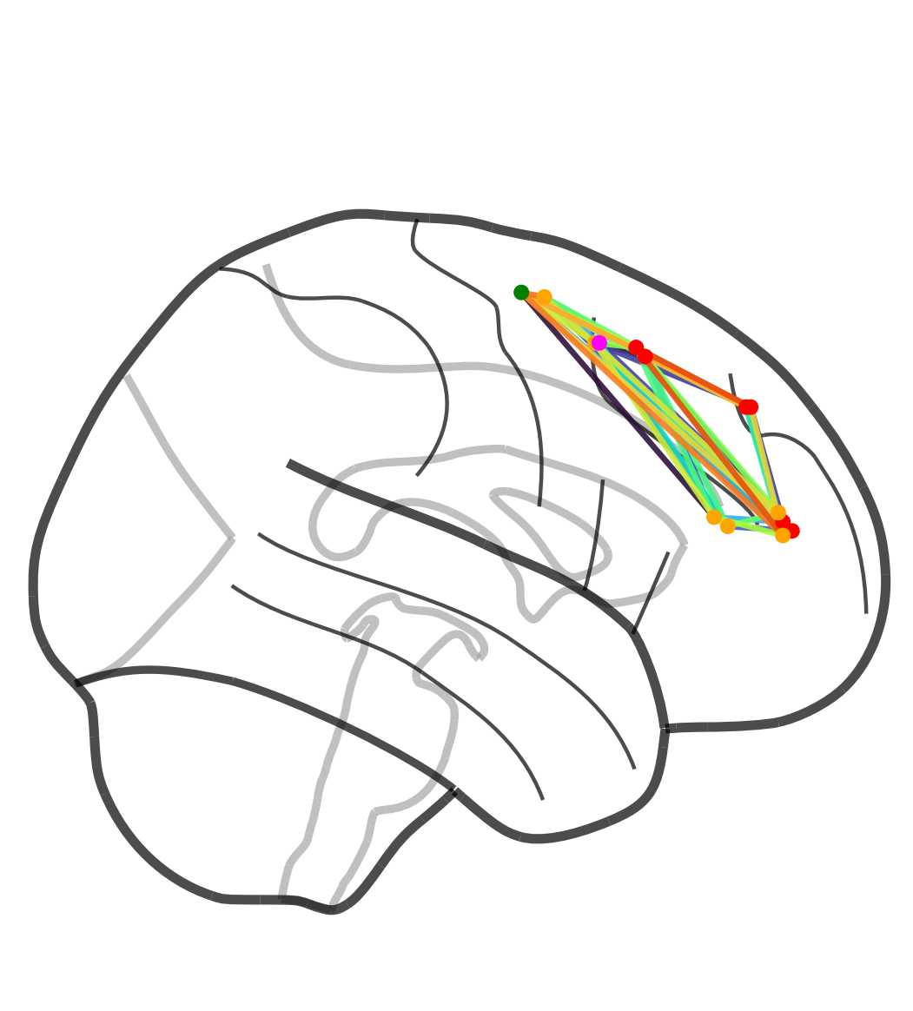
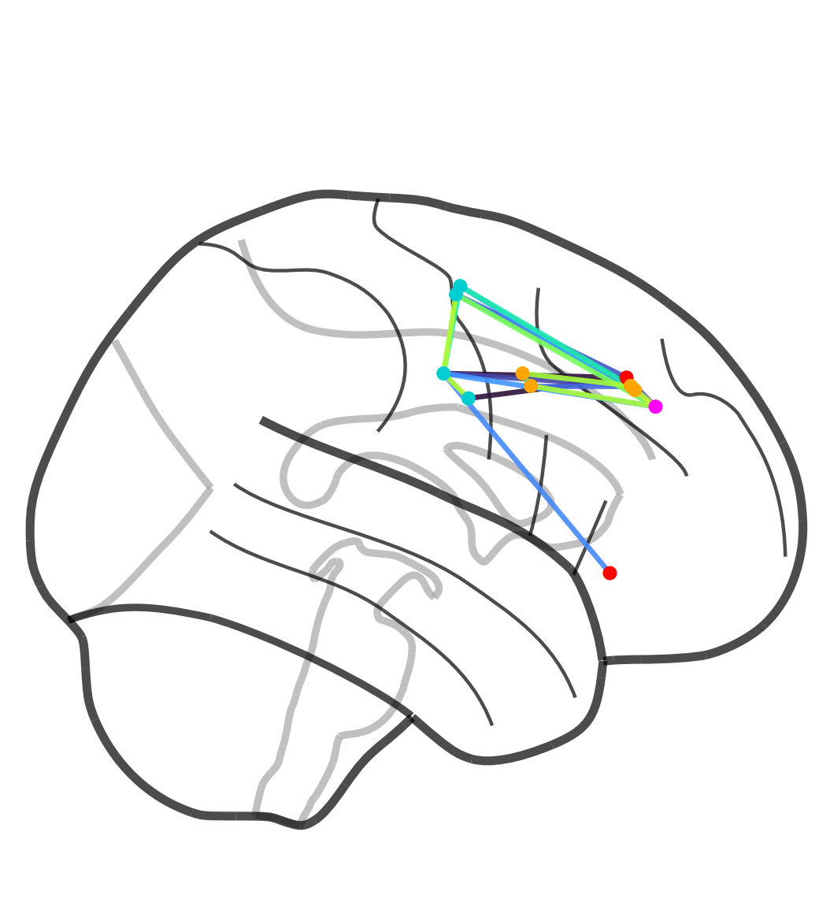
Figure 17

Slide 11
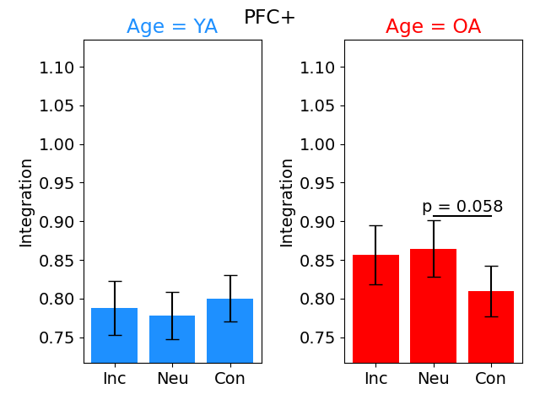
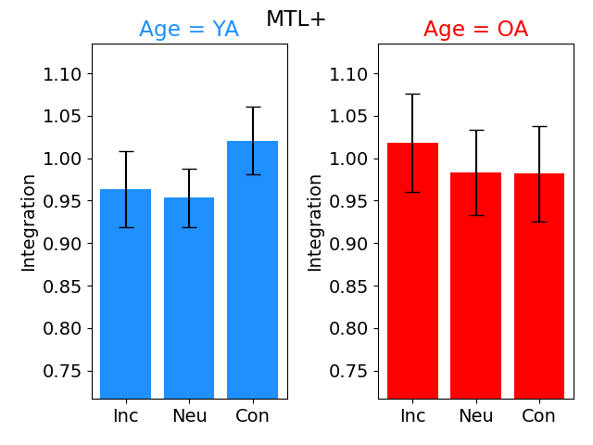
Figure 17
Notes:
It is somewhat weak (only p < .05)
Procedure may be seen as cherry picking (effects specific to one sub-module and effects rely on either within vs. between vs. integration)
Given this, I don’t think it’s a major loss that this result didn’t remain

Slide 12
What are we left with?
MTL is linked to higher integration than PFC
  No YA vs. OA differences
MTL is linked to greater inter-trial variability in its connectivity patterns for YA
  MTL is linked to stronger memory-related reconfiguration for YA
Subsequent memory is linked to weaker connectivity between the PFC and MTL with other brain areas
  No YA vs. OA differences

Slide 13
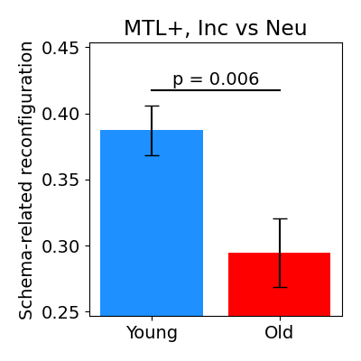
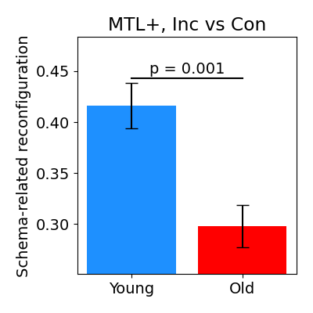
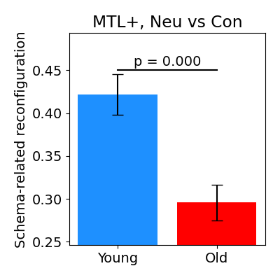
Proposed result: Schema-related reconfiguration
Similar to the memory-related reconfiguration analysis from before but now looking at the correlation between connectivity associated with Incongruent vs. Neutral vs. Congruent
YA show larger effects of schema congruency on MTL connectivity

Slide 14
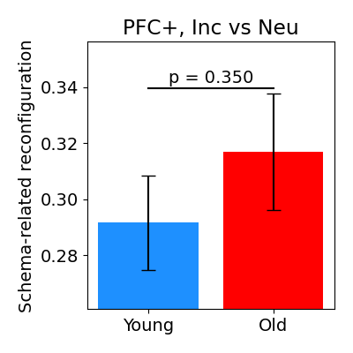
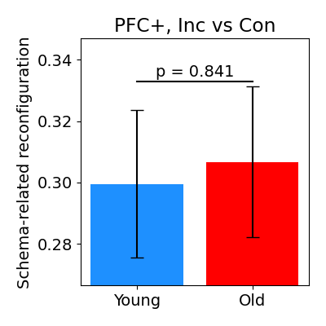
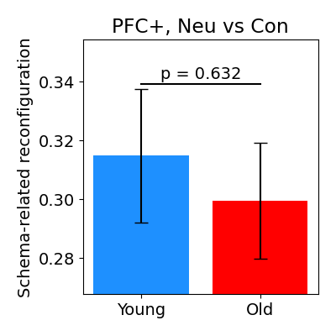
Null effect on PFC

Slide 15
Sanity test: Ensure that YA don’t simply show more MTL reconfiguration between random trials
Trials were randomly organized into Incongruent/Neutral/ Congruent
  Mean dif = 0.08 (SD = 0.02), d = 0.34 (SD = 0.085)
Randomly split Hit/Miss
  Mean dif = 0.10, d = 0.42

Slide 16
TODO:
Need to implement my subject-specific ConnSearch analsyis

Slide 17
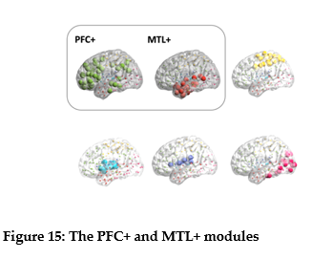
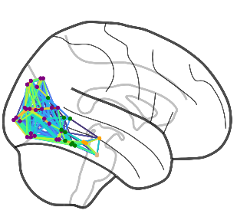
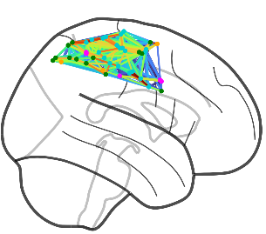
Figure 15A

Slide 18
