Slide 1
SchemeRep Networks

Slide 2
Methodological note
Recursive

Slide 3
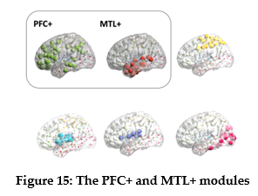
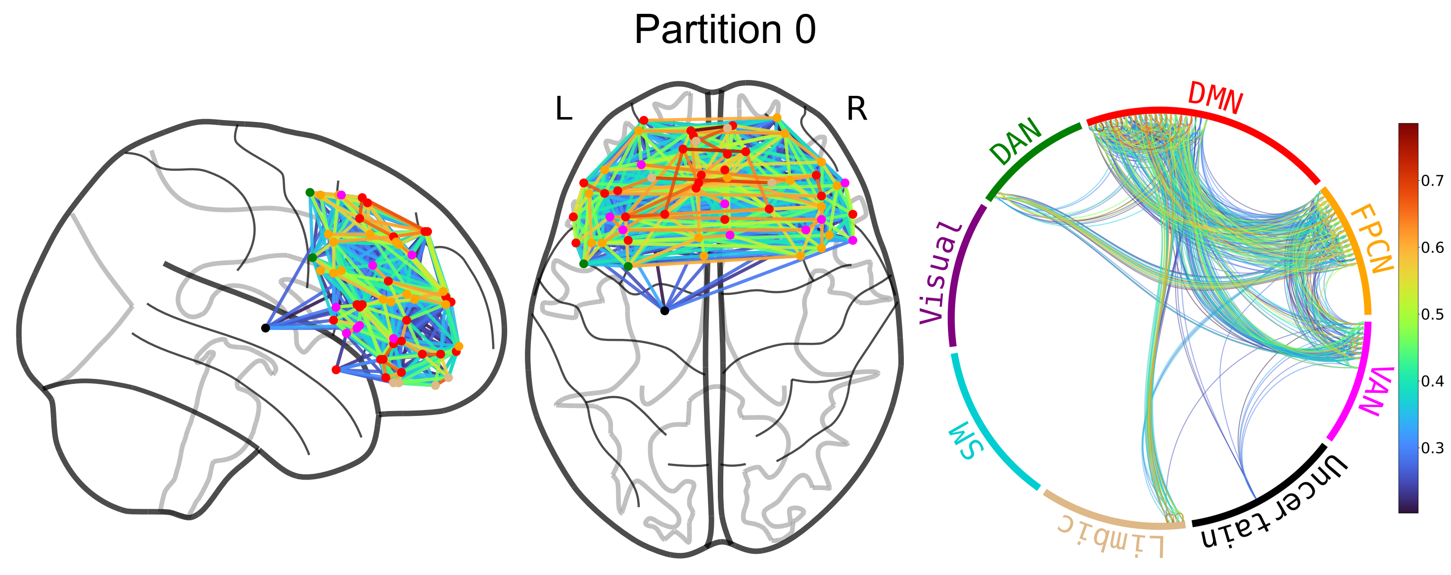
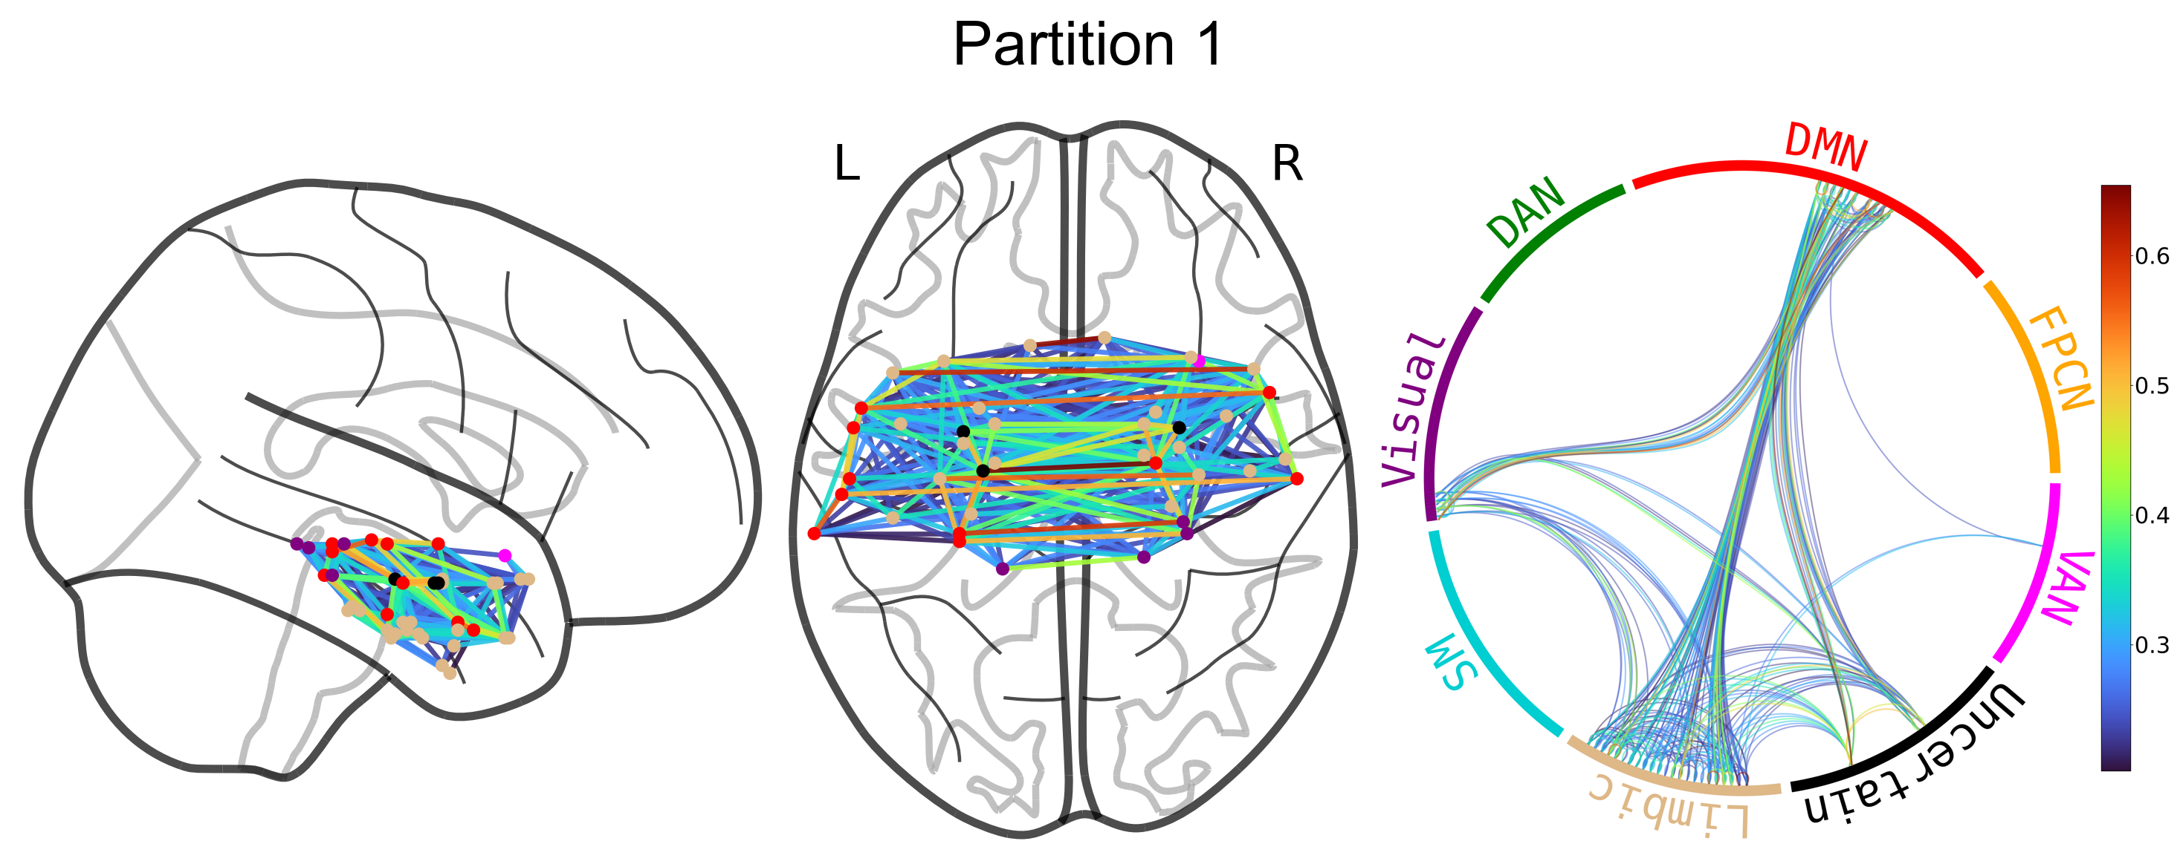
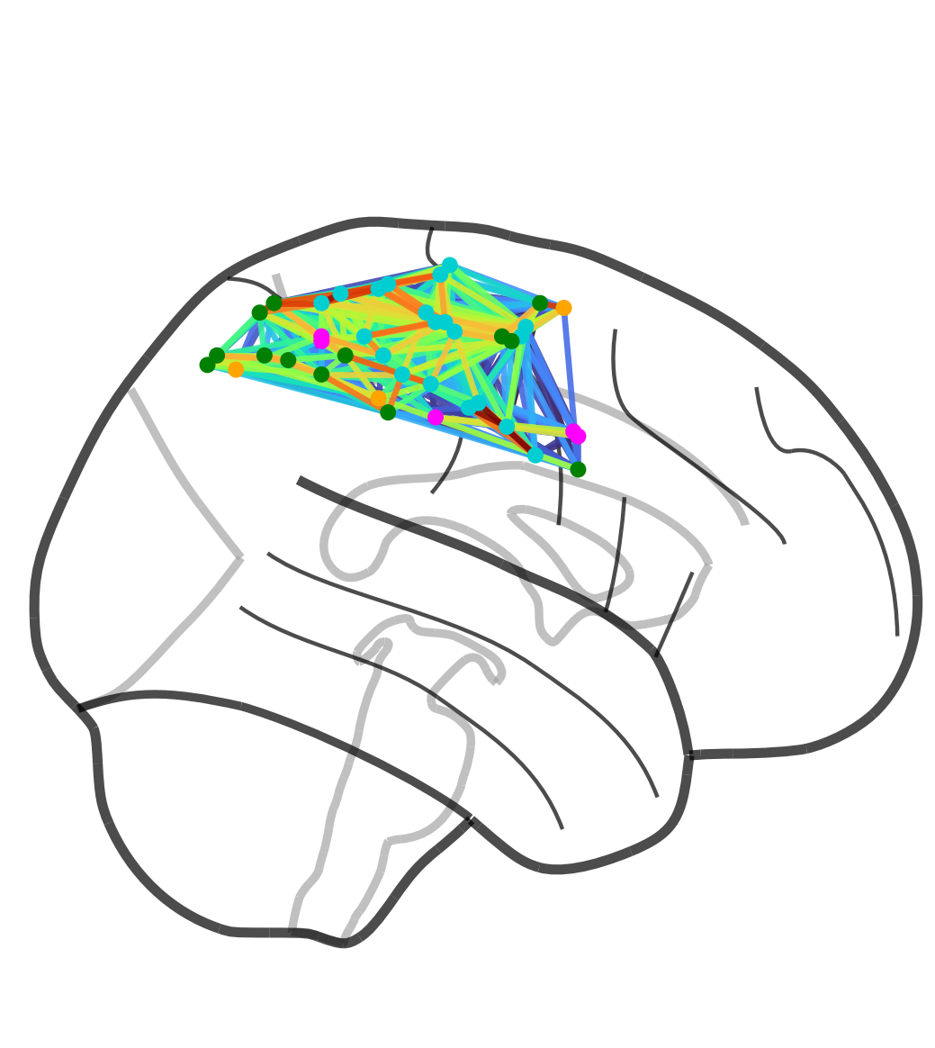
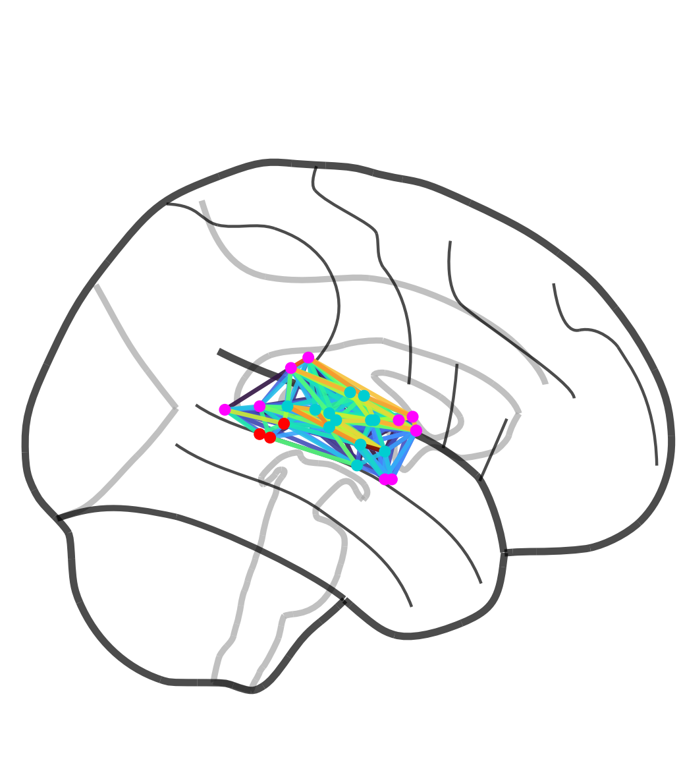
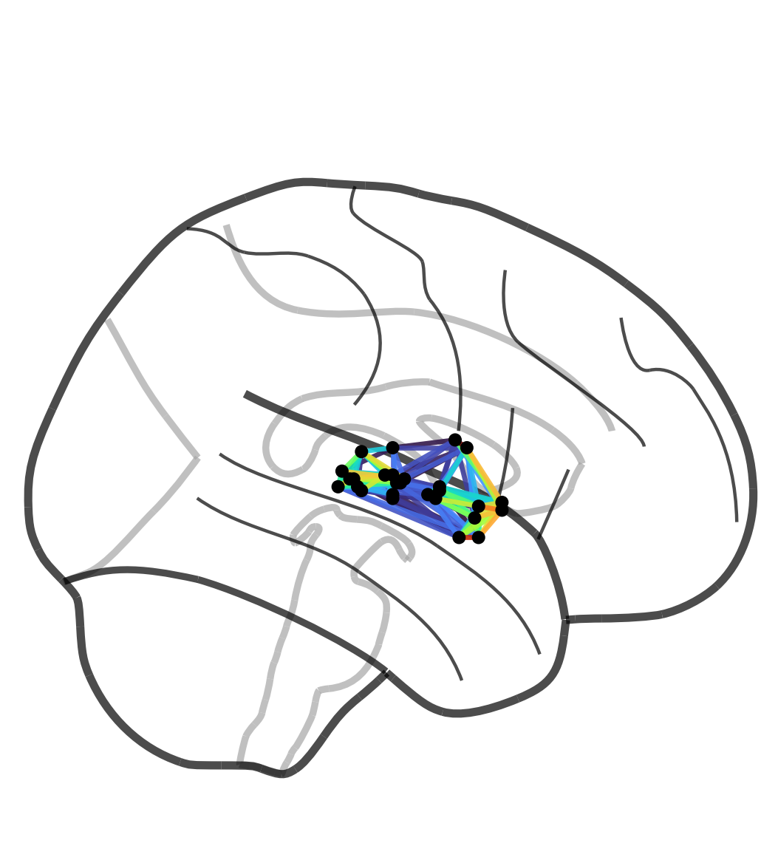
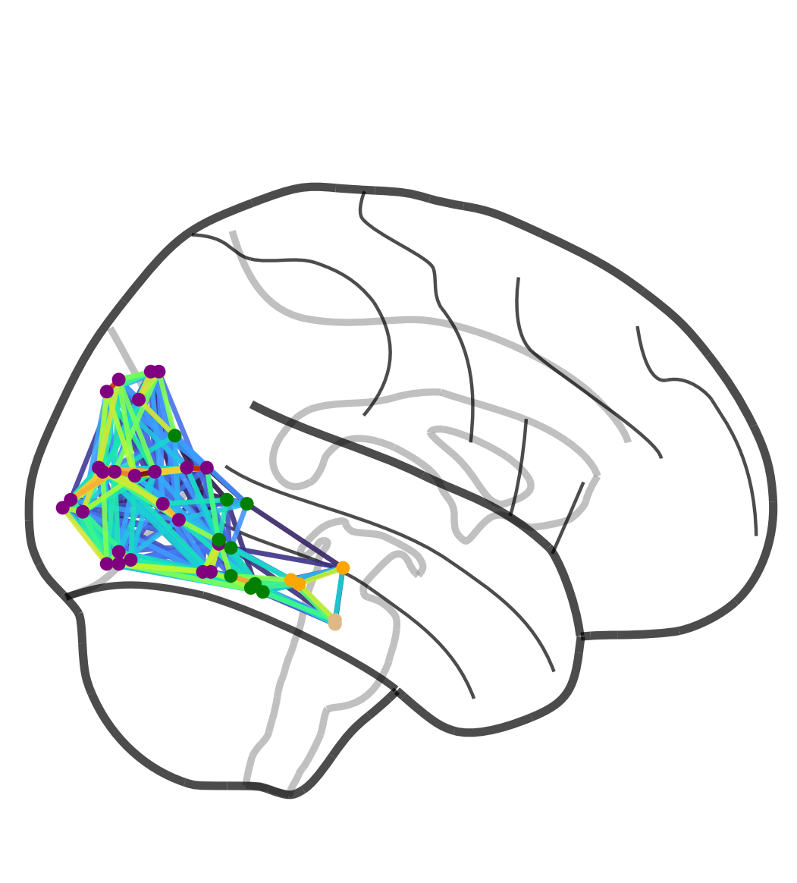
Figure 15A
Strikingly consistent
Slight differences
  My PFC module doesn’t include temporal + parietal ROIs
  My MTL+ is more exclusively anterior
Notes:
Alternative thresholding at 0.95%tile leads to a dissociation in the PFC (dorsal PFC & ventral PFC)

Slide 5
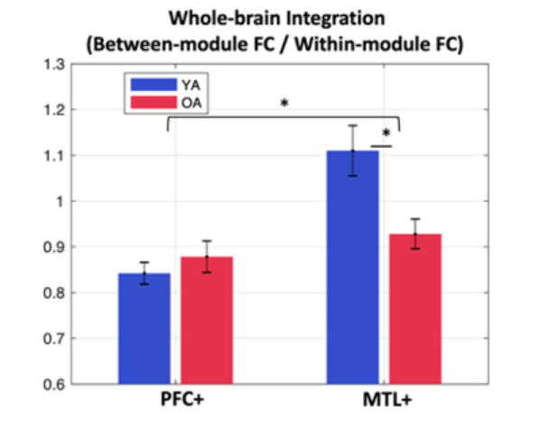
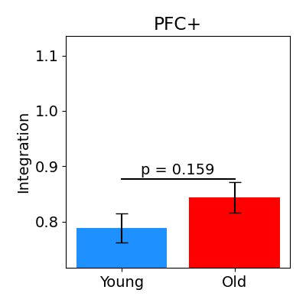
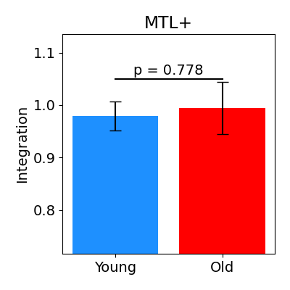
Figure 15B
Lifu
Paul
***

Slide 6
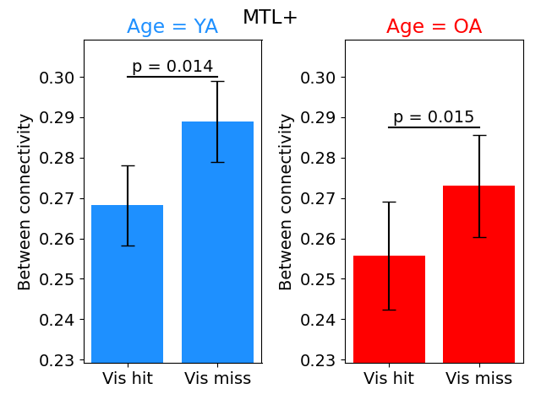
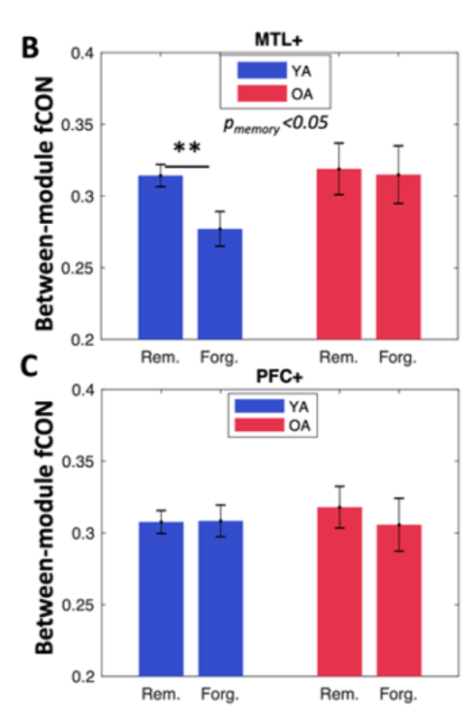
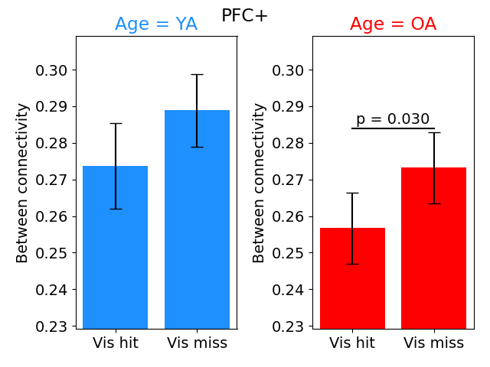
Figure 16B & 16C

Slide 7
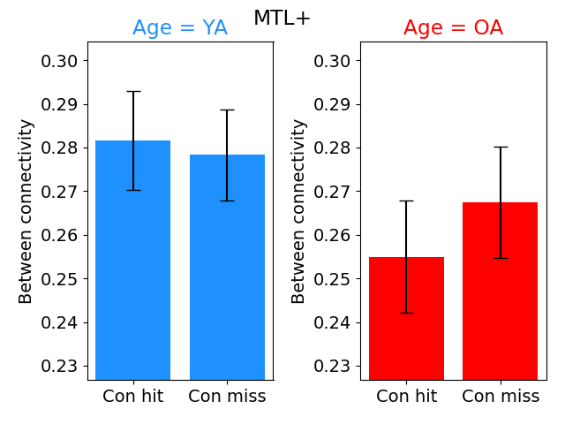
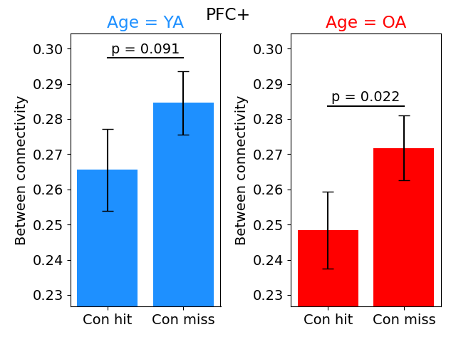
Figure 16B & 16C

Slide 8
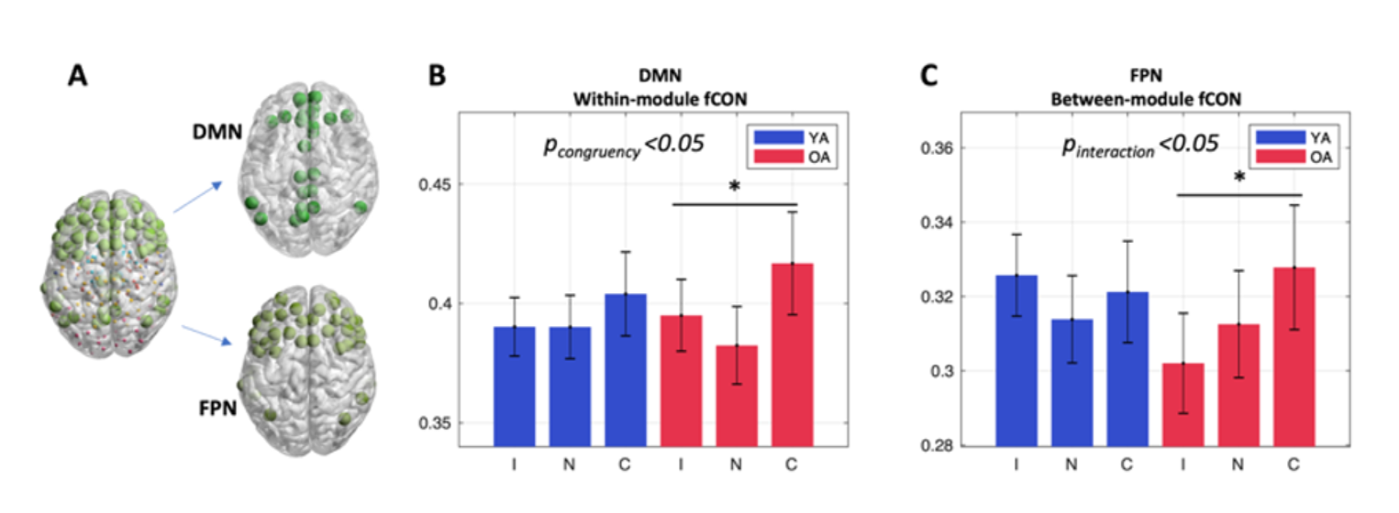
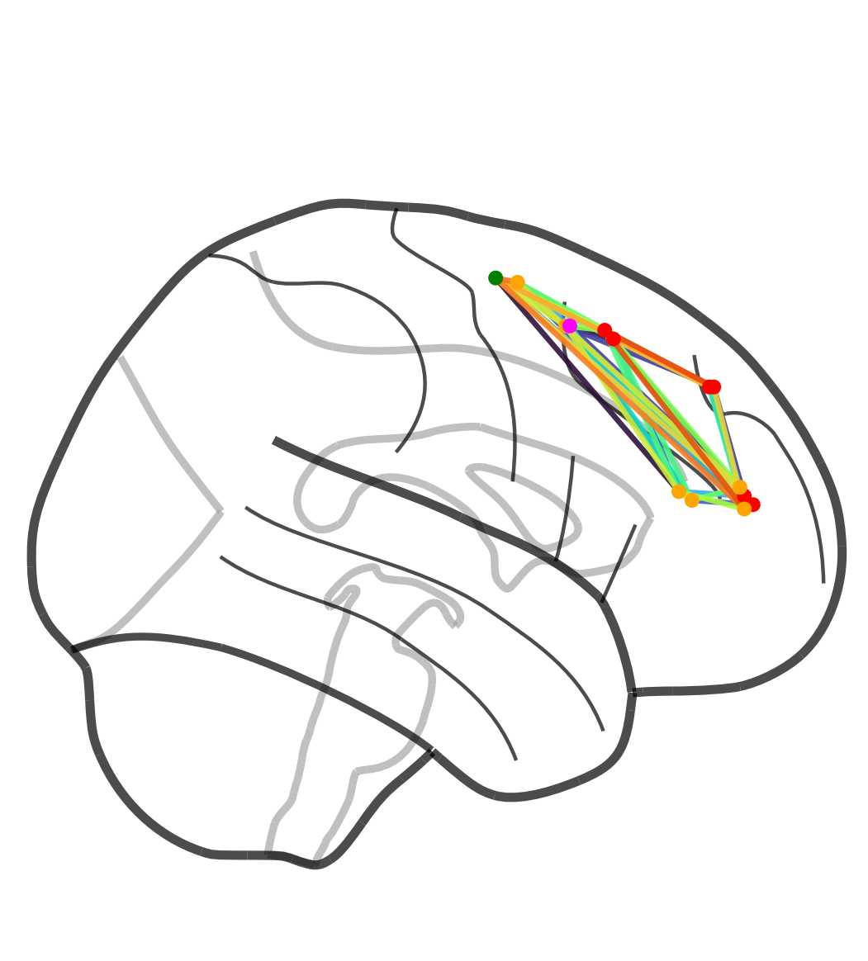
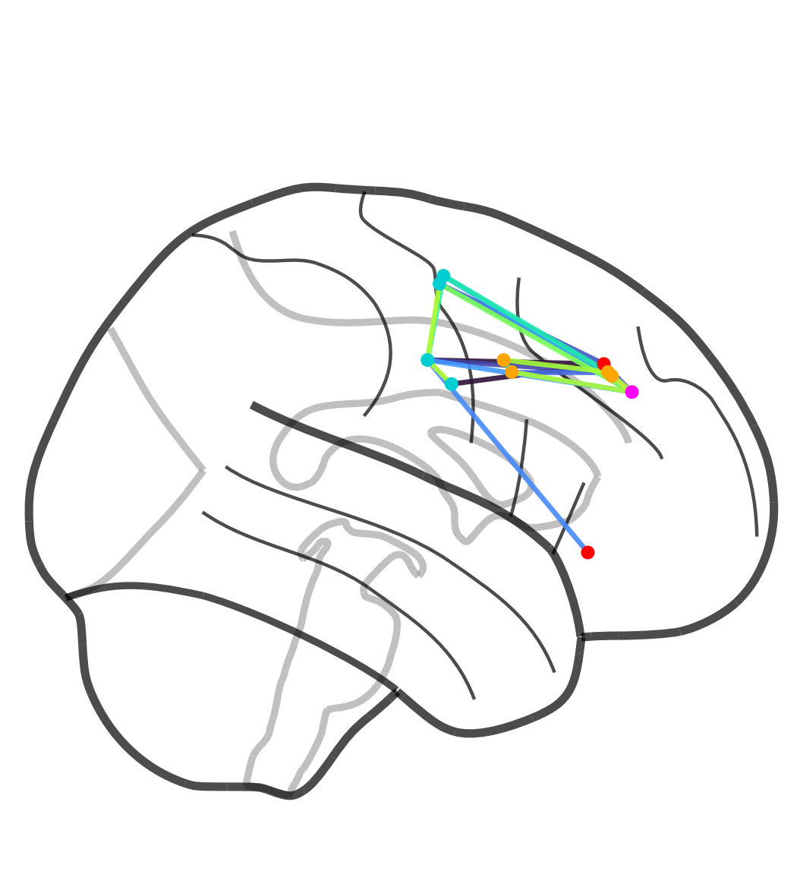
Figure 17

Slide 9
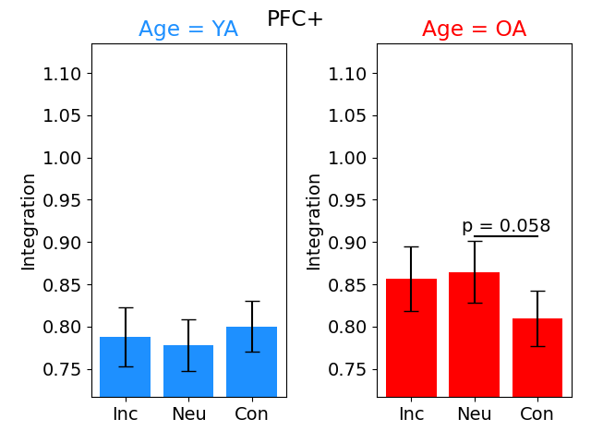
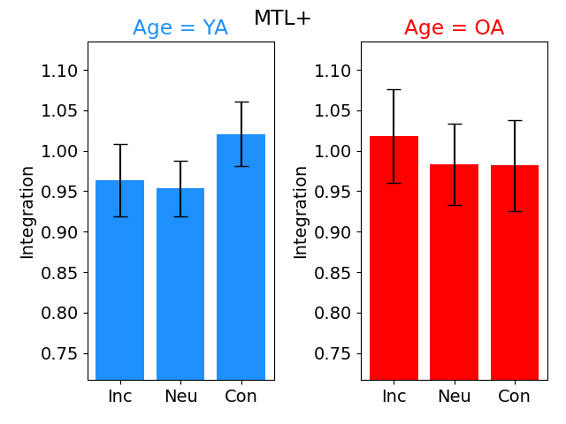
Figure 17
Notes:
It is somewhat weak (only p < .05)
Procedure may be seen as cherry picking (effects specific to one sub-module and effects rely on either within vs. between vs. integration)
Given this, I don’t think it’s a major loss that this result didn’t remain

Slide 10
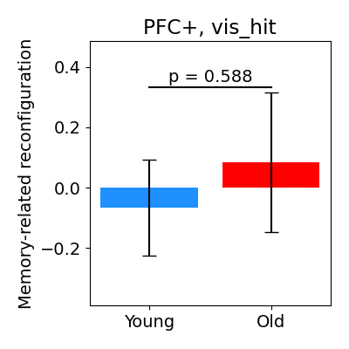
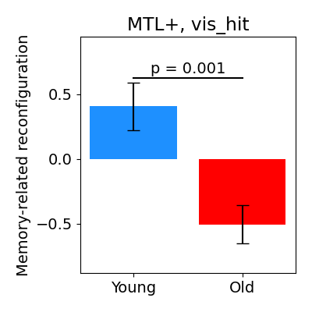

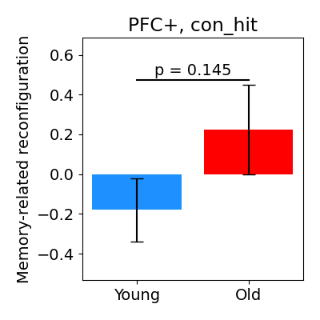
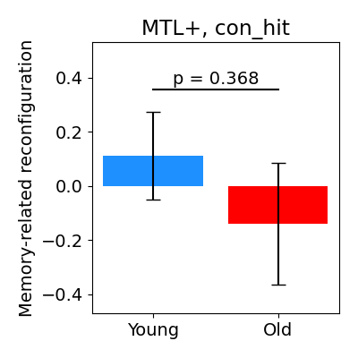
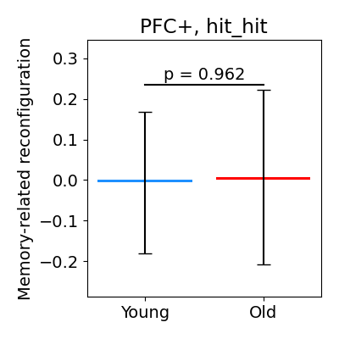
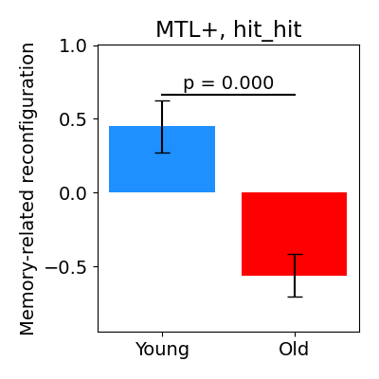
Figure 16A
Methods
Measure, for each subject, the correlation between their connectivity for hit trials x connectivity for miss trials
Lower correlation = more reconfiguration
Hence, a higher score here for YA relative to OA means that YA show greater effects of subsequent memory on connectivity
Using “z-score” as the unit is mysterious

Slide 11
Problem: YA show more variance in MTL connectivity
Analysis: Measure reconfiguration while randomly assigning trials to “hit” or “miss”
Consistently get a reasonably strong YA effect
  (mean difference = 0.10, Cohen’s d = .40)
Hence, the results on the previous slide are because young adults generally just show more variability in their MTL connectivity
  This is interesting, but it’s not a memory effect
  ☹

Slide 12
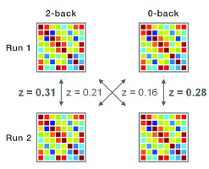
Getting around this issue
Split remember trials into odd/even and forgotten trials into odd/even
With this layout, measure the similarity between R-F while controlling for R-R and F-F similarity
Essentially, measures the degree of “reconfiguration” between two conditions while controlling for the amount that would be expected solely due to chance
Null results
Remember
Forgotten
Odd
Even

Slide 13
Classification-based analysis
Analyze each participant independently
  Fit a classifier attempting to label some condition (e.g., Incongruent vs. Congruent)
  Create one example per trial
  For connectivity

Slide 14
Fitting a classifier
Activation based classifier on Schema (I vs. N vs. C) for object betas yields a significant MTL classification (35.1%) in older adults (t = 4.0) but not younger adults (t = 0.26)
  Whereas both show effects in PFC and Visual
Generally, both YA and OA seem to show schema-related effects in the PFC
  However, OA also show schema effects across the brain (MTL + Visual)

Slide 15
Fitting a group-cv classifier (object betas in encoding task)
Connectivity-based classifier predicting I vs. N vs. C or I vs. C
  YA and OA in PFC
  Neither in MTL
  OA only in Visual
  Ergo, larger effect of schema congruency on connectivity within the visual lobe
Activity-based classifier
  YA and OA in PFC
  Maybe OA in MTL
  OA only in visual

Slide 16
Various difference due to memory effects
Using a classifier approach
No OA vs. YA differences stood out to me, but I did not closely look as I’m not sure if they would be considered interesting

Slide 17
What are we left with?
MTL is linked to higher integration than PFC
  No YA vs. OA differences
MTL is linked to greater inter-trial variability in its connectivity patterns for YA
  MTL is linked to stronger memory-related reconfiguration for YA
Subsequent memory is linked to weaker connectivity between the PFC and MTL with other brain areas
  No YA vs. OA differences

Slide 18
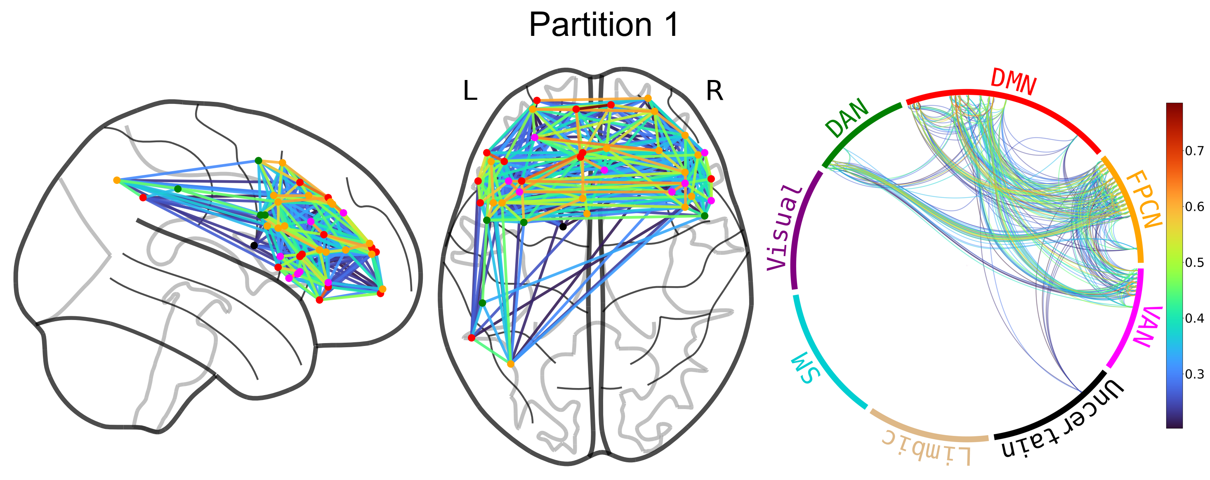
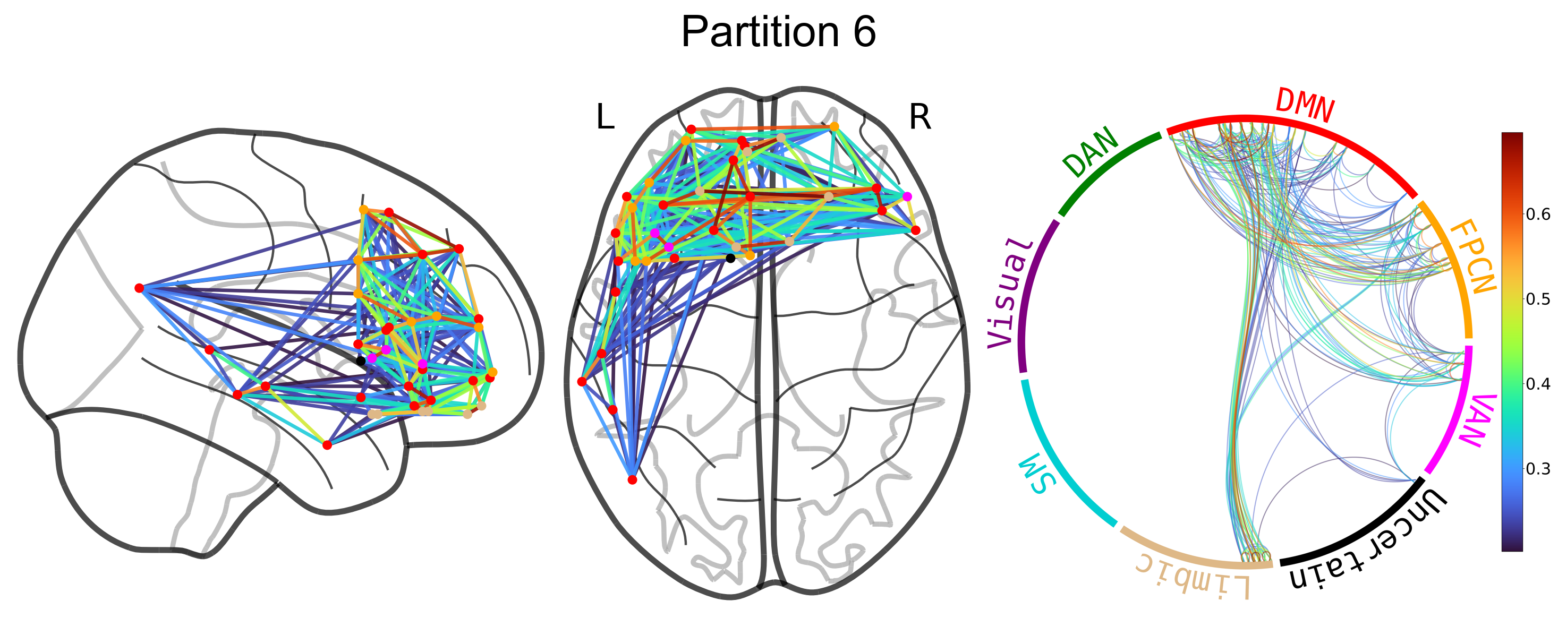
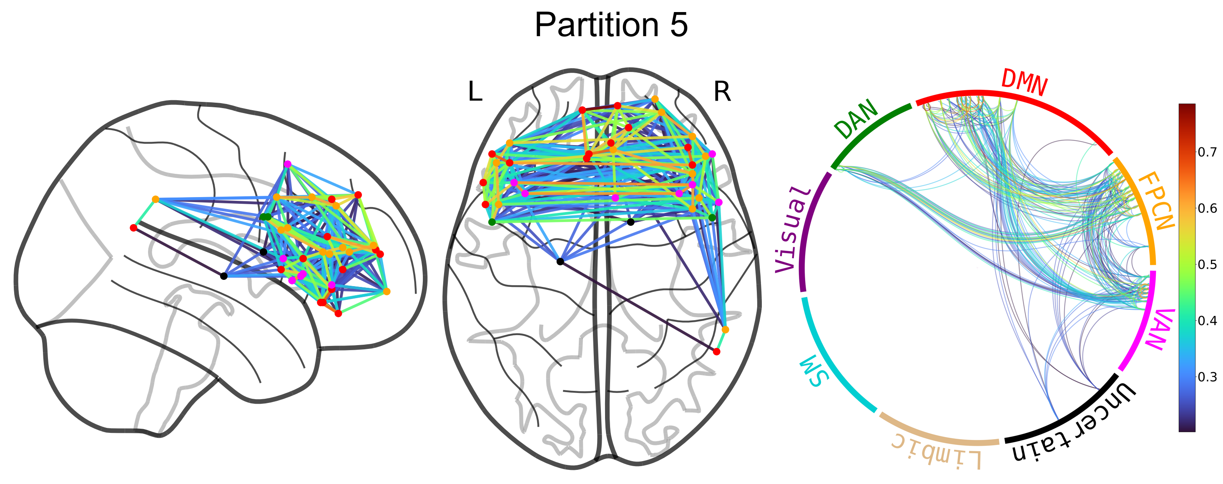
Overlapping modules

Slide 19






Behavioral results

Slide 20
End

Slide 21
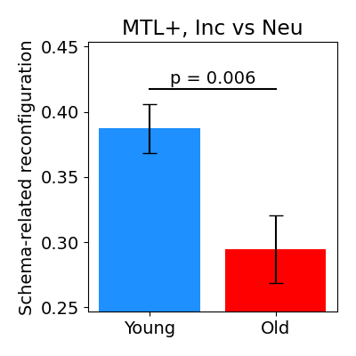
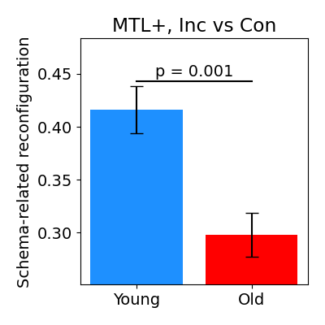
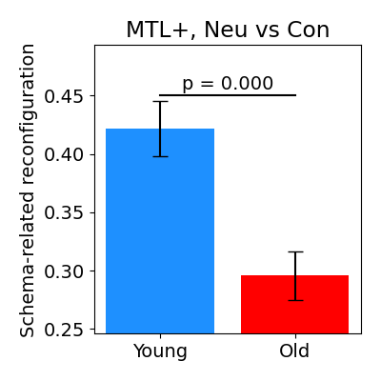
Proposed result: Schema-related reconfiguration
Similar to the memory-related reconfiguration analysis from before but now looking at the correlation between connectivity associated with Incongruent vs. Neutral vs. Congruent
YA show larger effects of schema congruency on MTL connectivity

Slide 22
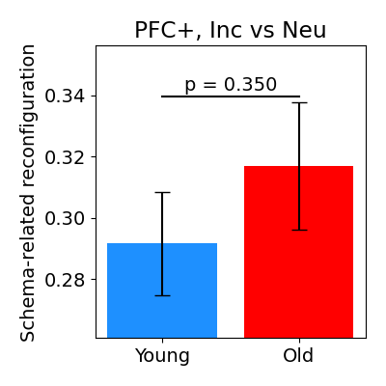
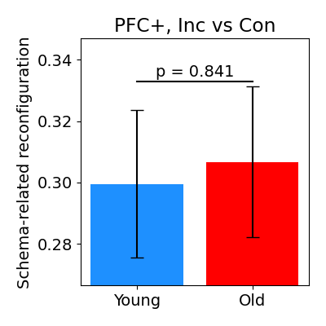
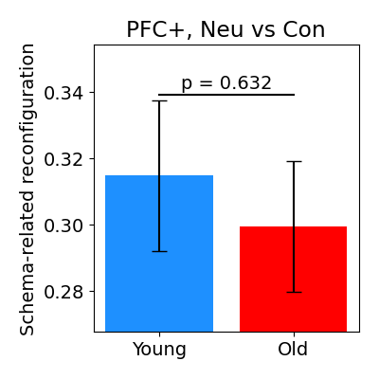
Null effect on PFC

Slide 23
Sanity test: Ensure that YA don’t simply show more MTL reconfiguration between random trials
Trials were randomly organized into Incongruent/Neutral/ Congruent
  Mean dif = 0.08 (SD = 0.02), d = 0.34 (SD = 0.085)
Randomly split Hit/Miss
  Mean dif = 0.10, d = 0.42

Slide 24
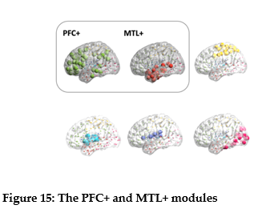
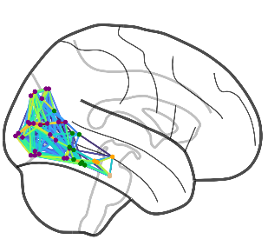
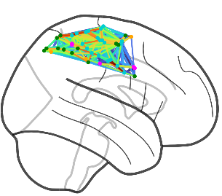
Figure 15A

Slide 25
