Slide 1
Paul Update
(now, with results now)
11/12/2023

Slide 2
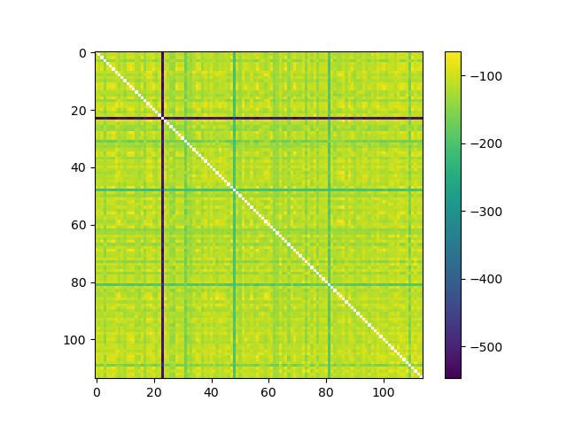
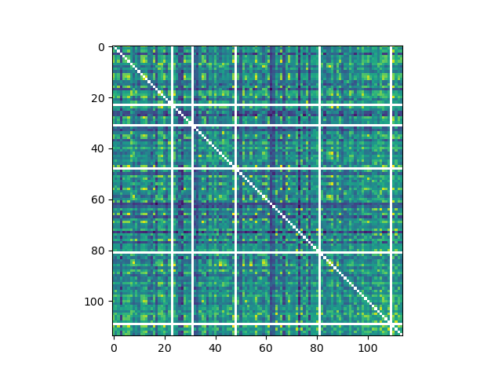
Big outlier if looking at Euclidean dist

Slide 3

3-session fMRI study (SchemRep)
Baseline: rated image-label typicality for objects
Encoding: Presentation of scene and object. Rated how likely one is to find the object in the scene
Retrieval: conceptual old/new followed by visual old/similar/new

Slide 4
Standard way to mix RSA and connectivity
Informational connectivity:
  Create fMRI RDM for each ROI
  Measure RDM_{ROI-0} x RDM_{ROI-1}
  Difficult to interpret
    Roughly: When one region strongly represents a stimulus, another region will also tend to strongly represent the stimulus
    However, this method is model-free (does not incorporate stimulus RDM)
IRAF x IRAF
  Correlate IRAF_{ROI-0} x IRAF_{ROI-1} across trials
  Model-based
    Unlike above, with this, you can discern what stimulus information is represented

Slide 5
Question
RSA is typically thought to identify regions where populations of neurons represent some information
Is information also represented based on signals between regions?
  Informational connectivity methods do not probe this
  Informational connectivity analyses attempt identify pairs of regions that are related in how their neural populations represent information
  Here, I wonder whether information is represented as communication within a network

Slide 6
Methodological issue
RSA requires making a neural RDM
  RDM requires measuring similarity in neural responses between every trial and every other trial
  Hence, we must measure be able to quantify each trial’s neural response
  However, functional connectivity is generally measured as a Pearson correlation over the course of multiple trials
    Thus, Pearson correlations can’t quantify the extent of connectivity in a single trial
Notes:
Can alternatively be roughly framed as an interaction effect
This quantity is orthogonal to simple beta activation

Slide 7
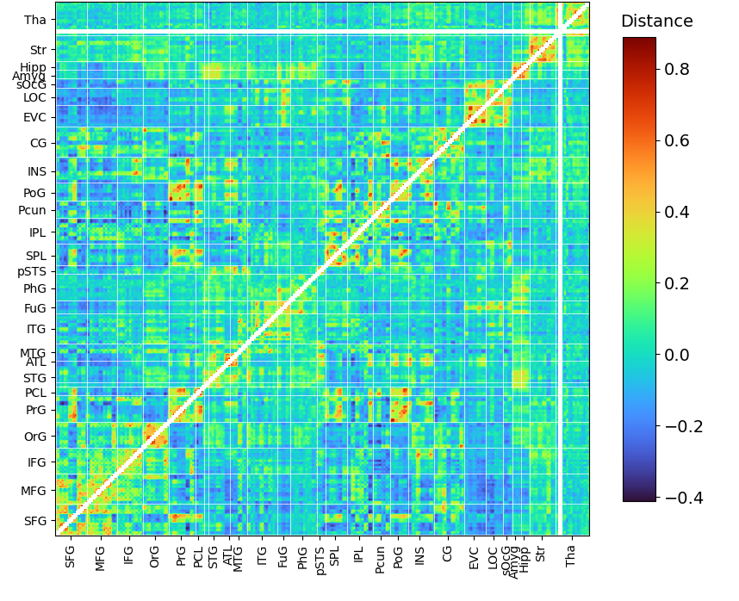
Single-trial connectivity
Region 1
Strongly
connected
Hence, I measured “connectivity” in terms of Euclidean distance
  In a given trial, if ROI-0 beta = 4.0 and ROI-1 beta = 2.5, then the connectivity is 1.5
To stick closer to a traditional Pearson correlation, connectivity can alternatively be defined as the product of standardized values.
  If ROI-0 (std) = 1.0 and ROI-1 = -0.5, then connectivity = -0.5
Region 2
Notes:
Can alternatively be roughly framed as an interaction effect
This quantity is orthogonal to simple beta activation

Slide 8
Model-free and model-based analyses
Model-free analysis
  Measure between-session similarity
  E.g., similarity between occipital connectivity in baseline and object
Model-based analysis
  RSA
Similarity
RSA
Stim RDM

Slide 9
Many sessions
Increase power by using data from 3+ sessions
  Consider sessions: (a) baseline, (b) encoding, (c) visual retrieval
  Similarity measured for a-b, a-c, b-c and averaged
  RSA calculated for a, b, c and averaged
  Debatable whether it would help to add (d) conceptual retrieval
Combining data for multiple sessions is what let me get this off the ground
RSA
Similarity
RSA
[
RSA
Notes:
Could measure connectivity between session

Slide 10
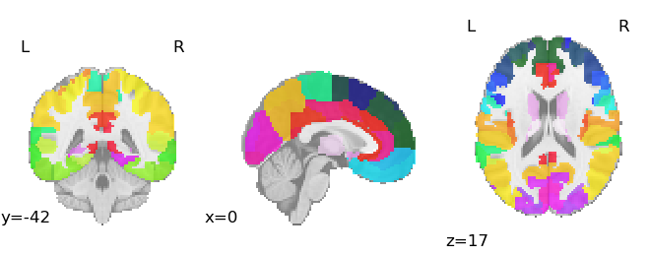
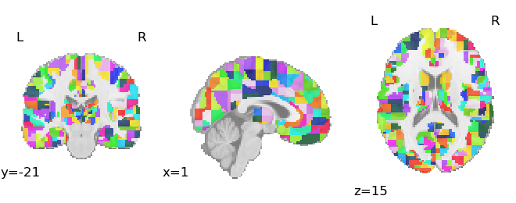
Splitting ROIs
Brainnetome atlas has 246 ROIs
  This number is typically plenty, yet is limited for investigating connectivity within a region
  E.g., only 8 LOC ROIs
I explored splitting the ROIs into 8ths
  Octants

Slide 11
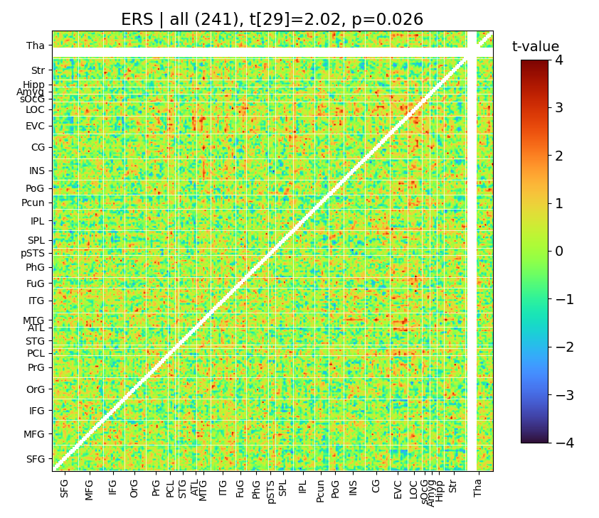
Between-session similarity
Model-free analysis of representations
Does the same object elicit similar connectivity patterns each time it’s shown?
  Yes, it does
Connectome-wide: t = 2.02
Connectivity among occipital ROIs: t = 3.69
  LOC, EVC, Superior occipital
Connectivity among ventral stream ROIs: t = 2.98
  Dorsal stream is null (t = -0.70)

Slide 12
Conclusion
Representations do not just exist at the level of neural populations
Occipital results
  Connectivity between subregions
  Shows that representations cover wider a volume than typically believed
  I previously identified similar patterns in analyses using the Human Connectome Project dataset
PFC-occipital results
  Interesting?

Slide 13
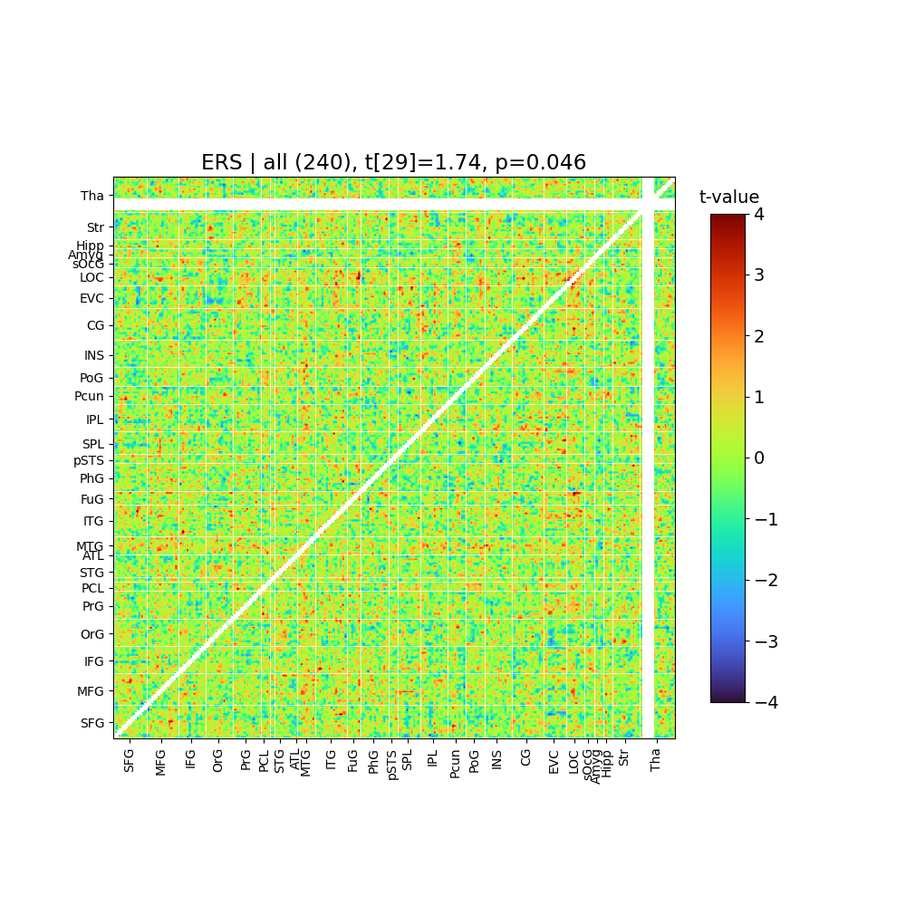
Between-session similarity
(connectivity as multiplication)
Model-free analysis of representations
Does the same object elicit similar connectivity patterns each time it’s shown?
  Yes, it does
Connectome-wide: t = 1.74
Connectivity among occipital ROIs: t = 3.71
  LOC, EVC, Superior occipital
Connectivity among ventral stream ROIs: t = 1.7
  Dorsal stream is weaker

Slide 14
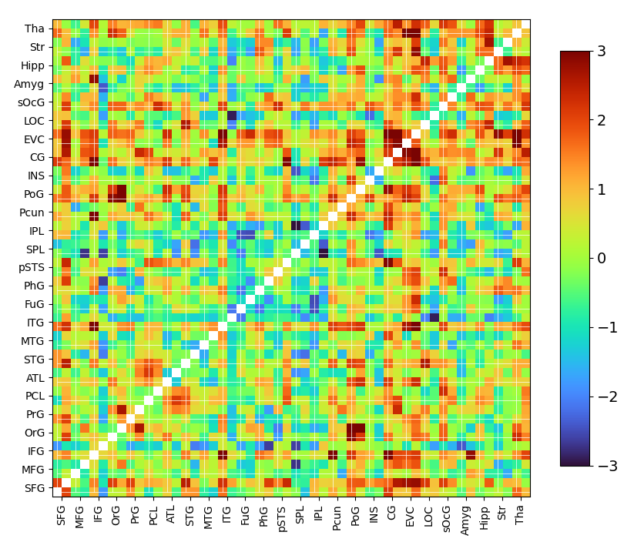
RSA
(connectivity as multiplication)
Connectome RSA
  Perceptual RSA: t = 2.7, p = .01
    Significant regardless of whether ROIs are grouped by region (e.g., average all four L LOC ROIs) or analyzed independently
    Semantic RSA never significant
Effects primarily linked occipital-occipital
  Within-occipital
  PFC-occipital
  Subcortical-occipital?
    Basal ganglia & thalamus

Slide 15
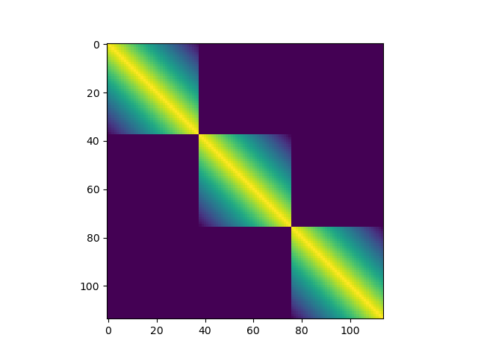

Slide 16
Next steps
Compare YA vs. OA

Slide 17
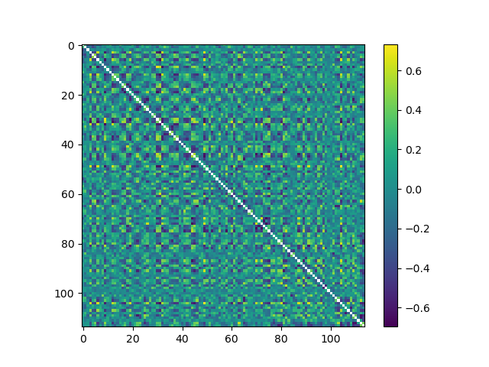
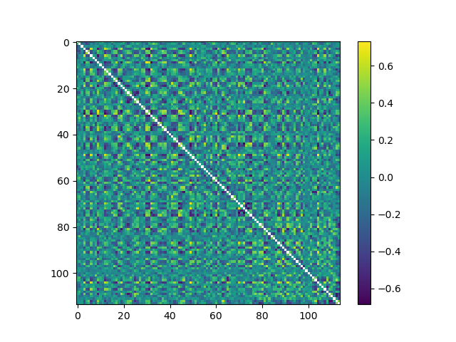

Slide 18
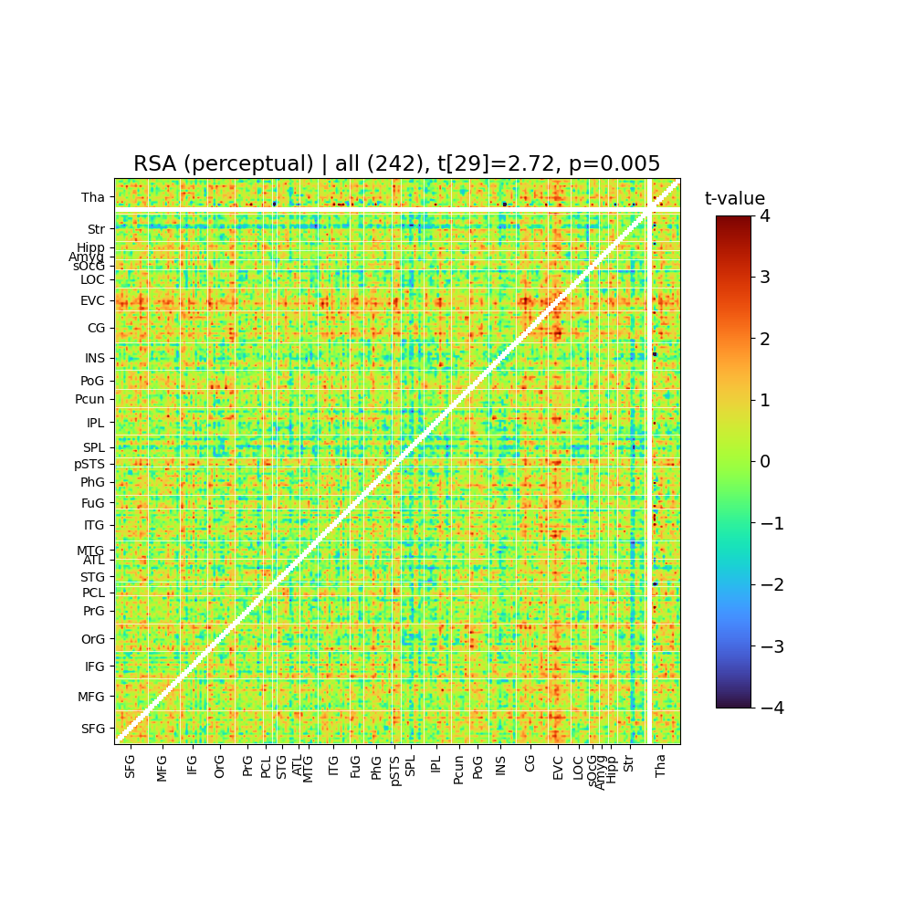

Slide 19
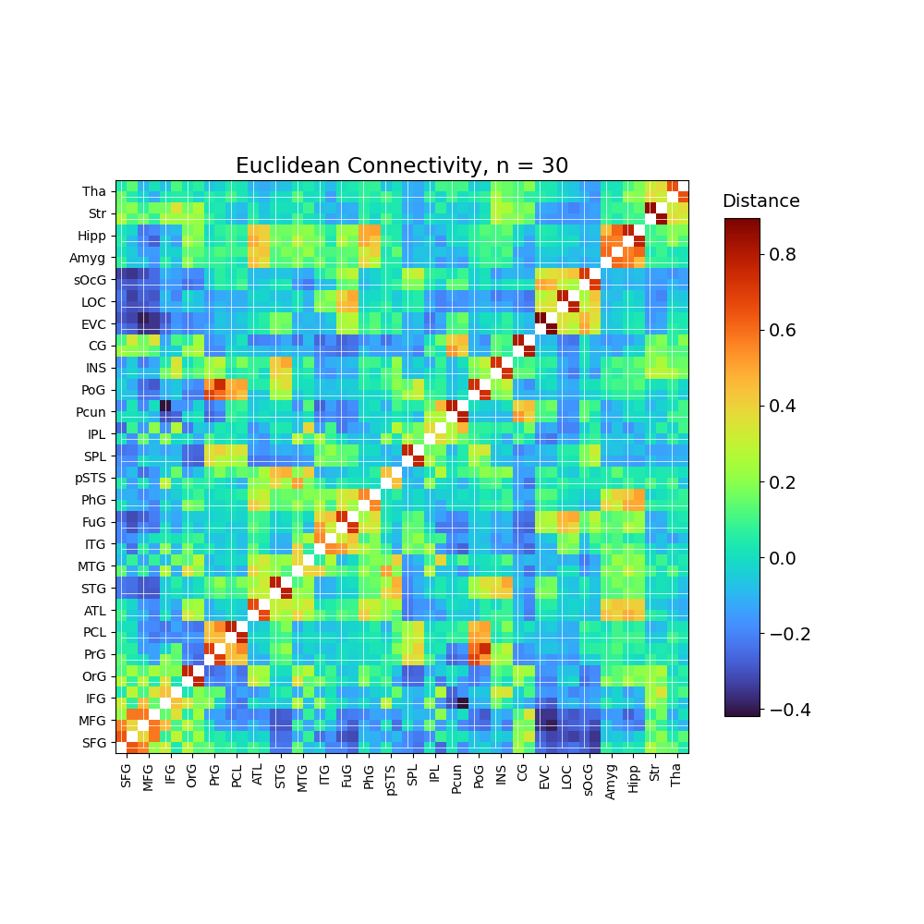

Slide 20
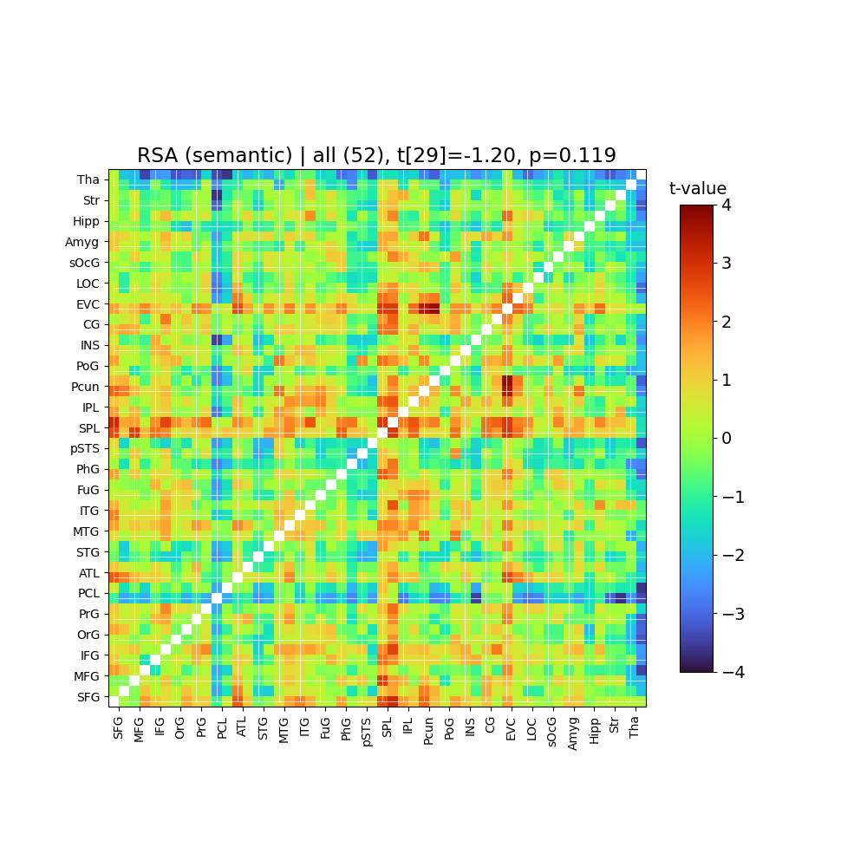

Slide 21
Power
To increase power, average across multiple analyses with the same stimuli

Slide 22
Paul Update
10/3/2023

Slide 23
Edge-based connectivity RSA
Goal: Measure whether the connectivity patterns linking a pair of regions is linked to a model RDM in some way
IRAF x IRAF connectivity
Triple-connectivity RSA
  This “triple correlation” measures whether the product of X & Y is linked to high Z
    Calculate: E[XYZ] – E[X]E[Y]E[Z]
  i.e., measure whether model similarity (between trials 1 and 2) is linked to regions A and B both also showing similarity or neither showing similarity
Region-product RSA
  Typically neural RDMs are calculated based on vectors representing BOLD activity for a given trial in one ROI
  Here, I selected pairs of ROIs and calculated the elementwise products of their vectors
    e.g., if vector A has 100 elements and vector B has 50 elements, then the product vector has 5000 elements, and it can be used to calculate the neural RDM
  Also tried the elementwise absolute differences

Slide 24
Network-based connectivity RSA
Goal: Measure whether the connectivity pattern among a set of regions is linked to a model RDM in some way
  e.g., are perceptual features represented in the connectivity between 20 different occipital sub-regions?
  If it is possible to measure connectivity on a single-trial basis, then you could create a neural vector based on just the 190 connections among the 20 regions, then use that to create the RDM
    However, it is unclear how one could measure connectivity for a single trial, given that connectivity is a relationship over time, but a single trial is generally seen as a single time point
To calculate single-trial connectivity, I tried:
  For the encoding session: Measuring the correlations between single-trial beta for scene presentation x object presentation
    Correlation between two time points. This will always yield -1 or 1
  For the baseline session: Taking the four TRs following object presentation, and measuring connectivity among those
  Region product procedure
  Along with attempting RSA, I tried using this single-trial approach to measure item-wise similarity between baseline and encoding responses (analogous to encoding-retrieval similarity)

Slide 25
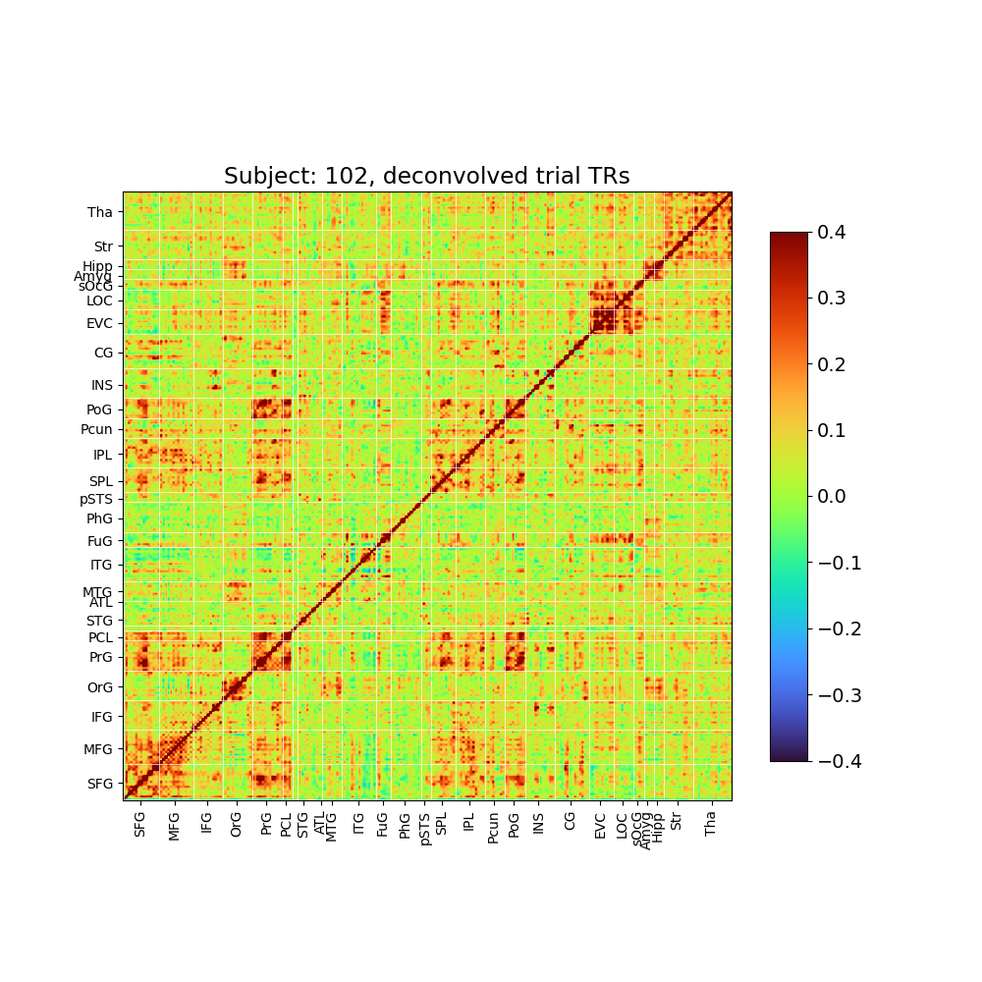
Single trial connectivity
The method I used (4 TRs in each trial) yields reasonable networks
  Averaged across all trials

Slide 26
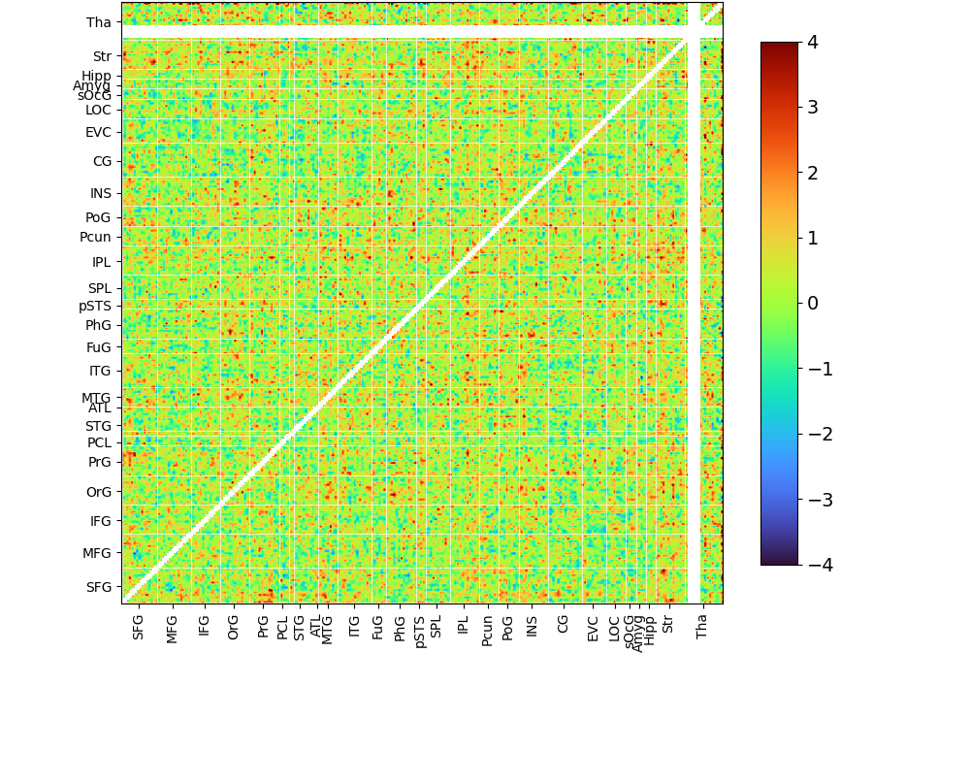
RSA based on connectivity strength of a single edge
Semantic shown here
>:|

Slide 27
Justifying the use of the SchemeRep data specifically
The SchemeRep dataset shows the same stimulus multiple times

Slide 28
Some analyses

Slide 29


Significance testing and permutation testing
Investigated whether current multiple hypothesis correction strategies are too strict, via doing permutation-testing
Notes:
This may be of general interest: You know how the RSA values (z-scores and IRAFs) between regions seem to be spatially correlated (neighboring regions are similar). This violates assumptions of independence. This violation may mean that multiple hypothesis correction methods may not be appropriate, and FWER corrections will be too strict. I explored this question in the SchemeRep data. The data can be split into either 45 large or 222 smaller ROIs meaning 45 or 222 comparisons*. I did a permutation-testing analysis, where I shuffled every trial, meaning that every trial’s fMRI data is matched with random stimulus data. I only shuffled within-run (e.g., moving Run 2 trial 1’s fMRI data to the Run 2 trial 5 position), to avoid issues related to within/between run RSA. The RSA analysis, for each ROI, entailed doing the fMRI_RDM x stim_RDM correlation, and submitting each participant’s score to a one-sample t-test, examining whether it is significantly above zero. I did this 2000 times for the analysis of 50 ROIs and 760 times for the analysis of 250 ROIs.
I plot here, in red, the maximum t-value seen across any ROI, for a given simulation. For reference, I also plot in green what would be expected if each ROI’s analysis independent from each other ROI’s analysis (this parallels the t-value threshold required after Bonferroni correction). We can see that the red line is slightly lower than the green line but not by very much (e.g., Bonferroni correction would require t = ~3.3, but the simulation suggests that t = ~3.15 is sufficient for FWER correction). In blue, I also tried modeling the red line to gain some intuition for its shape. It basically models the t-values by sampling from a multilevel model using variance settings measured from the simulated data.
In sum, standard multiple hypothesis correction techniques are basically fine. However, if your results are just barely falling under a standard FWER threshold, they may end up significant if permutation-testing is used. It’s not clear to mean what implications this would have for FDR correction.
*Note, I’m using the brainnetome atlas and 222 is slightly less than the number of ROIs in the brainnetome atlas. This is lower because I simply discarding ROIs where one or more participants have too many nan values.

Slide 30
RSA with functional connectivity
RSA depends on trial-level measurements
  E.g., single-trial betas
  Needed for measuring similarity between trials
How can connectivity be calculated for a single trial?
  Baseline session trials involve the presentation of an image and are 8 seconds long
  I tried taking the 3-4 TRs following an image and measuring connectivity based on that
    Attempted to perform RSA based on occipital connectivity
It did not work
  Potentially, the analysis was just too crude, as I simply took BOLD activation and did not fit any GLM
  In either case, in testing this, I took a close look at the file structure and Shenyang’s single-trial beta code. I couldn’t find any bugs

Slide 31


Modularity
Replicate modules identified by Lifu

Slide 32
Task idea
10/30/2023

Slide 33

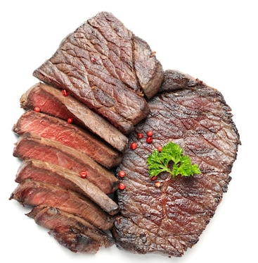
What are we doing?
What memory processes are tested?
  Participants are not encoding “steaks are made from cows” or “steaks and cows are related”. They already know this
    Formally, participants have already formed a relation between their cow schema and steak schema (mPFC process)
  Possible mechanism relevant to the retrieval question “What picture was shown near this cow in the encoding session?”
    Requires link between this instance of a cow and this instance of a steak
      Represent this instance of a cow in the perirhinal cortex (PRc)
      Represent this instance of a steak in the perirhinal cortex (PRc)
      Bind the two via the hippocampus
    Alternatively, requires participants to update their cow schema and steak schema to include an additional relation: “were presented together in the encoding session”
What does RSA do?
  We are not measuring the neural correlates of encoding the relation “steaks are made from cows”
  Rather, RSA measures the neural correlates of when the relation is:
    activated,
    used for encoding,
    retrieved
Encoding
Retrieval
?

Slide 34
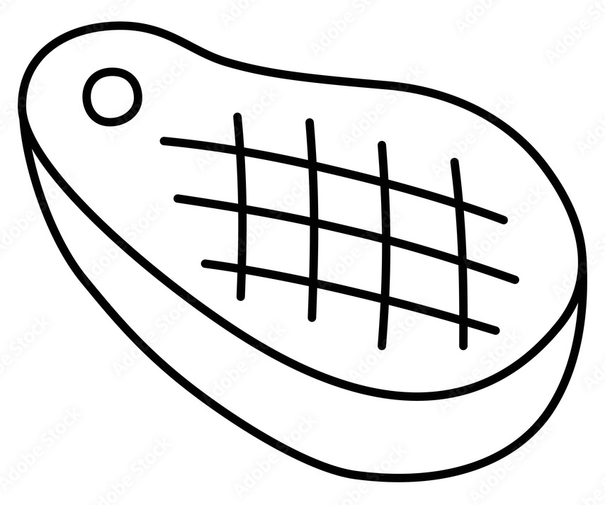

Possible Mechanism 1 & RSA
mPFC
Relations encoded within the mPFC likely have a meaningful structure.
If our task reactivates these relations, then they can likely be investigated with RSA
(schemas)
Hippocampus
However, it’s less clear whether the meaningful structure also arises in these new hippocampal relations
Assumption that the mPFC structure bears relevance to the perirhinal structure
Perirhinal cortex

Slide 35
Three types of relational memory tasks
Novel items
  Pair fractal 1 & fractal 2
  Relations must also be novel
Known items + novel relations
  Pair cow & hat
  Memory accuracy can be based on relations formed between item schemas or item instances
Known items + known relations
  Pair cow & steak
  Memory accuracy must be based on relations formed between item instances

Slide 36
Encoding task
“Cue”
Some pairs are related, some are unrelated
Each cue appears once
Each target is paired with three cues
+
“Target”
Presenting on different screens deters unitization, but does this make the task too hard for OAs?
Target position may vary (e.g., left/right). This creates another dimension (spatial relation) that can be tested.
Because targets appear multiple times, then the target’s position relative to the cue image must be a relation and “position” can’t just be encoded as a feature of the item
Response

Slide 37

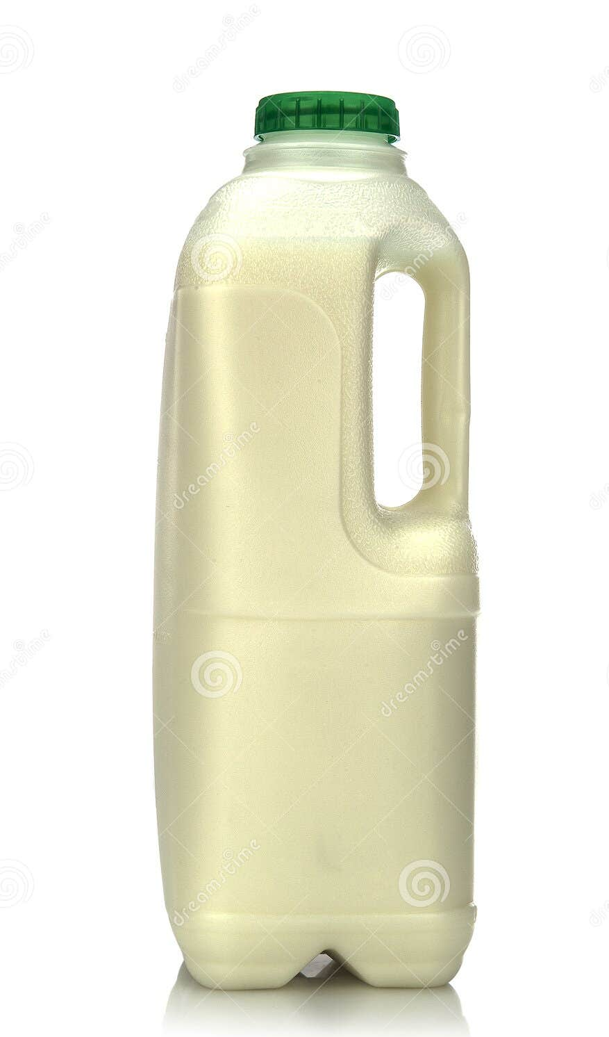
Retrieval task
Cue
Is pair related?
Select pair
Yes / No
Pair position?
R/K/N or Old/New
Left / right /
above / below
Foils are related & old
Must avoid participants simply using logic to answer the pair without memory
  If participants were previously cued with a chicken and retrieved drumstick, when they are cued with a cow, we want to avoid them reasoning that the pair must be steak (especially if participants know steak was shown at one point during encoding but don’t have memory for its pair)
To do this, the encoding task is designed such that the full set of target images includes three options that are related to each cue
  E.g., the targets included a barn and a milk container, which can serve as foils in the retrieval test
Could also ask about temporal order between cue and target
However, it is possible that participants encoded this information as a cue feature (i.e., encode “cow appeared first” rather than “cow appeared before steak”).
This isn’t a problem for the spatial test because the cue is always centered, and the target position varied depending on which cue it was paired with

Slide 38
Extra test before the main retrieval task
Before the retrieval scanning, participants complete an Old/New test for the target images
  Priming participants with these may improve performance on the relational memory test
  Also, given that the targets will be shown three times during the retrieval test, there could be differences between the 1st time they appear vs. 2nd/3rd times
    Presenting the images in an Old/New test beforehand mitigates this issue

Slide 39
Multiple RDMs
Type of analogy hierarchy:
  Functional
  Characteristic
Position:
  Whether the target appeared below/above/left/right?
Target identity
  Target similarity (based on the fact each target is presented three times)
  Target stimulus vector (perceptual/semantic)
Combination vectors
  E.g., absolute difference between stimulus vectors
Notes:
Correlation between spatial IRAF x analogical IRAF =

Slide 40
Real-world relevance
Outside the laboratory, memory encoding has a practical purpose
  We learn the relations between stimuli so that we can reason about them in the future
  The present research gets at that

Slide 41
Task idea 2
10/30/2023

Slide 42

Reinforcement learning and states
Decision-making can be conceptualized as purposeful transitions through different states
  Many cognitive processes are abstracted away, such as perception, and memory
Maps onto neural patterns
  OFC represents state spaces (Schuck et al., 2016, Neuron)
  Unclear how memory systems come into play to support this
Prep for individual meeting
Have
great
meeting
Do work
Have
results
Have
ok
meeting
Morning
Read
book
Watch
TV then
sleep
Have
no
results
Have
bad
meeting
Cry

Slide 43
Multi-part states
In the real world and the brain, states have multiple parts
  Psychological/neural research
  hasn’t investigated this
Morning
  Own TV
  Have preprocessed data
  Etc.
Where does memory fit in?
  Literally, in this diagram, where does memory
  operate for learning and decision-making?
Own
TV
Have
data
Sunny
Prep for individual meeting
Have
great
meeting
Do work
Have
results
Have
ok
meeting
Morning
Read
Watch
TV then
sleep
Have
no
results
Have
bad
meeting
Cry

Slide 44
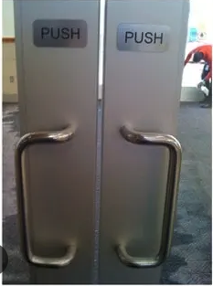
Affordances
Affordances:
  Idea that objects in the world are perceived in terms of what actions they make permissible
  This door design is bad because it is meant to be pushed yet the handles allow pulling
State framing:
  Affordances are features of a state that define which actions (transitions) are available to go toward another state
  I need to own a TV in order to watch TV
Sunny
Have
data
Own
TV
Prep for individual meeting
Have
great
meeting
Do work
Have
results
Read
book
Have
ok
meeting
Morning
Watch
TV then
sleep
Have
no
results
Have
bad
meeting
Cry

Slide 45
Goals
Goal:
  Something you value
  People perform actions to achieve goals
R&S
pleased
Ready
to write
paper
Tired
Prep for individual meeting
Have
great
meeting
Have
results
Read
book
Have
ok
meeting
Morning
Watch
TV then
sleep
Have
no
results
Have
bad
meeting
Cry

Slide 46
Affordances
Affordances:
  Idea that objects in the world are perceived in terms of what actions they make permissible
  For example, this door design is bad because it is meant to be pushed yet the handles allow pulling
State framing:
  Affordances are features of a state that define which actions (transitions) are available to go toward another state
  I need to own a TV in order to watch TV

Slide 47
Episodic memories
Episodic memories, to me, often feel “active”
  When I recollect an experience, I don’t just see a collection of stimuli in my mind’s eye
  I also recollect what I was doing and/or what led to the experience
  This would suggest that typical research on episodic memory is missing a fundamental element
In some way, this feels related to episodic simulation (reasoning/planning)
  Inference about how one experience leads to another
Prep for individual meeting
Have
great
meeting
Have
results
Read
book
Have
ok
meeting
Morning
Watch
TV then
sleep
Have
no
results
Have
bad
meeting
Cry
Notes:
Do between-experience links differ from within-experience relations?

Slide 48
Question: Scenes
How are items bundled together into scenes?
  I’m using “scenes” to refer to a group of items presented together

Slide 49
Question: Individual relations
How are relations encoded?
How is spatial information on the connection encoded?

Slide 50
Question: Recollection and episodic memory
When participants recollect, what exactly are they retrieving?
  What is an “episodic memory”
  Is information about the action leading up to it included?
?
?
?
Notes:
Downside because participants will need to be trained

Slide 51
Question: Semantic memory

Slide 52
Question: Actions
How are actions represented?
  Semantic memory encoding: Actions are encoded based on the states they change
  Episodic memory encoding: Actions encoded as a transition from one scene to another
  How do the neural representations of actions interface with the representation of states or scenes

Slide 53
Question: Affordances
How do affordances operate?
  Test whether activation of a given item representation leads to activation of its associated action representations

Slide 54
Question: Goals
How do representations of items interact with neural mechanisms for values/goals
  Less novel question

Slide 55



General task idea
Basic scheme:
  Learn phase:
    Explore and pursue goals
    e.g., goal = “Find the robin”
    Randomly move at first but learn steadily
  Memory test phase
Avoid excessive difficulty
  Learn + memory are done as pairs of runs
  If a session has six runs, then that’s three independent learn + memory runs
Environment
  Environment doesn’t have a start or end.
    Just a bunch of interconnected connected scenes
  10 scenes made up of 15 items
  5 or 10 actions, depending on button box options
Memory test
  Challenge: Participants will encounter the same pictures and scenes multiple times
  This may make retrieval too easy
  This also raises concerns about testing R/K
Press 2
Press 5
Notes:
If they visit multiple times, then R/K is questionable

Slide 56
Other idea
Can be investigated by incorporating a decision-making element that links scenes
Make a link between the current images and the actions afforded
  E.g., blue circle being in a scene increases the likelihood of pink square action
Assign values to some shapes?
Notes:
Evaluate episodic vs. semantic retrieval based on speed?

Slide 57
Old

Slide 58
Episodic memory is intertwined with relational memory
What does it mean to retrieve an episodic memory?
  It entails retrieving a bundle of items, tied together by relational memories
In the R/K test:
  Remember responses reflect episodic memory and can be conceptualized as familiarity + relational memory
The study ideas here focus on episodic memory and relational memory
  To investigate how individuals represent episodic memories and how individuals encode relations between items
  There has been little RSA research investigating this type of complex neural encoding, which goes beyond item representation
  Relational memory is a central focus of aging research
Notes:
Consolidation
Via episodic memory retrieval, a semantic network is built
Possibly also entails retrieving an “action”

Slide 59
Examining relational memory from multiple levels
Spatial and temporal relational memory
  Spatial relations exist among items within a scene
  Temporal relations exist between scenes
Episodic vs. semantic retrieval

Slide 60
Broad aim: Focus on edges and groups not nodes
We do not want to only study how multiple items representations may be active at the same time
  Nor just study how activating one item representation leads to the activation of another item representation
  Not novel enough
Rather, we want to investigate the relations themselves
  Empirically:
    During encoding: Identify the neural correlates of connecting item representations
    During retrieval: Identify the neural correlates of activating a relation, which in turn activates an item representation
  e.g., if two items are represented in the perirhinal cortex, and their association is implemented as connections from each representation to the hippocampus.
    Can we model the hippocampal signatures of the relation being encoded and, later, the relation being activated used during retrieval?
    Can we model an episodic memory as the collection of relations and items
    Can we model the semantic network of relations that form among multiple stimuli?
Central novel design element: presenting some stimuli multiple times

Slide 61
fMRI analysis
How do we investigate the neural correlates of relational memory encoding?
One possible way is with RSA using combination vectors
  Combining stimulus features linked to each items
Alternatively, because some stimuli are presented multiple times, we can leverage this and measure similarity between trials involving associations to the same stimulus
  Participants encode relations Bird-Pizza and Cat-Pizza
  Later, during retrieval, we may see similarity between retrieval of Bird and Cat
    Regions showing similarity indicate areas involved in encoding relations to specific other stimuli
    Need to rule out the possibility that the similarity is due to simply retrieval of the A item representation
  Through this and additional analyses, we can distinguish:
    (1) Regions where specific relations are encoded
    (2) Regions that support relational memory encoding yet do not contain the relations
    (3) Regions where items are encoded
Notes:
This analysis is premised on the idea that (1) how relations are encoded depends on the information being encoded and (2) this contingency is captured by the stimulus features we can model, e.g., with a DNN or word2vec
However, what if relational memory encoding isn’t tracked by our stimulus features
Maybe include a baseline task where participants just see all the targets. This will also help with encoding

Slide 62
Building on this analytic direction
Suppose participants encode eight relations:
  X-A, X-B
  Y-A, Y-B
  Z-A, Z-C
  W-C, W-D
In terms of the relations encoded:
  X is very similar to Y (both connected to A & B)
  X is somewhat similar to Z (both connected to A)
  X shows no similarity with W
Illustrated as an RSM
  Performing RSA using this RSM expands the analysis on the previous slide to work with many stimuli and relations
X
Y
Z
W
X
Y
Z
W
Notes:
(in task design 2, participants may encode X-A, X-B, and B-A simultaneously as an episodic memory)

Slide 63
Ways to extend and interpret these analyses
Participants encode a relational network
  Opens the door for graph theory analysis
  e.g., effects of retrieving stimuli with high centrality
  Parallels that journal club study which involved video clips
Participants encode a map
  Potential links to research on the PPA and spatial memory
    Investigating PPA maps is typically done in rat research, although studying this in humans opens new directions
  Can incorporate directionality (before/after) into the analysis
Episodic memories are a collection of relations
  Hence, these analyses can be thought of as investigating how episodic memories are represented
  Next study idea gets at this more directly
X
Y
Z
W
X
Y
Z
W
Z
X
A
C
W
Y
B
D

Slide 64
(Beyond the task)
Older adults prototype rather than generalize
Prototyping = link stimuli to a previous similar “prototypical” stimulus
Generalization = identifying patterns common across multiple stimuli
May reflect past knowledge influencing encoding
Red = first stimulus presented
Testable behaviorally and via fMRI

Slide 65
Analyzing generalizing and prototyping
5-stimulus group (u, v, w, x, y)
During some experiment phase:
  Measure pairwise correlations among u, v, w, x, and y
  Examine whether the correlations are more consistent with the diagram on the left vs. right
Notes:
u, v, w, x, y

Slide 66
Task: Analogies and relations with meaning
United states
Fried
drumstick
Frosting
Sugar
Chicken
Egg
Cake
Oven
Italy
Pizza
Cheese
Milk
Cow
Steak
Grill
Difficult to probe analogies while avoiding confounds:
  Encoding:
    Oven-Cake :: Grill-Steak
  Retrieval (different tests, similar problem):
    Oven-?A?, Grill-?B?
  Retrieval of ?A? = Cake and ?B? = Steak may elicit similar neural correlates simply due to overlapping features in terms of Cake and Steak (e.g., both edible)
    To pinpoint relationship effect, subtract similarity between Cake & Steak retrieved by non-analogies (e.g., Egg-Cake & Cow-Steak)
Notes:
Focus on true analogies (e.g., “ingredient of” or “cooked in”) and not just overlapping features or category examples
However, this makes the design more challenging
Either way, it would be hard to just look at similarity of analogy processing since it could just be confounded by overlaps in the representations of a given item (e.g., retrieving USA-Fried chicken :: Italy-Pizza, could be confounded by features “country” and “food”)

Slide 67
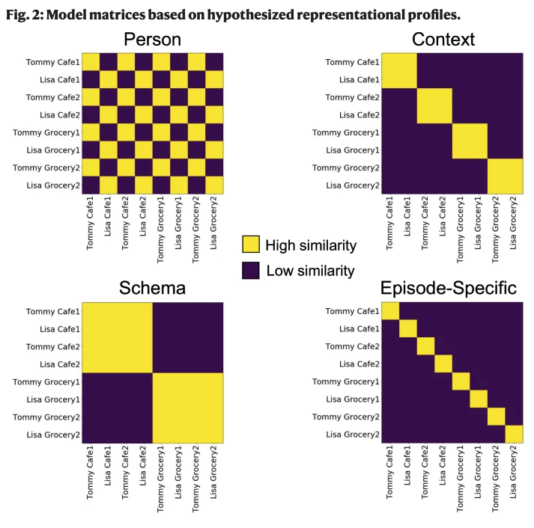
Task
Reagh & Ranganath (2023) presented eight videos, which overlapped in some dimensions
  Character
  Specific scene
  General schema
Could emulate this research

