Slide 1
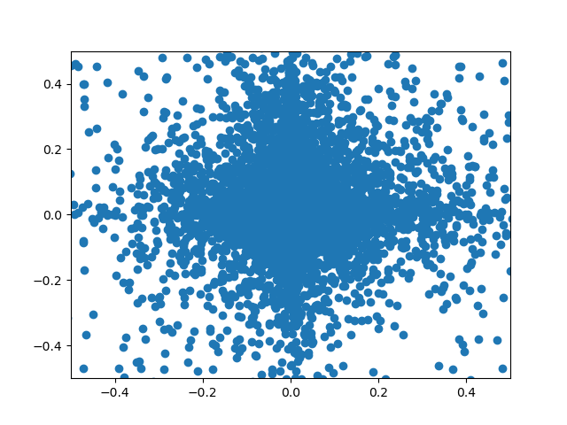
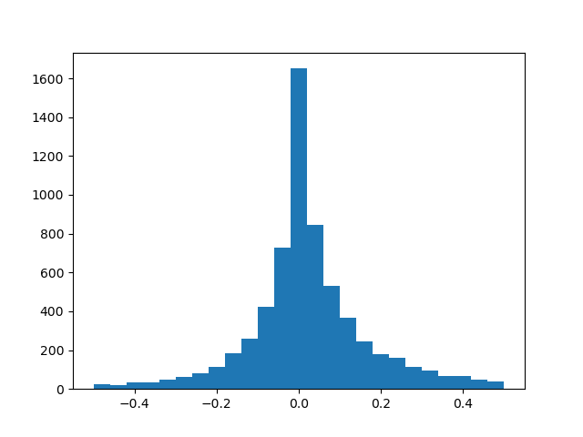

Slide 2
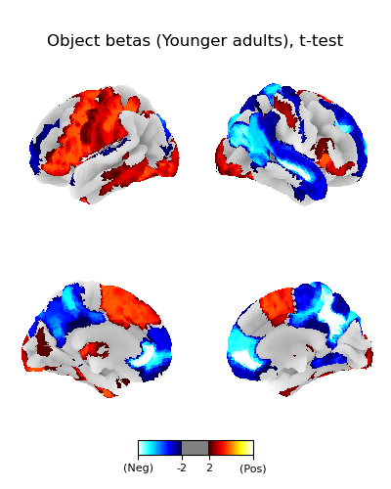
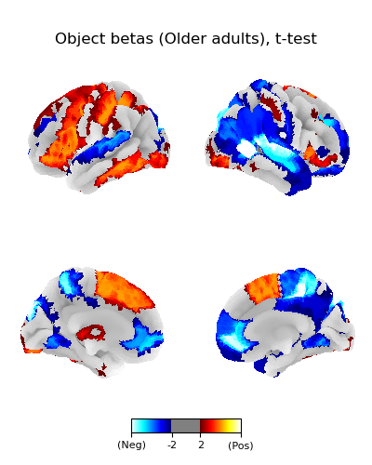

Slide 3
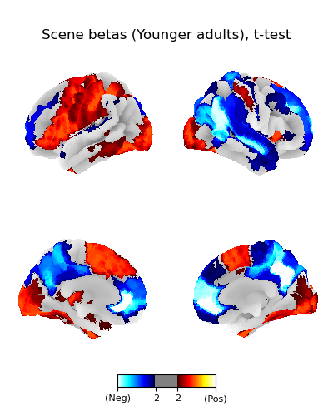
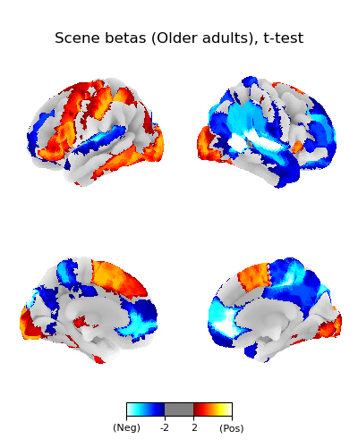

Slide 6
SchemeRep PB
2/2/2024

Slide 7
Incongruency-congruency conn matrix

Slide 8
Modularity algorithm

Slide 9

Quadrants

Slide 10

Outliers

Slide 11
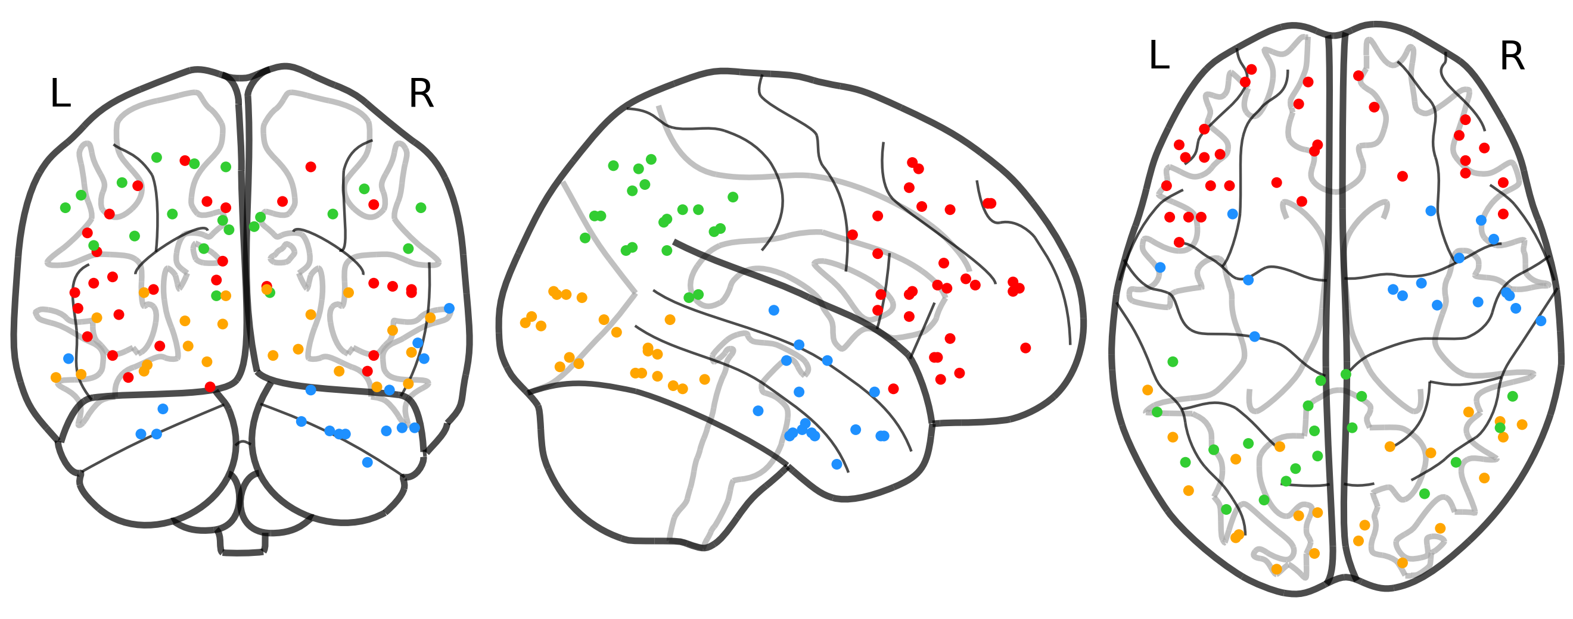
Scrubbed

Slide 12
Anatomically defined alternate?

Slide 13
Plot blobs based on using each quadrant as a seed
Plot blobs based on using each quadrant as a seed

Slide 14

Vendor effect
Effects in OA
Plot VEN & plot DOR

Slide 15
VEN x DOR

Slide 16

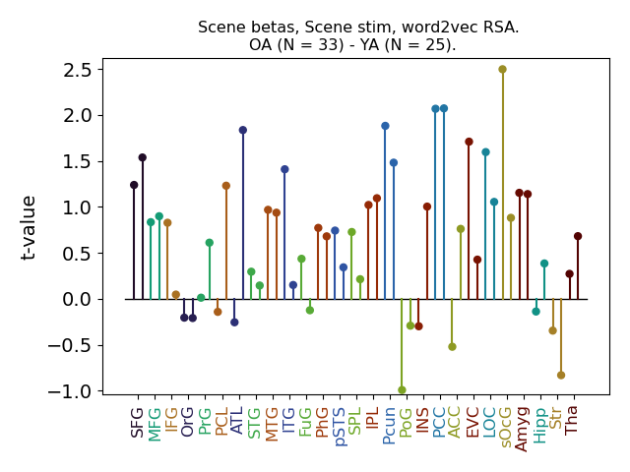

Scene semantic RSA
Do lmer control for object

Slide 17
Re-instantiation of the scene
We see substantial ERS between the scene betas and visual retrieval betas
  LOC effect (t = 6)
    Also other visual stream regions, albeit not so strongly
  Much weaker looking at conceptual retrieval but there is some consistency
  ERS effect emerges in both YA and OA
    Insignificant differences…
    Maybe OA show stronger re-instantiation in the ATL and MTG, but the between-group comparison is only t = 2.2 and t = 2.7

Slide 18
ERS individual differences
LOC: ERS effect correlates with RSA effect (r = .38, p = .005)
LOC: age effect on RSA
  Hence, we may be able to claim that OA processing of the screen has an indirect effect on re-instantiation

Slide 19
Regress out visual similarity to object
Effect disappears

Slide 20
Meeting follow-up

Slide 21
Linking vendor to scene IRAF
Vendor ~ 1 + IRAF_{scene} + (1 | subject)
  I invested very much effort into exploring this and related ideas
    e.g., modeling the dorsal-dorsal part of the vendor response as a multivariate effect rather than just an increase/decrease
    Using the single-trial ERS score rather than the IRAF
  Just doesn’t yield robust results

Slide 22
Is the congruency response similar to the subsequent memory response?
Measure each participants’ connectome for:
  Congruent
  Incongruent
  Memory hit
  Memory miss
  (By “connectome”, I mean that I am defining a matrix and not just looking for an increase/decrease of a pair of edges)
Examine whether each participant’s congruent – incongruent effect is similar to their memory hit – miss effect
This got close to yielding robust results
  It yields a significant effect if you simply look at the correlations between C – I x hit – miss (p < .005)
  However, we need to account for the fact that congruent trials are more likely to be hits, which can create an artificial relationship
  When I do this, the results are no longer significant (.05 < p < .20)

Slide 23
IRAF x IRAF predicting memory
Hit ~ IPL * MFG + LOC * ATL + (1 | subject)
No coefficient is significant results
Tried a likelihood-ratio test to see whether all of the coefficients together are predictive
  Analogous to an F-test in ANOVA;
  It did not yield anything

Slide 24
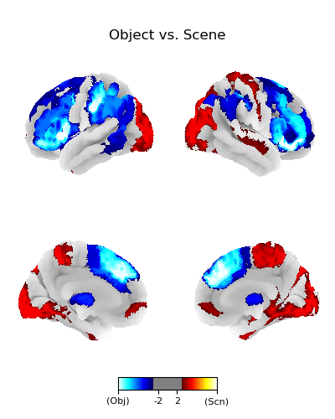
Object betas vs. scene betas

Slide 25
BL x encoding item pattern similarity
Not impacted by congruency

Slide 26
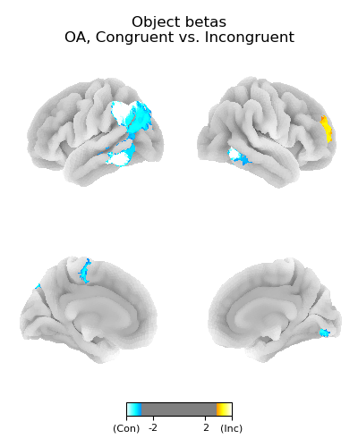
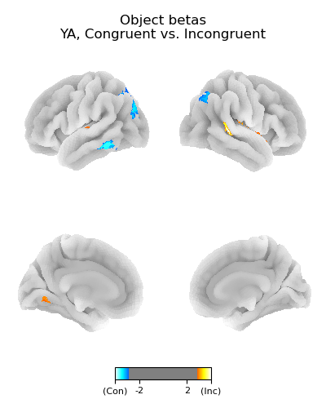
Univariate activation effects:
Congruent vs Incongruent
Older adults
Younger adults

Slide 27
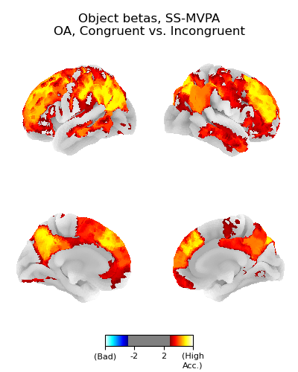
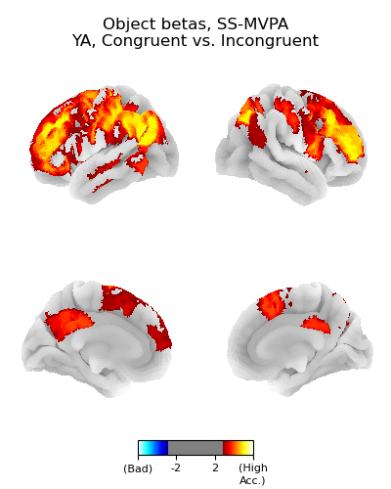
Activation MVPA effects:
Congruent vs Incongruent
OA MVPA
YA MVPA
What did you mean by “MVPA”?

Slide 28
Distinguishing congruent vs. incongruent in retrieval
No univariate effects
No MVPA effects

Slide 29
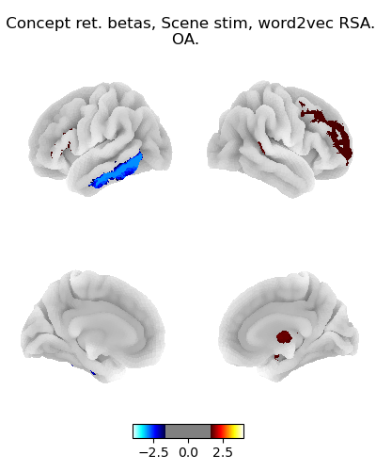
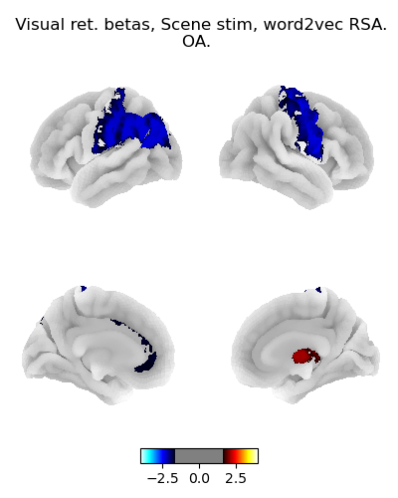
RSA of scene information from retrieval betas
Didn’t yield anything
  Threshold is quite low in this picture (t = 1.65)
In the meeting, I was actually fairly optimistic about this one…
  Something like this worked with Lifu’s data
Results are similar for YA

