Slide 1
Delay meeting was good
I implemented the final (hopefully) exclusion criteria

Slide 2
Ven-Dor
2/2/2024

Slide 3
Introduction
The human mind is continuously applying existing knowledge to incoming information
  At the most basic level, pattern-detection is an example of this, as it is the process of evaluating whether stimuli are congruent with schemas
  Evaluating matches
This topic is seeing ever-growing interest
  Consider the rising popularity of neural and cognitive theories based on prediction errors
Yet there are limitations with existing research
  Studies typically focus on small subsets of the brain (e.g., single regions), even though congruency-assessment is a whole-brain phenomena
  Relatedly, most studies focus on “basic” forms of congruency (i.e., prediction error in decision-making) rather than the type of semantic-congruency assessment, which makes us human

Slide 4
Introduction
This topic is of particular interest to aging research
Older adults show greater use of prior knowledge when processing incoming stimuli
  This is a defining characteristic of aging
  Behavioral studies have demonstrated several downstream effects (e.g., on memory)
However, the neural correlates of how older adults apply their prior semantic knowledge (schemas) to incoming information remains mostly unclear

Slide 5
Questions / Aims
How do individuals (YA & OA) process congruency?
  Searching for brain-wide phenomena
How do OAs process congruency differently?
  By default, are OAs always in a high “processing congruency” state?
How are the neural correlates of congruency processing linked to other aspects of cognition?
  Stimulus representation
  Memory

Slide 6

3-session fMRI study (SchemRep)
Baseline: rated image-label typicality for objects
Encoding: Presentation of scene and object. Rated how likely one is to find the object in the scene
Retrieval: conceptual old/new followed by visual old/similar/new

Slide 7
Result 1: Identifying the Ven-Dor modules

Slide 8
Result 1: How do YA and OA process congruency?

Slide 9
Summary
Congruent vs. Incongruent comparison reveals the Ven & Dor modules
  Congruent = heightened within
  Incongruent = heightened between
  (Could also report activation-related results on univariate/MVPA/RSA/etc.)
Profiling Ven & Dor with dynamic functional connectivity
  Ven & Dor should be seen as fluctuating with Ant & Pos
    Alternating between a “Ven-Dor state” and an “Ant-Pos” state
  Congruency not only heightens within-connectivity but also increases the trial-wise “synchrony”
  These modules also appear in the baseline or retrieval tasks
  Ven acts more like a single bilateral module whereas Dor acts as two separate but parallel ones
  I think that if I submitted the dynamic FC data to a modularity, it would reproduce the Ven-Dor modules
  Overall, these results provide strong evidence that Ven, Dor, Ant, & Pos are meaningful divisions of the brain. Also gives credence to the four quadrants idea
Investigating the behavioral correlates of Ven & Dor
  Ven is linked to stimulus representation
  Dor is linked to memory retrieval
  These results are a bit more exploratory/based on weaker evidence
Aging:
  Modulates these different effects at both the level of static (average) connectivity and dynamic connectivity
  Older adults tend to be in a Ven-Dor state more

Slide 10
How to frame this paper
We started looking at congruency vs. incongruency and followed a Ven-Dor rabbit hole
  Relatedly: We know that congruency/incongruency has brain-wide effects, and so we searched for wide-scale phenomena
We investigated the brain in terms of four (anatomical) quadrants
  Yielded interesting patterns related to dynamic FC, which are consistent across tasks
  The networks were linked to schema processing, stimulus representation, and memory
Aging: We investigated how older vs. younger adults use schemas, which we expected to have brain-wide effects

Slide 11
Non-aging paper titles
“Investigation of Schema Congruency Reveals Dissociable Ventral-Dorsal Functional Modules”

Slide 12
Note
A part of me wants to investigate Ven-Dor across different tasks
However, a larger part of me wants to submit a paper

Slide 13

Incongruency-congruency conn matrix
t-test compare congruent vs. incongruent
Combine YA and OA
Notes:
fin_plot_conn_matrix.py

Slide 14



Modularity
Submitted the thresholded connectivity matrix to a modularity-detection algorithm
  I used a version of Louvain’s algorithm
These modules reflect t-tests done on both YA and OA data
  If only OA were used, then later analyses of the modules comparing YA vs. OA would be circular
Dorsal
Congruency
Par.
Ventral
PFC
Occ.
Congruency
ATL

Slide 15

Dort?
Rather than a “dorsal” module, it’s actually more of a frontoparietal control network (FPCN) module
  I know the FPCN is a construct based on resting-state fMRI
  But it’s popped up in task studies
  It’s striking to me that the MTG spot lands closely to where the temporal component of the FPCN typically appears
Instead of Ven-Dor, it may be more correct to say “Ventral-FPCN”
  Nonetheless, I proceed with the Ven-Dor idea and the MTG component for now
FPCN
Congruency
Par.
PFC
MTG

Slide 16

Quadrants
The two modules can be split into quadrants
Outlier
Parietal
PFC
ATL
OccTemp

Slide 17

Quadrants (scrubbing)
The two modules can be split into quadrants
Outlier
Parietal
PFC
ATL
OccTemp

Slide 18

Anatomical Quadrant
The quadrants could be defined anatomically
  Here, I picked regions based on the atlas region labels
Parietal
PFC
ATL
OccTemp
I didn’t pursue this in the current slides’ results, but it’s an option

Slide 19






Traditional modularity results (for reference)
Modules based on average connectivity (quite localized)

Slide 20




Quadrant seeds
Parietal
PFC
Parietal
PFC
OccTemp
ATL
Each quadrant was tested as a seed
OccTemp
ATL

Slide 21
Background: Dynamic functional connectivity
Richard Betzel and Olaf Sporns argue in a recent TiCS paper:
  Functional connectivity can be studied as a dynamic process
That is what I did here
  I (and Shenyang) have been measuring timepoint-specific connectivity, as just the product between activation in two areas
  They advocate for this and call it “time-varying FC”
They also argue that the correlations between modules/networks are meaningful
  Correlate on a TR-by-TR basis
  Reflect brain states and transitions

Slide 22
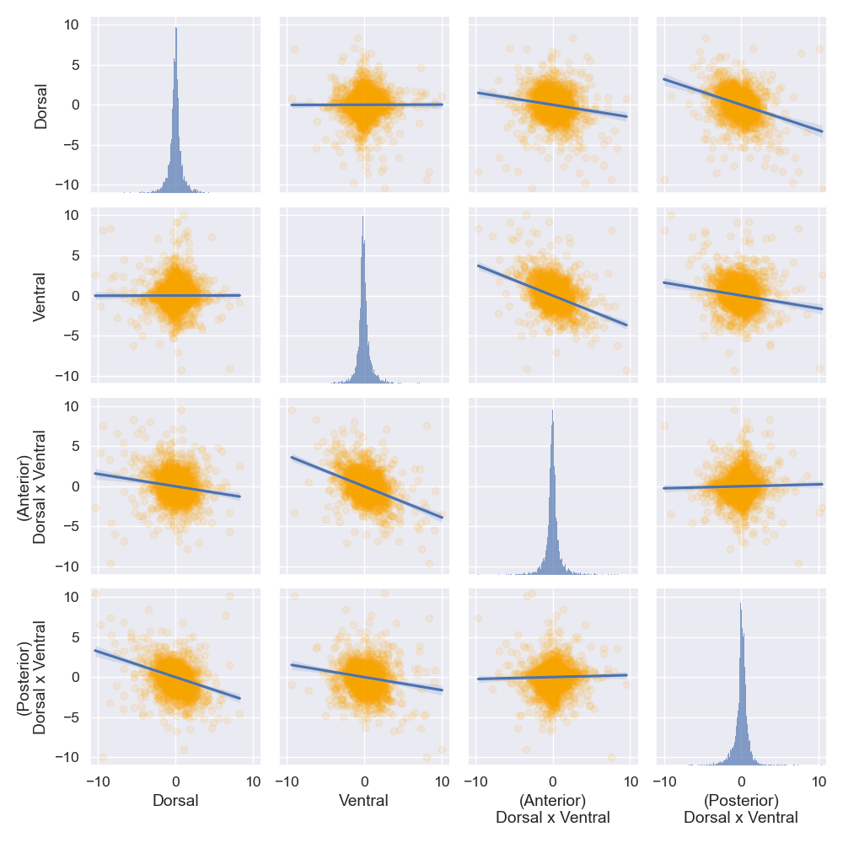
Ven x Dor
Connectivity is not static
The modules are in flux
  Notably, this (clear) fluctuation gives credence to organizing them as Ven & Dor
Negative correlations indicating fluctuation
Perhaps instead of calling Ven and Dor as modules, it’s more appropriate to reference a “Ven-Dor state”
Processing congruency pushes participants toward the Ven-Dor state
This figure just shows correlations from pooling every participant’s data into a big dataset but everything is consistent when I use multilevel regressions

Slide 23
Results 1 summary
Processing congruency upregulates connectivity within a Ven module and a Dor module
More specifically…
  Individuals (YA and OA) are continuously fluctuating between a Pos-Ant state & Ven-Dor state
  Processing congruency pushes individuals toward Ven-Dor
  I haven’t searched the literature, but I assume our work is not the first to show this type of horizontal vs. vertical fluctuation…
Ven-Dor
Pos-Ant
Fluctuation
Par.
Par.
PFC
PFC
Occ.
Occ.
ATL
ATL

Slide 24
An interlude
What does high within-connectivity mean?
  High dorsal?
  High ventral?

Slide 25
1.5 New
2/13/2024

Slide 26
Ven-Dor ROIs do not map onto network segmentations
In the meeting, I completely forgot that my visuals mention which resting-state network each ROI belongs to... (?!)
So, we can’t say that this is the FPCN obviously
FPCN
Congruency
Par.
PFC
MTG

Slide 27
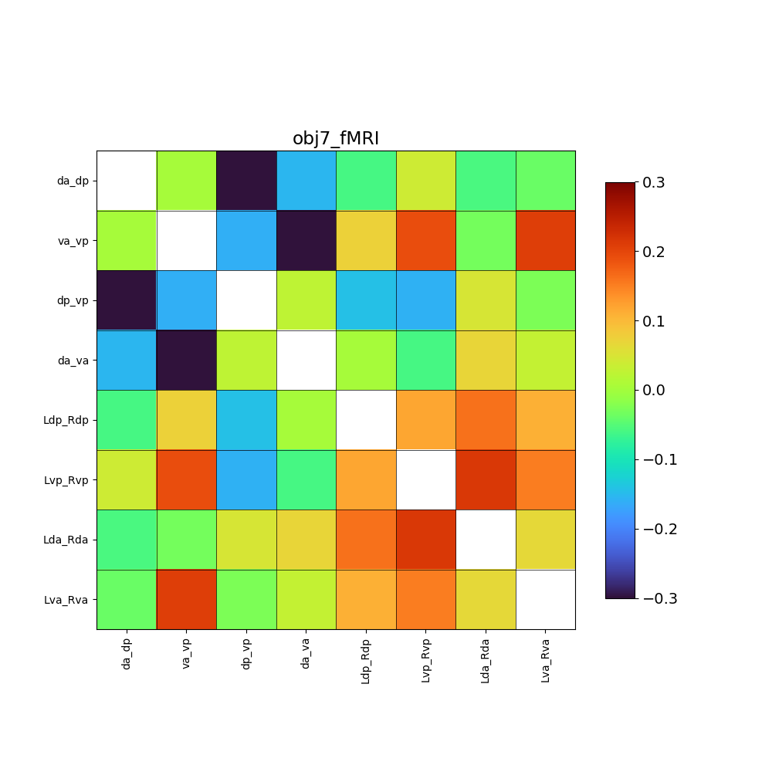
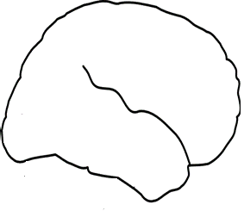
Further evidence of modularity
Ven edges move in sync with other Ven edges
  L pos-ant x R pos-ant
  L pos-ant x pos L-R
  etc.
Dor doesn’t act as a single big module
Similar patterns for every task
Ven synchrony upregulated by Inc and OA
(Anatomical quadrants)
Par.
Par.
PFC
PFC
Occ.
Occ.
ATL
ATL
Although unrelated to ven-dor, I saw one other interesting pattern: All cross-hemisphere edges correlate with one another
e.g., parietal L-R connectivity correlates with ATL L-R connectivity
Notes:
Further evidence supporting the meaningfulness of these modules

Slide 28
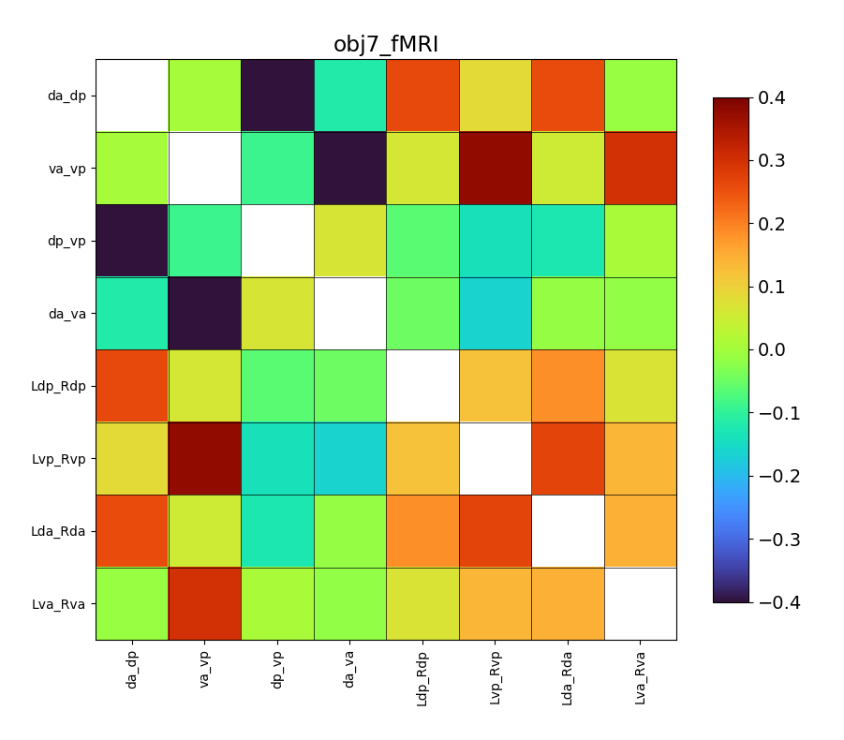
Further evidence of modularity
Dor edges move in sync with other Dor edges
  L pos-ant x R pos-ant
  L pos-ant x pos L-R
  etc.
  Same for Ven
Dor & Ven synchrony is upregulated by congruency
Ven synchrony upregulated in OA
Par.
Par.
PFC
PFC
Occ.
Occ.
ATL
ATL
Although unrelated to ven-dor, I saw one other interesting pattern: All cross-hemisphere edges correlate with one another
e.g., parietal L-R connectivity correlates with ATL L-R connectivity
Notes:
Further evidence supporting the meaningfulness of these modules

Slide 29
Specifying the fluctuation more exactly
To a degree, the fluctuation on the left is occuring
However, the fluctuation on the right is more intense
Whole brain
Precise
Ven-Dor
Pos-Ant
Fluctuation
Par.
Par.
Par
Fluctuation
PFC
PFC
PFC
PFC
Occ.
Occ.
Occ.
Fluctuation
Occ.
ATL
ATL
ATL
Notes:
Look into the Par-ATL edge
Could compsre the scene vs object betas

Slide 30
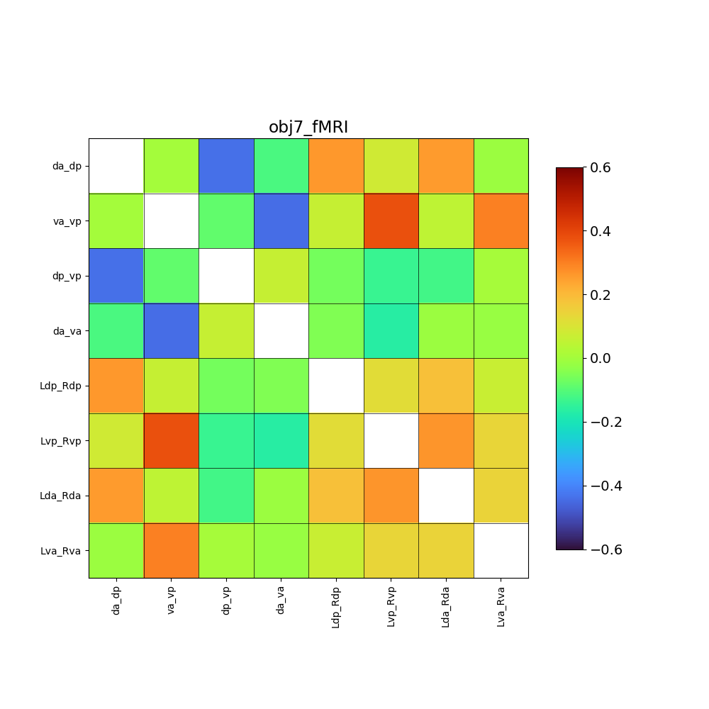
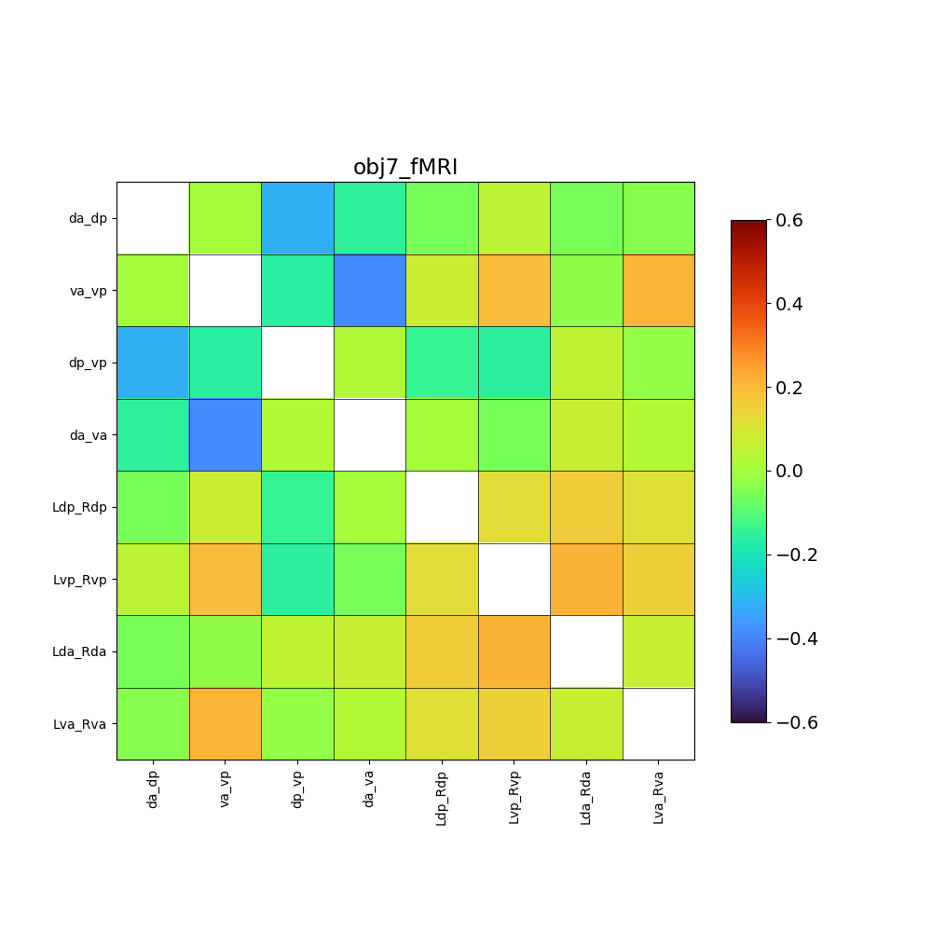
Anatomical vs. Functional quadrans
The correlations are all around duller (closer to zero) if the anatomical quadrants are used
However, the fluctuations are still robust (rs < -.3)

Slide 31
Ven-Dor
Pos-Ant
Ven-Dor
Pos-Ant
Fluctuation
Fluctuation
Par
Par.
Par.
Par.
PFC
PFC
PFC
Occ.
Occ.
Occ.
Occ.
ATL
ATL
Ven-Dor
Pos-Ant
Ven-Dor
Pos-Ant
Fluctuation
Fluctuation
Par.
Par.
PFC
PFC
Occ.
Occ.
ATL
ATL

Slide 32
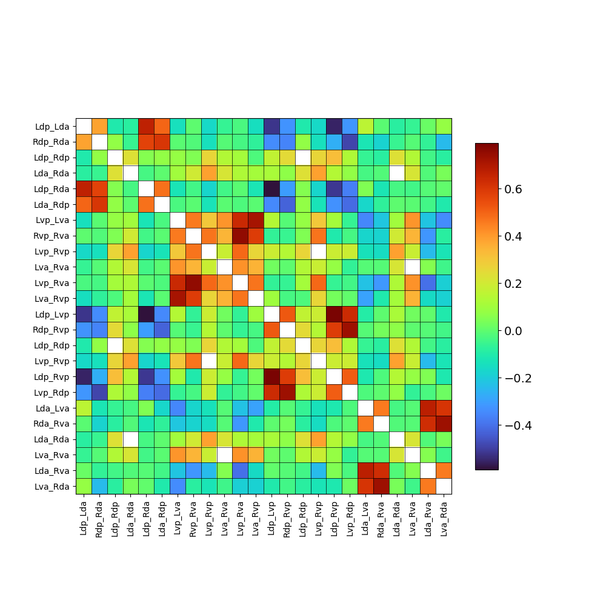
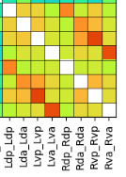
Hemispheres
No scrub, not anatomical
Question:
Ventral module works as a single large unit
Dorsal module works as two parallel units
This effect only comes out when looking at dynamic connectivity
  The L/R correlation is similar for DA, DP, VA, VP
  (it’s high in all cases)
Two hemispheres are in sync
  However, A/P not in sync
OA show greater VV connectivity x Vant or Vpos hemispheric connectivity
  Their ventral network is more in sync
Weaker
singularity
Left Dor ~ Right Dor
Dor
Singular
Left Dor ~ LR/RL Dor
Ven
Pos
Alternating
Weaker
Alternation
Ant

Slide 33
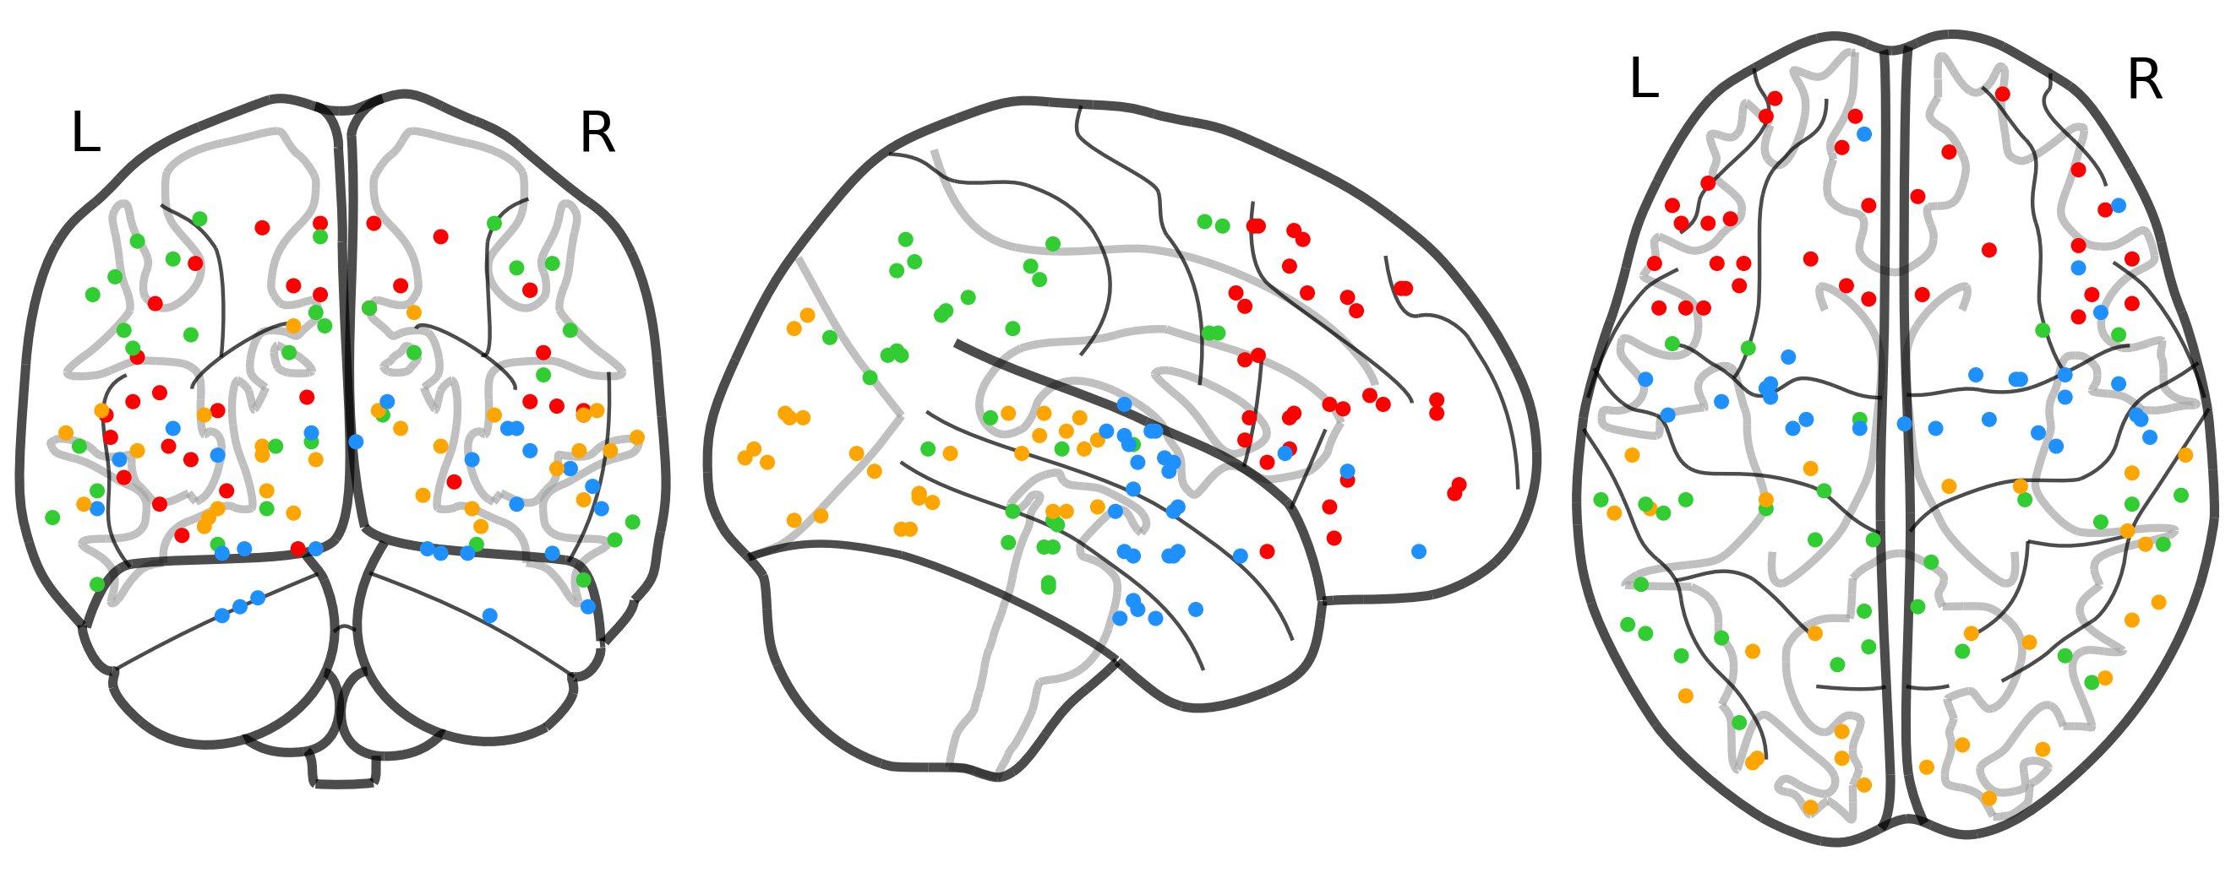

Slide 35
Result 2: The effects of aging on processing congruency and Ven-Dor

Slide 36

Ven vs. Dor
Par.
Within
Between
PFC
Many effects and interactions attempted
There exists Ven-Dor “brain state”, characterized by a dissociation of the two modules
  High within
  Low between
People (YA & OA) enter this Ven-Dor state when processing congruency
This state is heightened at all times for OA, reflecting a constant increased application of semantic knowledge in coming stimuli
  This occurs even when processing incongruency
  However, this state is particularly heightened when processing congruency
Current interactions don’t significantly show this
Need to still look into ipsilateral only
Occ.
Within
ATL

Slide 37

Anatomical-based results
Results are a bit more attractive if we select the ROIs based on anatomical labels
One upside to this approach, is that it avoids any circularity biases
However, there is a risk, with just plucking and choosing anatomical labels, that one is making arbitrary choices
  (and massaging the data)
  For what it’s worth, I didn’t tweak the labels after seeing these results
Surprising that YAs do not show anything
  I think the results on OA are more compelling if YA show weaker but still present Ven-Dor effect
Notes:
No matrix_mask

Slide 38
Bar graphs for the four sides
I just didn’t have time to prepare this
Rather than just showing bars for Between vs. Within, I wanted to show bars for all four sides

Slide 39

Aging modulates fluctuation
Method:
  These analyses do not look at congruency
Results:
  In older adults, the Ven and Dor modules move in greater sync
  Interestingly, so do the anterior and posterior connections
Constantly fluctuating between Ven-Dor and Ant-Pos
  Fluctuation is evidenced by the negative correlations
  Although it’s hard to judge magnitude based on the figure, the negative slopes are quite strong (up to r = -.38)
Ven x Dor
Aging interaction
Ven x Dor
Aging interaction
Negative correlations indicating fluctuation

Slide 40
Interim summary
Individuals (YA and OA) are continuously fluctuating between a Pos-Ant state & Ven-Dor state
  Processing congruency pushes individuals toward Ven-Dor
OAs show a greater tendency to be in the Ven-Dor state
  This occurs particularly when processing congruency (congruency x aging)
  However, there is also a main effect: OAs always lean toward this state of “congruency”
Aging also influences fluctuation
  In OA, Ven & Dor move in sync more
  In OA, Pos & Ant move in sync more
  Interpretable as OA showing less global processing?
These results together serve as strong evidence for the meaningfulness of the constructed Ven-Dor modules
Ven-Dor
Pos-Ant
Fluctuation
Par.
Par.
PFC
PFC
Occ.
Occ.
ATL
ATL
Would it help to look at resting state data? See if we find this fluctuation there too?

Slide 41
Result 3: Interpreting
Ven & Dor
(These analyses would be framed as exploratory)
(These results are also the least cooked. I arrived at them at the last second, I need to do my double-checks)

Slide 42


Scene representation & Ven
Participants represent the scenes
  Representation stronger in OA
  We can measure trial-by-trial representational strength with IRAF
Is scene representation in the most potent areas (e.g., LOC) linked to Ven or Dor?
  IRAF_{LOC} ~ 1 + Ven + Dor + (1 + Ven + Dor | Subject)
Yes, stronger scene representation is linked to a stronger connectivity within the Ven module (p < .01)
  Remains significant when controlling for age or congruency
  No effect on Dor
Note: IRAF is measured during scene presentation whereas Ven & Dor are measured durng object presentation

Slide 43
Conceptual memory & Dor
Another multilevel regression:
conceptual hit ~ 1 + Ven + Dor + (1 + Ven + Dor | Subject)
Greater connectivity within the Dor module during encoding predicts subsequent memory accuracy (p = .04)
  No effect of Ven
  Given that this result is rather frail, I think it should be treated with some caution and regarded as exploratory
  Hard to find anything more robust given the limited conceptual hit trial numbers
  Results stay the same if looking at hit-hit accuracy

Slide 44
Results 3 summary
Why was Ven found to be linked to scene processing?
Why was Dor found to be linked to subsequent conceptual memory accuracy?
Ven-Dor
Par.
PFC
Occ.
ATL

Slide 45
3.5 New
2/13/2024

Slide 46
Dor
During a retrieval task
  Decrease Dorsal connectivity was associated with successful retrieval

Slide 47
Conclusion
When individuals process incoming information, they fluctuate between Ven-Dor and Pos-Ant states
  Detecting congruency pushes the brain toward the Ven-Dor state
The effect of aging on congruency processing should be understood in terms of these states
  Aging pushes people toward Ven-Dor state
  Particularly when processing congruency
  However, in general, OA seem to be in Ven-Dor more often by default
Ven and Dor functioning is related to other important dimensions of congruency processing
  Representing stimuli’s semantic features
  Encoding conceptual information

Slide 48
Congruency
IPL
Congruency
MFG
Par.
LOC
PFC
FuG
Occ.
Congruency
ATL
ATL
Fluctuation
Par.
Par.
Par.
PFC
PFC
Incongruency
Occ.
Occ.
PFC
Incongruency
Occ.
ATL
ATL
ATL
Fluctuation
Par.
Par.
PFC
PFC
Occ.
Occ.
ATL
ATL

Slide 49

Vendor effect
Effects in OA
Plot VEN & plot DOR
Could plot a triangle matrix for each pair?

