Slide 1
SchemeRep
January 11, 2024

Slide 2

3-session fMRI study (SchemRep)
Baseline: rated image-label typicality for objects
Encoding: Presentation of scene and object. Rated how likely one is to find the object in the scene
Retrieval: conceptual old/new followed by visual old/similar/new

Slide 3
Results overview
Older adults process schemas more intensely
  They represent schema content more strongly (RSA analysis using BOLD data; does not measure connectivity)
  Reflected by stronger representation in medial occipital areas, inferior parietal areas, and the ATL
Older adults are more sensitive to schema-object congruency
  Reflected by effects of congruency on connectivity between the IPL and ventral stream
  Greater impact on perceptual processing

Slide 4
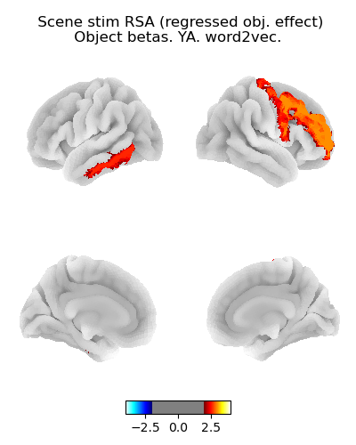
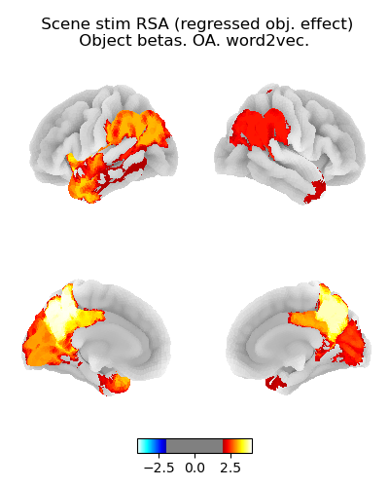
Scene RSA: Object presentation betas
Younger adults
Older adults
RSA performed:
  Model RDM is based on word2vec embeddings of the scene’s image’s name
  fMRI RDM is based on the object betas (next slide would show similar results suing the scene betas)
OA show significant RSA effects
Thresholding is liberal (p < .05, uncorrected)
Hence, some activation patterns may be Type I Errors (e.g., the YA ITG and/or MFG effect)
t-value
t-value

Slide 5
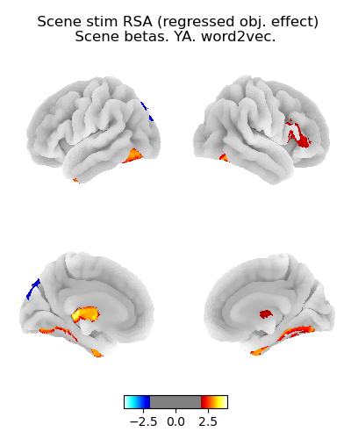
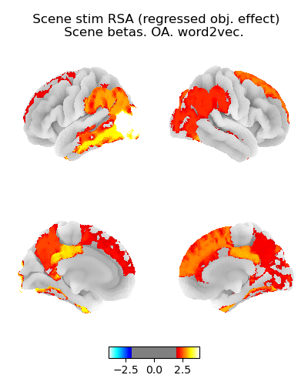
Scene RSA: Scene presentation betas
Younger adults
Older adults
Similar results when using the scene betas as when using the object betas
OA show significant representation

Slide 6
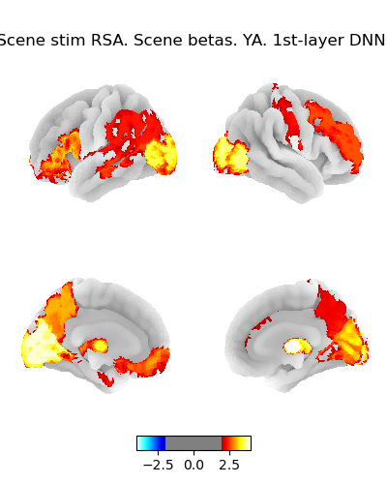
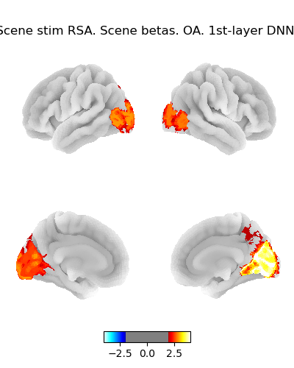
Scene beta RSA using perceptual model

Slide 7
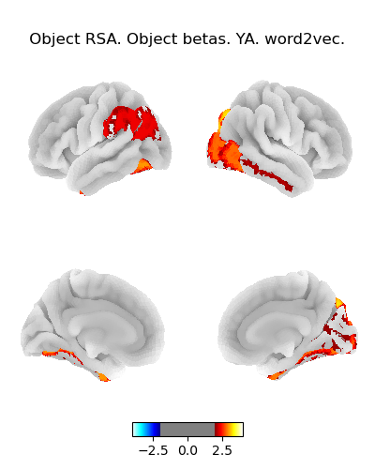
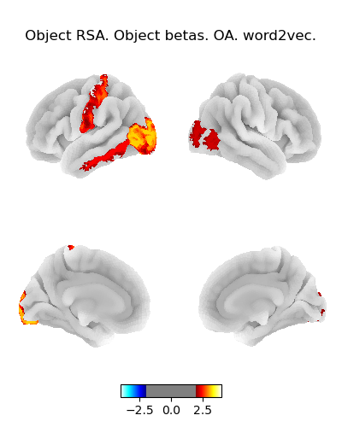
Object RSA: Object presentation betas
Younger adults
Older adults
Sanity check
RSA performed using word2vec embeddings of the object’s name
These results show that OA aren’t representing objects particularly more intensely, just the scenes

Slide 8
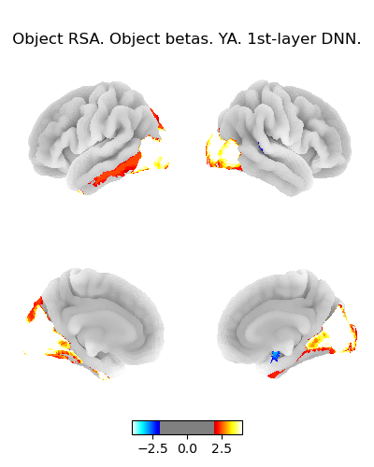
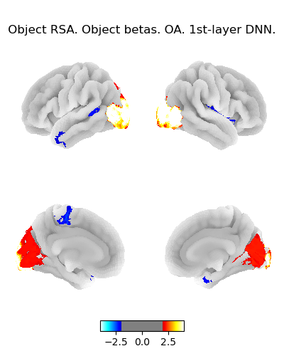
Object RSA, object betas perceptual

Slide 9
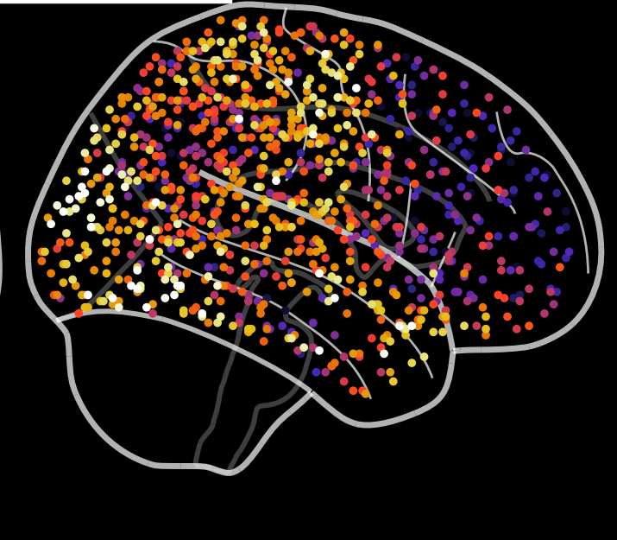
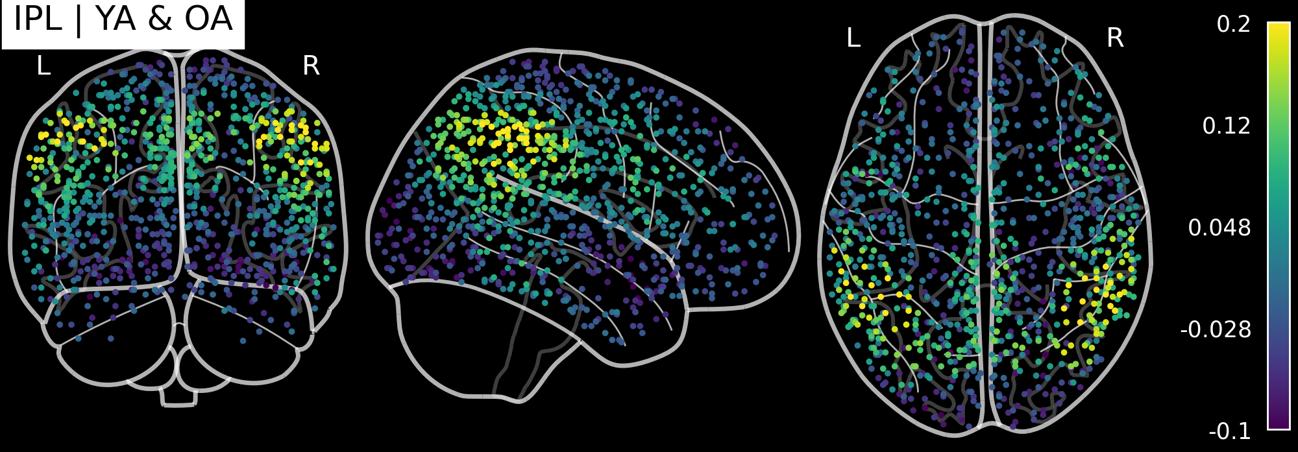
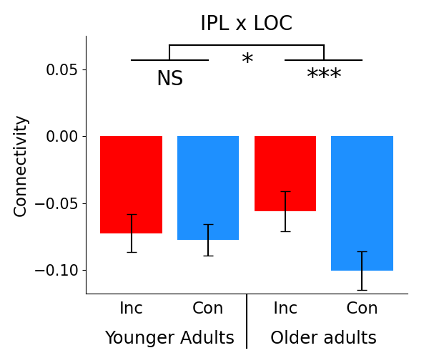
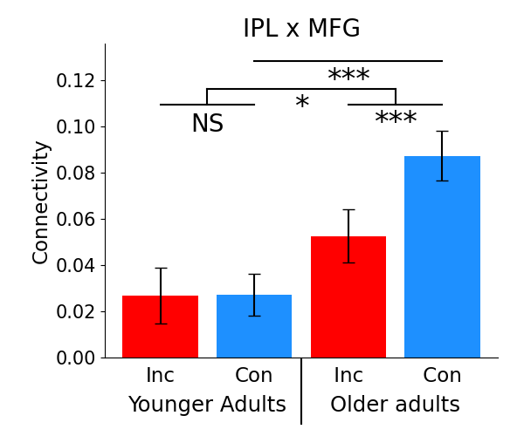

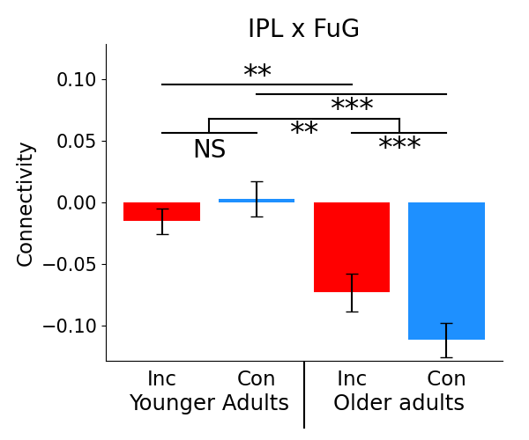
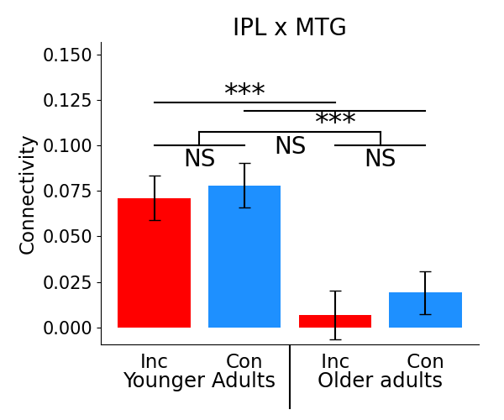
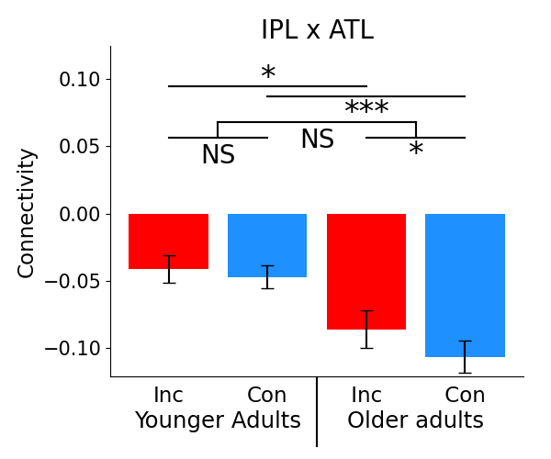
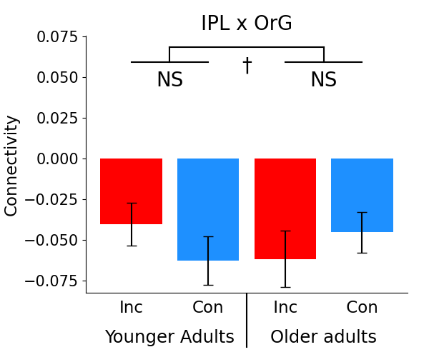
Inferior parietal lobule (IPL)
Focus on IPL is justified by classifier-based analyses showing that it’s connectivity is impacted by congruency
PCun showed a prominent RSA effect, but it doesn’t show connectivity effects linked to congruency
Mean
FC
Effects in OA
OA t-tests
Congruency
IPL
MFG
LOC
FuG
Incongruency
ATL

Slide 10
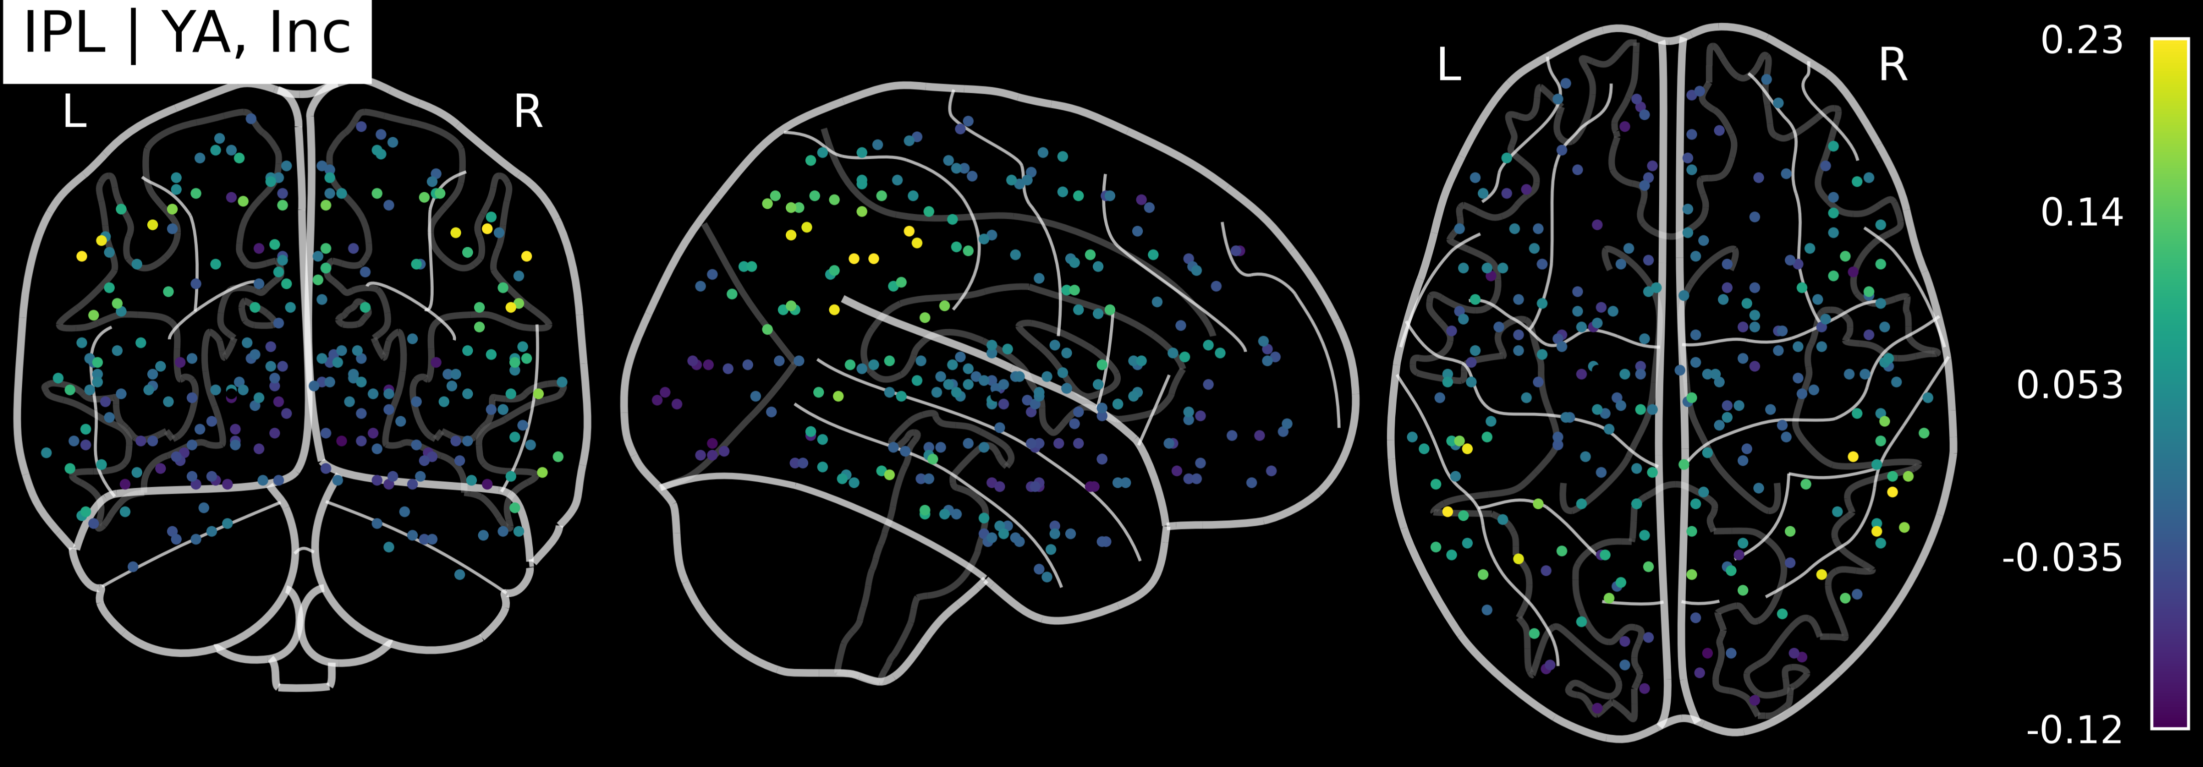
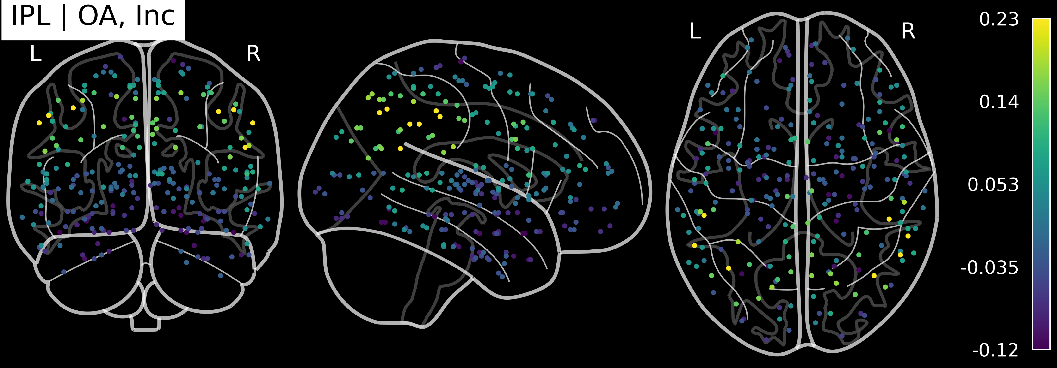
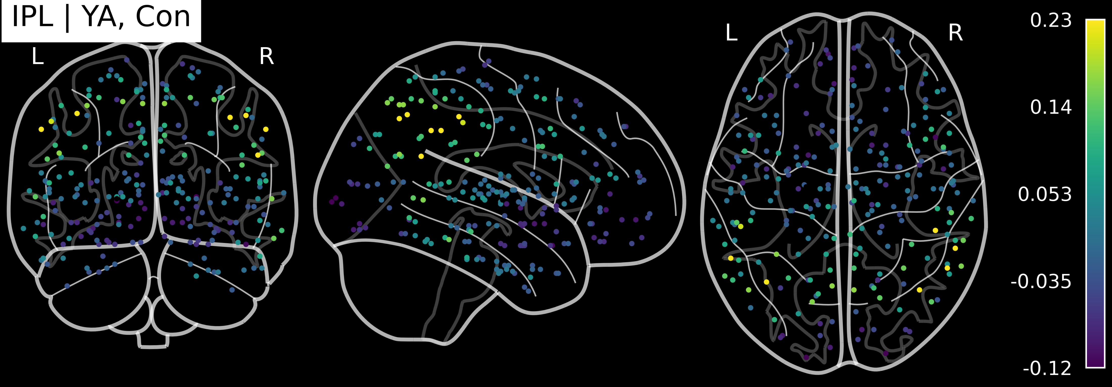
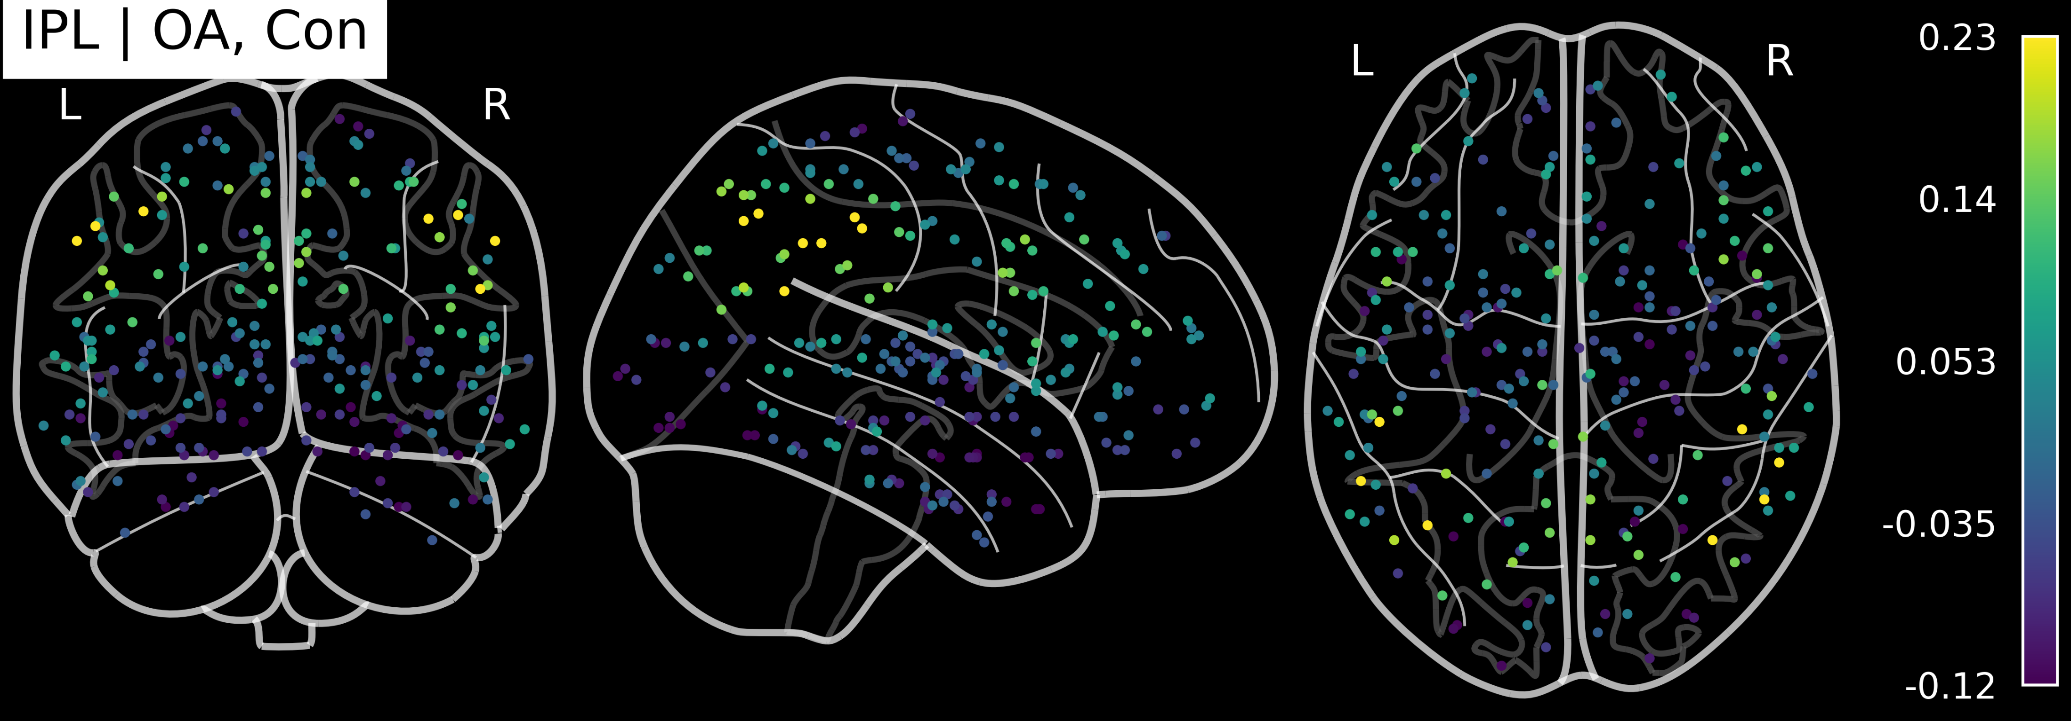
Mean connectivity by age and condition
OA vs. YA numerical differences are small
Younger adults
Older adults
Incongruent
Congruent

Slide 11
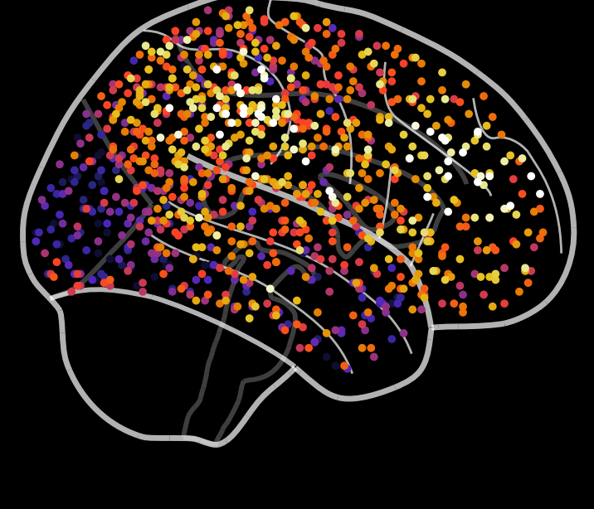
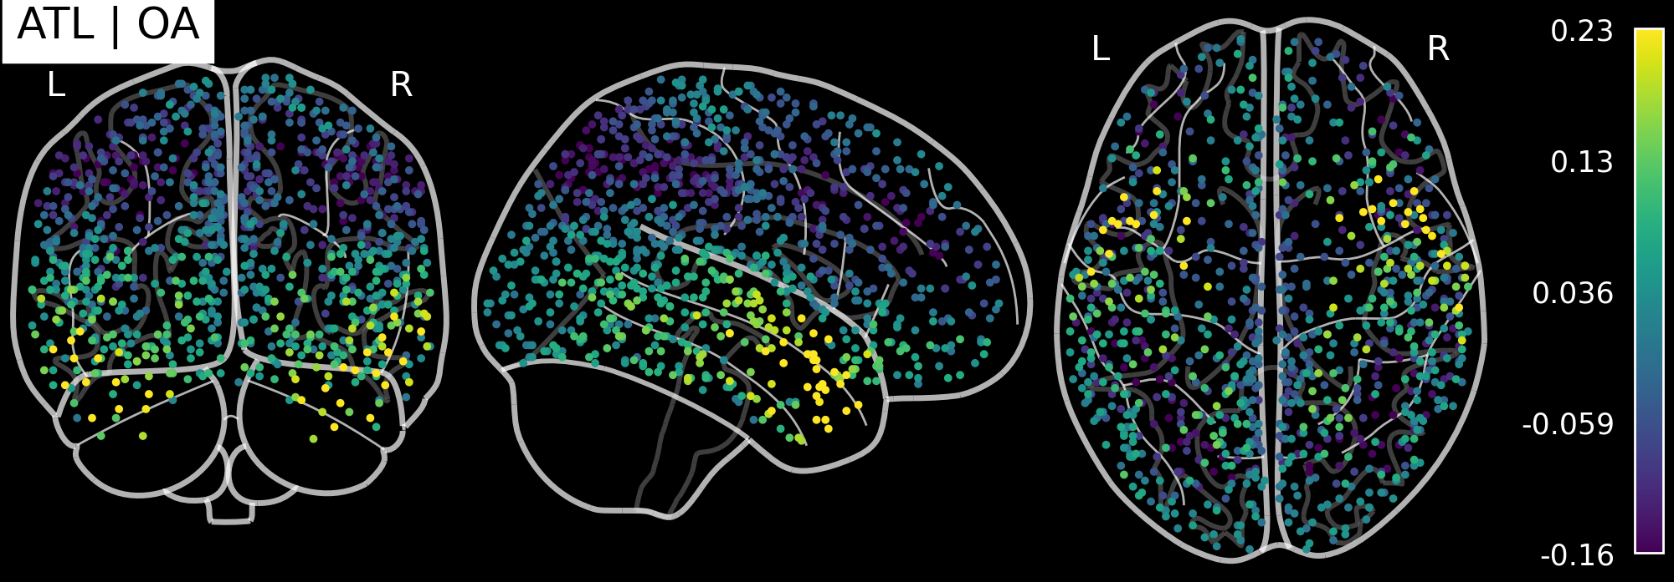
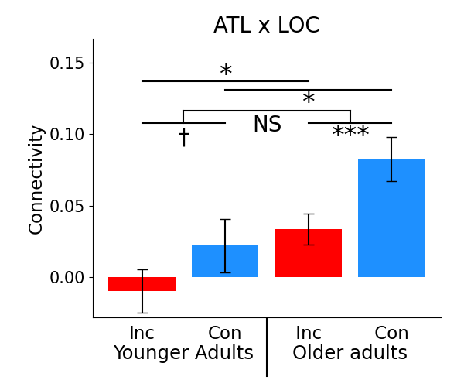
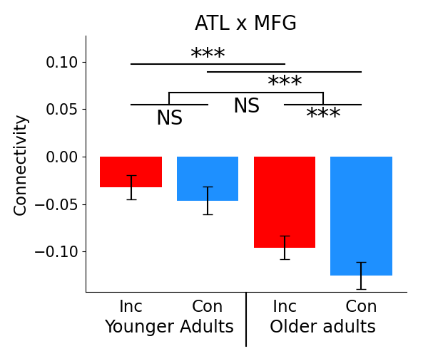
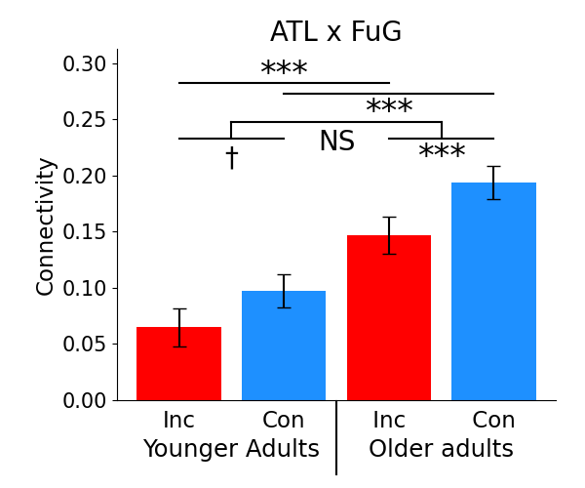
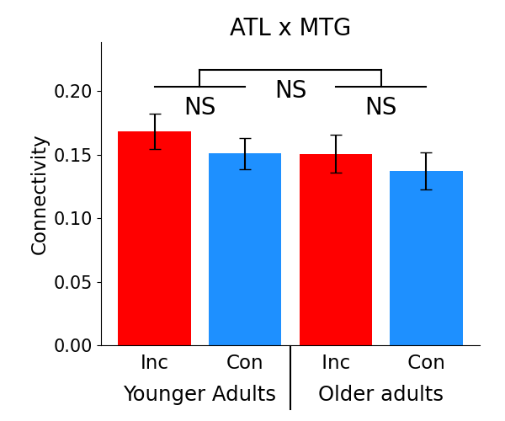
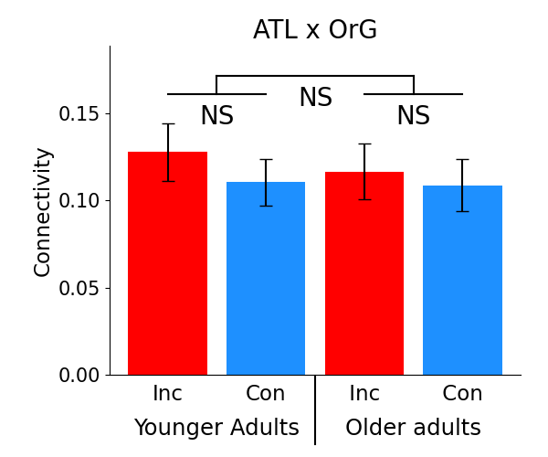
Anterior temporal lobe (ATL)
Mean
FC
Effects in OA
OA t-tests
Incongruency
IPL
MFG
LOC
FuG
Congruency
ATL

Slide 12
Note
It would be good if we can argue that these OA vs. YA differences do not just reflect differences in task engagement
  The behavioral data may support this

Slide 13
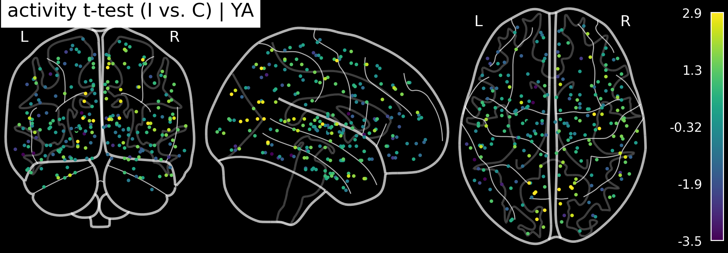
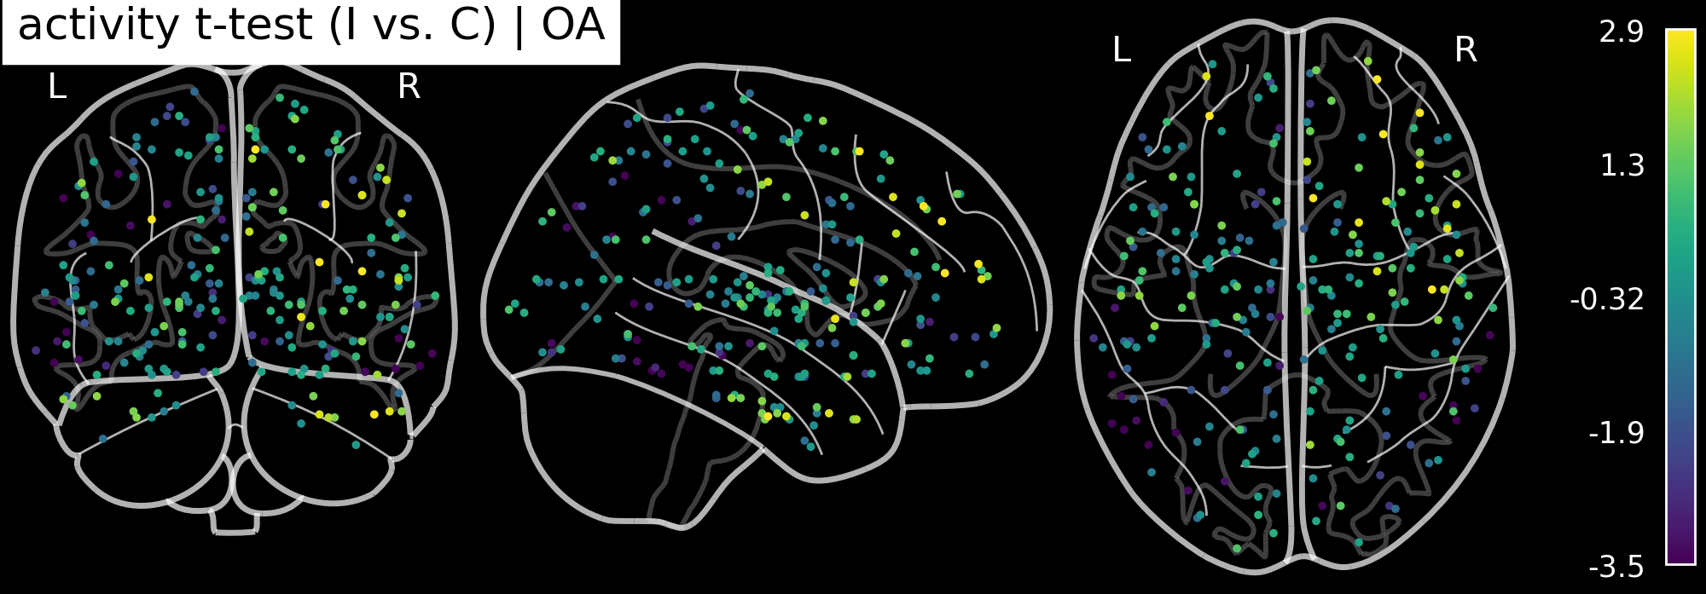
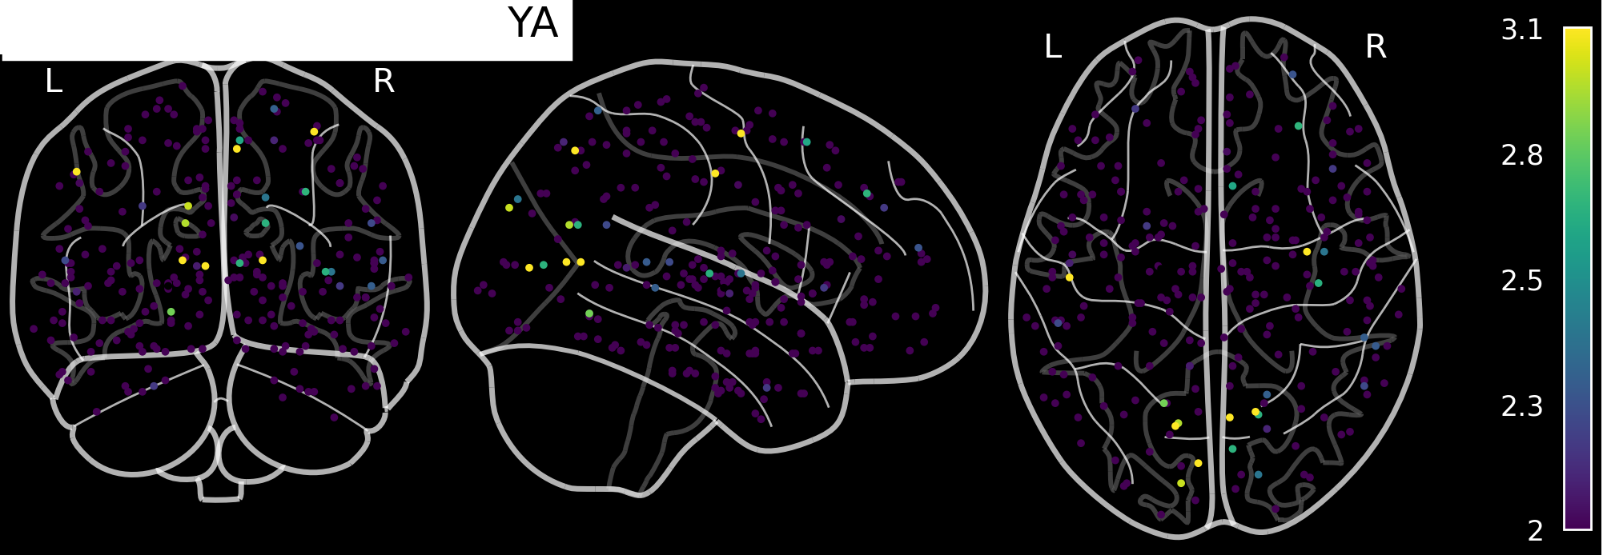
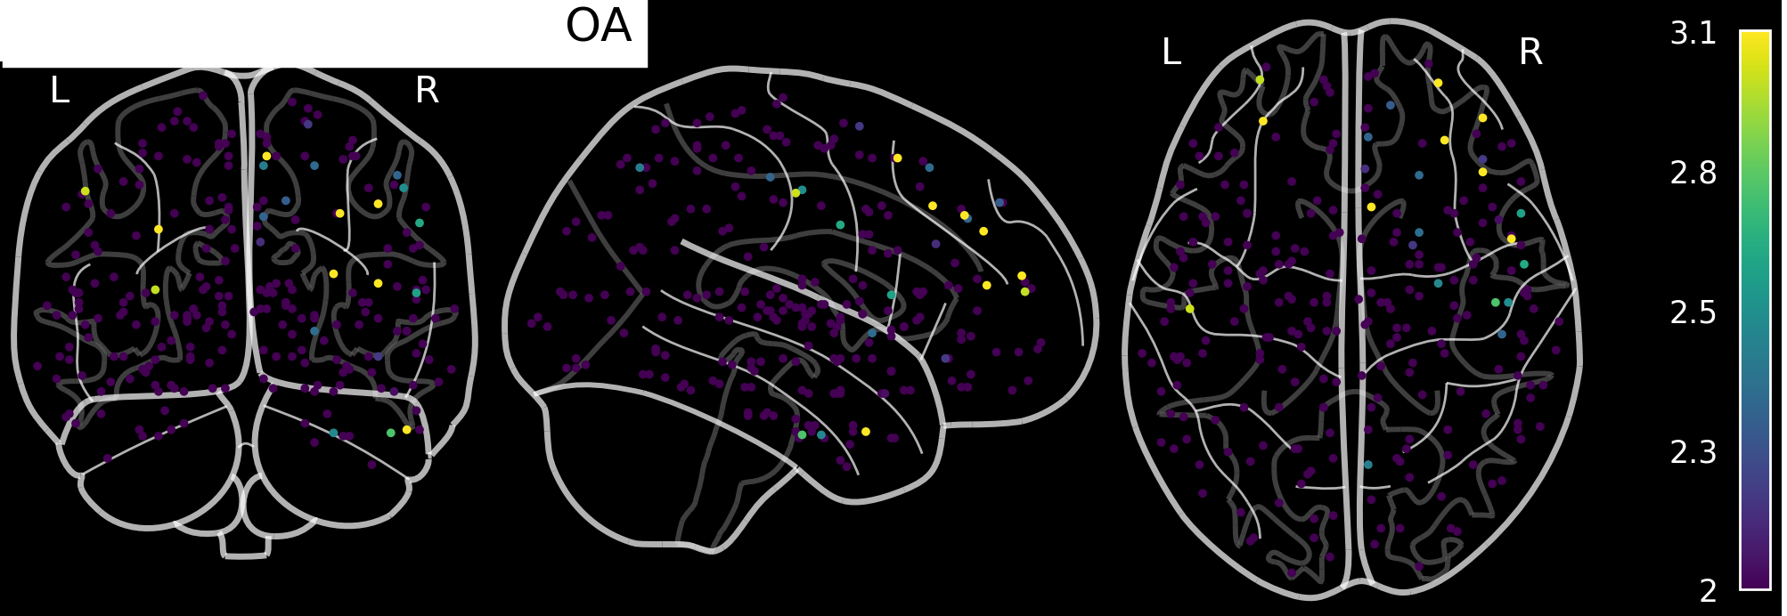
Activation-based analyses on congruency vs. incongruency
(not much; ignore this slide)
Colors reflect t-test
Positive = greater for incongruent,
negative = greater for congruent
Younger adults
Older adults
Univariate t-test
Subject-specific
classifier
Activity effects are small looking at just a single ROI or a small set may not be enough. Classification greatly improves if looking at large areas (e.g., full occipital + some ventral stream or full PFC)

Slide 14
SchemeRep
January 15, 2024

Slide 15
Results
Older adults represent schemas more strongly
In OA, congruency is processed by separate ventral and dorsal modules
YA-OA differences in connectivity are more larger when processing congruent information
  The effect of aging is greatest when applying schemas

Slide 16
Scene RSA: Scene presentation betas
Younger adults
Older adults
Similar results when using the scene betas as when using the object betas
OA show significant representation

Slide 17
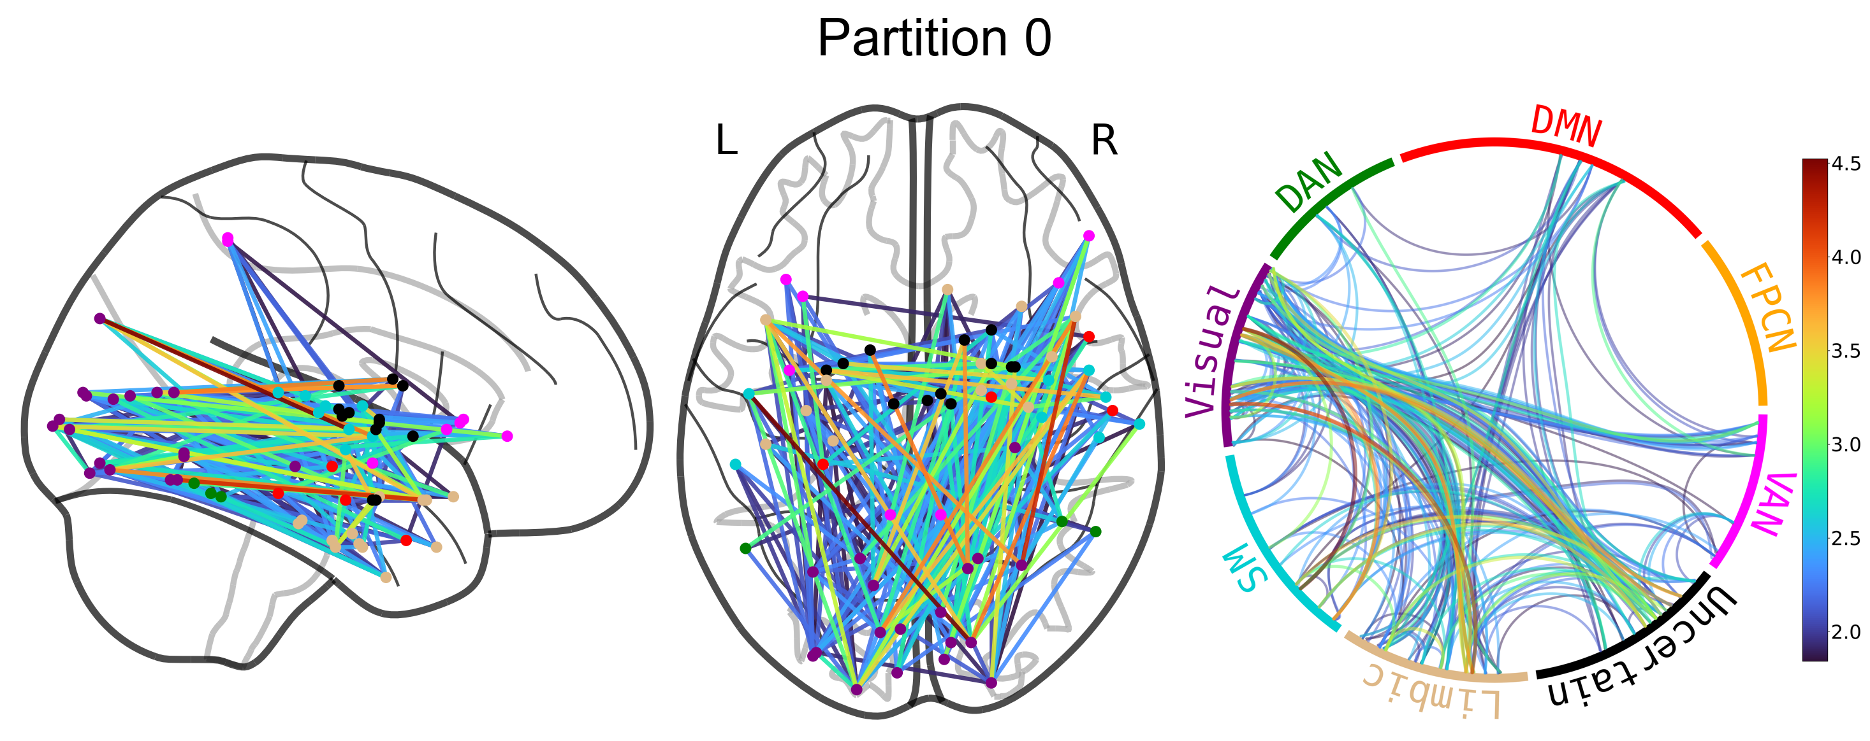
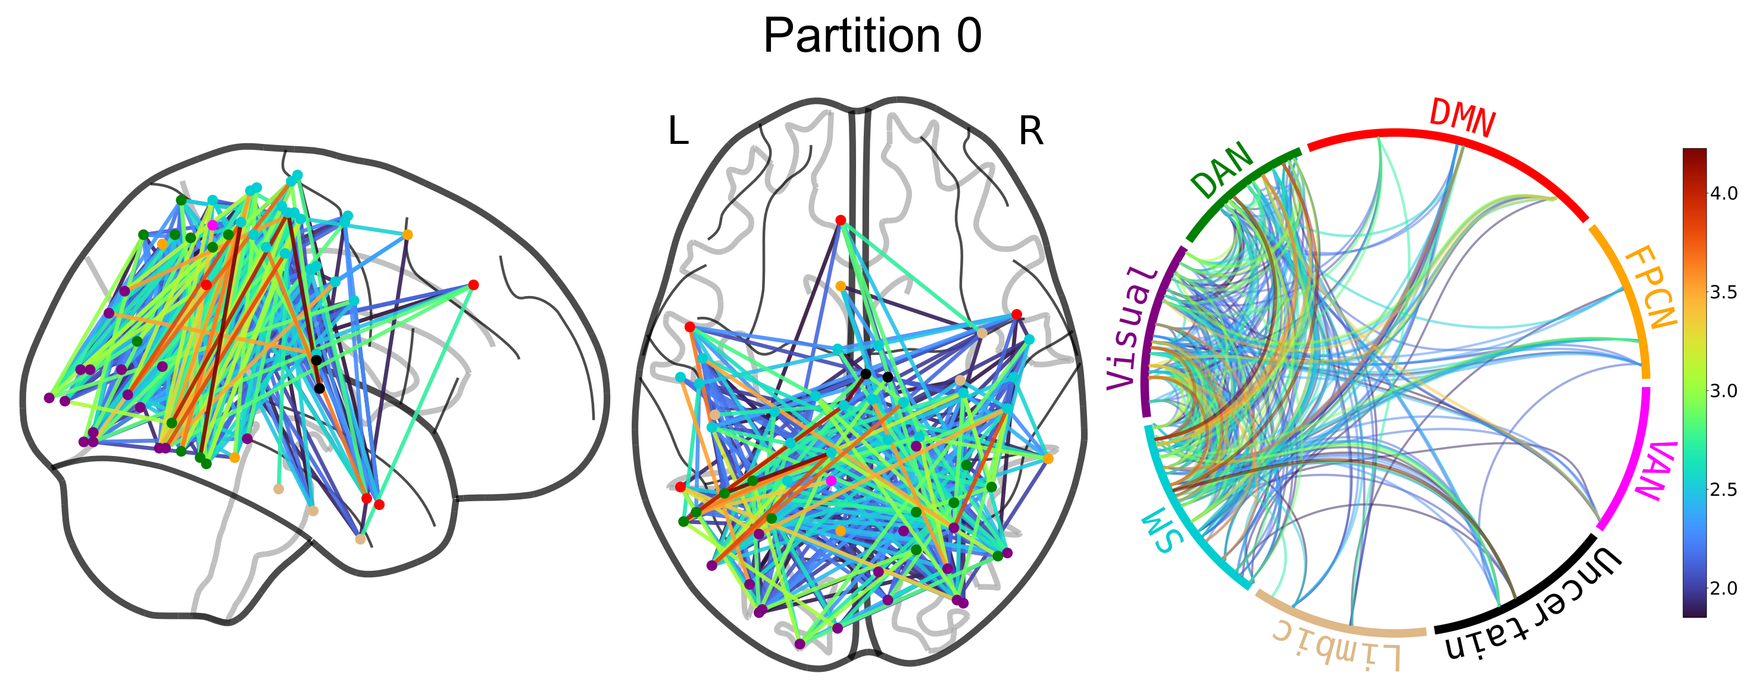
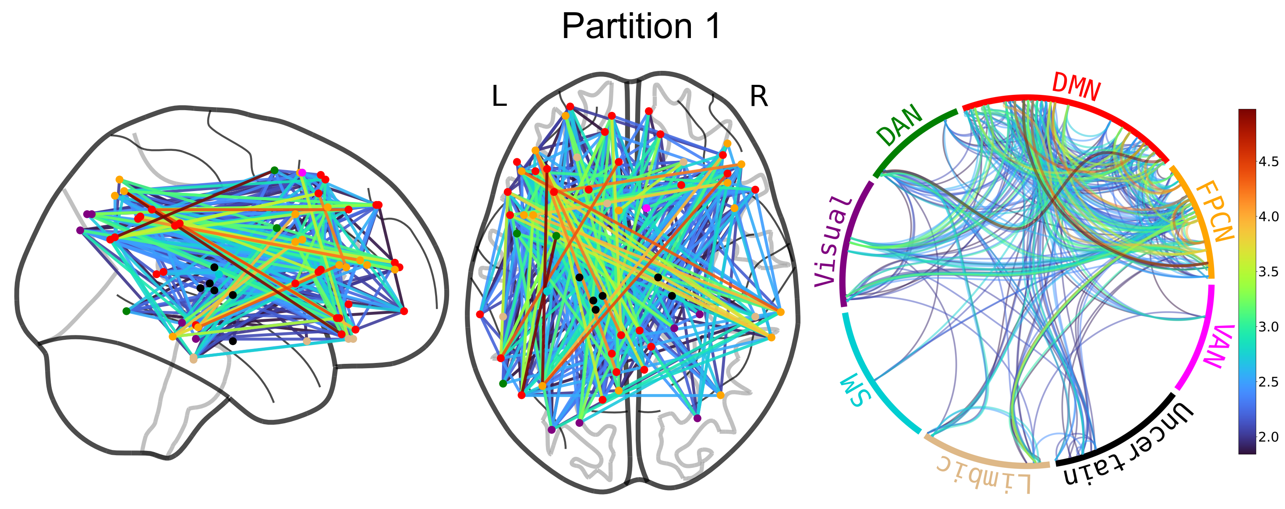
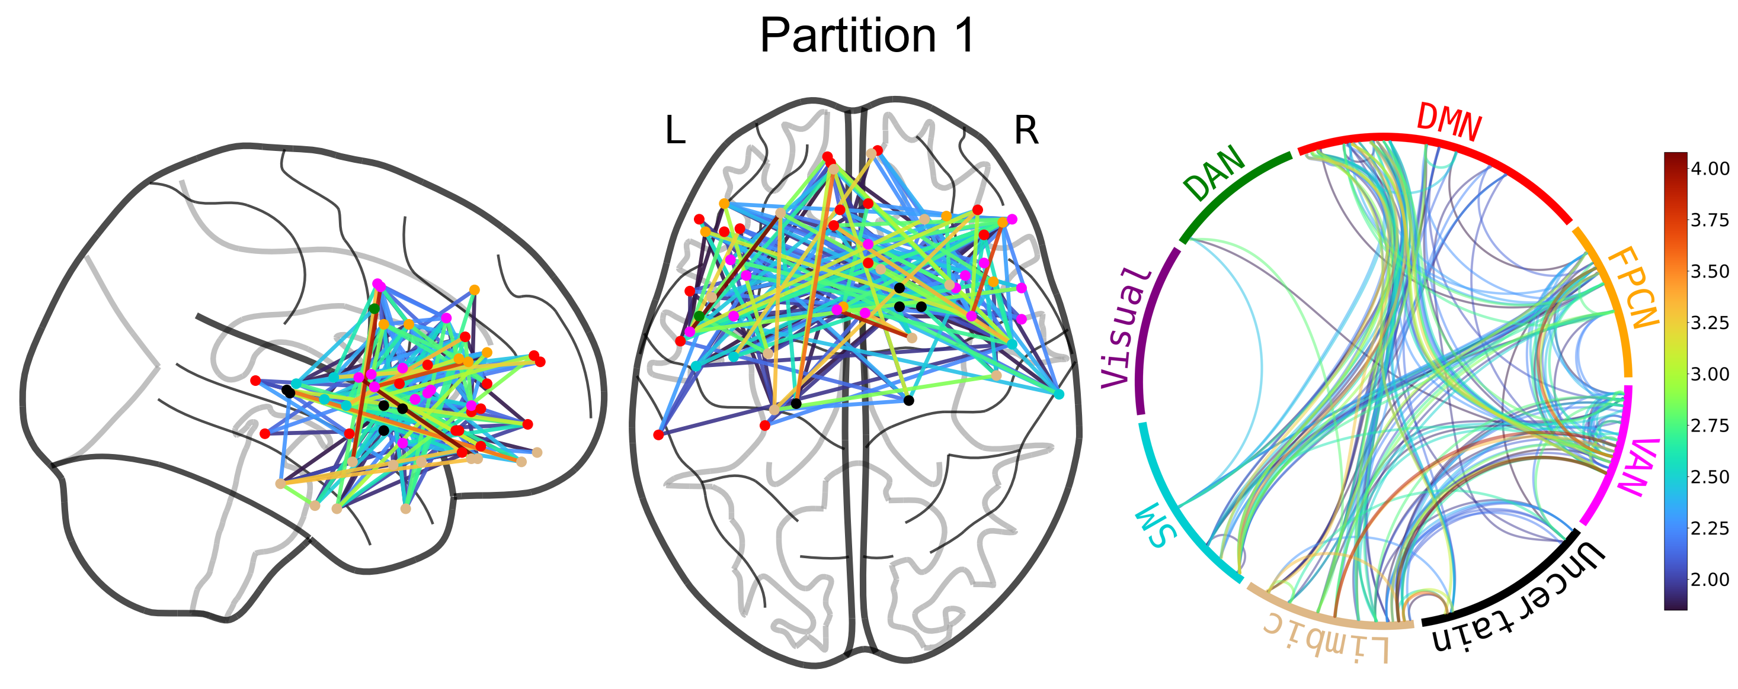
Modularity analysis of the congruency t-graph
Aging leads to a dorsal-ventral division of congruency processing
Congruency
Congruency
Incongruency
Incongruency
Average connectivity within one of these “modules” does not predict subsequent memory
Notes:
Could do the models to formally test YA vs. OA. Look at between/within
Correlate item accuracy with between/within average

Slide 18
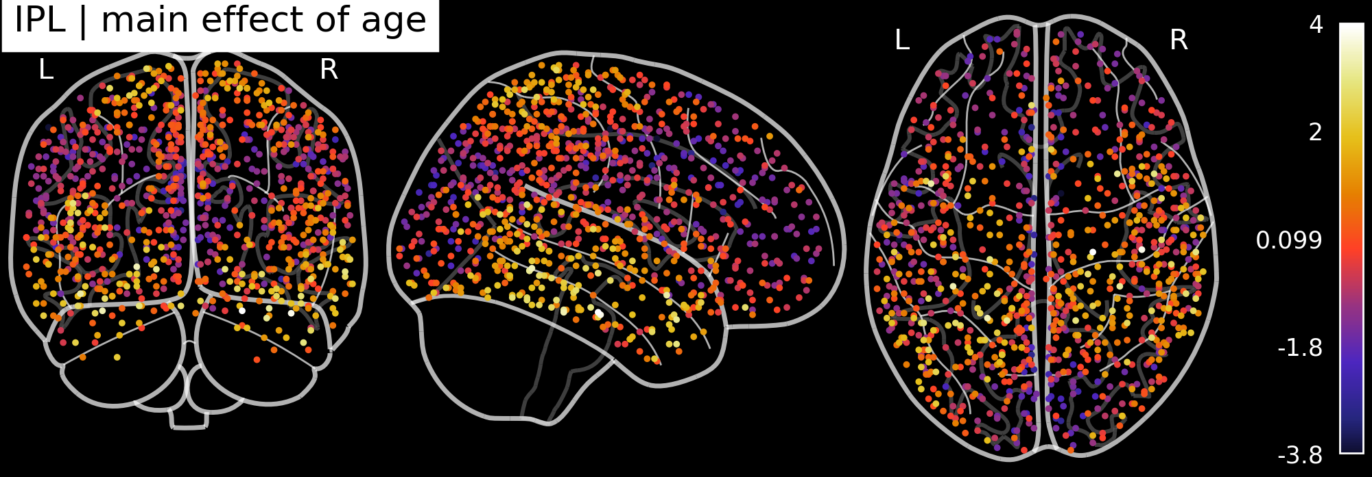
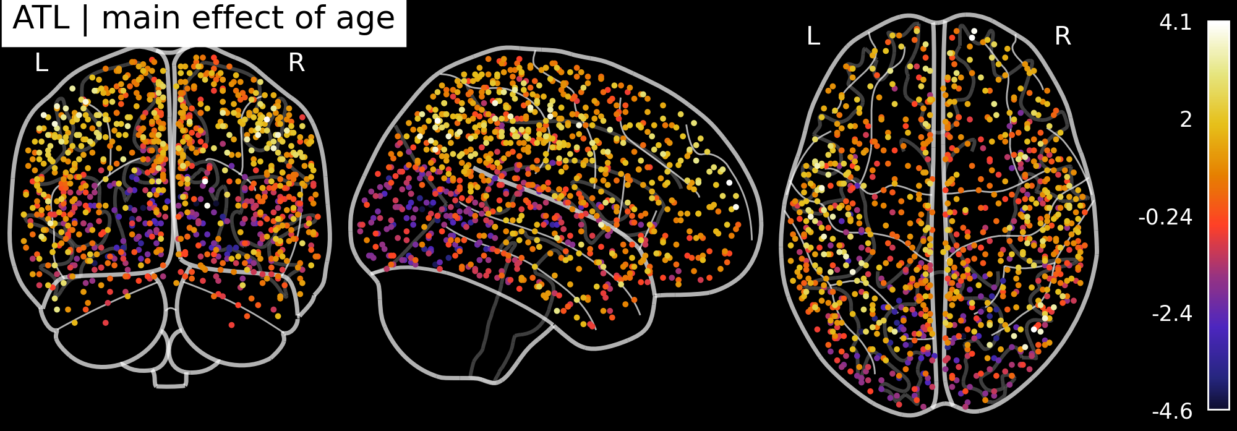
Main effect of age
Positive (bright color) = higher in YA
Negative (dark) = higher in OA
Incongruency leads to YA becoming more like OA
Maybe could look at a contrast with rs-fMRI to establish that these are task-related differences

Slide 19
Tried regressing memory accuracy on scene RSA
Hit ~ IPL * MFG + LOC * ATL + (1 | subject)
Does not yield reliably significant results
  I tried switching around the dependent variable (visual vs. conceptual hit) and the terms

