Slide 1
Paul Update
10/3/2023

Slide 2
Lifu dissertation results

Slide 3

3-session fMRI study (SchemRep)
Baseline: rated image-label typicality for objects
Encoding: Presentation of scene and object. Rated how likely one is to find the object in the scene
Retrieval: conceptual old/new followed by visual old/similar/new

Slide 4

Lifu results 1.1

Slide 5

Lifu Results 1.2

Slide 6

Lifu Results 2.1

Slide 7

Lifu Results 2.2

Slide 8

Lifu Results 2.3

Slide 9
Warning: Results may shift

Slide 10



Preprocessing
As Cortney said, the data will be preprocessed again
Also, as we discussed in the lab meeting, we will need to discuss exactly what will be done about the within-run point
There are also questions about what exactly it means to “regress out” (e.g., should it be done run by run?)

Slide 11



Emerging property
If including within-run analysis, then we see similar IRAF across all ROIs for a given trial

Slide 12
Proposed direction

Slide 13
Background
Predictive coding theory argues that all information is processed in terms of prediction errors
  Prediction error is a computational mechanism used across the brain
    Goes well beyond early theories that reward prediction error underlies behavioral learning and ventral striatum processing
  Perceptual prediction error
    Perception depends on the perceived likelihood of encountering a stimulus
  Cognitive prediction error
    Information is processed in terms of prior beliefs and updating
Predictive coding has been studied with univariate analyses
  Perceptual prediction error correlated with activity in both cortical and subcortical regions
Notes:
Prediction error is not just an “outcome” of processing information but rather is a computational mechanism that influences
Example of perceptional prediction error: car honking feels louder in a classroom than on a busy street
Meta analysis: Corlett, P. R., Mollick, J. A., & Kober, H. (2022). Meta-analysis of human prediction error for incentives, perception, cognition, and action. Neuropsychopharmacology, 47(7), 1339-1349.
Perception results: Iglesias, S., Mathys, C., Brodersen, K. H., Kasper, L., Piccirelli, M., den Ouden, H. E., & Stephan, K. E. (2013). Hierarchical prediction errors in midbrain and basal forebrain during sensory learning. Neuron, 80(2), 519-530.
* dlPFC result (IFG and MFG)

Slide 14
Primary Question
Are stimuli represented as prediction errors?
  No study has genuinely investigated this question
    “Genuinely” = beyond univariate tests
  Yet, this idea is a central element of predictive coding theory
  This question gets at a critical point of contention
    Opponents of the theory accept that prediction error plays some role in the brain (e.g., in the striatum) but push back against these bolder higher-order claims
Multivariate analyses of representations are strong tests of predictive coding theory
  Other neural theories, supported by univariate results, broke down when tested via multivariate methods

Slide 15
Present Study and Hypotheses
Identify areas that make predictions
  Based on schema (scene) presentation, which regions represent the schema?
Among the regions representing the scene, does any area represent the object as a prediction error relative to the scene?
Is prediction error used as a computational mechanism?
  Specifically, is object information encoded as a prediction error?
    Does stronger prediction-error representation predict subsequent memory?
    Are there signatures of prediction error during retrieval, even when the original scheme is no longer shown?

Slide 16
Methods

Slide 17

Data
I looked at the encoding data for SchemeRep
  Object presentation screen
  Scene presentation screen
3 s
3 s
jitter
4 s
Notes:
I learned about how to run Word2Vec + DNNs because Lifu didn’t yet try applying these to the scene images
However, I didn’t do the word2vec properly, so I don’t provide results on that

Slide 18
3-session fMRI study (SchemRep)
Baseline: rated image-label typicality for objects
Encoding: Presentation of scene and object. Rated how likely one is to find the object in the scene
Retrieval: conceptual old/new followed by visual old/similar/new

Slide 19






Behavioral results

Slide 20

Brainnetome atlas
Used by Lifu and Shenyang
246 ROIs
  Cortical and subcortical
Notes:
Notably organized into:
EVC
LOC
FuG
ATL
Hippocampus
IFG
MFG
SFG

Slide 21

Stimulus representations
Single trial
Presentation of the scheme serves to inform the prediction
  RSA: scene vector x scene presentation fMRI
  Unsigned prediction error
Presentation of the object may elicit a prediction error
  RSA with the absolute-difference vector x object presentation fMRI
  Confound risk:
    Driven by solely the object
    Driven by solely the scene
  Hence:
    Regress out object RSA z-score and scene RSA z-score
-
=
absolute
difference
1
2
3
4
5
1
2
3
4
5
1
2
3
4
5
Trial 1
Trial 1
Trial 1
Trial 2
Trial 2
Trial 2
Trial 3
Trial 3
Trial 3
Trial 4
Trial 4
Trial 4
Trial 5
Trial 5
Trial 5
Object RDM
Scene RDM
Abs-Dif RDM

Slide 22
Many ways to interpret the abs-difference vector
Psychological meaning of the difference vector:
  Prediction error:
    Scenes establish a “prediction” that may be violated
    Predictive coding theory argues that all information is processed as prediction errors
  Priming:
    Scenes prime some representations, which will show weaker/stronger responses if activated again by the object
    Link to repetition suppression
  Relational memory:
    Broadly: The informational content of items influences how an association is encoded
    Specifically: Associative memories do not just blindly connect item representations. Rather, associations should be seen as representations that encode the relationship between the items
Speculative:
  Unclear meaning yet informative
    There is no clear psychological meaning of a “difference vector”
    Nonetheless, because this measure combines object and scene information, the findings must reflect some type of interaction between representations
  Analogical reasoning
    In the analysis, representational similarity entails parallels between trial 1’s scene-object relationship and trial 2’s scene-object relationship (i.e., an analogy)
    Because the analysis is looking for analogies, this implies that this is related to how humans process analogies?
Framed as possible competing hypotheses?

Slide 23


Perceptual vectors
Scene
Object

Slide 24

Abs-dif vector
Pink object
Object Scene
Brown scene
Green scene

Slide 25
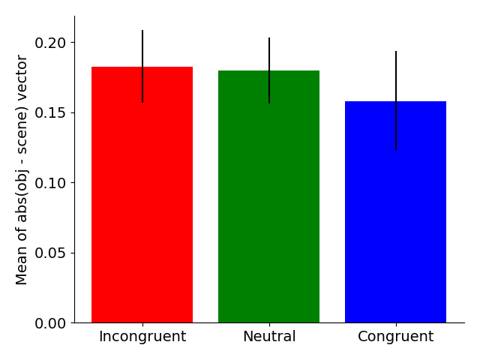

Slide 26
RSA overview
Stimulus RDM based on:
  Object stimulus vector
  Scene stimulus vector
  Object/scene abs-difference vector
fMRI RDM based on:
  Scene-presentation single-trial betas
  Object-presentation single-trial betas
Scene
fMRI
Object
fMRI
Scene
RDM
Object
RDM

Slide 27

Further temporal trend testing

Slide 28



Stimulus RSM/RDMs
Perceptual representations (1st layer of DNN)
The difference vector RSM doesn’t look particularly weird
Although not visualized here, the congruent/incongruent/neutral conditions don’t have much bearing on the vectors or RSMs

Slide 29
Results

Slide 30


Result 1A: Schema representation
Perceptual scene decoding
Semantic scene decoding
PFC
Establishes the prediction
Notes:
Post hoc tests on bilateral SFG, for the eight dmPFC ROIs, t = 4.14. For the six dlPFC ROIs, t = 2.94. SFG bilateral altogether is 4.17.
mPFC overall (including some orbital and CG, yields 3.85. Excluding CG, we get 3.6.

Slide 31


Result 1C/1D: Object representation
Perceptual object decoding
Semantic object decoding
Weak/Null PFC
Reproducing patterns from Lifu’s thesis

Slide 32


Result 2A/2B: Schema-object prediction error
LPFC
Notes:
Downside: Doesn’t pan out for word2vec analysis. lPFC doesn’t pan out for connectivity. Also, doesn’t work if only looking at a single congruent/incongruent/neutral condition
HC result a bit less robust

Slide 33
Result 2A/2B: Schema-object prediction error
Confirmed by an additional “macro-level” analysis focusing on the LPFC overall
  Activation averaged by ROI
    26 ROIs = 26-length vector
    Submitted to RDM
  Significant RSA effect
  (t = 2.1, p = .02)
“Micro”
(standard)
“Macro”
LPFC
Notes:
Downside: Doesn’t pan out for word2vec analysis. lPFC doesn’t pan out for connectivity. Also, doesn’t work if only looking at a single congruent/incongruent/neutral condition
HC result a bit less robust

Slide 34
Result 2C: Connectivity: Activity x IRAF
Related to the linking and boosting points made in the grant/papers
Correlate:
  Region A: Mean connectivity across all voxels for a given trial
  Region B: IRAF
  Note: A x B ≠ B x A
  Test if significantly above zero

Slide 35
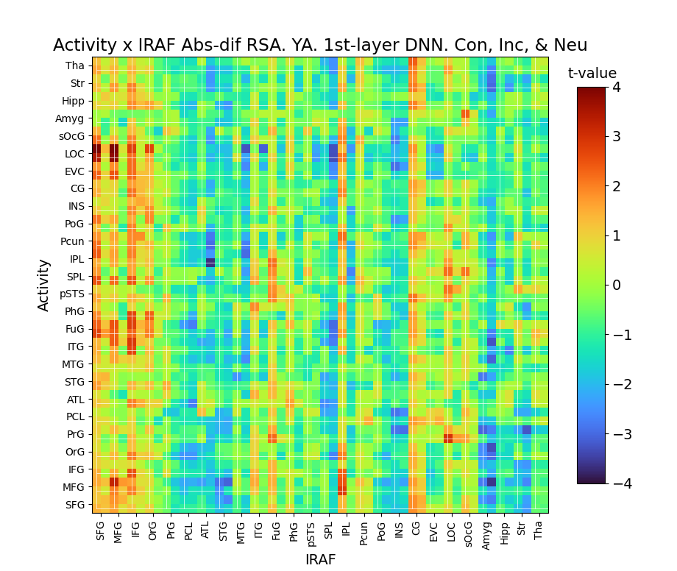
Result 2C: Difference RSA x connectivity
MFG IRAF linked to stronger LOC connectivity
  General pattern of LPFC-Occipital
  Possible link to fusiform gyrus and posterior inferior temporal lobe as well
Notes:
The amygdala also shows an interesting pattern
Stronger representation in the amgydala is linked to decreased connectivity with everything else
Beyond the present focus?

Slide 36
Result 3A: Prediction error IRAF predicts subsequent memory
LPFC abs-dif IRAF predicts subsequent memory

Slide 37


Result 3B: Retrieval retrieves scene representation
Conceptual task: Scene RSA
Visual task: Scene RSA

Slide 38
Other things

Slide 39


Modularity
Replicate modules identified by Lifu

Slide 40
Encoding retrieval similarity
We see correlations:
  Baseline x encoding
  Baseline x visual (ERS)
  Encoding x visual (ERS)
Possibly interesting further work:
  Similarity is, in part, due to the same representation being activated
  Hence, we would expect to see an IRAF x ERS correlation
    Further, we would expect the correlation to be stronger based on what type of stimulus properties are used to calculate IRAF
    (e.g., if using DNN vectors, we would expect stronger IRAF x ERS in occipital, but if using word2vec vectors, we would expect stronger IRAF x ERS in ATL)
  Not sure how this could be useful. Maybe this can prove to be a more sensitive measure than RDM x RDM correlations?

Slide 41
Whiffs

Slide 42
Other analyses
Can you do RSA with respect to the fMRI difference vector?
  E.g., examine whether presenting a scene shifts the neural representation of the object between baseline ➜ retrieval
    [Scene stimulus vector] x [baseline-fMRI minus visual-fMRI]
    Overlapping ideas with that journal club paper we read on semantic shifts after learning
  No significant results
    This route may have potential, but it may just be too much of a stretch given the present design
Does congruency lead to connectivity patterns during scene presentation being more correlated with connectivity during object presentation?
  No, it doesn’t
If you calculate single-trial connectivity based on the scene x object betas (binary connectivity), and submit the data to RSA, will you find significant results?
  No, not really
  Found one significant RSA result:
    Within-occipital-lobe-connectivity x last-layer-activation-DNN
    My guess is that this is spurious

Slide 43
Study ideas

Slide 44
Generalize the past, pinpoint the future
Hypothesis: When people think about an event, they have a broad imagination about what could have led to it, but narrowly consider what will follow the event.
Encoding task (roughly):
  Participants view a series of images, linked together sequentially (e.g., by telling participants that they’re traveling between locations)
  Same images are shown repeatedly
Retrieval (roughly):
  Cue participants with an image, and ask them to freely recall “all the images that may have preceded/followed” the cue
  Different further design elements can be included to test hypothesis

Slide 45
Episodic memories as state transitions
Do participants encode episodic memories as “state transitions”?
  Suppose participants view the sequence A-X-B and A-Y-B. Later, participants are asked to retrieve X and Y. In the retrieval test, will we see a positive correlation between X and Y activation patterns?
    By “correlation” I mean in the sense of encoding-retrieval similarity
  Confirmatory analysis: the X-Y similarity is greater than the “baseline” correlation between X and Y during encoding
Furthermore, if participants also view the sequence B-Z-A, is Z less correlated with X and Y?
  Z × X < X × Y
  Z × Y < X × Y
  Evidence that the directionality of A ➜ B is imbued in the representation of X and Y
Could also look at difference vectors, like for SchemeRep

Slide 46
Investigating hippocampal traces
Encoding an association between items X and Y requires:
  Representing X
  Representing Y
  Binding the two
Analysis:
  Investigate interplay between X-IRAF, Y-IRAF, BOLD activation, and memory accuracy
  Looking at encoding fMRI data:
    Accuracy ~ PFC_{X-IRAF} × PFC_{Y-IRAF} × HC_{BOLD}
  Looking at retrieval fMRI data, does cuing with X lead to activation of Y representations?
    PFC_{Y-IRAF} ~ PFC_{X-IRAF} × HC_{BOLD} (hit trials only)
    Linking X and Y without HC involvement may reflect consolidation
Maybe with some tweaks to the task, we can use it to compare different memory trace theories

Slide 47
Possible aging effects
Show less of a directionality effect
  The past-generalizing vs. future-pinpointing directionality effect
Retain representations of prior stimuli for longer/shorter intervals
  To what extent is the trial n stimulus maintained in working memory for trials n+1 or n+2?

Slide 48
(Beyond the task)
Older adults prototype rather than generalize
Prototyping = link stimuli to a previous similar “prototypical” stimulus
Generalization = identifying patterns common across multiple stimuli
May reflect past knowledge influencing encoding
Red = first stimulus presented
Testable behaviorally and via fMRI

Slide 49
Analyzing generalizing and prototyping
5-stimulus group (u, v, w, x, y)
During some experiment phase:
  Measure pairwise correlations among u, v, w, x, and y
  Examine whether the correlations are more consistent with the diagram on the left vs. right
Notes:
u, v, w, x, y

Slide 50
Other possible aging effect
Instead of more prototyping, maybe they show the opposite: more generalization due to only encoding gists and using crystalized knowledge
  Could get at this gist idea with an R/K test

Slide 51
Analyzing generalizing and prototyping with combination features (not done)
Identifying generalization:
  Integrating stimulus vectors
  One way to combine: Elementwise multiplication (u × v = g) will yield a product vector that represents features common across the two
    Other ways may work better for 3+ stimuli
    Definitions linked to computational memory theories?
  Examine whether participants retrieve g
    Perform RSA with the “generalization” vector g
Identifying prototyping
  Again, integrating stimulus vectors, but now to create a “prototype” vector (p)
  If u is the prototype…?

Slide 52
Extension into decision-making
Idea: Replace every other “location” with a “decision”
Participants are given a choice that influences the next image that will be shown (what location they will travel to)
  E.g., at location A, participants can choose between options X or Y, which will take them to locations B or C
  The options themselves are stimuli (e.g., “X and Y are magical objects that will teleport you to a new location”)
  “Selecting X/Y” is the episodic memory formed
Retrieval task:
  Could include a task where participants are asked “you are in A and you want to get to B, should you select X or Y?”
Downsides:
  Issue 1: different participants will see different stimuli, maybe some will not show diversity in their decision-making
  Issue 2: less statistical power for investigating state transitions (half as many state transitions)

Slide 53
Expanding to incorporate others’ interests
This is still on associative memory, so hopefully, Cortney would like it
I think Ricky’s interest in task sets and the instructions about focusing on perception/semantic information could be incorporated?

Slide 54
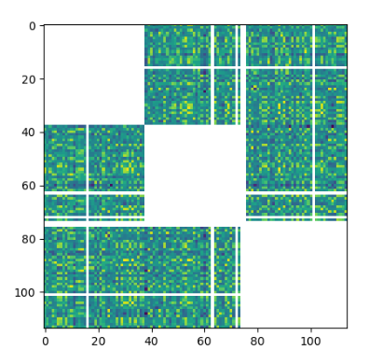
After removing outliers

