Slide 1
SchemeRep
January 8, 2024

Slide 2
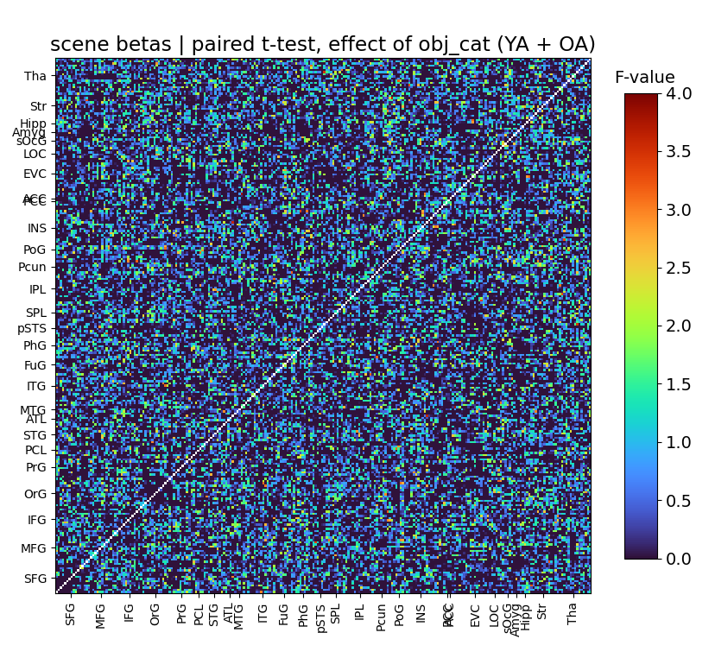
Item category ANOVA
Object categories:
  Living animal
  Living plant
  Non-living small
  Non-living medium
  Non-living large
The number of edges crossing some threshold (e.g., p < .05) crosses what would be expected due to chance (2000 significant vs. 1500 expected false positives)

Slide 3
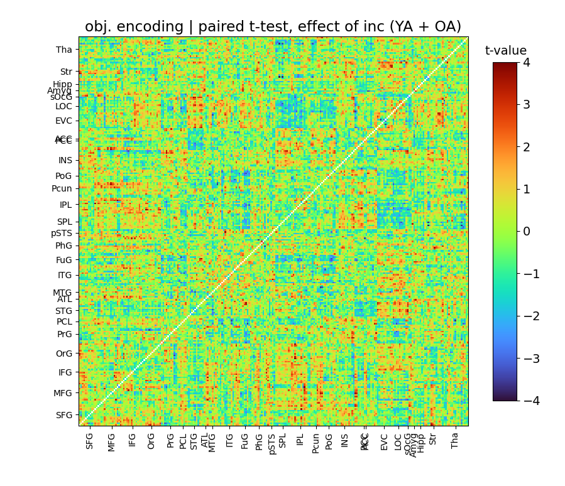
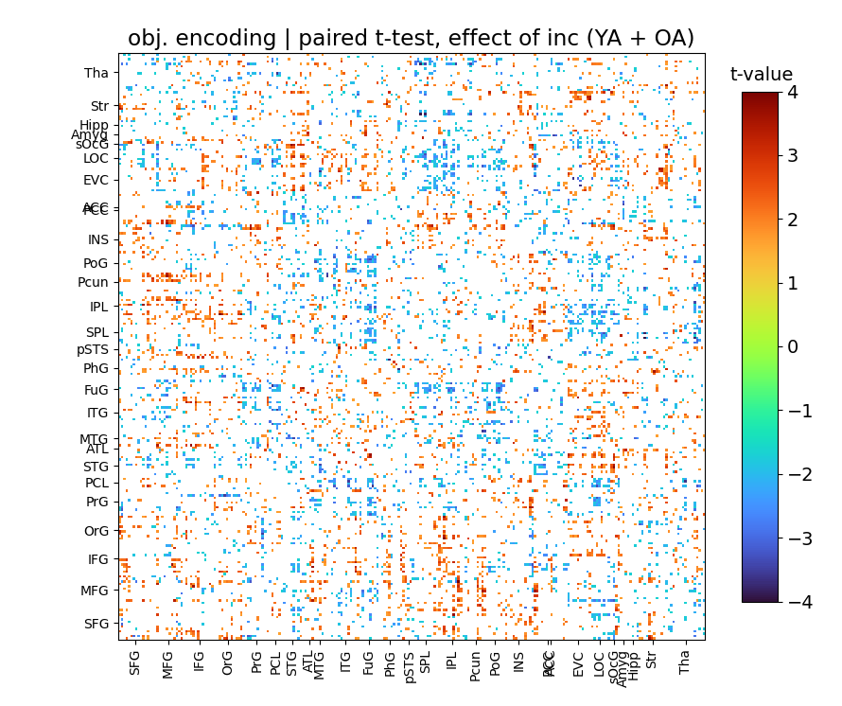
Congruency t-test
3600 edges cross p < .05
Hence, there definitely is some connectivity-related phenomena going on

Slide 4
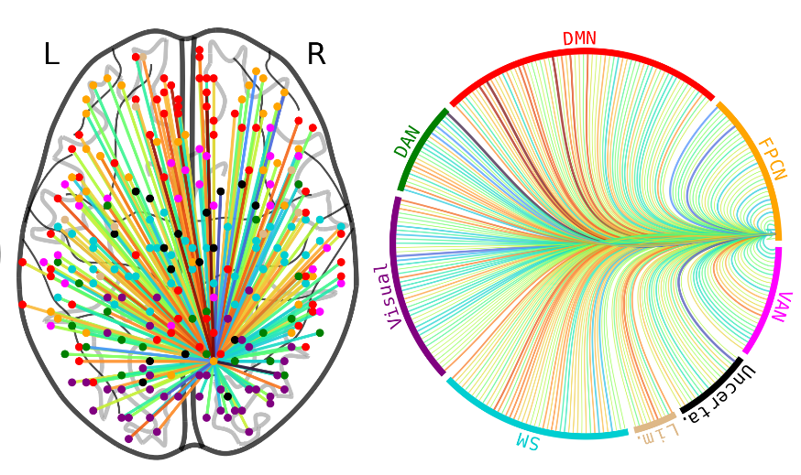
Congruency t-test
3600 edges cross p < .05
Hence, there definitely is some connectivity-related phenomena going on
However, it’s not an obvious effect and we need methods to compress these thousands of edges into meaningful patterns
  Multivariate approaches do this (e.g., classification-based methods)

Slide 5
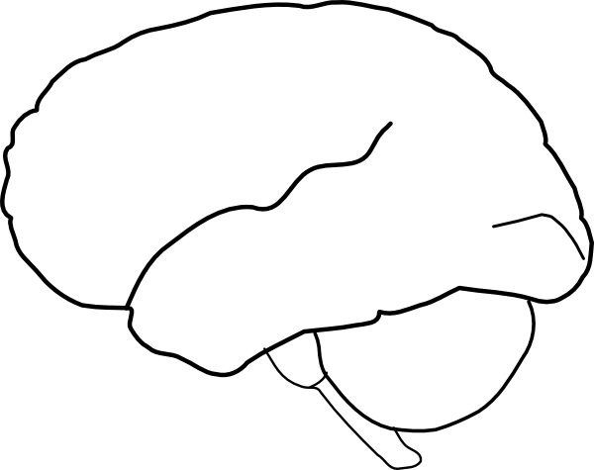
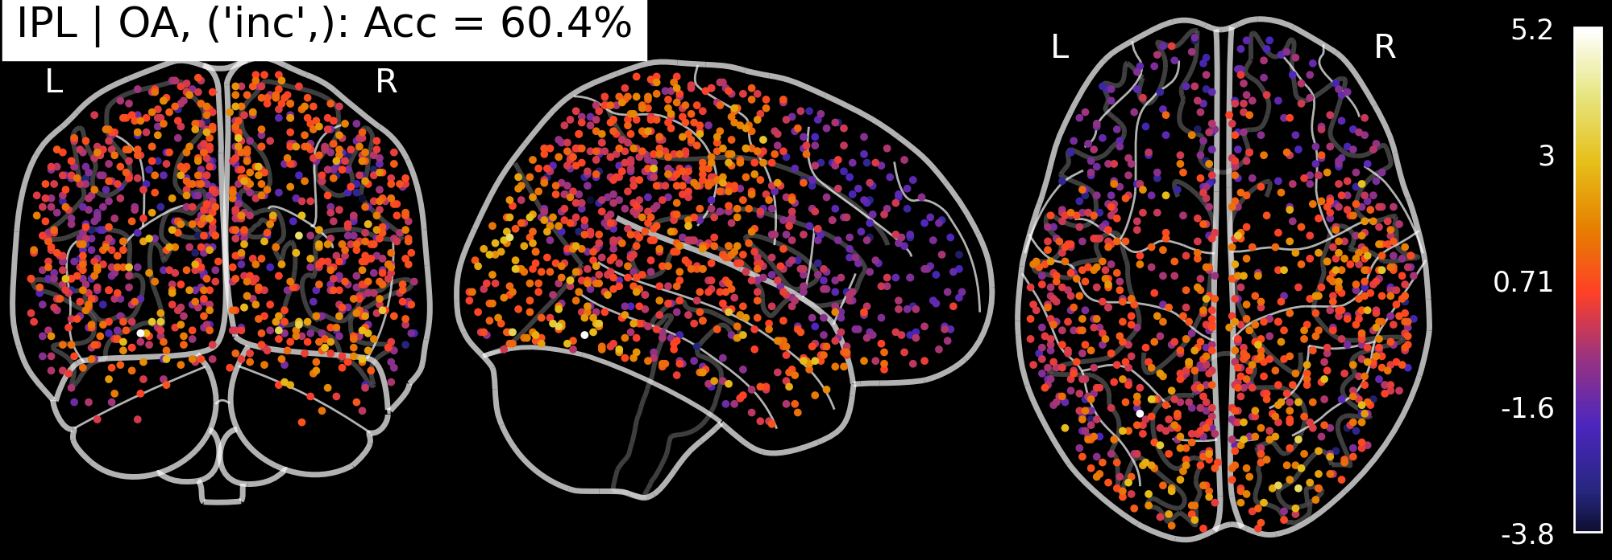
Older adult sensitivity to congruency
Congruency
Incongruency
Ventral stream

Slide 6
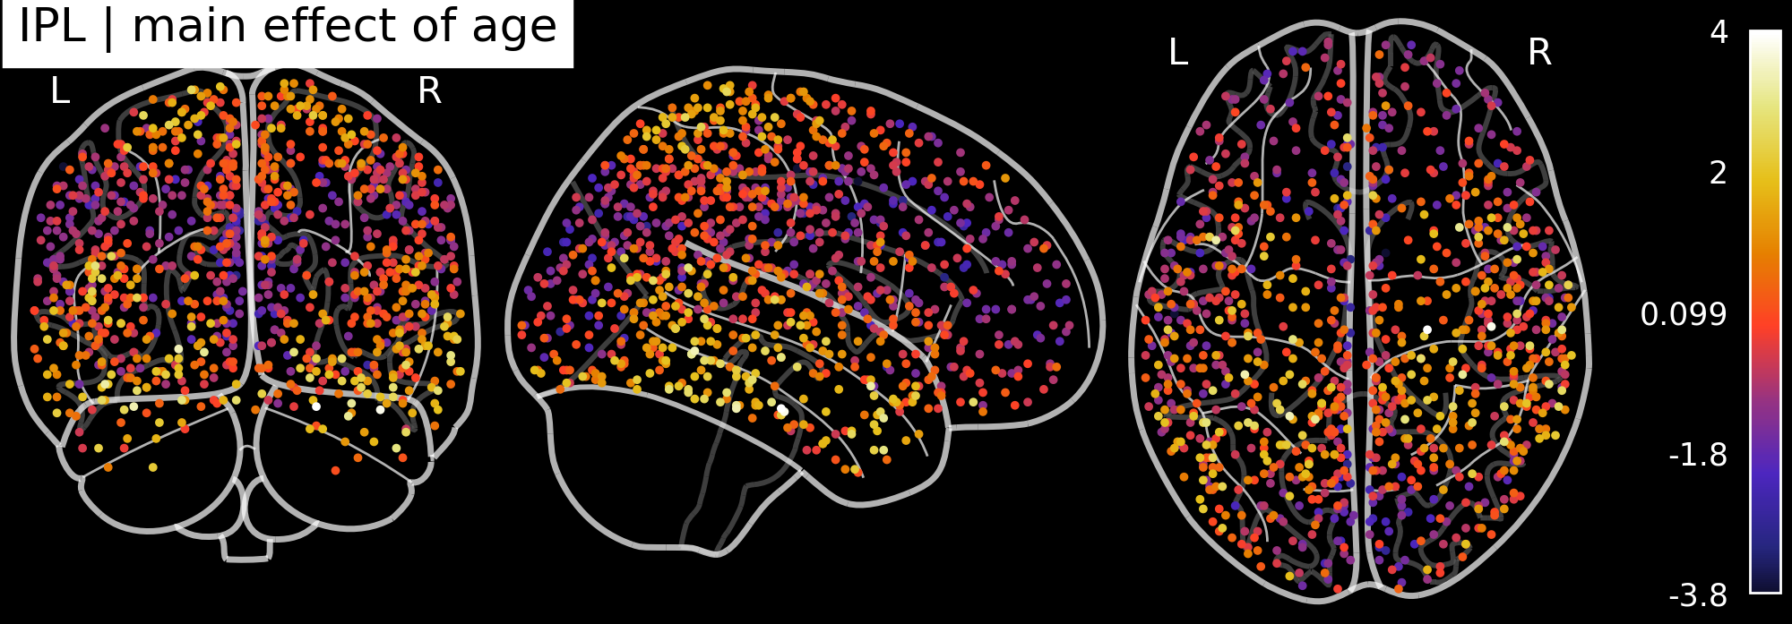
Main effect of age
There are notably main effects of age linked to these regions
  Younger adults show greater IPL-FuG and IPL-ATL connectivity

Slide 7
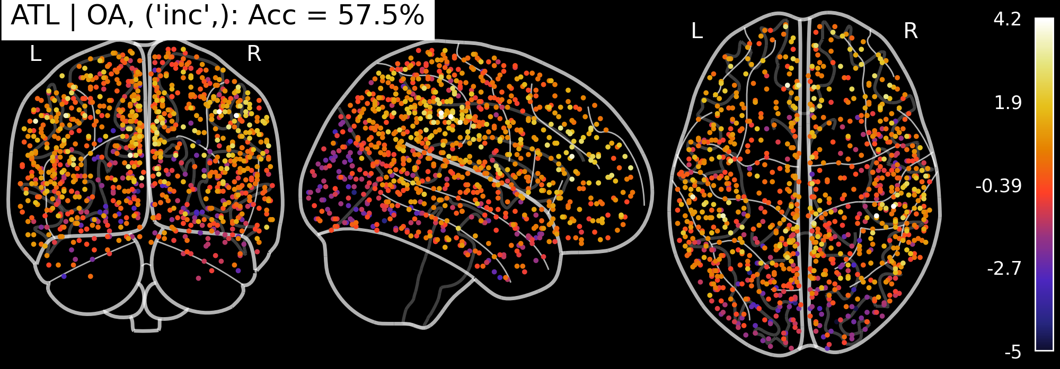
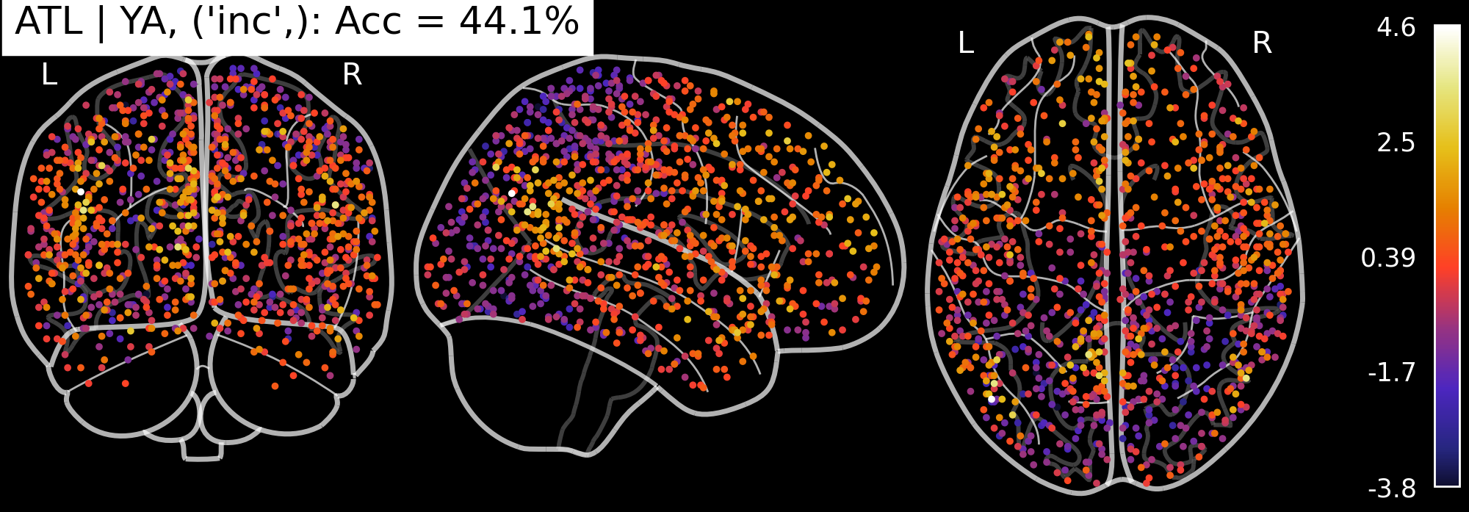
Anterior temporal lobe
Older adults
Younger adults

Slide 8
SchemeRep
January 10, 2024

Slide 9
Older adults are able to recover (compensate?) perceptual processing if it is congruent?
  I need to make bar graphs

Slide 10
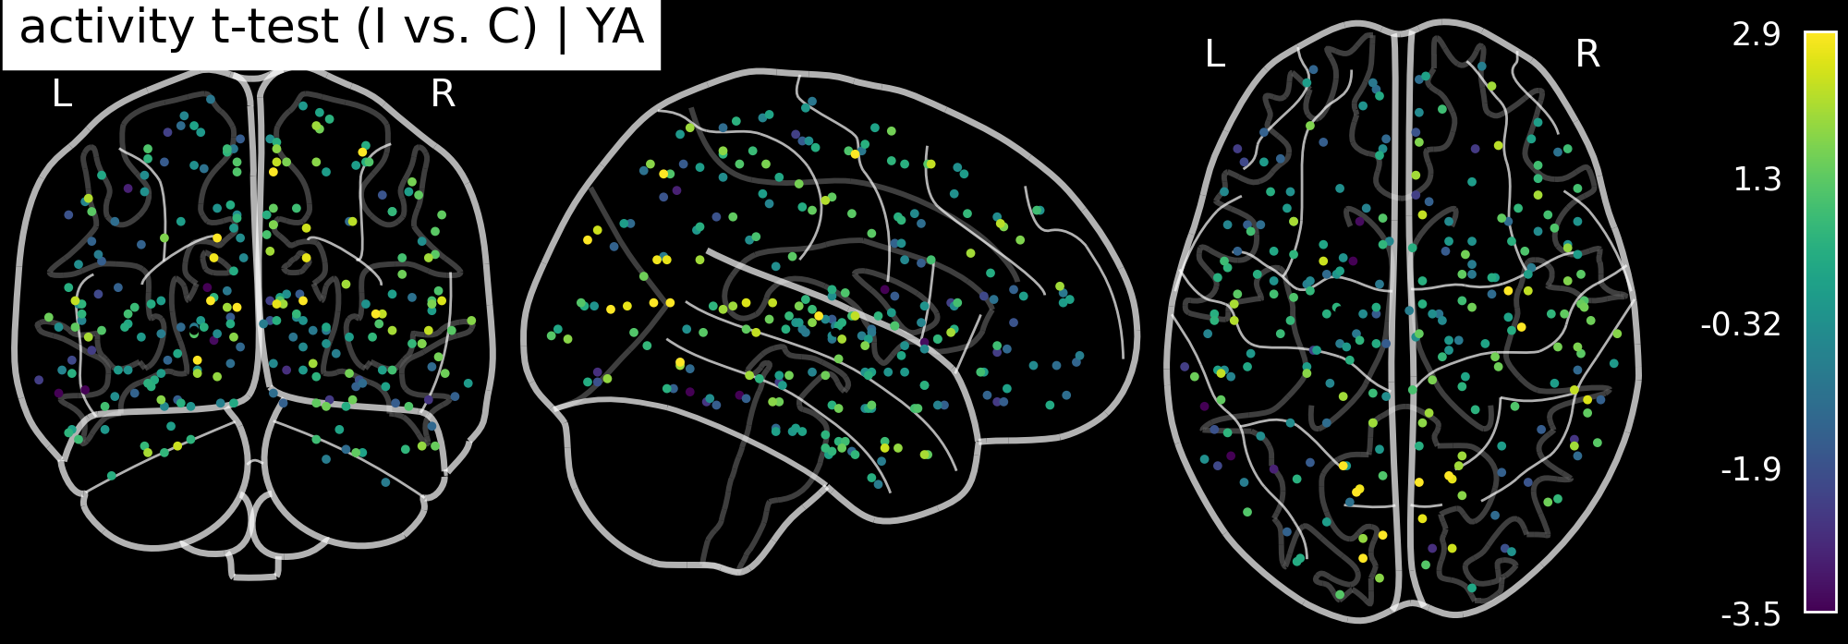
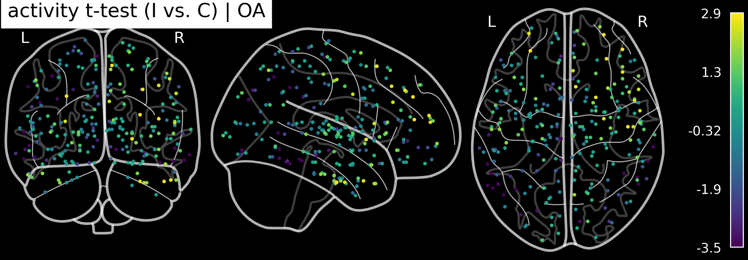
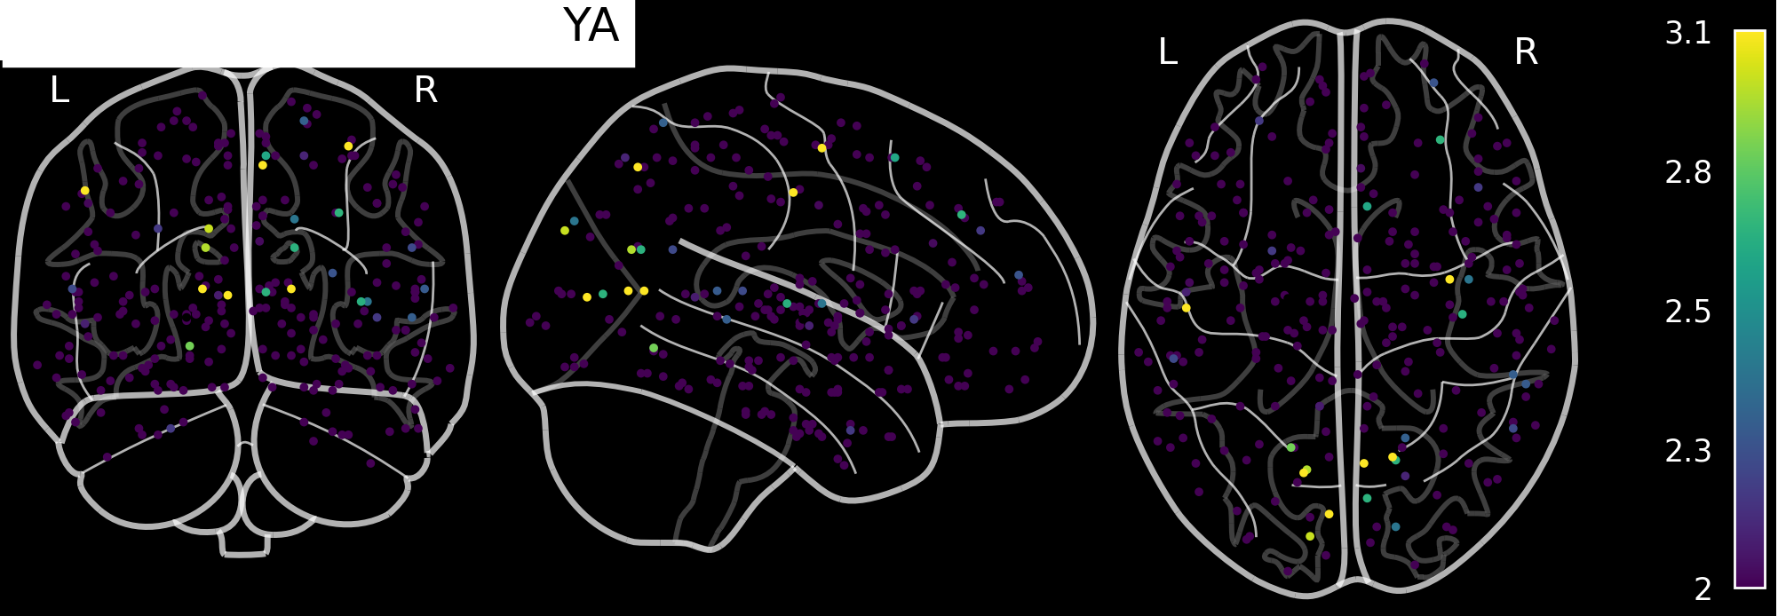
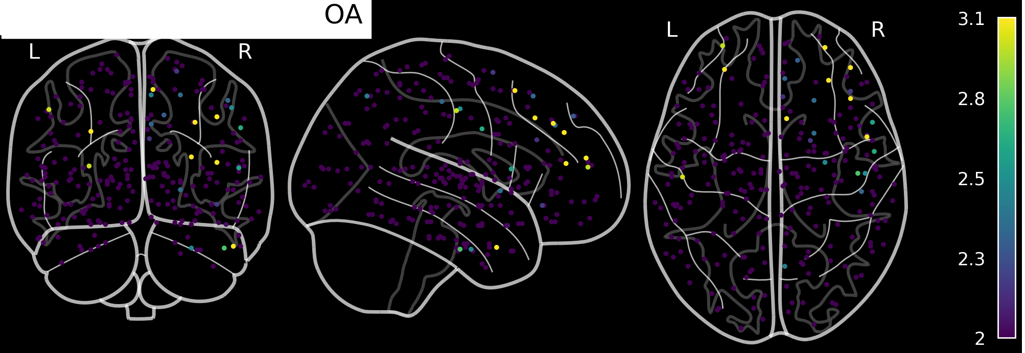
Activation-based analyses
Younger adults
Older adults
Univariate t-test
Subject-specific
classifier
Activity effects are small looking at just a single ROI or a small set may not be enough. Classification greatly improves if looking at large areas (e.g., full occipital + some ventral stream or full PFC)

Slide 11
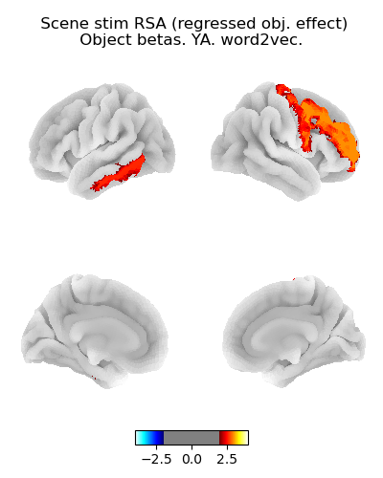
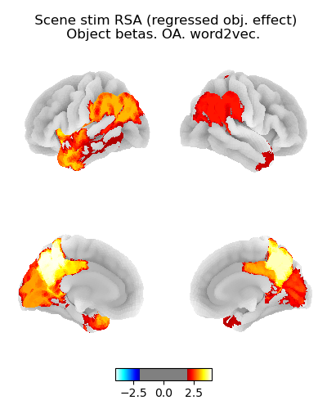
Scene RSA: Object presentation betas
Younger adults
Older adults
Thresholding is liberal (p < .05, uncorrected)
Some activation patterns are likely Type I Errors
t-value
t-value

Slide 12
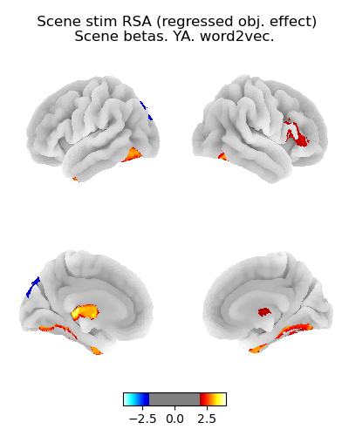
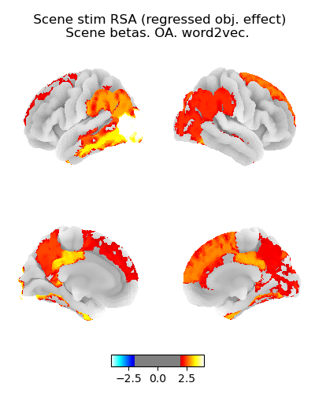
Scene RSA: Scene presentation betas
Younger adults
Older adults

Slide 13
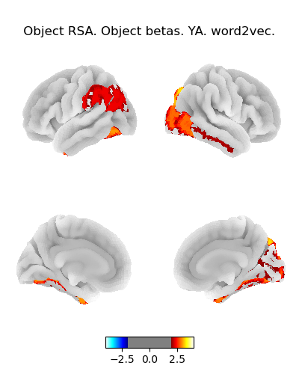
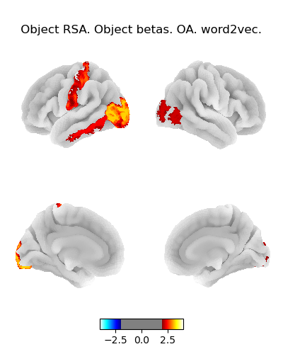
Object RSA: Object presentation betas
Younger adults
Older adults
These results show that OA aren’t representing objects particularly more intensely

Slide 14
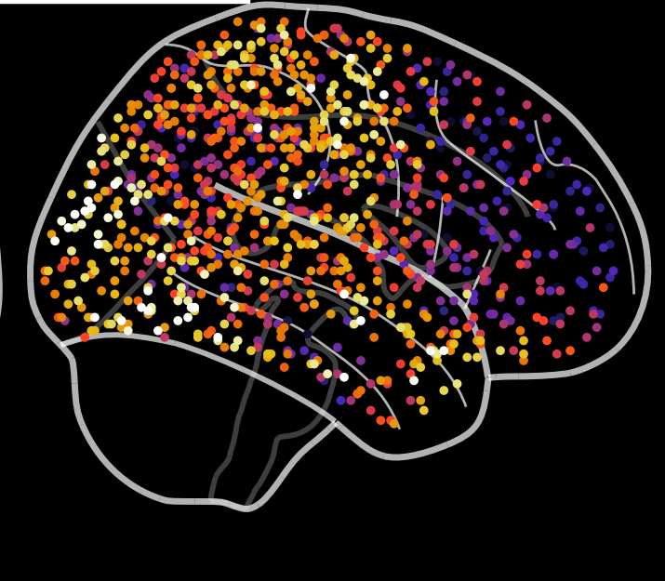
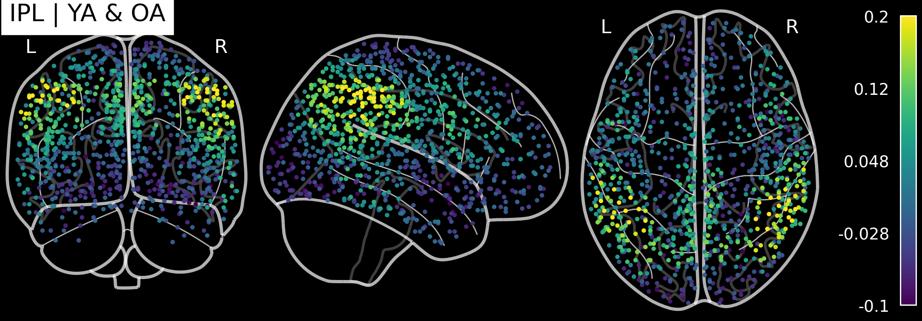
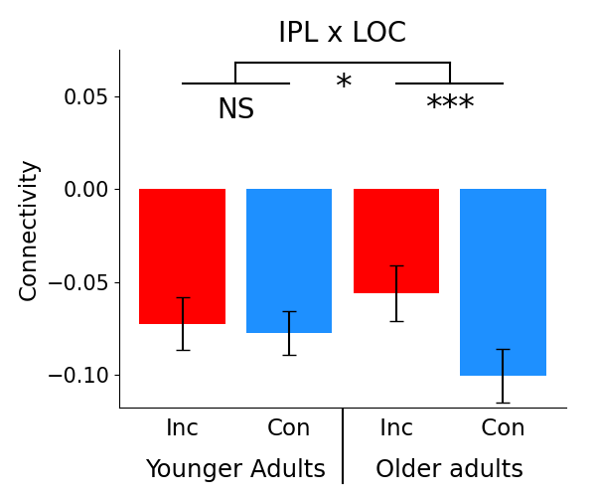
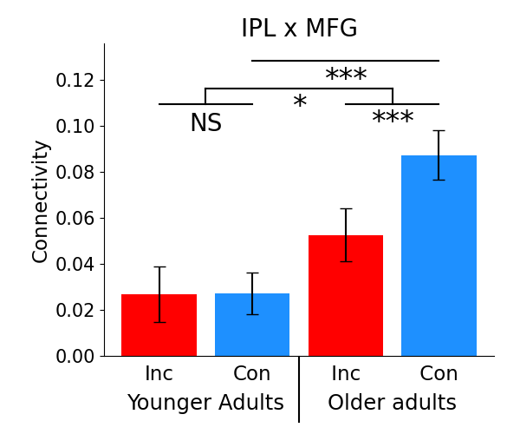

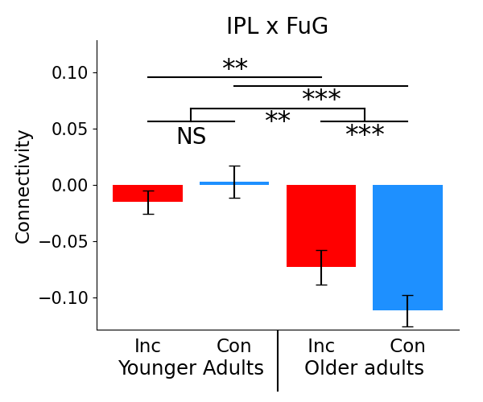
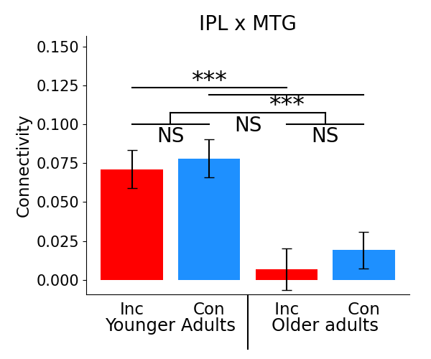
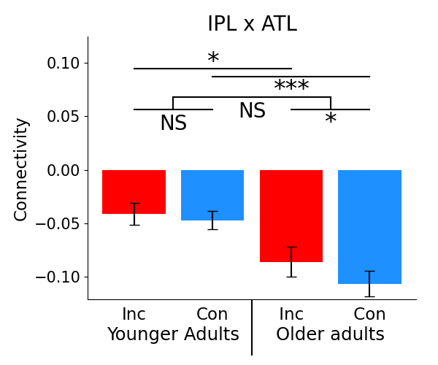
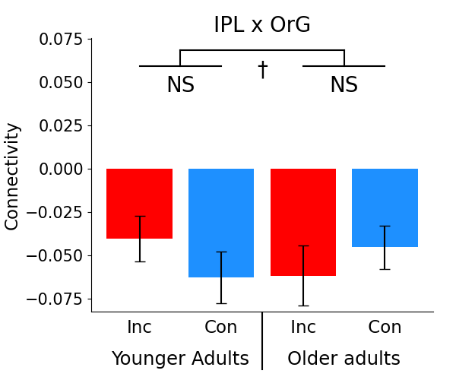
Inferior parietal lobule (IPL)
Mean
FC
Effects in OA
OA t-tests
Congruency
IPL
MFG
LOC
FuG
Incongruency
ATL

Slide 15
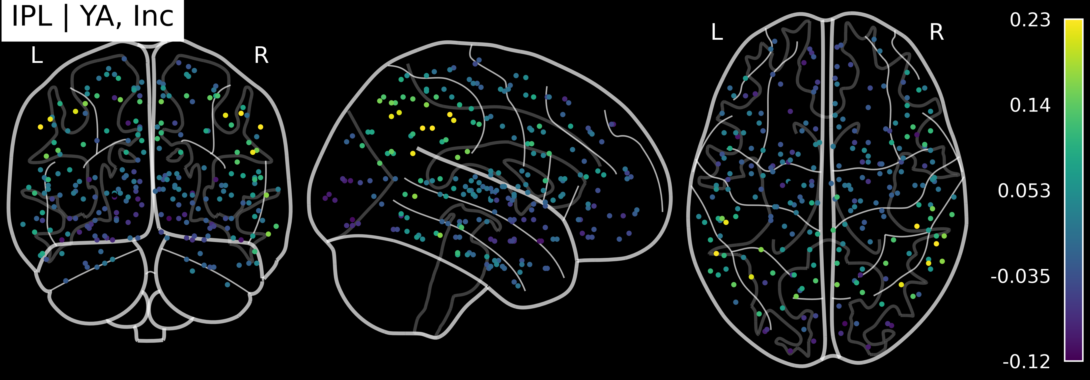
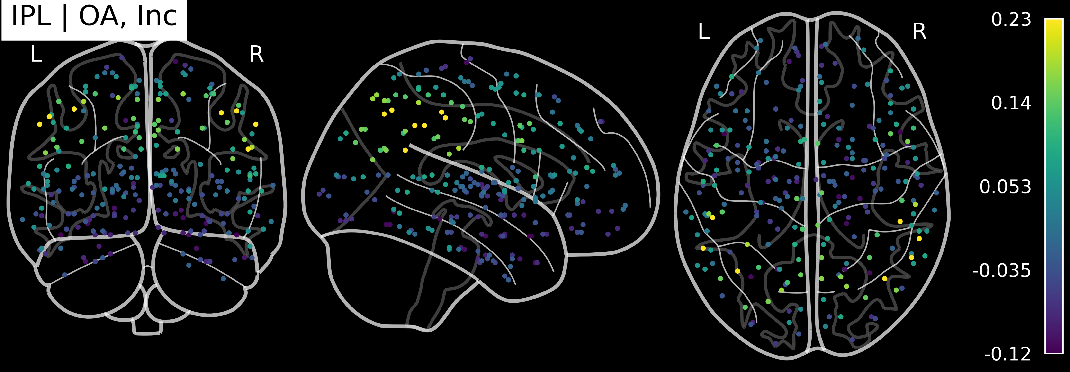
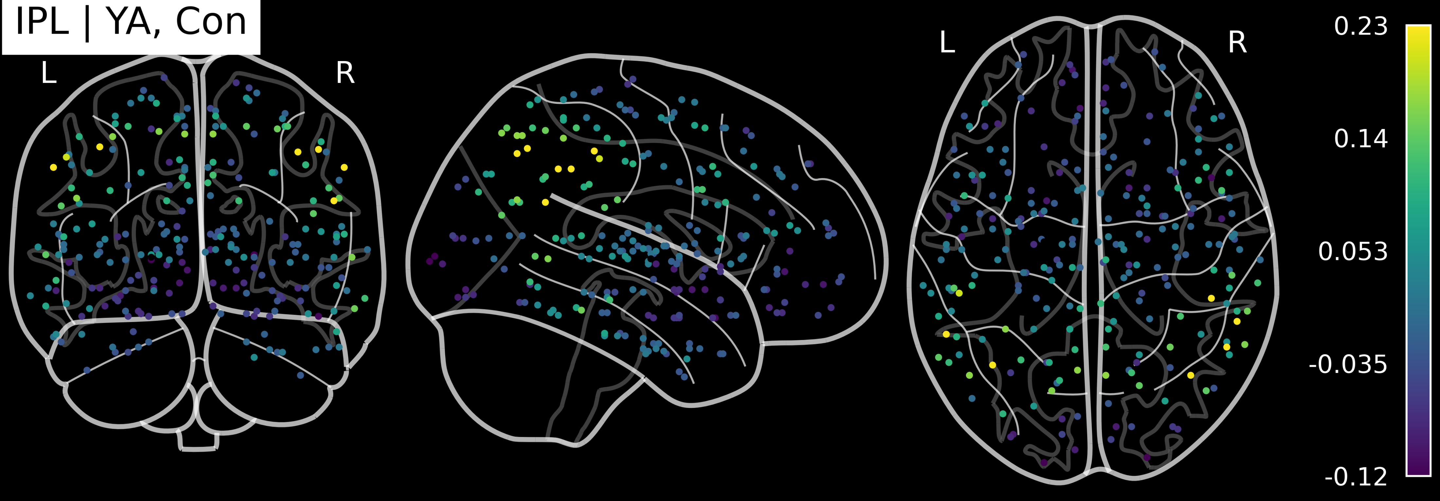
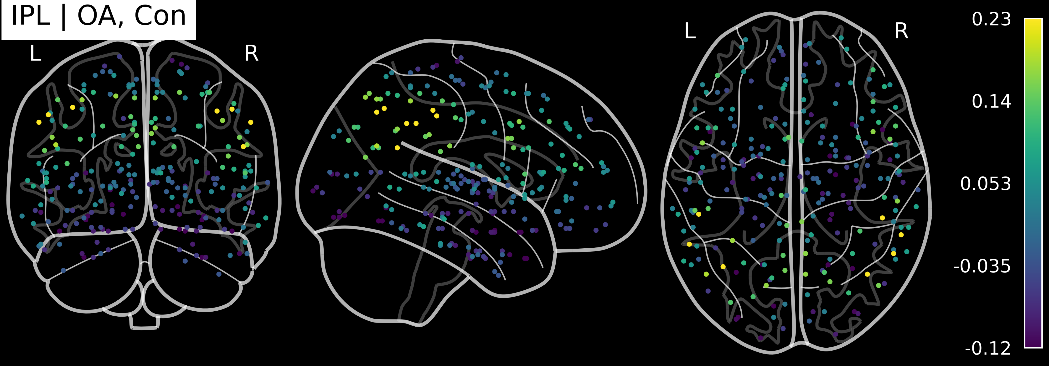
OA vs. YA numerical differences are small
Younger adults
Older adults
Incongruent
Congruent

Slide 16
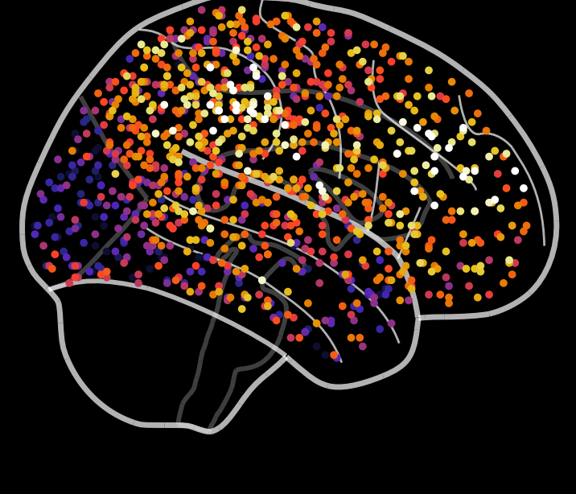
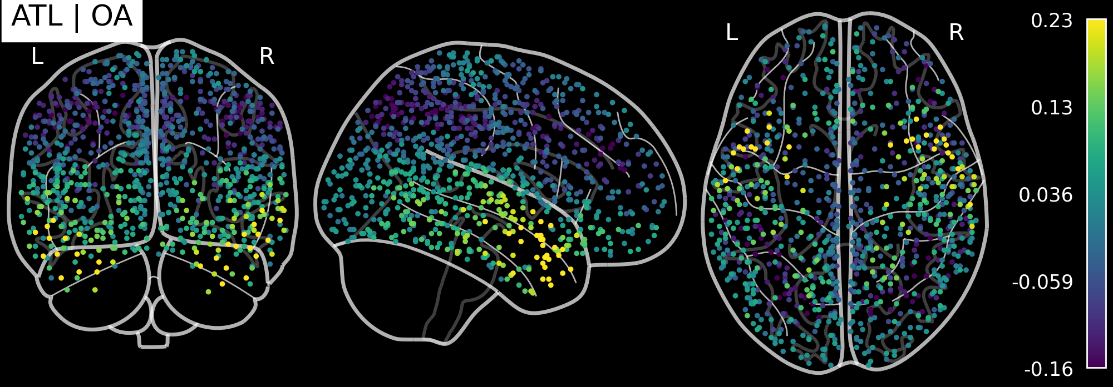
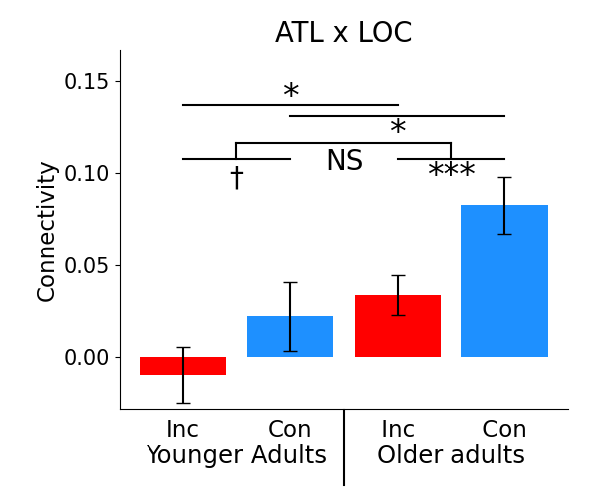
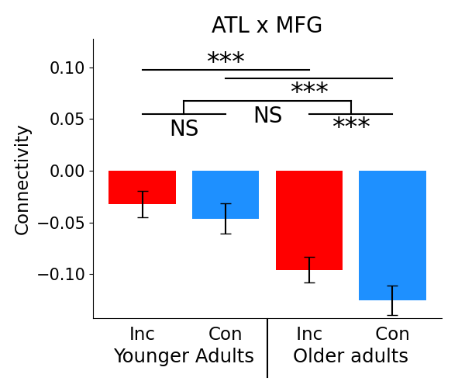
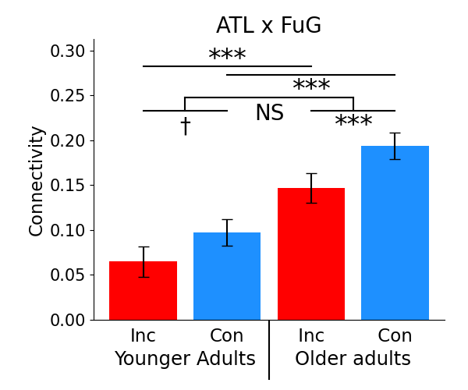
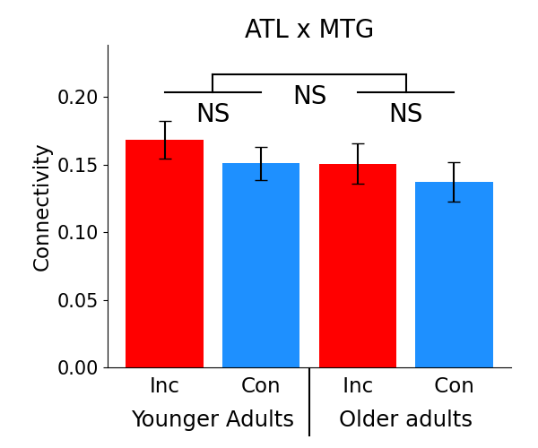
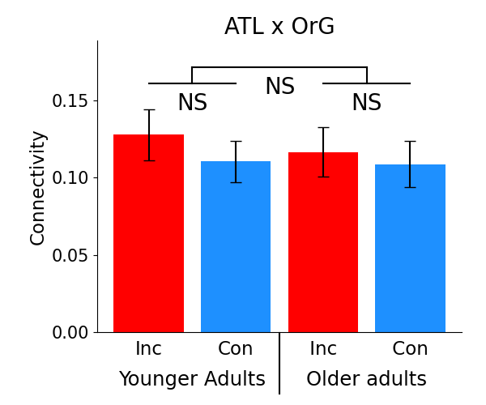
Anterior temporal lobe (ATL)
Mean
FC
Effects in OA
OA t-tests
Incongruency
IPL
MFG
LOC
FuG
Congruency
ATL

Slide 17
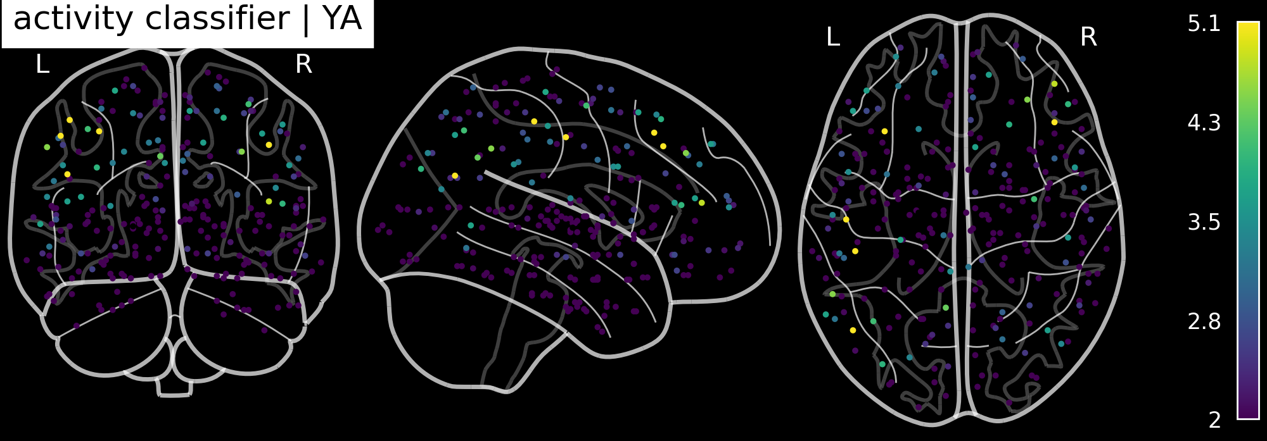


Slide 18
Inferior parietal lobule (IPL)

Slide 19
