Slide 1
Paul Update
9/18/2023

Slide 2
Overview

Slide 3
Methods

Slide 4

Data
I looked at the encoding data for SchemeRep
  Object presentation screen
  Scene presentation screen
3 s
3 s
jitter
4 s
Notes:
I learned about how to run Word2Vec + DNNs because Lifu didn’t yet try applying these to the scene images
However, I didn’t do the word2vec properly, so I don’t provide results on that

Slide 5

3-session fMRI study (SchemRep)
Baseline: rated image-label typicality for objects
Encoding: 3 pre-defined conditions for scene-object schema congruency, subjective ratings 1-4
Retrieval: conceptual old/new followed by visual old/similar/new

Slide 6

Brainnetome atlas
Used by Lifu and Shenyang
246 ROIs
  Cortical and subcortical
Notes:
Notably organized into:
EVC
LOC
FuG
ATL
Hippocampus
IFG
MFG
SFG

Slide 7
Analysis overview
Perform RSA
  fMRI RDM based on:
    Scene-presentation screen single-trial betas
    Object-presentation screen single-trial betas
  Stimulus RDM based on:
    Object stimulus vector
    Scene stimulus vector
    Object-scene difference stimulus vector
  Use IRAF to measure links to subsequent memory hit/misses
Connectivity analysis
  Connectivity between activation x IRAF
  Investigates how one region provides information for another region’s stimulus representations

Slide 8

Stimulus representations
Single trial
Psychological meaning of the difference vector:
  Priming:
    Scenes prime some representations, which will show weaker/stronger responses if activated again by the object
    Link to repetition suppression
  Prediction error:
    Scenes establish a “prediction” that may be violated
    Predictive coding theory argues that all information is processed as prediction errors
    Hard to distinguish from priming view
  Relational memory:
    Broadly: The informational content of items influences how an association is encoded
    Specifically: Associative memories do not just blindly connect item representations. Rather, associations should be seen as representations that encode the relationship between the items
Speculative:
  Unclear meaning yet informative
    There is no clear psychological meaning of a “difference vector”
    Nonetheless, because this measure combines object and scene information, the findings must reflect some type of interaction between representations
  Analogical reasoning
    In the analysis, representational similarity entails parallels between trial 1’s scene-object relationship and trial 2’s scene-object relationship (i.e., an analogy)
    Because the analysis is looking for analogies, this implies that this is related to how humans process analogies?
Possible competing hypotheses?
-
=
absolute
difference
1
2
3
4
5
1
2
3
4
5
1
2
3
4
5
Trial 1
Trial 1
Trial 1
Trial 2
Trial 2
Trial 2
Trial 3
Trial 3
Trial 3
Trial 4
Trial 4
Trial 4
Trial 5
Trial 5
Trial 5
Object RDM
Scene RDM
Abs-Dif RDM
Notes:
Analogical reasoning
In the analysis, representational similarity entails parallels between trial 1’s scene-object relationship and trial 2’s scene-object relationship (i.e., an analogy)
Because the analysis is looking for analogies, this implies that this is related to how humans process analogies?
This interpretation feels the most shaky

Slide 9



Stimulus RSM/RDMs
Perceptual representations (1st layer of DNN)
The difference vector RSM doesn’t look particularly weird
Although not visualized here, the congruent/incongruent/neutral conditions don’t have much bearing on the vectors or RSMs

Slide 10
Connectivity: Activity x IRAF
Related to the linking and boosting points made in the grant/papers
Correlate:
  Region A: Mean connectivity across all voxels for a given trial
  Region B: IRAF
  Note: A x B ≠ B x A
  Test if significantly above zero
Why not simply correlate IRAFs between two regions?
  I tested this and found that high IRAF x IRAF connectivity doesn’t necessarily reflect meaningful stimulus representation
  Permutation testing showed that highly positive IRAF x IRAF correlations are common across the brain, even when stimulus vectors are shuffled
  On the other hand, shuffling vectors leads Activity x IRAF to surround zero

Slide 11
Results

Slide 12
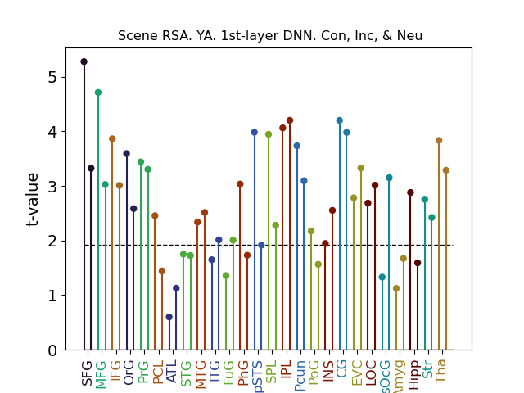

Result 1A/1B: Scene representation
Perceptual scene decoding
Semantic scene decoding
SFG is partially mPFC
Beyond what Lifu looked into
Notes:
Post hoc tests on bilateral SFG, for the eight dmPFC ROIs, t = 4.14. For the six dlPFC ROIs, t = 2.94. SFG bilateral altogether is 4.17.
mPFC overall (including some orbital and CG, yields 3.85. Excluding CG, we get 3.6.

Slide 13
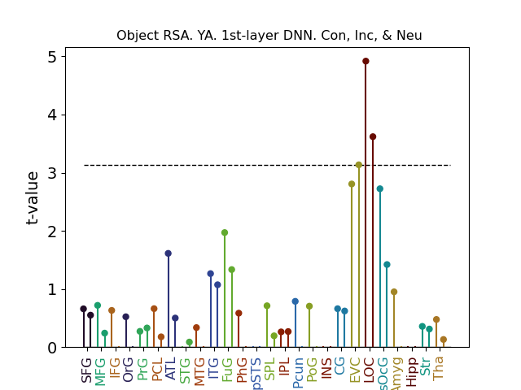
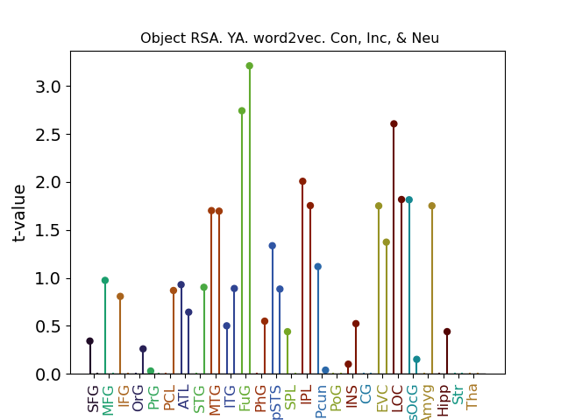
Result 1C/1D: Object representation
Perceptual object decoding
Semantic object decoding
Reproducing patterns from Lifu’s thesis

Slide 14
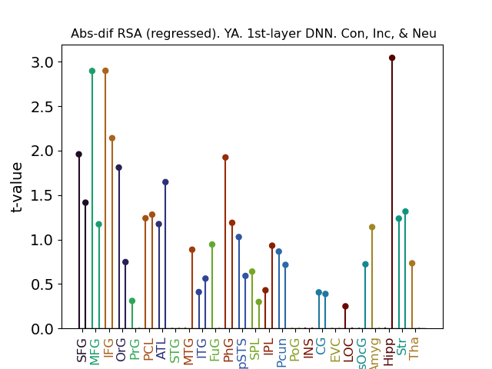
Result 2A/2B/2C: Schema-object integration
Confirmed by an additional “macro-level” analysis focusing on the LPFC overall
  26 ROIs
  Activation averaged across ROI
  fMRI vector calculated using ROI-activation in place of voxel-activation
  Submitted to RDM
  Yields significant RSA effect
  (t = 2.1, p = .02)
Trend suggests that high LPFC IRAF linked to subsequent memory hit
  Analysis on shown in graph significant if looking at hits but not if looking at misses
  However, the t-test comparing IRAFs for hit vs. miss doesn’t cross the significance threshold
  Link to memory not seen for hipp.
Unexpectedly, OA do not show this effect
LPFC
Hipp.
Notes:
Downside: Doesn’t pan out for word2vec analysis. lPFC doesn’t pan out for connectivity. Also, doesn’t work if only looking at a single congruent/incongruent/neutral condition
HC result a bit less robust

Slide 15
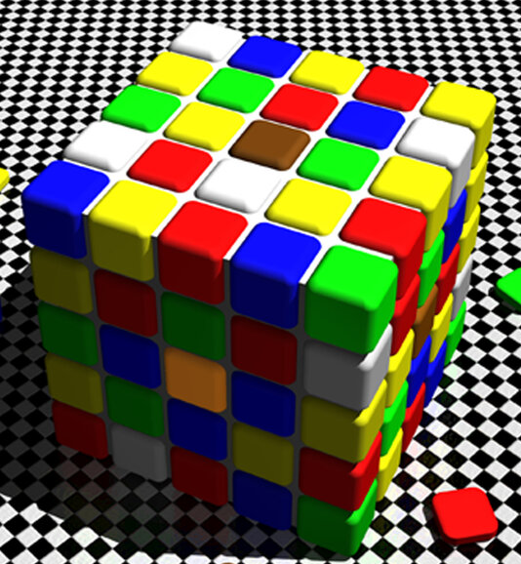
Interpretation
LPFC result:
  Findings consistent with the prediction error idea
    LPFC processes the scene
    The LPFC processes the object relative to the scene
  However, it is hard to analytically distinguish this interpretation from the priming idea:
    Scene primes neural populations, which influences those populations’ responses to the object
    Could the fact that this analysis panned out for the perceptual but not semantic RSA support one of the two views?
Hippocampus result
  The hippocampus does not bind information arbitrarily
  Rather, the hippocampus’s response depends on what items it is binding
  The binding should be seen as a relationship, whose meaning is based on analogies to other bound pieces of information
    e.g., when people associate a red stimulus and a green stimulus, they infer the relationship between the two stimuli by bootstrapping previously formed relationships between red and green stimuli
    Green stoplight = go, red stoplight = stop
    Green text = reward, red text = punishment

Slide 16
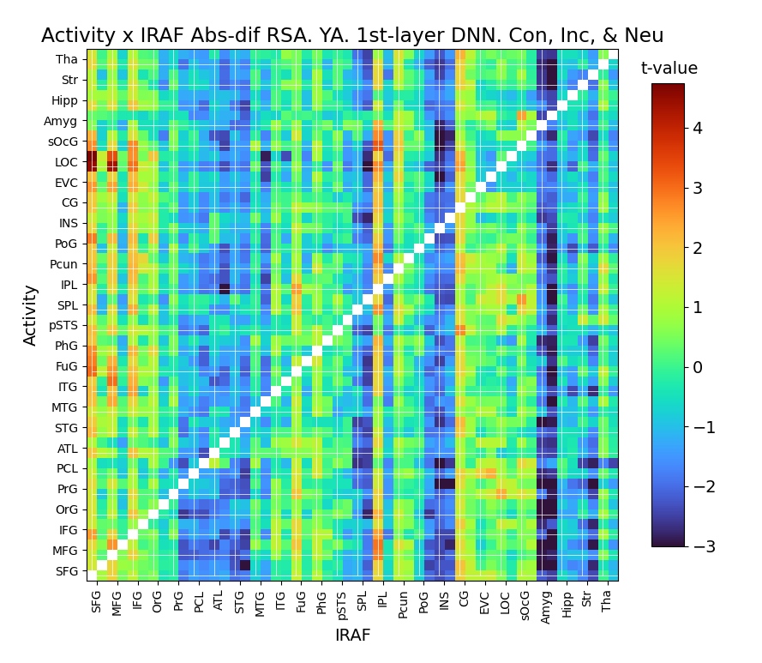
Result 3: Difference RSA x connectivity
Similar to beta series correlations
  Use difference-vector IRAF for one region
PFC IRAF linked to stronger occipital connectivity and PhG/FuG connectivity
This effect only arises for objects that yield subsequent hit
Notes:
The amygdala also shows an interesting pattern
Stronger representation in the amgydala is linked to decreased connectivity with everything else
Beyond the present focus?

Slide 17
Result 4: Retrieval data
When participants retrieve an object, what do they retrieve?
  Object
  Scene
  Object relative to the scene (difference vector)
Link to retrieval data?

Slide 18
Supplemental

Slide 19
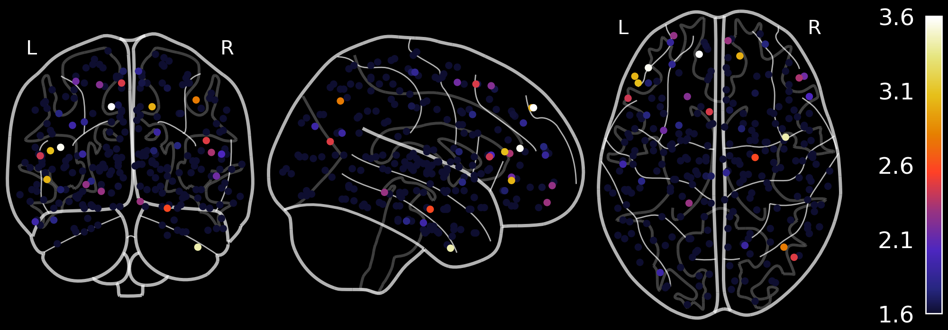
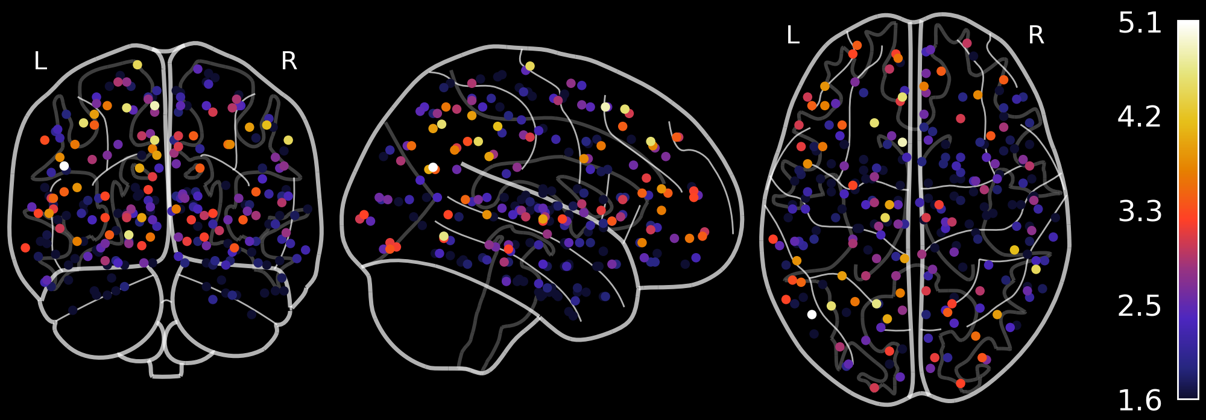
Abs dif from obj_fMRI
Scene from scn_fMRI

Slide 20
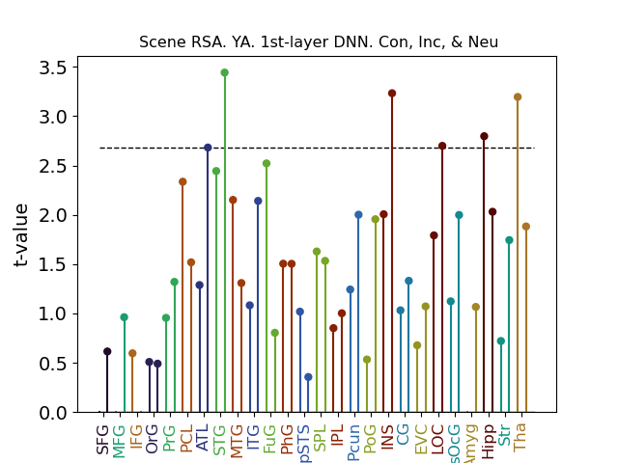
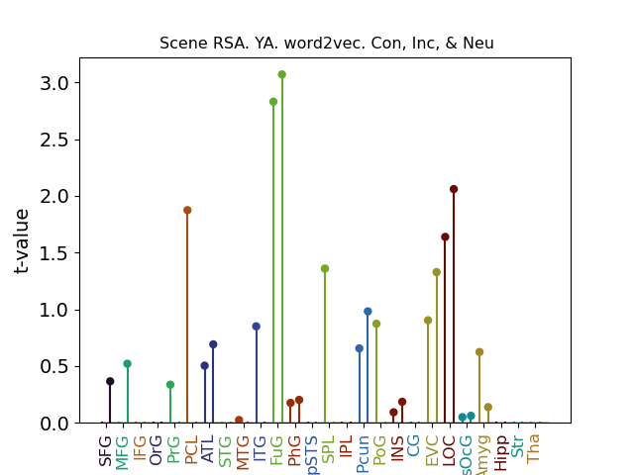
Scene representation
Perceptual scene decoding
Semantic scene decoding
Need scene single-trial betas
For congruent trials, it is difficult to distinguish from object decoding

Slide 21
RSA based on connectivity
RSA with respect to single-trial connectivity
Connectivity between scene betas x object betas
Connectivity among occipital ROIs (EVC, LOC, superior OC) yields significant RSA results with respect to the last layer of DNN for the scene + object sum
Doesn’t work for anything else
Probably a Type I Error

Slide 22
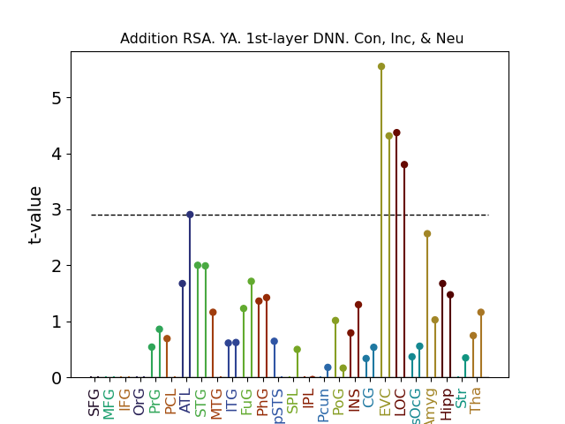
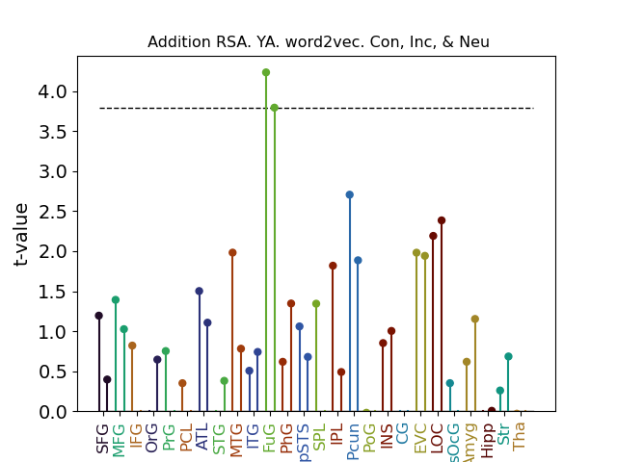
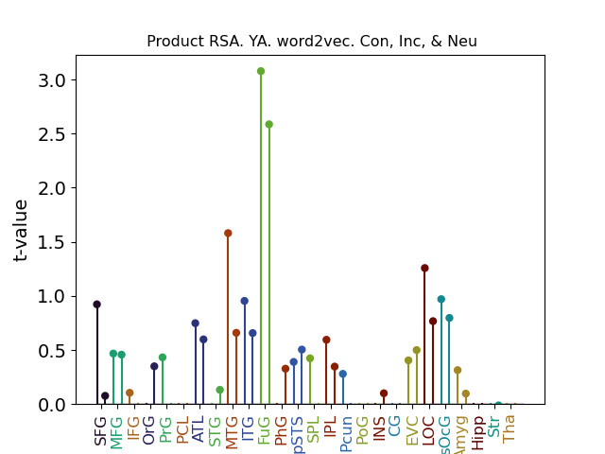
Addition & Product RSA
Perceptual addition
decoding
Semantic addition
decoding
Semantic product
decoding
Similar patterns when taking the absolute value of the addition or product vector. Note the null PFC results
Notes:
No meaningful perceptual product results

Slide 23
TODO
Look at the single-trial betas for the scene presentation screen
Look at retrieval data
  When participants retrieve an object, is the scene retrieved too?

Slide 24
Things that didn’t work

Slide 25
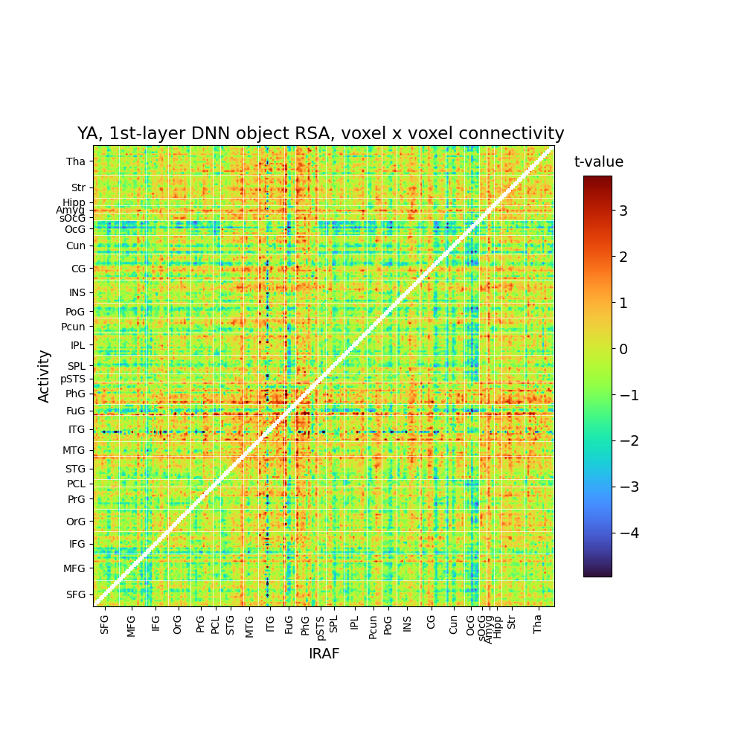
RSA single-trial connectivity
Single trial connectivity can be represented as the product of voxel activations
  E.g., Connectivity between voxel 0 from region a with voxel 0 from region b
  If region a has 100 voxels and region b has 50 voxels, there are 5000 combinations
  Can correlate these product vectors between trials to calculate fMRI RDM
Didn’t really pan out to anything meaningful

Slide 26
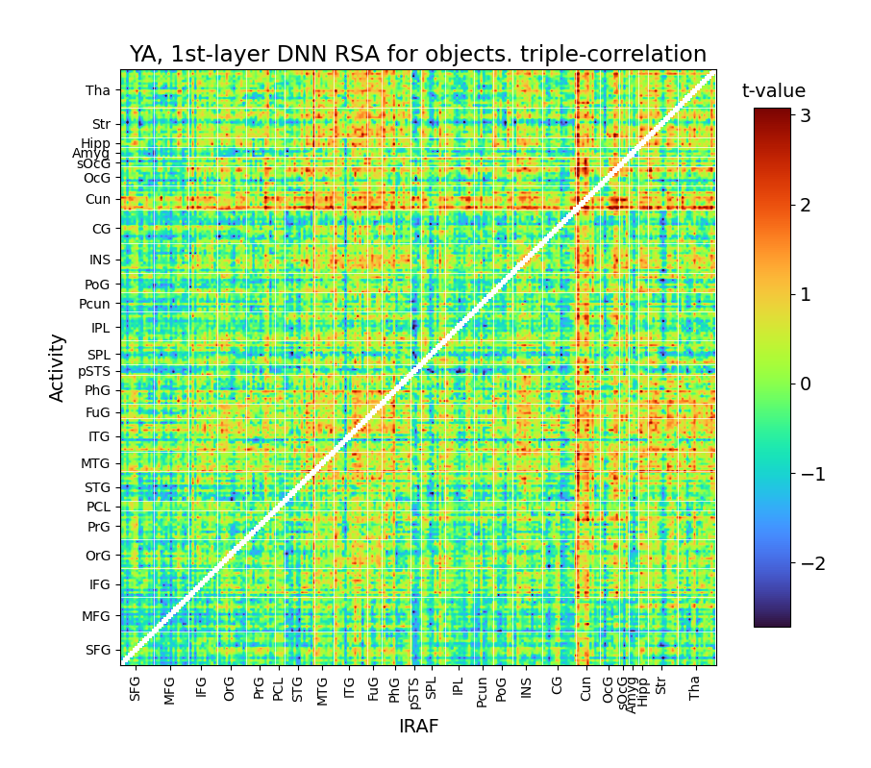
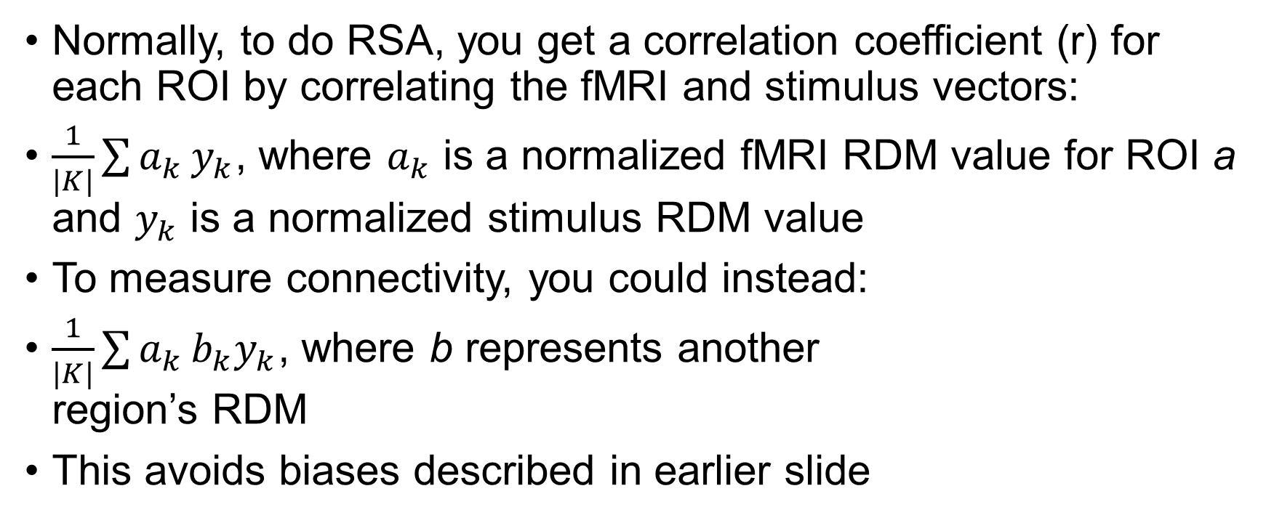
RSA connectivity as triple correlation
Normally, to do RSA, you get a correlation coefficient (r) for each ROI by correlating the fMRI and stimulus vectors:
$\frac{1}{|K|}\sum{a_{k}}y_{k}$, where $a_{k}$ is a normalized fMRI RDM value for ROI a and $y_{k}$ is a normalized stimulus RDM value
To measure connectivity, you could instead:
$\frac{1}{|K|}\sum{a_{k}}b_{k}y_{k}$, where b represents another
region’s RDM
This avoids biases described in earlier slide

Slide 27
RSA Connectivity

Slide 28
Overview: How do multiple brain regions work together to represent stimuli?
Linking regions based on their sensitivity to particular types of representations (IRAF)
  Trial-by-trial correlations between regions
  Similar to beta series correlations but with IRAF values
Does one region’s activity upregulate representational sensitivity in another region?
  Trial-by-trial correlation between activity in one region x IRAF in another region
  Consistent with the boosting/linking point in the grant
Representation of stimuli as connectivity
  Are stimuli represented as interactions between multiple voxels or regions?
  Investigate connectivity between pairs of regions or among multiple regions in a network
These types of results may speak to compensation if these connectivity patterns are more prominent among OAs

Slide 29
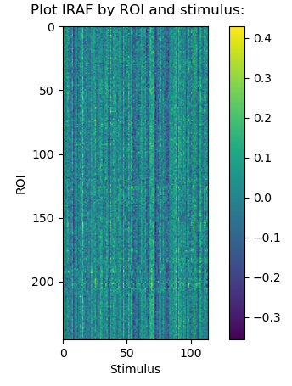
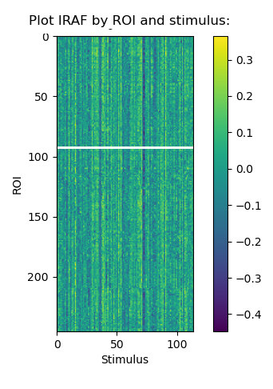
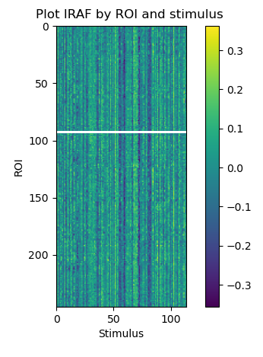
IRAF x IRAF connectivity
Plain IRAF x IRAF doesn’t really work
In part because IRAF patterns for a given stimulus are similar across all ROIs, which makes some connectivity measurements artificial
  Virtually every region shows positive IRAF connectivity with every other region
Three participant IRAF values are plotted here over time for every ROI
There are other issues with correlating IRAF between different regions that are harder to describe. Essentially, correlations between IRAFs will arise even if the stimulus vector is randomized.
I played around with normalizing with respect to stimulus

Slide 30
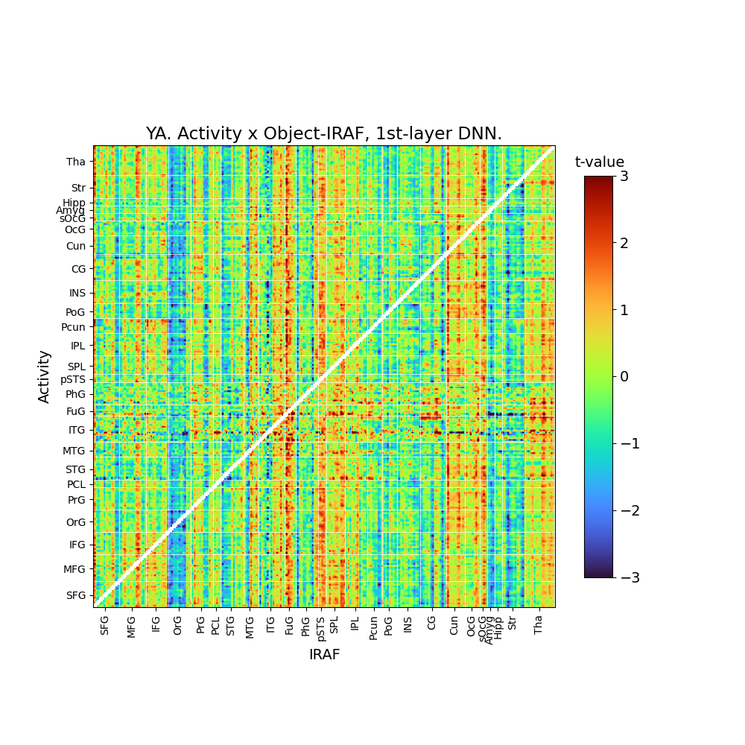
One area modulating IRAF in another region
Related to the linking and boosting points made in the grant/papers
Correlate:
  Region A: Mean connectivity across all voxels for a given trial
  Region B: IRAF
Correlation matrix plotted
  Not symmetrical, so it looks different from most connectivity matrices
Hard to say whether this is meaningful, but it is encouraging to see patterns linked to occipital IRAF

Slide 31
RSA network
Next steps, examine multiple regions
May employee some of the modularity methods used in Lifu’s thesis

Slide 32
Leftover slides

Slide 33
Brief exploration
What if…
  Instead of representing an fMRI vector as all the voxel activations within a given ROI, you instead calculated the ROI vector as the product of all voxel weights (a measure of connectivity)?
What happens?
  You get null results
  Even things like RSA of object in the occipital lobe is fail

Slide 34
Scene
Object

Slide 35
Investigating difference vector
Difference vector: (x0 – x1)
If (x0 – x1) yields an RSA effect, it may hard to distinguish from whether it is:
  Indeed a difference effect
  Driven by x0
  Driven by –x1
Analogous to how for regressions, people advice against using terms like (x0 – x1) but instead to just put x0 and x1 separately
This would be particularly problematic if the difference vector effect is in the same spot as the object effect

Slide 36
Stimulus representations
Cognitive meaning of the difference vector:
  Priming:
    Scenes prime some representations, which will show weaker/stronger responses if activated again by the object
  Relational memory:
    Broadly: The informational content of items influences how an association is encoded
    Specifically: Associative memories do not just blindly connect item representations. Rather, associations should be seen as representations that encode the relationship between the items
  Prediction error:
    Scenes establish an expectation (a “prediction”) that may be violated
    Predictive coding theory argues that all information is processed as prediction errors
  Unclear meaning yet informative
    There is no clear psychological meaning of a “difference vector”. Nonetheless, because the measure combines object and scene information, findings must reflect some type of interaction between representations
Single trial
-
=
absolute
difference
1
2
3
4
5
1
2
3
4
5
1
2
3
4
5
Trial 1
Trial 1
Trial 1
Trial 2
Trial 2
Trial 2
Trial 3
Trial 3
Trial 3
Trial 4
Trial 4
Trial 4
Trial 5
Trial 5
Trial 5
Object RDM
Scene RDM
Abs-Dif RDM

